Slide 1
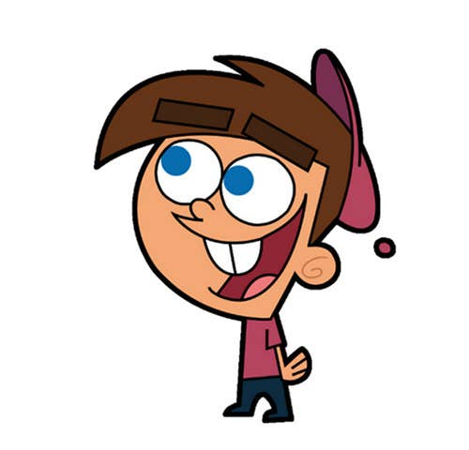
Welcome to class
T.
Mohamad
Zaid

Slide 2
Day
sunday
Date
17th Jun 2022
Subject
We can 4
Unit
1 Wild Animals
Lesson
1 Talk Time

Slide 3
Revision for the previous unit :
What is he doing?
What is she doing?

Slide 4
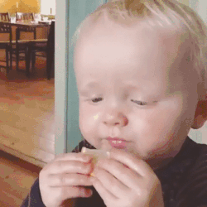
Revision for the previous unit :
sour
hot
Lemons are ……….
Soup is ………..

Slide 5
Revision for the previous unit :
and
but
and
I have apples ……… bananas .

Slide 6
PAGEs 2 , 3

Slide 7
Objectives
By the end of this lesson
I Can…
act out the talks about wild animals.
tell friends the names of six wild animals using the animal chart.
استطيع أن اتحدث عن الحيوانات البرية
استطيع أن أخبر اصدقائي عن أسماء 6 حيوانات برية من مخطط صور الحيوانات الموجود

Slide 9
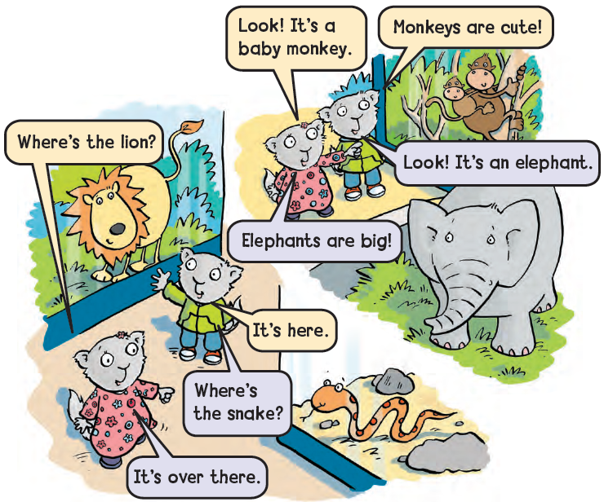
Listen and point

Slide 10
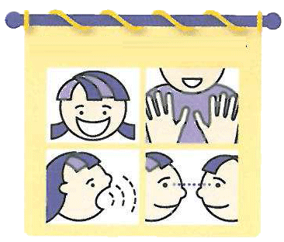
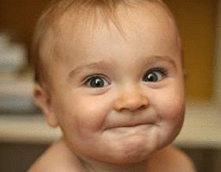
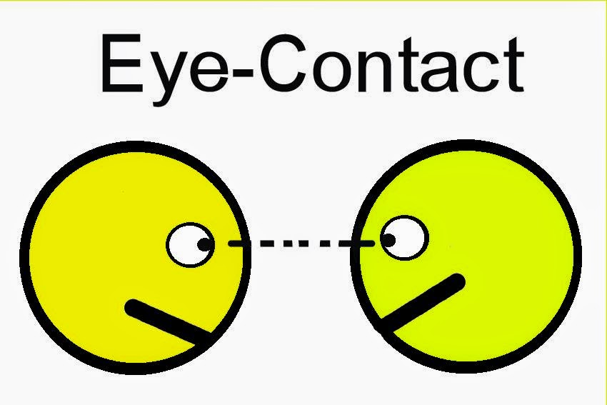
The big FOUR when you speak English :
Use appropriate gestures
Speak in a loud voice
Maintain good eye contact
Smile

Slide 11
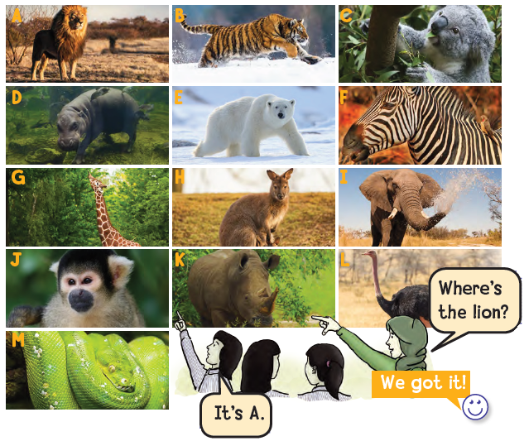
Find the Animal
Listen to the teacher and look for the animal. Say the letter.

Slide 12
Goal Check

Slide 13
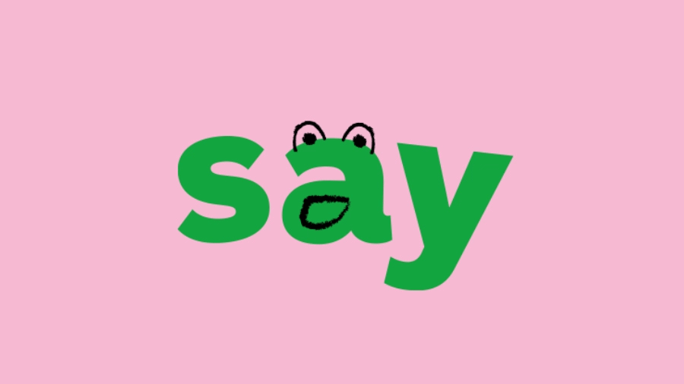
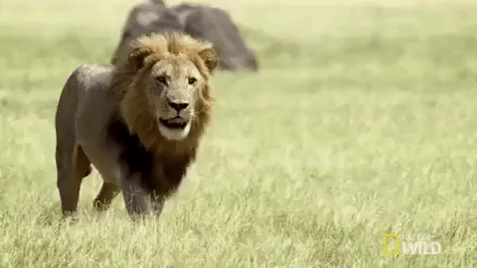
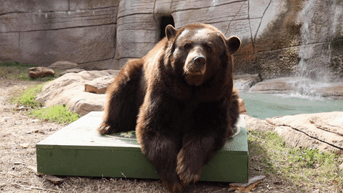
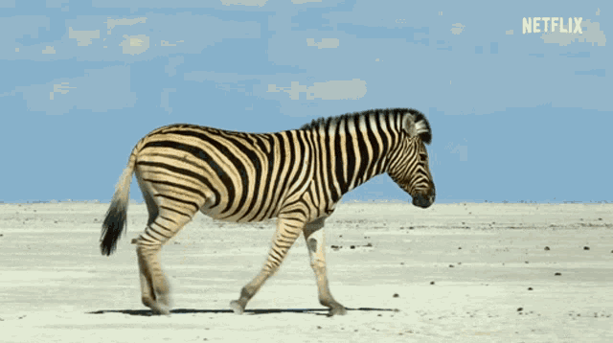
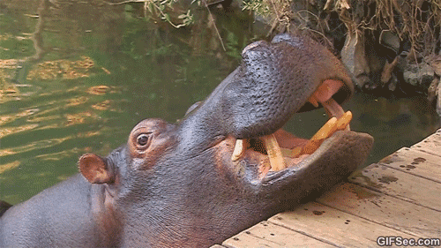
and

Slide 14
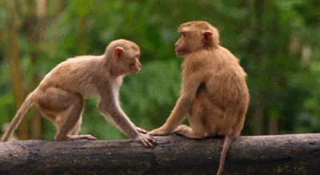
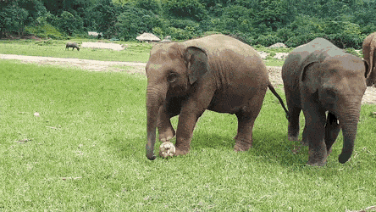
Talk about these animals

Slide 15
https://www.liveworksheets.com/worksheets/en/English_as_a_Second_Language_(ESL)/Vocabulary/We_can_4_wild_animals_jr1550236kx

Slide 16
إنتاج معرفي
Let’s learn a sentence or more DAILY

Slide 17
Open your workbook
Pages 63 , 64

Slide 18
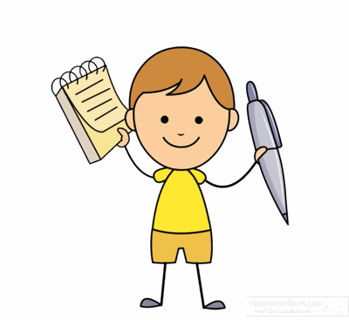
Home work at

Slide 20
