Slide 1
Mega Goal 1.2
Unit 3 GAME
You’ve Got Mail!
By: Essa Al Hussaini

Slide 2





U3
You’ve Got Mail!
1
1
1
1
1
2
2
2
2
2
3
3
3
3
3
4
4
4
4
4
5
5
5
5
5

Slide 3
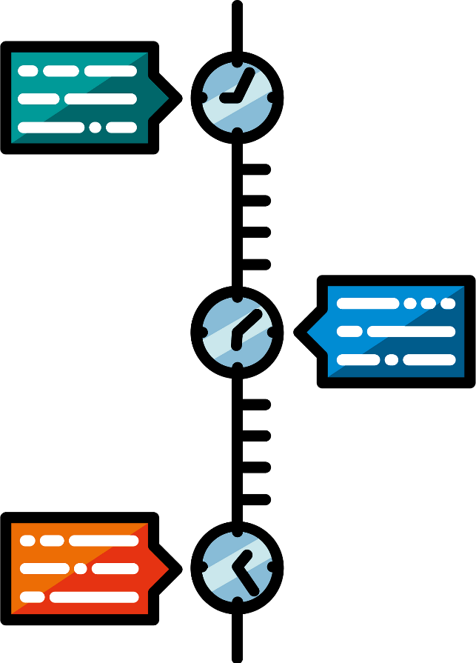


From the (a period in the history) to the present, people have shown a desire to communicate with one another.
Smoke Fire
Stone Age
Stone Wall

Slide 4
To be straight, the party was great.
We enjoyed ourselves very much.
be selfish
be honest
be disappointed

Slide 5
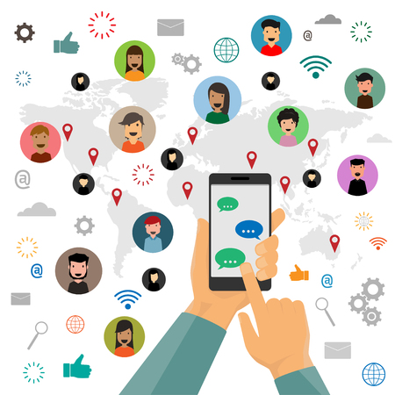
The use of WhatsApp has become widespread and a favorite way of communication.
over a large area
limited
revolution

Slide 6
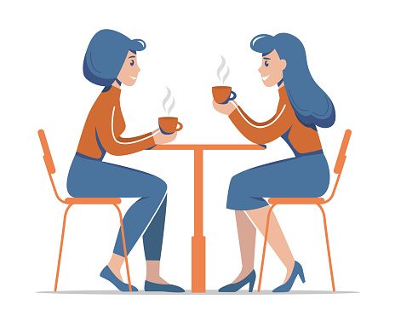
I look forward to drinking coffee with you next week.
very important
benefit from
be excited about

Slide 7
Opposite of
" modern "
updated
new
ancient

Slide 8
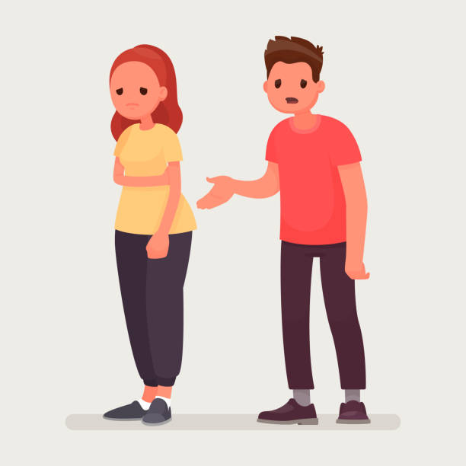

Ali apologizes ______ my book.
to take
for taking
for take

Slide 9
My mother insists _____ calling her every night.
on
about
for

Slide 10
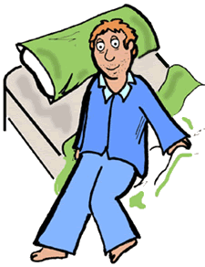
He ______ getting up early.
is used
uses to
is used to

Slide 11
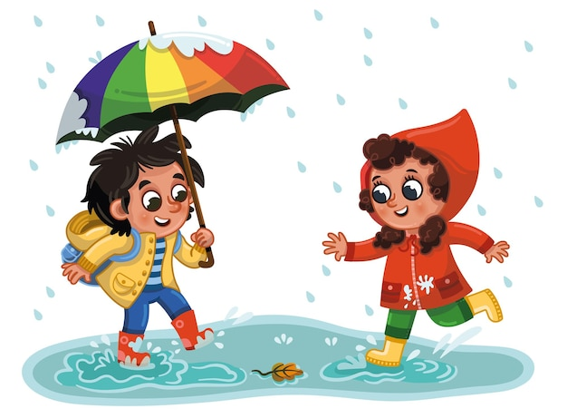
We had fun outside _________ the rain.
although
even though
in spite of

Slide 12

I’ll tell Ali as soon as ______ (get) home.
I get
I’ll get
I got

Slide 13


What do you say to someone who just graduated from college ?
Thank you
Congratulation!
I apologize

Slide 14
Identify the odd word
car
letter
mail
phone

Slide 15
Identify the odd word
foot
man
mail
fish

Slide 16


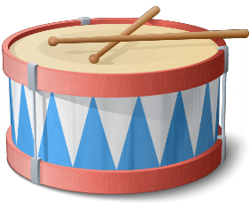

1- letter - signal tower - apology - drum
2- letter - cell phone - greeting - drum
3- email - signal tower - apology - drum
1
2
3

Slide 17


Classify when forming plural
man – fish – foot - deer - person - mouse
regular
nouns
Oops!!
WRONG
card – wife – city - mail - letter - boy - story
irregular nouns
card – fish – city - child - letter - boy - mouse

Slide 18

I will write you ____________as soon as I arrive home.
a video call
a voice message
an email

Slide 19
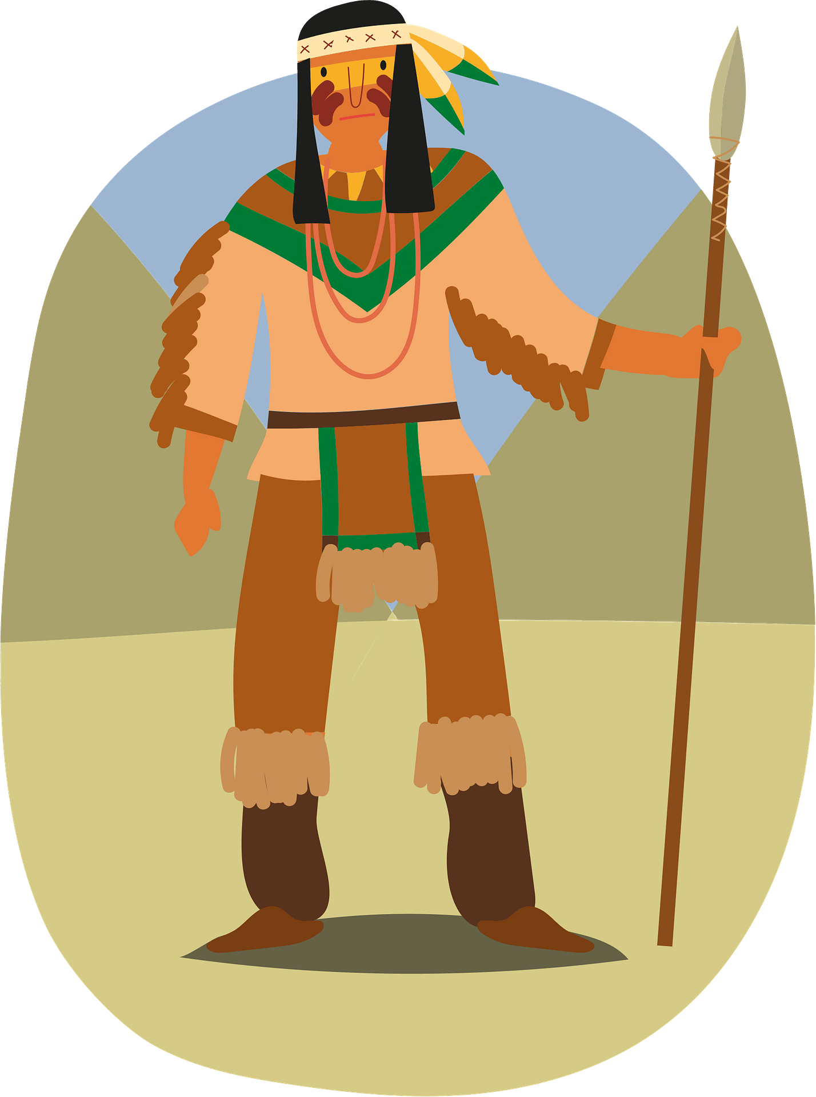

Native Americans used __________ from fires to transmit messages.
smoke
letters
drums

Slide 20
“ ______________ “
is said to a friend when forgetting
attending his graduation party.
Hi Sir,
Best regards
I apologize

Slide 21
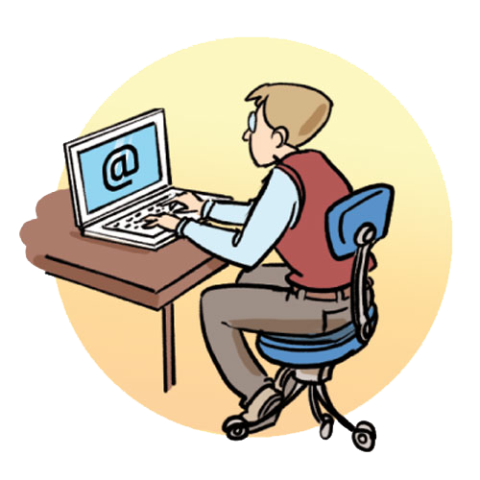
The use of email is a ________ in communication.
It makes the communication easier and quicker.
dialect
revolution
drum

Slide 22
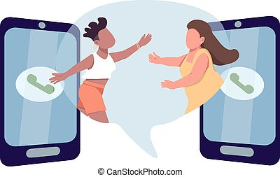
These days, it is much quicker to ________ with people , but life before the Internet sure sounds amazing!
keep in touch
import from
send email

Slide 23

My father ___________ (watch) movies, but he doesn’t anymore.
uses to watch
used to watched
used to watch

Slide 24
Make it Negative
They ____________ (used to play) in the street when they were young.
didn’t use to play
didn’t used to play
don't used to play

Slide 25
When I was young, I _______ have a lot of energy.
am used to
used to
would

Slide 26
I saw John reading ____ book.
My friend told me that was ____ Holy Qur’an.
the book
Holy Qur’an
a book
the Holy Qur’an
book
a Holy Qur’an

Slide 27
The plural form of
“boy”
boys
boyes
boies

