Slide 1
Mega Goal 1.2
Unit 1 GAME
Did You Hurt Yourself?
By: Essa Al Hussaini

Slide 2
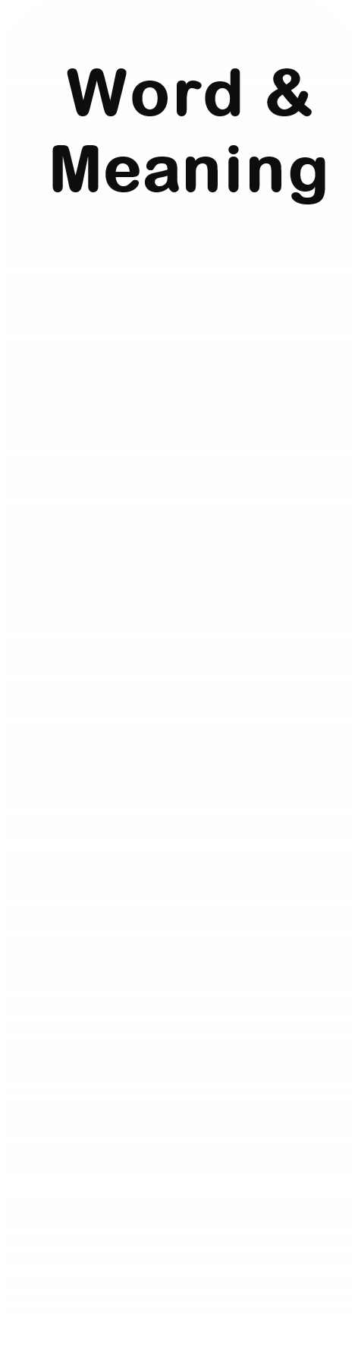
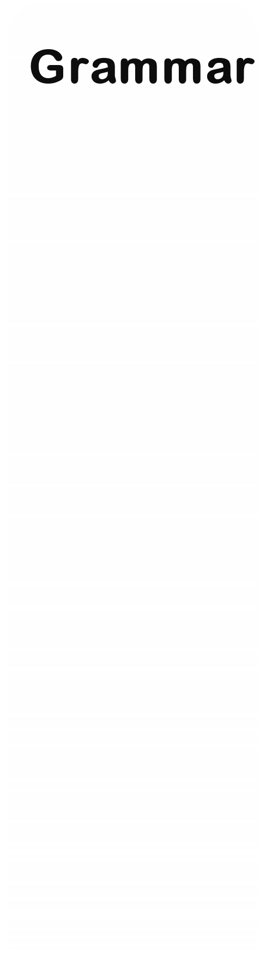
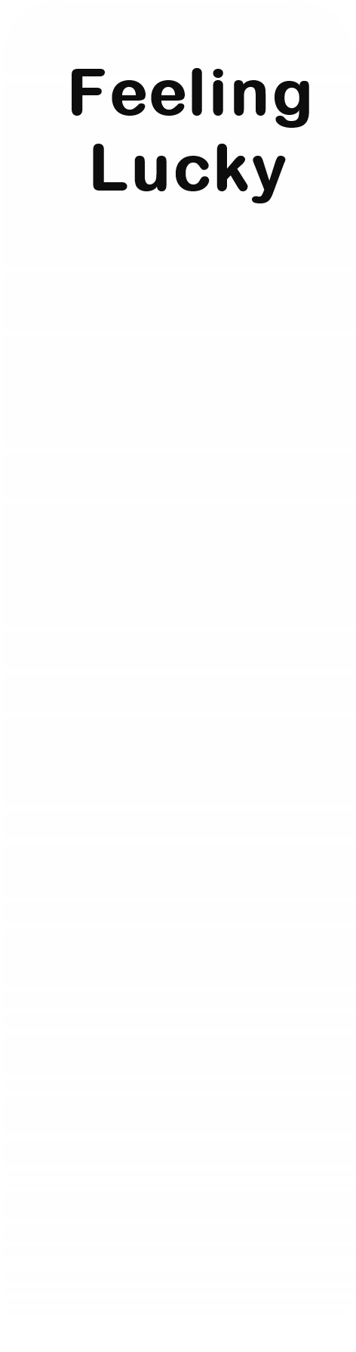
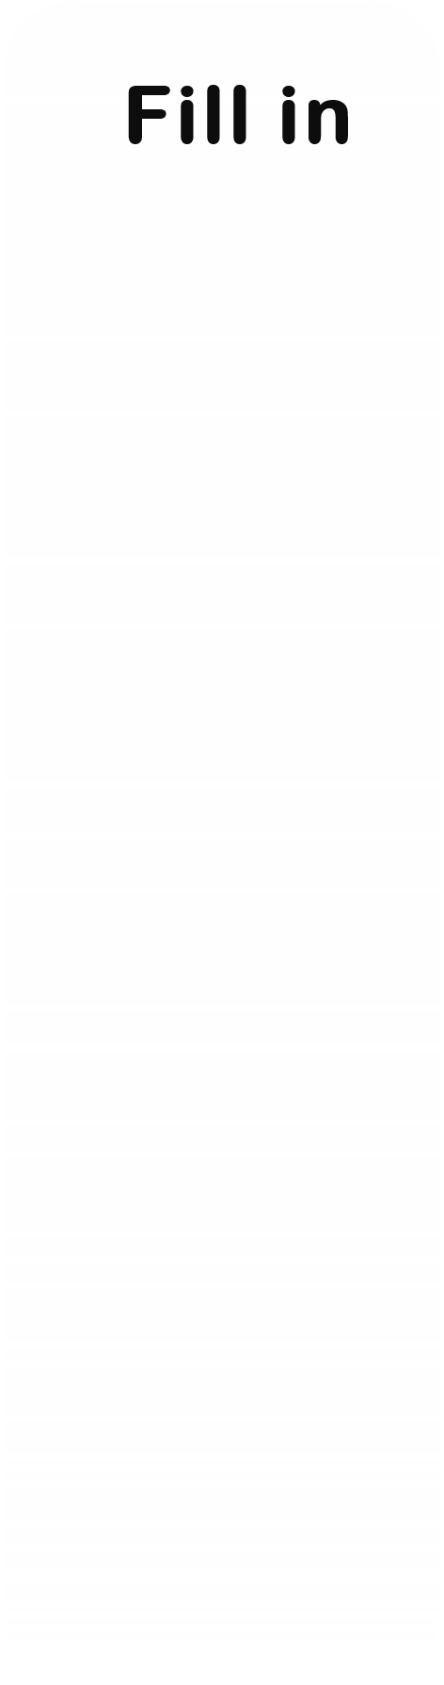
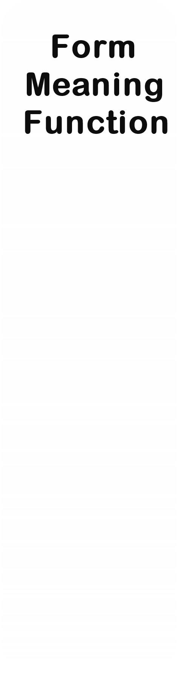
U1
Did You Hurt Yourself?
1
1
1
1
1
2
2
2
2
2
3
3
3
3
3
4
4
4
4
4
5
5
5
5
5

Slide 3
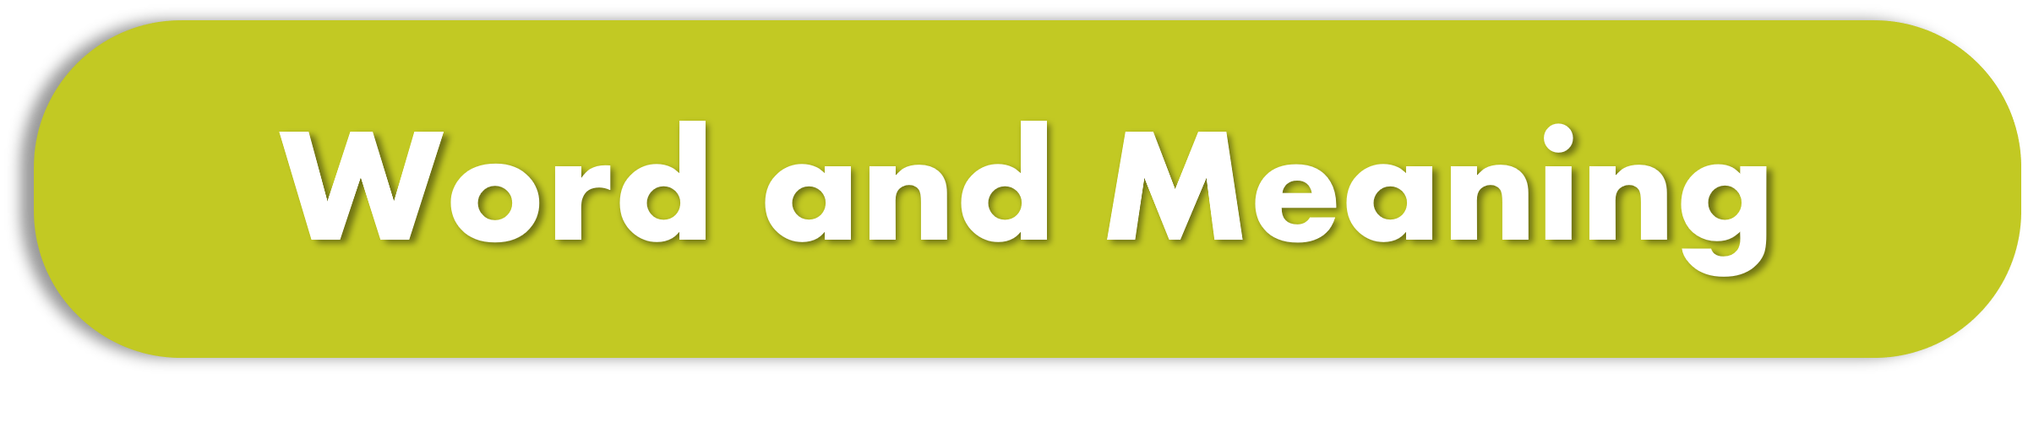
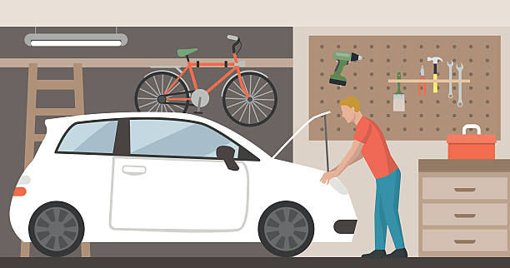

I got my car (caught and unable to move out) the garage.
crashed
stuck in
accident

Slide 4
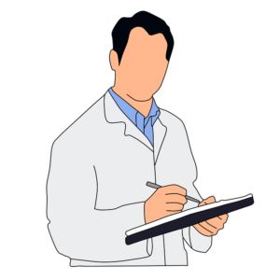
He should (get better) completely to release him from the hospital.
bald
weave through
recover

Slide 5
We have a quiz tomorrow, I’ guess.
not totally sure
totally sure
sure

Slide 6


Go straight
Oops!!
WRONG
Oops!!
WRONG
Take a right
Turn left

Slide 7
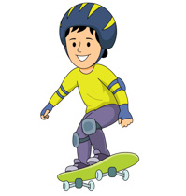
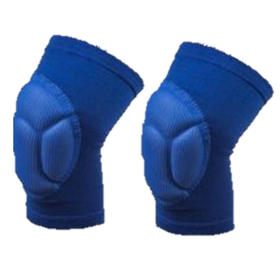
Because the skateboarder had
So he didn’t hurt himself.
helmets
kneepads
seatbelts

Slide 8
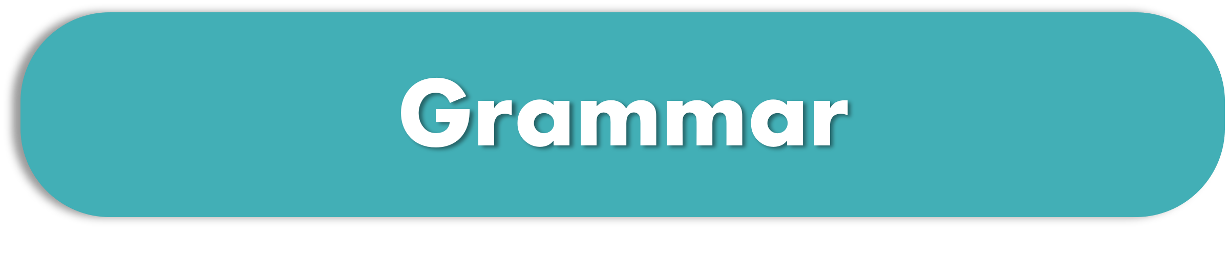
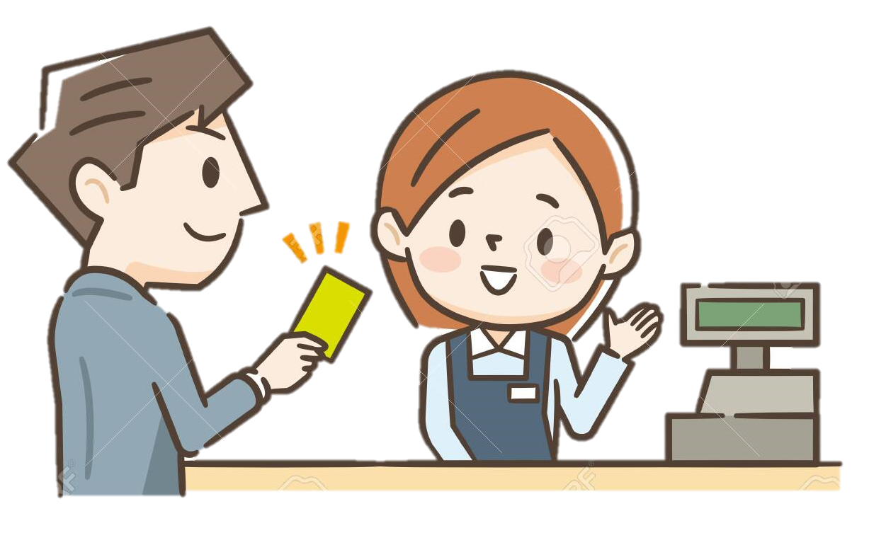
He bought ________ a new tablet.
herself
himself
myself

Slide 9


You and I
ourselves
he
Oops!!
WRONG
myself
they
themselves
I
himself

Slide 10
Choose the correct use of (because / so )
1- I went to the doctor so I was sick
2- I went to the doctor because I was sick.
3- I was sick because I went to the doctor .
1
2
3

Slide 11
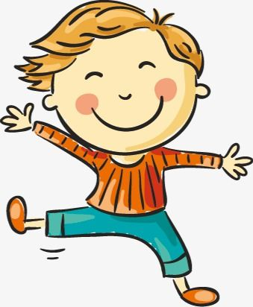
Show agreement
I am happy.
So am I
So I am
Neither am I

Slide 12
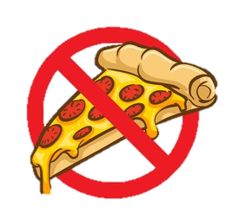
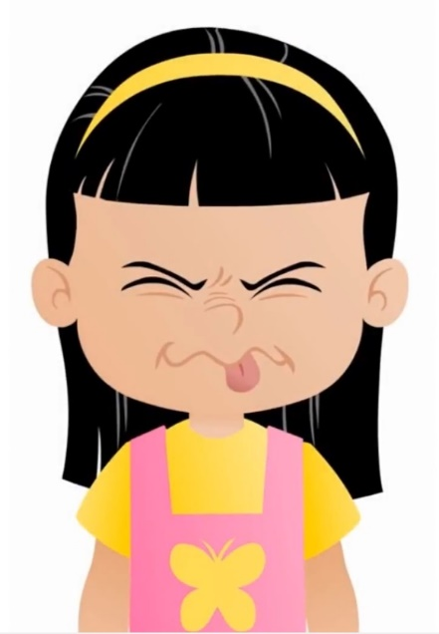
Show agreement
I don't like pizza.
Neither I do.
So don’t I
Neither do I.

Slide 13
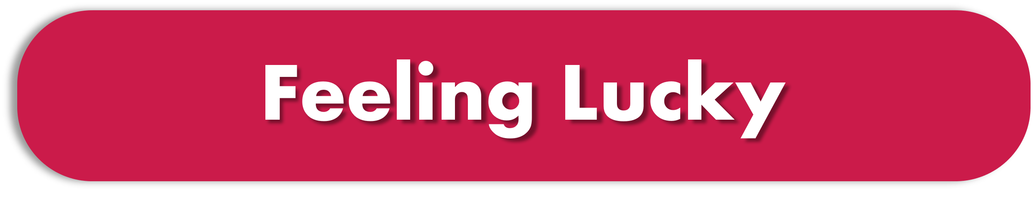
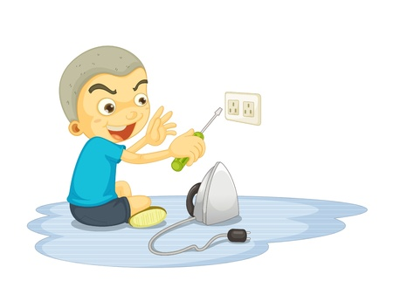
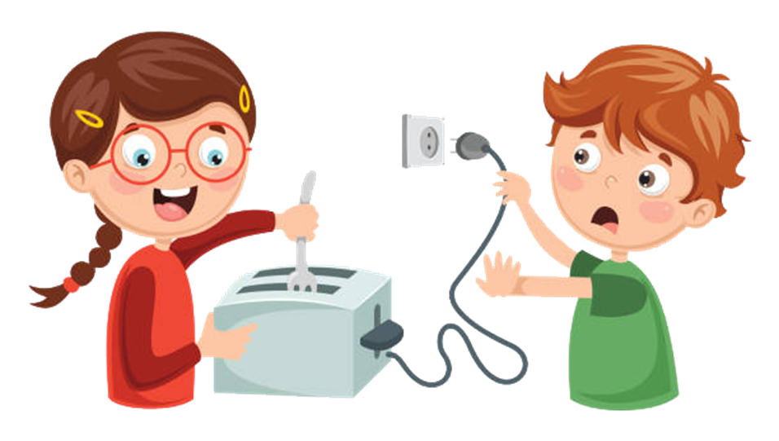
These acting can cause
an automobile crash
an electric shock
a hand burning

Slide 14


The correct prefix to form the opposite of ( judge) is
injudge
unjudge
misjudge
misjudge
misjudge

Slide 15
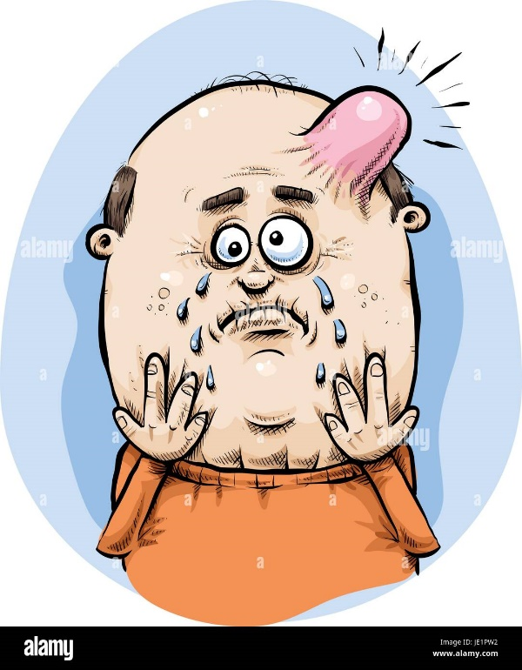
It wasn’t my ______ that
I got a bump on my head.
lucky day
stuck in
look at it this way

Slide 16
Identify the odd word
eye
ankle
finger
kneepad

Slide 17
Identify the odd word
cut
knife
burn
break

Slide 18
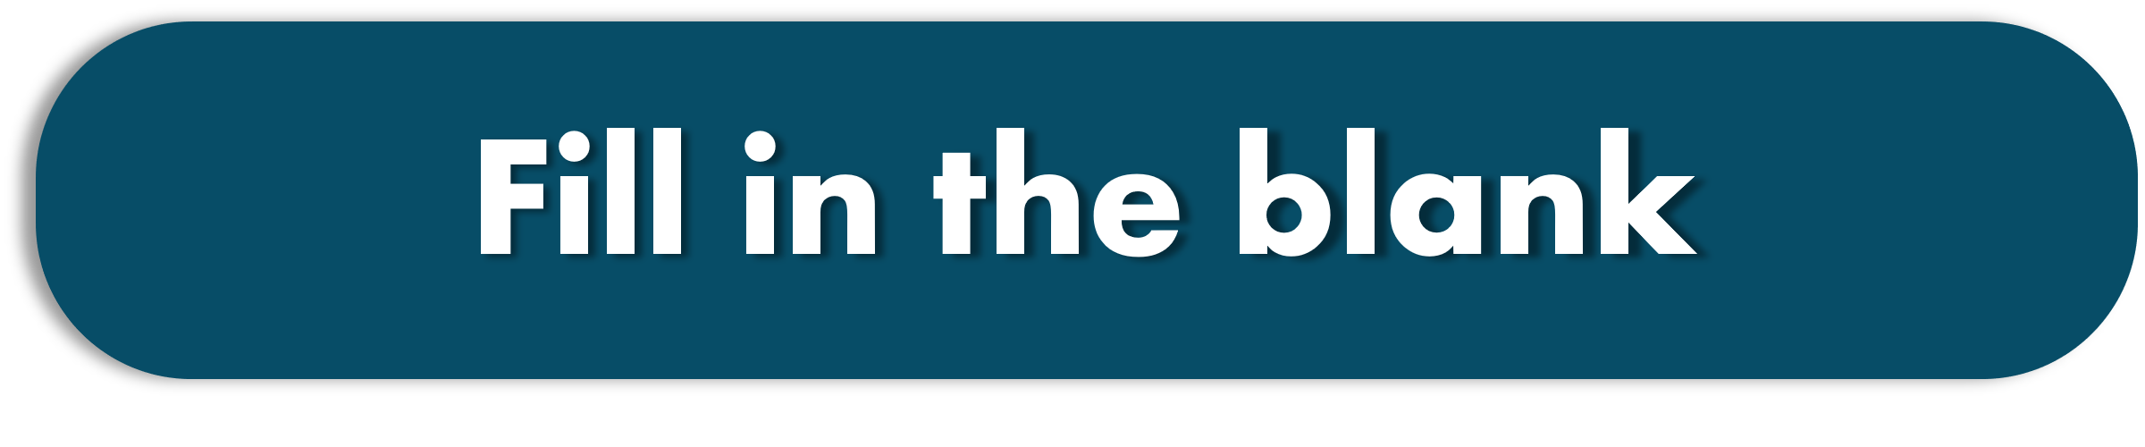
Sarah __________ her finger while she was opening the can.
cut
burned
poke

Slide 19
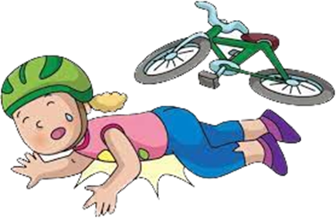
Luckily, she was wearing a _______________ when she had an accident on her bike.
seatbelt
equipment
helmet

Slide 20
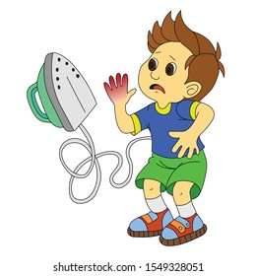
I _________________ my hand when I was using iron.
slipped
fell off
burned

Slide 21
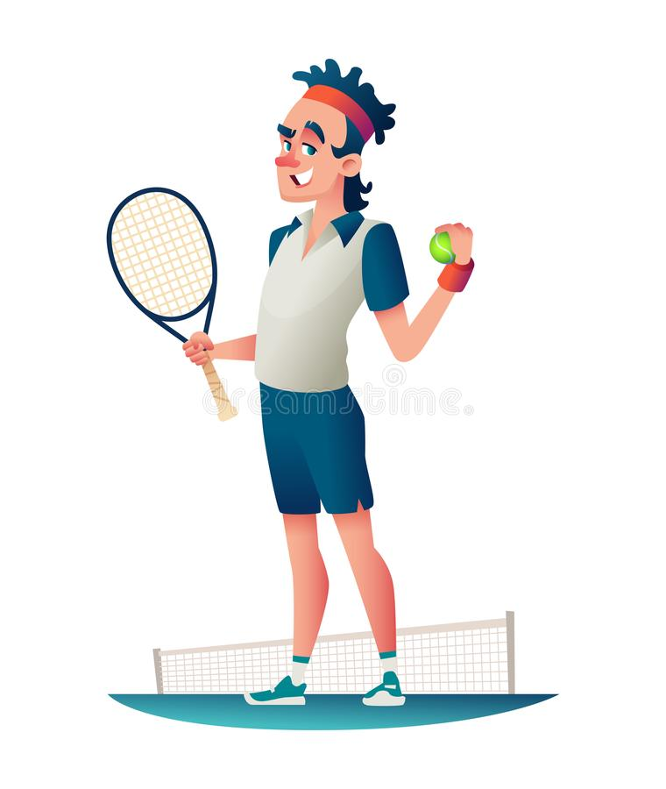
He __________ his brother to a tennis match.
(fights against)
dies
challenges
breaks

Slide 22
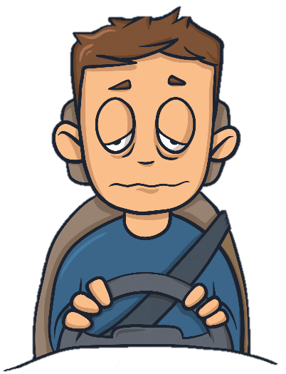
Tired and ______ drivers may go off the road.
obeyed
heavy rain
drowsy

Slide 23
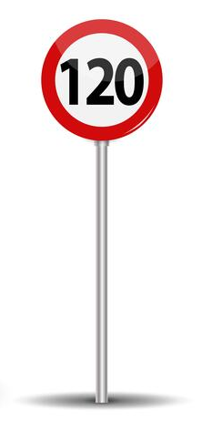
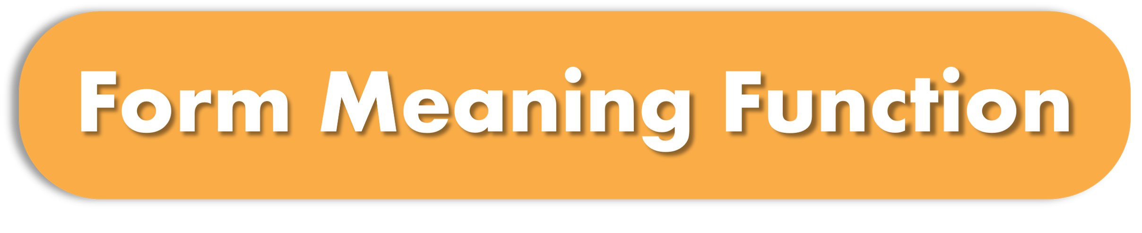
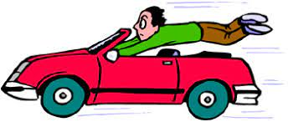
Express obligation
He is driving 140 km/h.
He ________ slow down.
should
must
shouldn’t

Slide 24
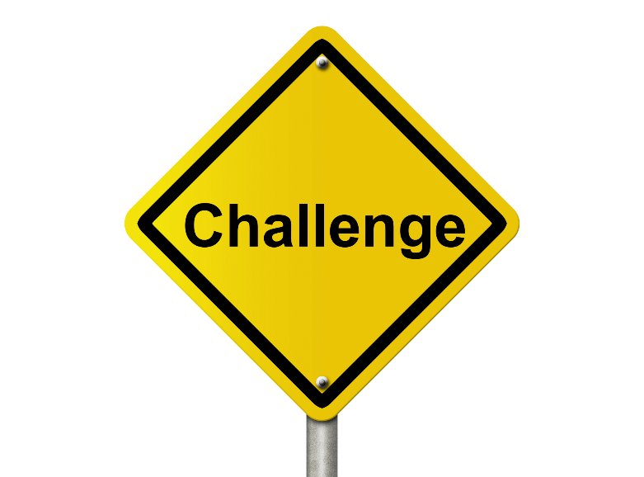
Use the adverb form
I didn’t study _____________ (good). I must study _____________ (hard). Then, I’m sure I’ll pass the test _____________ (easy).
goodly - hardly - easily
good - hardly - easily
well - hard - easily
well - hard - easily
well - hard - easily

Slide 25
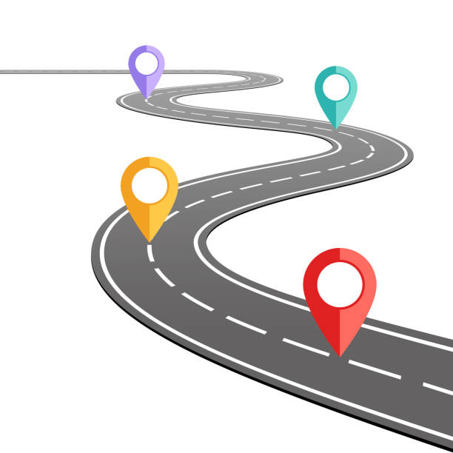
Excuse me! How to get to the bank?
Well. ________ straight. ___________ a right.
The bank is on the corner.
go // in
go // turn
go // take

Slide 26
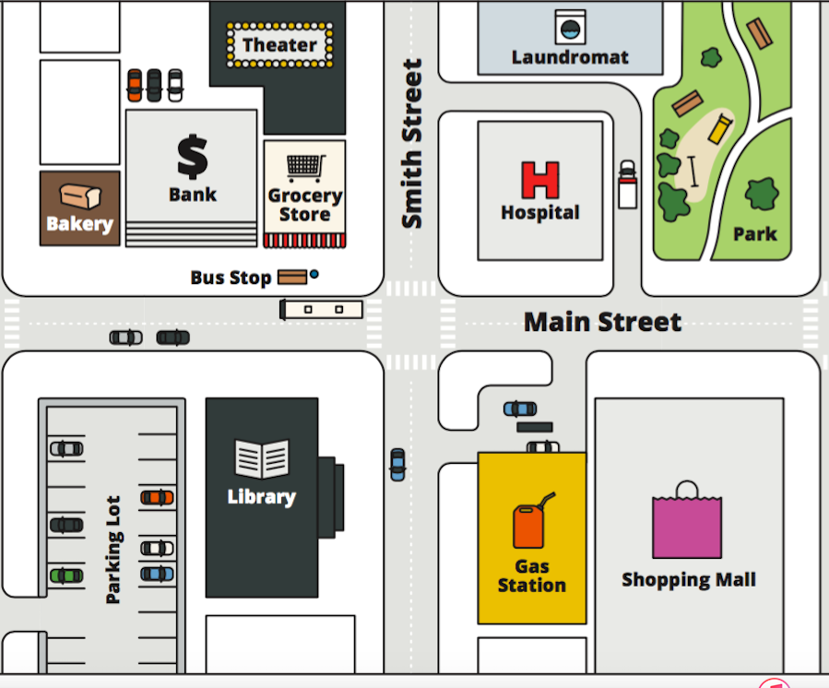
The shopping mall is ________
the gas station.
next to
far from
between

Slide 27
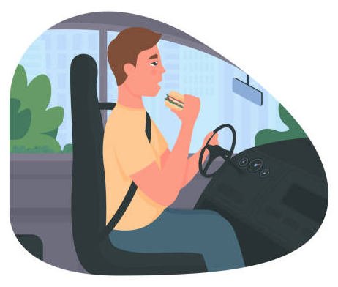
Give advice
You __________ eat while driving.
should
shouldn’t
mustn’t

Slide 28
The correct prefix to form the opposite of (conscious)
imconscious
unconscious
misconscious

Slide 29
The adverb form of the adjective ( fast ) is
fast
fastly
fastlly

