Slide 1

Unit 7
Fun on the weekend
Find out time

Slide 2

بسم الله الرحمن الرحيم
Day:
Date:

Slide 3

Learning Objectives
Use regular verbs in statements
Use past simple tense to tell about states that happened in the past
Build up questions and answers about weekend

Slide 4
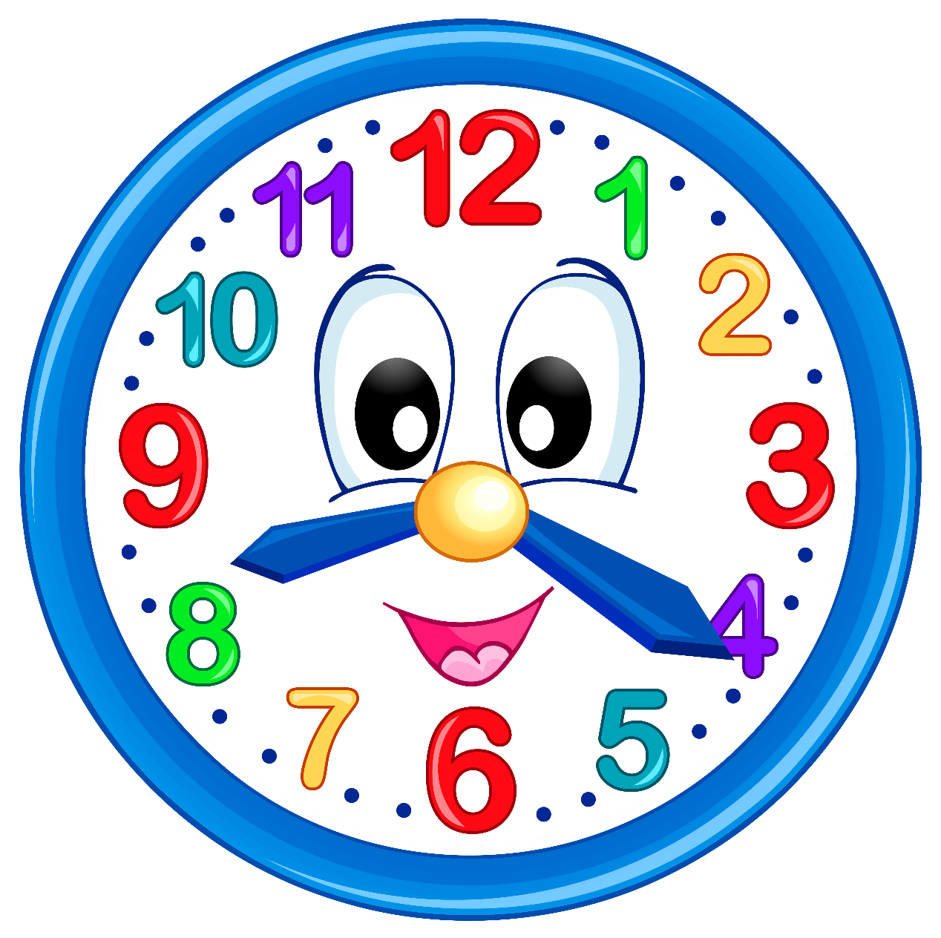
What time is it?

Slide 5

Revision

Slide 6

Warm up

Slide 7
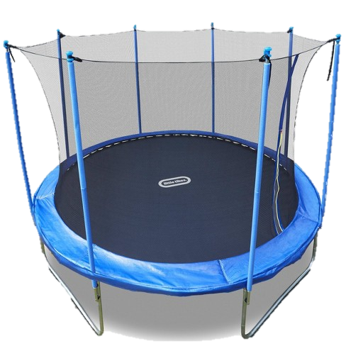
trampoline

Slide 8

DVD

Slide 9
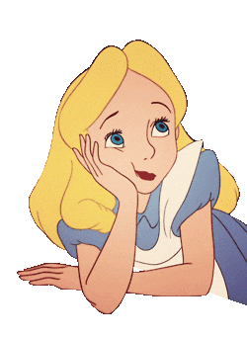
That’s boring.

Slide 10

That’s great.

Slide 11
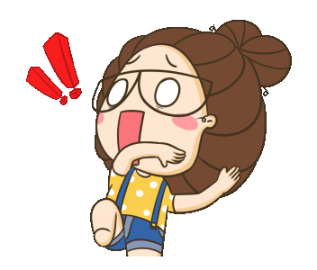
That’s scary .

Slide 12

That’s okay.

Slide 13

That’s fantastic.

Slide 14
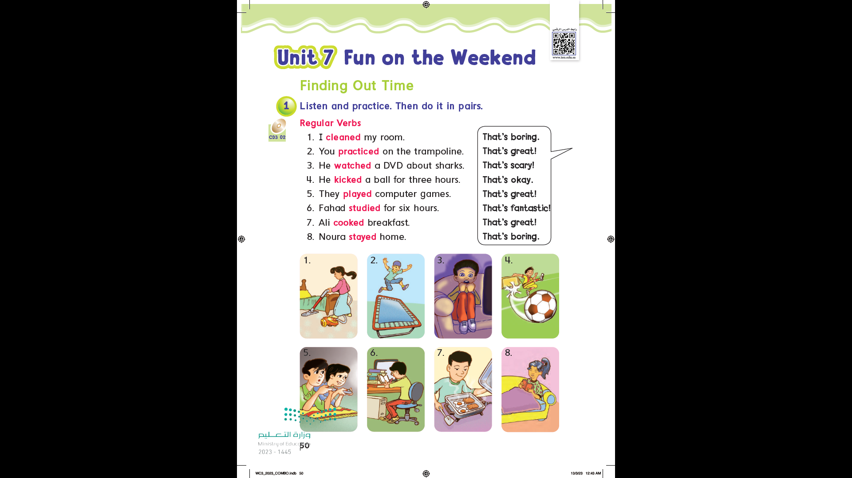

Page 50

Slide 15
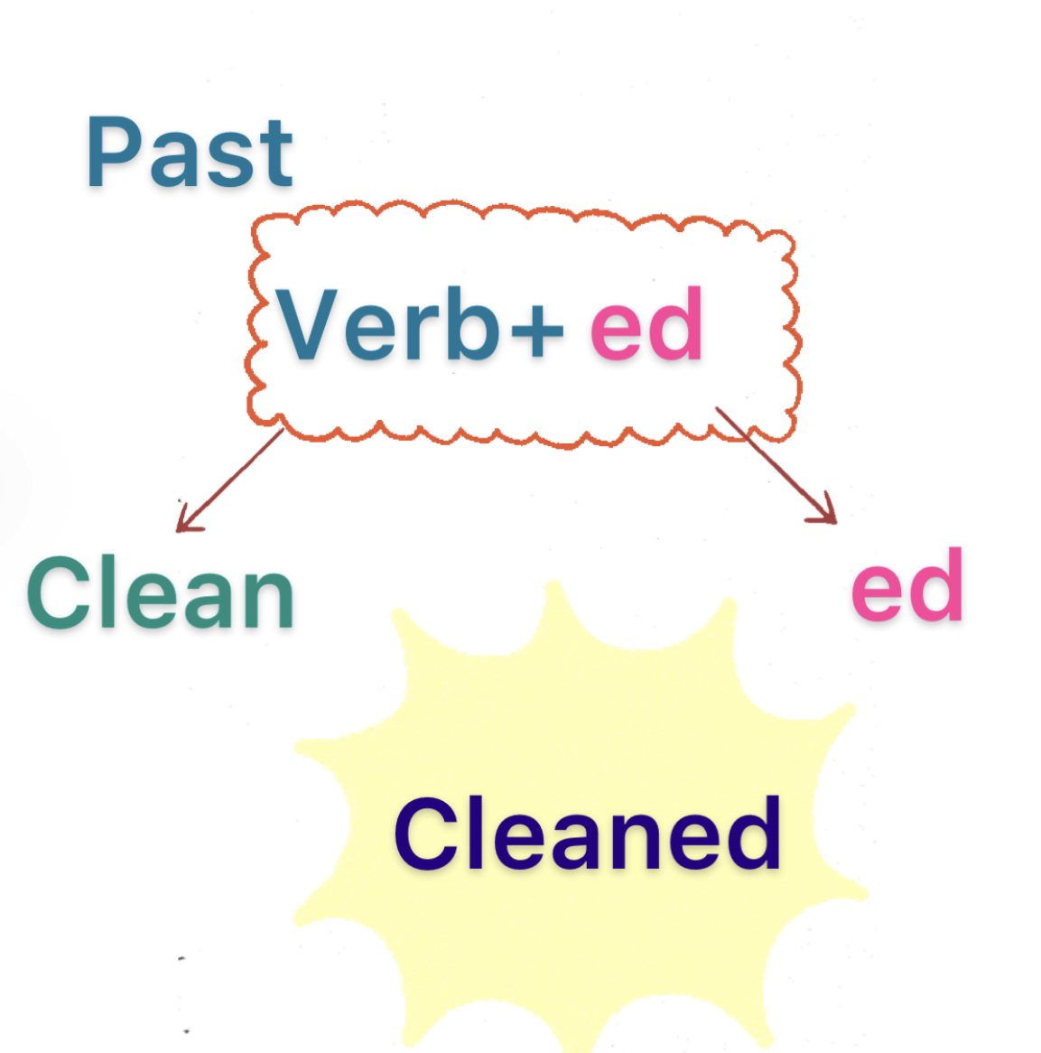

Slide 16
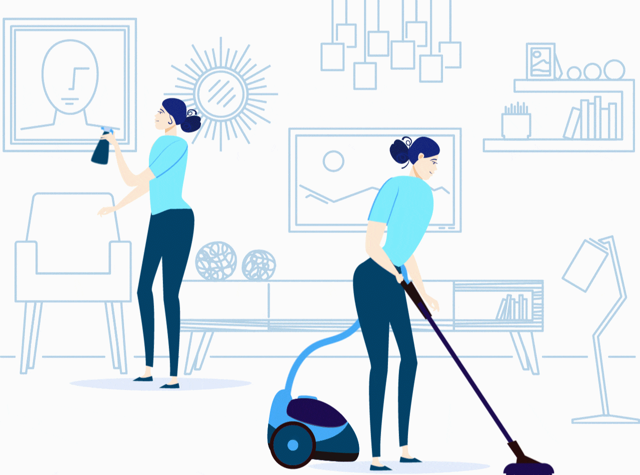
clean
ed

Slide 17
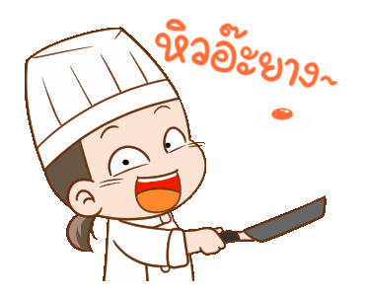
cook
ed

Slide 18

ed
watch

Slide 19
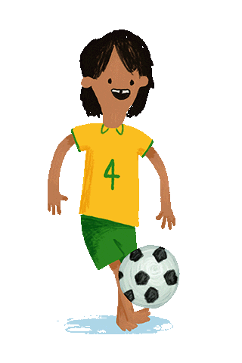
kick
ed

Slide 20
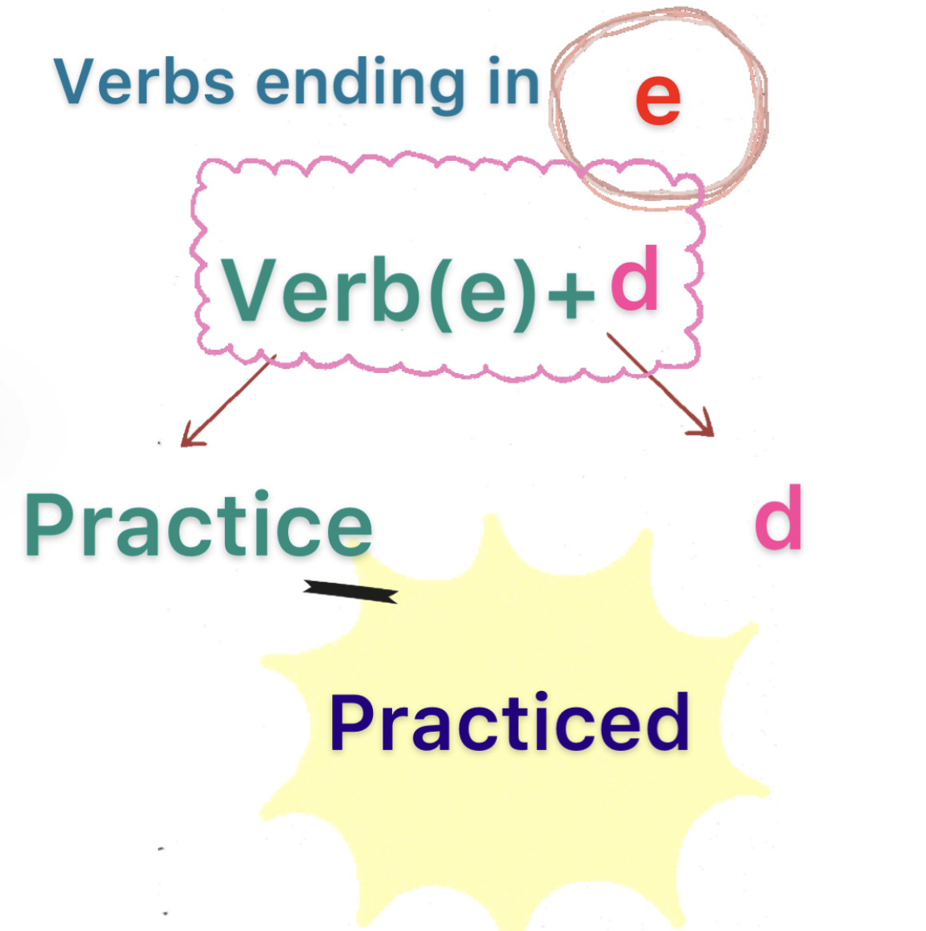

Slide 21
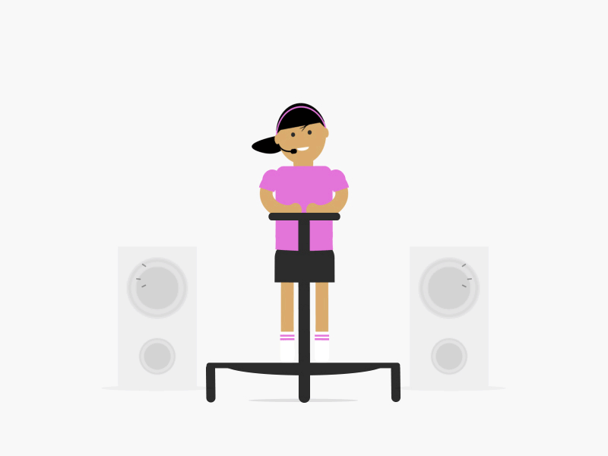
practice
d

Slide 22
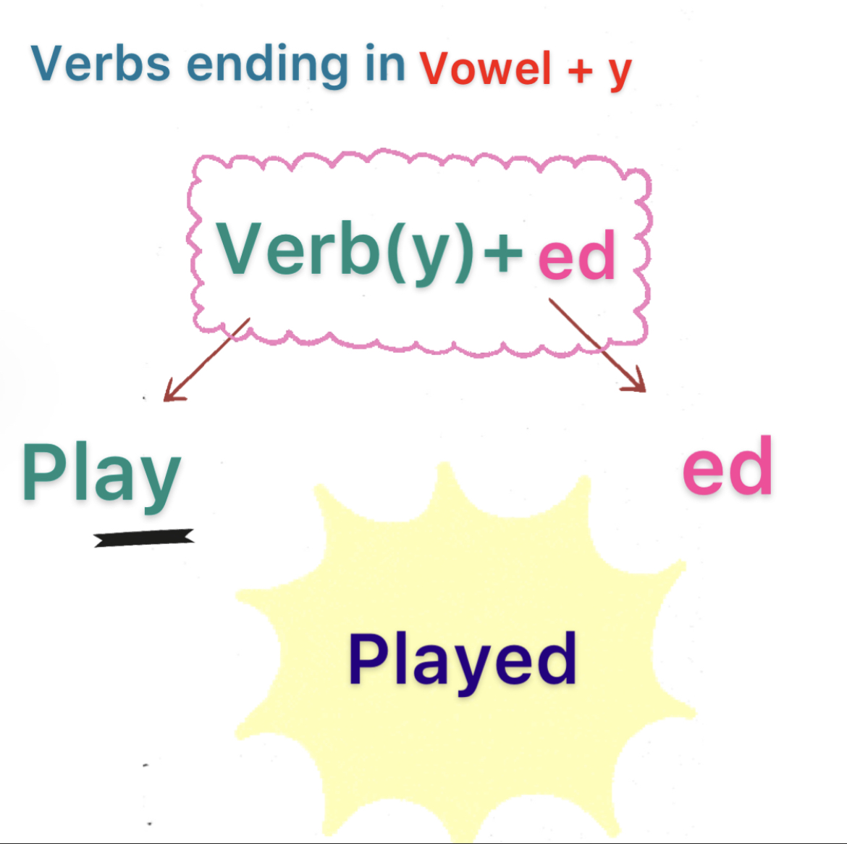

Slide 23
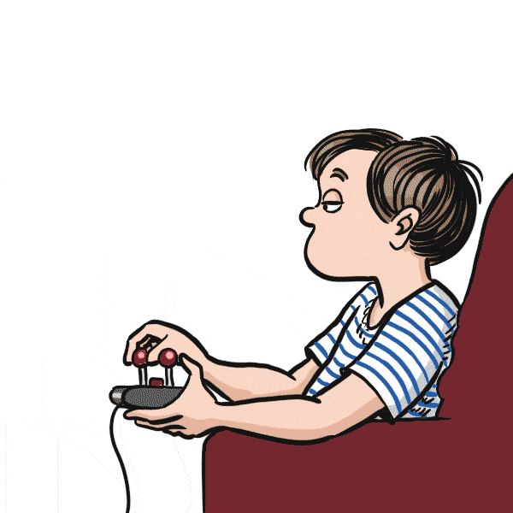
play
ed

Slide 24

stay
ed

Slide 25
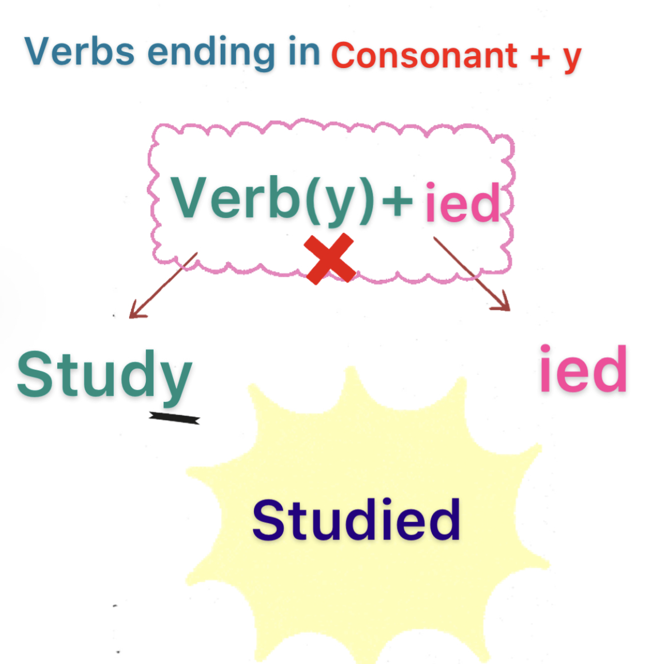

Slide 26
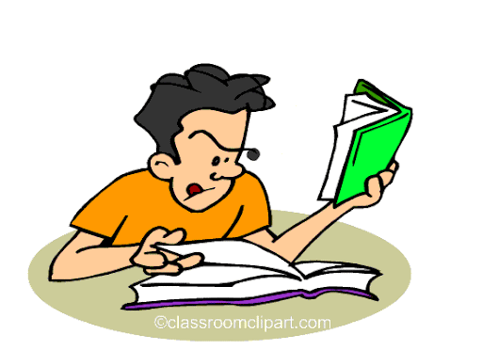
y
stud
ied

Slide 27
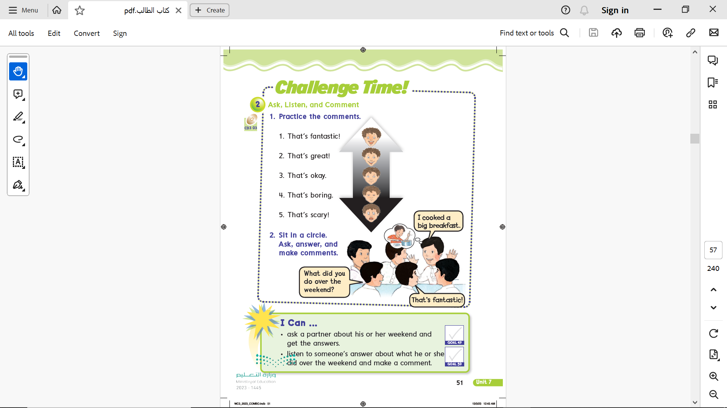
Page 51

Slide 28
Page 51

Slide 29
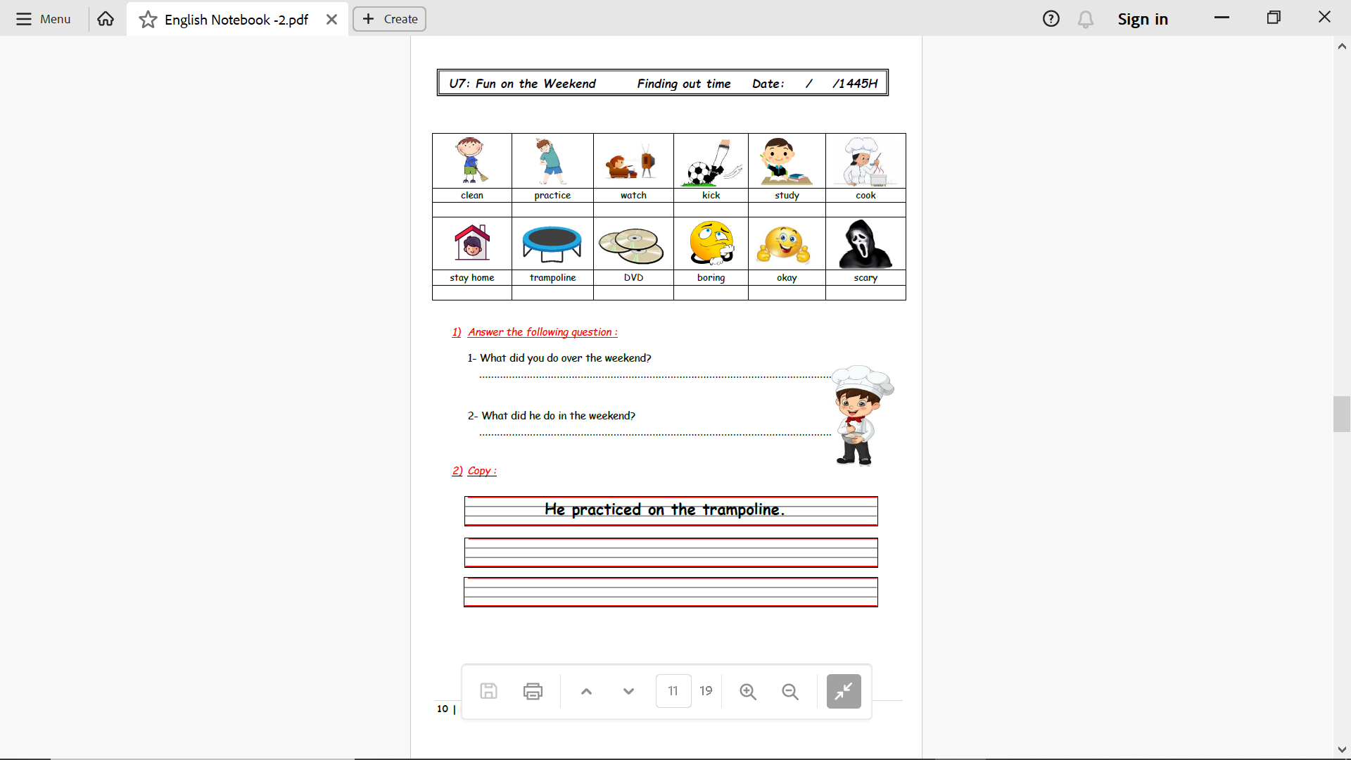
Notebook
Page 10

Slide 30
Notebook
Page 10

Slide 31
Notebook
Page 10

Slide 32

Practice

Slide 33

Homework
Pages 187 & 188

Slide 34
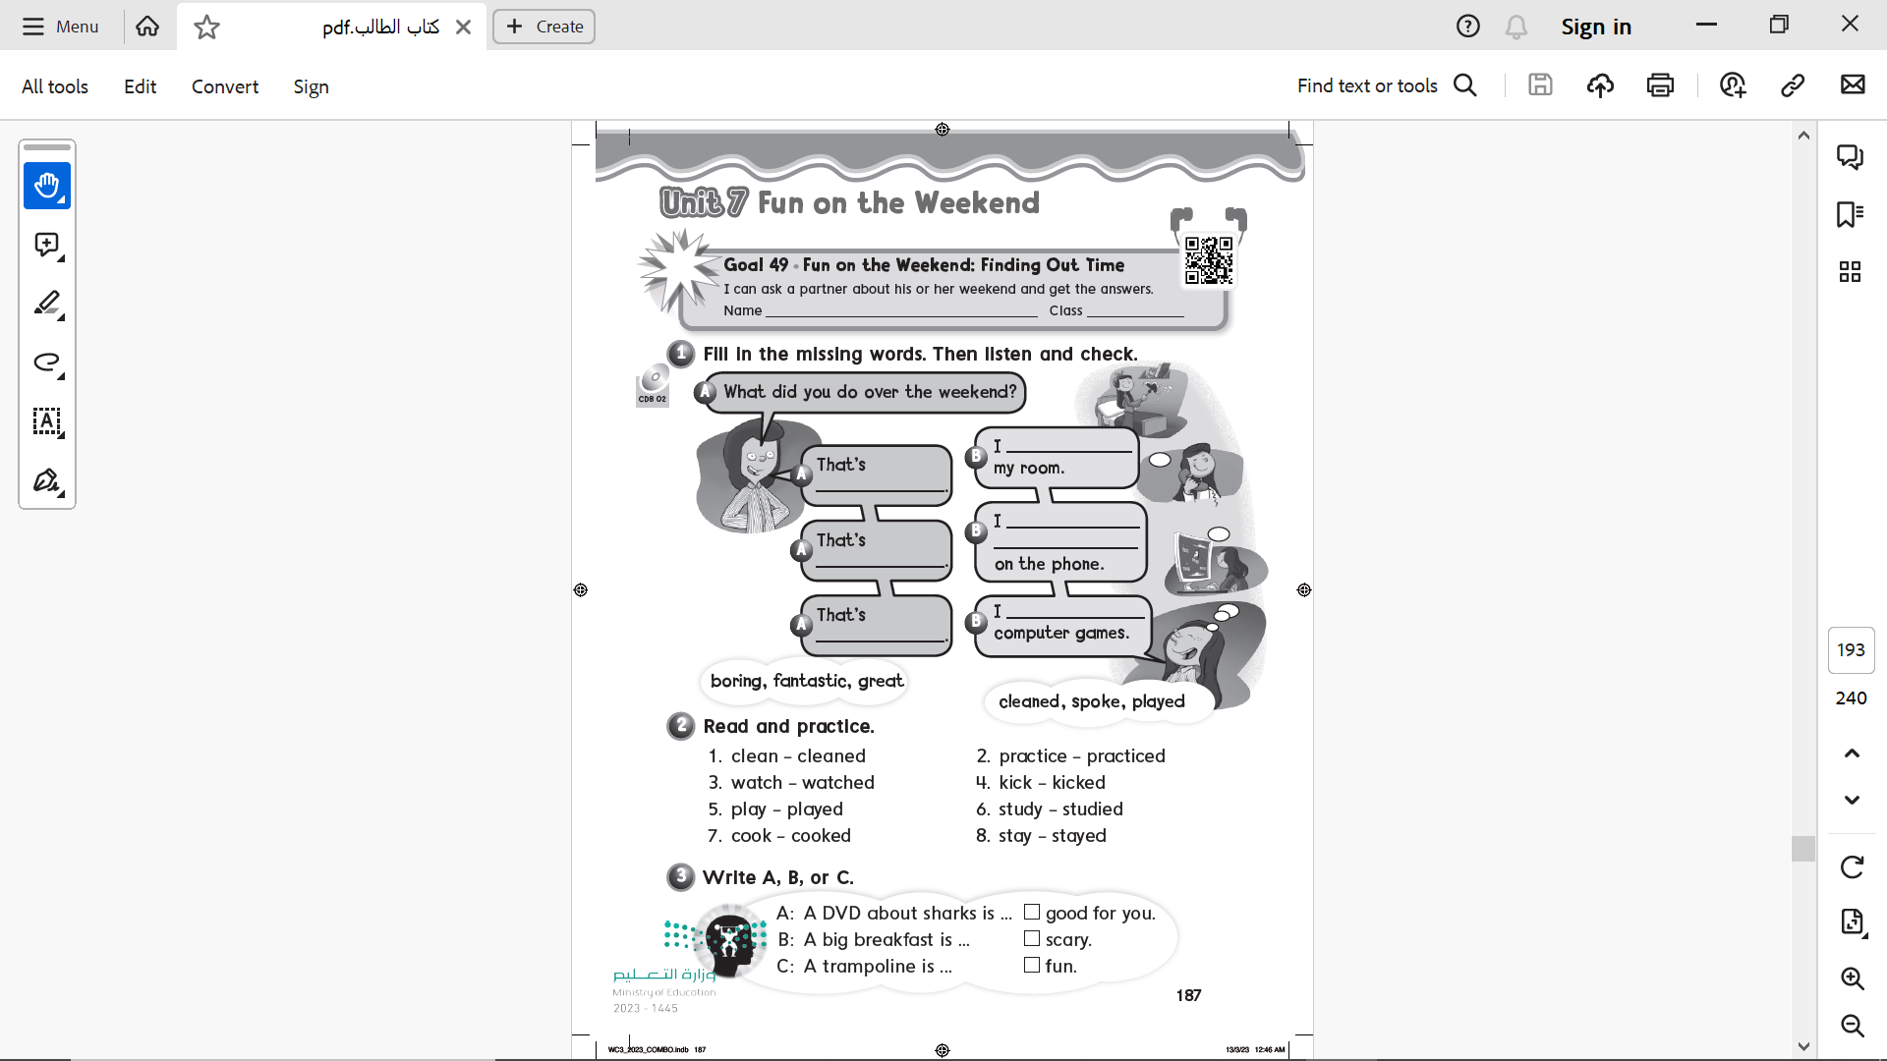
Page 187
cleaned
boring
spoke with my friends
Fantastic
great
played

Slide 35
Page 187
B
A
C

Slide 36
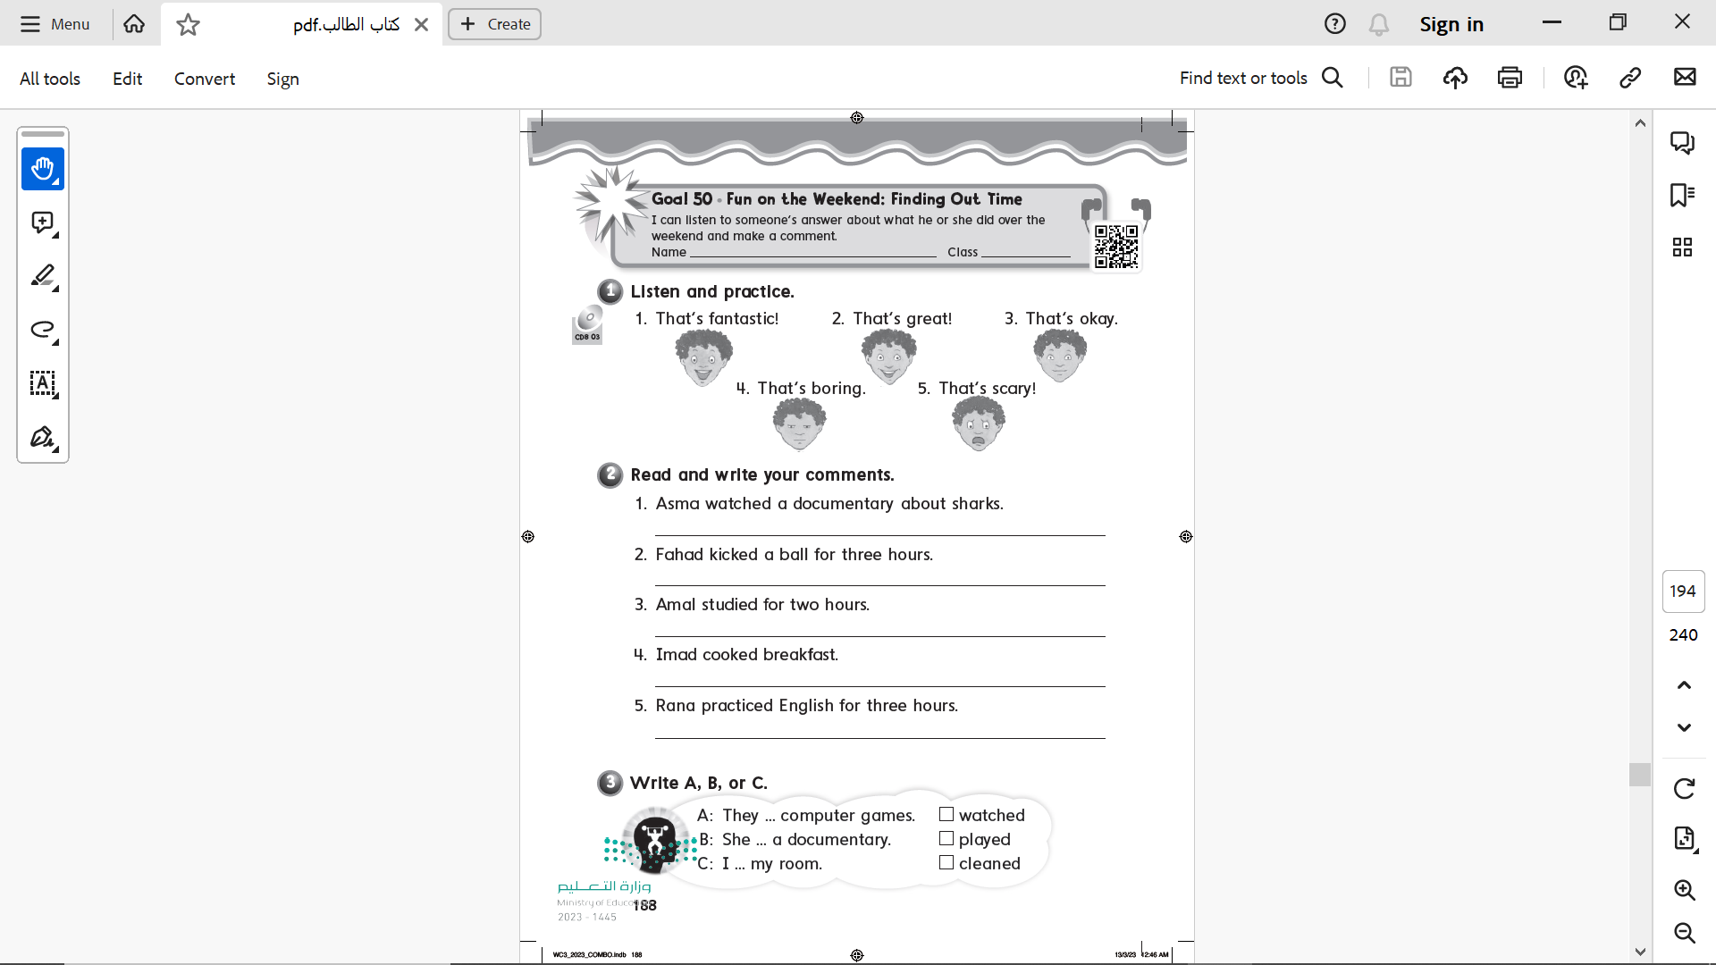
Page 188

Slide 37
Page 188
That’s scary
That’s boring
That’s okay
That’s great
That’s fantastic

Slide 38
Page 188
B
A
C

