Slide 1


اعداد : هدى الصبحي
Start

Slide 2


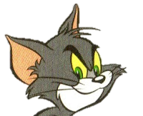



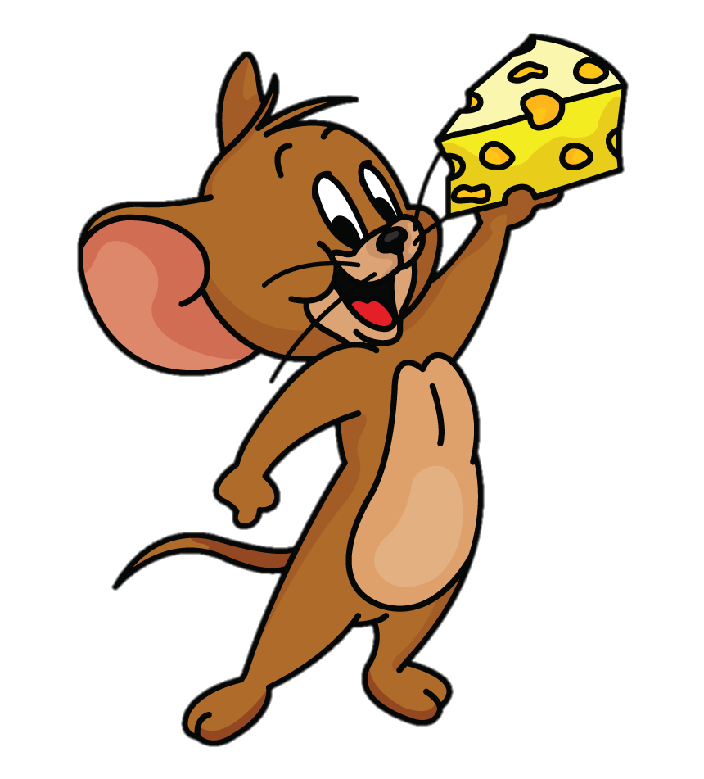
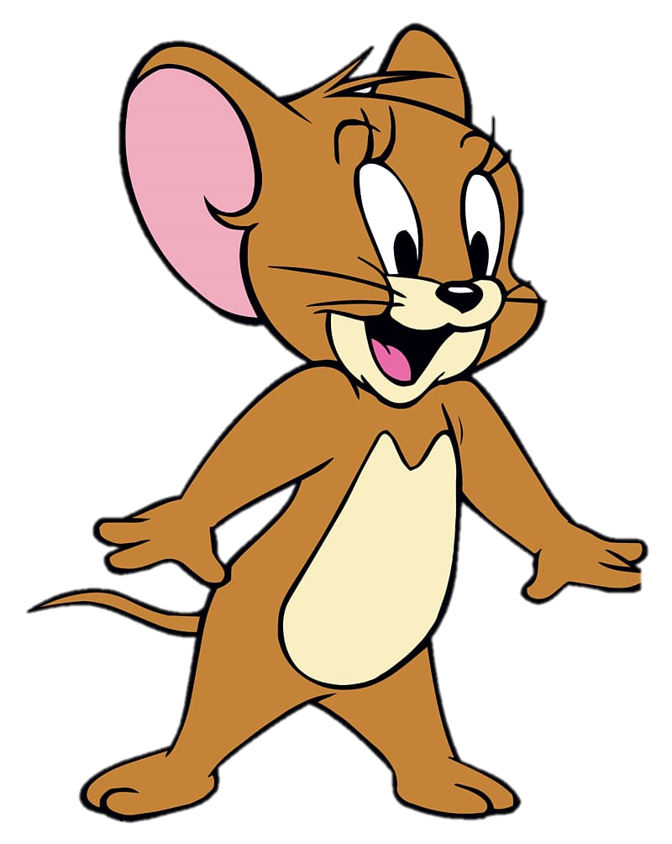
ere
oy
oi
P…nt

Slide 3
ea
ai
ere
H….r

Slide 4
ea
ai
oy
B….r

Slide 5
I’ve no
horse
I’ve no rocket
There isno plane
I’d like to try riding but

Slide 6
air
ere
ear
wh…. ?

Slide 7
I’ve no
falcon
I’ve no rocket
There isno plane
I’d like to try falconing but

Slide 8
oy
ai
oi
T…..

Slide 9
don’t know
how
I’ve no rocket
There isno plane
I’d like to try cooking but

Slide 10

