Slide 1


Mega Goal 2.2
Unit 7 - There’s No Place Like Home
Listen and Discuss

Slide 2
Objectives
Differentiate
between a house and a home
Distinguish between the interior and exterior of a home
01
02
03
04
Name important things at home
Write a quote about home

Slide 3


Warm Up
What comes into your mind
when you see the picture?
HOUSE & HOME mean the same.

Slide 4



Warm Up
Which picture does represent a house & a home?
HOUSE
HOME

Slide 5
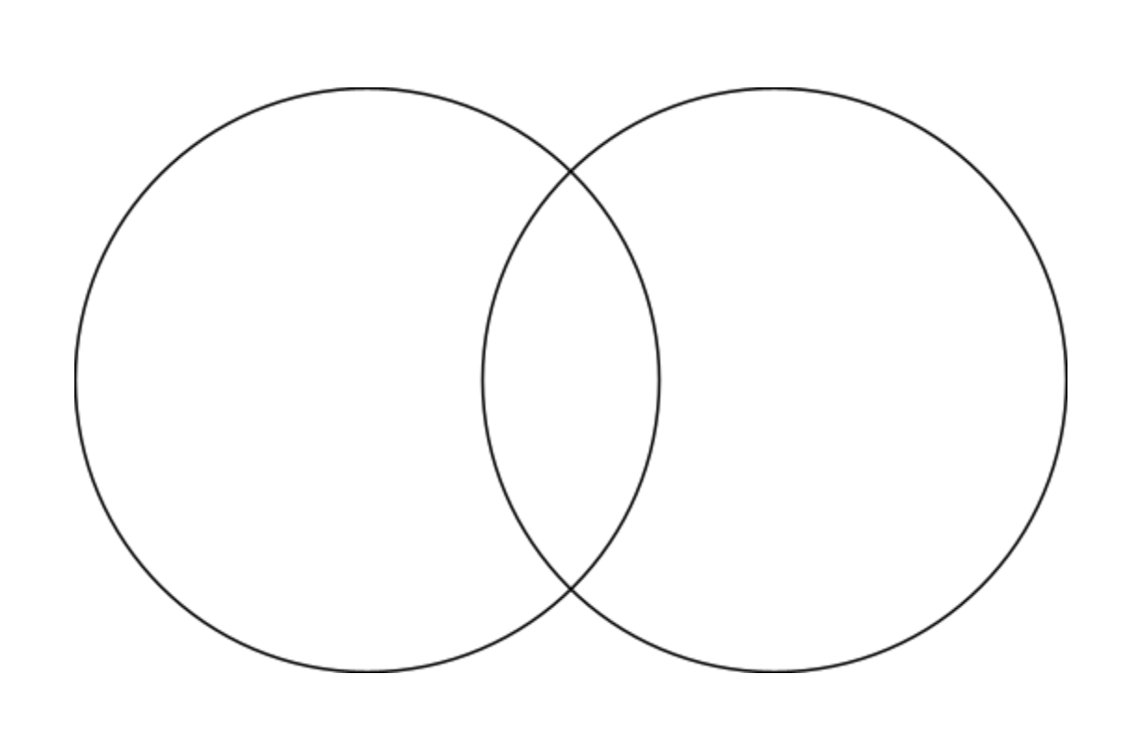
Venn Diagram strategy
Warm Up
HOUSE
HOME

Slide 6
Warm Up
What is the difference?
HOUSE
HOME
refers to the BUILDING in which someone lives
a concrete concept
refers to the PLACE where someone lives
Represents safety, comfort and emotion

Slide 7

Warm Up
What are the most important things in your home?

Slide 8

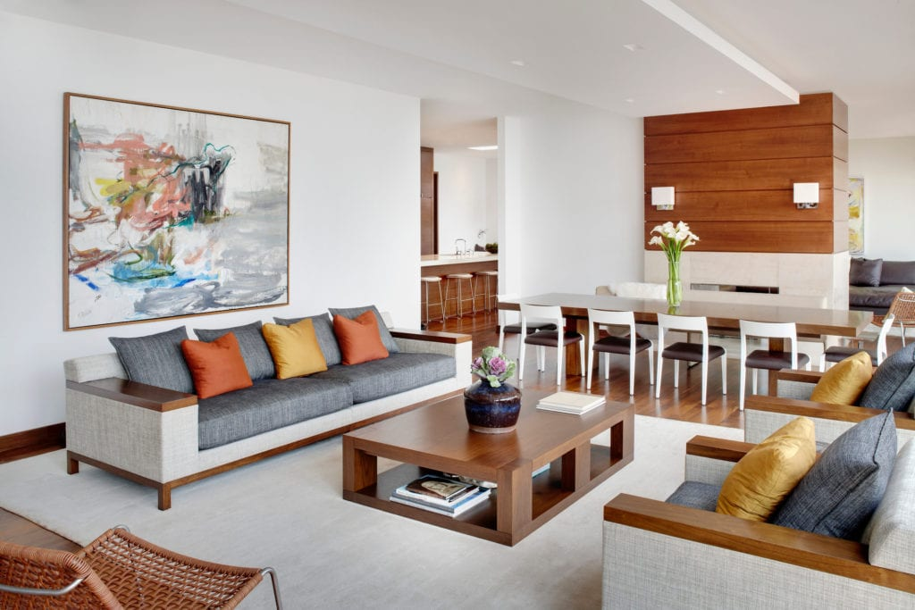

Warm Up
Describe your dream home
New? Old? Big? Small? Modern? Traditional? Villa? Apartment? …… ?
interior
exterior

Slide 9

"وَاللَّهُ جَعَلَ لَكُمْ مِنْ بُيُوتِكُمْ سَكَنًا"

Slide 10
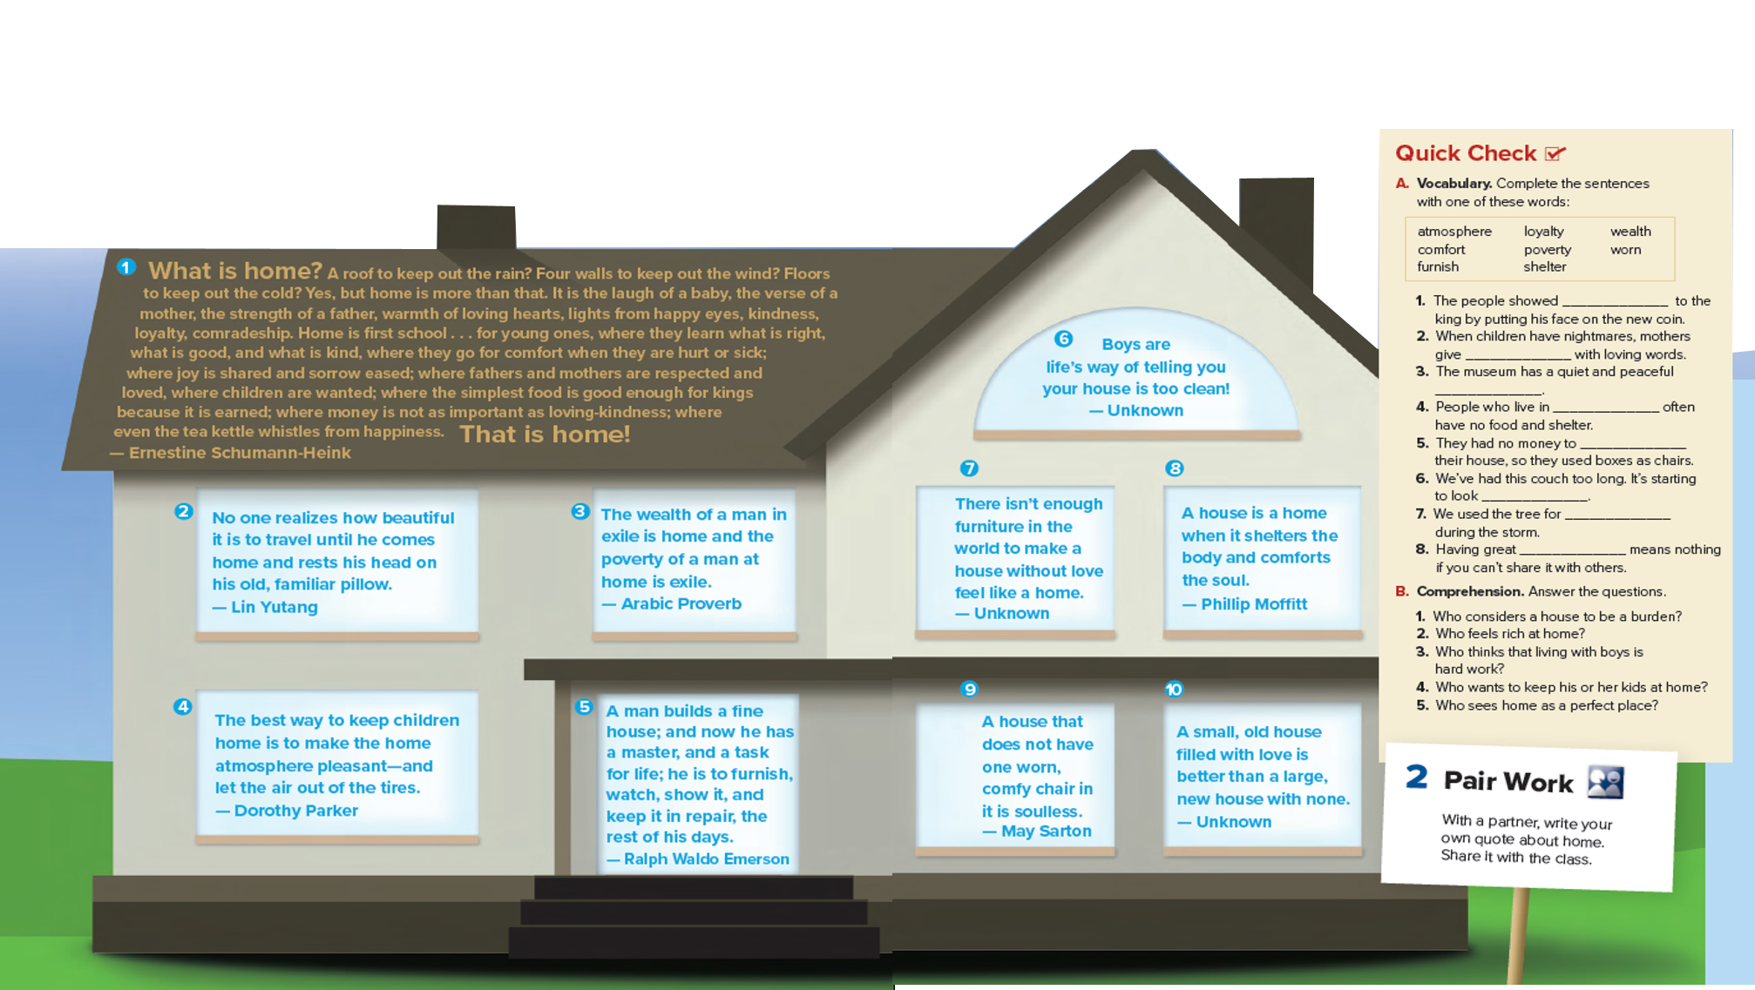
Listen & Discuss
Books open @

Slide 11
What are these?
Listen & Discuss
How many quotes ..?
Quotes are about …?

Slide 12

Your Turn
Write your own QUOTE about home

Slide 13


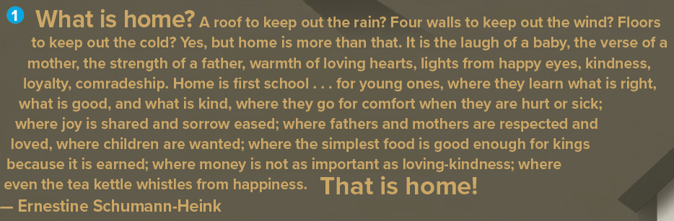

Listen & Discuss
Listen & read a long
Who said this quote?
What’s the most important a BUILDING or FEELINGS?
showing honesty support for someone
the sound indicates to happiness
Notes:
She (the writer) Pointed out that the home is a feeling more than a concrete or just a building

Slide 14
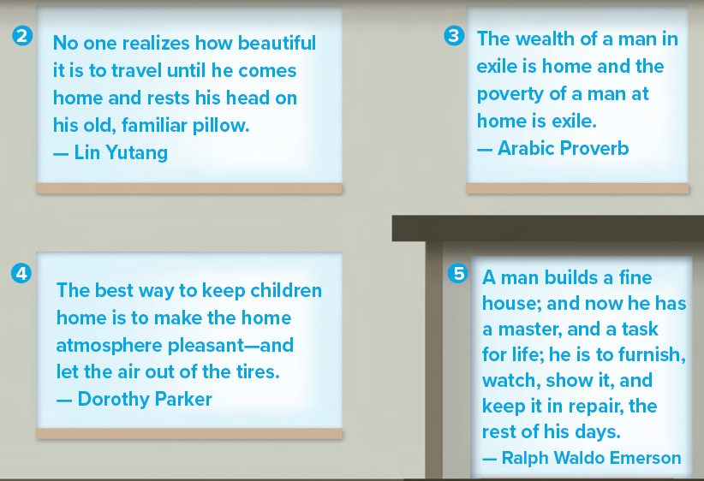
Listen & Discuss
Listen & read a long
a large amount of money
A forces absence from one’s country
Who said that quote?
What do you miss most when you travel away and come back home?
Who said that quote?
How do you feel about it?

Slide 15
Listen & Discuss
Listen & read a long
The mood of the place
Who said that quote?
How will this keep children home?
No air in the tire = Children never leave

Slide 16
Listen & Discuss
Listen & read a long
Who said that quote?
The writer compares home like ….
a person who controls you or is your boss
What should you do to your master?
Serve and take responsibility

Slide 17
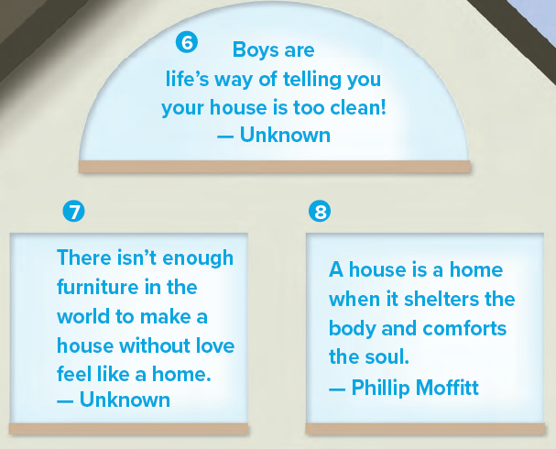

Listen & Discuss
Listen & read a long
Who said that quote?
No Children = a clean house
to protect from something
According to the writer
What is the most important thing ….
Furniture?
Love?
to make someone feels good

Slide 18
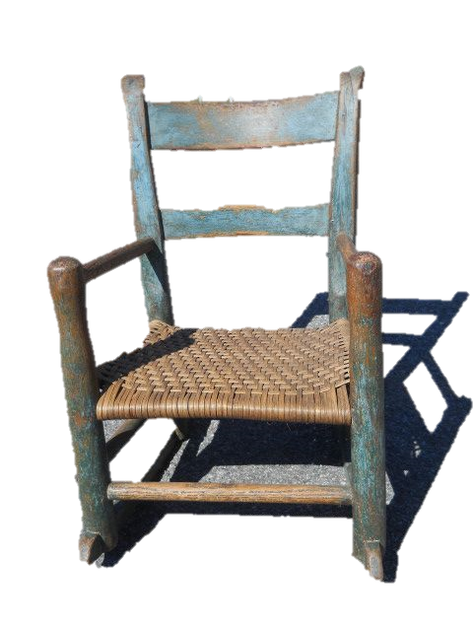

Listen & Discuss
Listen & read a long
According to the writer
old chair in home refers to the
Life of home, feel of trust & old memories
the most important thing is to have
a new house?
Old & used
comfortable
Notes:
According to the writer
Old furniture indicates to the trust that someone feels because he used to set in it.

Slide 19
Listen & Discuss
Which quote do you like best & WHY?

Slide 20

QUIZ TIME

Slide 21

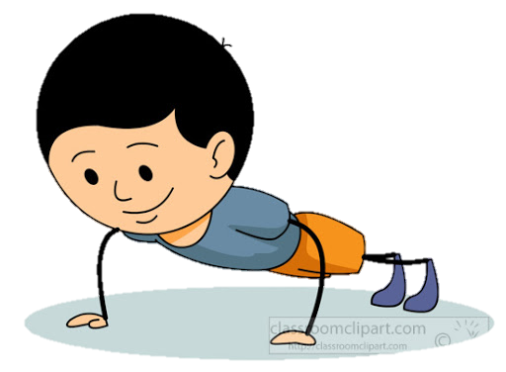
walls
Words refer to
a ‘HOUSE'
love
roof

Slide 22
living
Words refer to
a ‘HOME'
comfort
building

Slide 23
4 bedrooms,4 bathrooms, an office, and a kitchen
interior design
exterior design

Slide 24
interior design
a small garden, a pool, and parking area
exterior design
interior & exterior

Slide 25
comfort
When children have nightmares, mothers give _____________ with loving words.
worn
poverty

Slide 26
comfort
People who live in _____________ often have no food and shelter.
worn
poverty

Slide 27

What is the effective role of Saudi Arabia towards Housing ?

Slide 28

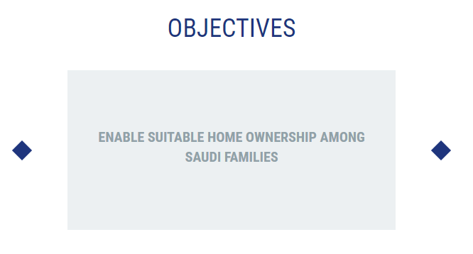

Slide 29
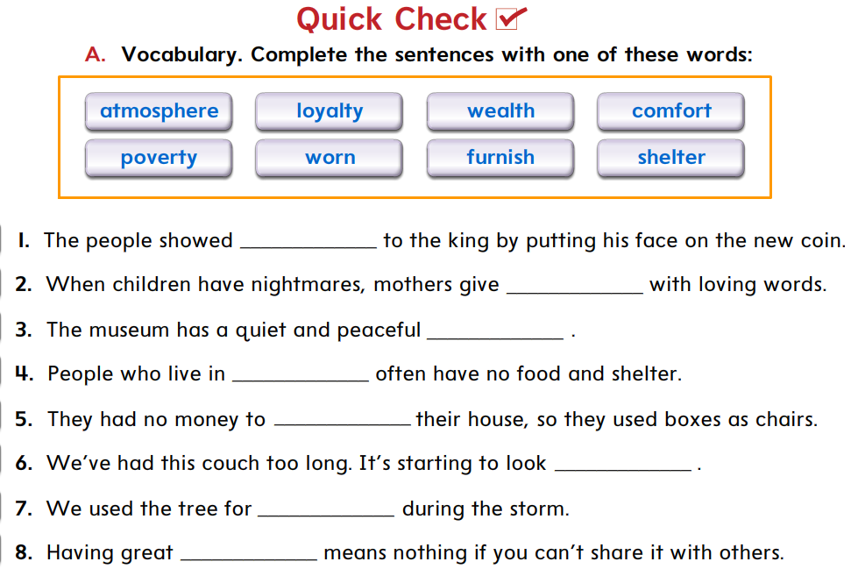
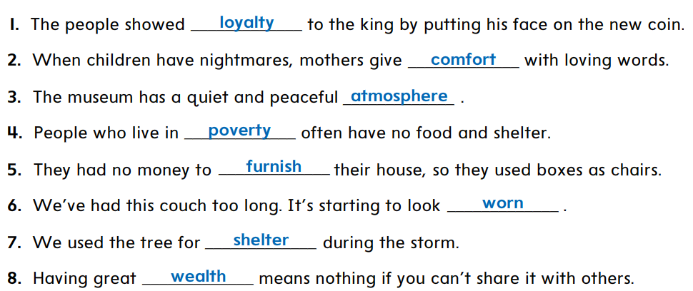

Quick Check

Slide 30



1
HOMEWORK
Workbook page
https://forms.office.com/Pages/ShareFormPage.aspx?id=b4OQU5QpqkK9sELnf3f9C0tUDGzPRYpDjgbnhRSJpRlUREJCTFdHQVlVTlVRVDRCVzU2SE4wNVZXVC4u&sharetoken=ve3d1cK21SI72A82wQQ4

Slide 31



