Slide 1



Slide 2
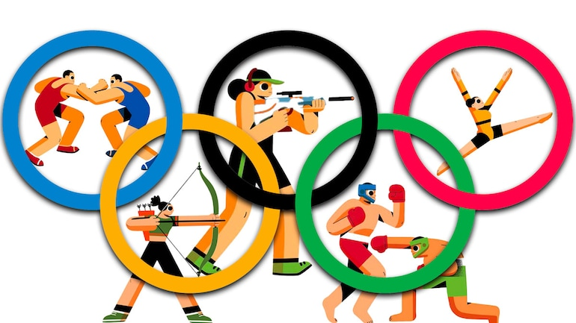
Uint-4-
The Sporting Life

Slide 3
Reading
Speaking

Slide 4
Objectives
Mention some information about Norway.
Read for specific information
Name some winter sports in Norway .
Talk about popular sports in Saudi Arabia.

Slide 5
Reading

Slide 6
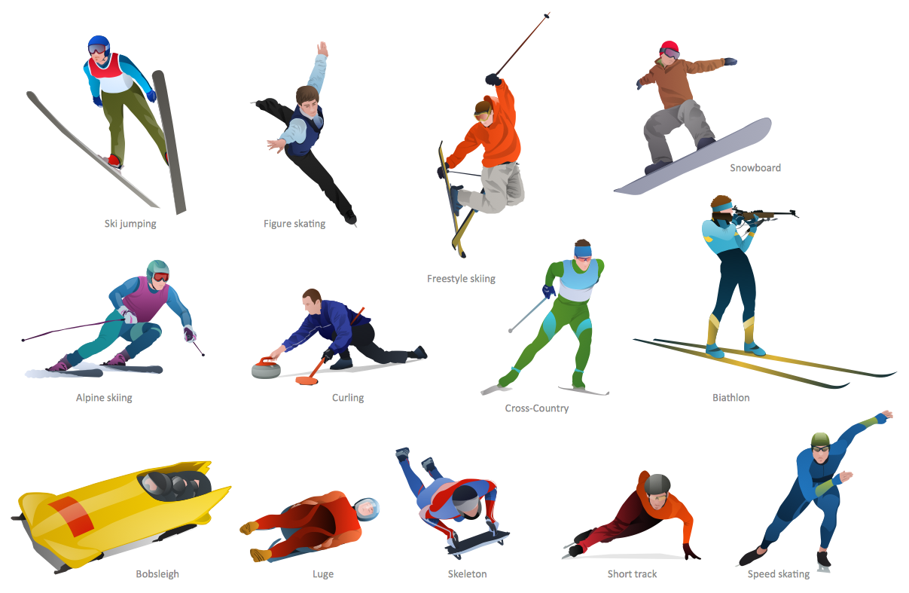


What are the people doing in each picture ?
Speed skating
Ski jumping

Slide 7
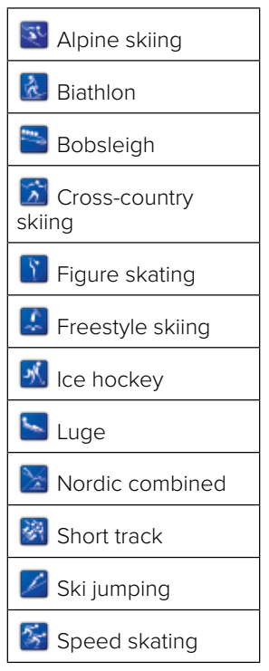
These are winter sports .
These are ……………….

Slide 8

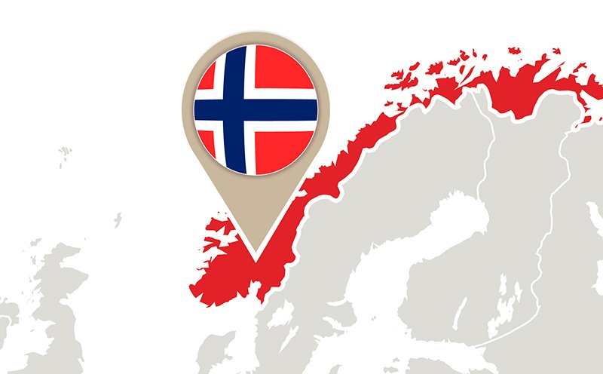
What do you think of the title?
What is this country?
When do
Norwegians go skiing?

Slide 9
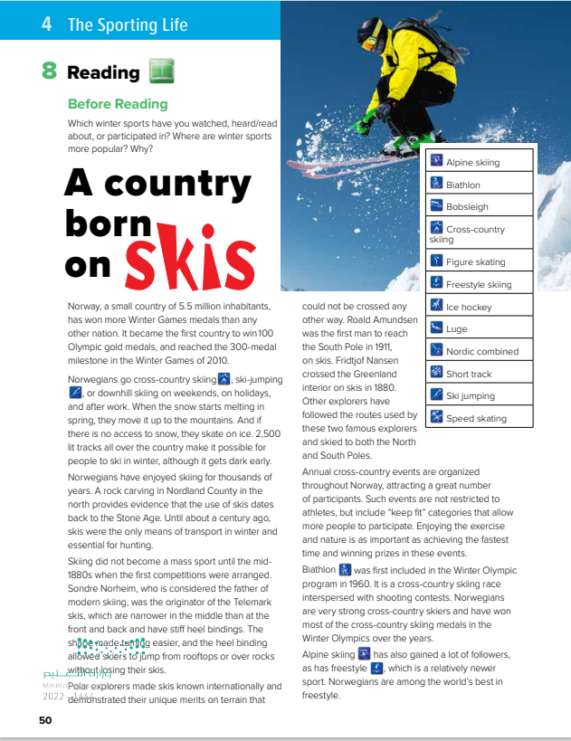
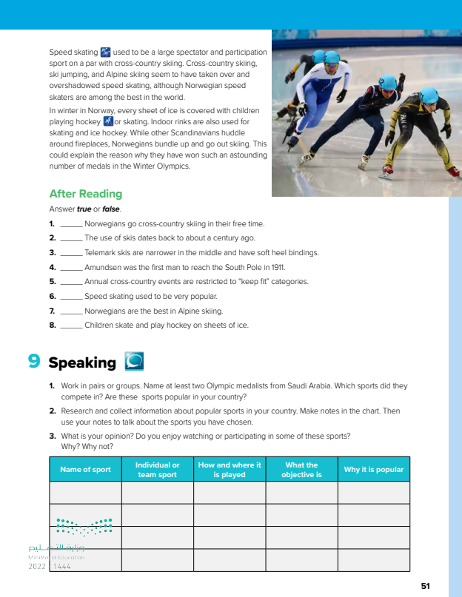
READING STRATEGY Timed reading

Slide 10
8
9
1
What is the title of the text ?
2
5
3
6
How many paragraphs are there ?
4
7

Slide 11


Read as long as you listen

Slide 12

Norway, a small country of 5.5 million inhabitants, has won more Winter Games medals than any other nation. It became the first country to win 100 Olympic gold medals, and reached the 300-medal milestone in the Winter Games of 2010.
could not be crossed any other way. Roald Amundsen was the first man to reach the South Pole in 1911, on skis. Fridtjof Nansen crossed the Greenland interior on skis in 1880. Other explorers have followed the routes used by these two famous explorers and skied to both the North and South Poles.
Norwegians go cross-country skiing , ski-jumping , or downhill skiing on weekends, on holidays, and after work. When the snow starts melting in spring, they move it up to the mountains. And if there is no access to snow, they skate on ice. 2,500 lit tracks all over the country make it possible for people to ski in winter, although it gets dark early. Norwegians have enjoyed skiing for thousands of years. A rock carving in Nordland County in the north provides evidence that the use of skis dates back to the Stone Age. Until about a century ago, skis were the only means of transport in winter and essential for hunting.
Annual cross-country events are organized throughout Norway, attracting a great number of participants. Such events are not restricted to athletes, but include “keep fit” categories that allow more people to participate. Enjoying the exercise and nature is as important as achieving the fastest time and winning prizes in these events
Biathlon was first included in the Winter Olympic program in 1960. It is a cross-country skiing race interspersed with shooting contests. Norwegians are very strong cross-country skiers and have won most of the cross-country skiing medals in the Winter Olympics over the years
Skiing did not become a mass sport until the mid1880s when the first competitions were arranged. Sondre Norheim, who is considered the father of modern skiing, was the originator of the Telemark skis, which are narrower in the middle than at the front and back and have stiff heel bindings. The shape made turning easier, and the heel binding allowed skiers to jump from rooftops or over rocks without losing their skis.
Alpine skiing has also gained a lot of followers, as has freestyle , which is a relatively newer sport. Norwegians are among the world’s best in freestyle.
Polar explorers made skis known internationally and demonstrated their unique merits on terrain that

Slide 13
Norway, a small country of 5.5 million inhabitants, has won more Winter Games medals than any other nation. It became the first country to win 100 Olympic gold medals, and reached the 300-medal milestone in the Winter Games of 2010.
Norwegians go cross-country skiing , ski-jumping , or downhill skiing on weekends, on holidays, and after work. When the snow starts melting in spring, they move it up to the mountains. And if there is no access to snow, they skate on ice. 2,500 lit tracks all over the country make it possible for people to ski in winter, although it gets dark early. Norwegians have enjoyed skiing for thousands of years. A rock carving in Nordland County in the north provides evidence that the use of skis dates back to the Stone Age. Until about a century ago, skis were the only means of transport in winter and essential for hunting.
could not be crossed any other way. Roald Amundsen was the first man to reach the South Pole in 1911, on skis. Fridtjof Nansen crossed the Greenland interior on skis in 1880. Other explorers have followed the routes used by these two famous explorers and skied to both the North and South Poles.
Annual cross-country events are organized throughout Norway, attracting a great number of participants. Such events are not restricted to athletes, but include “keep fit” categories that allow more people to participate. Enjoying the exercise and nature is as important as achieving the fastest time and winning prizes in these events
Skiing did not become a mass sport until the mid1880s when the first competitions were arranged. Sondre Norheim, who is considered the father of modern skiing, was the originator of the Telemark skis, which are narrower in the middle than at the front and back and have stiff heel bindings. The shape made turning easier, and the heel binding allowed skiers to jump from rooftops or over rocks without losing their skis.
Biathlon was first included in the Winter Olympic program in 1960. It is a cross-country skiing race interspersed with shooting contests. Norwegians are very strong cross-country skiers and have won most of the cross-country skiing medals in the Winter Olympics over the years
Alpine skiing has also gained a lot of followers, as has freestyle , which is a relatively newer sport. Norwegians are among the world’s best in freestyle.
Polar explorers made skis known internationally and demonstrated their unique merits on terrain that
Speed skating used to be a large spectator and participation sport on a par with cross-country skiing. Cross-country skiing, ski jumping, and Alpine skiing seem to have taken over and overshadowed speed skating, although Norwegian speed skaters are among the best in the world.
In winter in Norway, every sheet of ice is covered with children playing hockey or skating. Indoor rinks are also used for skating and ice hockey. While other Scandinavians huddle around fireplaces, Norwegians bundle up and go out skiing. This could explain the reason why they have won such an astounding number of medals in the Winter Olympics.

Slide 14
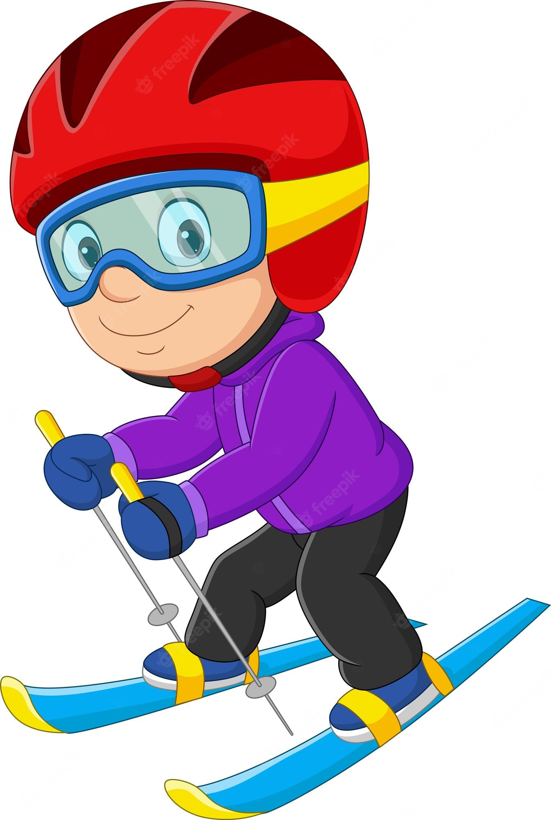
Speed skating used to be a large spectator and participation sport on a par with cross-country skiing. Cross-country skiing, ski jumping, and Alpine skiing seem to have taken over and overshadowed speed skating, although Norwegian speed skaters are among the best in the world.
In winter in Norway, every sheet of ice is covered with children playing hockey or skating. Indoor rinks are also used for skating and ice hockey. While other Scandinavians huddle around fireplaces, Norwegians bundle up and go out skiing. This could explain the reason why they have won such an astounding number of medals in the Winter Olympics.

Slide 15
Quick Check
Who is considered to be the father of modern skiing?
(Sondre Norheim)
How important were skis a century ago?
What was important about the Telemark skis?
(allowed skiers to jump without losing their skis)
(they were the only means of transport in winter
Is it possible for people to ski in winter in the dark?
Who was the first man to reach the South Pole?
Yes
(Roald Amundsen)
What do they do if there is no access to snow?
Is Biathlon an Olympic sport?
Yes
they skate on ice)
When do Norwegians go cross-country skiing?
Which country has won most of the Olympic medals in cross-country skiing?
(on weekends, on holidays, after work)
(Norway

Slide 16
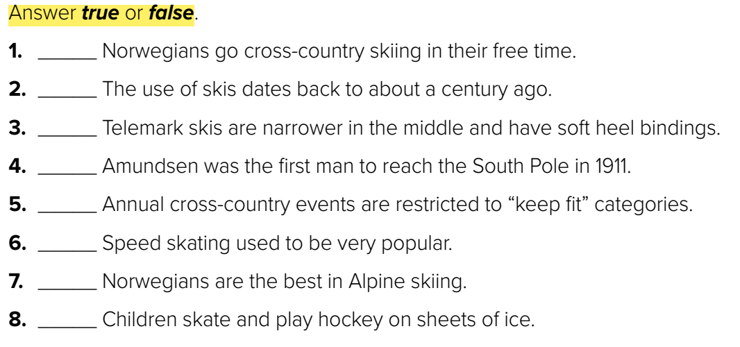
T
F
F
T
F
T
F
T

Slide 17
Speaking

Slide 18
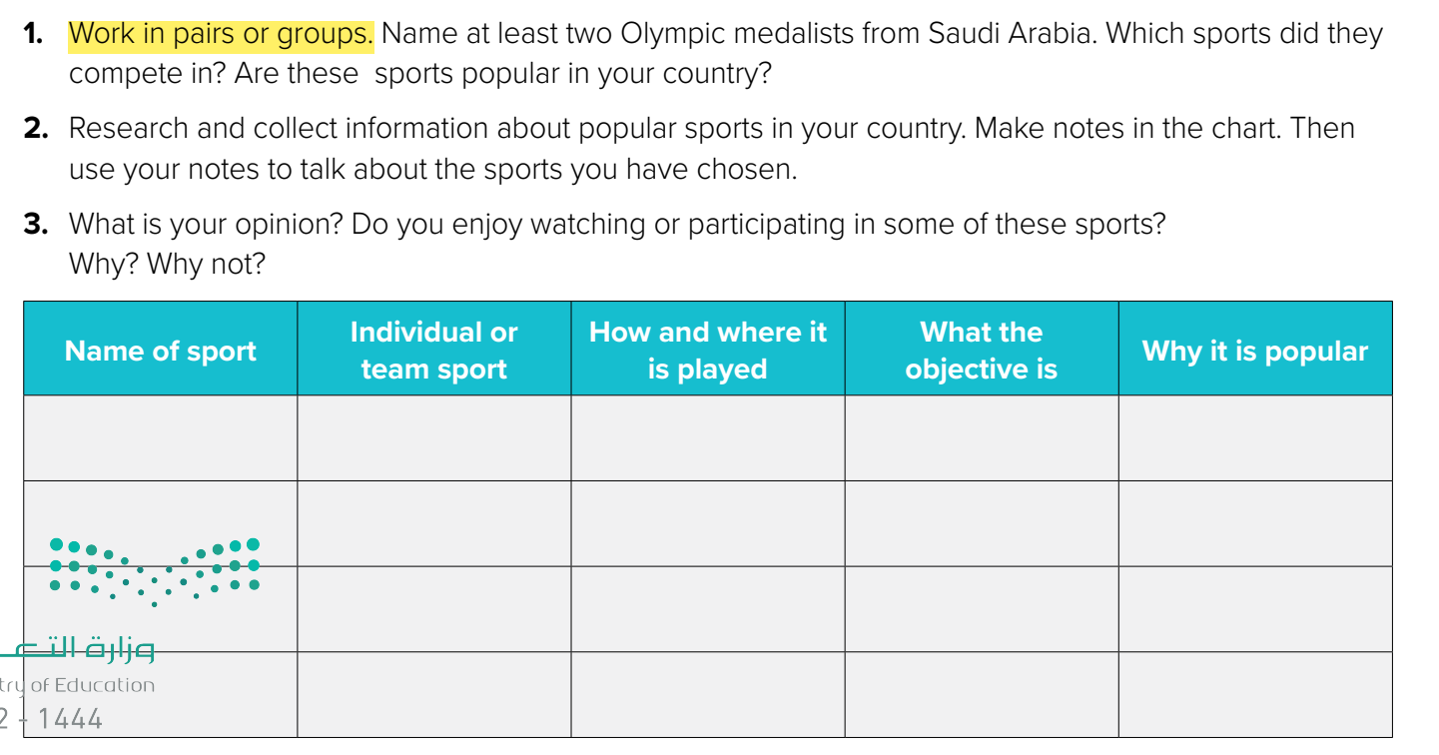


Slide 19

قال النبي صلى الله عليه وسلم:
" إِنّ اللَّهَ َتعَالىُ يحِبّ إِذَا عَمِلَ أَحَدُكُمْ عَمَلاً أَنْ يُتْقِنَهُ"

Slide 20

Trojena

Slide 21


