Slide 1



Slide 2

Uint-4-
The Sporting Life

Slide 3
Form , Meaning & Function

Slide 4
Present Perfect Progressive versus Present Perfect Simple
Time Expressions: How long …?
Adverbs of Manner
Comparative Forms of Adjectives and Adverbs
Than and As … As

Slide 5
Objectives
Distinguish between present perfect simple and present perfect progressive .
Form sentences with comparative form of adjectives and adverbs .
Form sentences using present perfect progressive .
Form sentences using as……………as .
Use adverb of manner in a correct sentence .
Apply the rules to do the exercises .

Slide 6
Present Perfect Progressive versus Present Perfect Simple

Slide 7
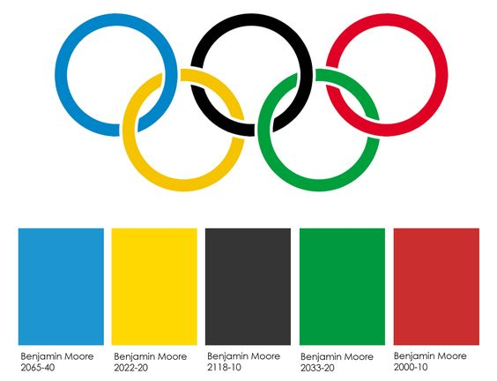
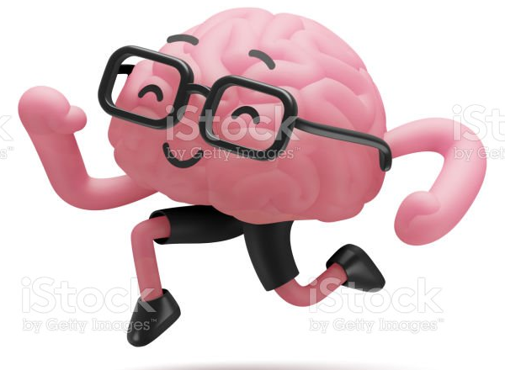
Refresh Your Memory
“ Present Perfect progressive“
Key Words
I have hiked that mountain many times with my kids .
We have been hiking for more than an hour .
She has been driving since two o’clock .
We have been hiking for more than an hour .
She has been driving since two o’clock .
He has painted his bedroom .
He has been painting his bedroom .
He has been painting his bedroom .
Have you ever played tennis ?
Have you been playing tennis ?
Have you been playing tennis ?
How many pages of that book have you read ?
How long have you been reading that book ?
How long have you been reading that book ?

Slide 8
“ Present Perfect progressive“
She has been driving since two o’clock .
He has been painting his bedroom .
We have been hiking for more than an hour .
Have you been playing tennis ?
How long have you been reading that book ?
to talk about an action that started in the past and has a connection with the present time.
duration
to emphasize the results of the action.
to say how long something has been happening.
Past.
Future
Present
Subject + have / has been + v-ing

Slide 9
Refresh Your Memory
“Present Perfect simple“ “
Key Words
I have hiked that mountain many times with my kids .
I have hiked that mountain many times with my kids .
She has been driving since two o’clock .
We have been hiking for more than an hour .
He has painted his bedroom .
He has painted his bedroom .
He has been painting his bedroom .
Have you ever played tennis ?
Have you ever played tennis ?
Have you been playing tennis ?
How many pages of that book have you read ?
How many pages of that book have you read ?
How long have you been reading that book ?

Slide 10
“Present Perfect simple“ “
I have hiked that mountain many times with my kids .
He has painted his bedroom .
Have you ever played tennis ?
How many pages of that book have you read ?
to say how many things have been done.
Result
Past.
Future
Present
Subject + have / has + v3

Slide 11
Venn Diagram Strategy
Present perfect simple VS Present perfect progressive

Slide 12
Time Expressions: How long …?

Slide 13
He has painted his bedroom .
I have attended five cross-country skiing events

Slide 14


