Slide 1

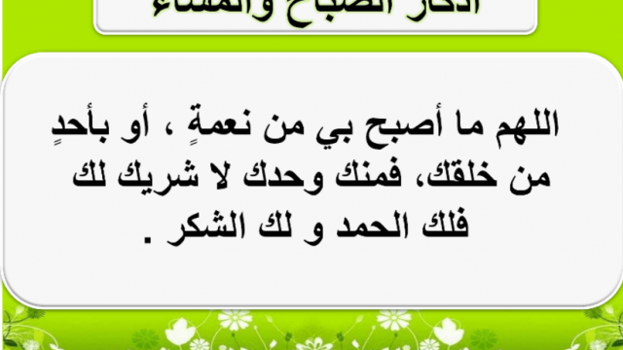

Slide 2

Uint-4-
The Sporting Life

Slide 3
Conversation

Slide 4
Objectives
Answer questions about the conversation
Express confidence in someone
Use
the (real talk) phrases in sentences

Slide 5

Who in the class has competed in an important sporting event, a big school game,?

Slide 6
How did you feel before the game or event? Were you nervous?
How did you feel while you were playing or doing the sport?
What advice did other people give you?

Slide 7

What sport are these for?

Slide 8



Listen to someone who is about to skate in important competition talking to his coach.

Slide 9

Coach: After two years of training, we’re finally at the regional skating competition! How does it feel, Barry?
Barry: Actually, not so good. I’m not sure I’m up for this.
Coach: What are you talking about?
Barry: What if I mess up?
Coach: You’re not going to mess up. You’ve been practicing day and night. You have your routine down pat. Skating in front of those judges is going to be a piece of cake. Now, I want you to take a deep breath and exhale. Trust me. You’re going to knock their socks off.
Barry: Do you really think so?
Coach: You bet! I have total confidence in you. You have the guts and the talent to win this competition. There’s no doubt in my mind that you can do it.
Barry: OK. I feel better. I’m psyched.
Coach: You’ll be on in a few minutes. You should get your skates on. Where are your skates?
Barry: My skates? Oh no! I left them in the car!

Slide 10
Practice the conversation
Coach: After two years of training, we’re finally at the regional skating competition! How does it feel, Barry?
Barry: Actually, not so good. I’m not sure I’m up for this.
Coach: What are you talking about?
Barry: What if I mess up?
Coach: You’re not going to mess up. You’ve been practicing day and night. You have your routine down pat. Skating in front of those judges is going to be a piece of cake. Now, I want you to take a deep breath and exhale. Trust me. You’re going to knock their socks off.
Barry: Do you really think so?
Coach: You bet! I have total confidence in you. You have the guts and the talent to win this competition. There’s no doubt in my mind that you can do it.
Barry: OK. I feel better. I’m psyched.
Coach: You’ll be on in a few minutes. You should get your skates on. Where are your skates?
Barry: My skates? Oh no! I left them in the car!

Slide 11
Coach: After two years of training, we’re finally at the regional skating competition! How does it feel, Barry?
Barry: Actually, not so good. I’m not sure I’m up for this.
Coach: What are you talking about?
Barry: What if I mess up?
Coach: You’re not going to mess up. You’ve been practicing day and night. You have your routine down pat. Skating in front of those judges is going to be a piece of cake. Now, I want you to take a deep breath and exhale. Trust me. You’re going to knock their socks off.
Barry: Do you really think so?
Coach: You bet! I have total confidence in you. You have the guts and the talent to win this competition. There’s no doubt in my mind that you can do it.
Barry: OK. I feel better. I’m psyched.
Coach: You’ll be on in a few minutes. You should get your skates on. Where are your skates?
Barry: My skates? Oh no! I left them in the car!
Real Talk

Slide 12

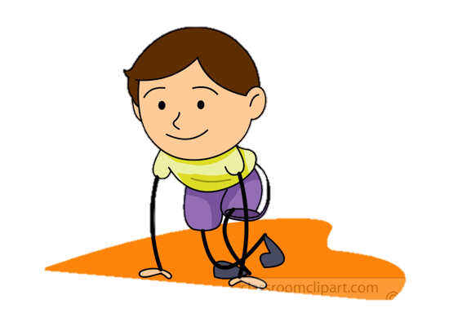





Real Talk
up for
ready for
You bet
Of course
mess up
make a mistake
guts
courage
down pat.
at the point of perfection
psyched.
Yes I can do it
excited and psychologically prepared

Slide 13
1
Are you up for a game of basketball after school?
3
Have the vocabulary down pat. How about you?
2
Did you ever mess up during an important game?
Have you ever done anything that took guts?
4

Slide 14
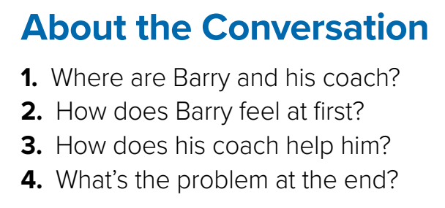
1
At an ice-skating competition
2
Nervous
3
Encourages him and gives him more confidence
4
Barry forgot his skates in the car.

Slide 15


Slide 16

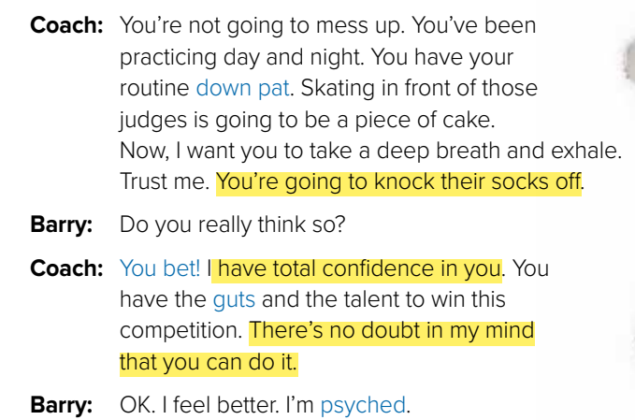
Which expressions does the coach use to encourage Barry?
Encouraging and Expressing Confidence in Someone
(I know) You can do it. You’ll do great. I have confidence/faith in you. You’re going to knock ’em There’s no question in my mind… dead/knock their socks off. You’ve got what it takes

Slide 17

Role-play with a partner. Pretend you are about to do something you are nervous about, such as take an important exam, or give a presentation in front of the class. Your partner will offer encouragement and express confidence in you.
Encouraging and Expressing Confidence in Someone
(I know) You can do it. You’ll do great. I have confidence/faith in you. You’re going to knock ’em There’s no question in my mind… dead/knock their socks off. You’ve got what it takes

Slide 18


