Slide 1



Mega goal.3.2
The Gender Divide.
Conversation

Slide 2
Objectives:
Write sentences about directions
Use the 'real talk" in a conversation
Find the meanings of new words through the text

Slide 3
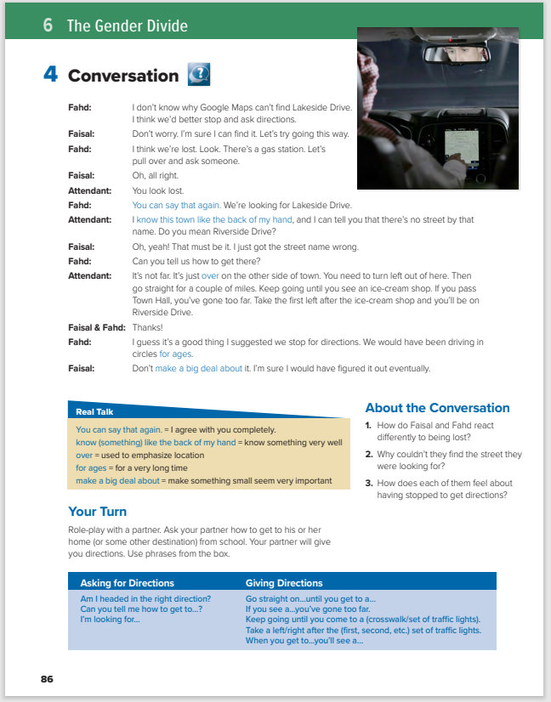

Students Book
P.86

Slide 4
What do you see?
a driver using Google Maps for finding directions
How many of you use Google Maps for finding directions?

Slide 5



listen with your books closed

Slide 6
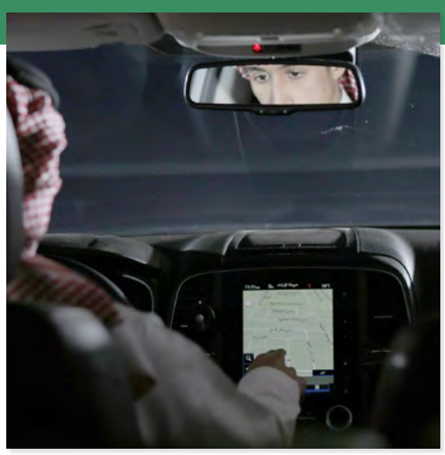
Fahd: I don’t know why Google Maps can’t find Lakeside Drive. I think we’d better stop and ask directions.
Faisal: Don’t worry. I’m sure I can find it. Let’s try going this way.
Fahd: I think we’re lost. Look. There’s a gas station. Let’s pull over and ask someone.
Faisal: Oh, all right.
Attendant: You look lost.
Fahd: You can say that again. We’re looking for Lakeside Drive.
Attendant: I know this town like the back of my hand, and I can tell you that there’s no street by that name. Do you mean Riverside Drive?
Faisal: Oh, yeah! That must be it. I just got the street name wrong.
Fahd: Can you tell us how to get there?
Attendant: It’s not far. It’s just over on the other side of town. You need to turn left out of here. Then go straight for a couple of miles. Keep going until you see an ice-cream shop. If you pass Town Hall, you’ve gone too far. Take the first left after the ice-cream shop and you’ll be on Riverside Drive.
Faisal & Fahd: Thanks!
Fahd: I guess it’s a good thing I suggested we stop for directions. We would have been driving in circles for ages.
Faisal: Don’t make a big deal about it. I’m sure I would have figured it out eventually

Slide 7

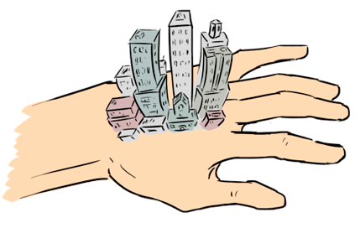
Fahd: I don’t know why Google Maps can’t find Lakeside Drive. I think we’d better stop and ask directions.
Faisal: Don’t worry. I’m sure I can find it. Let’s try going this way.
Fahd: I think we’re lost. Look. There’s a gas station. Let’s pull over and ask someone.
Faisal: Oh, all right.
Attendant: You look lost.
Fahd: You can say that again. We’re looking for Lakeside Drive.
Attendant: I know this town like the back of my hand, and I can tell you that there’s no street by that name. Do you mean Riverside Drive?
Faisal: Oh, yeah! That must be it. I just got the street name wrong.
Fahd: Can you tell us how to get there?
Attendant: It’s not far. It’s just over on the other side of town. You need to turn left out of here. Then go straight for a couple of miles. Keep going until you see an ice-cream shop. If you pass Town Hall, you’ve gone too far. Take the first left after the ice-cream shop and you’ll be on Riverside Drive.
Faisal & Fahd: Thanks!
Fahd: I guess it’s a good thing I suggested we stop for directions. We would have been driving in circles for ages.
Faisal: Don’t make a big deal about it. I’m sure I would have figured it out eventually
When Fahd says You can say that again, how does he feel?
He is a bit annoyed
What do you know like the back of your hand?
I know this town/street/neighborhood/hospital/ school like the back of my hand
Over
: Fahd says We would have been driving in circles for ages. How long do you think they actually would have driven in circles?
: When Faisal says Don’t make a big deal about it, how does he feel?
He is annoyed

Slide 8
About the Conversation
How do Faisal and Fahd react differently to being lost?
2. Why couldn’t they find the street they were looking for?
3. How does each of them feel about having stopped to get directions?
1.Fahd wants to stop and ask for directions, but Faisal doesn’t.
2. They were looking for the wrong street name.
3. Fahd is glad that they stopped, but Faisal isn’t.

Slide 9


Quick Check

Slide 10


