Slide 1
Unit 7 What happened?
Workbook pages (213 – 216)

Slide 2
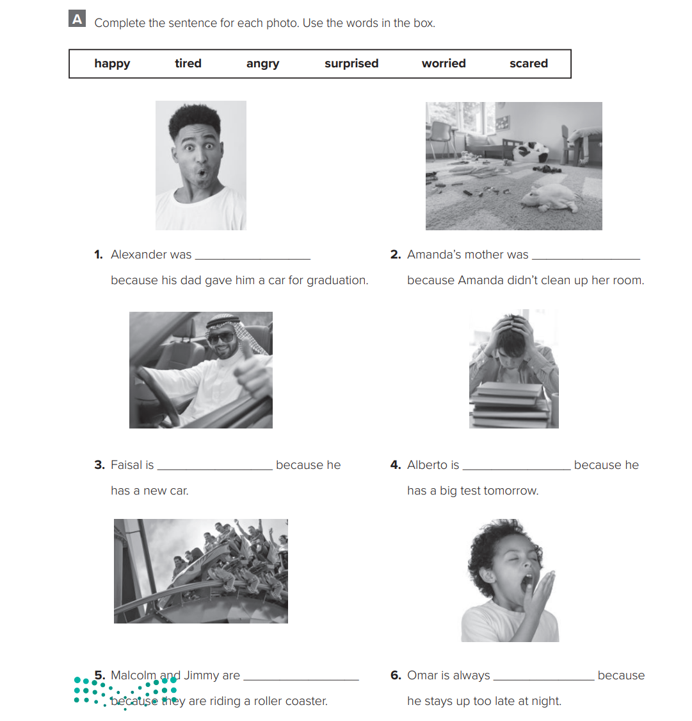
p.213
surprised
angry
happy
worried
scared
tired

Slide 3
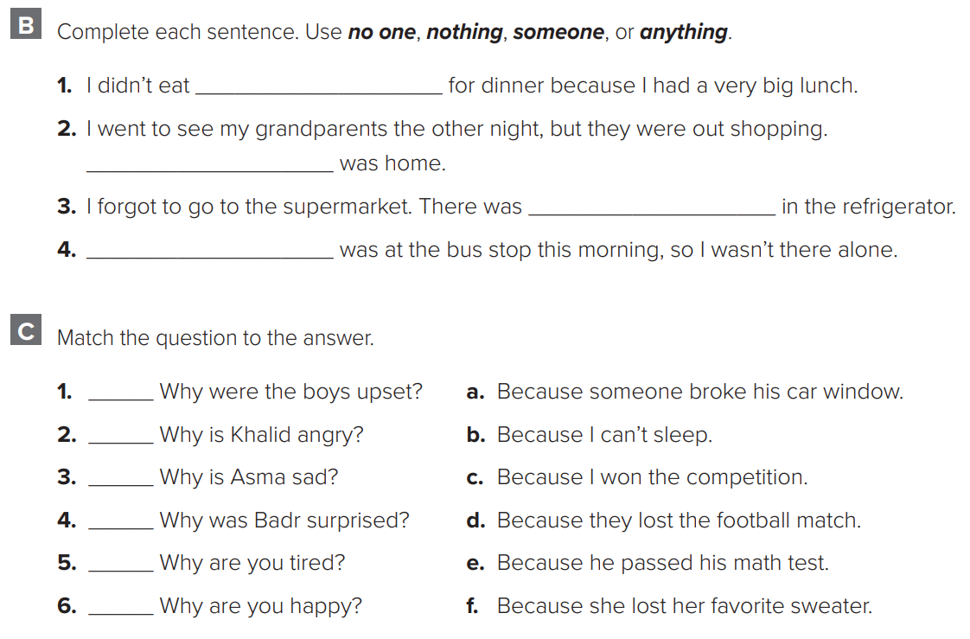
p.214
anything
no one
nothing
someone
d
a
f
e
b
c

Slide 4
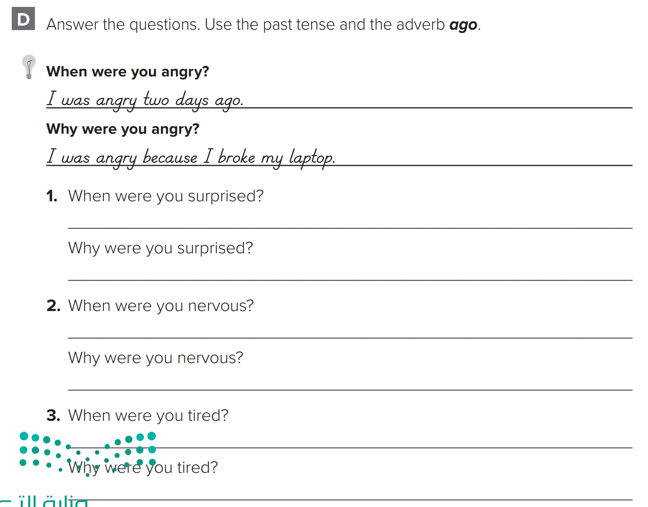
p.214
I was surprised a week ago.
I was surprised because I saw an old friend.
I was nervous two hours ago.
I was nervous because I had a test.
I was tired three days ago.
I was tired because I studied late night.

Slide 5
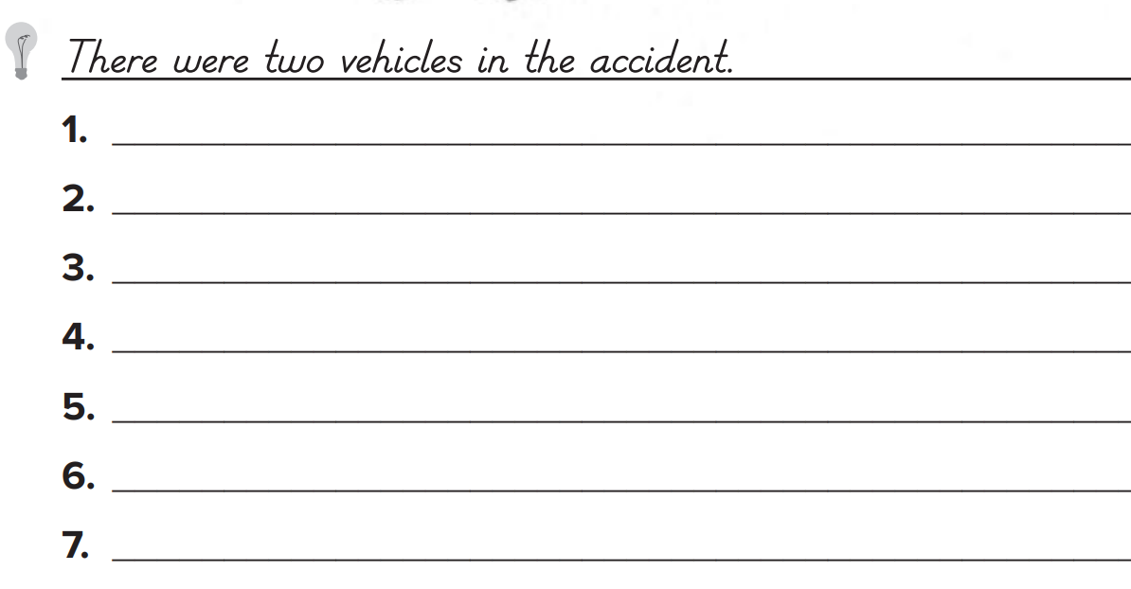
p.215
There were stop signs at the corner.
There was a child at the bus stop.
There were many cars in the street.
There was a man in the back seat.
There were two people at the bus stop.
There were two people on a bench.
There were two children.

Slide 6
p.215
There was an accident at the corner. A taxi crashed into another car. The drivers were relieved because no one was hurt. It was both drivers’ fault because they didn’t stop at the stop signs.

Slide 7
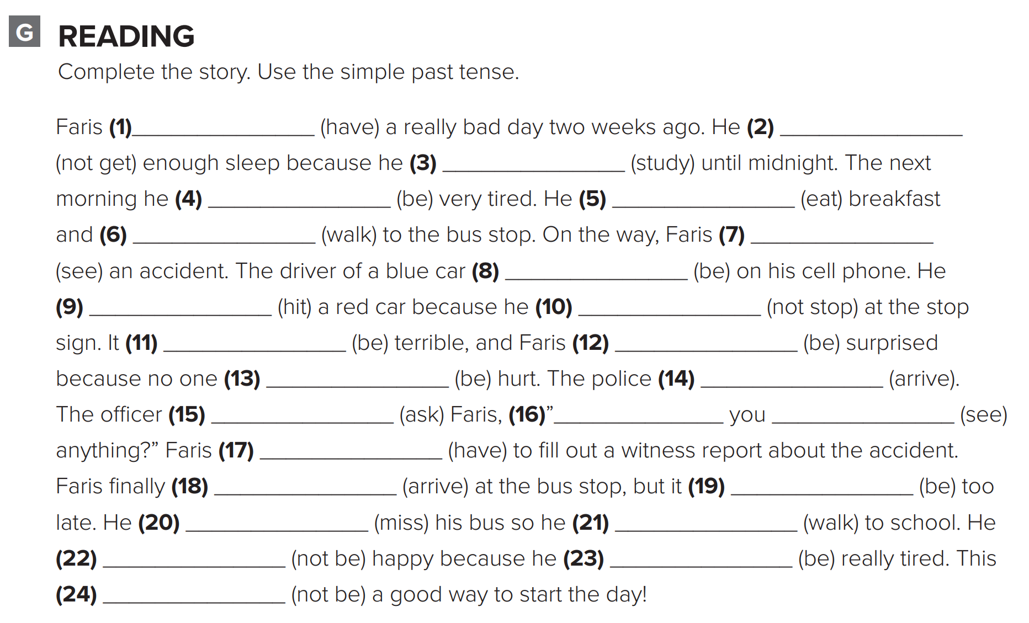
p.216
had.
didn’t get.
studied
was
ate
walked
saw
was
hit
didn’t stop
was
was
was
arrived
asked
Did
see
had
arrived
was
missed
walked
wasn’t
was
wasn’t

Slide 8
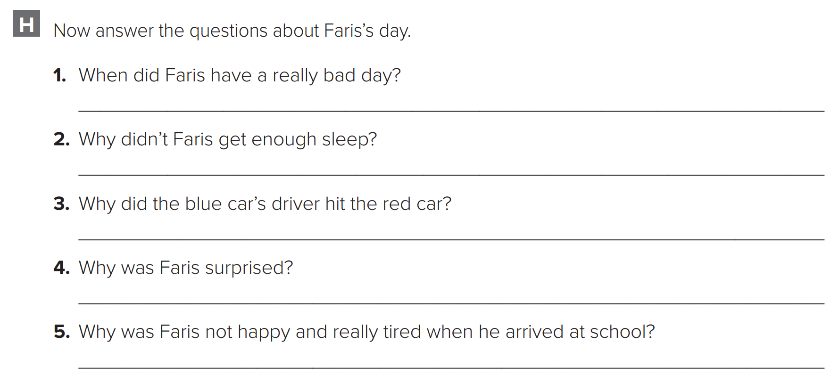
p.216
Faris had a really bad day two weeks ago.
Because he studied until midnight.
Because he didn’t stop at the stop sign
Because no one was hurt.
Because he didn’t get enough sleep and had to walk to school.

Slide 9
p.216
I had a really good day three days ago. It was awesome because I sold my bag for $150. Someone answered my ad. I was nervous because the girl only wanted to pay $125. There was nothing wrong with my bag. Then I told her to try it. That was a good idea. She really liked the bag, and she paid the $150. Now I can buy a new bag.

