Slide 1
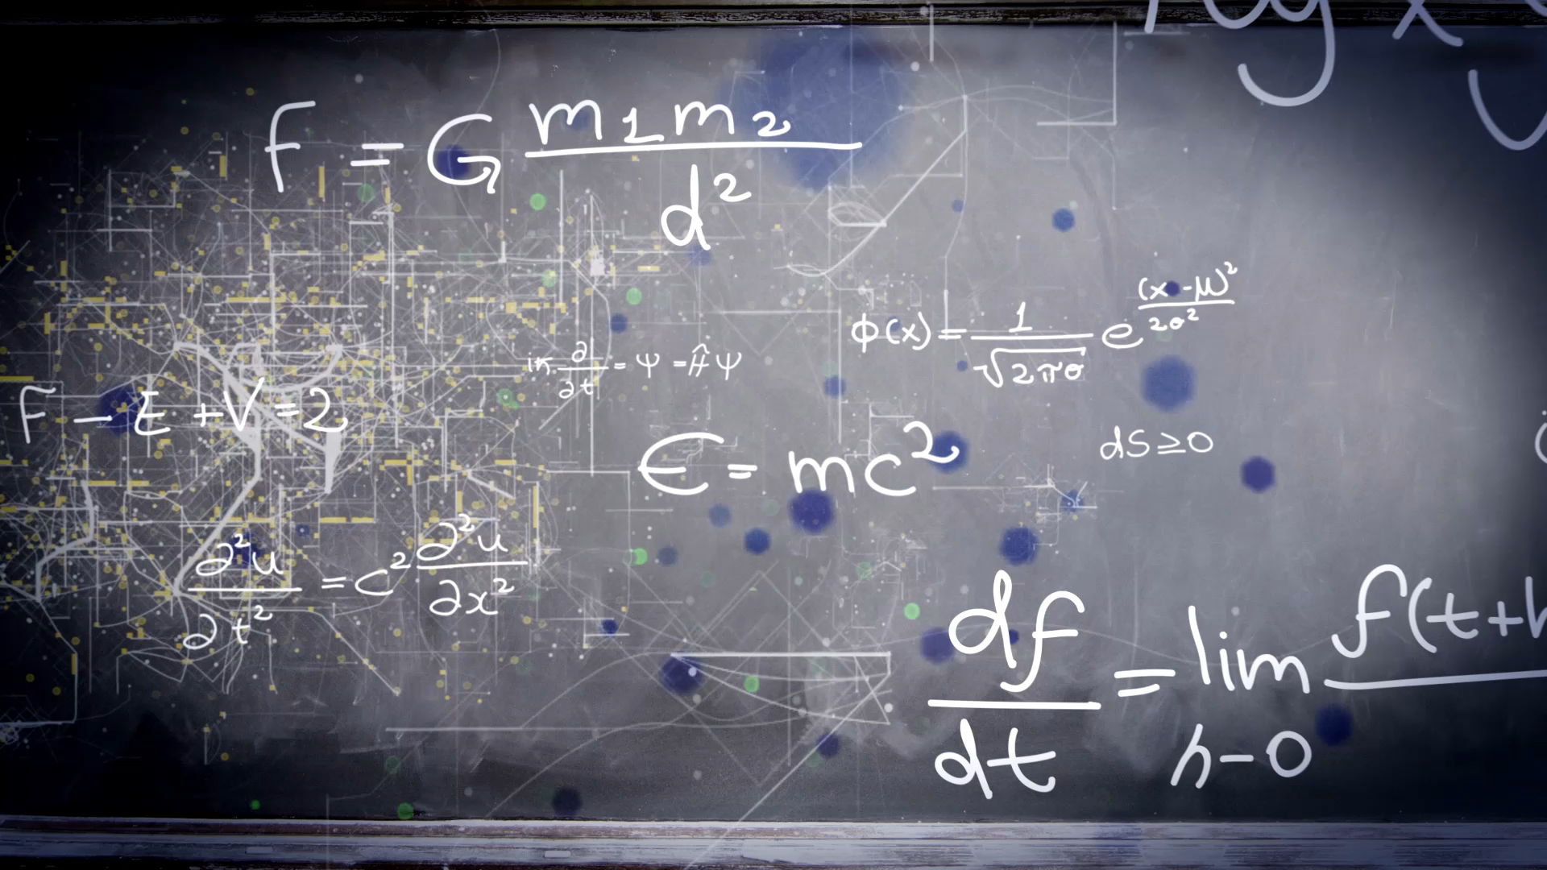
Unit 8
What are you doing?
Workbook pages (217 – 220)

Slide 2
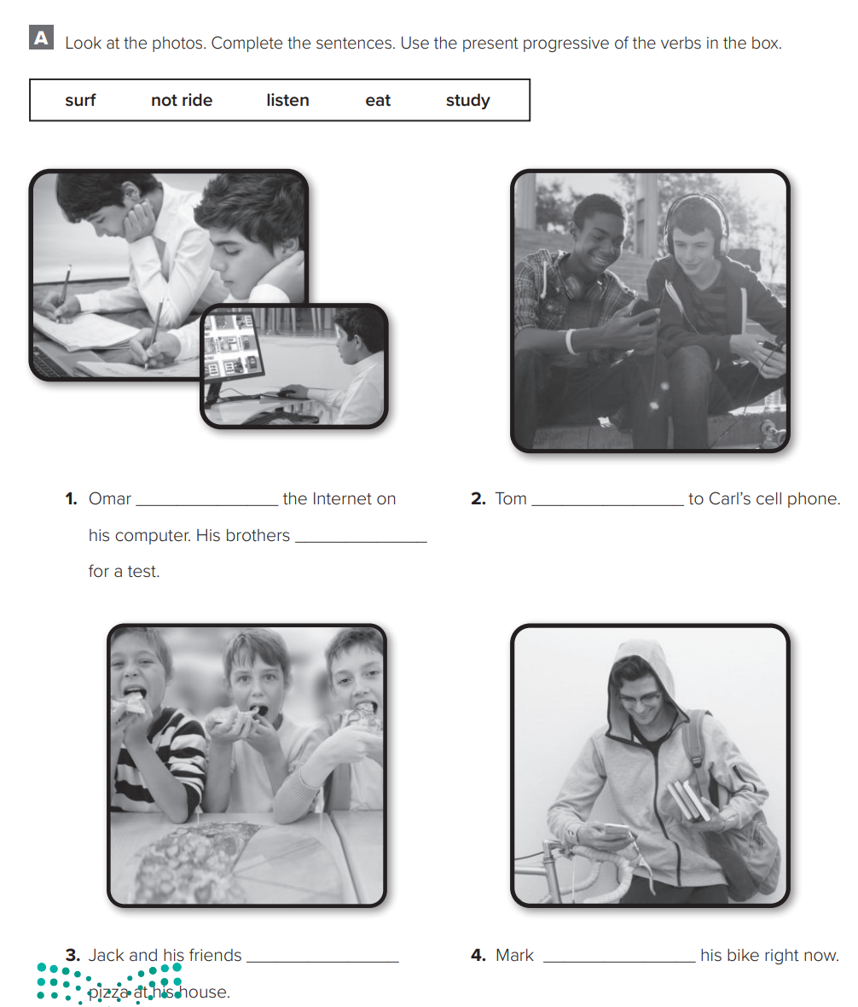

p.217
is surfing
is listening
are studying
are eating
isn’t riding

Slide 3
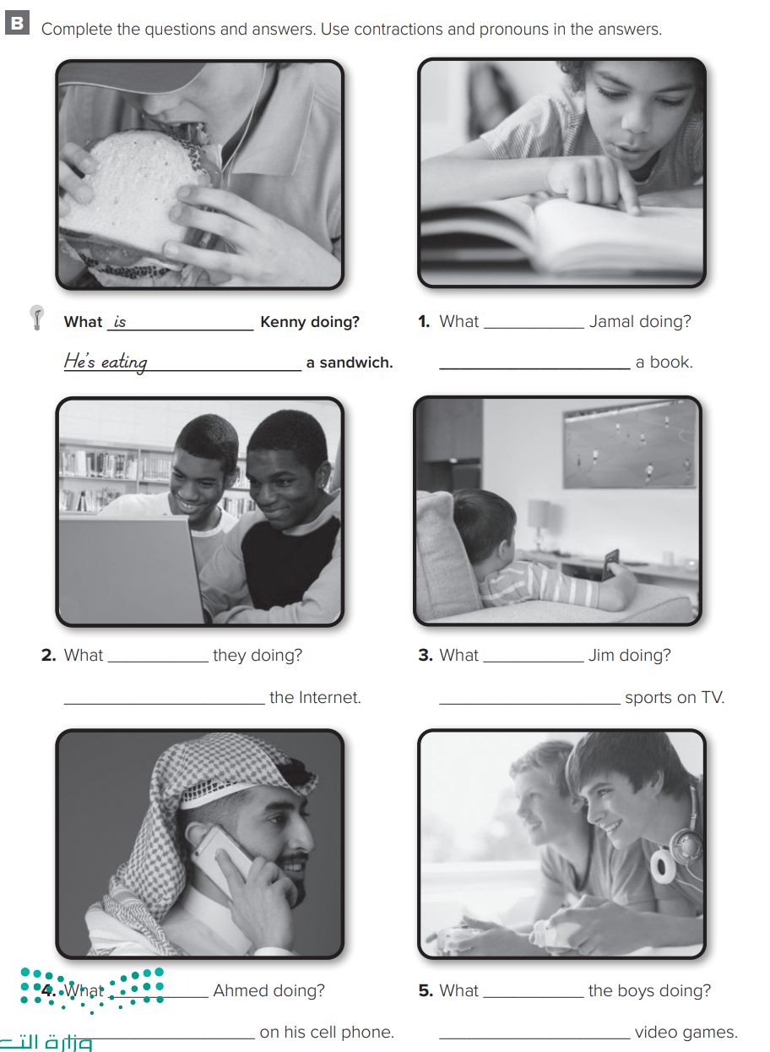

p.218
is
are
He’s reading
They’re surfing
is
is
are
He’s watching
He is talking
They’re playing

Slide 4
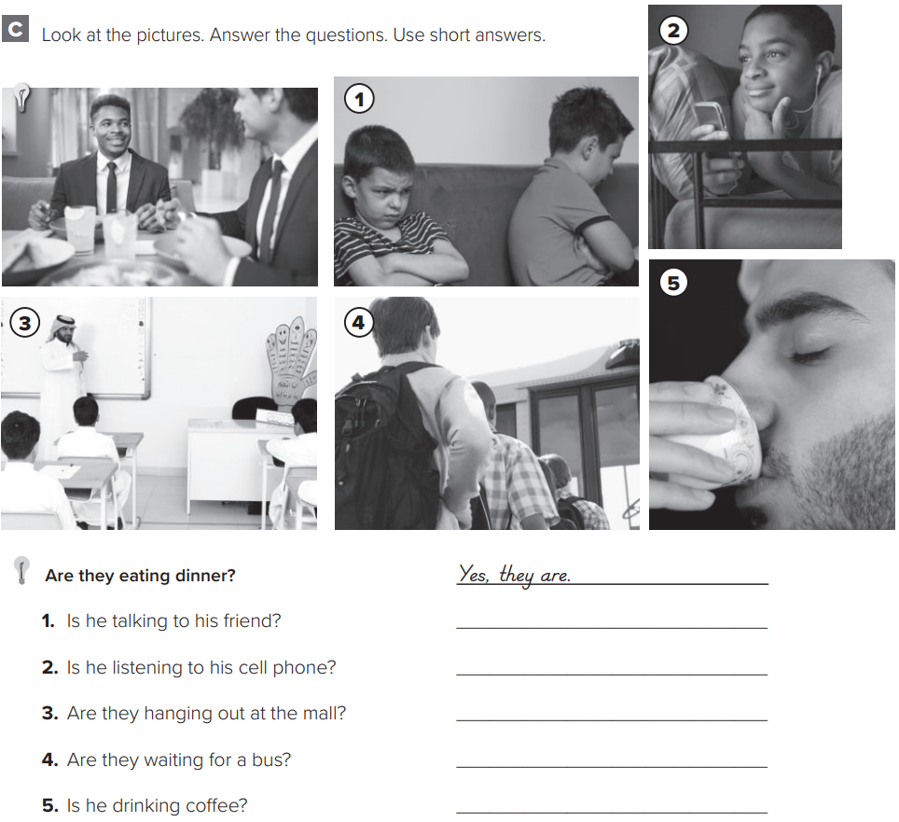

p.219
No, he isn’t.
Yes, he is.
No, they aren’t.
Yes, they are.
Yes, he is.

Slide 5
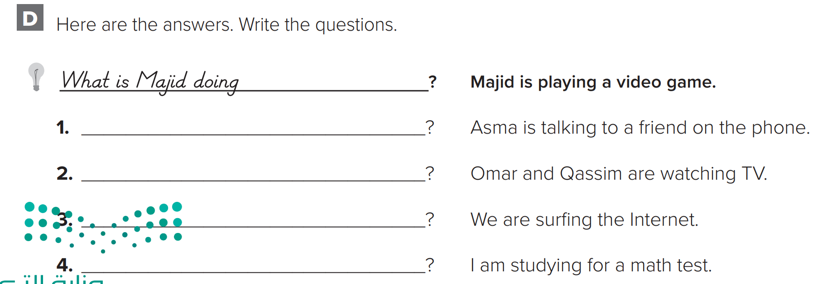

p.219
What is Asma doing
What are they doing
What are you doing
What are you doing

Slide 6
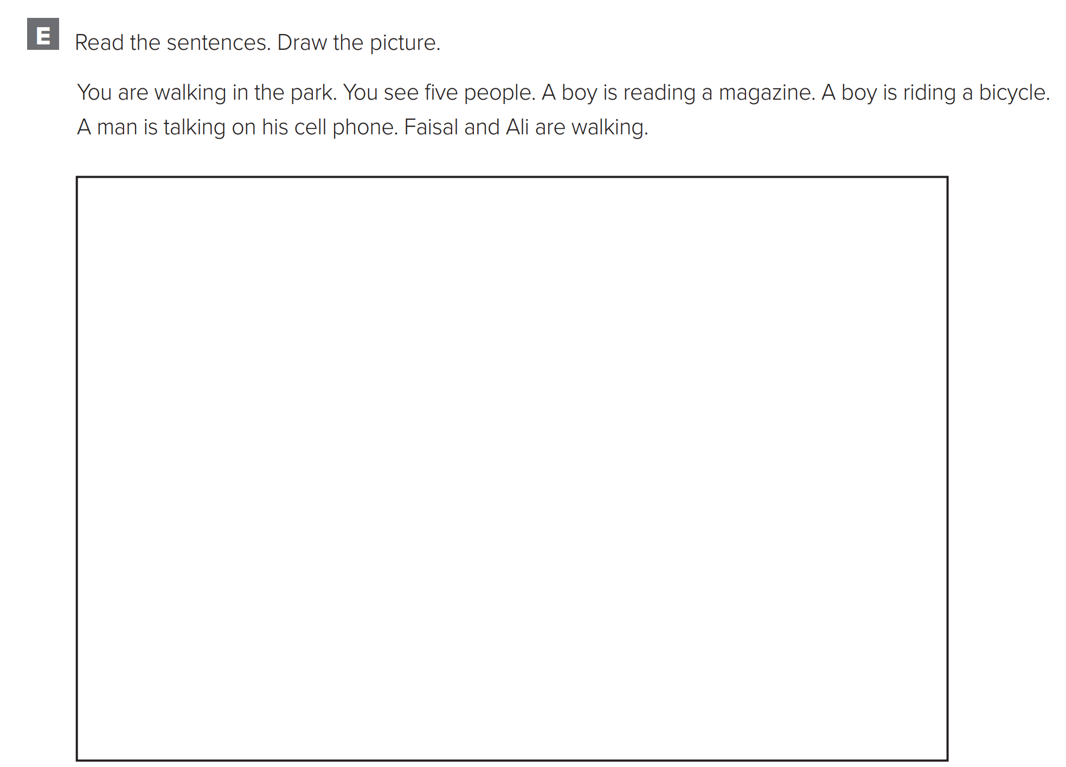



p.220

Slide 7
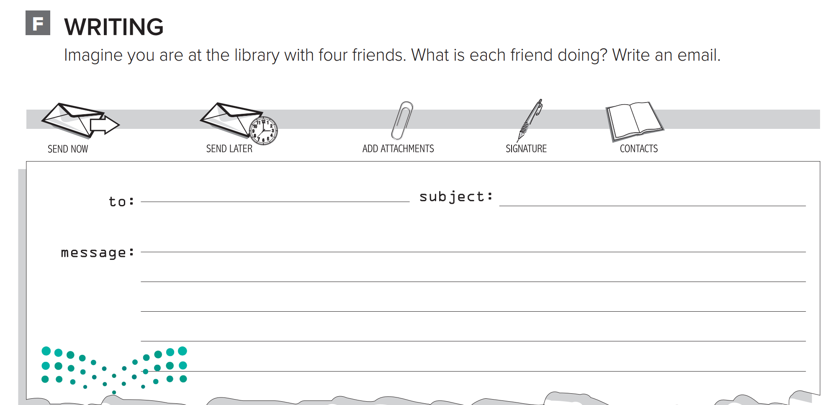

p.220
Hi Lujain,
I’m sitting at the library with four friends. Joud is doing homework. Ghena is studying for the exams. Manal
is writing an essay. Hala is looking for a book. What
are you doing with your friends? Bye for now,
Dalal

