Slide 1




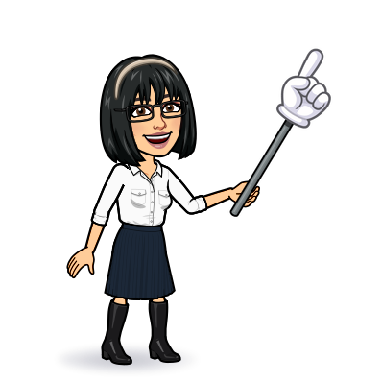

1 Listen & discuss
2 pair work
Today:
Date:
- -
Page 72
By: Dalal Al-Juaid

Slide 2


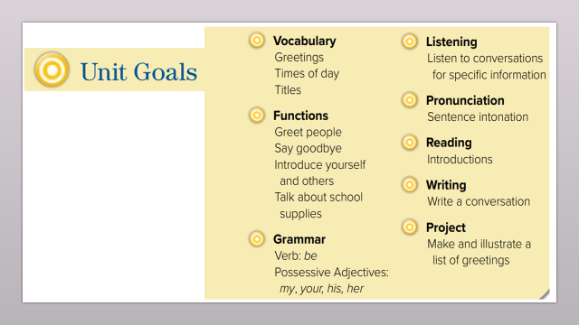
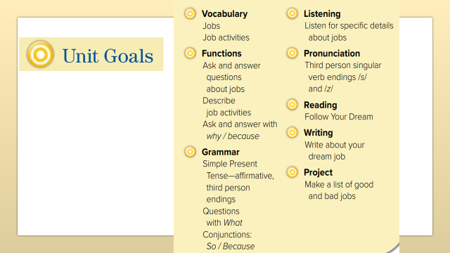
List a number of jobs
Describe job activity
Warm up
1-Listen
Discuss future jobs using ‘want
New words
Quick check
Ask & answer about jobs
2-Pair work

Slide 3
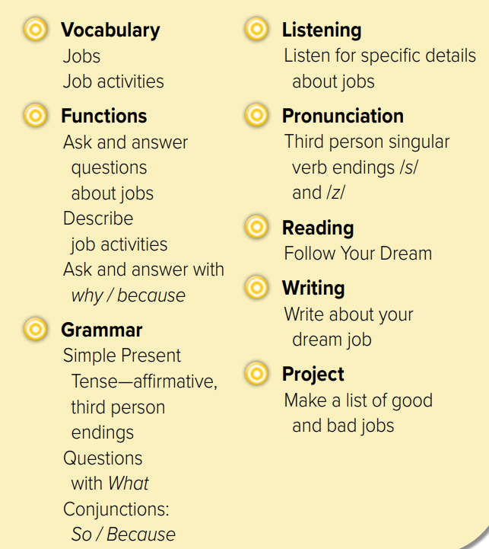
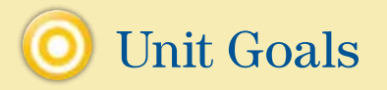

Slide 4





He’s a chef.
This is Peter
Does he work in a school?
Warm up
1-Listen
New words
Quick check
2-Pair work

Slide 5

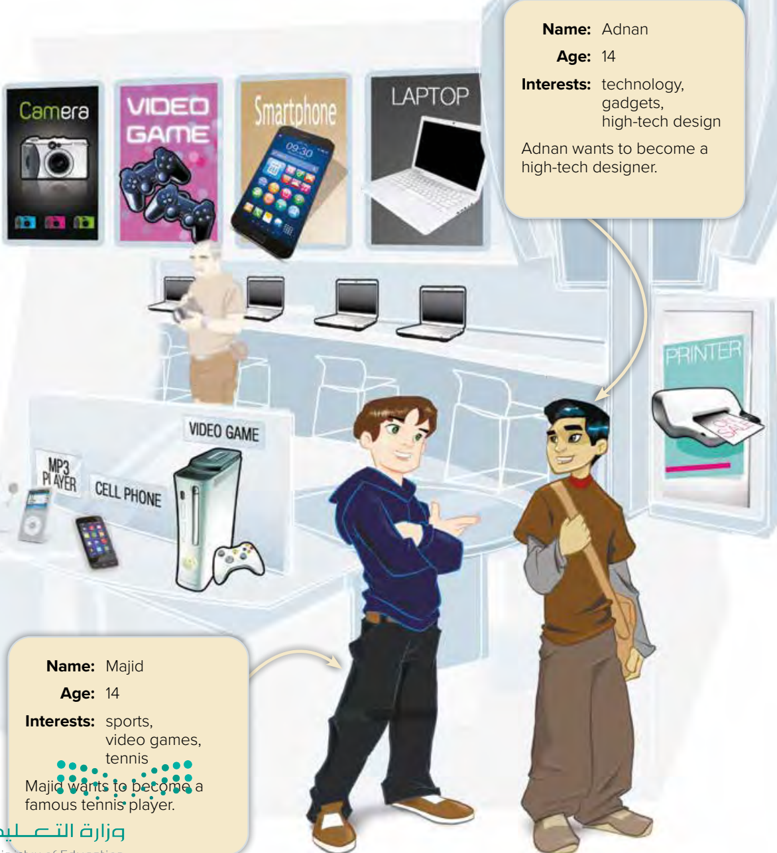


What do they want to be?
Page 72
Warm up
1-Listen
New words
Quick check
2-Pair work

Slide 6
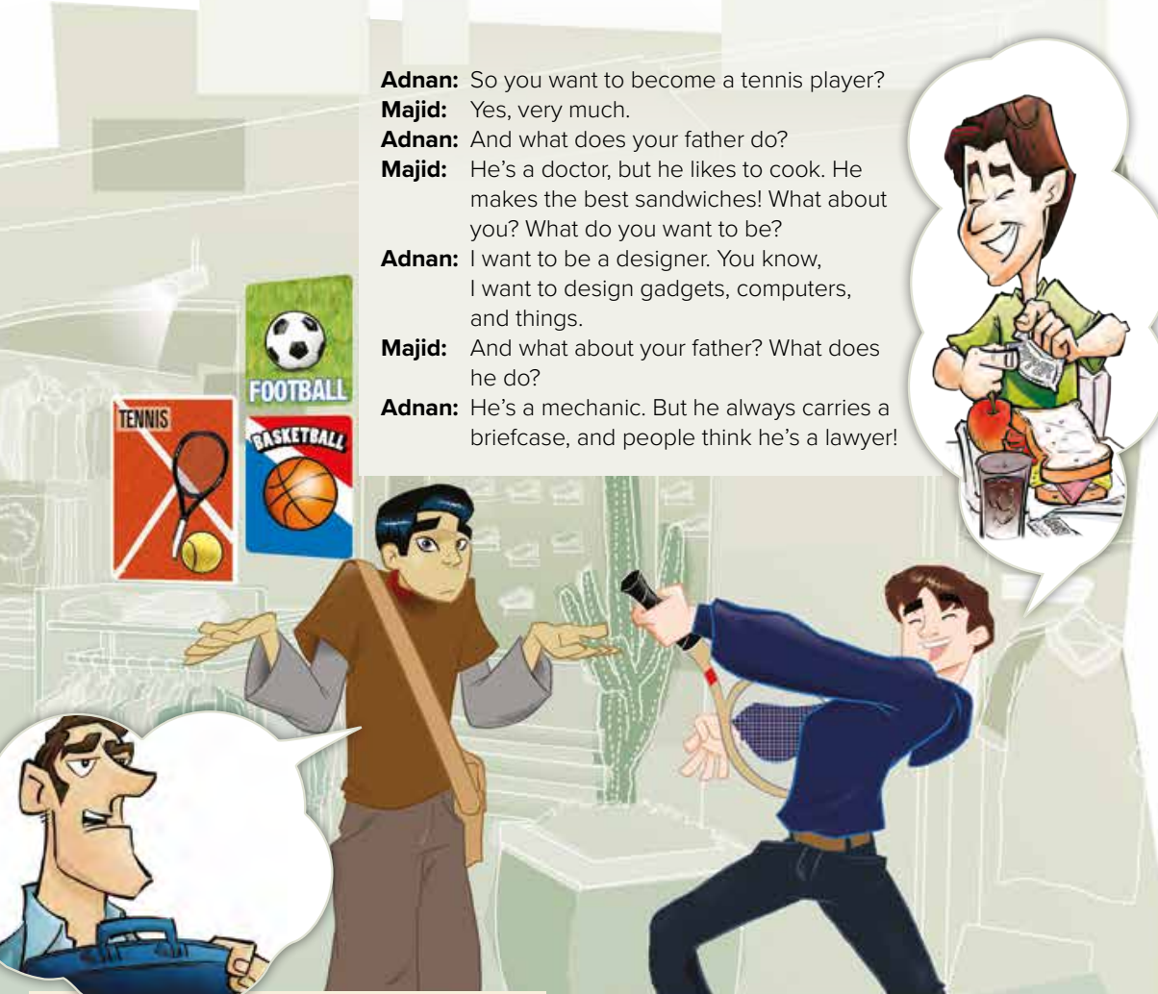
Page 73
Is Majid’s father a cook?
Is Adnan’s father a lawyer?
Why do people think he’s a lawyer?
Warm up
1-Listen
New words
Quick check
2-Pair work

Slide 7





Page 64
Read aloud
Warm up
1-Listen
New words
Quick check
2-Pair work

Slide 8
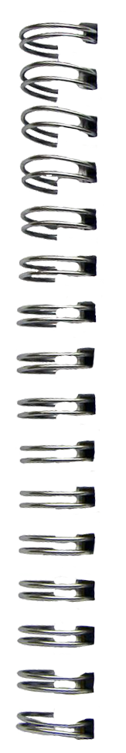






New Words
High-tech
technology
Tennis player
briefcase
mechanic
lawyer
Works in Law
designer

Slide 9

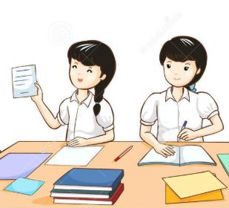

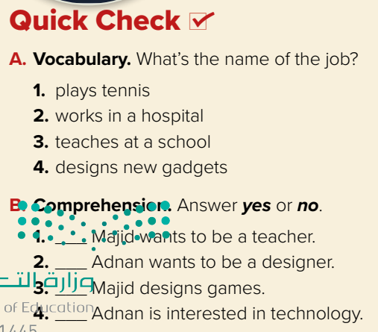
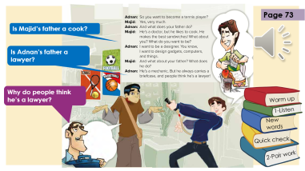
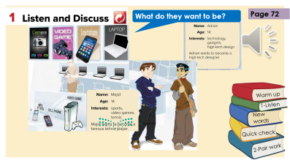
Think pair share
Fashion designer
design clothes : ………
Tennis player
photographer
takes photo: ………
Nurse / Doctor
Salesperson
Teacher
sells clothes: ………
High-tech designer
Warm up
no
1-Listen
New words
yes
no
Quick check
yes
2-Pair work

Slide 10

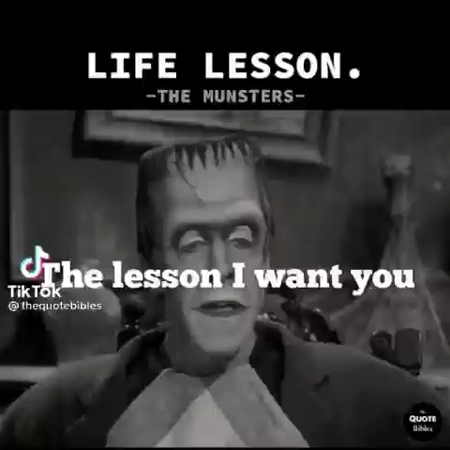

Lets play
Warm up
1-Listen
New words
Quick check
2-Pair work

Slide 11


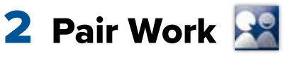
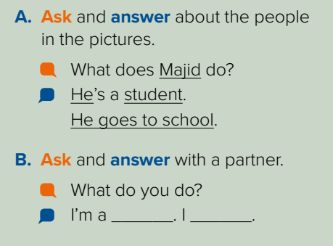
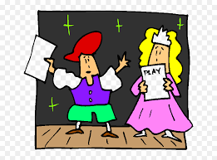
Name jobs in KSA?
Role paly
Warm up
1-Listen
New words
Quick check
2-Pair work

Slide 12
Write in your notebook
Like final test أسئلة للاختبار النهائي
Choose:
Mmmmmmm ………. mmmmmmm
( ssss – ssss – sssss)
Make a question

Slide 13





page 221 Ex(A)
for practice new words
Warm up
1-Listen
New words
Quick check
2-Pair work

Slide 14
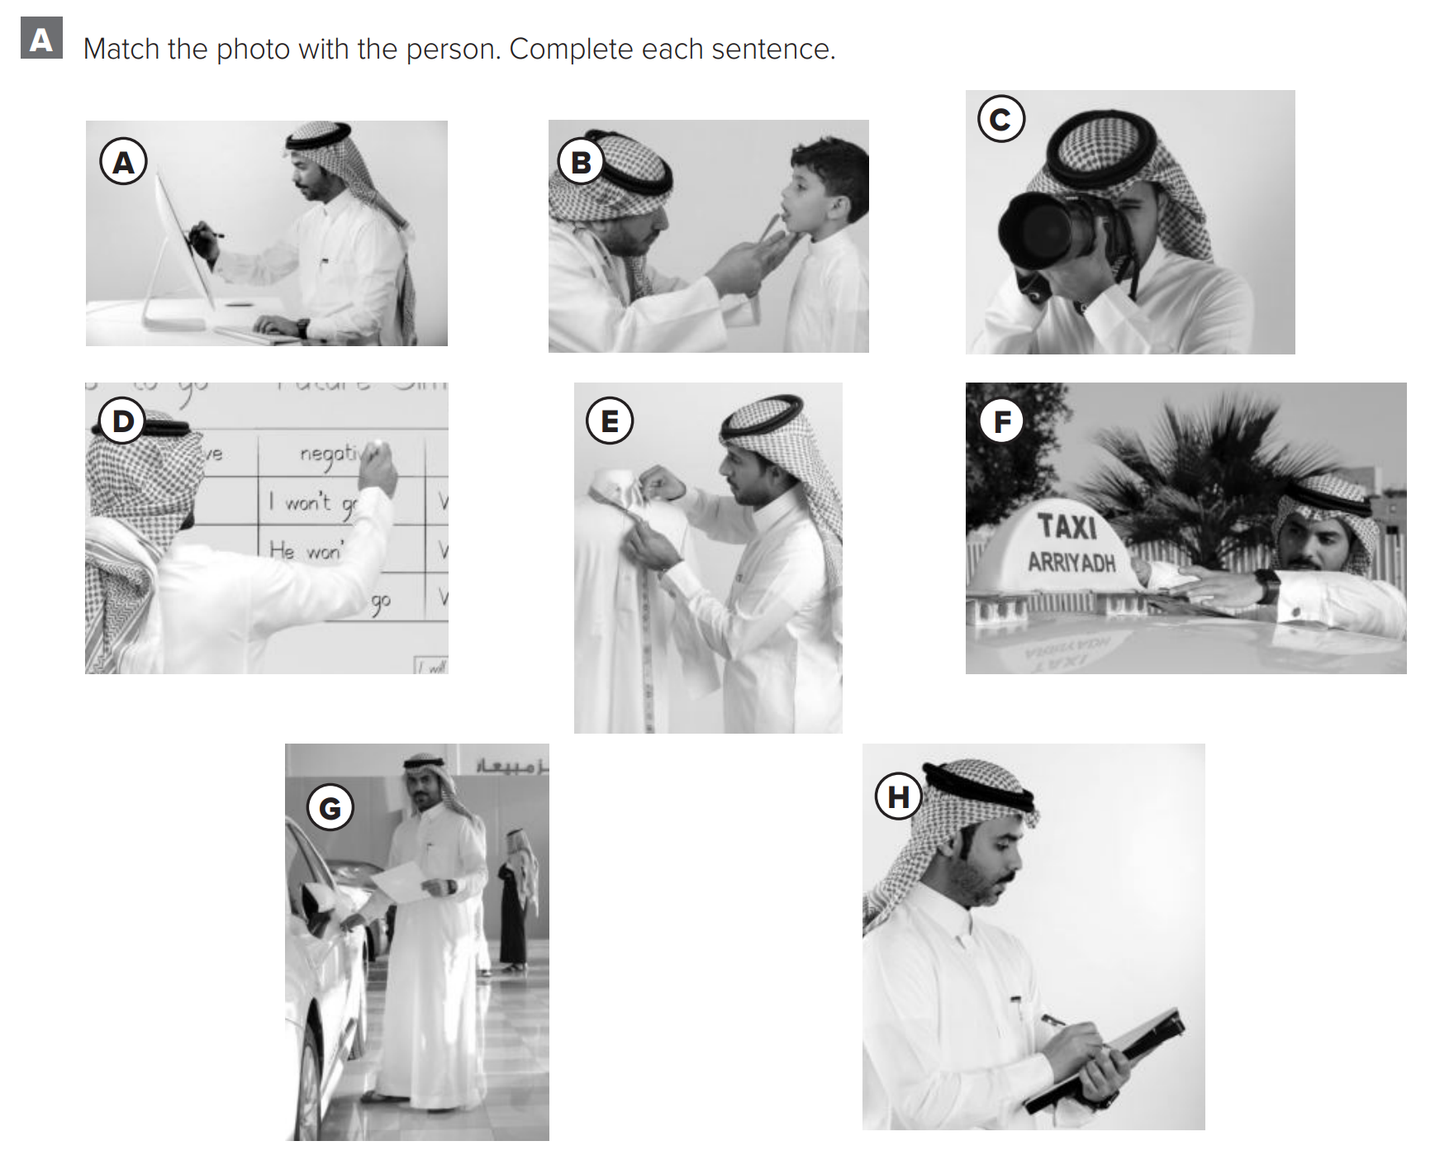
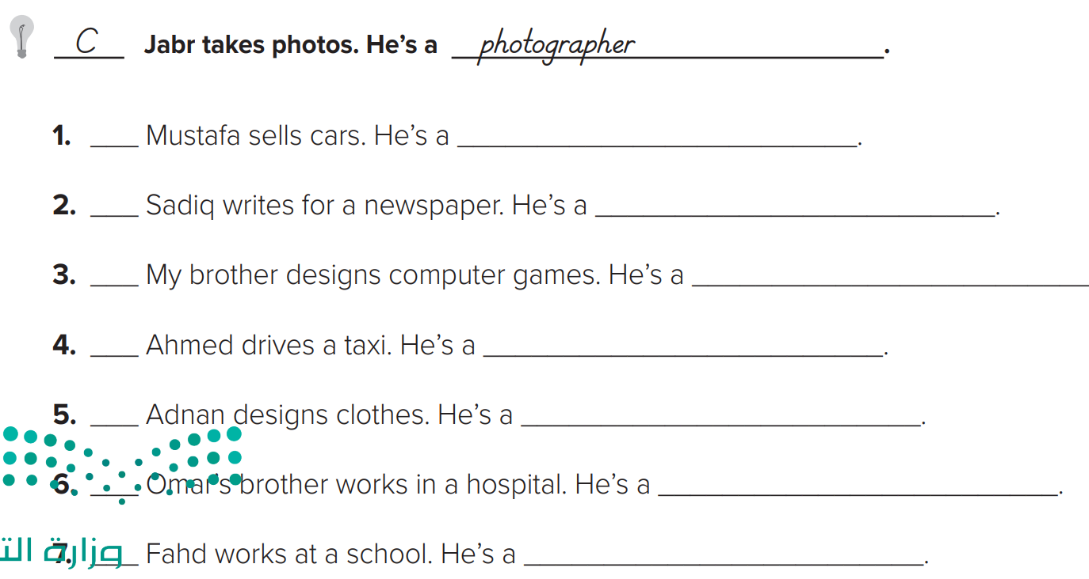
p.221
G
salesperson
H
reporter
Warm up
A
High-tech designer
1-Listen
F
taxi driver
New words
E
fashion designer
Quick check
B
doctor
D
teacher
2-Pair work

