Slide 1



Slide 2

    Unit -3-
    There is No Place Like Home

Slide 3
    Listen & Discuss
    Pair Work

Slide 4
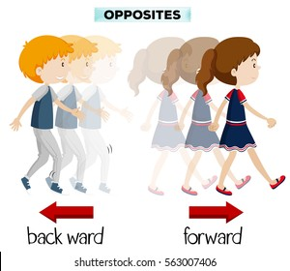
Say Your Name Backwards

Slide 5
Objectives
The students will be able to :
1 – Differentiate between a house and a home .
2 – Name important things at home .
3 – Distinguish between the interior and exterior of a home .
4 – Write a quote about home .
5 – Complete the sentences with the suitable word .

Slide 6


Do they mean the same ?
House & Home

Slide 7
What do you think is the
difference between?
House & Home

Slide 8
What do you think is the
difference between?
House
Home
is a permanent structure, a building .
refers to the BUILDING in which someone lives
a concrete concept
refers to the PLACE where someone lives
Represents safety, comfort and emotion
Can be the town / city / country where you grew up .

Slide 9
What are the most important things in your home?

Slide 10
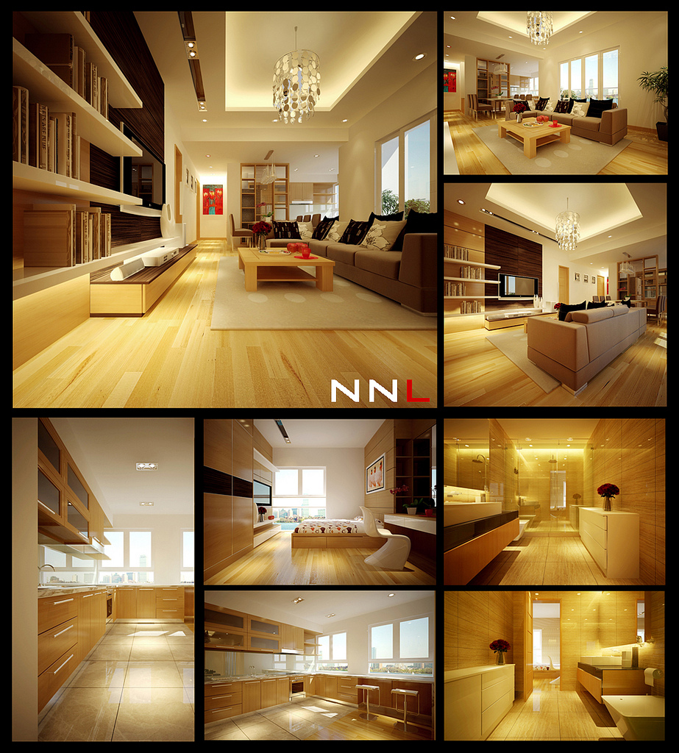

Describe Your Dream Home
Villa? Apartment?
New? Old?
Big?
Small?
Modern? Traditional?
Interior
Exterior

Slide 11
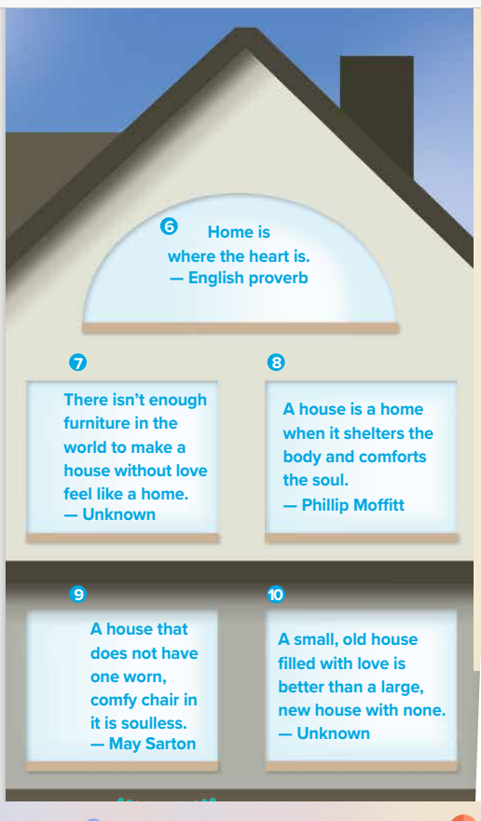
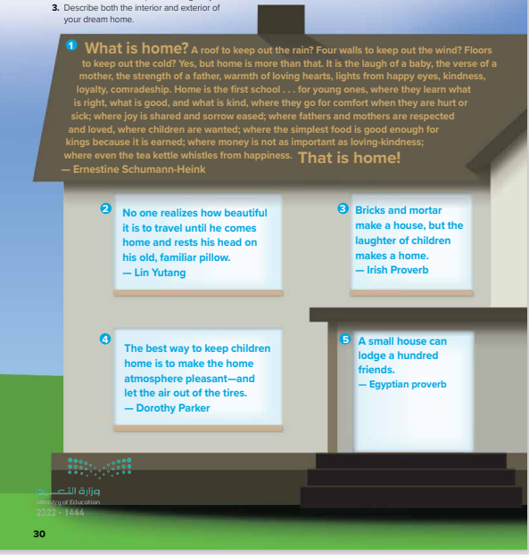
What are these?
How many quotes ?
What are they about ?

Slide 12


Listen

Slide 13

What is a tea kettle?
How can a tea kettle whistle?
(Something used to boil water for tea)
(When the water boils, many kettles make a whistling sound.)

Slide 14
The feeling when you travel for a long time and come back to your house
Who said this quote ?

Slide 15
Who said this quote ?
A mixture of CEMENT and sand and water, used in building for holding bricks or stones together .

Slide 16
Who said this quote ?
What are the tires referred to in the quote ?
the tires on a car .
Means the tires will be flat, and they won’t be able to drive away .
The writer here is humorous or sarcastic

Slide 17
Who said this quote ?

Slide 18
Who said this quote ?

Slide 19
Who said this quote ?
What is important furniture or love according to the writer?
To protect from something .
To make someone feels good .

Slide 20
Who said this quote ?
What does comfy mean ?
Do you agree or disagree with him ?
a short, informal form of comfortable .
Why is a worn chair more comfortable than a new chair?
Because it’s probably soft and you don’t need to be careful when you sit in it. You can relax .

Slide 21
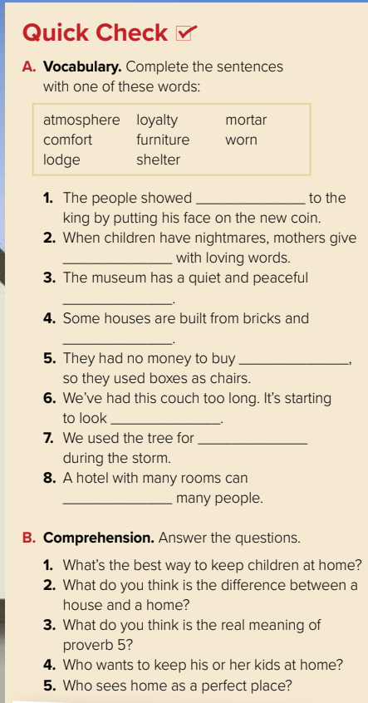
loyalty
comfort
atmosphere
mortar
furniture
worn
shelter
lodge

Slide 22
1- To make the home atmosphere pleasant .
2- House refers to the building in which someone lives but Home refers to the place where someone lives .
3- The proverb is commonly used to emphasis the importance of communal bonding and sharing. Having a little space is, according to the Egyptian proverb, not a reason not to share .
4- Dorothy Parker .
5- Lin Yutang and Ernestine Schumann-Heink .

Slide 23
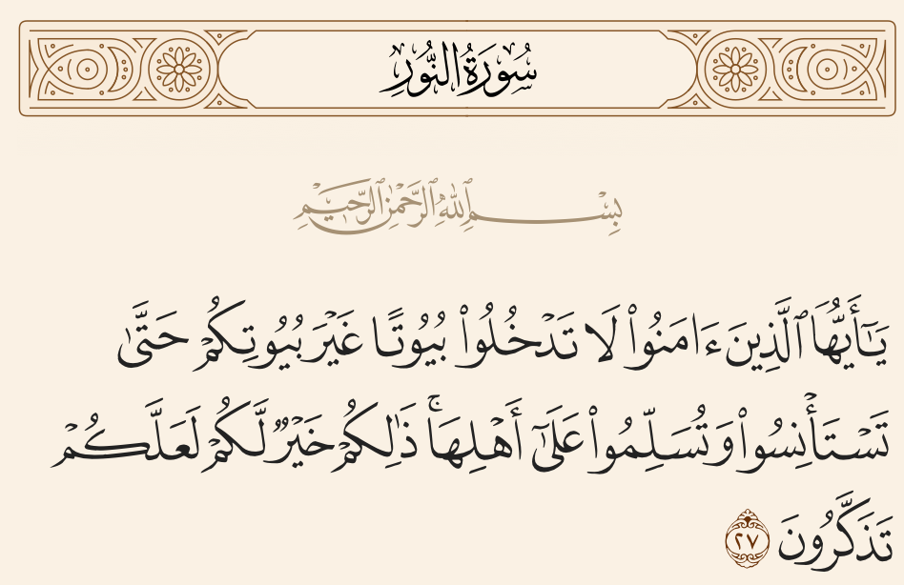
With a partner, write your own quote about home. Share it with the class.

Slide 24

Pair Work
With a partner, write your own quote about home. Share it with the class.

Slide 25

https://www.vision2030.gov.sa/en/programs/Housing

Slide 26


