Slide 1


Unit7
You’ve Got Mail
Mega Goal 1.2
Language in Context + Conversation
Done by : Entisar AL-Obaidallah

Slide 2
Lesson Objectives
01
02
03
04
05
06
Form
Listen
sentences with
“ used to”
For specific information
Answer
Recognize
Some questions about the conversation
the rule of Short vowels /ɛ/, /æ/, /ɪ/
Use
Practice
“ Real Talk” in correct sentences
accepting & refusing invitations

Slide 3

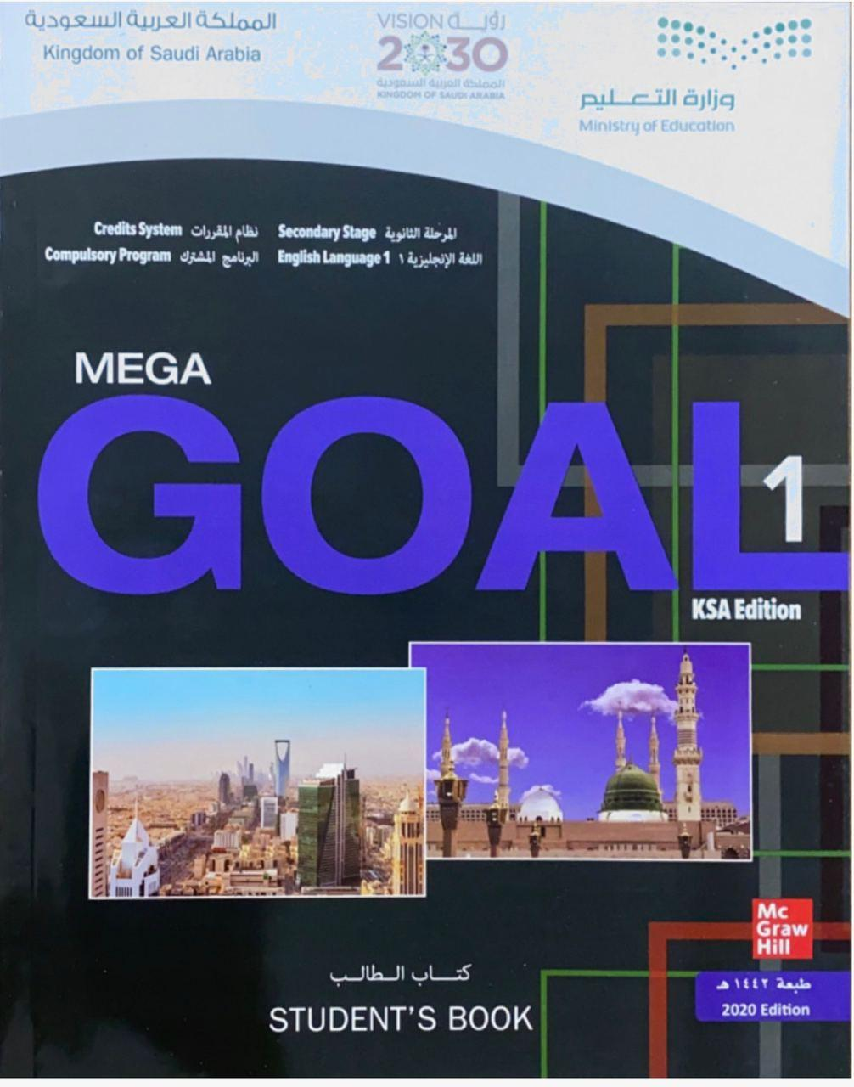
Open
your student’s book p.(104)

Slide 4

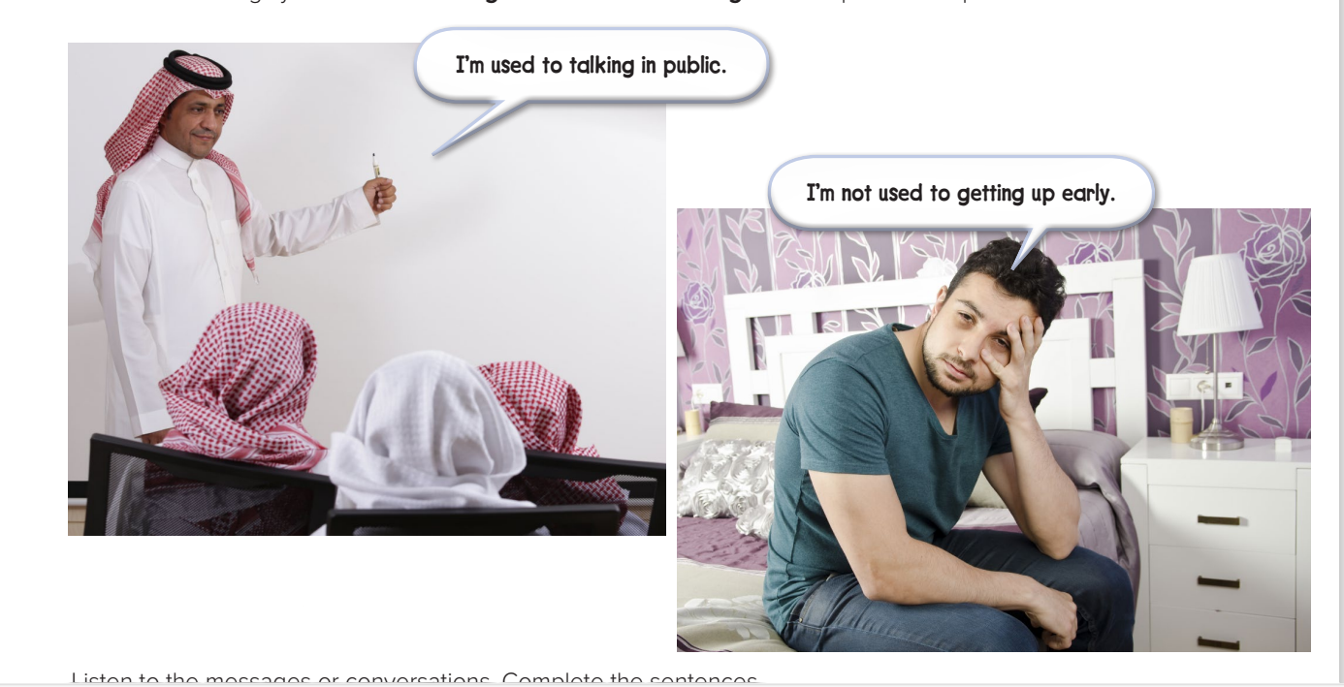
Look at the photos and read the speech bubbles
Make a list of things you’re used to doing & not used to doing

Slide 5

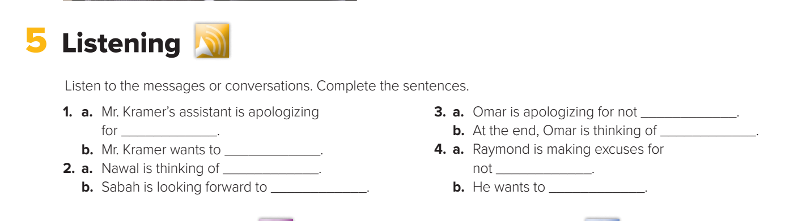
Listen to the conversation and complete the sentences:
1- a. changing the time of an appointment b. change the meeting to Monday at the same time
2. a. visiting New York b. seeing Brenda
3. a. coming to Ron’s house b. bringing his cousin to Ron’s house
4. a. handing in his history project b. hand the project in a couple of days late

Slide 6

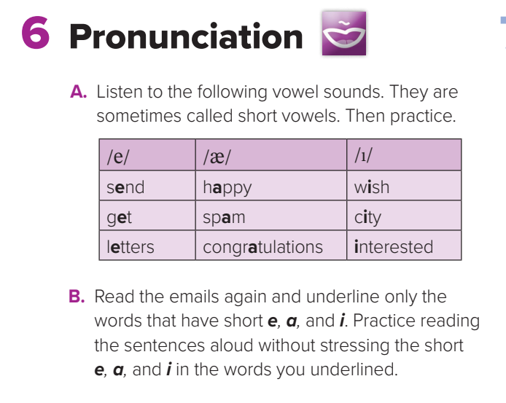

Slide 7

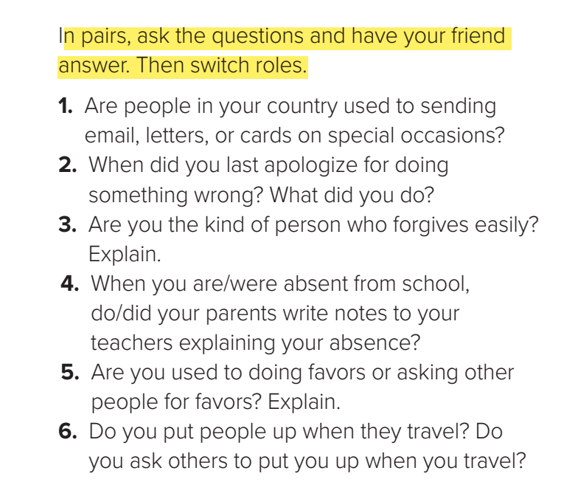
Now, Your Turn

Slide 8

Open
your student’s book p.(105)

Slide 9
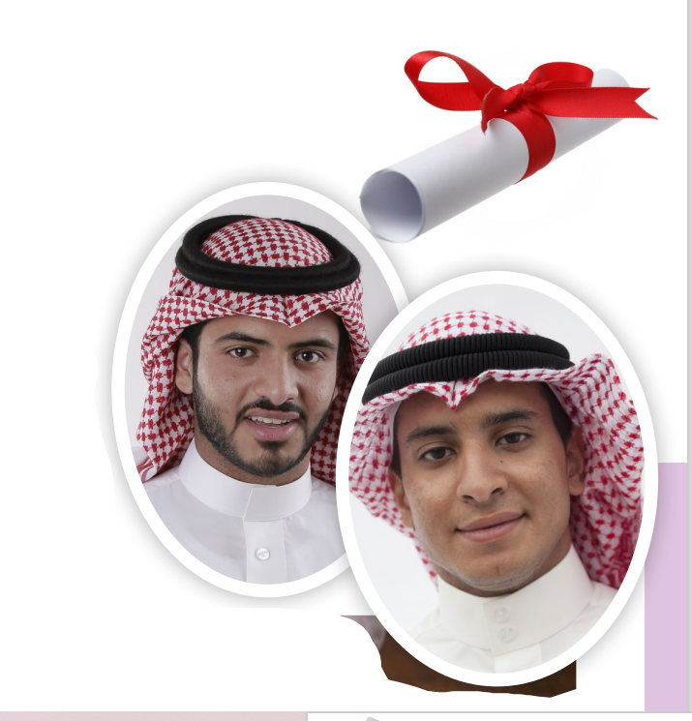
Student’s book p.(104 )
Can you predict what the phone conversation is about ?
What Can You see in the picture?

Slide 10
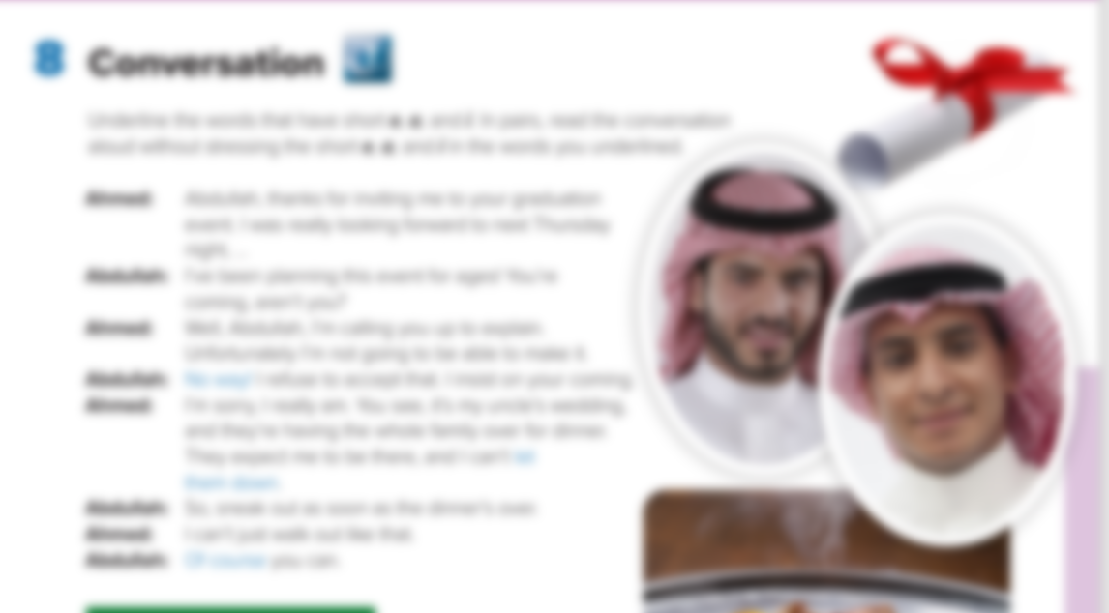
Listen and Read along
What is the phone Conversation about ?
an invention to graduation event
Whose graduation party is it ?
Abdullah
Why can’t Ahmed accept the conversation?
Because of his uncle’s wedding

Slide 11



Slide 12



Find word that means …….
excited about
Find word that means …….
disappoint
Find word that means …….
demand
Find word that means …….
achieve a specific goal
make it
Let down
Look forward to
Insist on

Slide 13
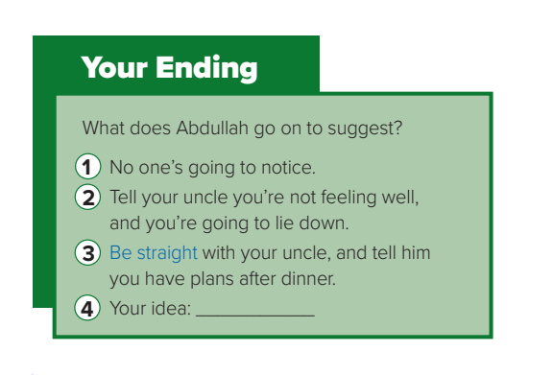
Your Ending p.(105)
which ending do you think is the most likely?
Write Your Ending here

Slide 14
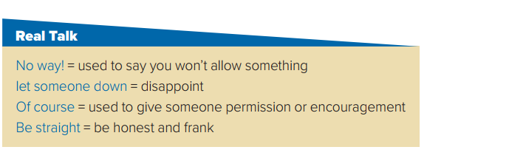
Read the words and their meanings:

Slide 15
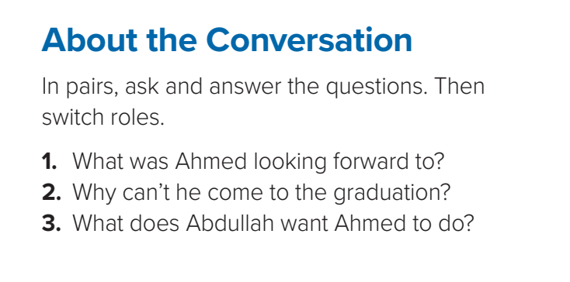

1- Ahmed was looking forward to going to Abdullah’s graduation event.
2- Ahmed has to go to a family dinner for his parents’ wedding anniversary.
3- He wants Ahmed to leave the dinner early

Slide 16

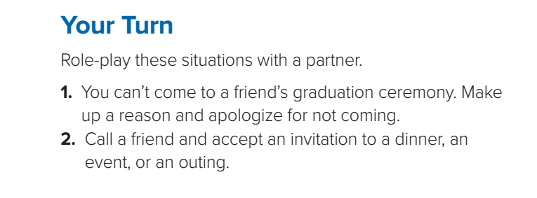
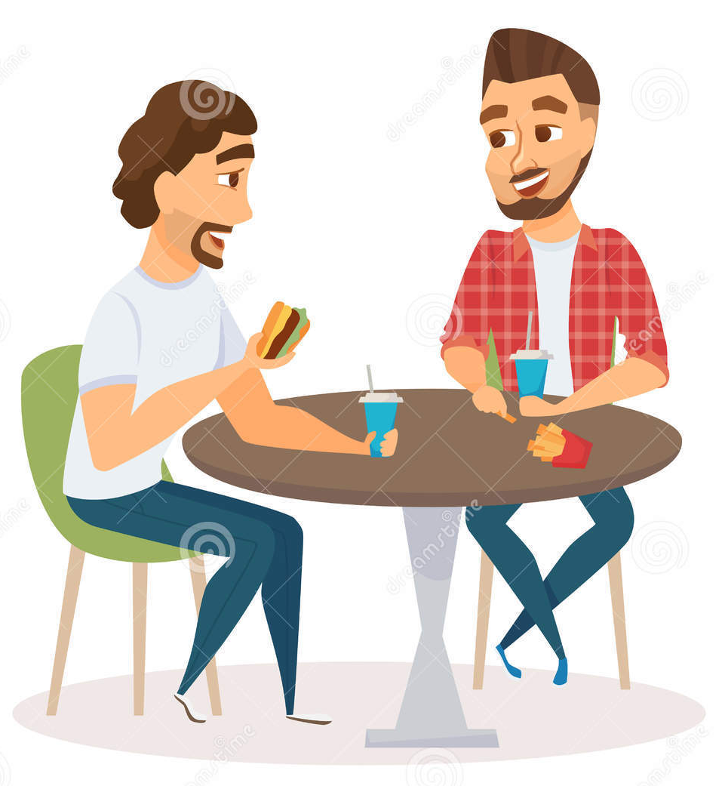


Now, Your Turn

Slide 17
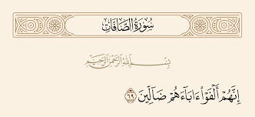
From The Holy Quran

Slide 18
Homework
Workbook , p. ( 105) ,
exercise ( O)

Slide 19

Thanks!

Slide 20
Alternative resources
Here’s an assortment of alternative resources whose style fits the one of this template:
Photos
Watercolor floral horizontal sale banner template for women’s day celebration III

