Slide 1


Slide 2


Unit 1:
Let's Go Out

Slide 3

Today’s lesson :
Listen & discuss.
Pair work .

Slide 4
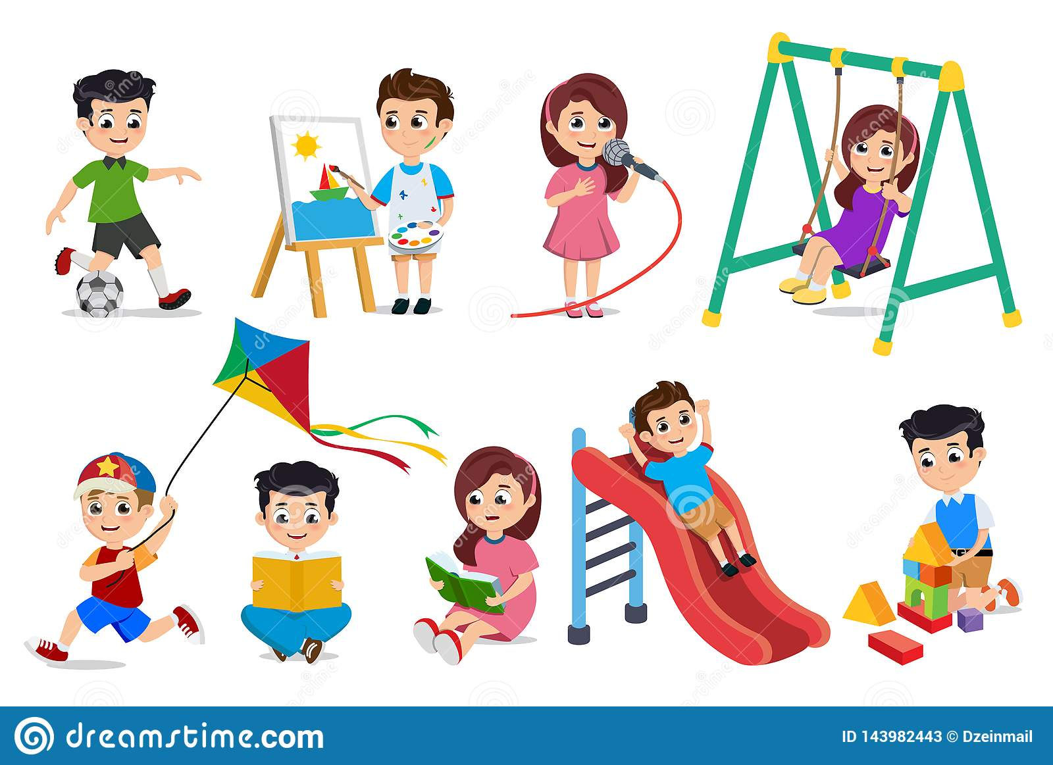
Which of the free-time activities and chores are most
common in your country? Add others.
Which fun activities and chores do you do most often?

Slide 5
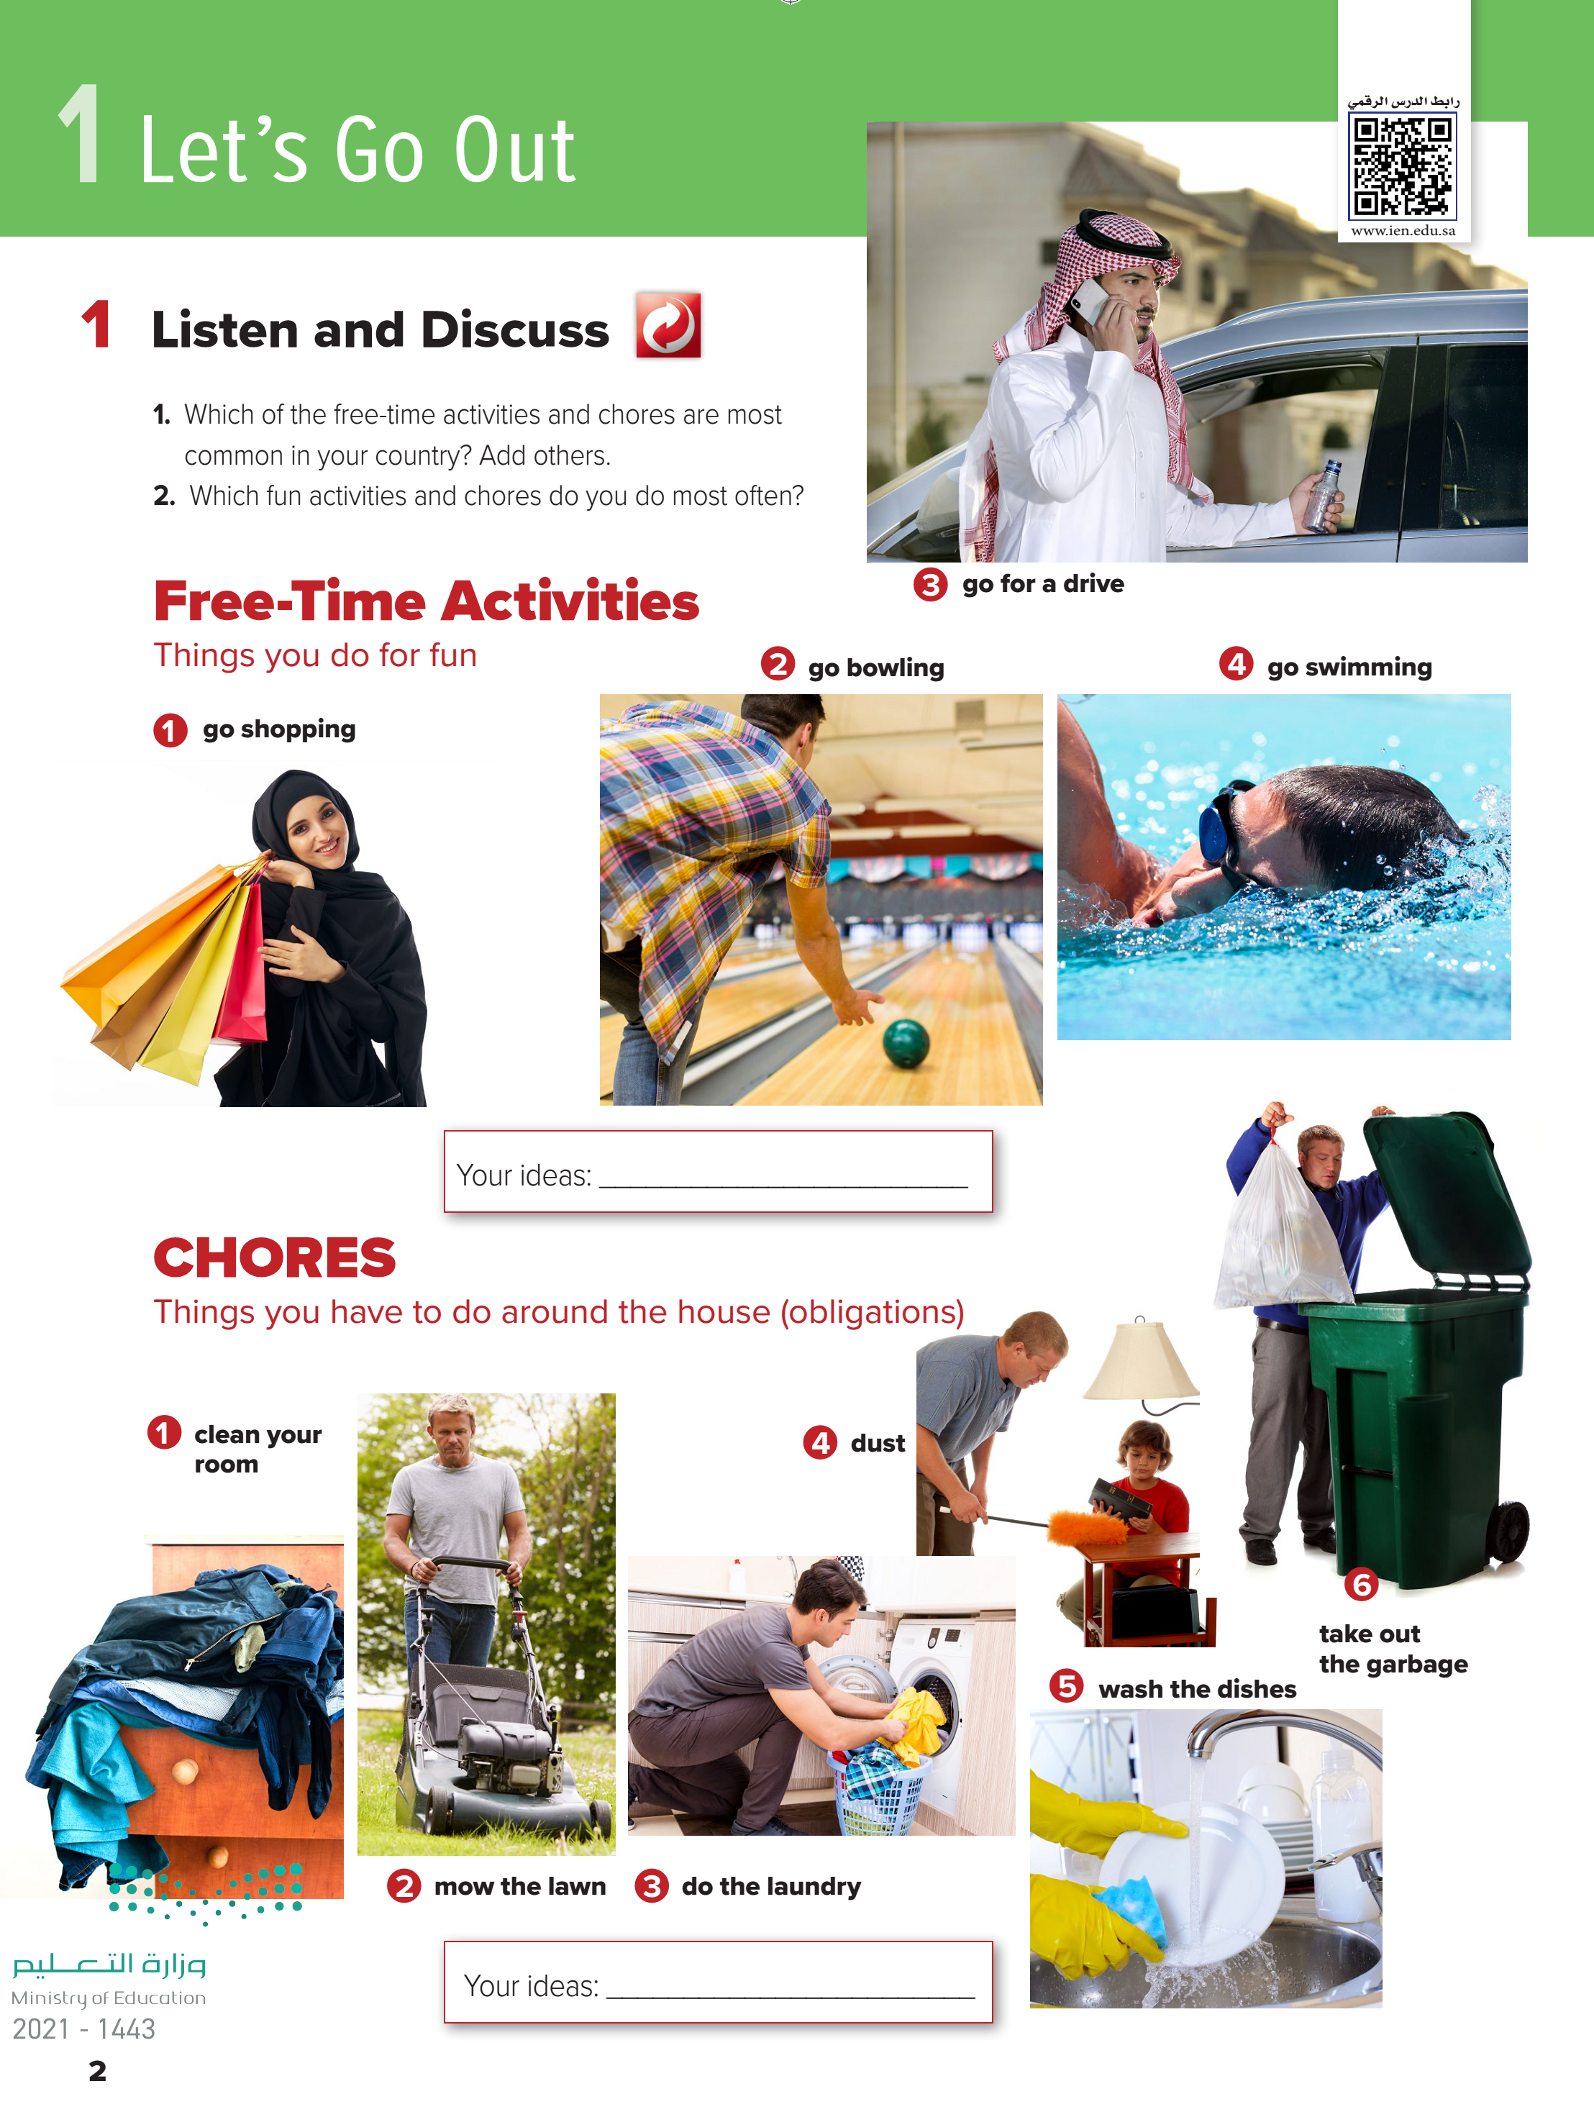
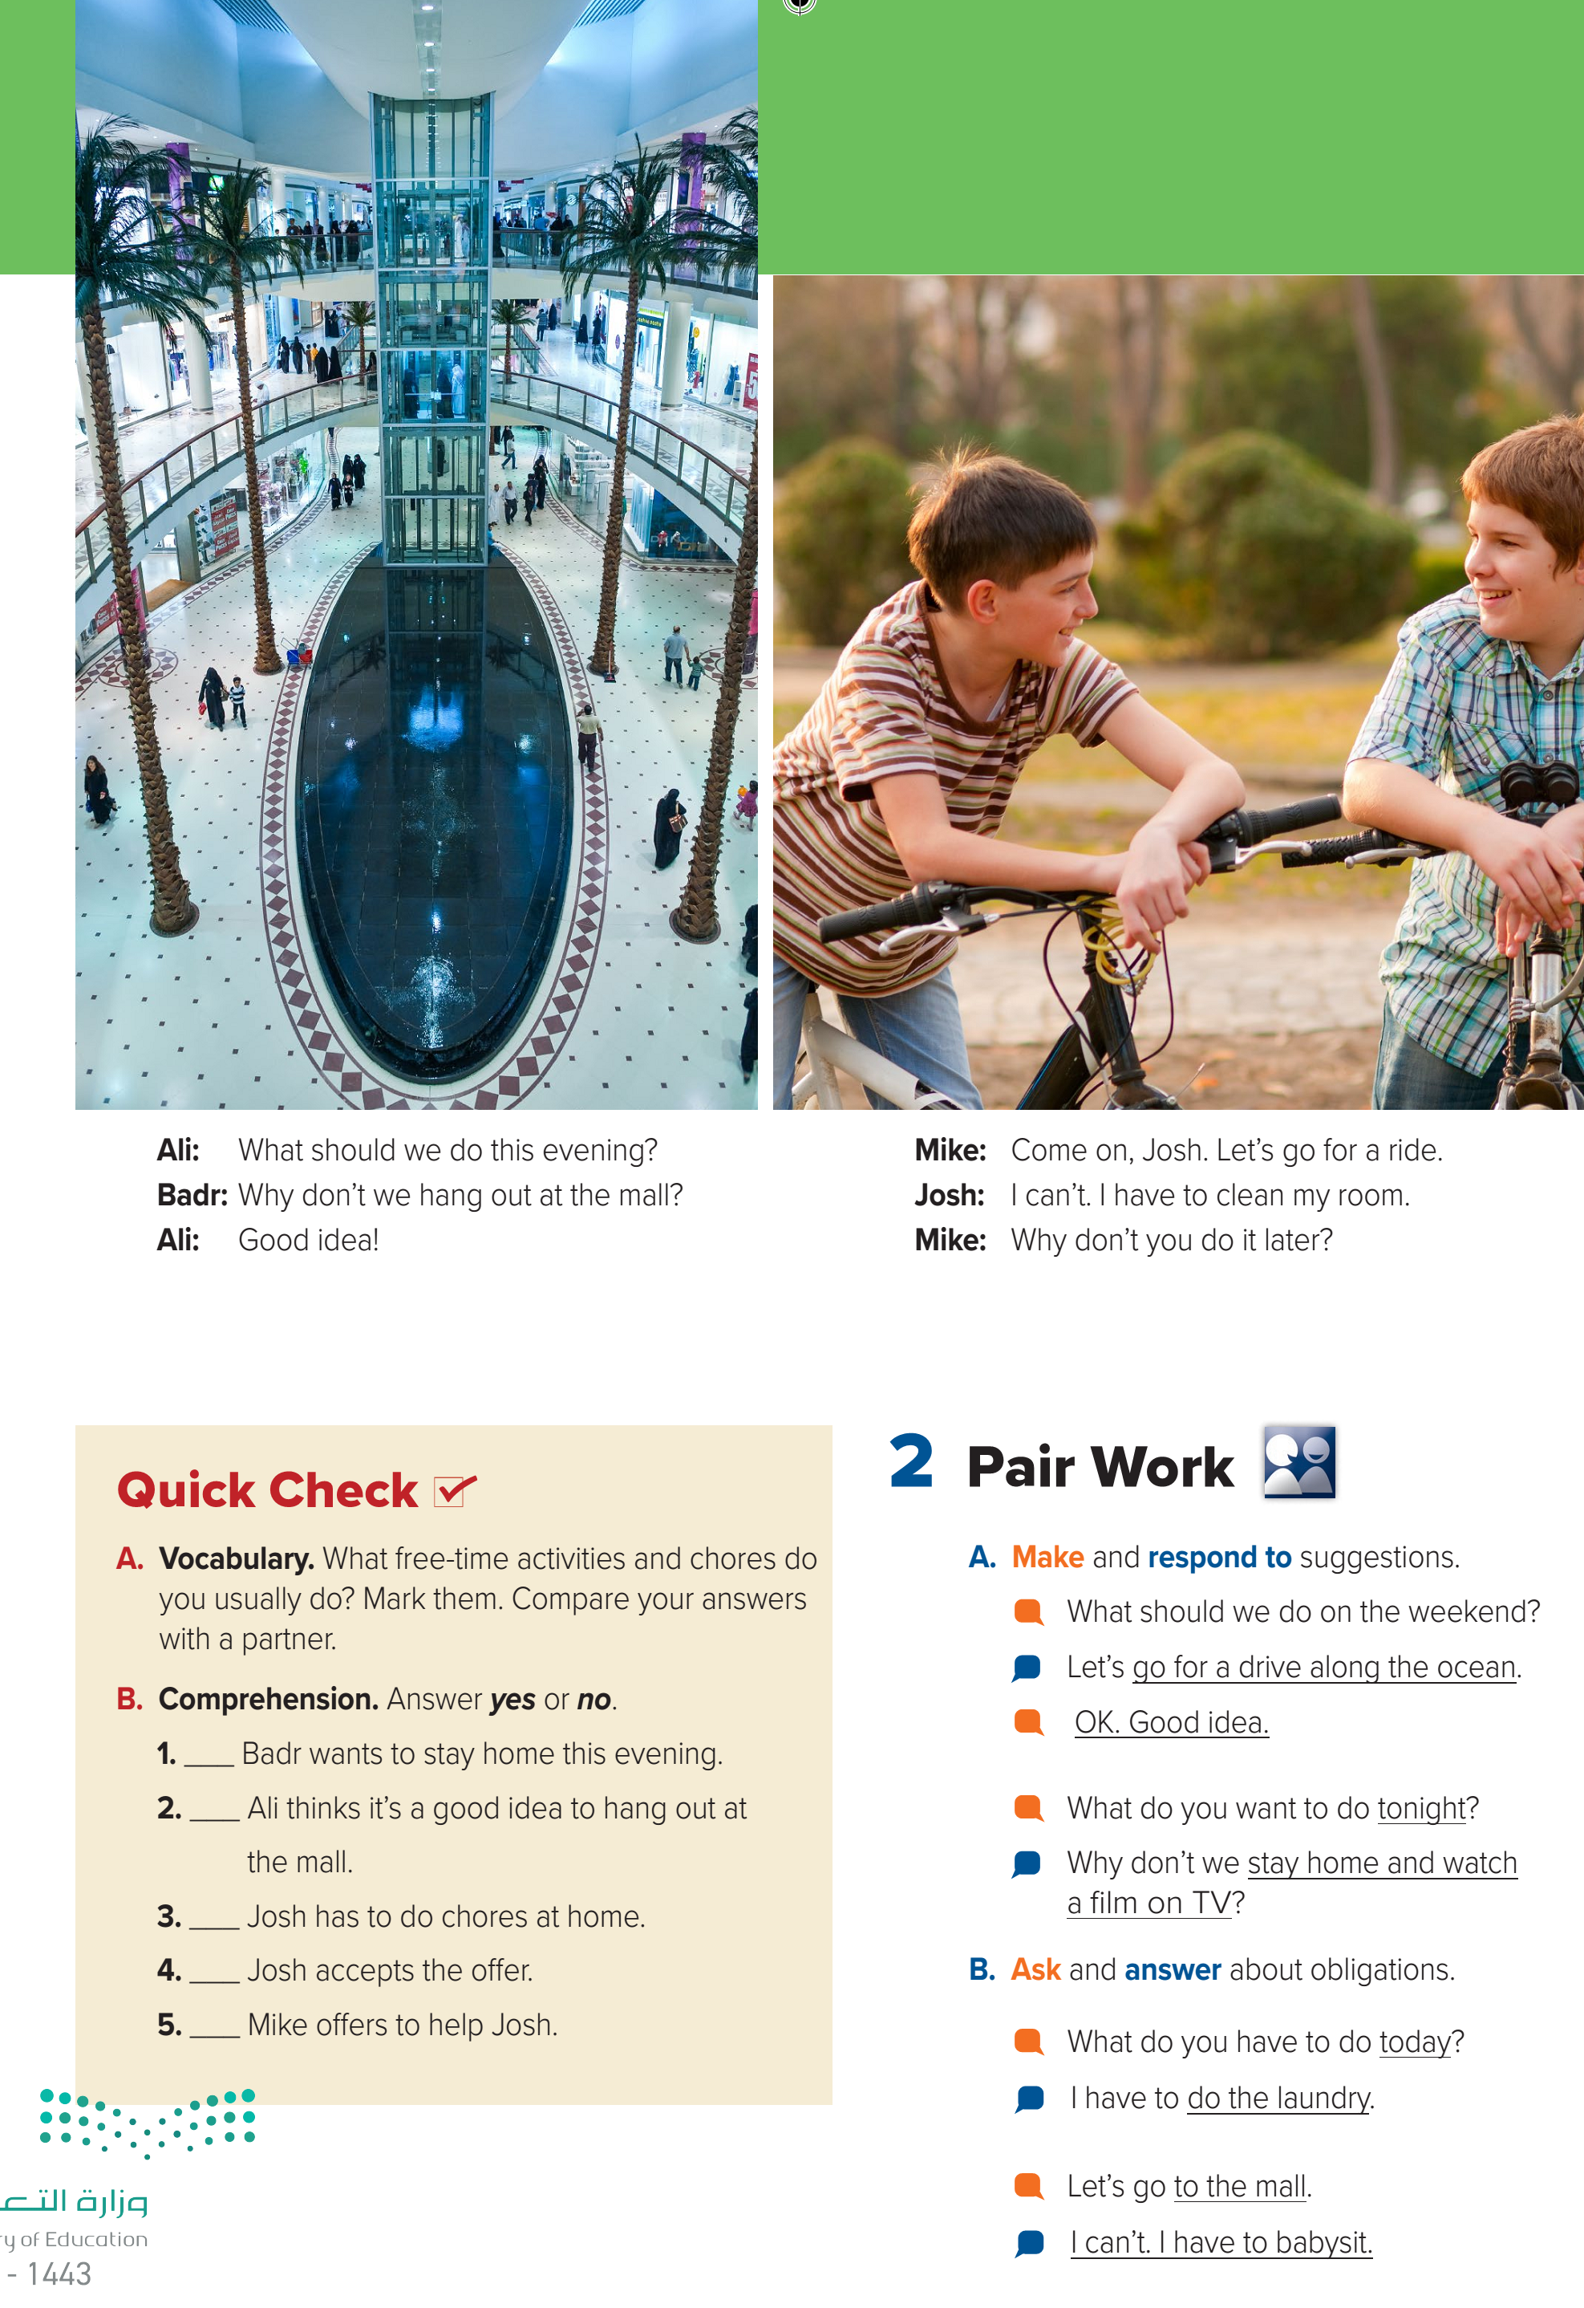

Slide 6
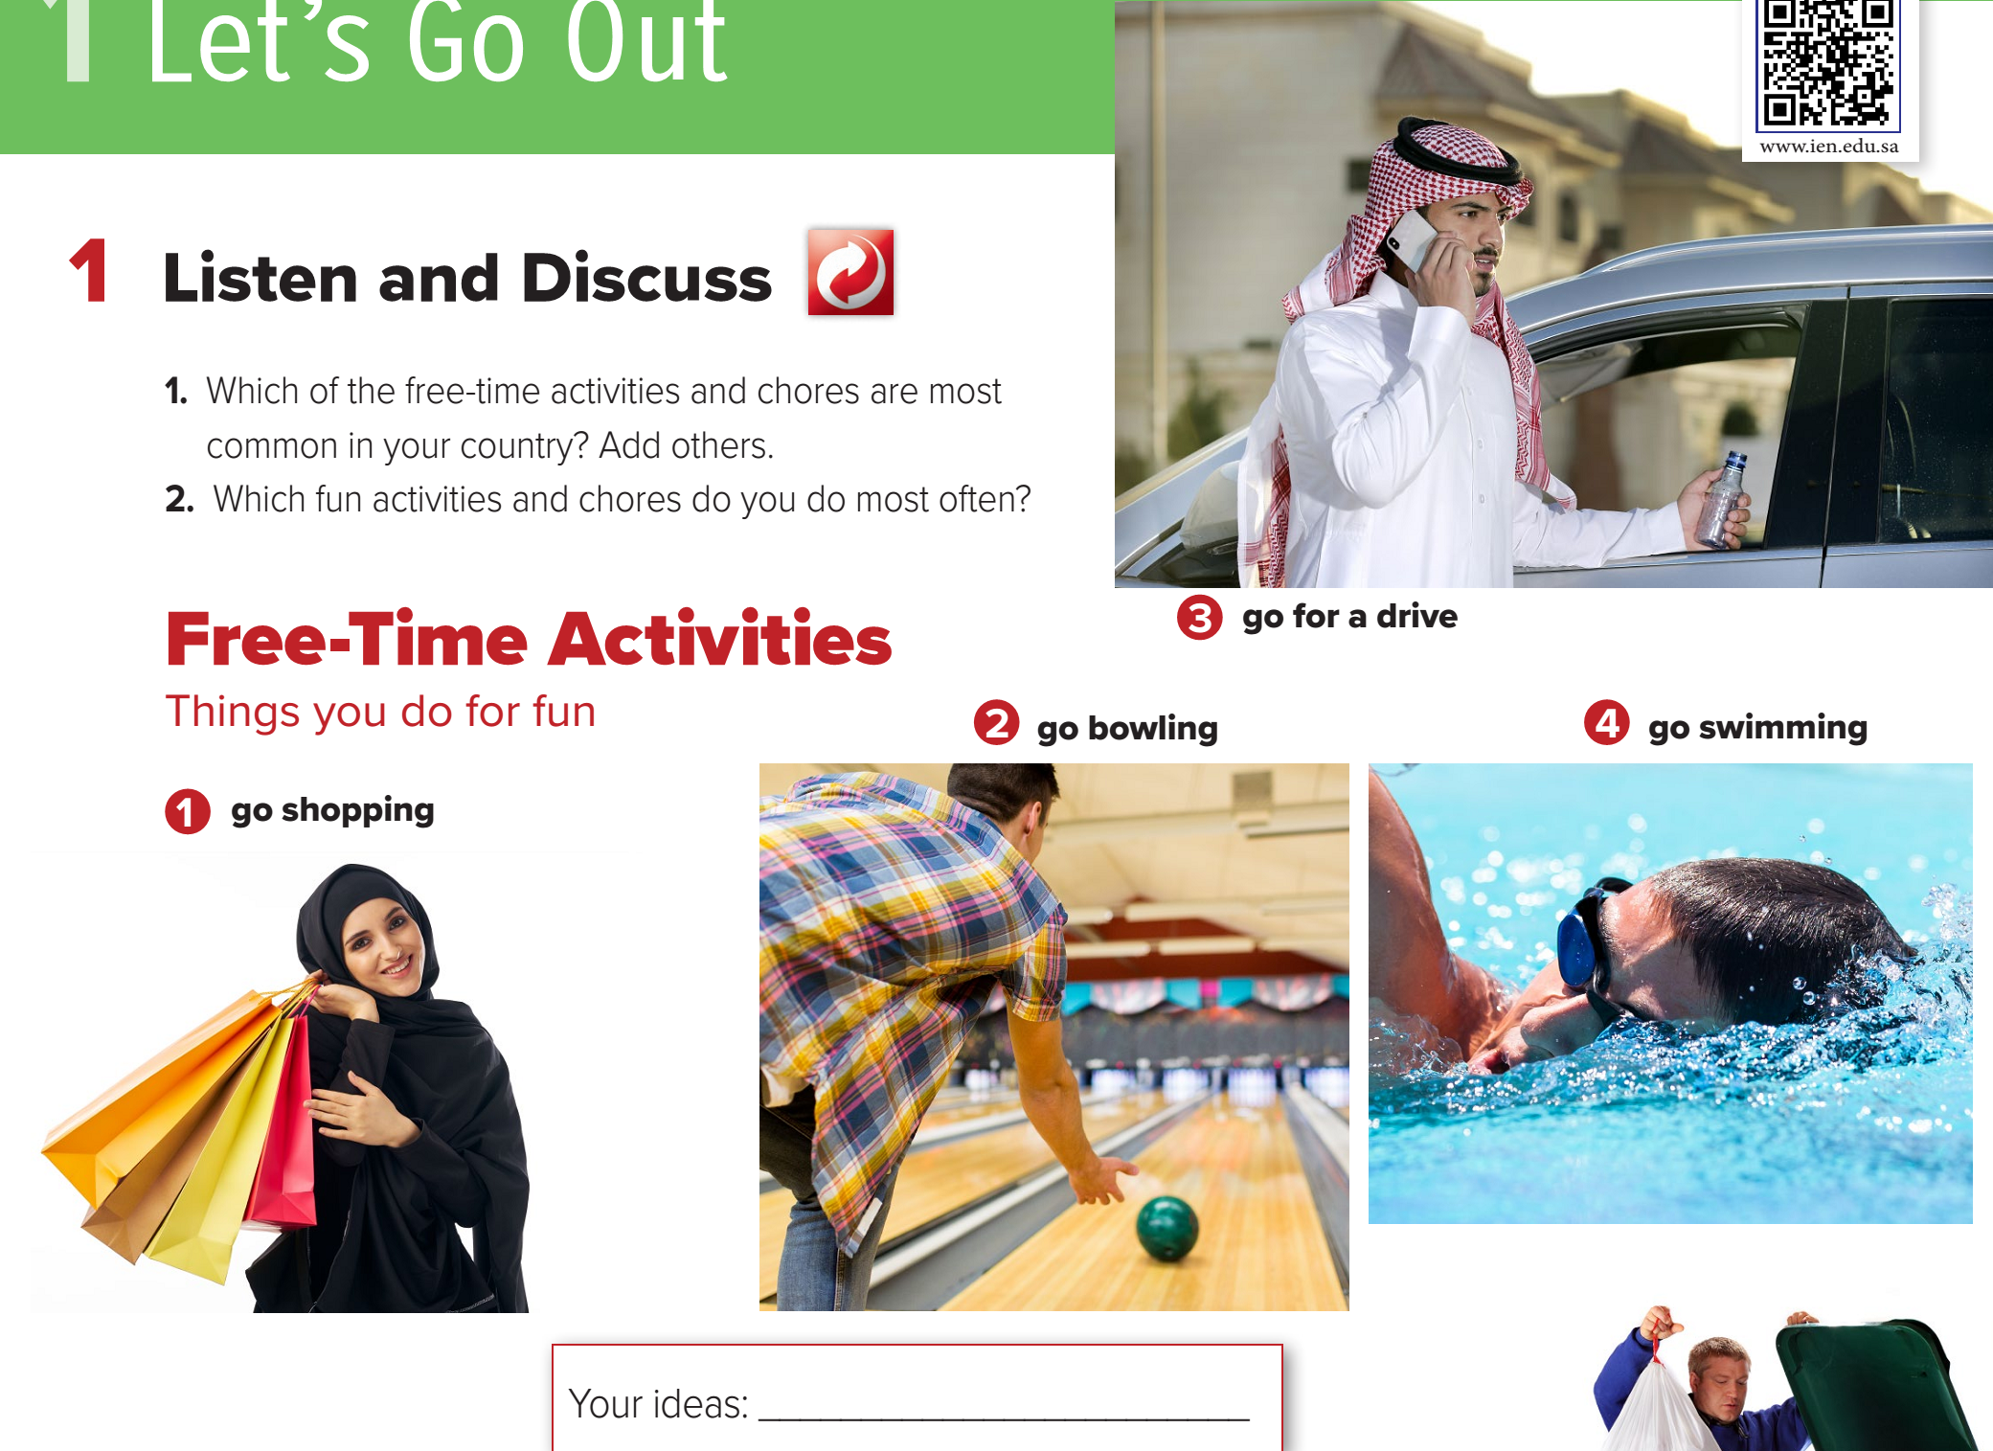

Page: 2

Slide 7
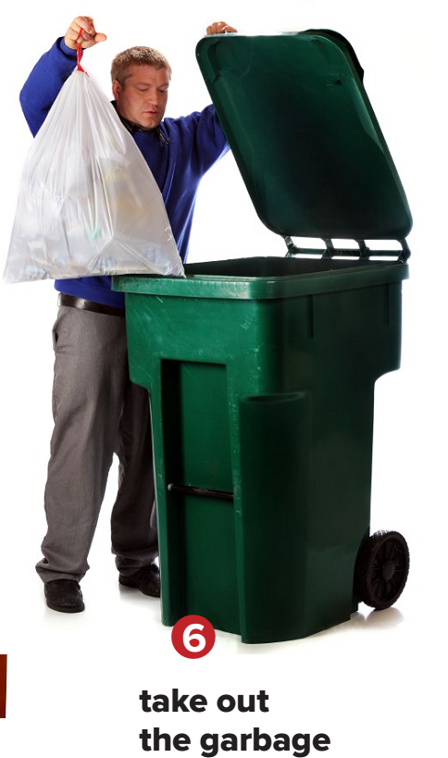
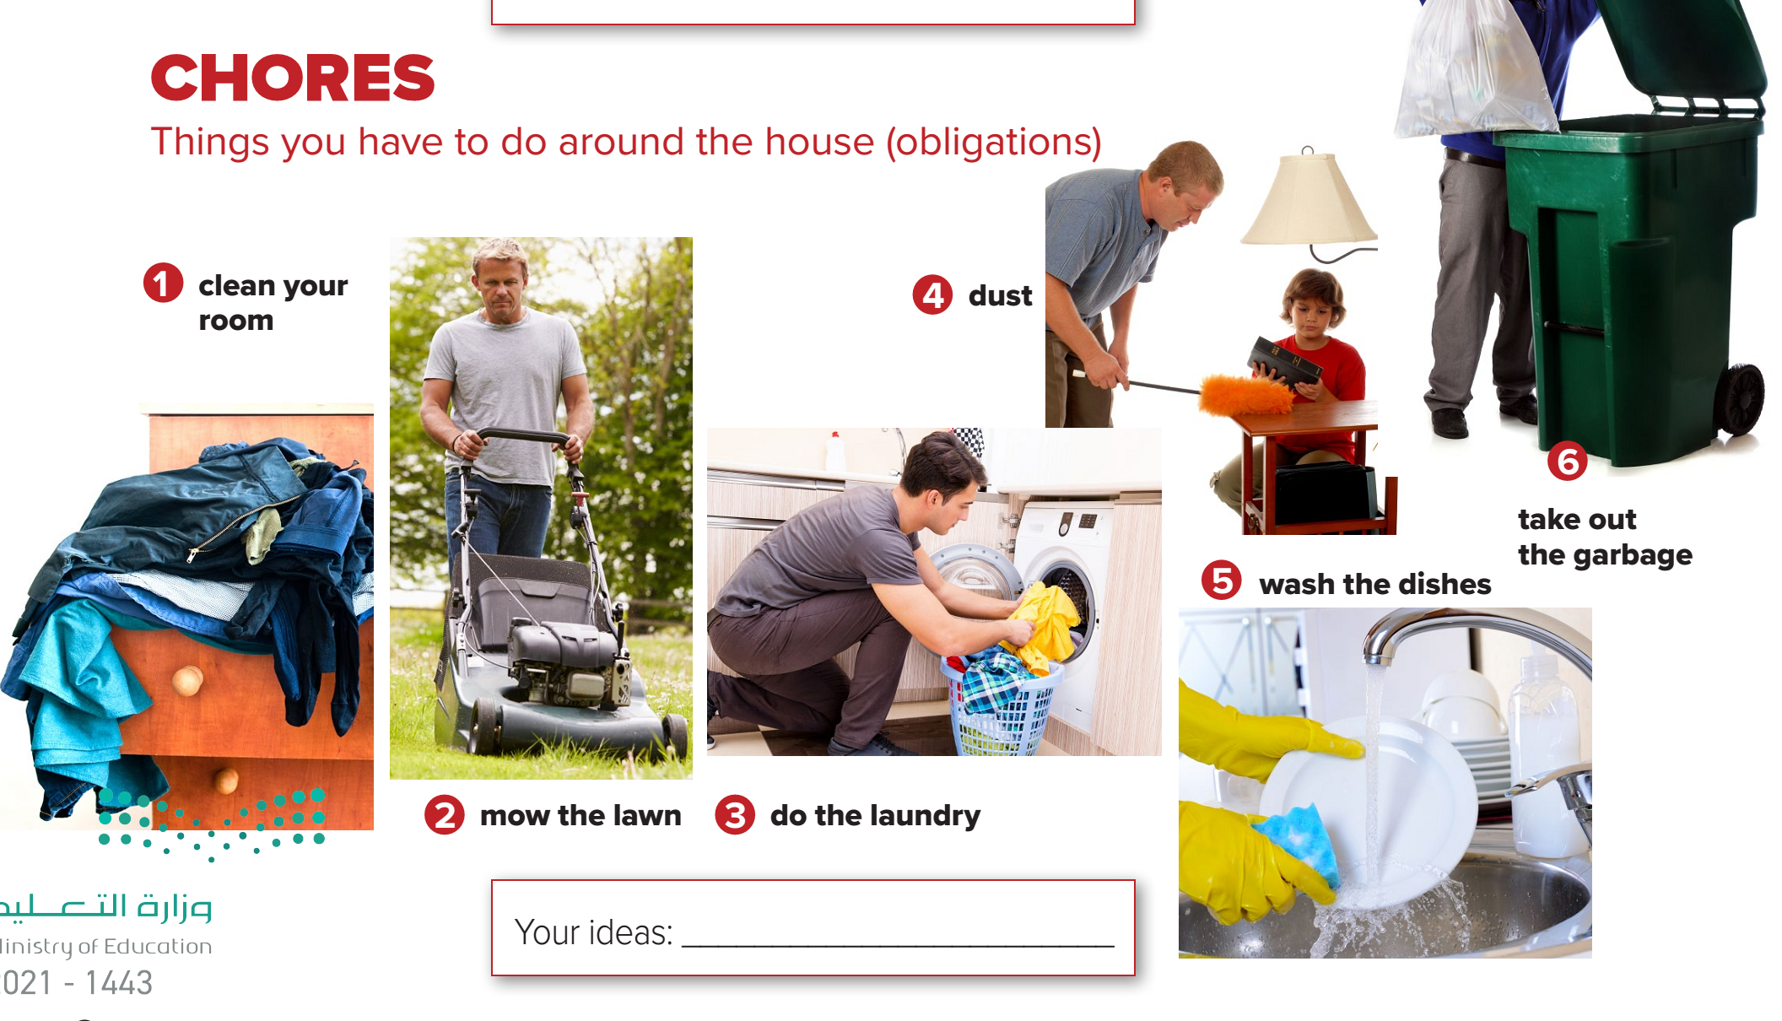
Page: 2

Slide 8
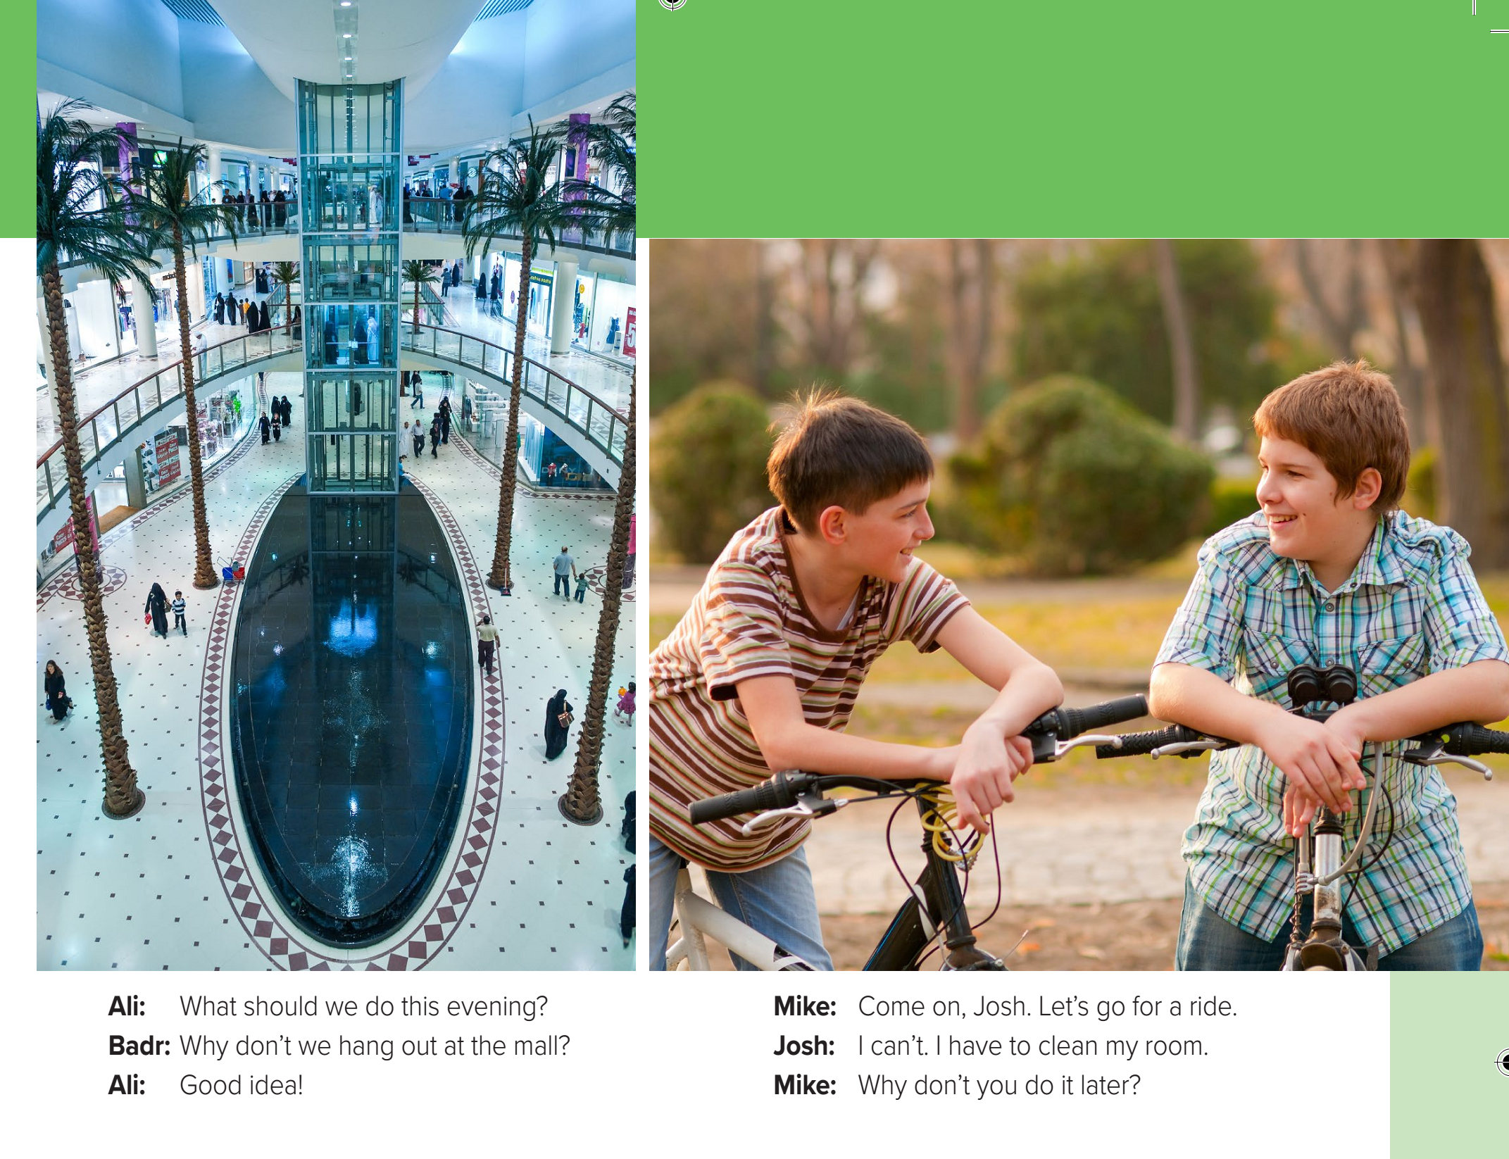
Page: 3

Slide 9
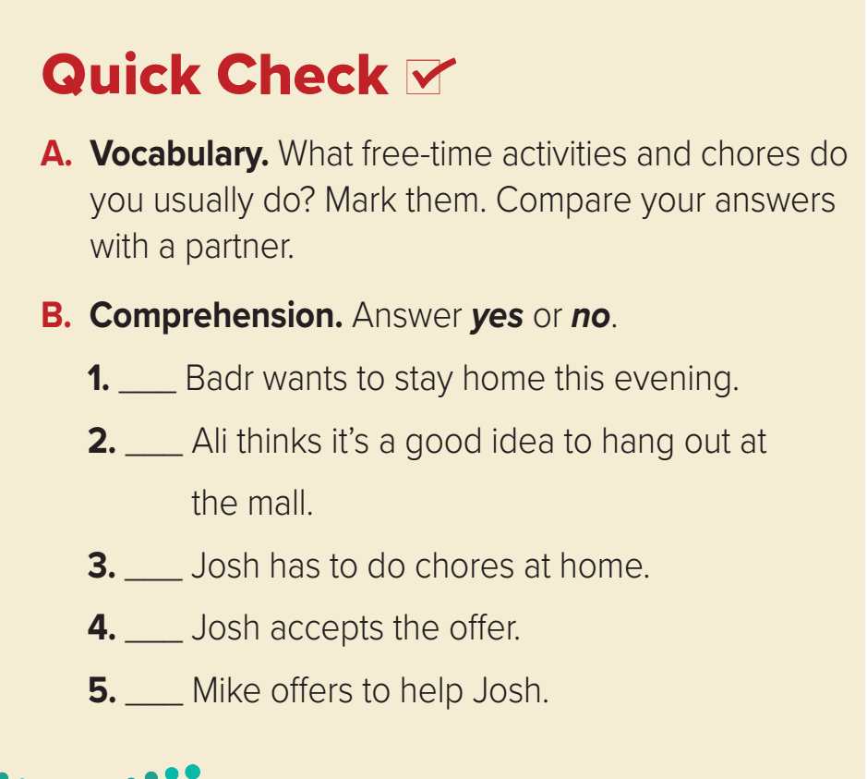
Page: 3
no
yes
yes
no
no

Slide 10
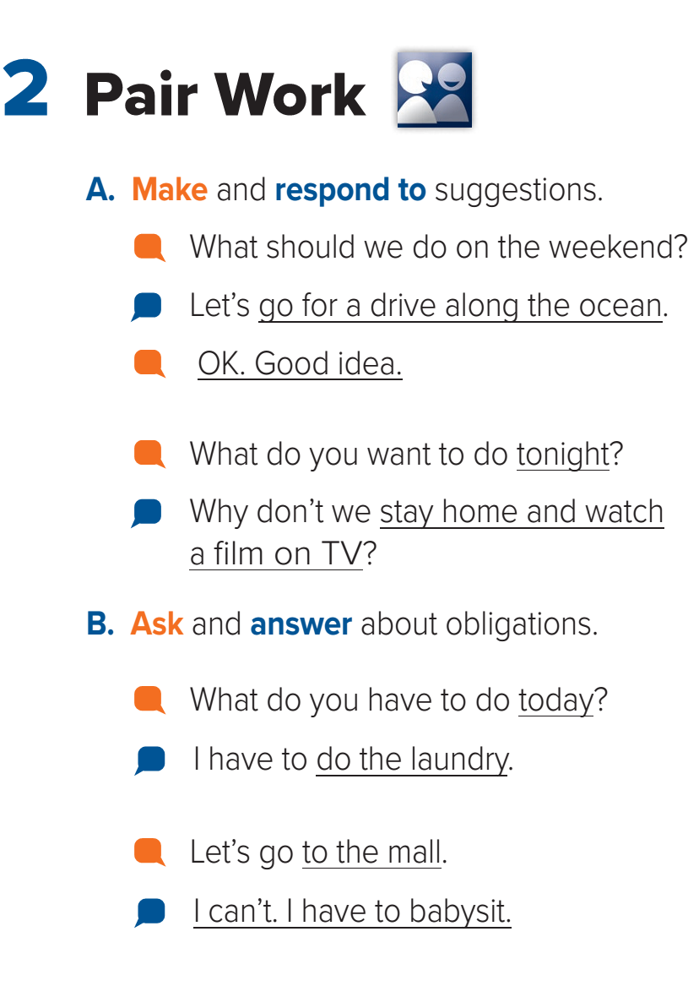
Page: 3

Slide 11
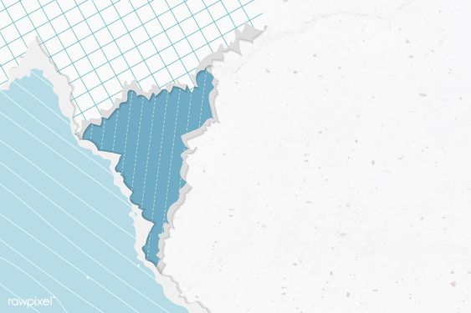
Homework
Workbook page: 89
( A , B )

Slide 12
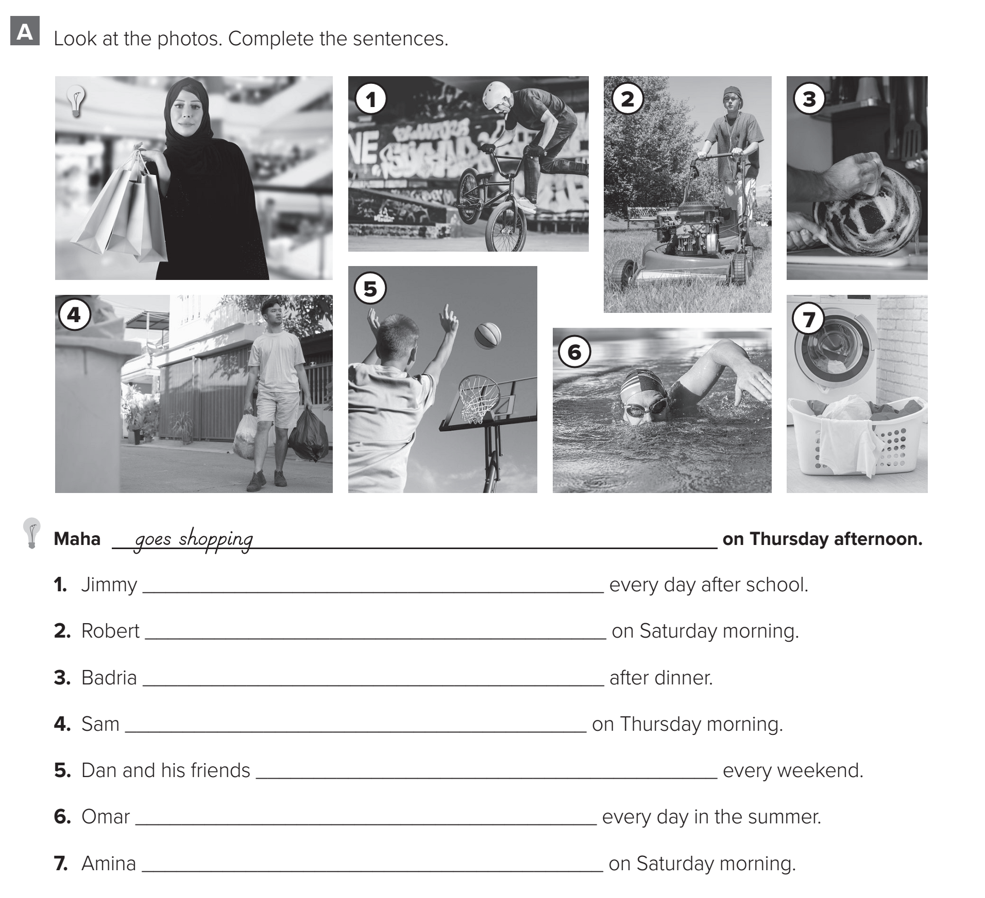
Page: 89
rides his bike
mows the lawn
washes the dishes
takes out the garbage
play basketball
goes swimming
does the laundry

Slide 13
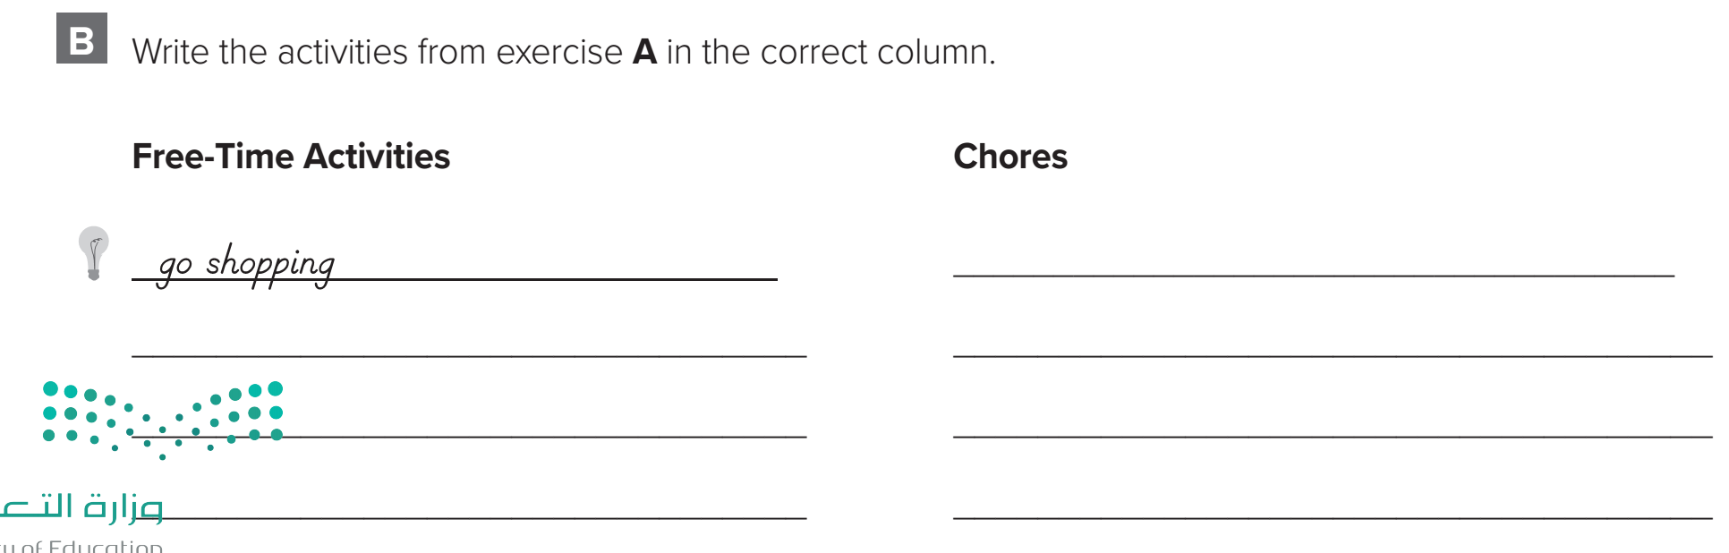
Page: 89
mow the lawn
ride a bike
take out the garbage
play basketball
wash the dishes
go swimming
do the laundry

Slide 14
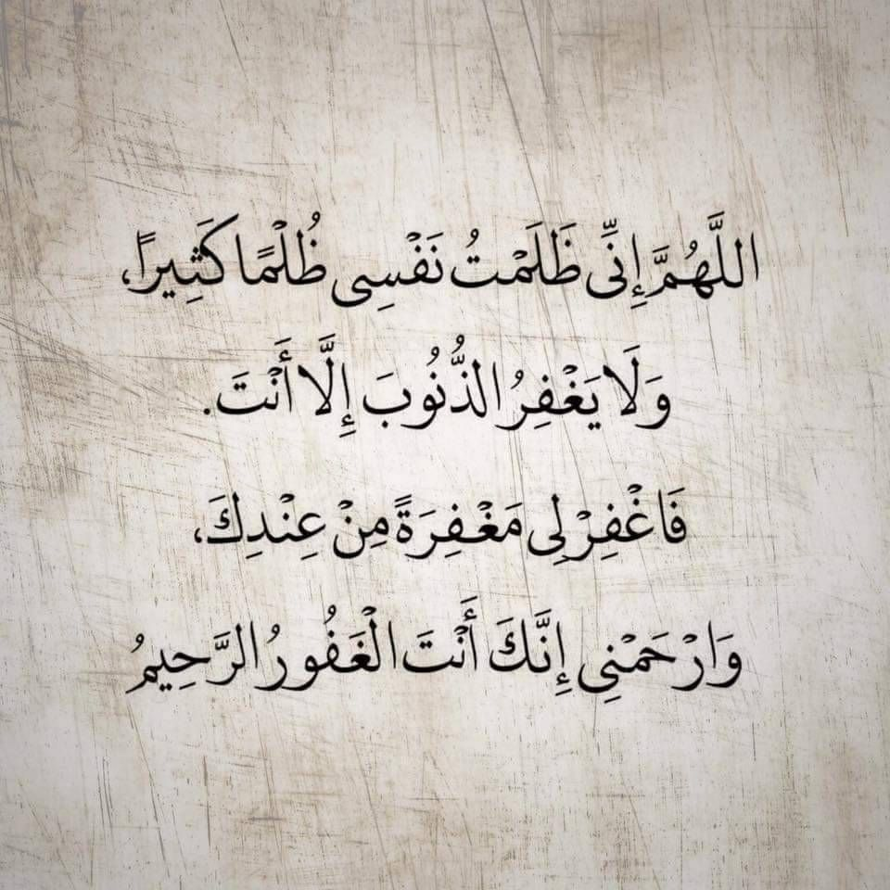

Slide 15
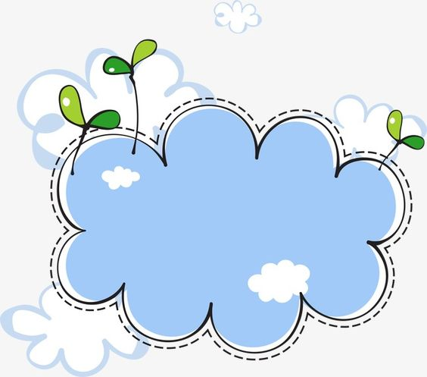
Today’s lesson :
3. Grammar .

Slide 16
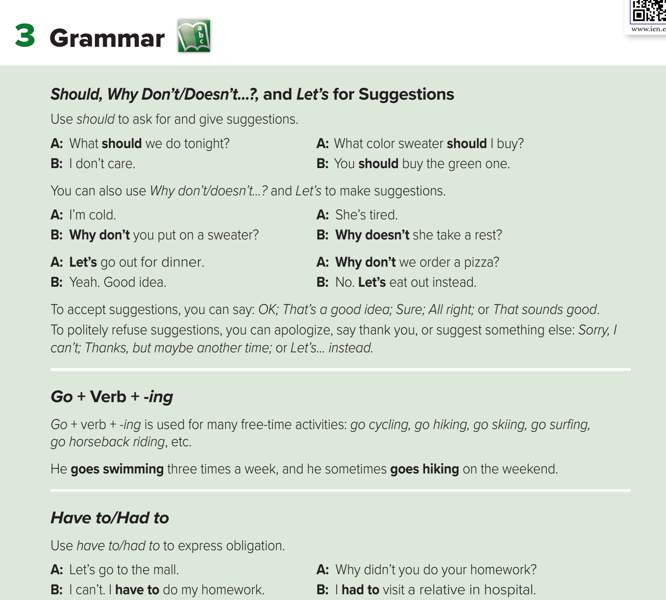
Page: 4

Slide 17
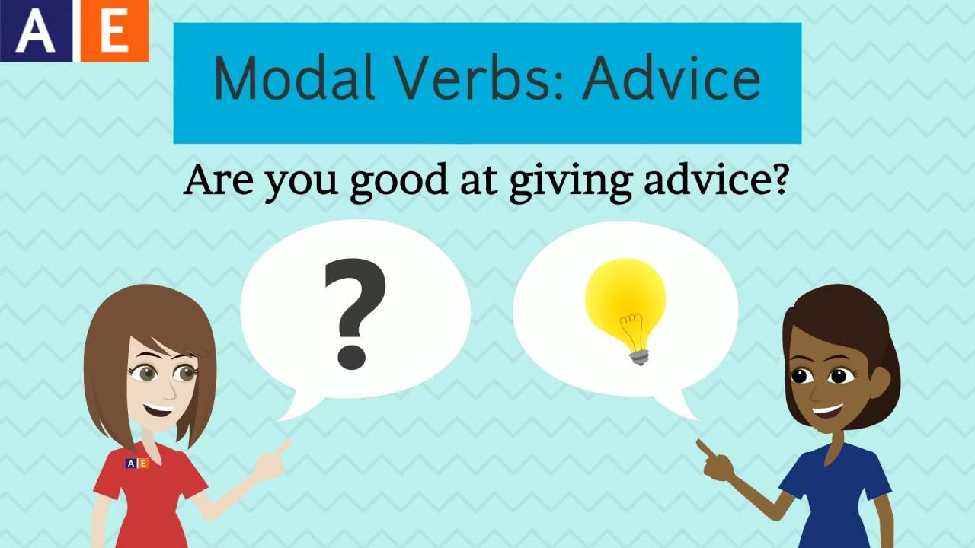

Slide 18


Slide 19
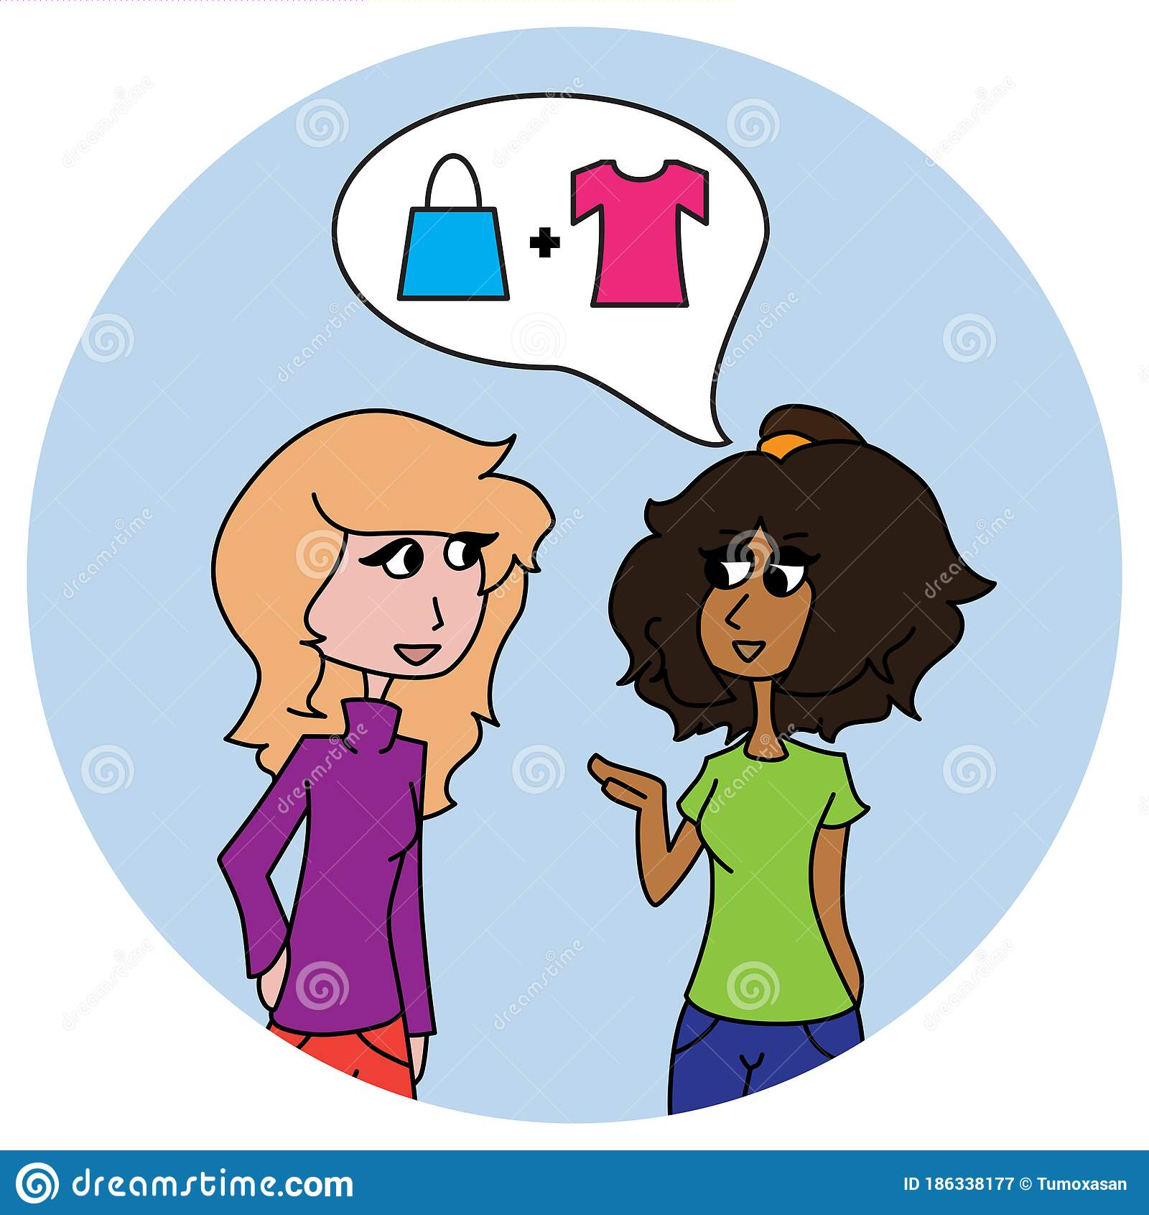
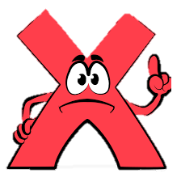

What should I buy ?
You should buy the shirt .
Advice
Suggestion

Slide 20
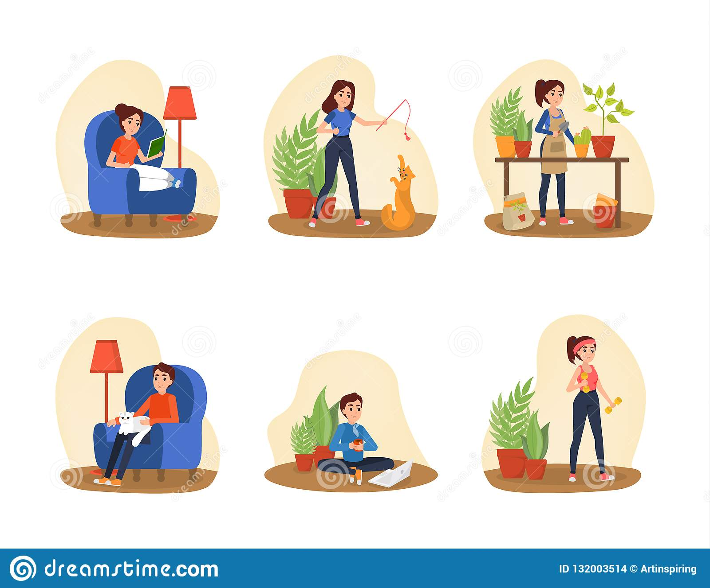
I don’t care.
I don’t care.
What should we do tonight?
What should we do tonight?

Slide 21

Can we use another word to make suggestion ?

Slide 22
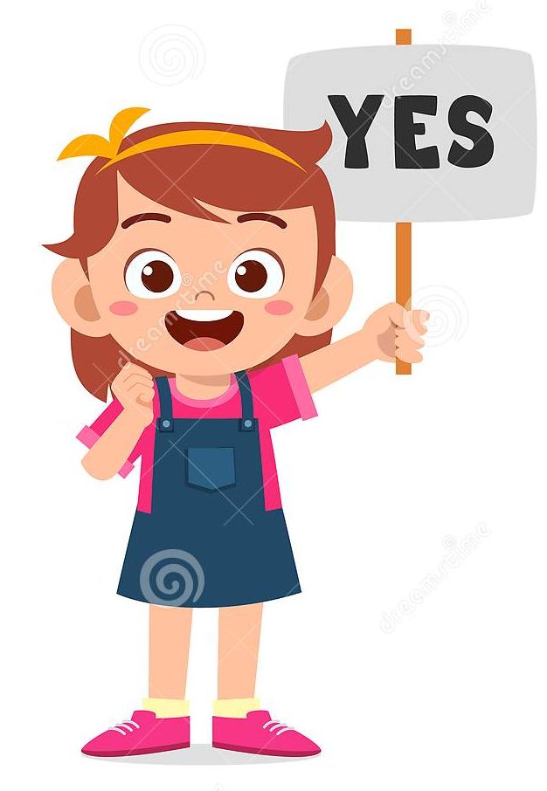
Why don’t/doesn’t…?
Let’s

Slide 23
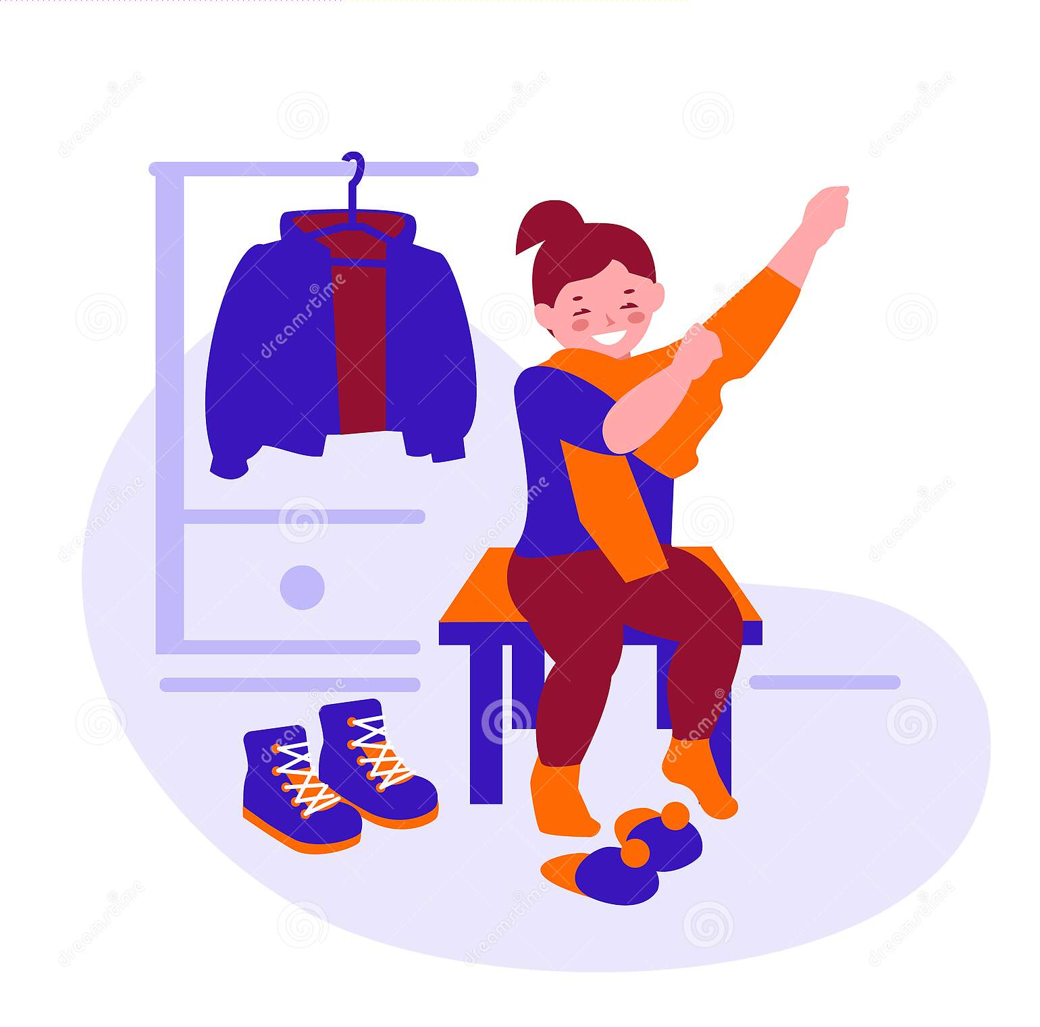
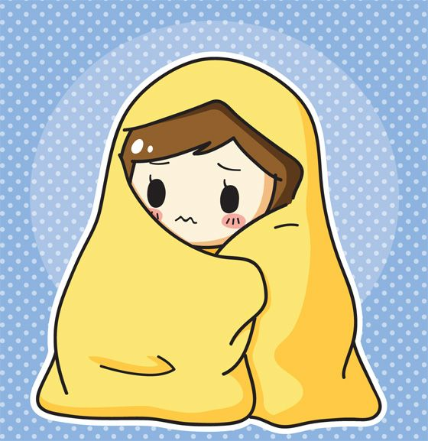
I’m cold.
Why don’t you put on a sweater?

Slide 24
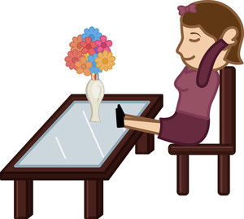
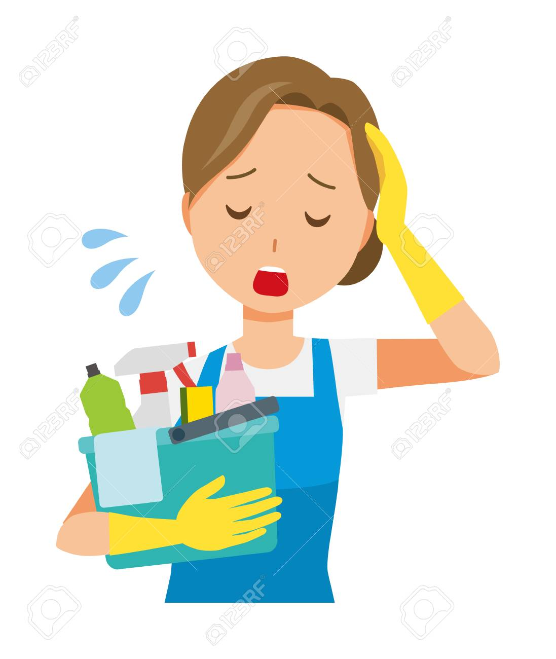
She’s tired.
Why doesn’t she take a rest?

Slide 25
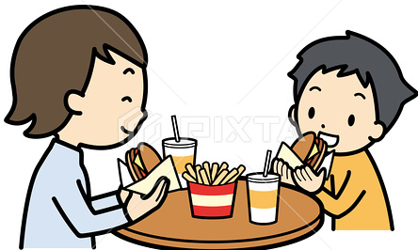
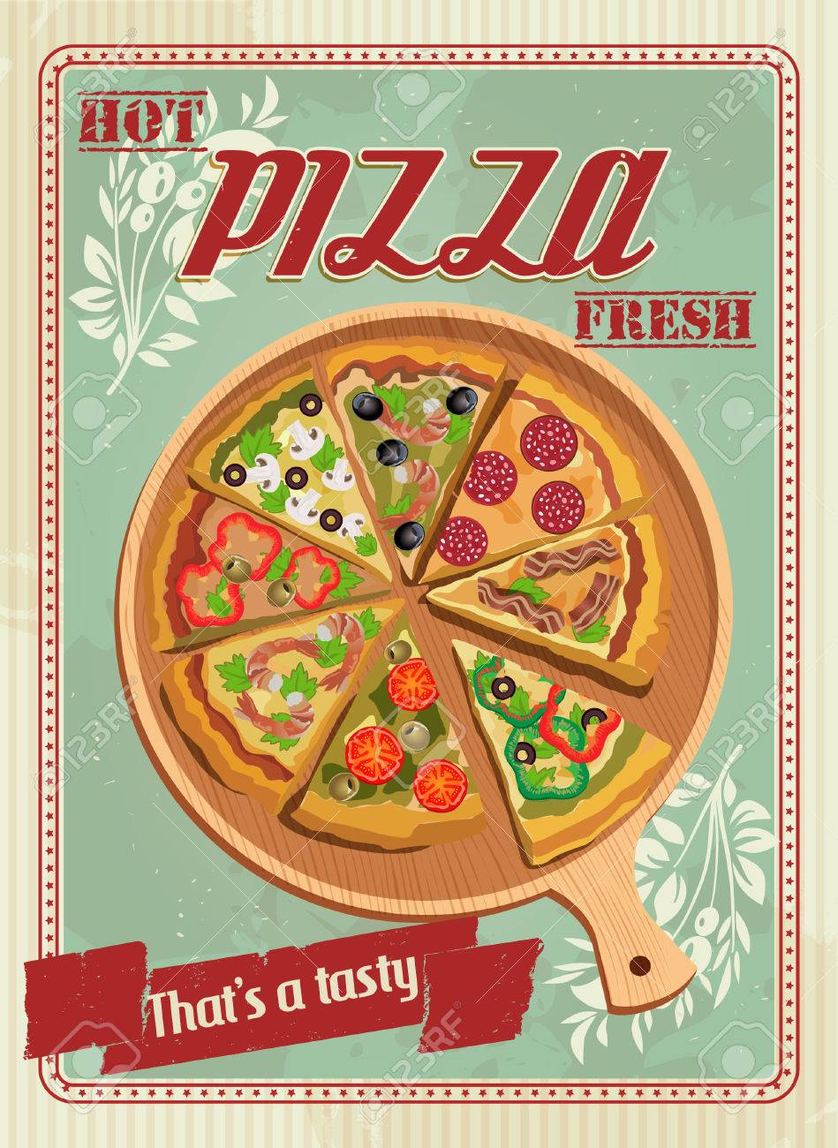
Why don’t we order a pizza?
No. Let’s eat out instead.

Slide 26
Why don’t/doesn’t
+
S
+
V(simple)

Slide 27
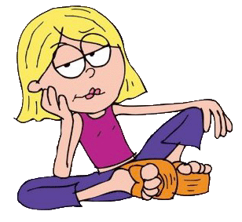
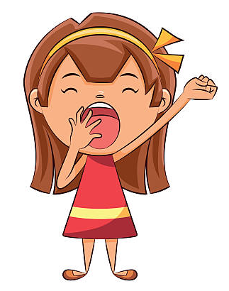
I’m bored .
I’m sleepy .

Slide 28
accept suggestions.
I’m bored .
OK
That’s a good idea .
Sure.
All right
That sounds good.

Slide 29
refuse suggestions
I’m bored .
you can apologize, say thank you, or suggest something else
Sorry, I
can’t.
Thanks, but maybe another time.
Let’s... instead

Slide 30
I’m sleepy .
OK
That’s a good idea .
Sure.
All right
That sounds good.
Sorry, I
can’t.
Thanks, but maybe another time.
Let’s... instead

Slide 31
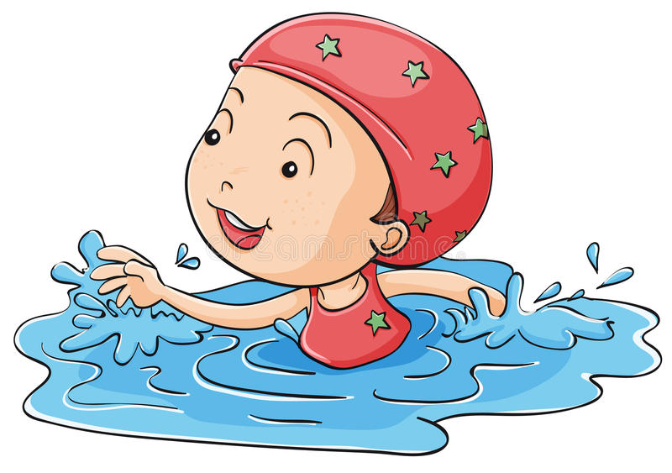
Go+ Verb + -ing
used for many free-time activities.
Ηe goes swimming three times a week

Slide 32
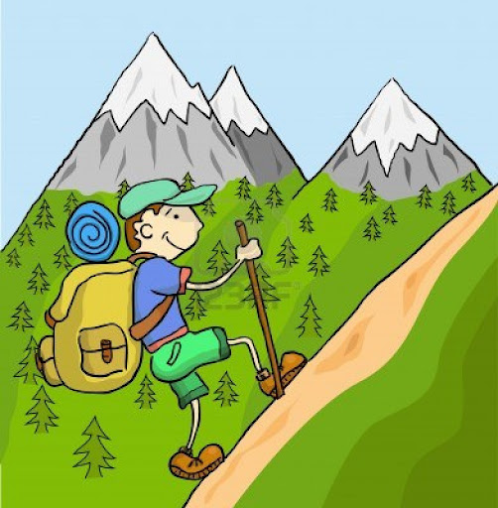
Go+ Verb + -ing
used for many free-time activities.
He goes hiking on the weekend

Slide 33

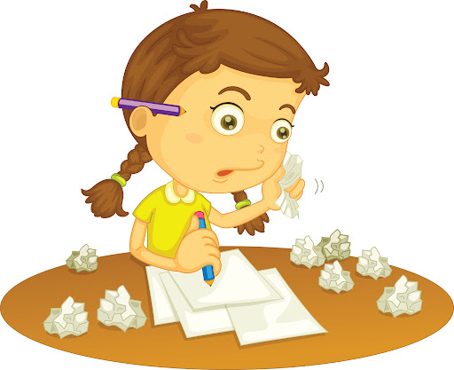
Let’s go to the mall.
I have to do my homework.
Suggestion
Obligation

Slide 34
Let’s go to the mall.
I have to do my homework.

Slide 35
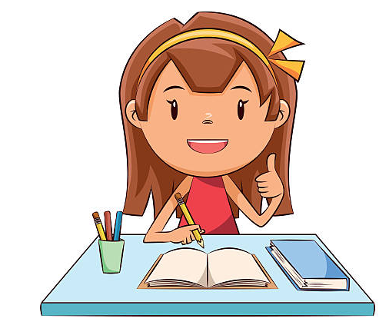
Have to / Had to
express obligation
I have to do my homework.

Slide 36
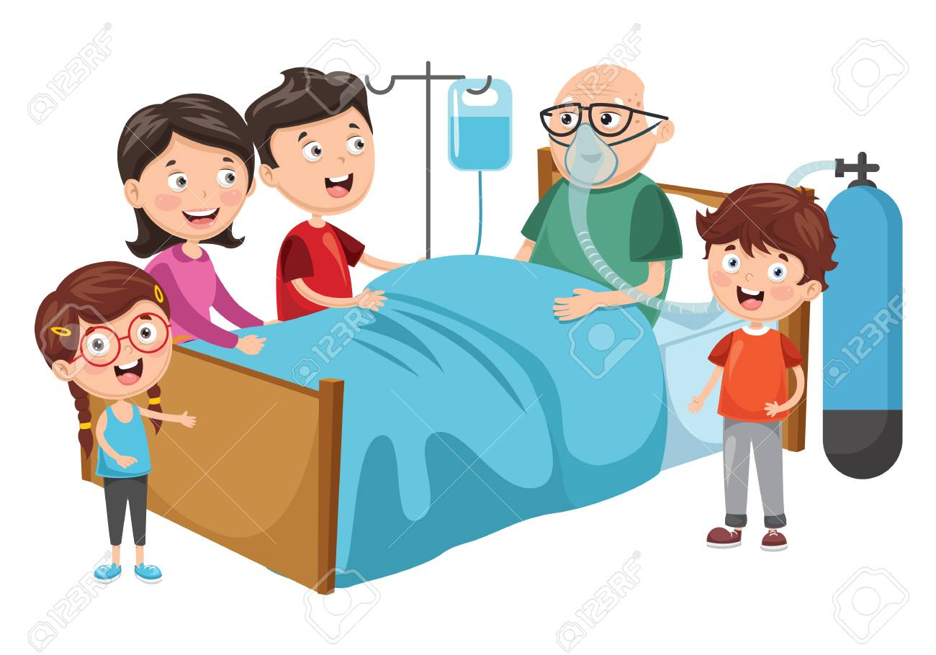
Why didn’t you do your homework?
I had to visit a relative in hospital

Slide 37
Page: 4

Slide 38
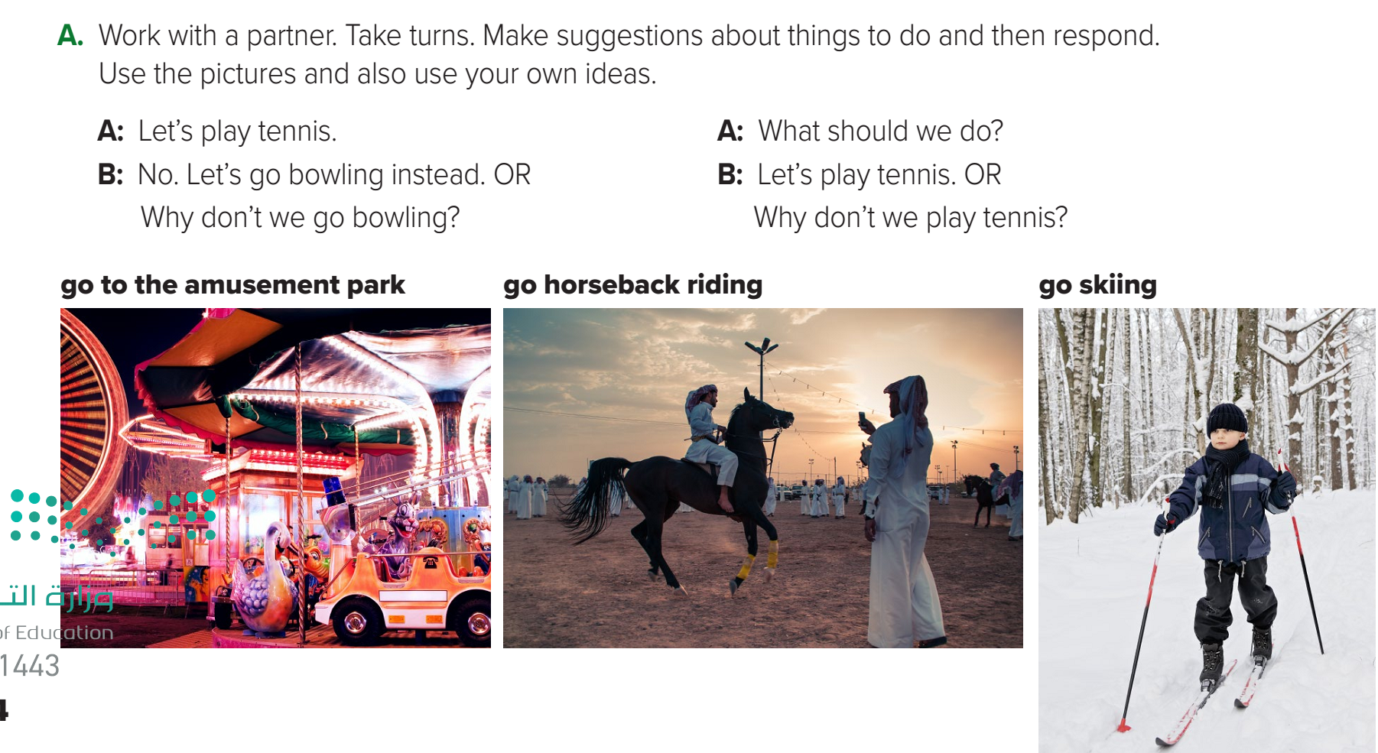
A: What should we do?
B: Let’s go out for dinner.
A: Why don’t we go to an Italian restaurant?
A: Let’s go to the amusement park.
B: No. Let’s go horseback riding instead.
Page: 4

Slide 39
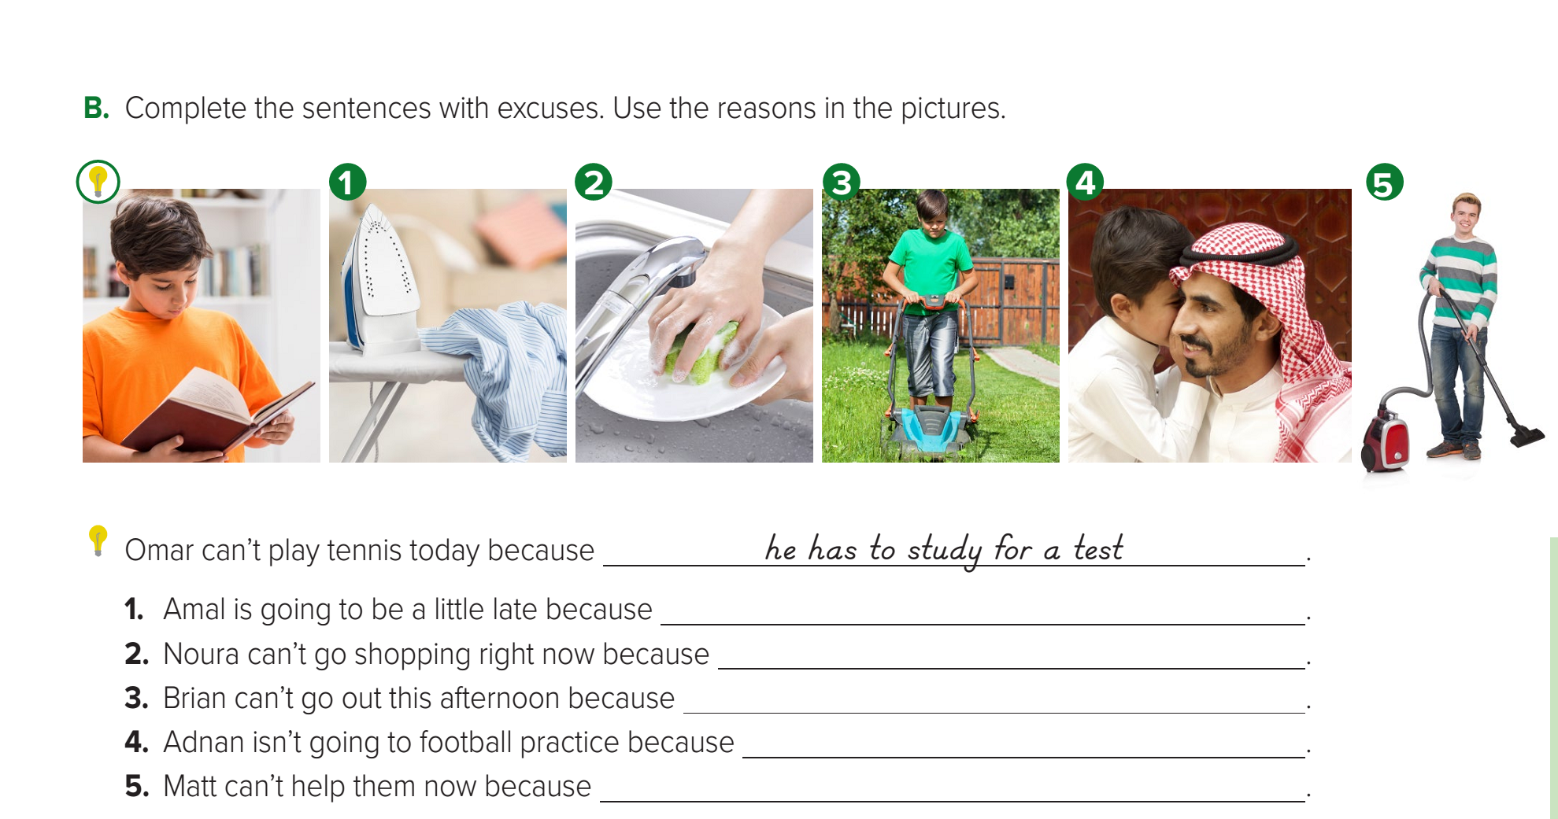
Page: 5
she has to do the laundry
she has to wash the dishes
he has to mow the lawn
he has to babysit
he has to clean the house

Slide 40
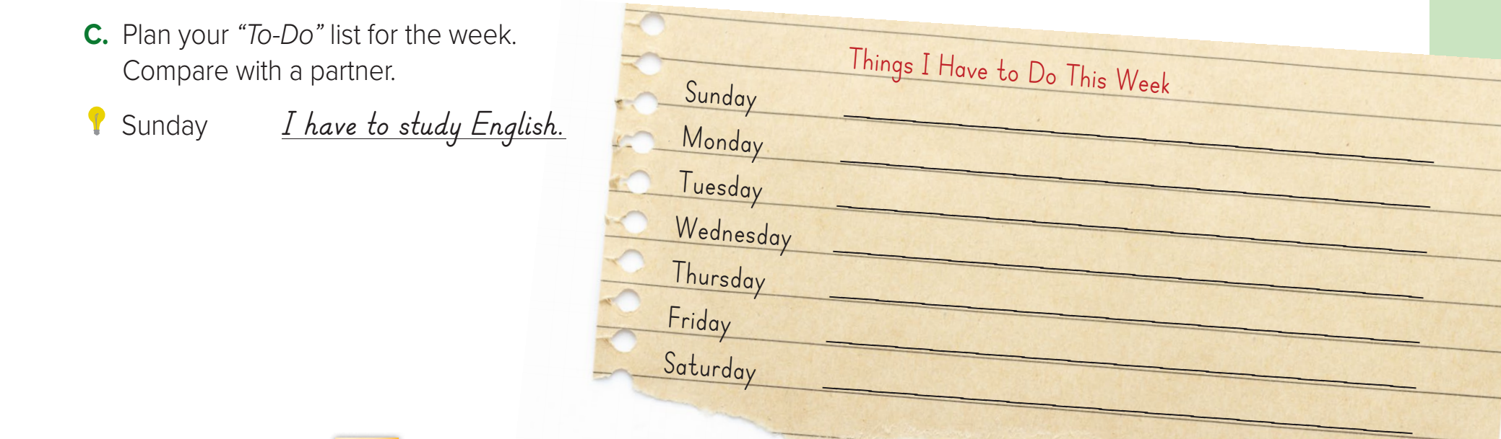
Page: 5

Slide 41
Homework
Workbook page: 90
( C , D, E, F, G )

Slide 42
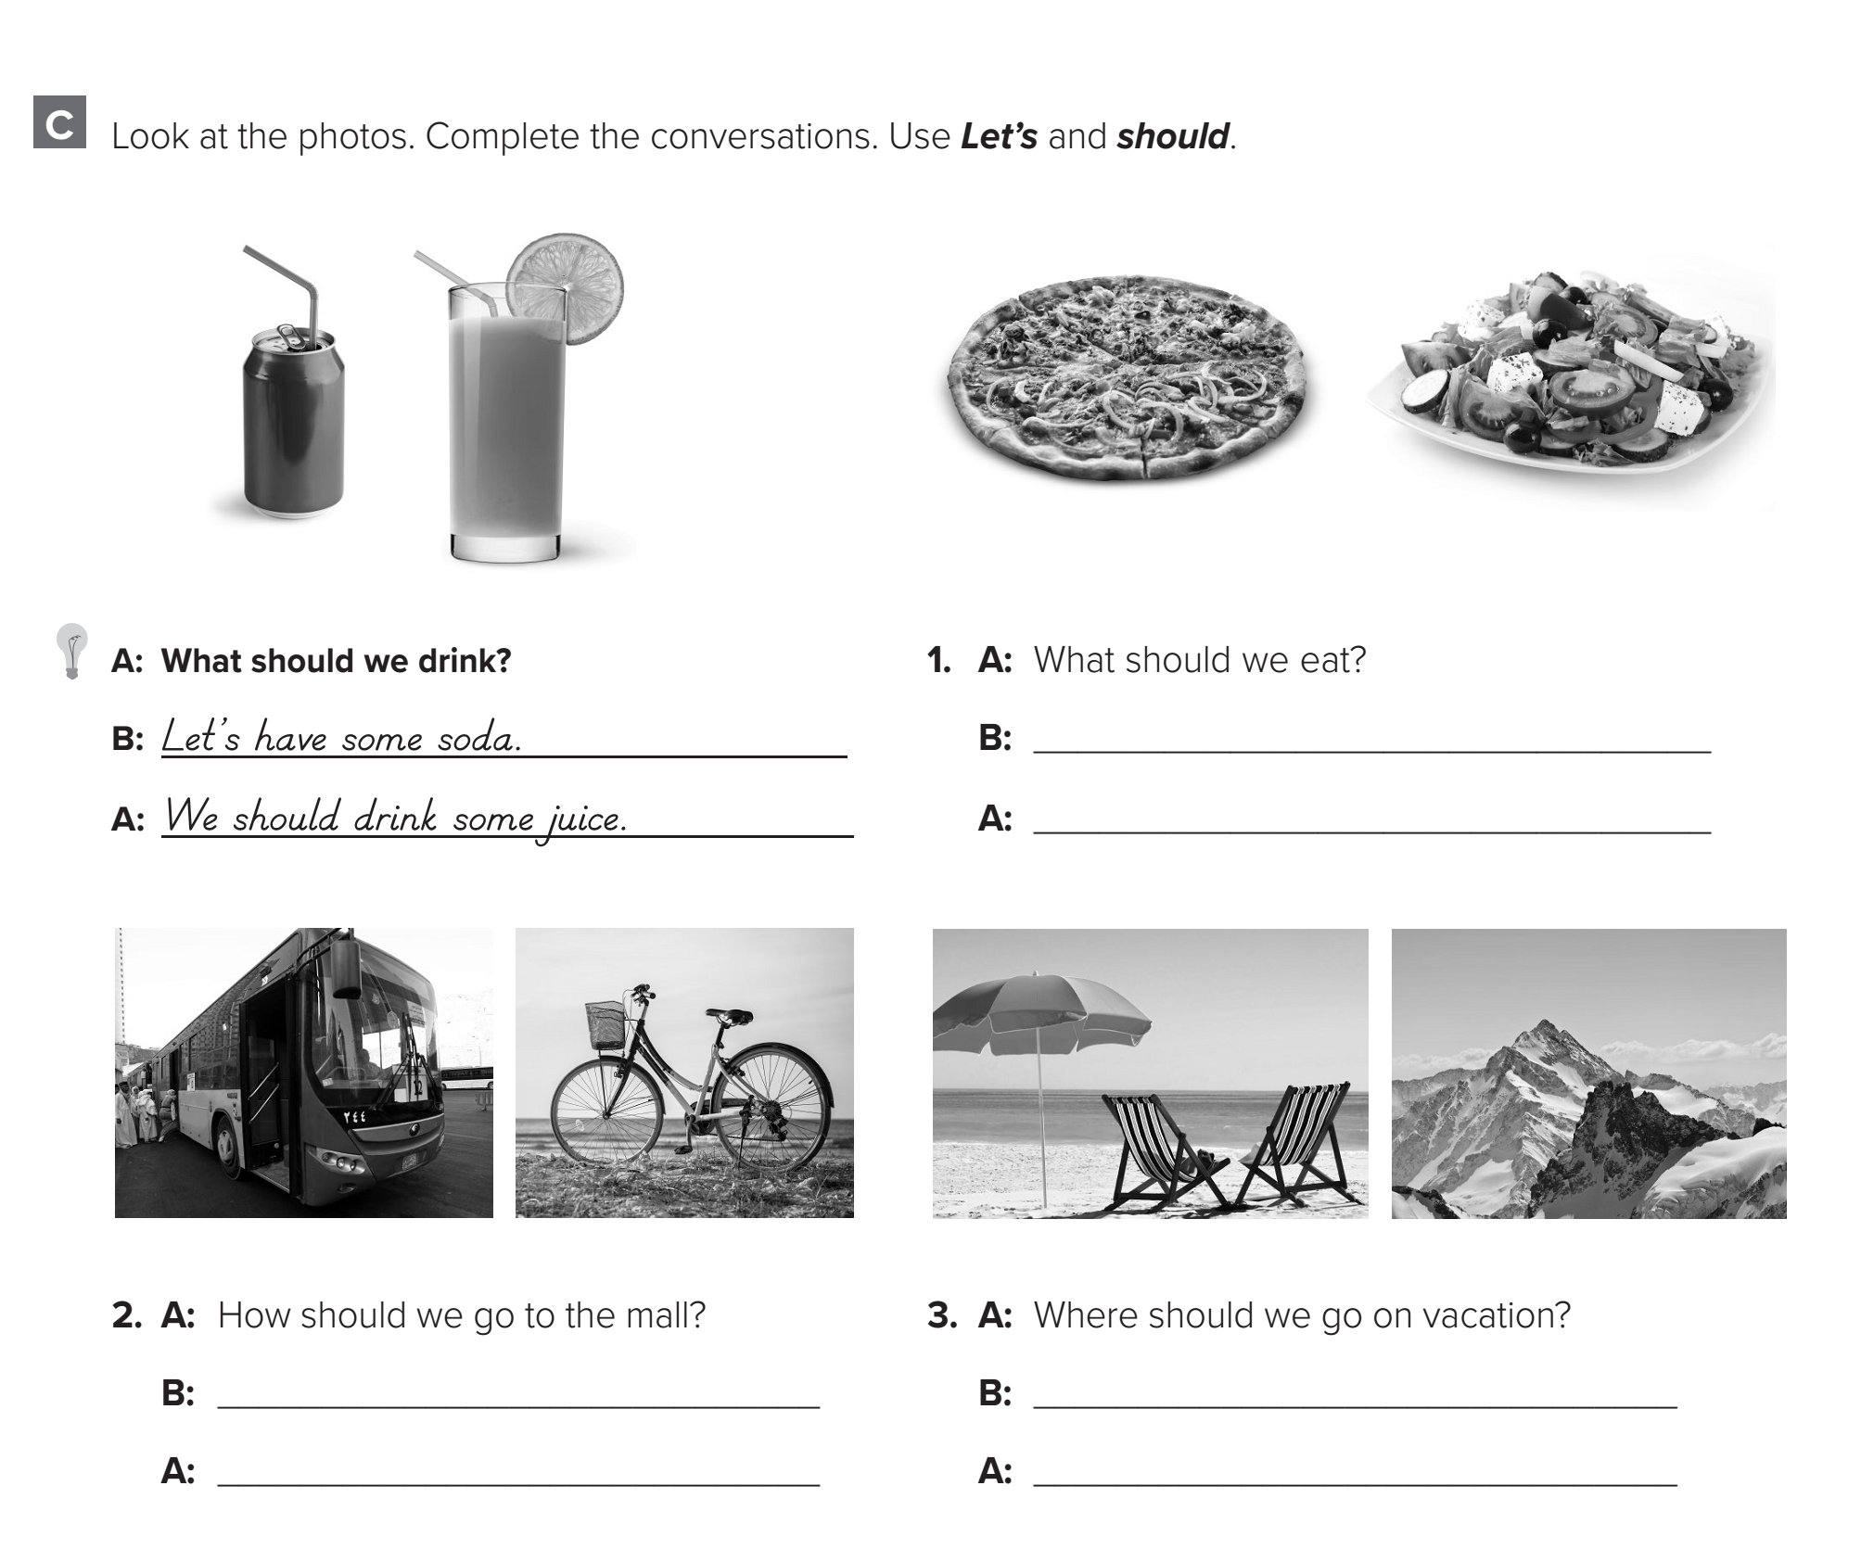
Page: 90
Let’s have some pizza.
We should eat some salad.
Let’s take the bus.
Let’s go to the beach.
We should ride our bikes.
We should go to the mountains.

Slide 43
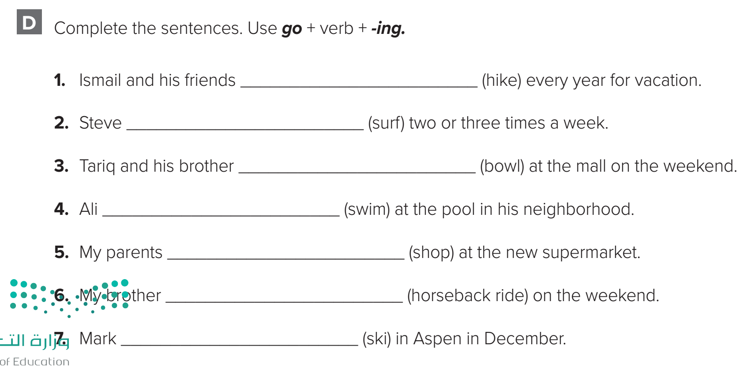
Page: 90
go hiking
goes surfing
go bowling
goes swimming
go shopping
goes horseback riding
goes skiing

Slide 44
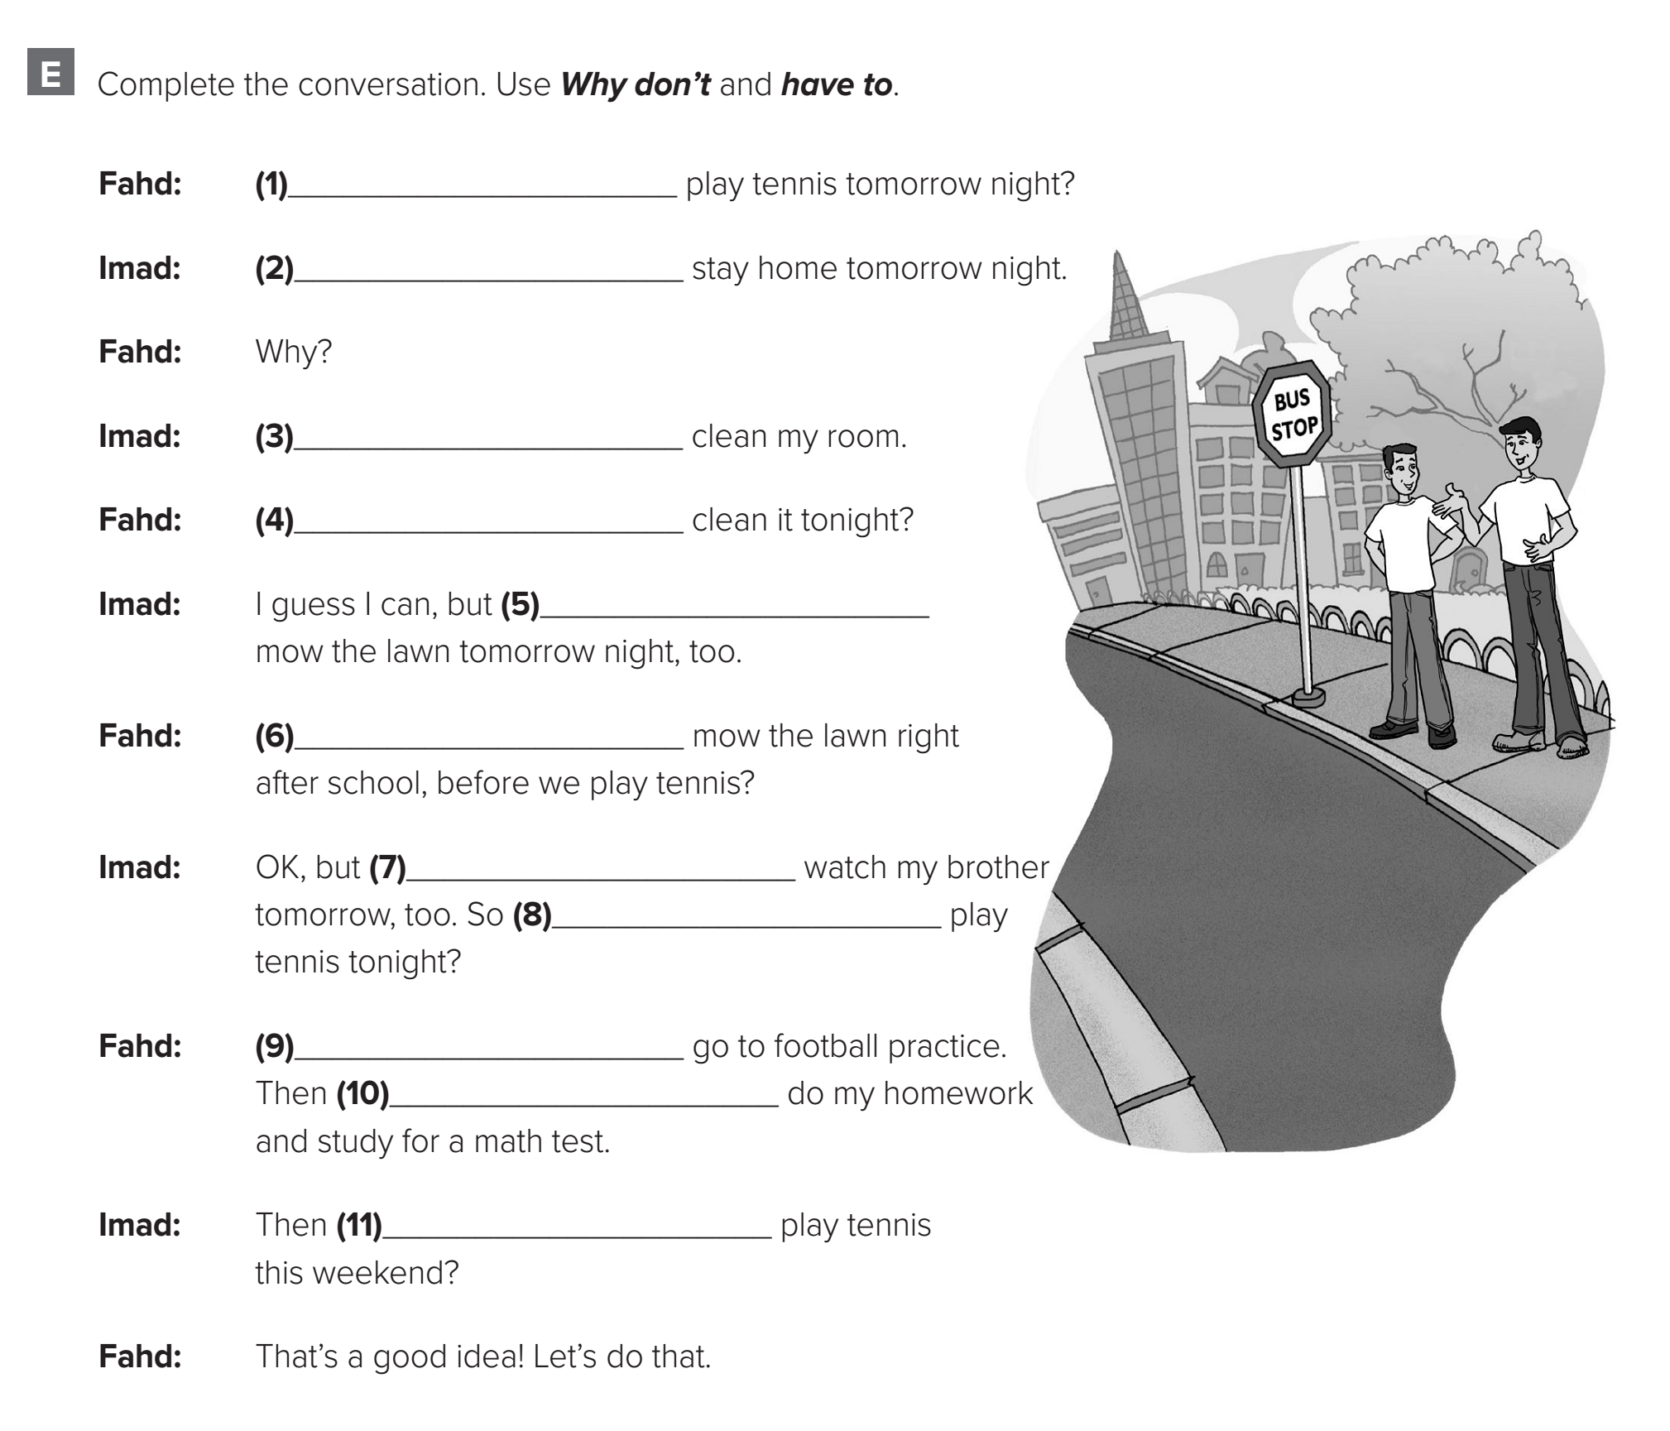
Page: 91
Why don’t we
I have to
I have to
Why don’t you
I have to
Why don’t you
I have to
why don’t we
I have to
I have to
why don’t we

Slide 45
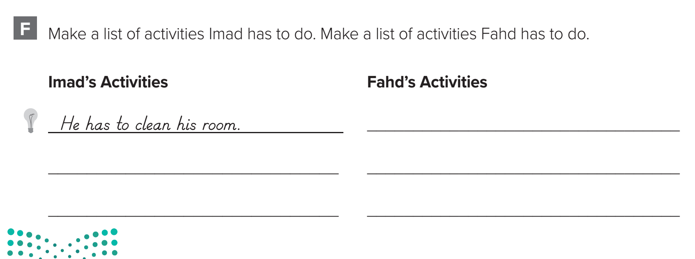
Page: 91
He has to go to football practice
He has to mow the lawn
He has to do his homework
He has to watch his brother.
He has to study for a math test.

Slide 46
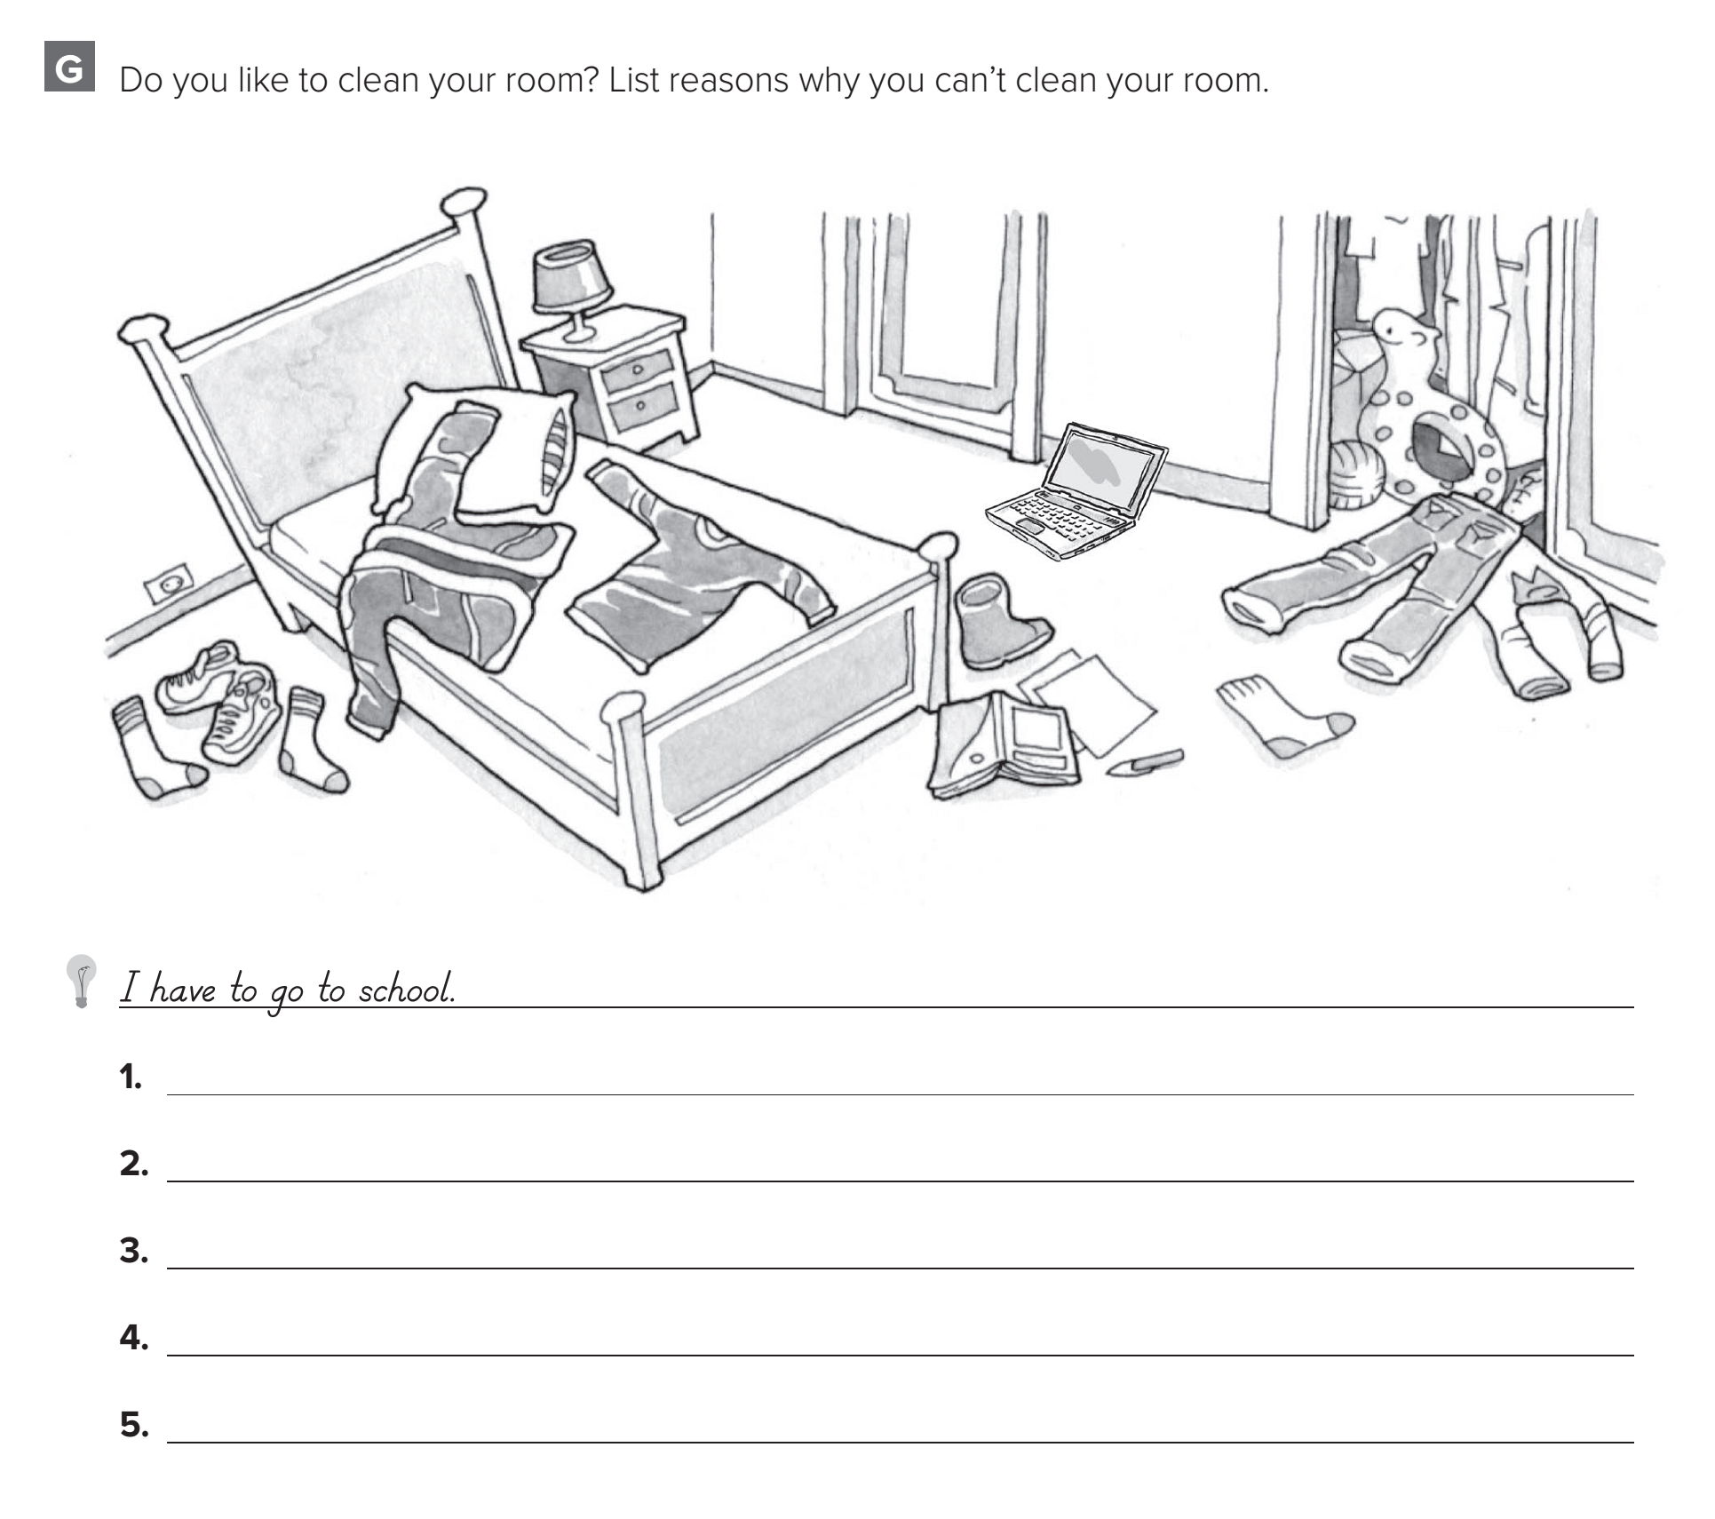
Page: 92
I have to play football.
I have to do my homework.
I have to go shopping.
I have to go swimming.
I have to wash the dishes

Slide 48


Slide 49
Today’s lesson :
5. Listening.
6. Pronunciation.
7. Conversation .

Slide 50
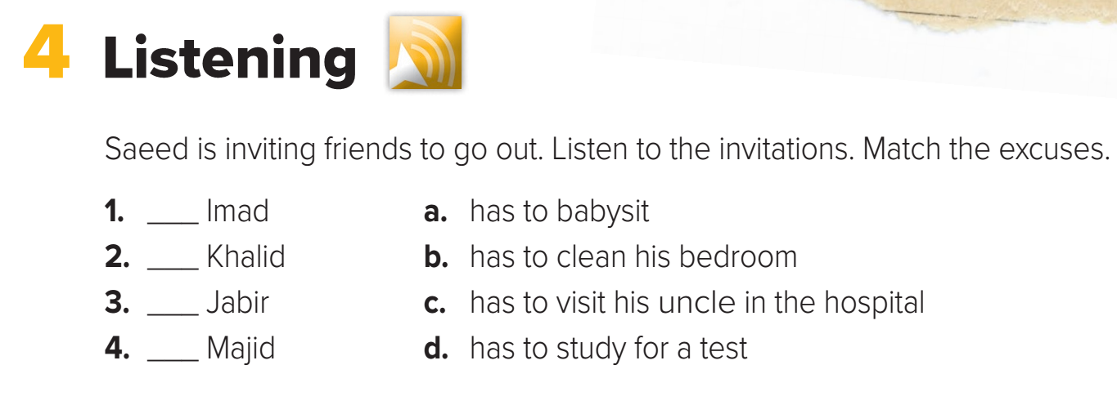
Page: 5
d
a
c
b

Slide 51
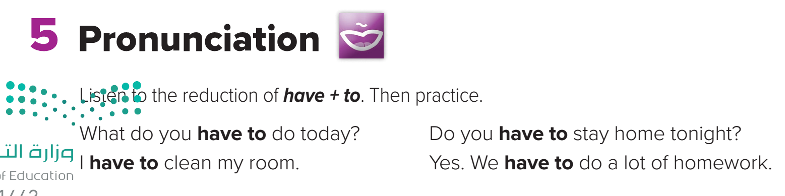
Page: 5

Slide 52
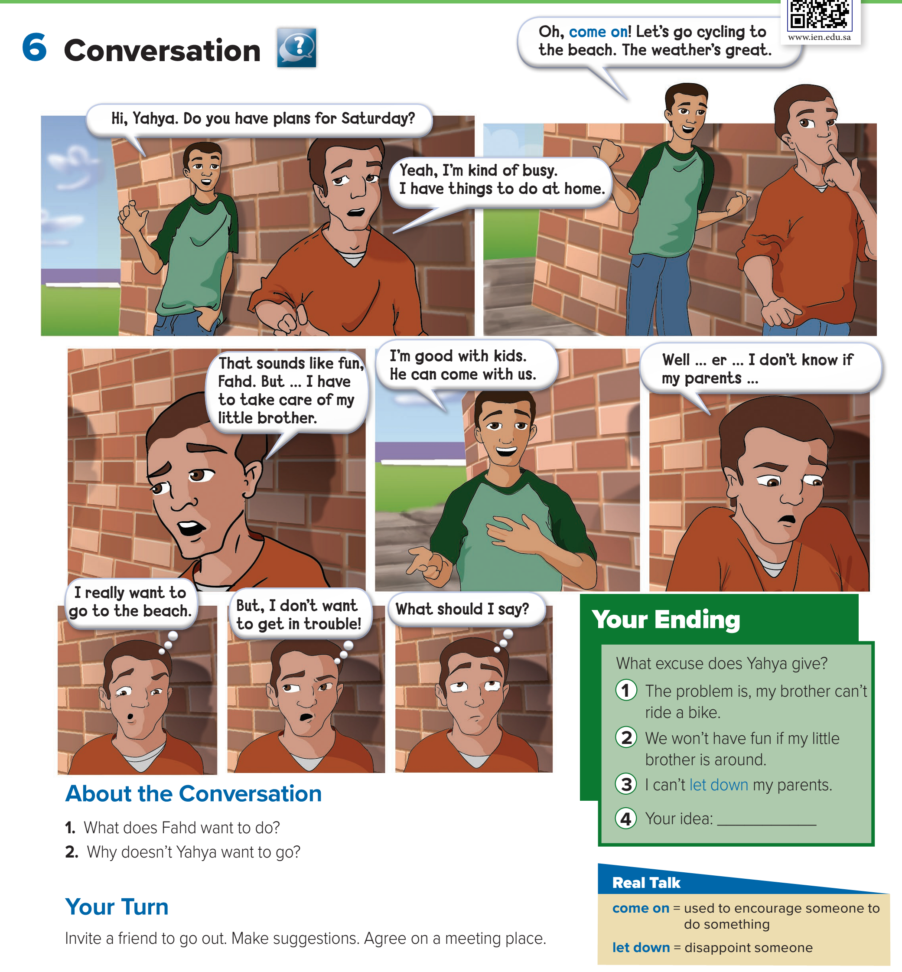
Page: 6

Slide 53
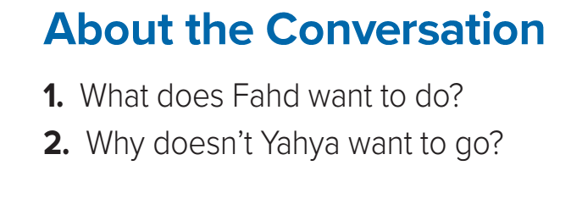
Page: 6
Fahd wants to go cycling to the beach.
Yahya doesn’t want to go because he might get in trouble.

Slide 54
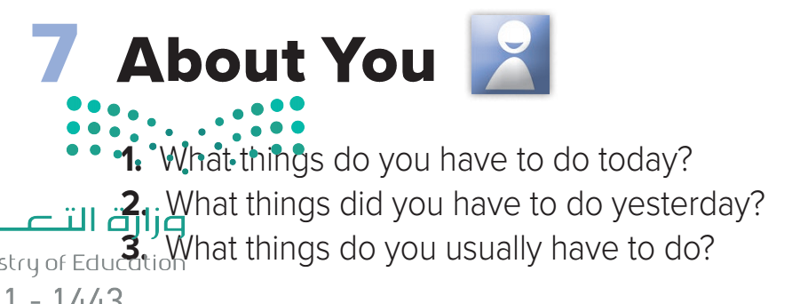
Page: 6

Slide 55


Slide 56
Today’s lesson :
8. Reading .

Slide 57
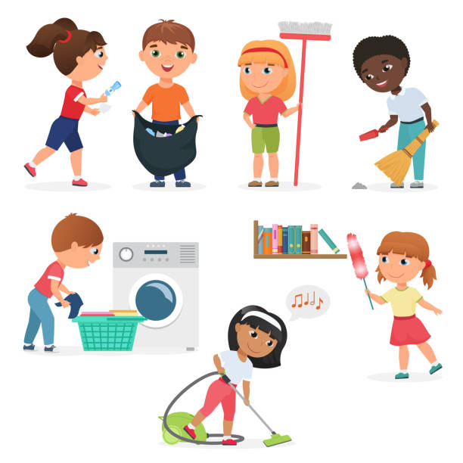
What kinds of chores do you do at home?

Slide 58
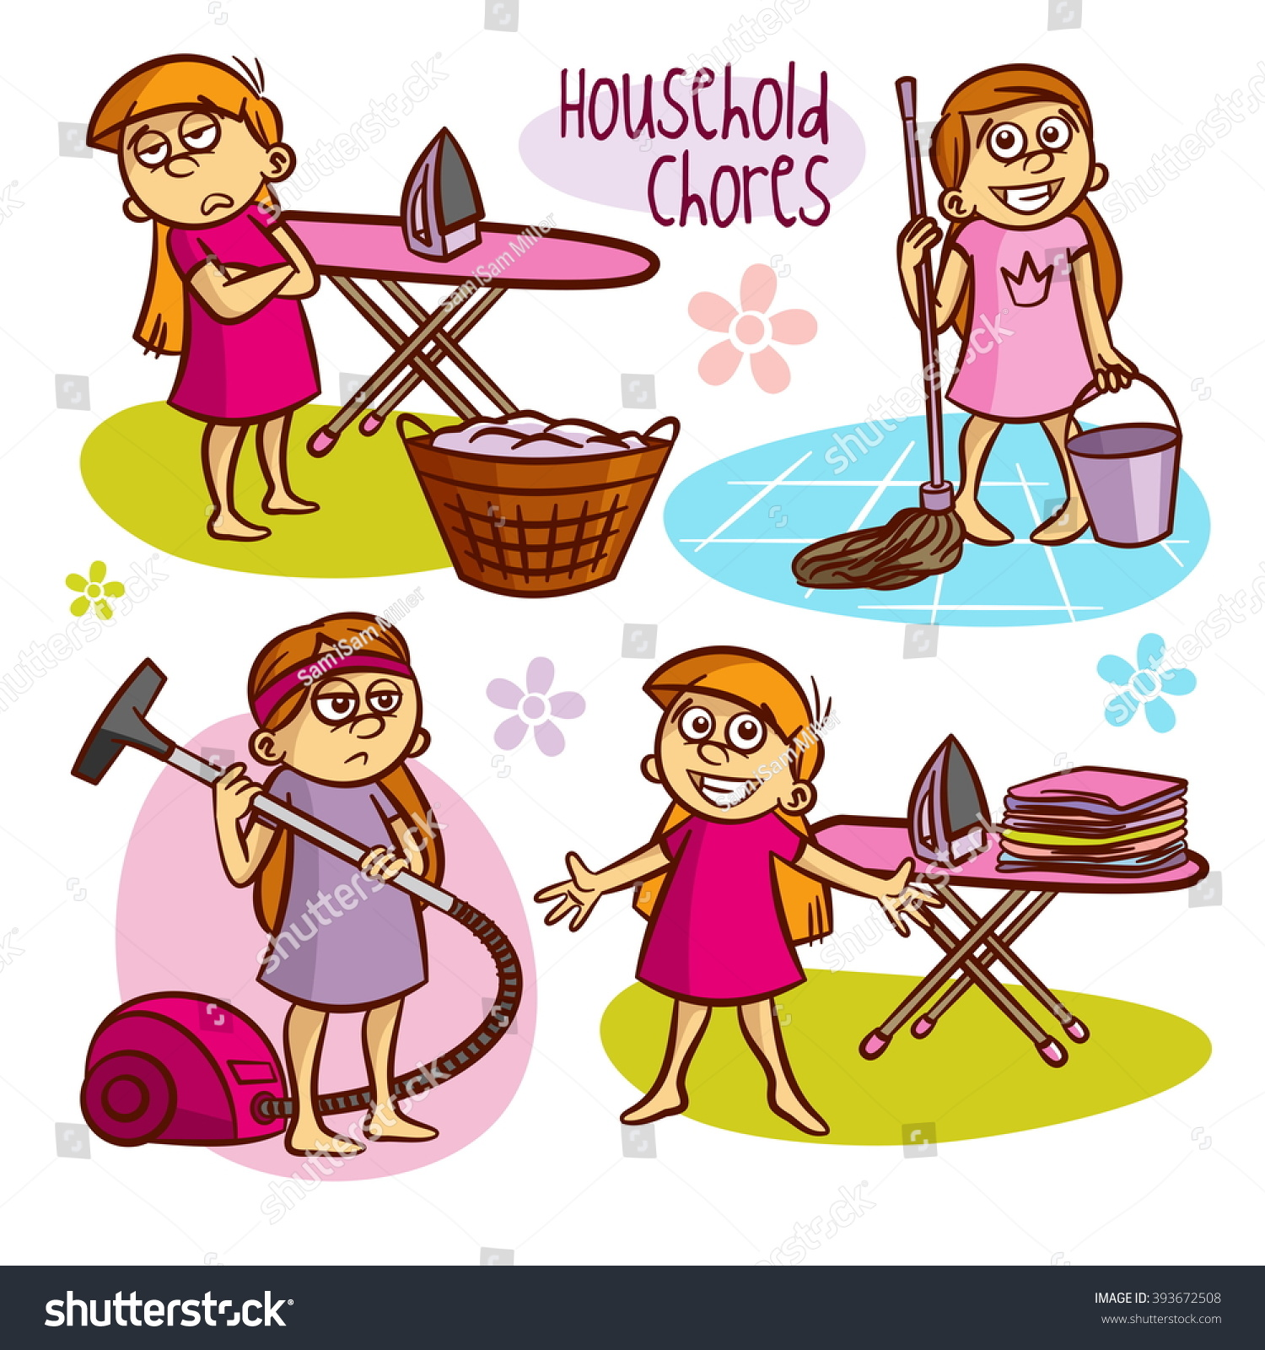
Who decides the chores you do?

Slide 59
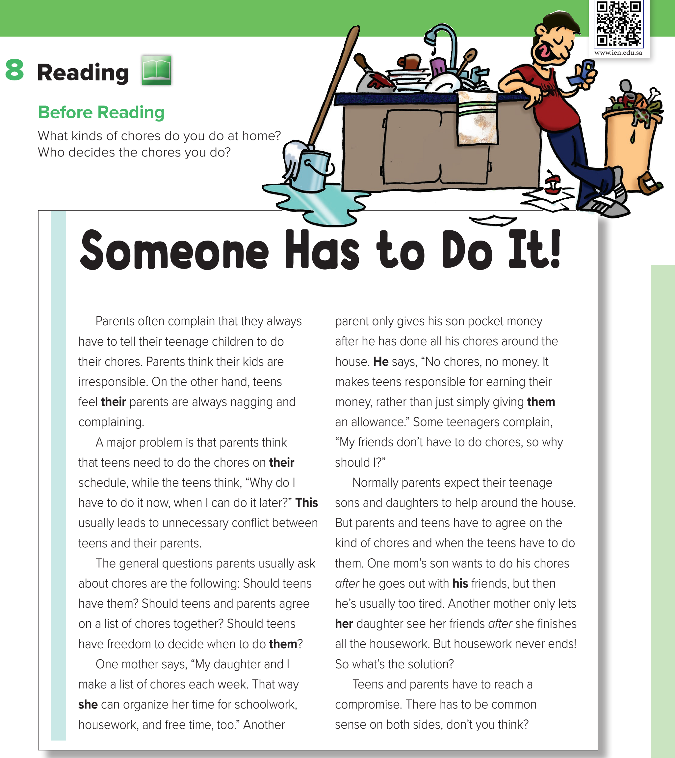
Page: 7
What do you
think the teen’s chores are?
How are his parents going to feel if they come home in the next few minutes?

Slide 60
Page: 7
Why do parents complain?
What is the problem between parents and their kids?
What are the complains ?

Slide 61
Page: 7

Slide 62
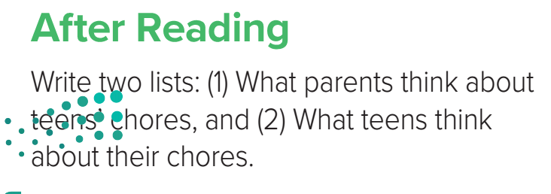


Page: 7

Slide 63


Slide 64
Today’s lesson :
9 . Writing .

Slide 65

Page: 8
housework
daughter
teens’
a parent
parents’
teens
a major problem
son’s
chores
mother’s

Slide 66
Most teenagers don’t want to do chores when their parents expect them to.
Possessive adjective
Object pronoun
Pronouns and possessive adjectives link ideas in sentences.

Slide 67
One mother lets her daughter see her friends after she finishes the housework.
Subject pronoun
Object pronoun
Pronouns help avoid repeating the same word or words.

Slide 68
Some teenagers refuse to do their chores. This can often lead to conflict.
Demonstrative pronoun
Demonstrative pronouns like this and that can refer to one word or a whole idea.

Slide 69

Page: 8

Slide 70

Page: 8
their
They
their
their
their
They
it
them

Slide 71

Page: 8

Slide 72

Page: 92

Slide 73


Slide 74
Today’s lesson :
11. Form , Meaning and Function .

Slide 75

Page: 9

Slide 76


He must stop at the traffic lights.
Obligation and necessity.

Slide 77


forbidden or not allowed.
You mustn’t talk during the test.

Slide 78


They have to wear uniforms at school.

Slide 79

Does she have to go now?
She has an exam . She overslept!

Slide 80
The form of have to changes
to agree with the subject.
She have to sleep early .
She has to sleep early .
Have to
You, I , we , they
Has to
She , he , it

Slide 81
It can also be used in the past tense as had to.
She have to sleep yesterday .
She had to sleep yesterday .
had to
You, I , we , they, She , he , it

Slide 82
It is followed by the
base form of the main verb.
She have to sleeping yesterday .
She had to sleeped.
She had to sleep.
She has to sleep.

Slide 83


You don’t have to iron the socks.
NO obligation; it isn’t necessary.

Slide 84

He didn’t have to work yesterday.
NO obligation; it isn’t necessary.

Slide 85

Page: 9
must / has to
mustn’t
must / has to
must / has to
must / has to
must / has to
mustn’t
mustn’t

Slide 86

Page: 9
must / have to
must / has to
didn’t have to
mustn’t
had to
do have to
must / have to
doesn’t have to
did have to
mustn’t

