Slide 1
There’s No Place Like Home
Student’s Book | Work Book
8 | 2

Slide 2
Mega Goal 4
Unit 1 - There’s No Place Like Home
Grammar
Adjective Order
Prepared by: Essa Al Hussaini
Edited by: Yousef Alshorbaji

Slide 3
Remember from (Mega Goal 3
.. the placement of the adjective?
Position of Adjectives
.. Adj changes for
sgl / plr nouns?
Riyadh is an interesting city.
Riyadh and Dammam are interesting cities.
NO
.. goes
before nouns
after verb to (be)

Slide 4
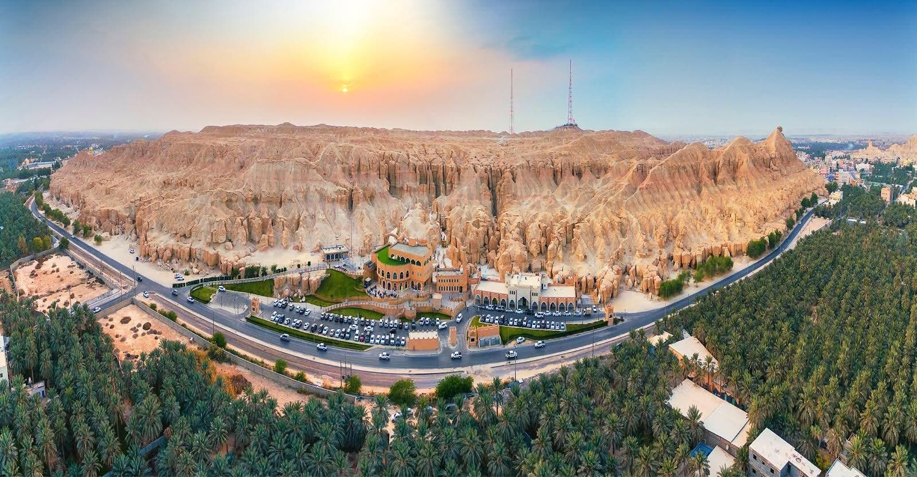
Remember from (Mega Goal 3
.. your words
Al-Ahsa is a/an …………… governorate.
calm
beautiful
big
humid
charming
wonderful
peaceful
amazing
Notes:
Language Builder
the use of the articles a/an in most phrases with singular nouns.
For example:
Saudi Arabia is an interesting place.
Riyadh is a wonderful city.

Slide 5
Opinion
Warm Up
What do you think of this place?
wonderful
exciting
suitable for children
amazing
fantastic

Slide 6
1- Opinion
good
great
nice
lovely
beautiful
unique
impressive
fancy
ugly
bad
terrible
difficult
hard
expensive
cheap
comforting
annoying

Slide 7
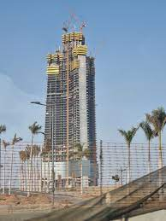
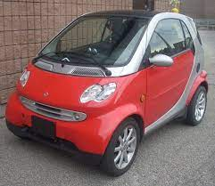
Size & Shape
Warm Up
Describe the following. (Size & Shape)
curved
small
huge
gigantic
straight
tiny
big
round
enormous

Slide 8
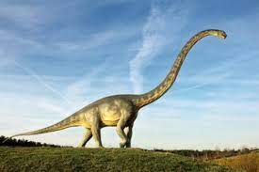
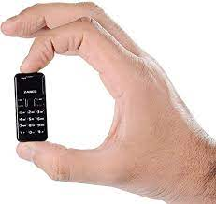
2.1- Size + (Height)
big
large
gigantic
enormous
huge
tall
short
small
tiny

Slide 9
2.2- Shape + (Weight)
straight
round
curved
circular
square
rectangular
triangular
light
heavy

Slide 10
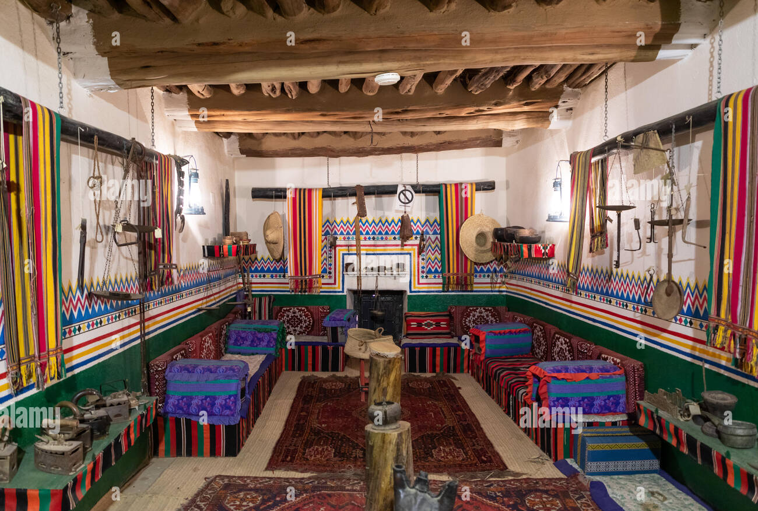
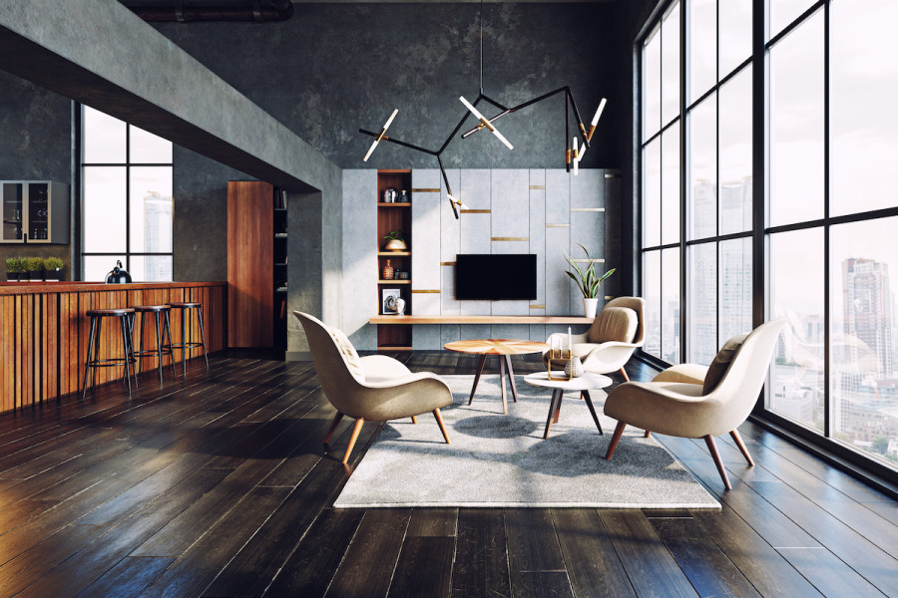
Age
Warm Up
Describe the following. (Age)
new
old
traditional
contemporary
modern
classic
ancient

Slide 11
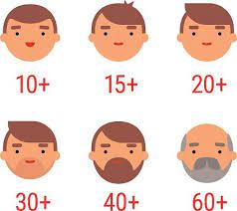
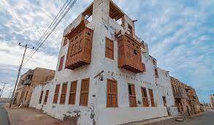
3- Age
old
young
ancient
antique
old-fashioned
traditional
classic
new
modern
contemporary

Slide 12
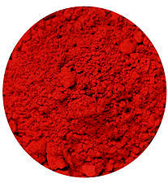
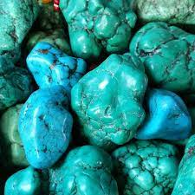
Color
Warm Up
What color is it?
red
blue
turquoise

Slide 13
4- Color
brown
black
white
green
red
blue
orange
turquoise
multicolored

Slide 14
Origin / Country
Warm Up
Describe the following. (Origin)
Chinese
Saudi
European
Japanese

Slide 15
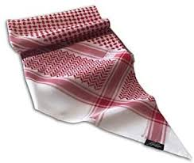
5- Origin (Country / Continent / Nation)
Saudi
Egyptian
Turkish
British
Mexican
Indian
Middle-eastern
Arabian
urban
tribal
Asian
African
European

Slide 16
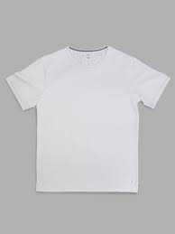
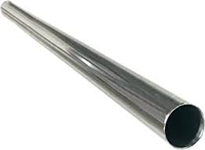
Material
Warm Up
What is it made of? (Material)
paper
cotton
steel

Slide 17
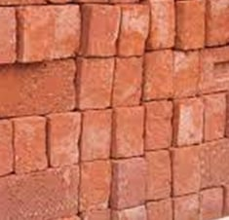
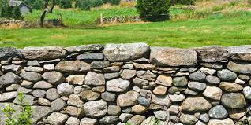
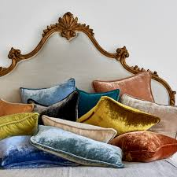
6- Material
glass
plastic
stone
velvet
silk
ceramic
brick

Slide 18
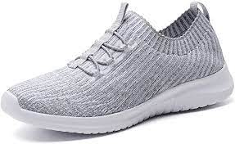
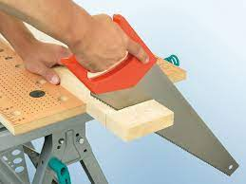
Purpose
Warm Up
What is it made for?
(Purpose)
walking
cleaning
cutting
jogging
sawing
running

Slide 19
7- Purpose
swimming
shopping
commercial
diving
industrial
formal
informal

Slide 20
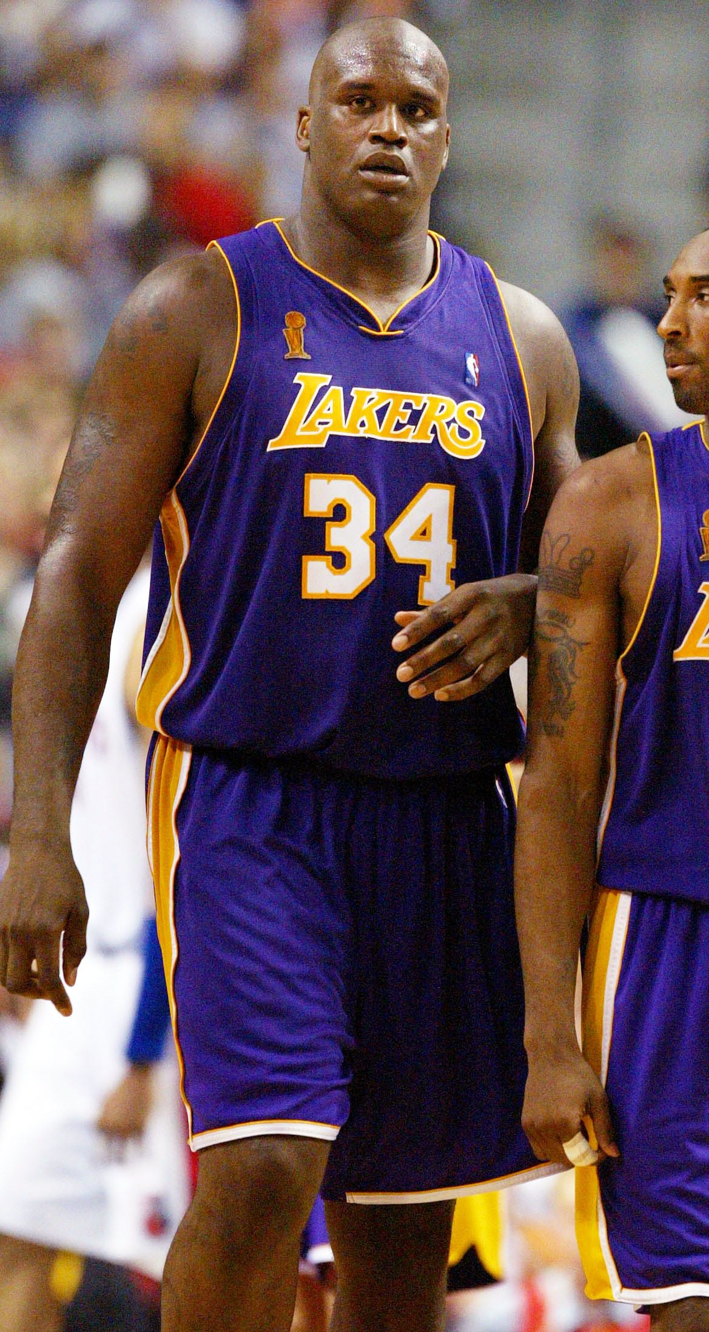
O S&SH A C O M P
Warm Up
Choose the correct order of the adjectives
A black, tall, basketball player.
A tall, black, basketball player.
A basketball, tall, black player.

Slide 21
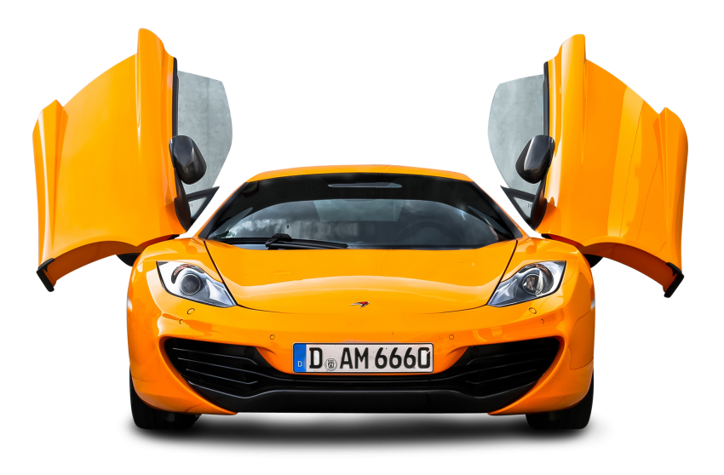
O S&SH A C O M P
Warm Up
Choose the correct order of the adjectives
It’s a beautiful, new, yellow car.
It’s a yellow, new, beautiful car.
It’s a new, beautiful, yellow car.

Slide 22
Adjective Order
HOW to place ADJECTIVE in order?
Opinion
great
Size / Shape
large / round
When you use more than one adjective before a noun,
the adjectives
USUALLY following this order
Age
old / new
color
red
(origin) /
Nationality
Saudi / Brazilian
Material
Usually 1 – 3 adjectives are used to modify a noun at a time
Use a comma between two adjectives
glass / paper
Purpose
swimming / formal
O S&SH A C O M P

Slide 23
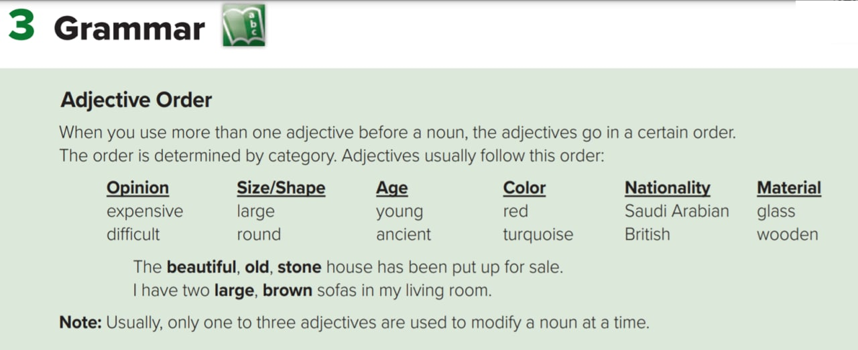
Mega Goal 4 .. SB (8)

Slide 24
Sticker
Adj Order
O | S& SH | A | C | O | M | P
Opinion | Size & Shape | Age | Color | Origin | Material | Purpose

Slide 25
Practice makes Perfect

Slide 26
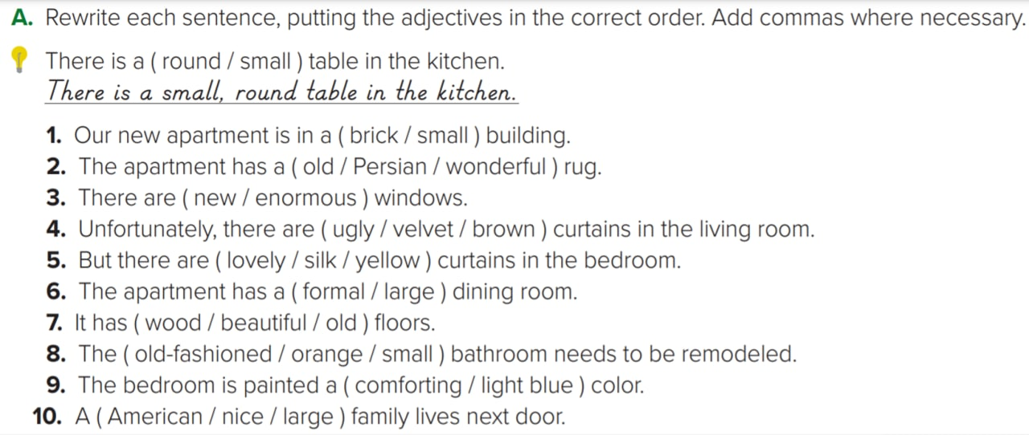
O S&SH A C O M P
Homework
Mega Goal 4 .. SB (8)

Slide 27
Exercise A SB (8)
A- Rewrite each sentence, putting the adjectives in the correct order. Add commas where necessary.
1- Our new apartment is in a ( brick / small ) ______________ building.
2- The apartment has a ( old / Egyptian / wonderful ) ________________ ______________ rug.
3- There are ( new / enormous ) _______________________ windows.
4- Unfortunately, there are ( ugly / velvet / brown) __________________ curtains in the living room.
5- But there are ( lovely / silk / yellow ) ____________________curtains in the bedroom.
O S&SH A C O M P
Homework 2.1
M
S
small, brick
A
O
O
wonderful, old,
Egyptian
A
S
enormous, new
O
M
C
ugly, brown, velvet
O
M
C
lovely, yellow, silk

Slide 28
O S&SH A C O M P
Homework 2.2
P
S
large, formal
6- The apartment has a ( formal / large ) _______________ dining room.
7- It has ( wood / beautiful / old ) _________________________ floors.
8- The (old-fashioned / orange / small) _________________________ bathroom needs to be remodeled.
9- The bedroom is painted a ( comforting / light blue )_______________
______________ color.
10- A ( American / nice / large ) ________________________ family lives next door.
M
O
A
beautiful, old, wood
A
C
S
small , old-fashioned, orange
O
C
comforting,
light blue
O
O
S
nice , large, American

Slide 29
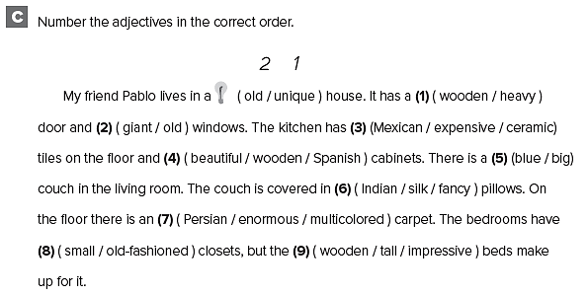
O S&SH A C O M P
2 1
1 2
2 1 3
Mega Goal 4 .. WB (2)
1 3 2
2 1
2 3 1
3 1 2
1 2
3 2 1

