Slide 1
Mega Goal 1.2
Unit 3 - You’ve Got Mail
L. 3 GRAMMAR

Slide 2
Vocabulary
Recall
to say sorry
bring from another country
very important
Let me stay in your home
apologize
import
urgent
put me up
supplier
soaked
import
advantage
apologize
Dear Sir,
inconvenience
put me up
urgent
cause problem or worry
benefit; good
a person who provides something
Extremely wet
inconvenience
advantage
soaked
supplier

Slide 3
Lesson Goals
Identify the correct verb form after the preposition.
Use the correct preposition for the verb.
Use the correct preposition for the adjective.
Build a correct sentence with (although and even though).
Write the correct word form after (in spite of).
Use the correct verb tense with (as soon as, when).
Form a sentence with (so).

Slide 4
Let’s know what you know
Classify
car
playing
in
about
reading
of
play
eat
to
book
leg
sending
on
teacher
think
prepositions | gerunds | verbs | Nouns
car
play
playing
in
book
eat
reading
about
leg
think
sending
to
teacher
of
on

Slide 5
Page: 34

Slide 6
1
Preposition + Gerund
Prepositions?
2
to for of on in about against
Page: 102
Gerund?
a verbal that ends in -ing and functions as a noun
verb + ing = noun
wear ➔ wearing
go ➔ going
appply ➔ applying
3
4

Slide 7
Some verbs are usually followed by certain prepositions
Preposition + Gerund
I apologize for arriving late.
I decided against wearing a uniform.
I look forward to meeting you personally.
I insist on paying for our lunch.
I’m thinking of moving to a new house soon.
I succeeded in getting into college.
I’m dreaming of going on vacation.
I asked about applying for a job.
Prepositions?
to for of on in about against
Gerund?
a verbal that ends in -ing and functions as a noun
verb + ing = noun
wear ➔ wearing
go ➔ going
apply ➔ applying

Slide 8
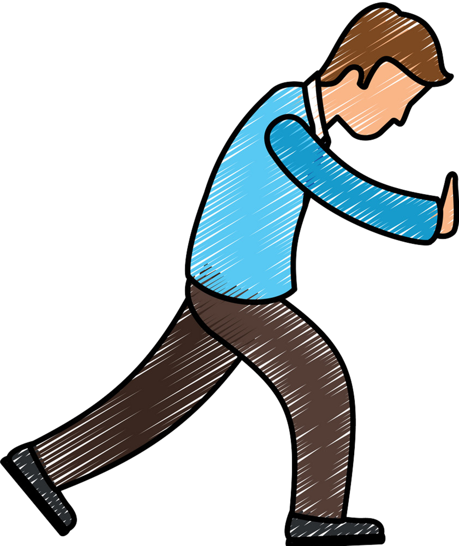
Some verbs are usually followed by certain prepositions
Preposition + Gerund
Prepositions?
I apologize for arriving late.
I decided against wearing a uniform.
I look forward to meeting you personally.
I insist on paying for our lunch.
I’m thinking of moving to a new house soon.
I succeeded in getting into college.
I’m dreaming of going on vacation.
I asked about applying for a job.
to for of on in about against
Gerund?
a verbal that ends in -ing and functions as a noun
verb + ing = noun
wear ➔ wearing
go ➔ going
apply ➔ applying

Slide 9
Preposition + Gerund
apologized to? apologized for?
noun
Some verbs are usually followed by certain prepositions
I apologized to Ali.
I apologized to him.
I apologized for losing your pen.
I apologized for forgetting her birthday.
Prepositions?
pronoun
to for of on in about against
I apologize for arriving late.
I decided against wearing a uniform.
I look forward to meeting you personally.
I insist on paying for our lunch.
I’m thinking of moving to a new house soon.
I succeeded in getting into college.
I’m dreaming of going on vacation.
I asked about applying for a job.
Gerund?
gerund
a verbal that ends in -ing and functions as a noun
verb + ing = noun
wear ➔ wearing
go ➔ going
apply ➔ applying

Slide 10
Preposition + Gerund
apologized to? apologized for?
noun
Some verbs are usually followed by certain prepositions
I apologized to Ali.
I apologized to him.
I apologized for losing your pen.
I apologized for forgetting her birthday.
Prepositions?
pronoun
to for of on in about against
I apologize for arriving late.
I decided against wearing a uniform.
I look forward to meeting you personally.
I insist on paying for our lunch.
I’m thinking of moving to a new house soon.
I succeeded in getting into college.
I’m dreaming of going on vacation.
I asked about applying for a job.
Gerund?
gerund
a verbal that ends in -ing and functions as a noun
verb + ing = noun
wear ➔ wearing
go ➔ going
apply ➔ applying

Slide 11
Preposition + Gerund
Some adjectives are followed by certain prepositions
apologized to? apologized for?
Some verbs are usually followed by certain prepositions
Prepositions?
I’m tired of waiting for an answer.
I’m used to having coffee at breakfast.
noun
to for of on in about against
I apologized to Ali.
I apologized to him.
I apologized for losing your pen.
I apologized for forgetting her birthday.
I apologize for arriving late.
I decided against wearing a uniform.
I look forward to meeting you personally.
I insist on paying for our lunch.
I’m thinking of moving to a new house soon.
I succeeded in getting into college.
I’m dreaming of going on vacation.
I asked about applying for a job.
pronoun
Gerund?
a verbal that ends in -ing and functions as a noun
verb + ing = noun
wear ➔ wearing
go ➔ going
apply ➔ applying
gerund

Slide 12
Preposition + Gerund
Some adjectives are followed by certain prepositions
apologized to? apologized for?
Some verbs are usually followed by certain prepositions
Prepositions?
I’m tired of waiting for an answer.
I’m used to having coffee at breakfast.
noun
to for of on in about against
I apologized to Ali.
I apologized to him.
I apologized for losing your pen.
I apologized for forgetting her birthday.
I apologize for arriving late.
I decided against wearing a uniform.
I look forward to meeting you personally.
I insist on paying for our lunch.
I’m thinking of moving to a new house soon.
I succeeded in getting into college.
I’m dreaming of going on vacation.
I asked about applying for a job.
pronoun
Gerund?
a verbal that ends in -ing and functions as a noun
verb + ing = noun
wear ➔ wearing
go ➔ going
apply ➔ applying
gerund

Slide 13
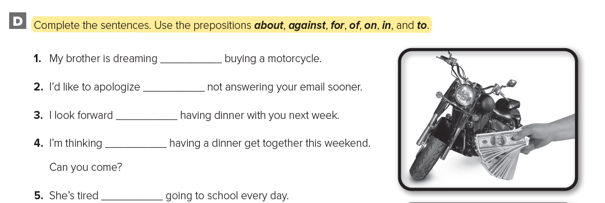
Workbook - 98
Preposition + Gerund
Some verbs are usually followed by certain prepositions
apologized to? apologized for?
noun
Some adjectives are followed by certain prepositions
I apologized to Ali.
I apologized to him.
I apologized for losing your pen.
I apologized for forgetting her birthday.
I apologize for arriving late.
I decided against wearing a uniform.
I look forward to meeting you personally.
I insist on paying for our lunch.
I’m thinking of moving to a new house soon.
I succeeded in getting into college.
I’m dreaming of going on vacation.
I asked about applying for a job.
pronoun
I’m tired of waiting for an answer.
I’m used to having coffee at breakfast.
gerund

Slide 14
Workbook - 98
Preposition + Gerund
Some verbs are usually followed by certain prepositions
apologized to? apologized for?
noun
Some adjectives are followed by certain prepositions
I apologized to Ali.
I apologized to him.
I apologized for losing your pen.
I apologized for forgetting her birthday.
I apologize for arriving late.
I decided against wearing a uniform.
I look forward to meeting you personally.
I insist on paying for our lunch.
I’m thinking of moving to a new house soon.
I succeeded in getting into college.
I’m dreaming of going on vacation.
I asked about applying for a job.
pronoun
I’m tired of waiting for an answer.
I’m used to having coffee at breakfast.
gerund

Slide 15
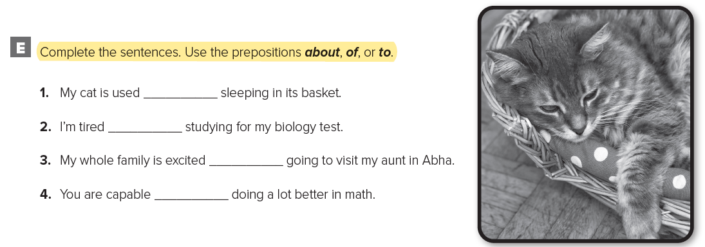
Workbook - 98
Preposition + Gerund
apologized to? apologized for?
Some adjectives are followed by certain prepositions
noun
of
I apologized to Ali.
I apologized to him.
I apologized for losing your pen.
I apologized for forgetting her birthday.
for
pronoun
I’m tired of waiting for an answer.
I’m used to having coffee at breakfast.
to
gerund
of
of

Slide 16
Workbook - 98
to
of
about
of

Slide 17
although even though in Spite Of
have similar meanings
although - even though
introduce a clause that has a subject and a verb
Preposition + Gerund
HOMEWOEK
Although it rained, we enjoyed the vacation
Even though it rained, we enjoyed the vacation
Make your own sentence
We enjoyed the vacation although it rained,
we enjoyed the vacation even though it rained,

Slide 18
although even though in Spite Of
have similar meanings
in spite of
although - even though
followed by a noun or gerund.
introduce a clause that has a subject and a verb
HOMEWOEK - 99
In spite of the rain, we enjoyed the vacation
In spite of raining, we enjoyed the vacation
Although it rained, we enjoyed the vacation
Even though it rained, we enjoyed the vacation
we enjoyed the vacation in spite of the rain.
we enjoyed the vacation in spite of raining.
We enjoyed the vacation although it rained.
we enjoyed the vacation even though it rained.

Slide 19
although even though in Spite Of
have similar meanings
in spite of
although - even though
followed by a noun or gerund.
introduce a clause that has a subject and a verb
HOMEWOEK - 99
In spite of the rain, we enjoyed the vacation
In spite of raining, we enjoyed the vacation
Although it rained, we enjoyed the vacation
Even though it rained, we enjoyed the vacation
we enjoyed the vacation in spite of the rain.
we enjoyed the vacation in spite of raining.
We enjoyed the vacation although it rained.
we enjoyed the vacation even though it rained.

Slide 20
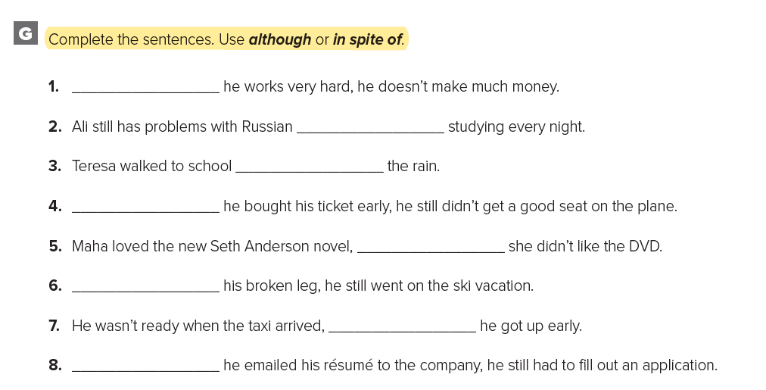
Workbook - 99
although even though in Spite Of
have similar meanings
in spite of
although - even though
followed by a noun or gerund.
introduce a clause that has a subject and a verb
In spite of the rain, we enjoyed the vacation
In spite of raining, we enjoyed the vacation
Although it rained, we enjoyed the vacation
Even though it rained, we enjoyed the vacation
we enjoyed the vacation in spite of the rain.
we enjoyed the vacation in spite of raining.
We enjoyed the vacation although it rained.
we enjoyed the vacation even though it rained.

Slide 21
Workbook - 99
although even though in Spite Of
have similar meanings
in spite of
although - even though
followed by a noun or gerund.
introduce a clause that has a subject and a verb
In spite of the rain, we enjoyed the vacation
In spite of raining, we enjoyed the vacation
Although it rained, we enjoyed the vacation
Even though it rained, we enjoyed the vacation
we enjoyed the vacation in spite of the rain.
we enjoyed the vacation in spite of raining.
We enjoyed the vacation although it rained.
we enjoyed the vacation even though it rained.

Slide 22
Workbook - 99
although even though in Spite Of
Make your own sentence
have similar meanings
in spite of
although - even though
introduce a clause that has a subject and a verb
followed by a noun or gerund.
in spite of
In spite of the rain, we enjoyed the vacation
In spite of raining, we enjoyed the vacation
Although it rained, we enjoyed the vacation
Even though it rained, we enjoyed the vacation
Although
although
we enjoyed the vacation in spite of the rain.
we enjoyed the vacation in spite of raining.
We enjoyed the vacation although it rained,
we enjoyed the vacation even though it rained,
In spite of

Slide 23
as soon as - when
right away, or immediately after
In spite of Corona pandemic, the Ministry of Education continues to provide services to students through Madrasati platform and Ein Doros educational channels.
Thanks to the Kingdom of Saudi Arabia's government’s unlimited assistance.
Present tense is used even though the verbs tells about future
I’ll tell you as soon as I know.
I’ll call you when I arrive.
I’ll ask him when he calls.
I’ll tell you as soon as I will know.
I’ll ask him when he call.

Slide 24
Workbook - 99
as soon as - when
right away, or immediately after
Present tense is used even though the verbs tells about future
I’ll tell you as soon as I know.
I’ll call you when I arrive.
I’ll ask him when he calls.
I’ll tell you as soon as I will know.
I’ll ask him when he call.

Slide 25
Workbook - 99
as soon as - when
right away, or immediately after
Present tense is used even though the verbs tells about future
I’ll tell you as soon as I know.
I’ll call you when I arrive.
I’ll ask him when he calls.
I’ll tell you as soon as I will know.
I’ll ask him when he call.

Slide 26
Workbook - 100
as soon as - when
right away, or immediately after
Present tense is used even though the verbs tells about future
hear
arrives
I’ll tell you as soon as I know.
I’ll call you when I arrive.
I’ll ask him when he calls.
I’ll tell you as soon as I will know.
I’ll ask him when he call.
get
take
Make your own sentence

Slide 27
So … (That)
The Messenger of Allah (PBUH) as stating that Allah say :”I am present when my servant thinks of me, and I am with him when he remembers me. If he remembers me inwardly I shall remember him inwardly, and if he remembers me among people I shall remember him among people who are better than they.”

Slide 28
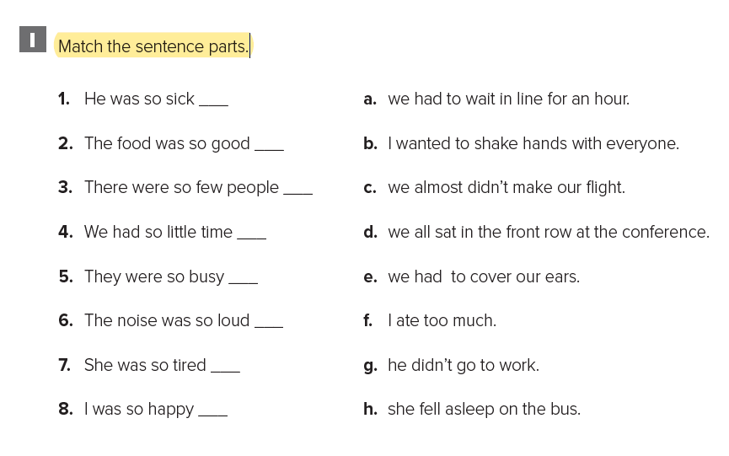
Workbook - 100
as soon as - when
So … (That)
Workbook - 100
right away, or immediately after
Use so with an adjective or with many, much, few, or little to express result or degree.
Present tense is used even though the verbs tells about future
g
hear
f
d
arrives
The noise was so loud (that) we could hardly hear ourselves talk.
There were so many cars (that) we couldn’t find a place to park.
c
I’ll tell you as soon as I know.
I’ll call you when I arrive.
I’ll ask her when she arrives.
I’ll tell you as soon as I will know.
I’ll ask her when she arrive.
get
a
take
Make your own sentence
e
h
b

Slide 30
CHOOSE
for taking
Ali apologizes ______ my book.
for take
to take
for
My mother insists _____ calling her every night.
on
about

Slide 31
CHOOSE
about
I am looking forward ________ visiting your relatives next week.
to
of
is used
He ______ getting up early.
uses to
is used to

Slide 32
We had fun at the beach even though the cold weather.
We had fun at the beach in spite of the cold weather.
We had fun at the beach although the cold weather.
Identify the
correct sentence
1
2
3
I went to school although being sick.
In spite I was sick, I went to school.
Even though I was sick, I went to school.
1
2
3
I’ll tell Ali as soon as I got home.
I’ll tell Ali as soon as I get home.
I’ll tell Ali as soon as I’ll get home.
1
2
3

Slide 33
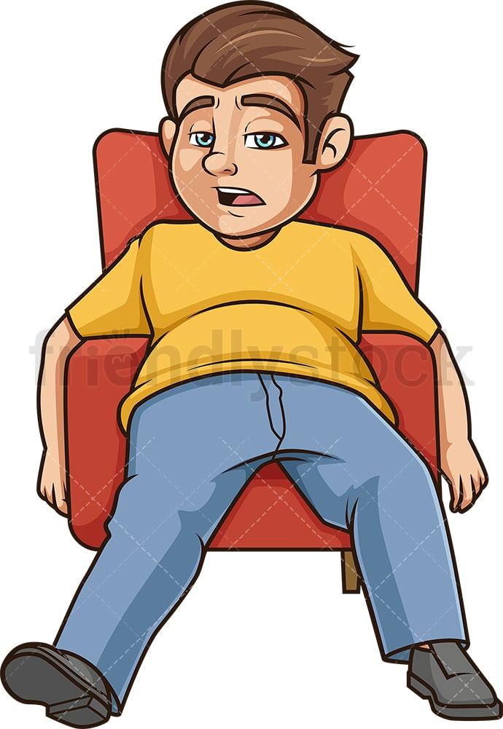
soon as
I
work
finish
when soon
tired
I’ll finish
as I
when
I’ll be
Make a correct sentence
I’ll be
tired
when
I
finish
work.

Slide 34
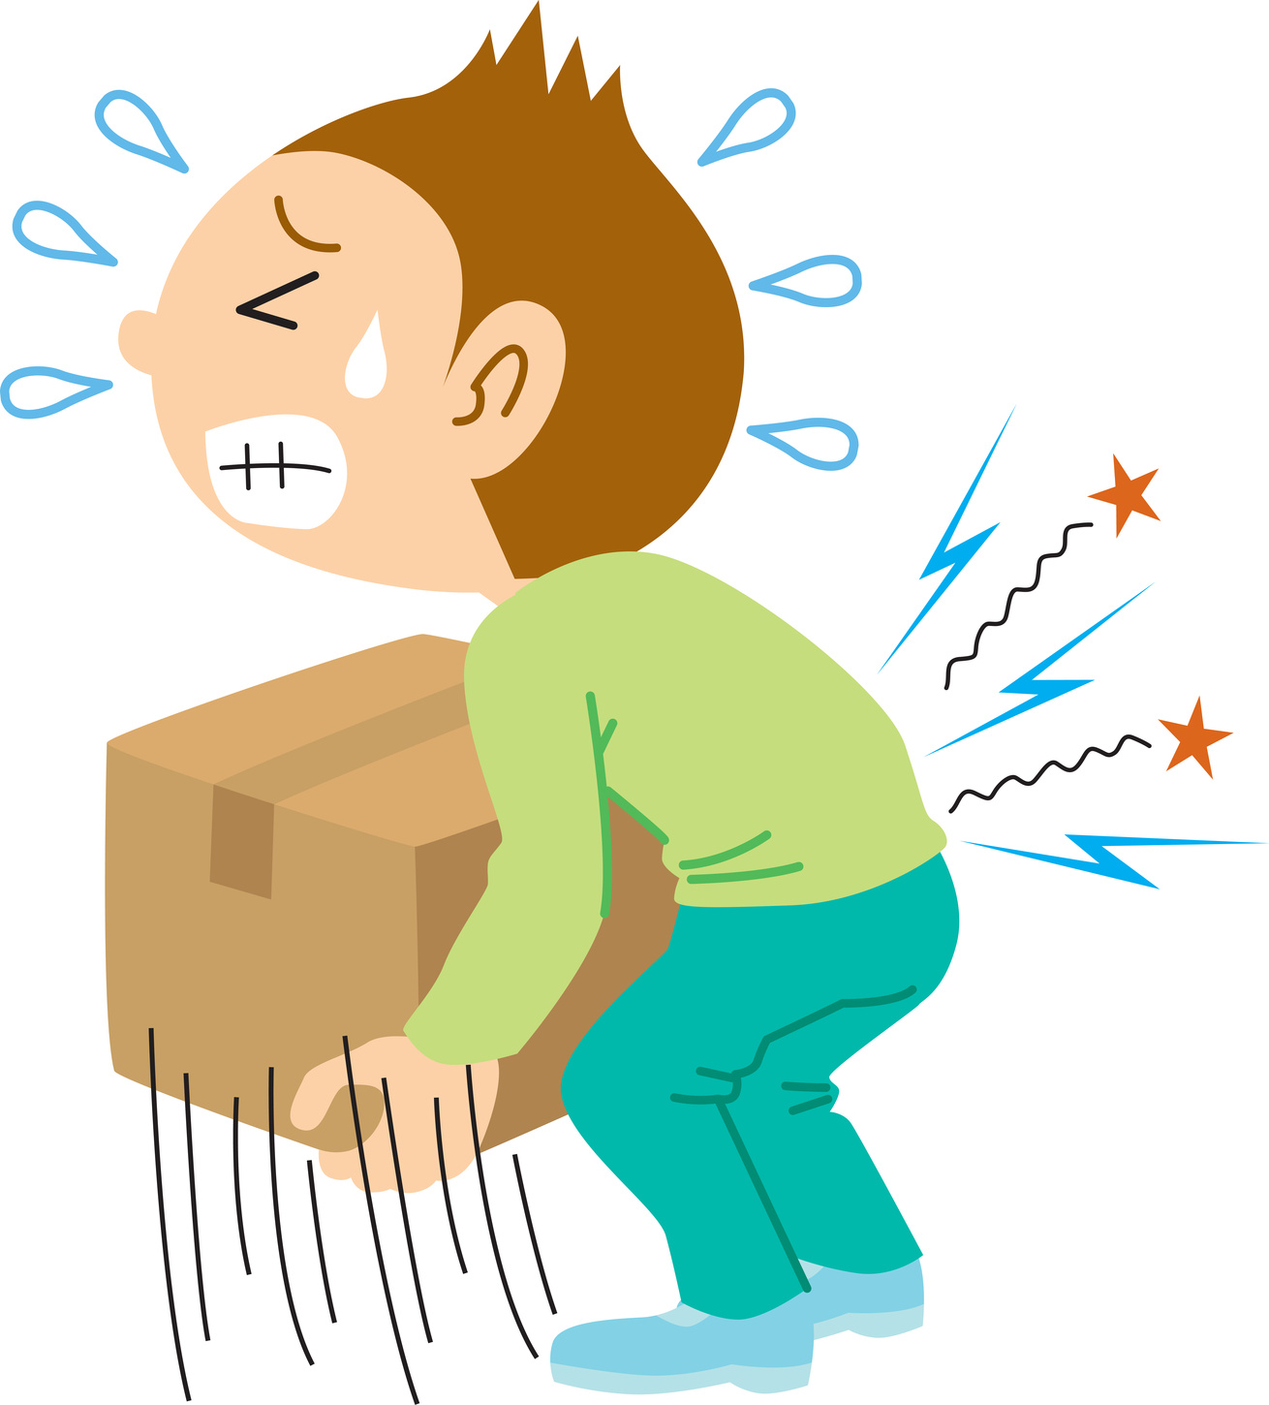
Match to express result // degree
I’ll drop the box.
I am so hungry right now
Oops!!
WRONG
I ate too much.
The box was so heavy
I dropped it.
I can’t wait for lunch.

