Slide 1

Unit 7
Fun on the weekend
Find out time

Slide 2









Slide 3



Discovering

Slide 4
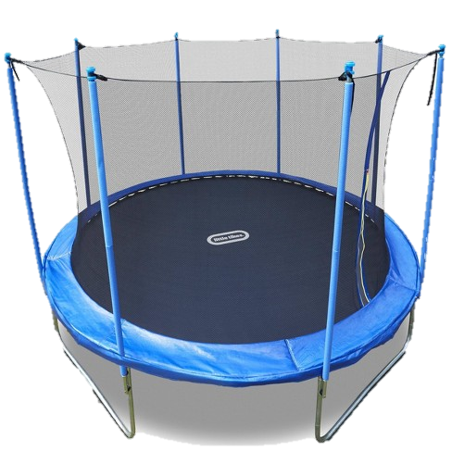
trampoline

Slide 5

DVD

Slide 6
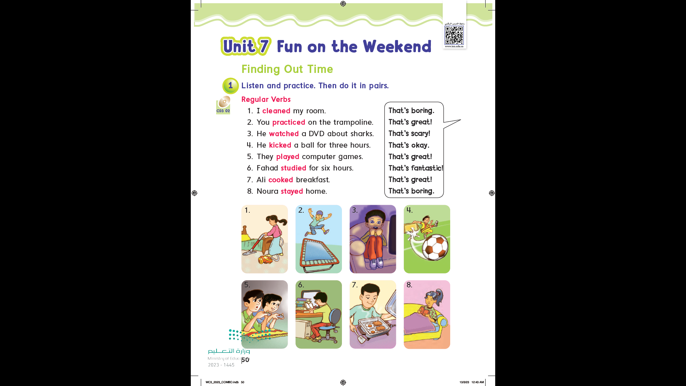

Page 50

Slide 7
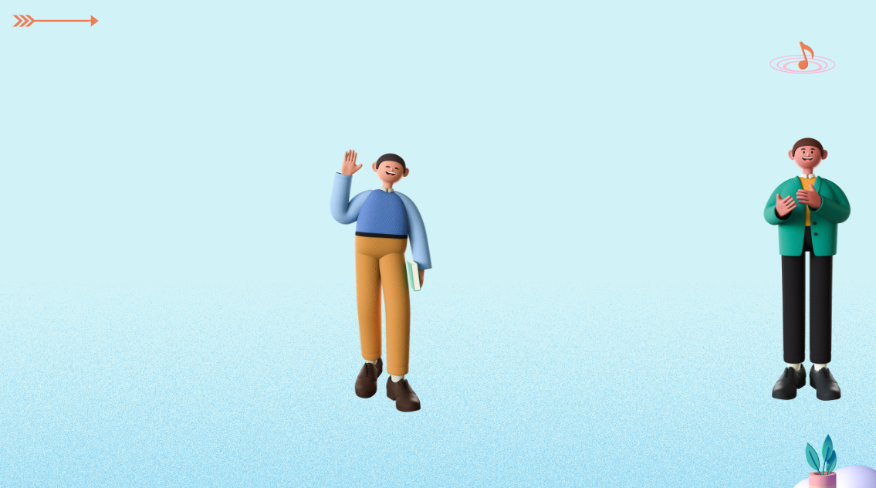
What did you do over the weekend?
Problem solving

Slide 8



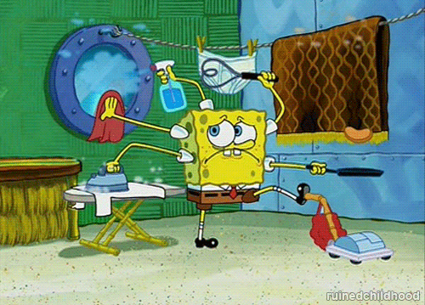
cleaned

Slide 9

Stayed home

Slide 10

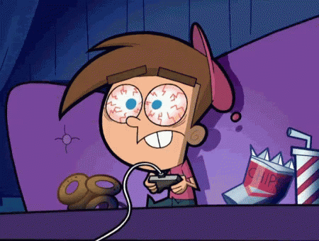
played computer games

Slide 11


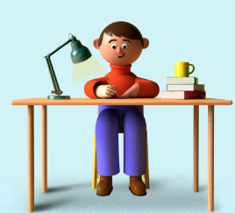
studied

Slide 12
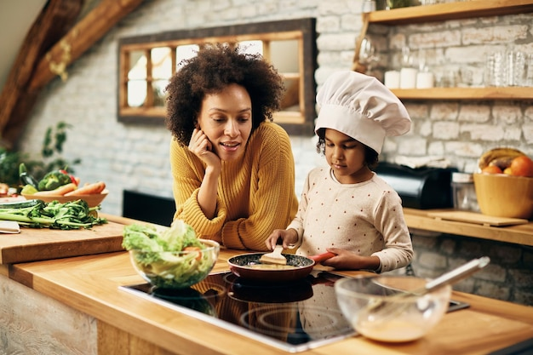
cooked

Slide 13


watched
TV

Slide 14
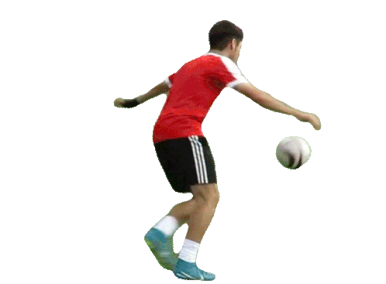
kicked a ball

Slide 15
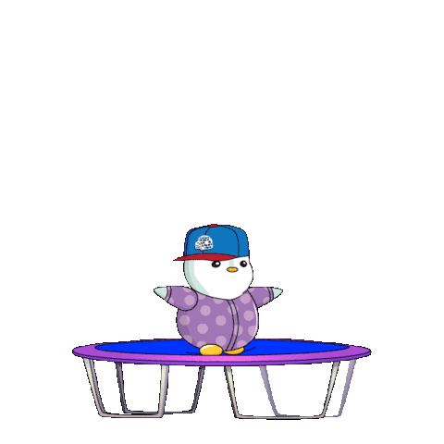


practiced
trampoline

Slide 16
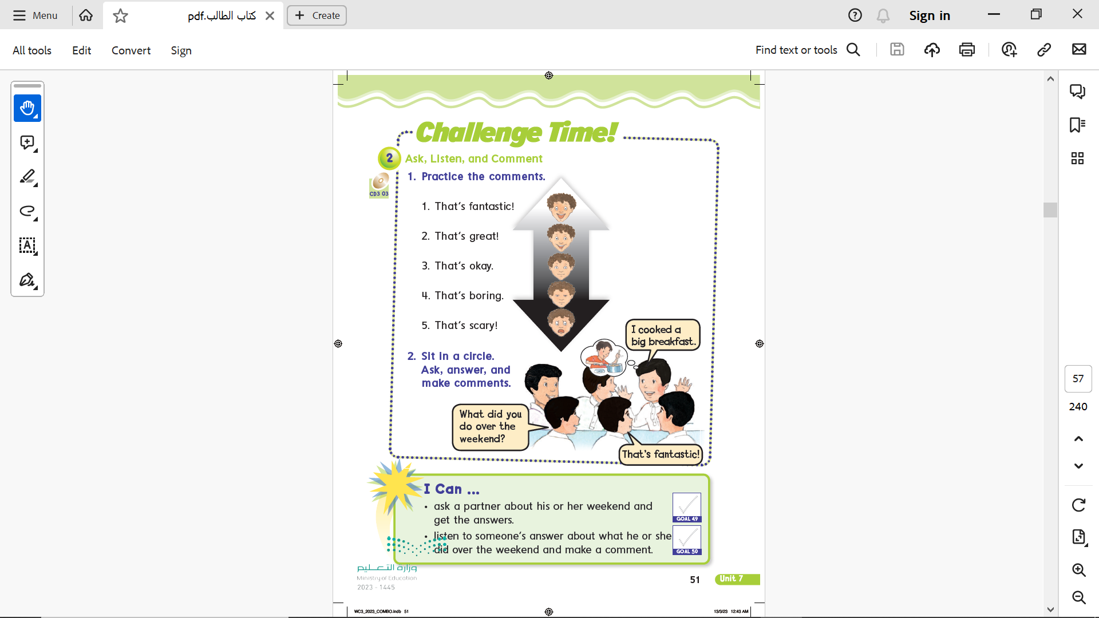
Page 51

Slide 17
Page 51

Slide 18
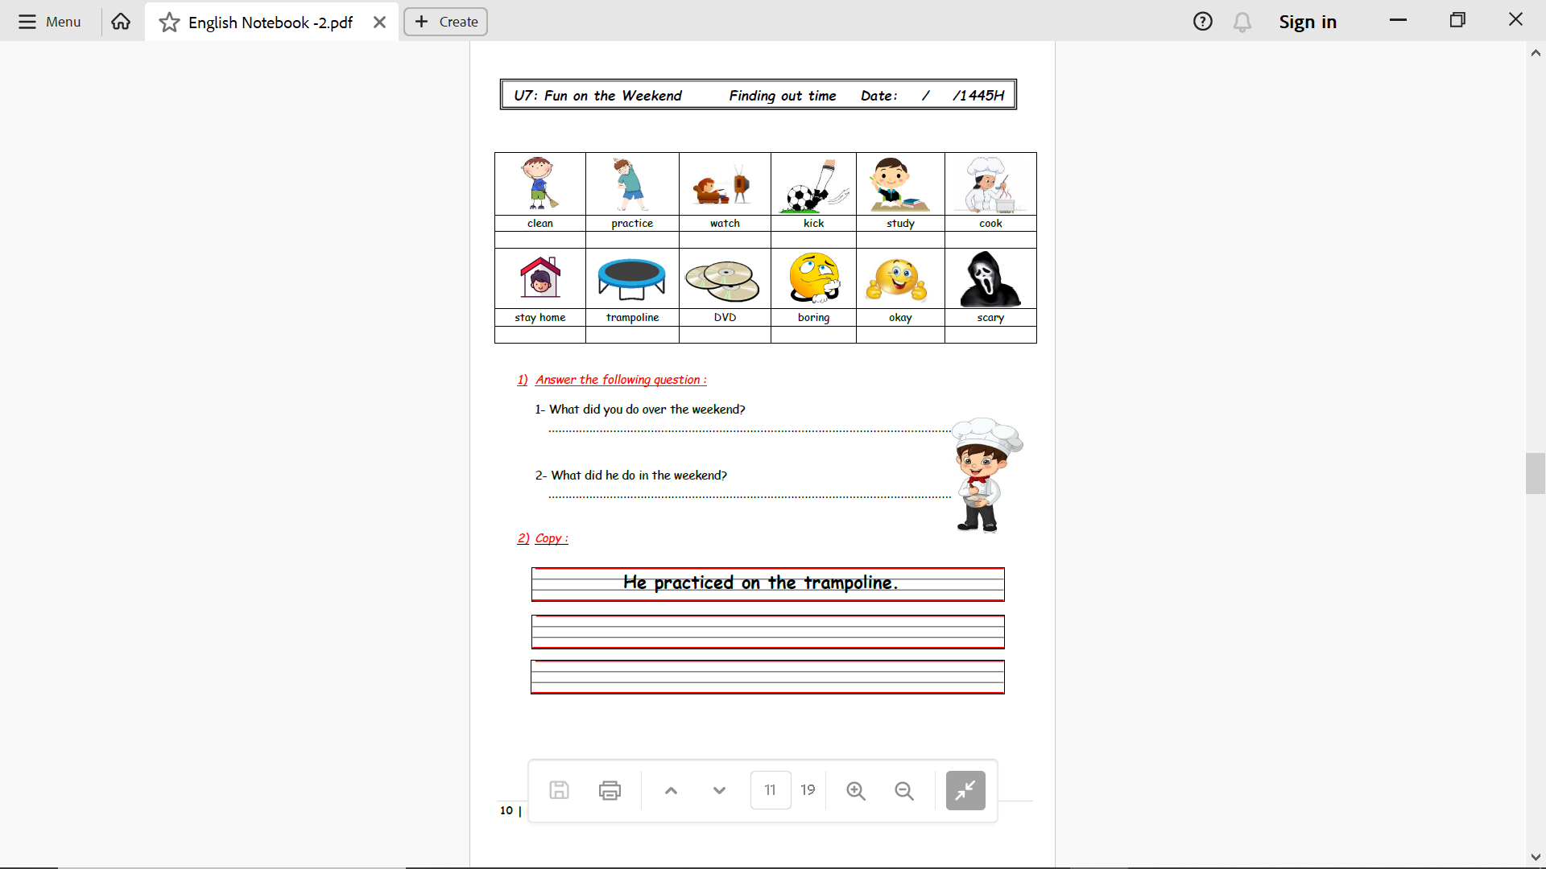
Notebook
Page 10

Slide 19

Homework
Pages 187 & 188

Slide 20
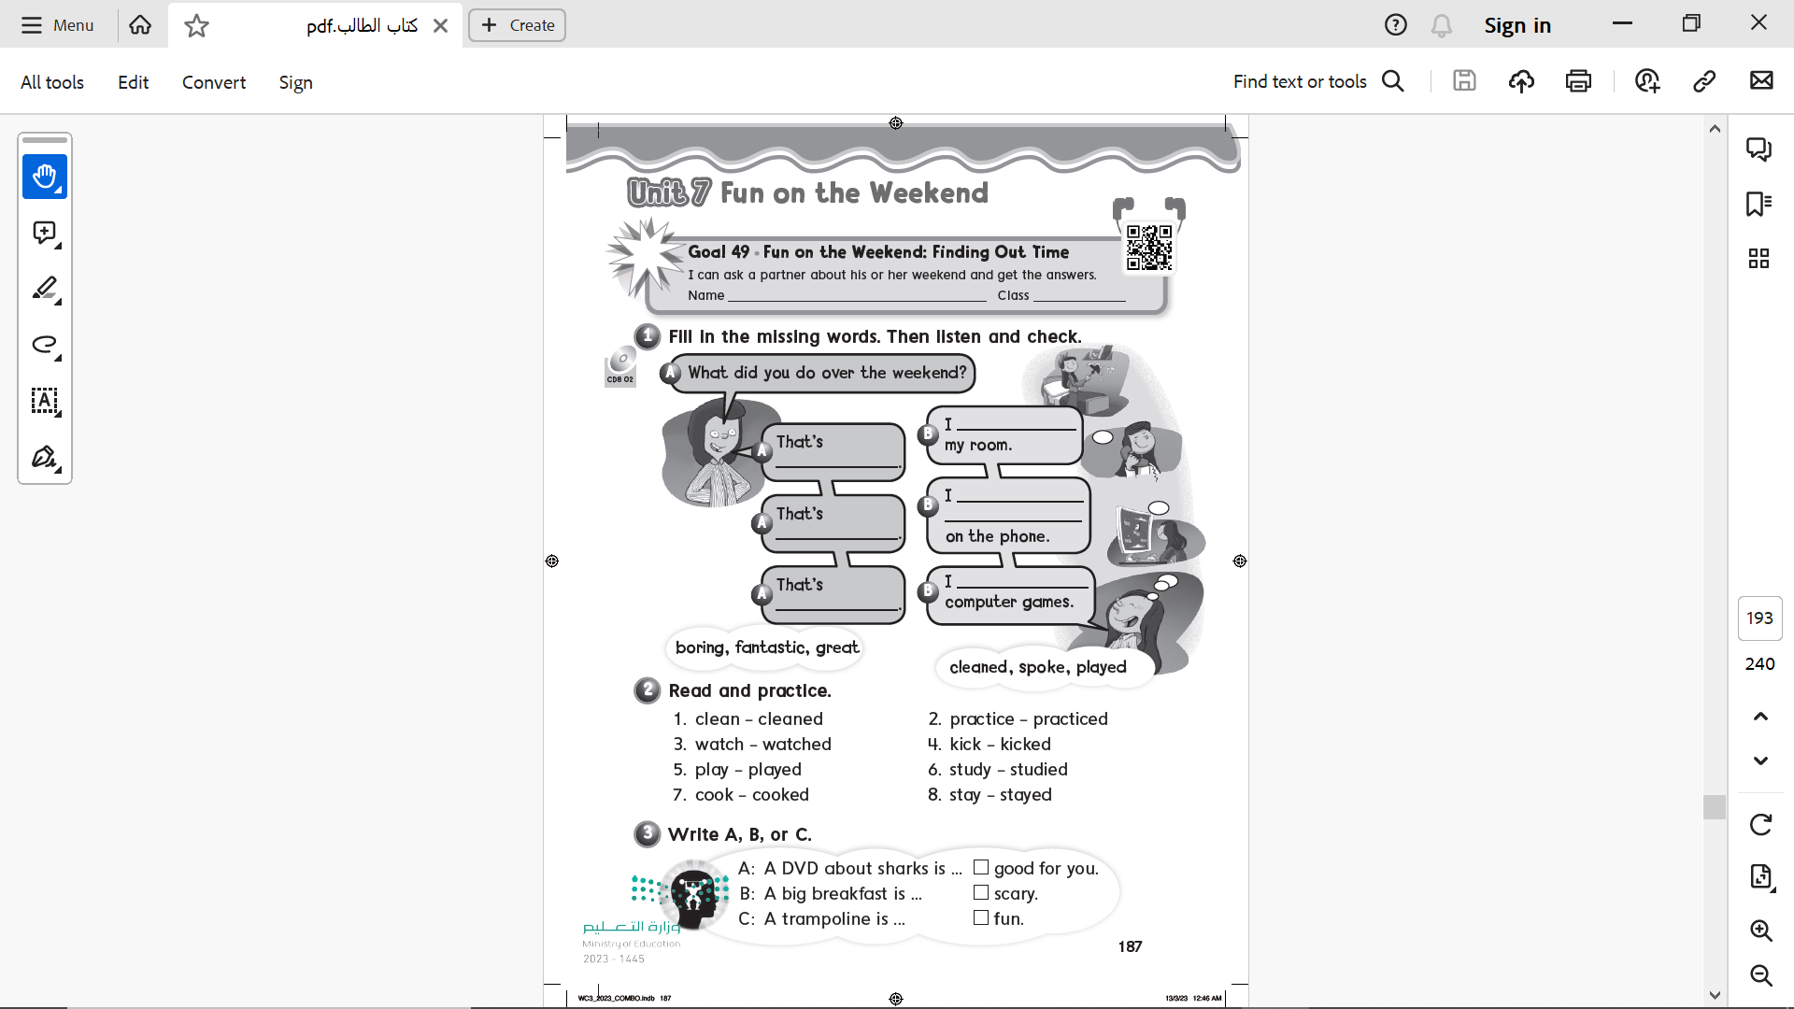
Page 187
cleaned
boring
spoke with my friends
Fantastic
great
played

Slide 21
Page 187
B
A
C

Slide 22
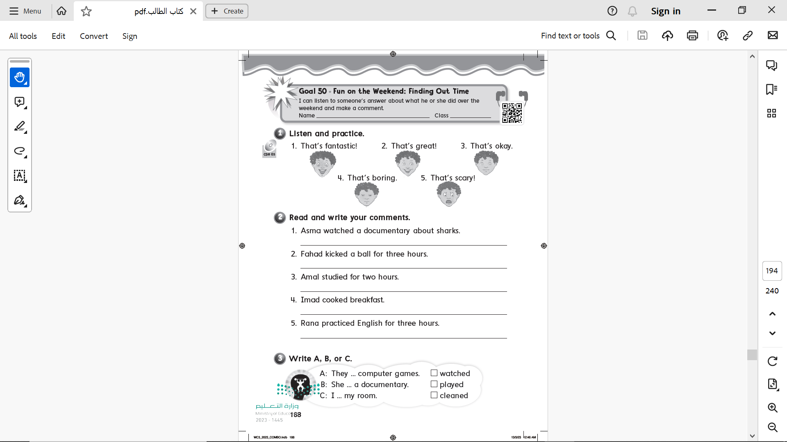
Page 188

Slide 23
Page 188
That’s scary
That’s boring
That’s okay
That’s great
That’s fantastic

Slide 24
Page 188
B
A
C

