Slide 1
Unit 7
Fun on the weekend
Rythms and Reading

Slide 2
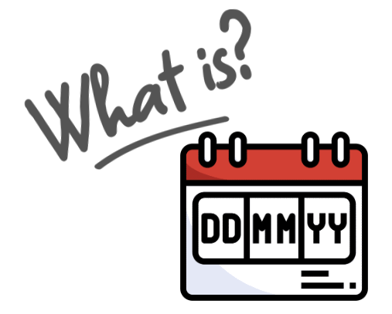

Slide 3
Homework

Slide 4
Page 189

Slide 5
Page 189
I practiced English
she cooked a big breakfast
he kicked football
We stayed home

Slide 6
Page 189
B
C
A

Slide 7
Page 190
8
4
5
1
6
7
3
2

Slide 8
Page 190

Slide 9
Page 190
B
A
C

Slide 10
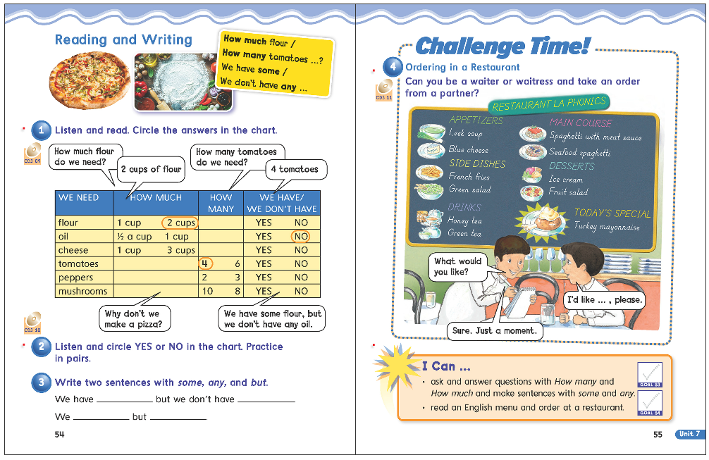
54
55

Slide 12
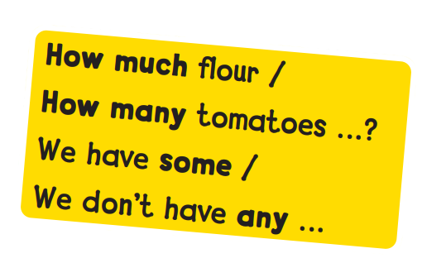

Slide 13
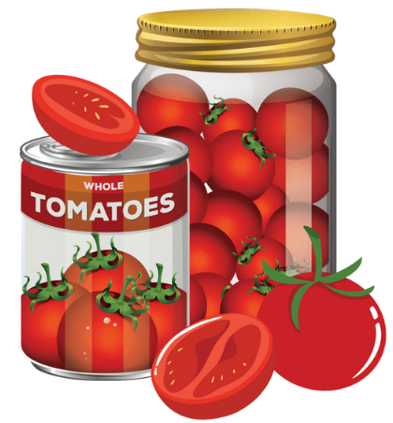
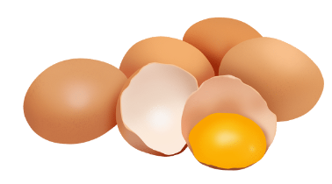

Slide 14
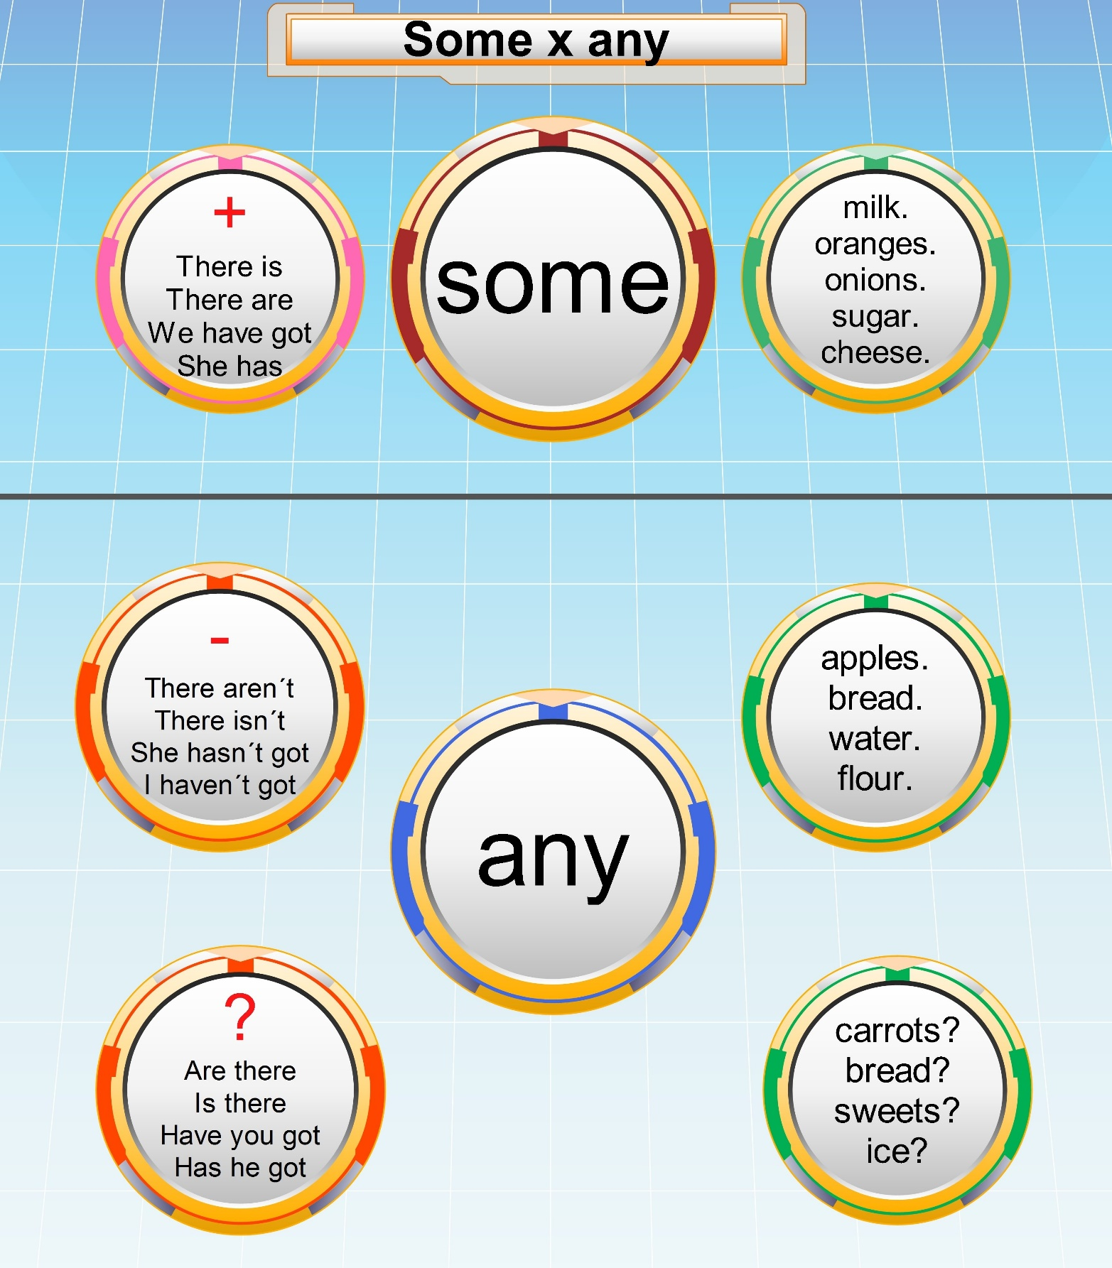

Slide 15
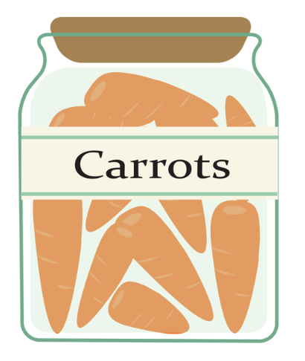
some
any
any
some

Slide 16
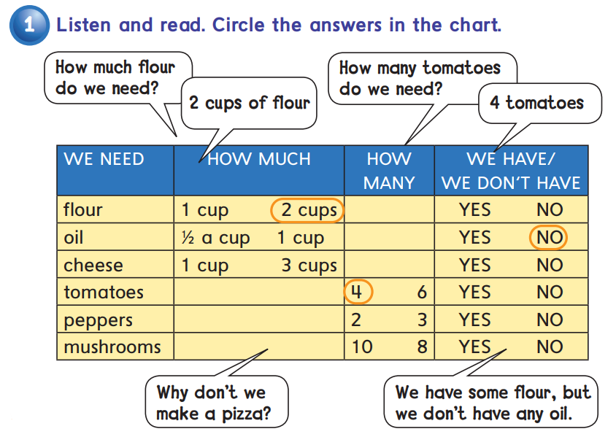

Slide 18
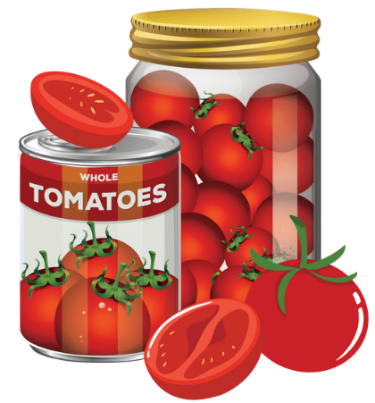
some flour
any oil
some ………
any ………

Slide 20
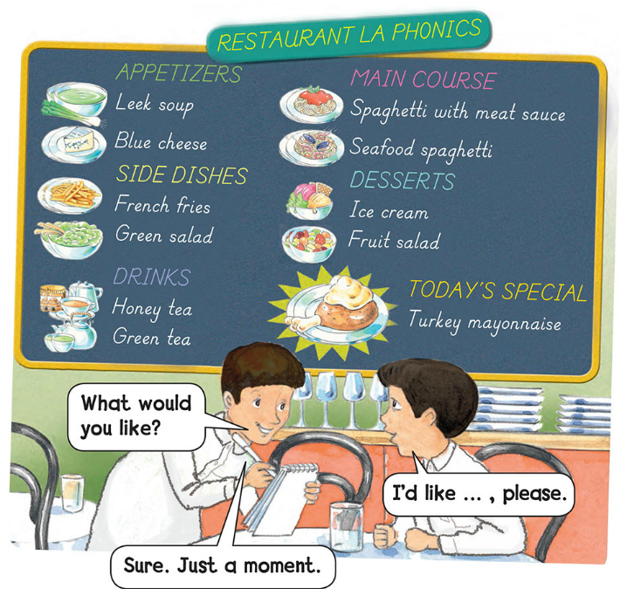

Slide 22
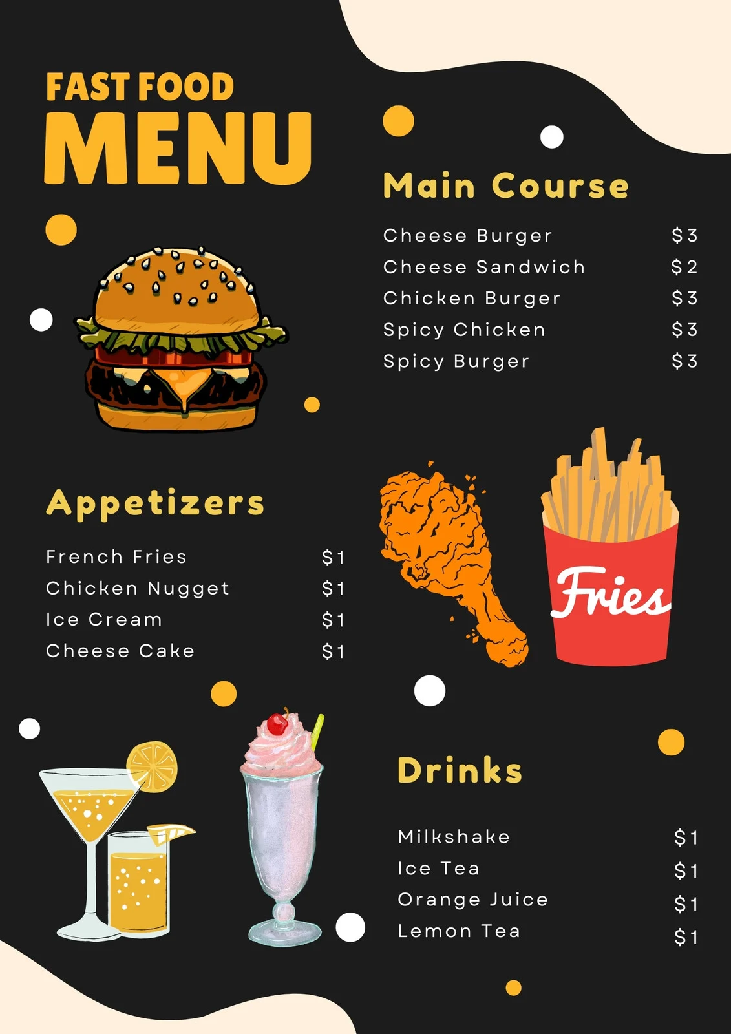

Slide 23
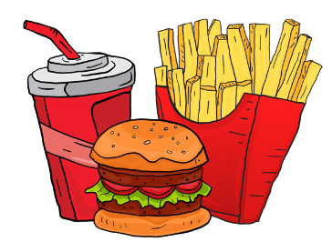
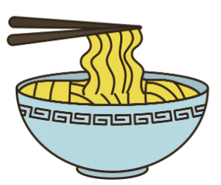
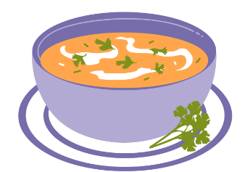
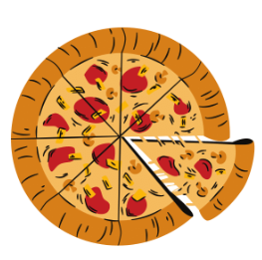
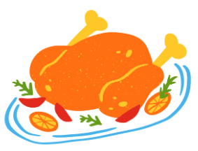
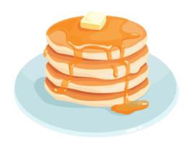
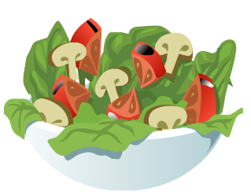

Slide 24
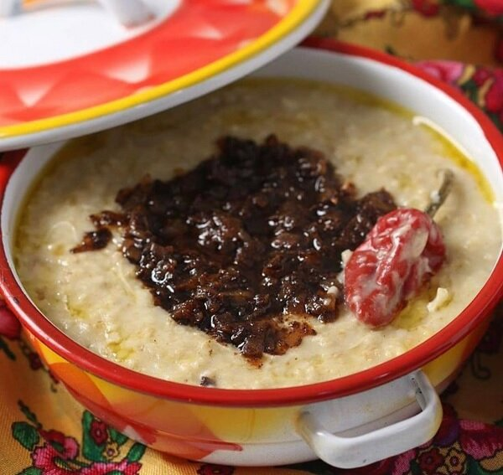

Slide 25
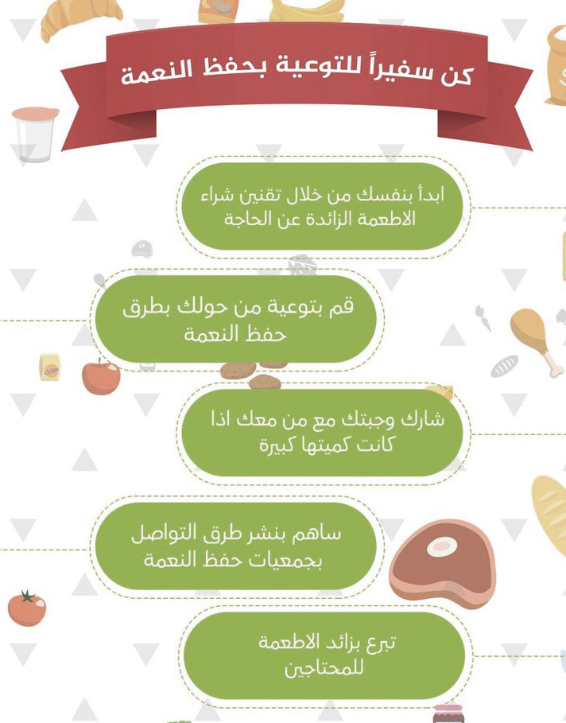

Slide 27
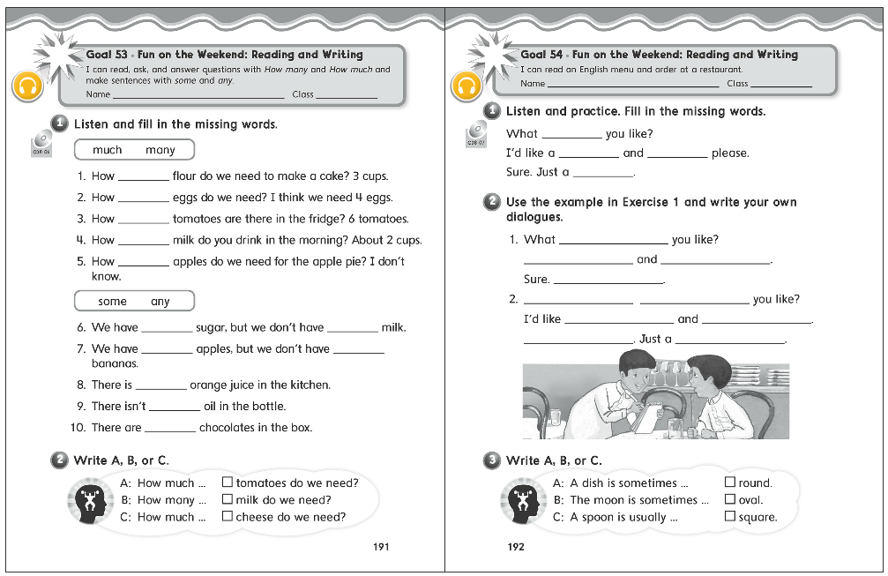
191
192

Slide 28
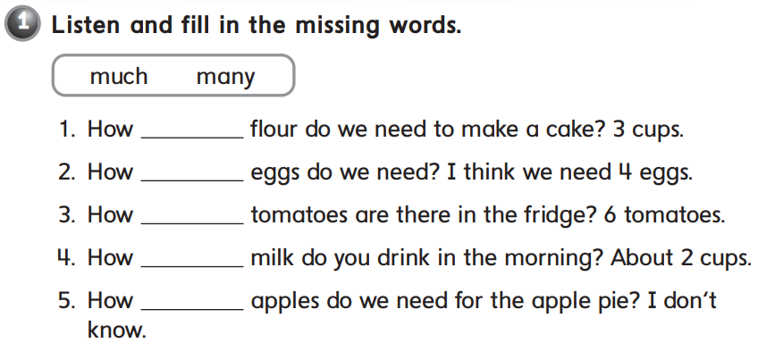
much
many
many
much
many

Slide 29
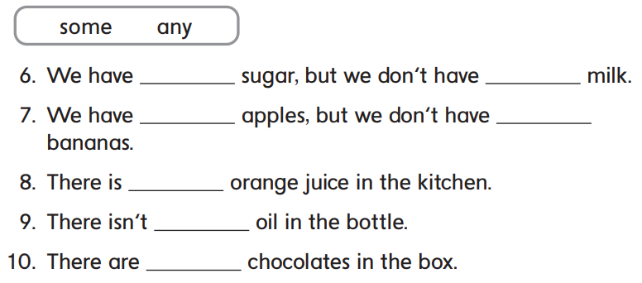
some
any
some
any
some
any
some

Slide 30
B
A
C

Slide 31
would
burger
fries
moment

Slide 32
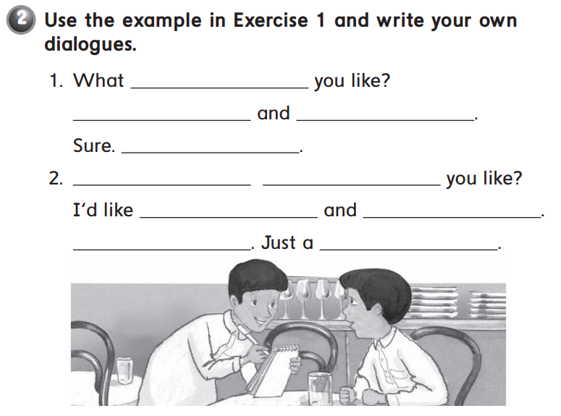
would
I’d like kabsa
soda please
Just a moment
What
would
pizza
a salad please
sure
moment

Slide 33
B
C
A

Slide 34
Thank you!

