Slide 2
Mega goal.3.2 Against The Odd Grammar

Slide 3
Such…That/So…That
Reducing Adverb Clauses

Slide 4
Objectives:
Use such and so make the adjective or adverb stronger
Express cause and effect in a sentence
Reduce adverb clauses
Complete sentences with so …that /such….that
Describes picture using so …that /such….that

Slide 5
Such…That/So…That

Slide 6
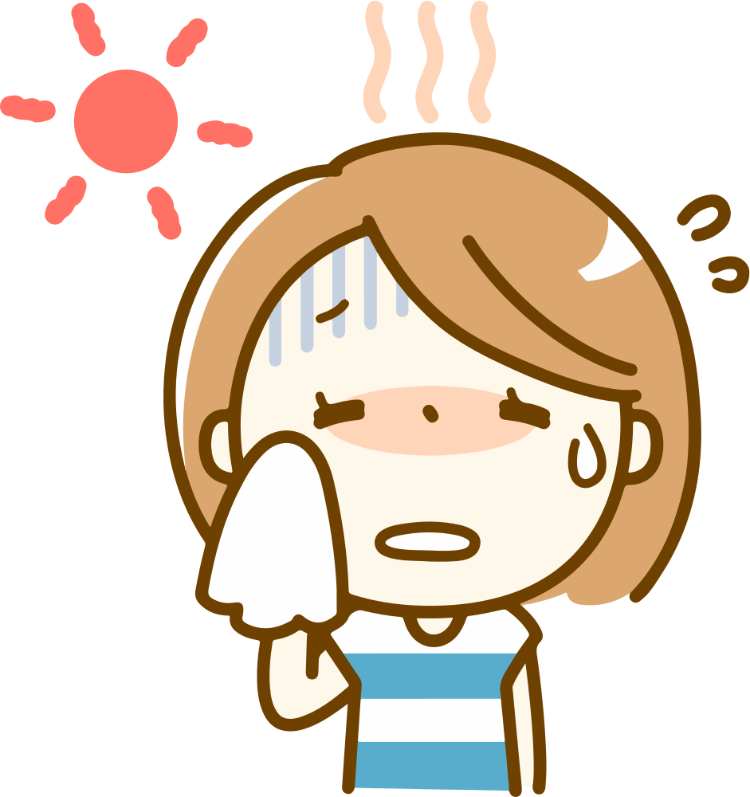
It was such a hot day.
What do such and so mean in these sentences?.
It was so hot today.
They emphasize the adjective and make it stronger.

Slide 7
Complete each sentence with an effect.
It was such a hot day that…….
It was so hot today that……..

Slide 8
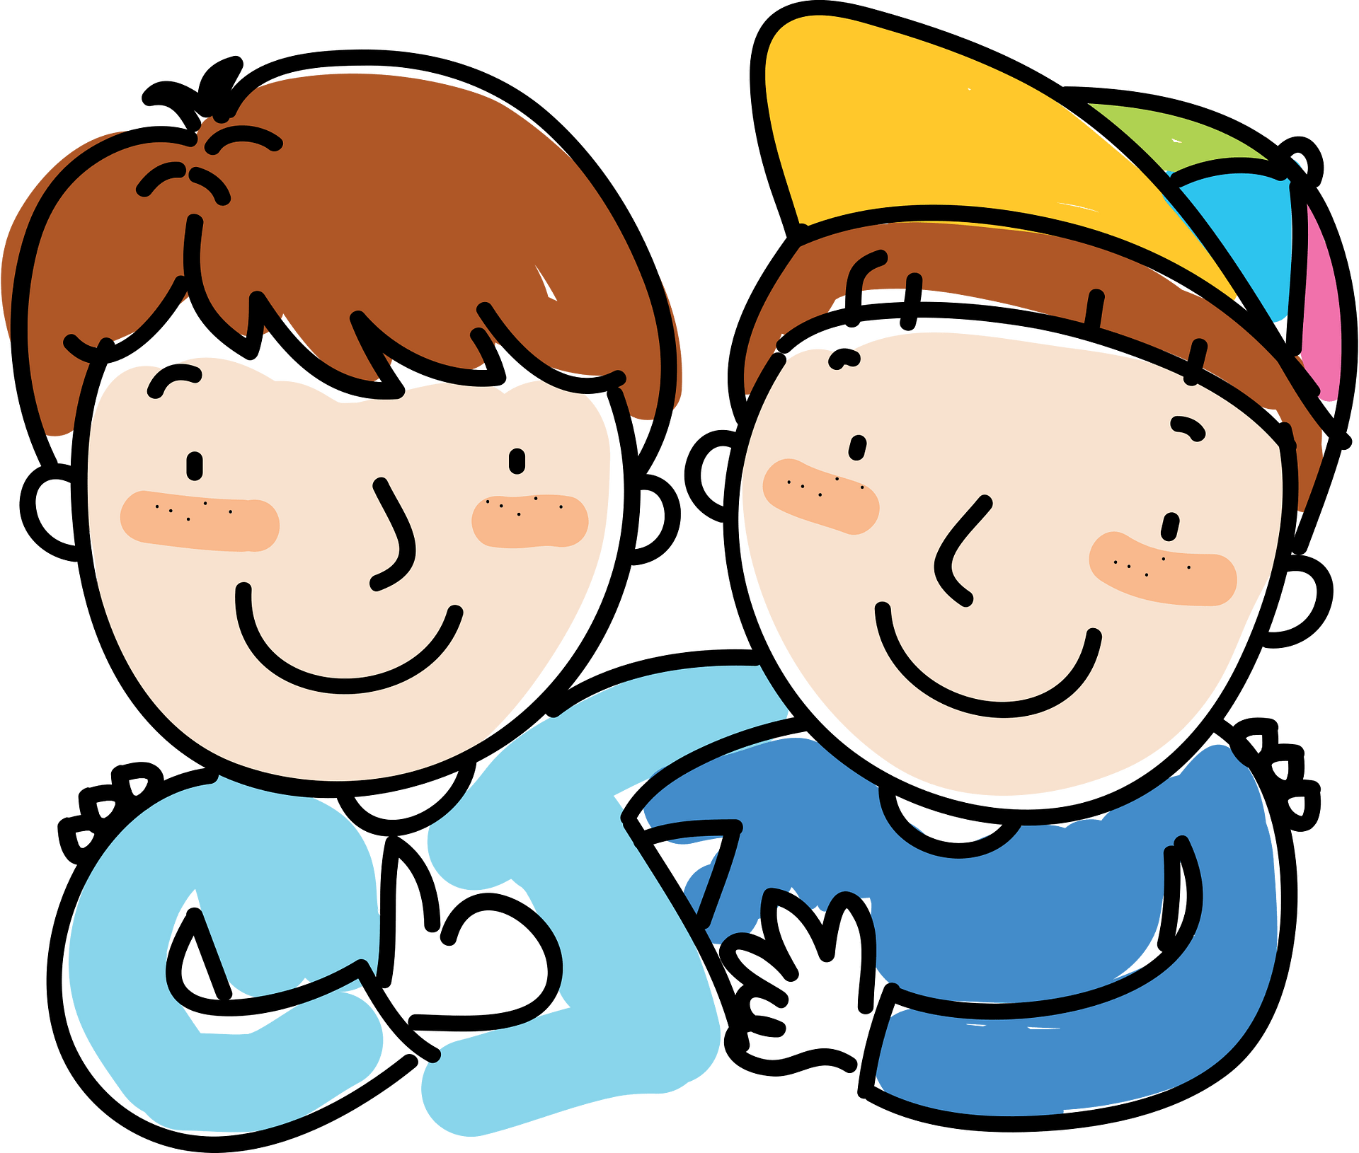
such + adjective + noun + that
It was such a strange experience to see my old friend again that I was speechless.
Jake is such a determined person that he always manages to succeed.

Slide 9
They emphasize the adjective and make it stronger.
Used to show cause and effect.
such + adjective + noun + that
It was such a strange experience to see my old friend again that I was speechless.
Jake is such a determined person that he always manages to succeed.

Slide 10
such + adjective or adverb+ that
Finding my keys on the beach was so unlikely that I was shocked when I spotted them.
He ran so quickly that he won the race

Slide 11
They emphasize the adjective and make it stronger.
Used to show cause and effect.
such + adjective or adverb+ that
Finding my keys on the beach was so unlikely that I was shocked when I spotted them.
He ran so quickly that he won the race

Slide 12
so + many/few + plural count noun + that
We discovered so many similarities between our lives that it almost frightened us.
So few people were accepted into the school that it’s amazing we both got in.

Slide 13
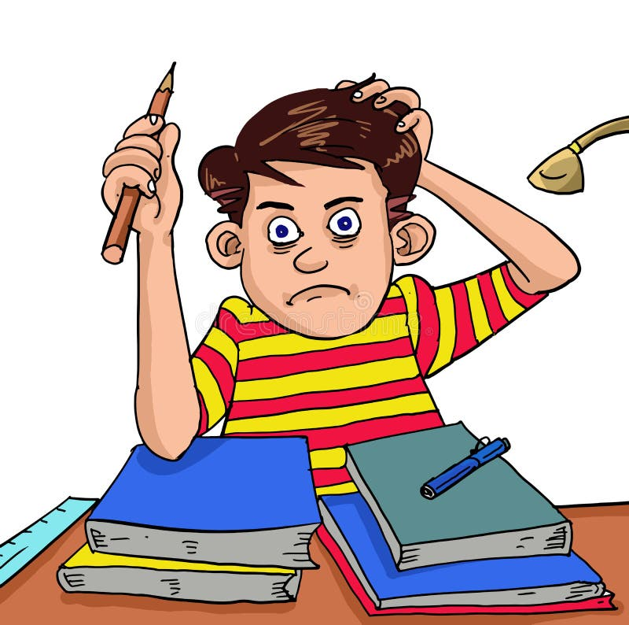
so + much/little + noncount noun + that
I have so much homework that I won’t be able to go out tonight.
He had so little training that no one thought he would be accepted to the energy company.
Note: That is frequently left out in casual speech.
The book was so popular (that) it sold out within a week.

Slide 15
Complete each sentence with such (a/an), so, so much, so many, so little, or so few.
1.My grandfather drives ……………… slowly that other drivers get annoyed.
2. I got ……………… sleep last night that I feel exhausted today.
3. He has ……………… big family that he has cousins he hasn’t even met.
4. They are ……………… good friends that they are more like brothers.
5. The restaurant was ……………… crowded that we couldn’t get a seat.
6. There are ……………… rooms left in the hotel that we’ll have to take whatever is available.
7. There are ……………… good courses this year that I can’t decide which ones to take.
8. That TV has ……………… large screen that it feels like you are almost part of the story.
9. There are ……………… shoppers in the store today that it looks empty.
10. There are ……………… good TV programs on these days that I hardly watch TV at all
so
So little
such a
such
So
So few
So many
such a
So few
So few

Slide 16
a
f
c
g
b
e

Slide 17
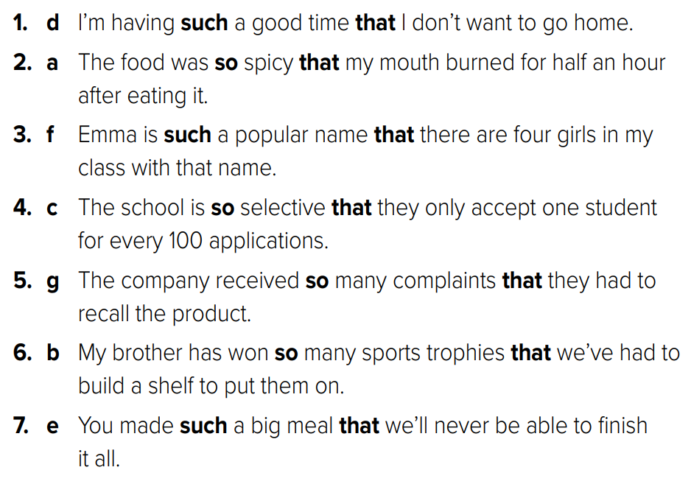
a
f
c
g
b
e

Slide 18
Reducing Adverb Clauses

Slide 19
After we met online, we discovered that we live in the same town.
After meeting online, we discovered that we live in the same town
I ran into him on the street while I was calling him on my cell phone.
I ran into him on the street while calling him on my cell phone

Slide 20
Before I came to class, I ate a sandwich. .
(Before coming to class, I ate a sandwich.)
While I was driving to school, I got into an accident.
(While driving to school, I got into an accident.)

Slide 22
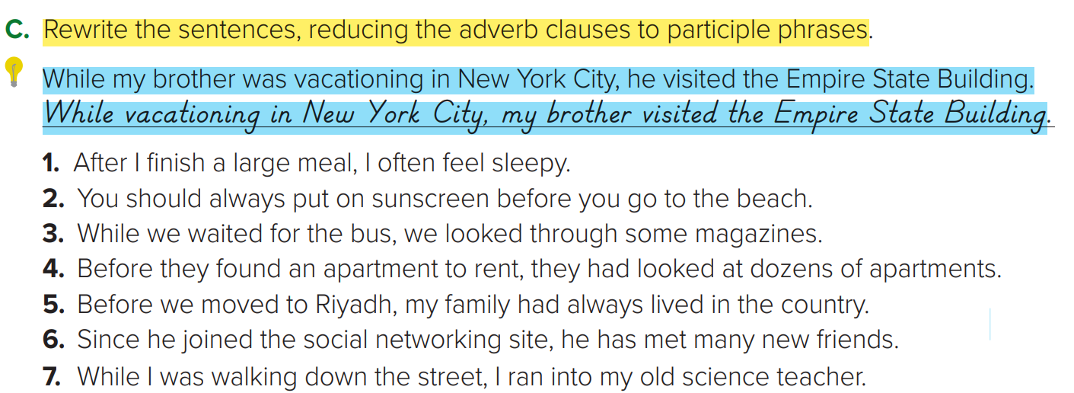
1. After finishing a large meal, I often feel sleepy.
2. You should always put on sunscreen before going to the beach.
3. While waiting for the bus, we looked through some magazines.
4. Before finding an apartment to rent, they had looked at dozens of apartments.
5. Before moving to Riyadh, my family had always lived in the country.
6. Since joining the social networking site, he has met many new friends.
7. While walking down the street, I ran into my old science teacher.

