Slide 2
Mega goal.3.2 Against The Odd Listen & Discuss Pair Work

Slide 3
Objectives:
Talk about achieving impossible things
Use new vocabularies in sentences
Ask about unusual events
Find main information about each story
Answer questions about the text

Slide 4
Listen & Discuss

Slide 5
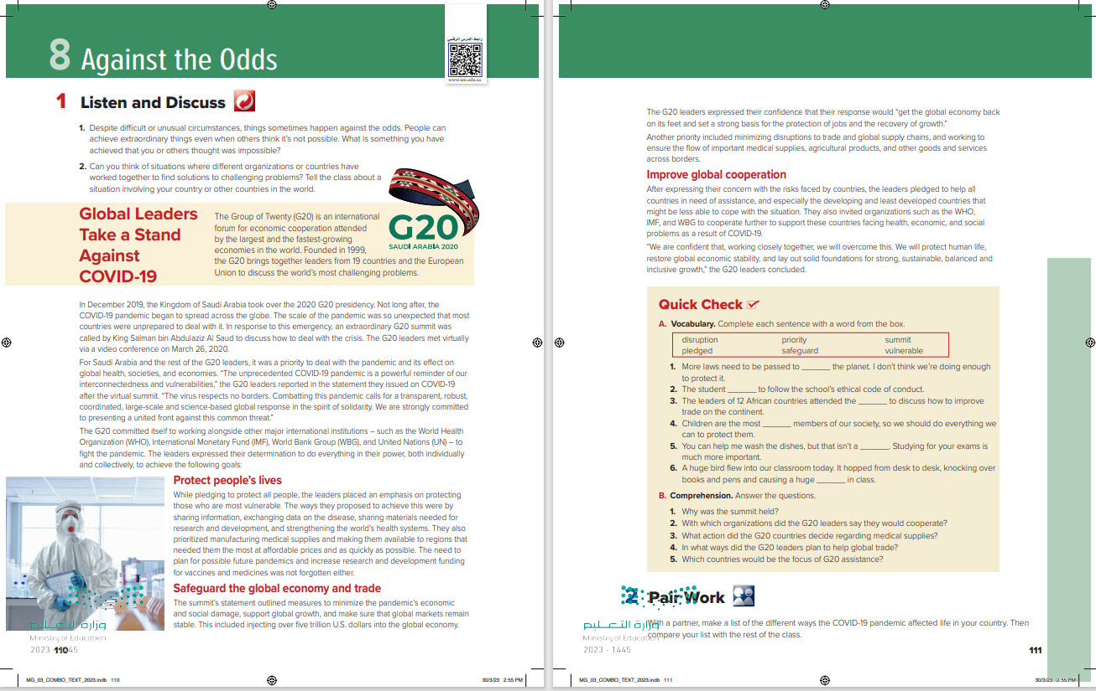
Students Book
P.110-111

Slide 6
What does this title mean?
It means the probability that something will occur When something happens that is against the odds, it happens or
succeeds in spite of being very unlikely or seemingly impossible.
Notes:
The phrase against all odds is often used in English to describe something that succeeded under impossible circumstances. For example: They were able to escape the deserted island against all odds. The phrase shorten the odds means to make something more likely to happen. For example: When the all-star player joined our team, it shortened the odds that we would become the league champions. The phrase lengthen the odds means to make something less likely to happen. For example: When I failed that test, it lengthened the odds that I would pass the course

Slide 7
7
1
8
2
-----Paragraphs are there?
--------- Titles?
--------Pictures?
3
4
5
6

Slide 8
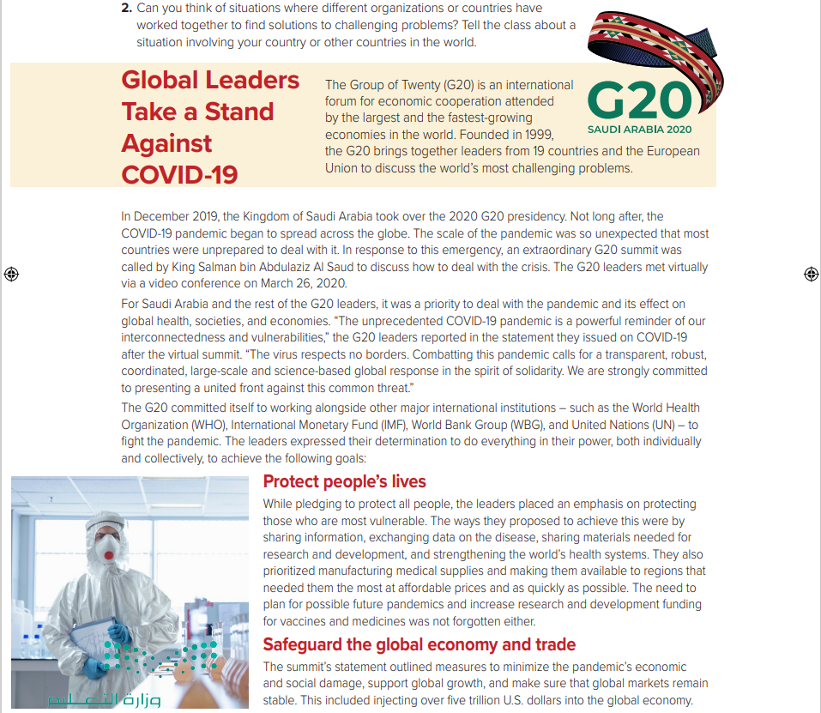
Do you know any countries that are members of the G20?
Did any Middle Eastern country take on the G20 presidency?

Slide 9
What happened soon after Saudi Arabia took over the G20 presidency for 2020?
(the Covid-19 pandemic)
Who called the summit?
(King Salman)

Slide 10
Who did the G20 promise to protect?
People, especially those who are vulnerable
How much money did the G20 leaders say they would put into the economy?
five trillion US dollars

Slide 11
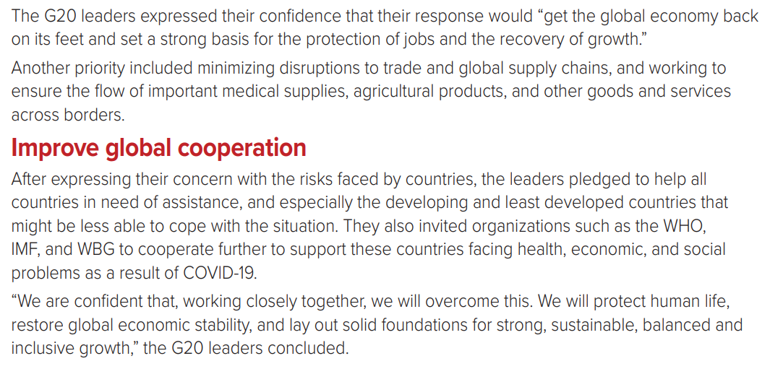
Did the G20 leaders promise to help only some countries?
No, they said they would help all countries.

Slide 12
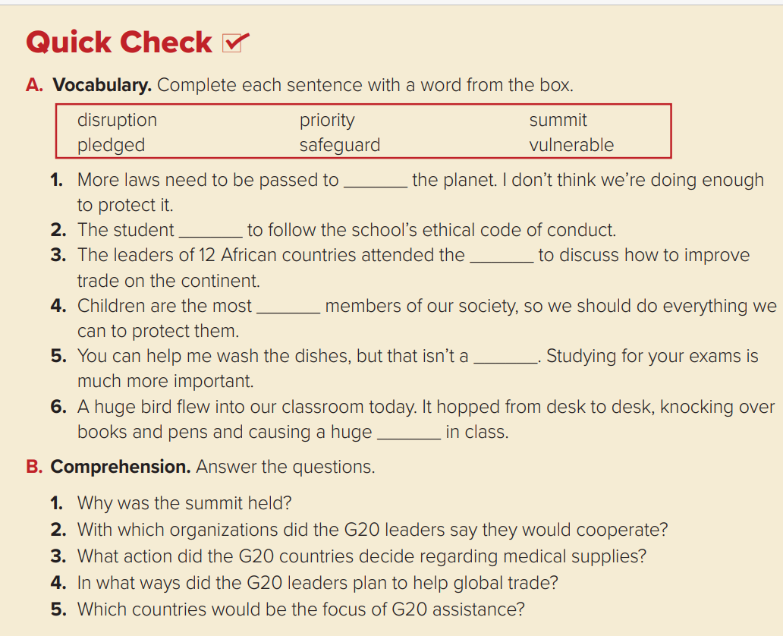
1.It was held to discuss how to deal with the crisis caused by the pandemic.
2.They would cooperate with international organizations such as the World Health Organization, the International Monetary Fund, the World Bank Group, and the United Nations.
3.They would manufacture more medical supplies and making them available to regions that need them the most at affordable prices and as quickly as possible.
4.They planned to make sure that there was no disruption in the flow of important medical supplies, agricultural products, and other goods and services across borders.
5.The G20 leaders would focus on helping developing and least developed countries.
safeguard
pledged
summit
vulnerable
priority
disruption

Slide 13
Pair Work

Slide 14
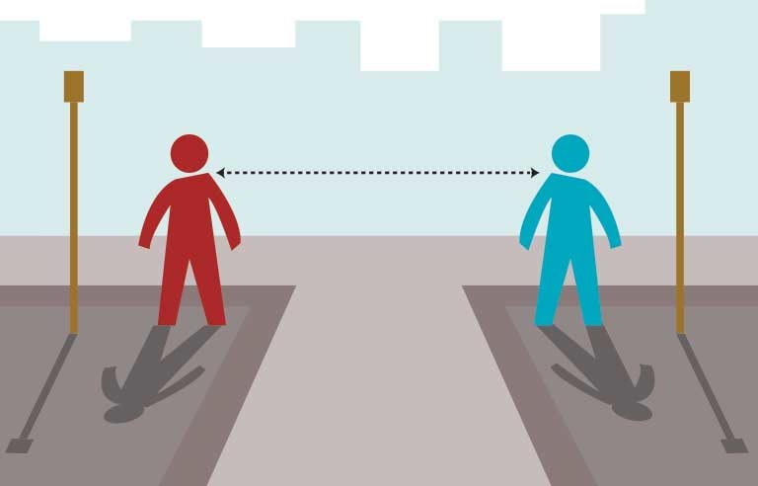
With a partner, make a list of the different ways the COVID-19 pandemic affected life in your country. Then compare your list with the rest of the class.

