Slide 4
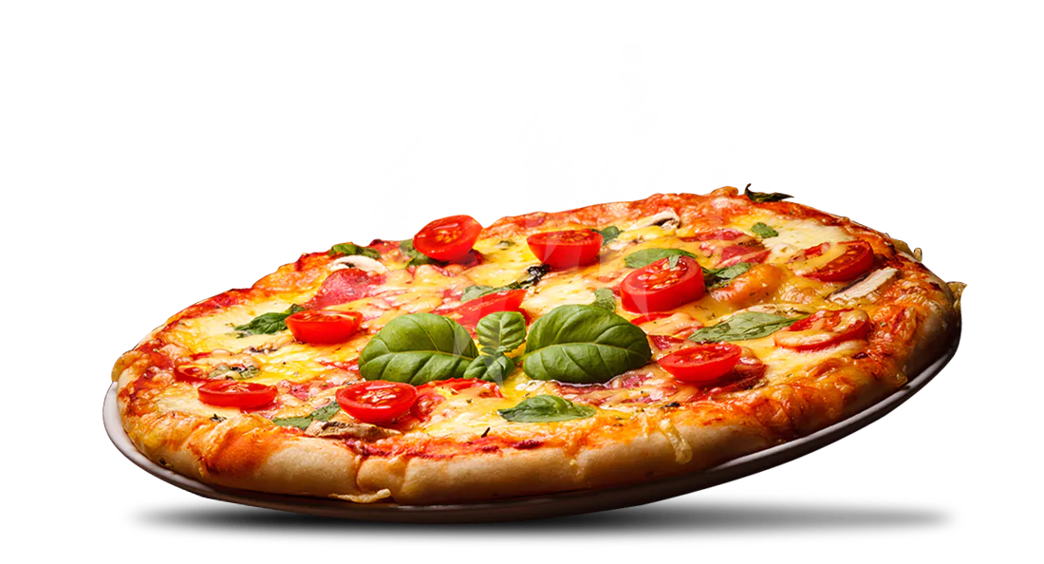
Do you like ……… ?

Slide 6
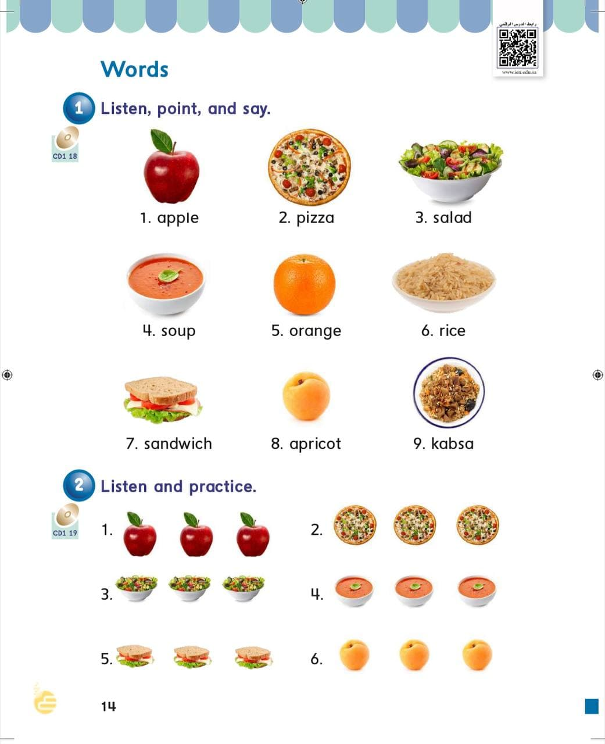
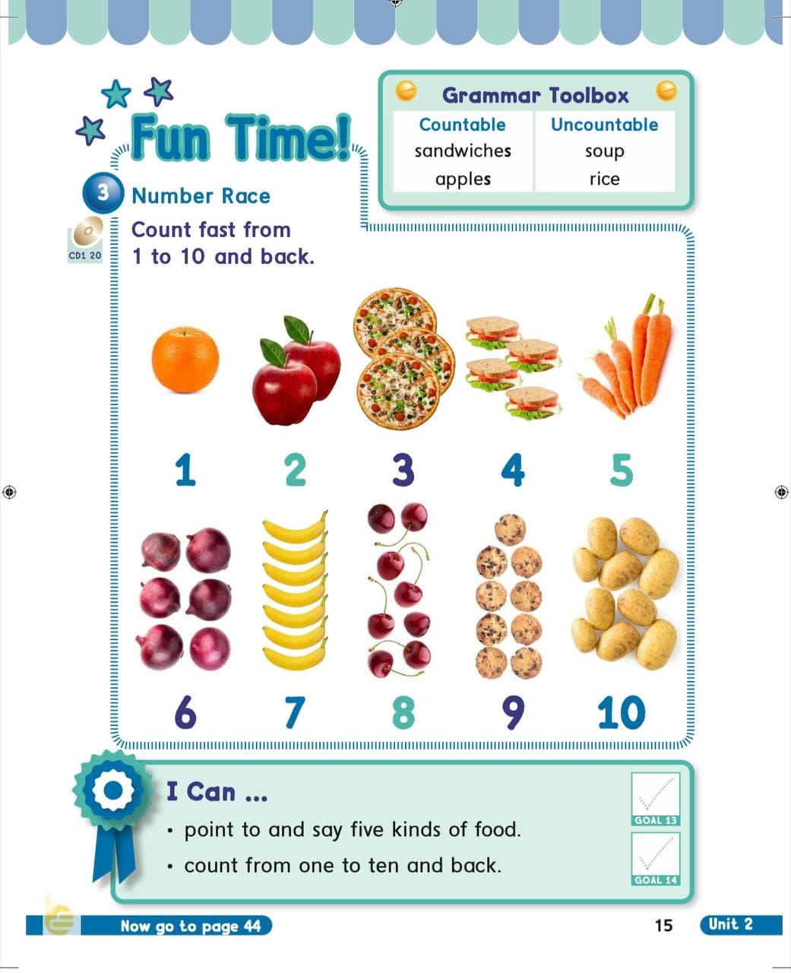
30
31

Slide 7
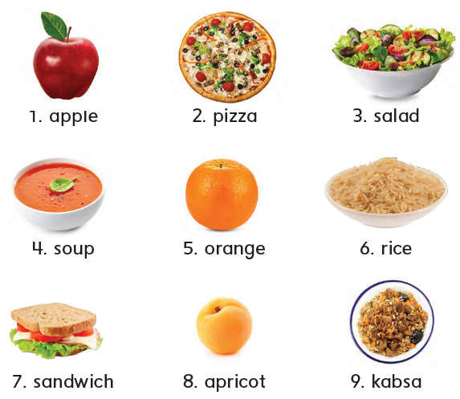
1
Listen , point and say

Slide 8
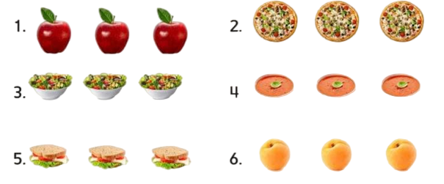
2
Listen and practice

Slide 9
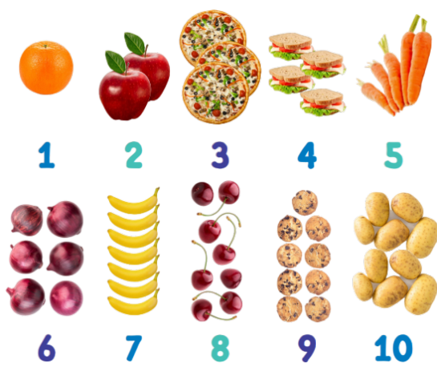
3
Number race
Count fast from 1 to 10 and back .

Slide 10
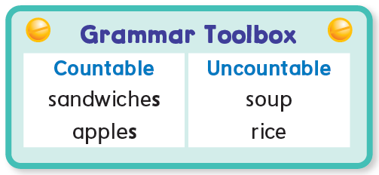
Countable
Uncountable

Slide 11
Let’s play

Slide 12
In a minute
Count from 1 - 10

Slide 13
In a minute
Count from 10 - 1

Slide 14
Count the candles
1
2
3
4
5
6
7

Slide 15
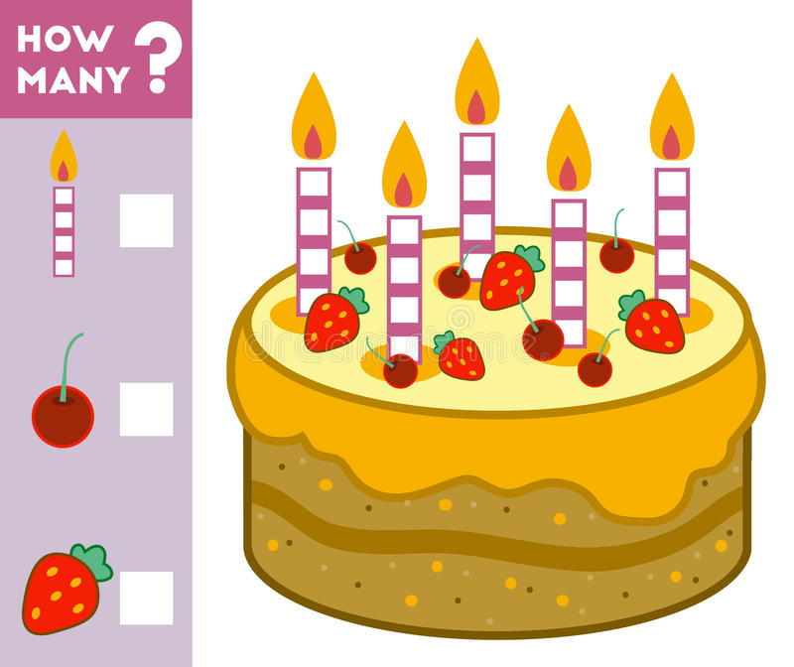
5
6
4

Slide 16
1
2
3
4
5
6
7
8
9
10

Slide 18
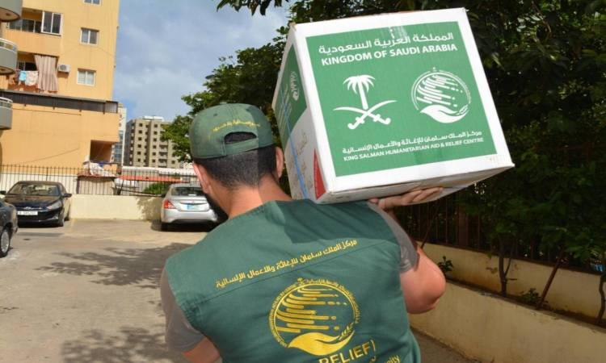

Slide 22
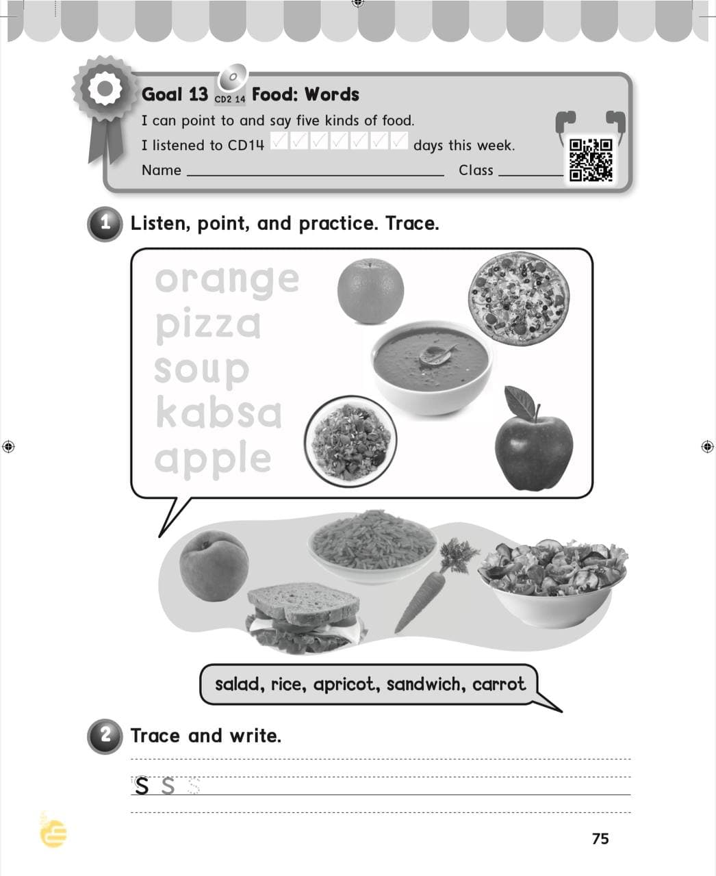
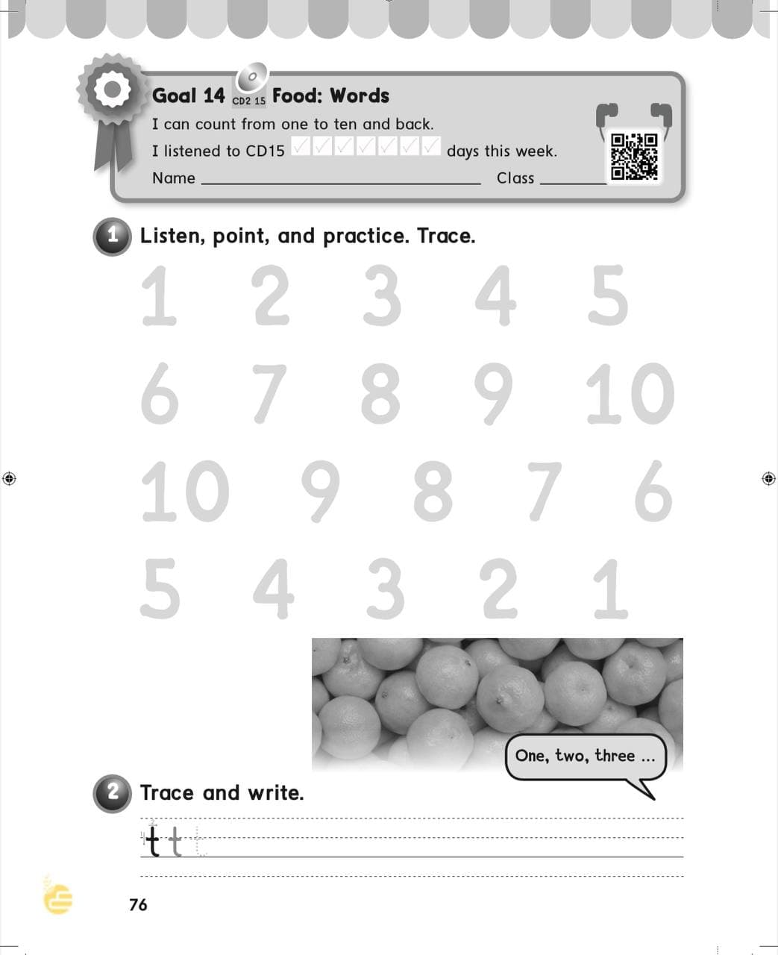
H.W
77
78

Slide 23
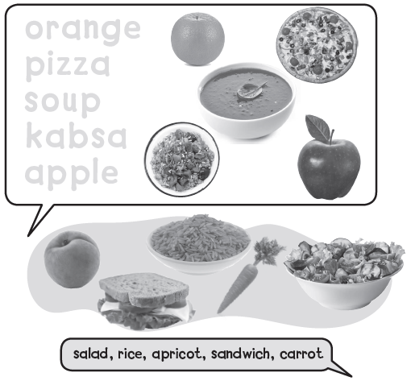
orange
pizza
soup
kabsa
apple

Slide 24
s s s s

Slide 25
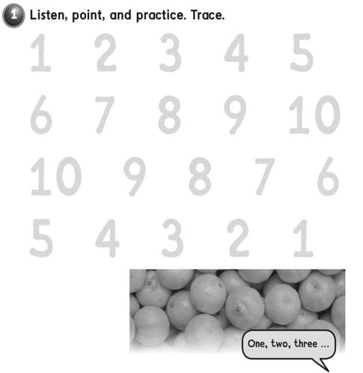
1 2 3 4 5
6 7 8 9 10
10 9 8 7 6
5 4 3 2 1

Slide 26
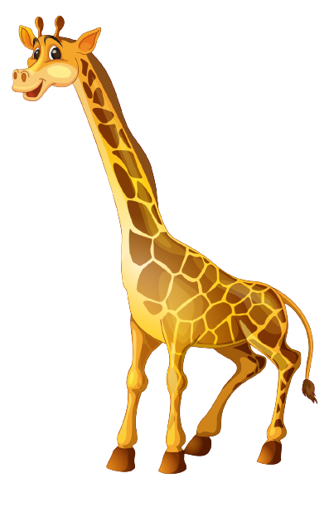
t t t t

