Slide 1






1 Listen & discuss
2 pair work
Today:
Date:
- -
Page 80
By: Dalal Al-Juaid

Slide 2


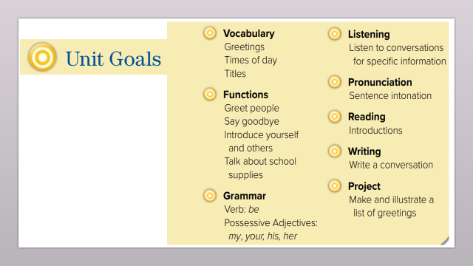
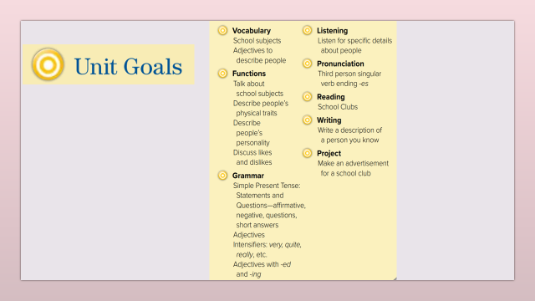
list a number of school subjects
Use adjectives to describe school subjects
Warm up
1-Listen
Use (look like) to describe classmate
New words
Quick check
Ask & answer about school
2-Pair work

Slide 3
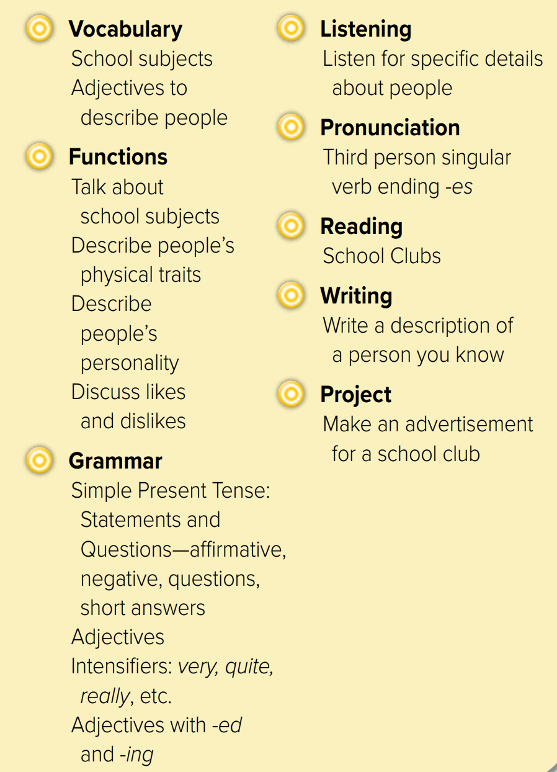
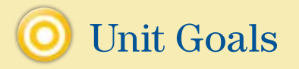

Slide 4






Who has black hair, brown eyes, and wears glasses?
Who teaches science?
Warm up
1-Listen
Who teaches Maths?
New words
Who teaches English?
Quick check
What does she look like ?
2-Pair work

Slide 5
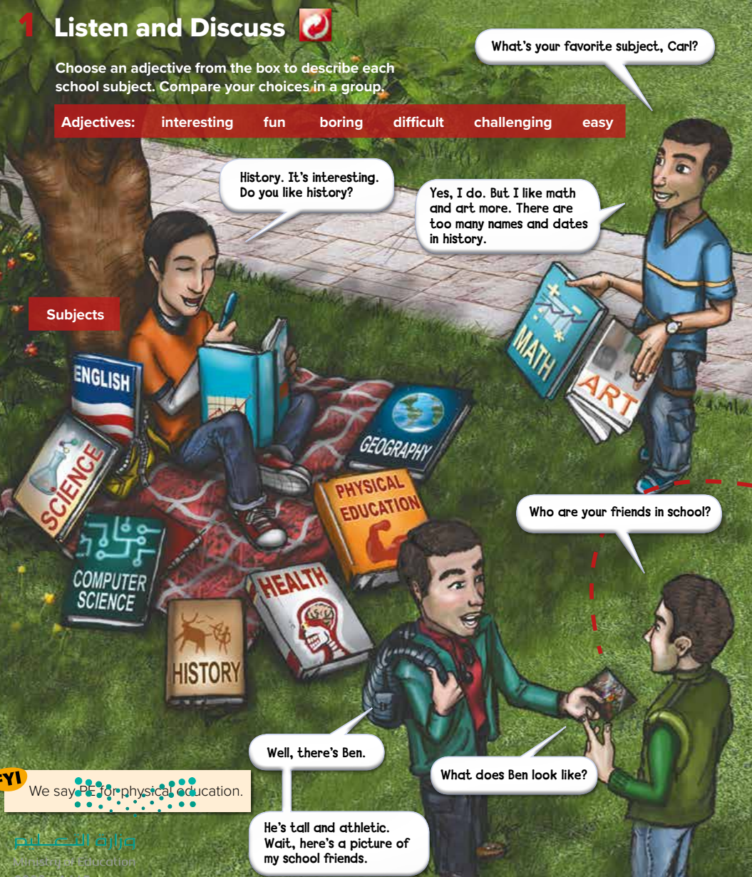









What is Carl doing?
Page 80
#
I think math is challenging
What does Ben look like?
Warm up
1-Listen
New words
Quick check
2-Pair work

Slide 6
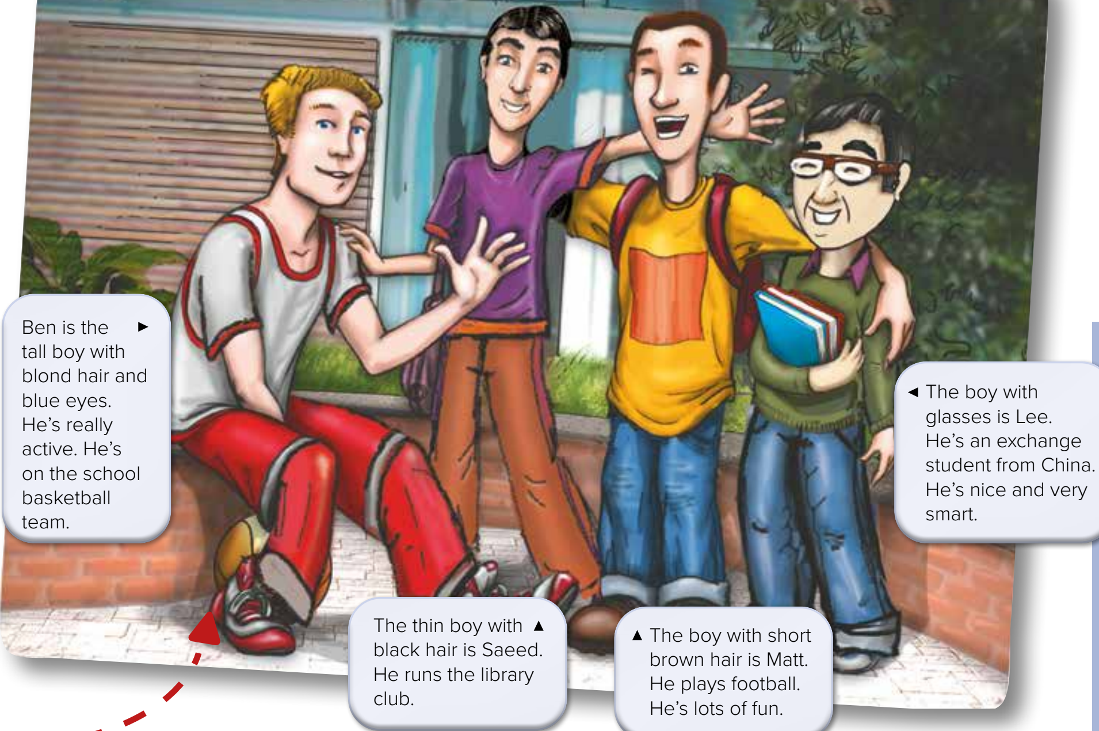










Who wears glasses ?
Who has blond hair ?
Page 81
Who has brown hair?
Warm up
1-Listen
New words
Quick check
2-Pair work

Slide 7
What is the opposite?
Page 64
#
=
easy
difficult
challenging
=
boring
#
fun
interesting
Warm up
1-Listen
What is the meaning?
New words
Quick check
2-Pair work

Slide 8
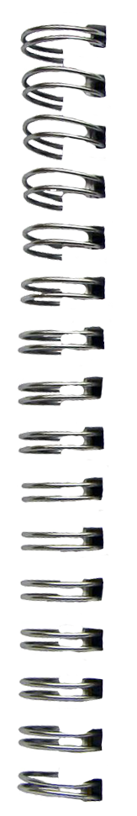


New Words
Look like
appearance
like
personality
subjects
Math – science – history
English – Art - Geography
adjectives
#
=
easy
difficult
challenging
#
=
interesting
boring
fun

Slide 9

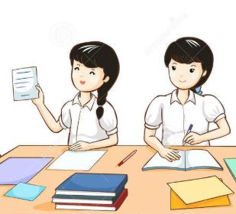

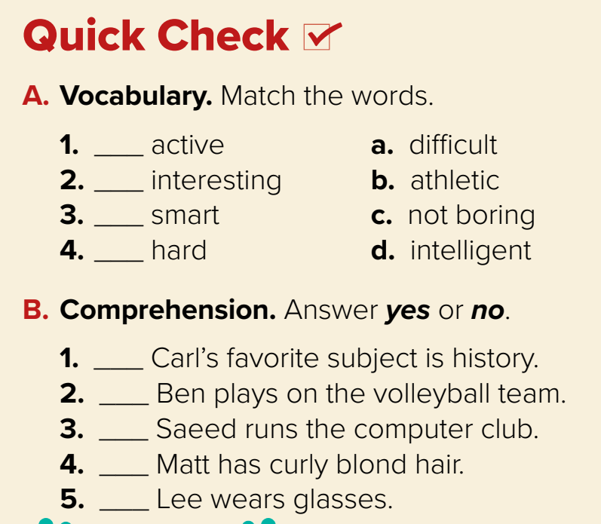
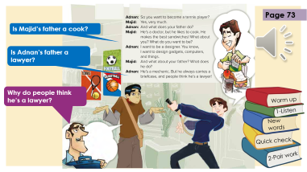
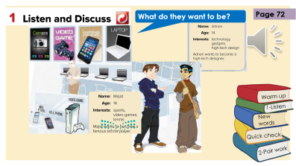
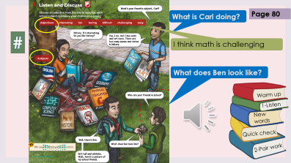
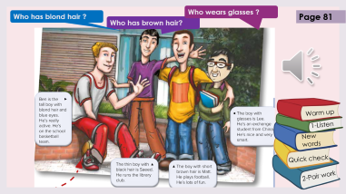
Think pair share
hard
difficult= ………
b
active
c
athletic= ………
d
intelligent
Smart = ………
a
Warm up
yes
1-Listen
no
New words
no
no
Quick check
yes
2-Pair work

Slide 10



Lets play
Warm up
1-Listen
New words
Quick check
2-Pair work

Slide 11


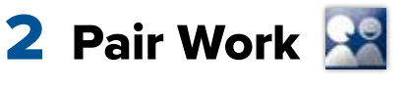
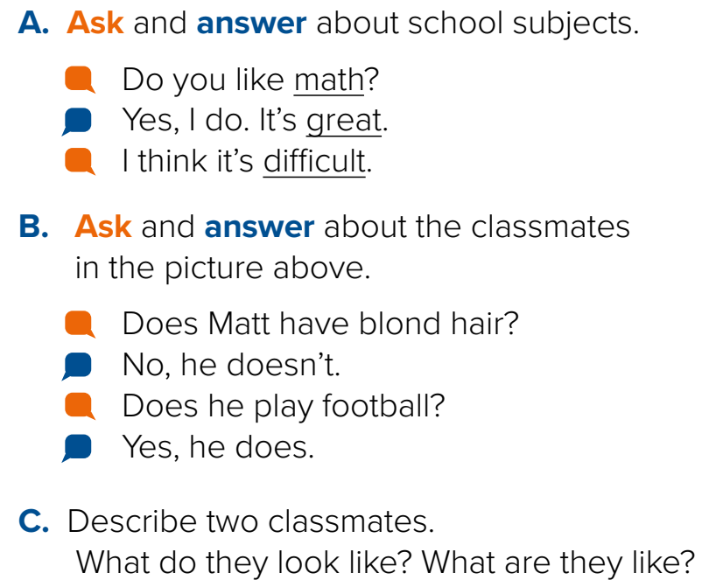
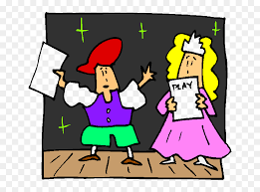
Talk about MBS ?
Role paly
Warm up
1-Listen
New words
Quick check
2-Pair work

Slide 12
Write in your notebook
Like final test أسئلة للاختبار النهائي
Choose:
Mmmmmmm ………. mmmmmmm
( ssss – ssss – sssss)
Make a question

Slide 13





page 225 Ex(A-B)
for practice new words
Warm up
1-Listen
New words
Quick check
2-Pair work

Slide 14
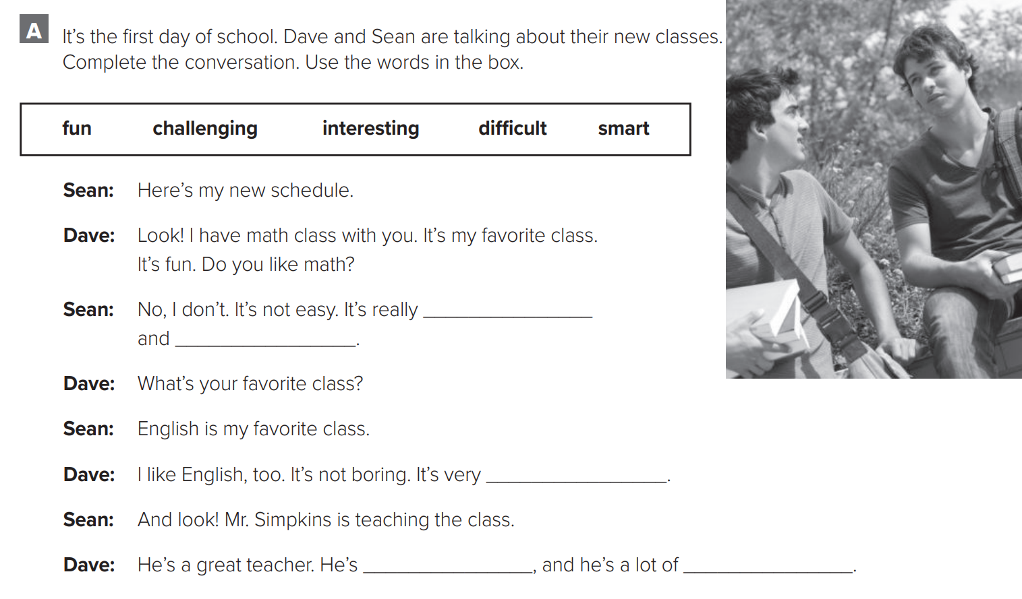
p.225
difficult
challenging
Warm up
1-Listen
interesting
New words
smart
fun
Quick check
2-Pair work

Slide 15
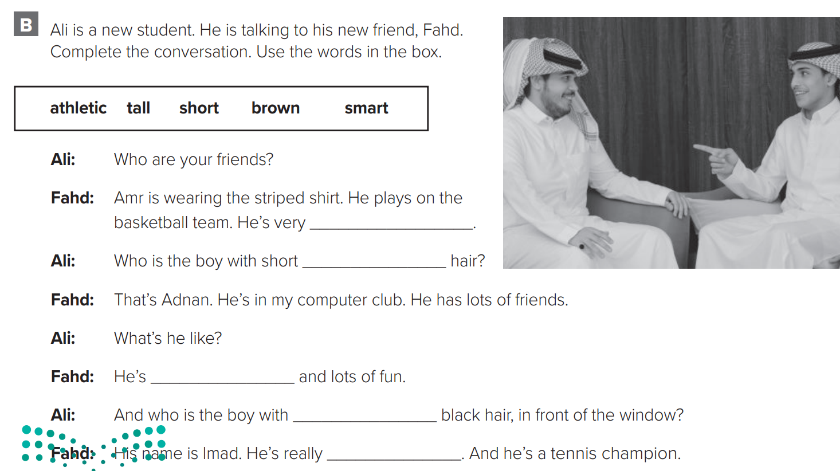
p.225
tall
brown
Warm up
1-Listen
smart
New words
short
athletic
Quick check
2-Pair work

