Slide 1




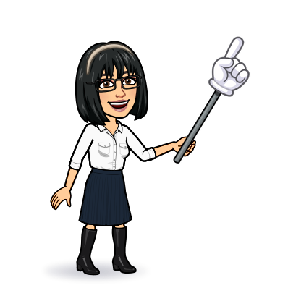

3 grammar
Today:
Date:
- -
Page 82
By: Dalal Al-Juaid

Slide 2


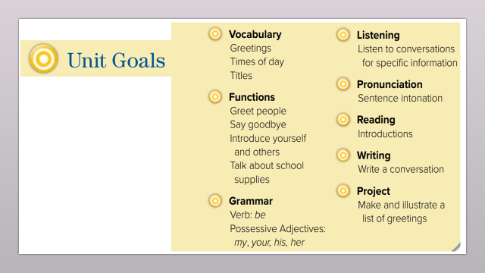
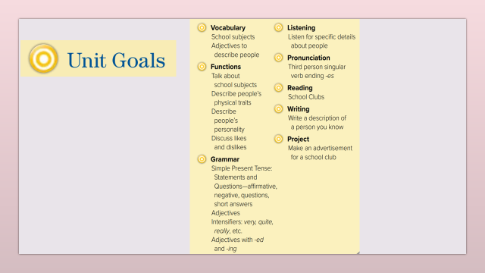
Use simple present for statements and questions
Use adjectives correctly in sentences
Warm up
Complete a description about Ahmad's teachers
2-Pair work

Slide 3
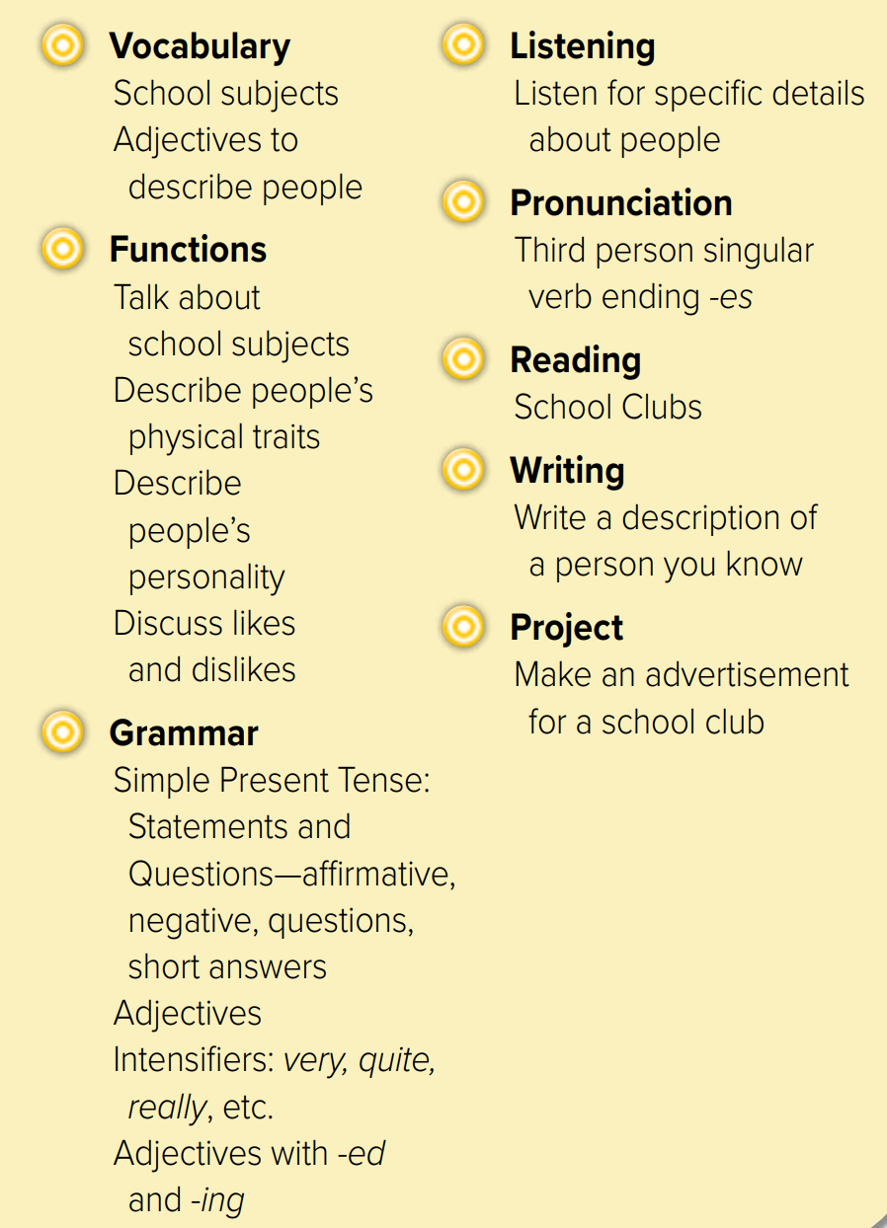
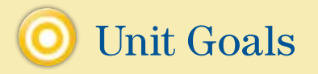

Slide 4

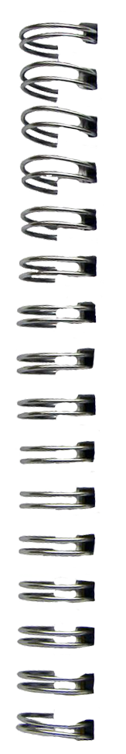

Revision
What does Dalal look like ?
subjects
Math – science – history
English – Art - Geography
Smart = ………
#
=
easy
……
……
#
=
……….
……
fun

Slide 5





What does she look like ?
Warm up
2-Pair work

Slide 6
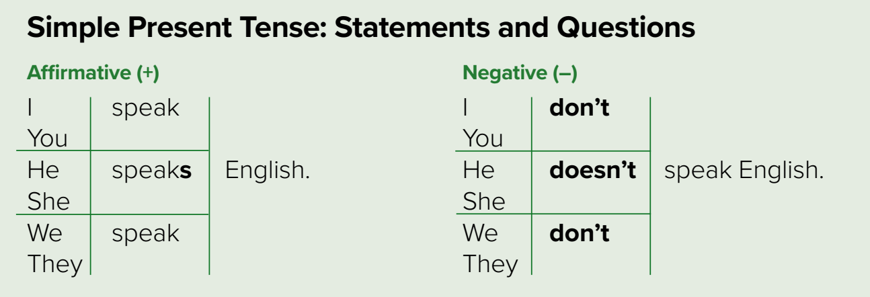
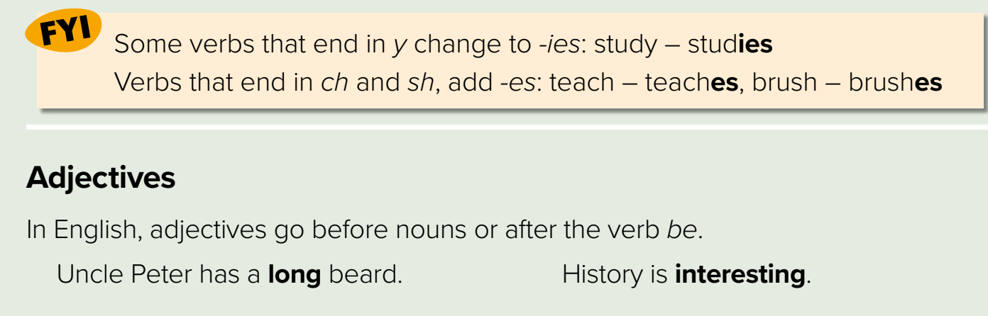








Page 82
not
He – she – it ( -s)
Warm up
2-Pair work

Slide 7
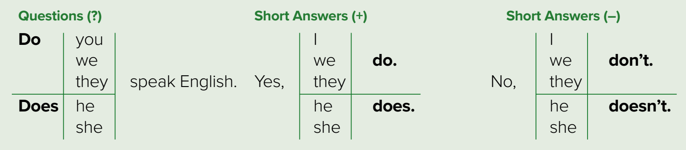
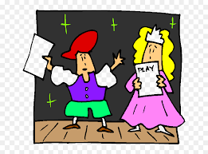










Page 82
Hv
Hv
Warm up
Hv
Make examples
Role paly
2-Pair work

Slide 8
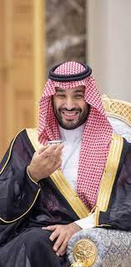







Page 82
Where ?
Warm up
Talk about MBS ?
2-Pair work

Slide 9
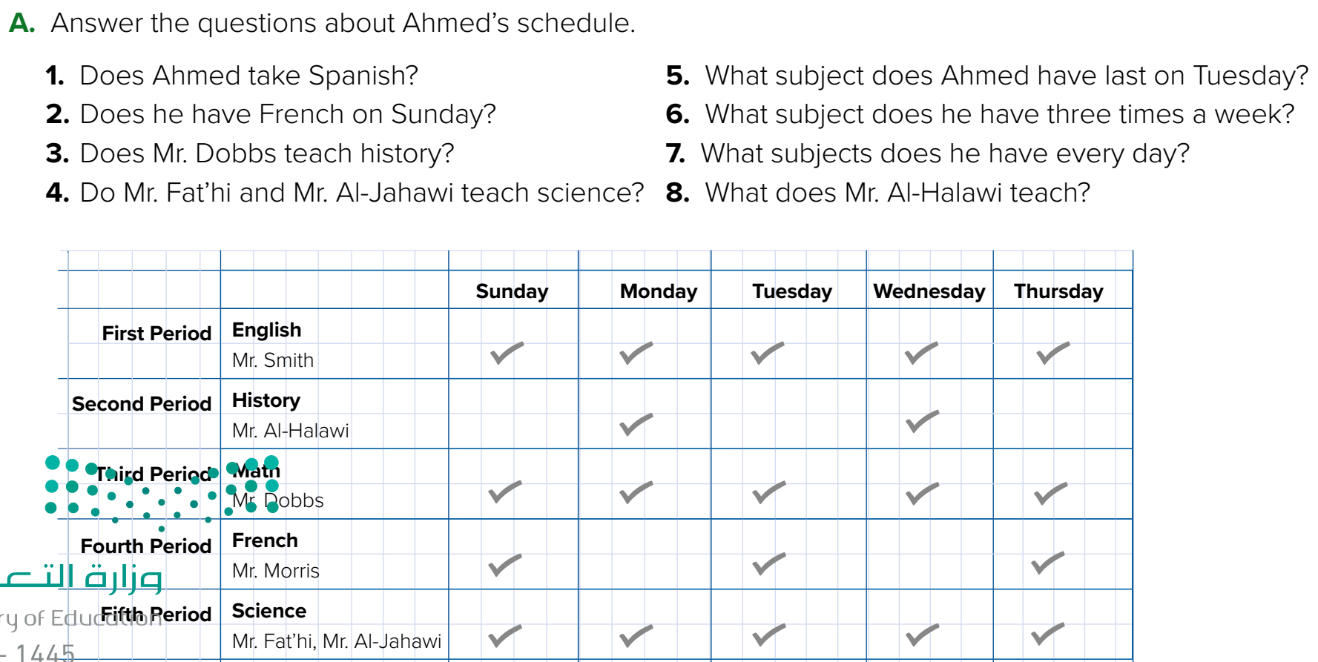

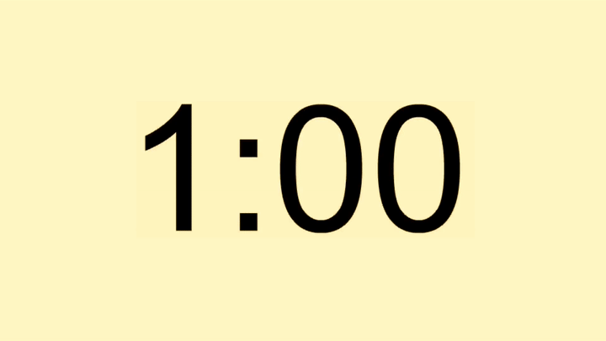
Page 82
Warm up
1- No, he doesn’t. He takes French.
2- Yes, he does.
6- He has French 3 times a week.
8- He teaches History.
2-Pair work

Slide 10
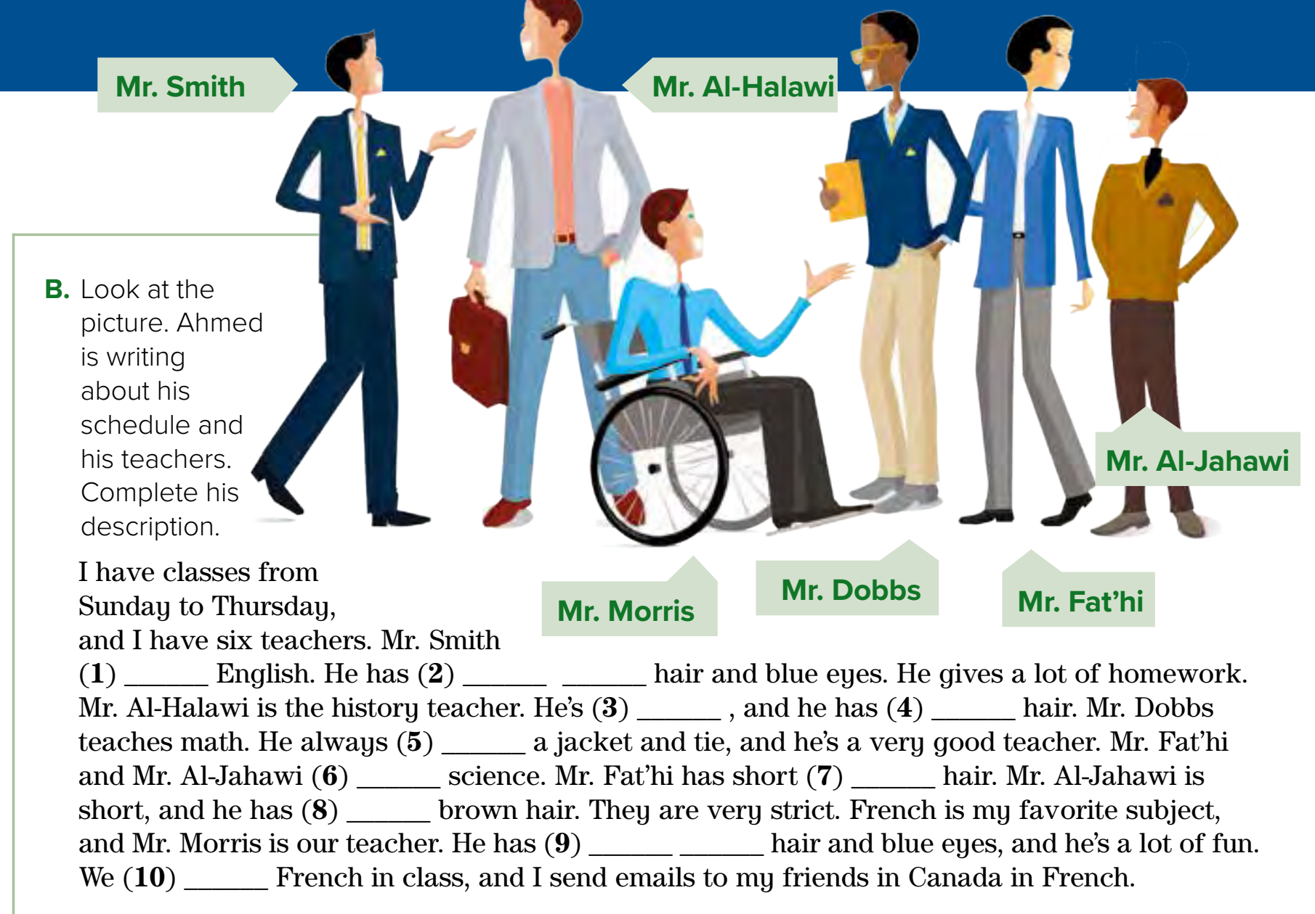

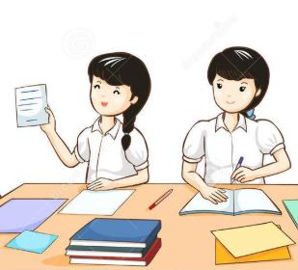

Page 83
Think pair share
Warm up
teaches
short black
tall
brown
wears
teach
black
short
short brown
speak
2-Pair work

Slide 11

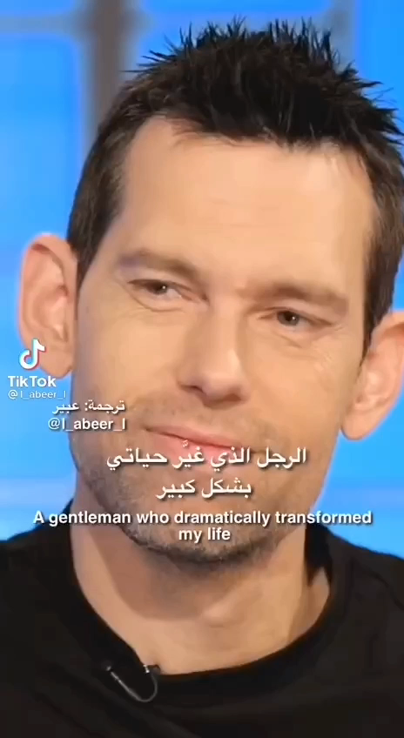

Lets play
Warm up
1-Listen
New words
Quick check
2-Pair work

Slide 12
Write in your notebook
Like final test أسئلة للاختبار النهائي
Choose:
Mmmmmmm ………. mmmmmmm
( ssss – ssss – sssss)
Make a question

Slide 13





page 226 Ex(C-D)
for practice grammar
Warm up
2-Pair work

Slide 14
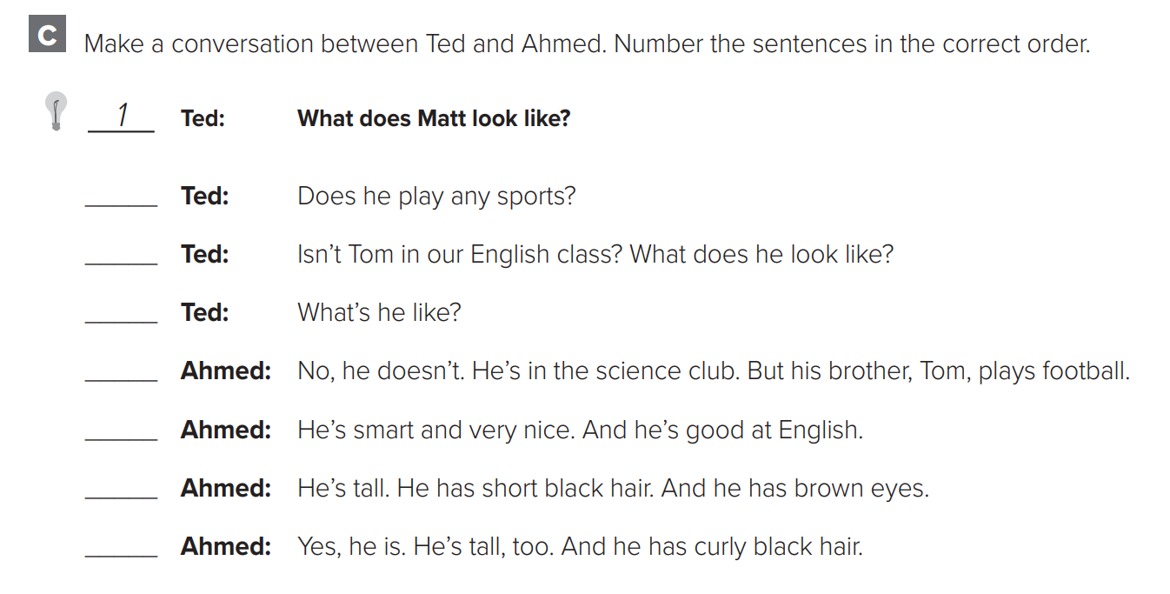
p.226
3
5
7
Warm up
4
8
2
6
2-Pair work

Slide 15
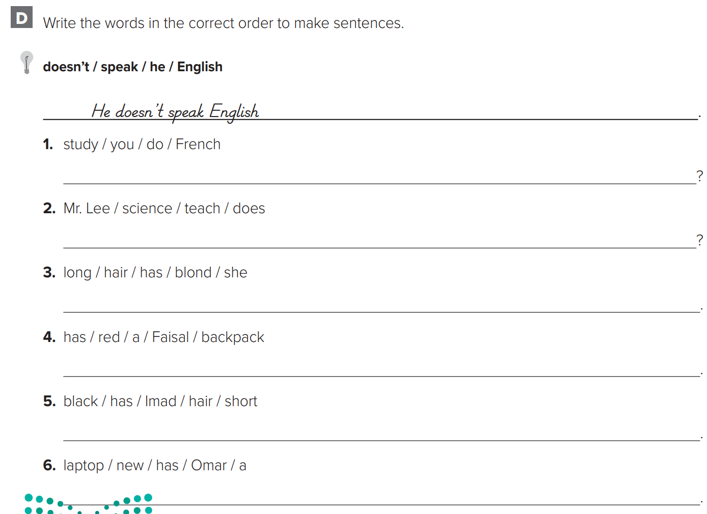
p.226
Do you study French?
Does Mr. Lee teach science?
She has long blond hair.
Warm up
Faisal has a red backpack.
Imad has short black hair
Omar has a new laptop.
2-Pair work

