Slide 1




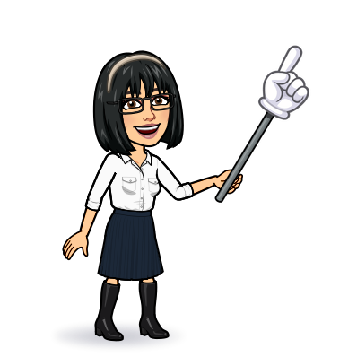

4 listening
5 pronunciation
6 conversation
7 about you
Today:
Date:
- -
Page 75
By: Dalal Al-Juaid

Slide 2


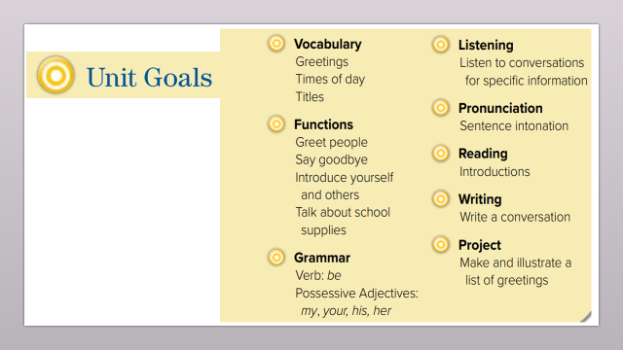
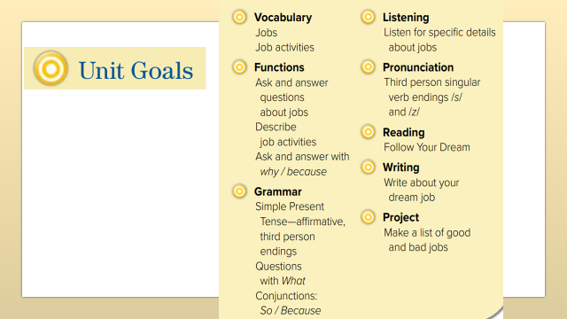
Ask & answer questions about jobs and place of work
Complete a chart with information from a listening text
Warm up
Recognize the different "s" sounds at the verb endings
answer questions from a conversation

Slide 3
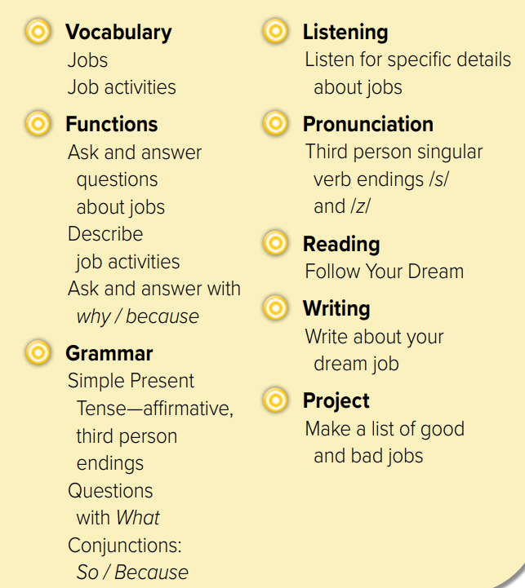
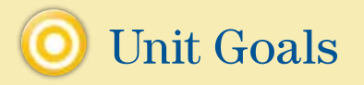

Slide 4
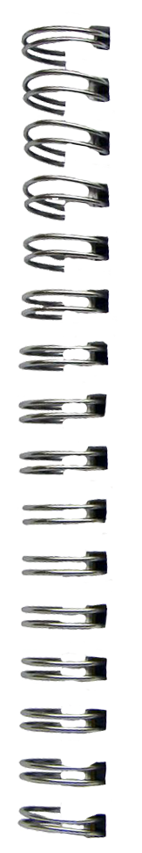






Revision
design clothes : ………
takes photo: ………
We read a book
She
reads a book
….
…..
….
……

Slide 5










Answer with emoji
Warm up
Tennis player
lawyer
High-tech
photographer
mechanic

Slide 6
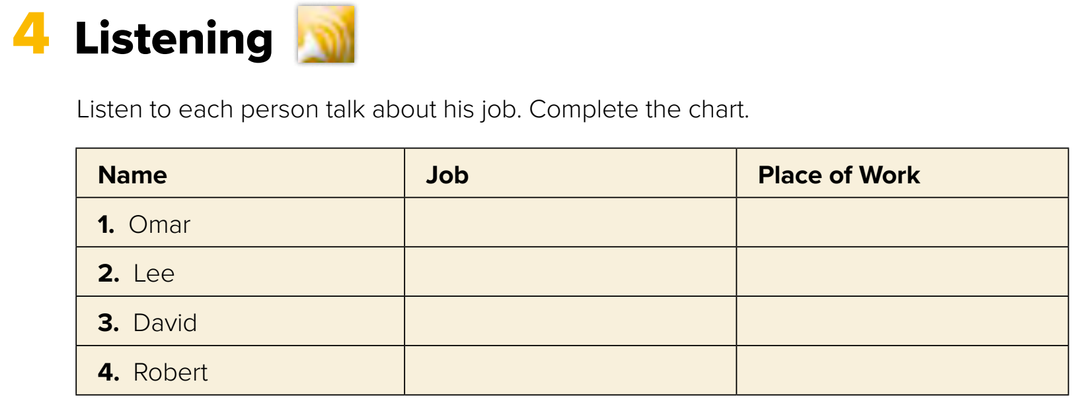




Page 75
chef
restaurant
salesperson
store
teacher
school
Warm up
doctor
hospital
Think pair share
H.W

Slide 7
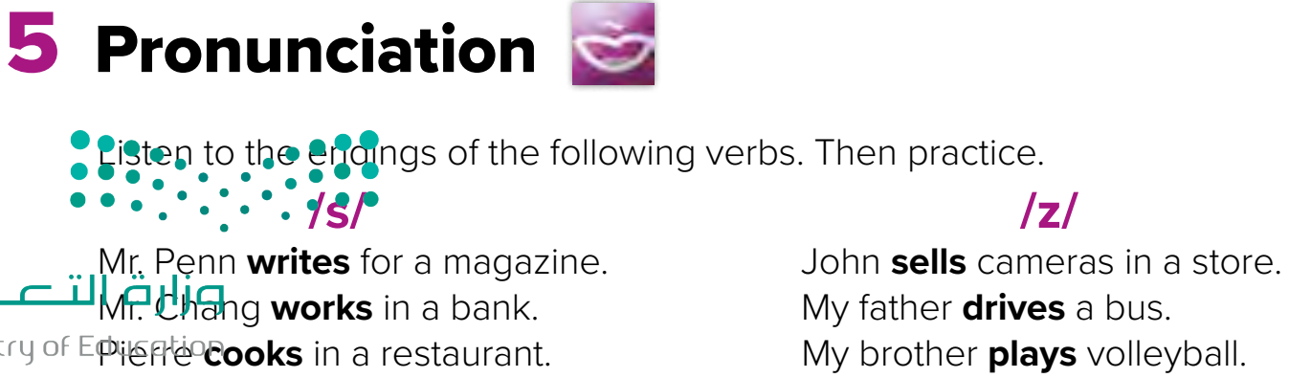

Page 75
Warm up
bus
buzz
Listen
repeat
H.W

Slide 8
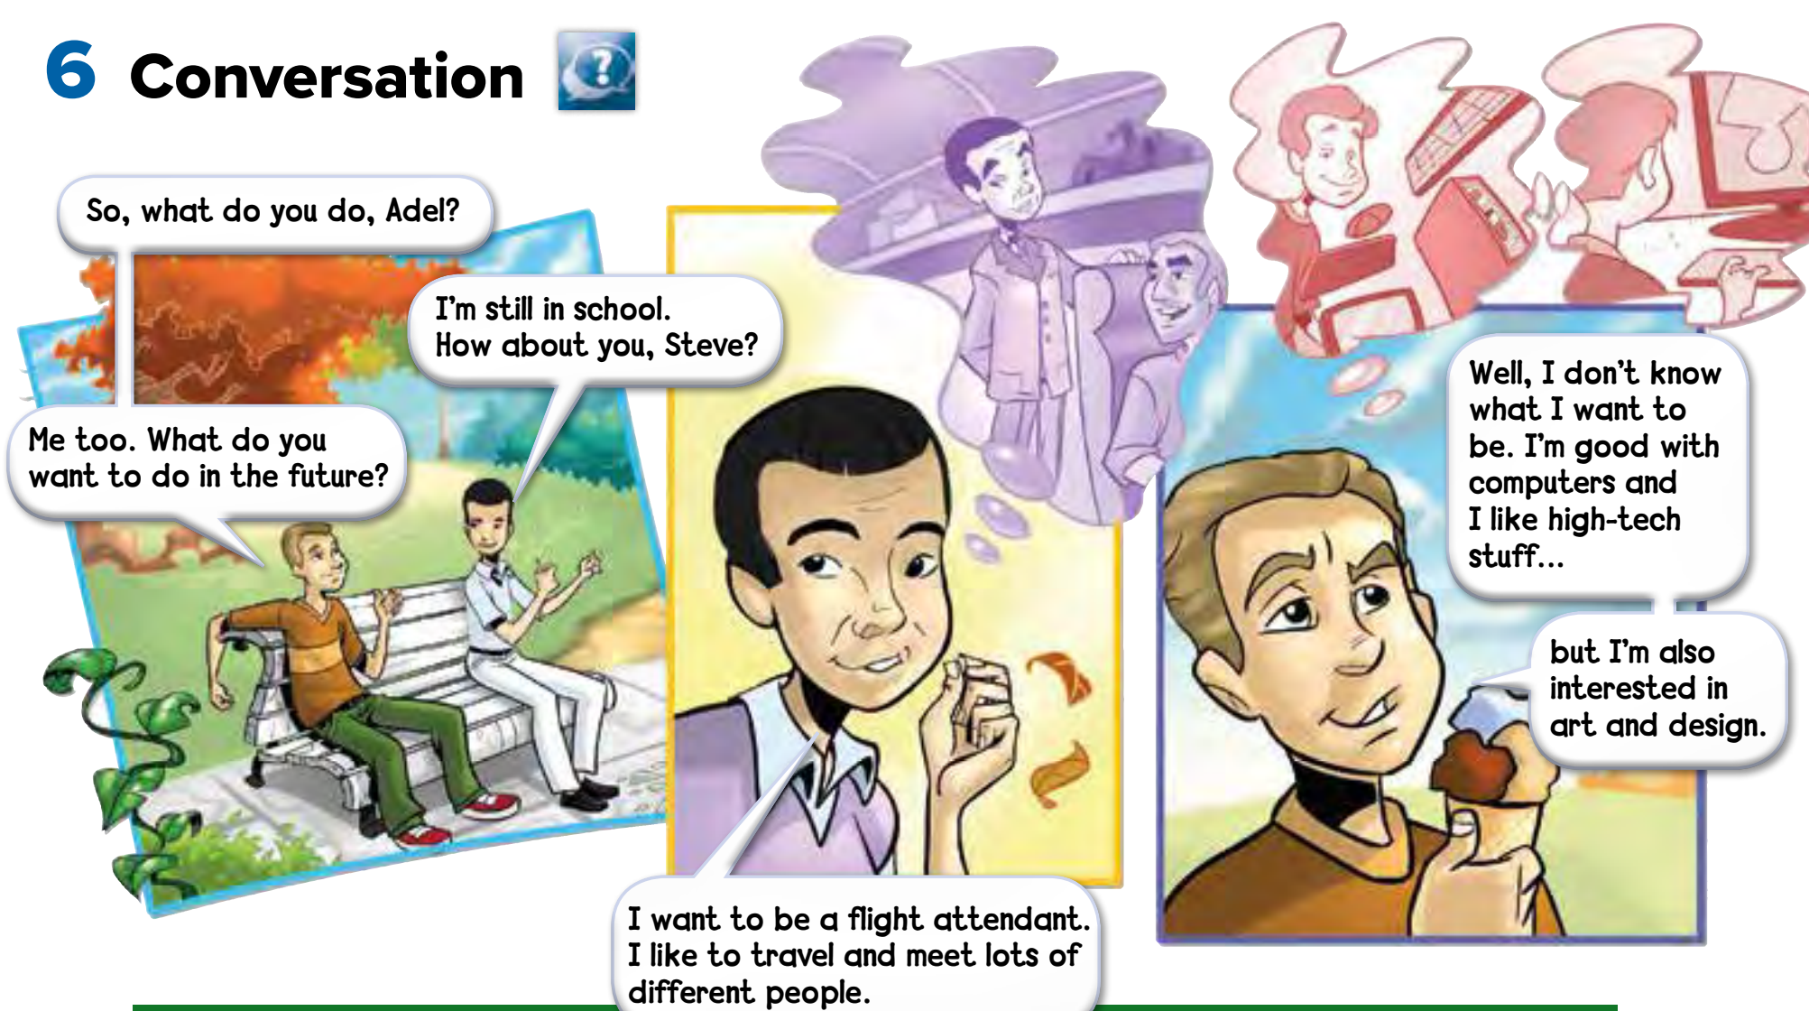

Where are they?
Page 76
Warm up
Where does aflight attendant work?
Role paly
H.W

Slide 9
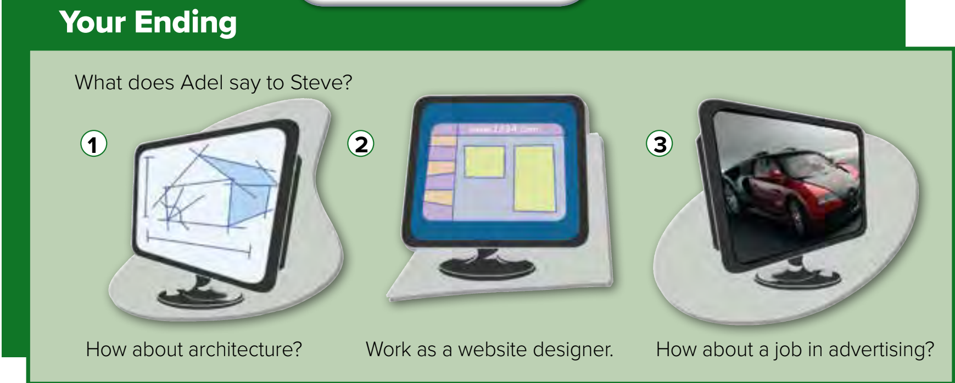


Page 76
What does an architect do?
Warm up
H.W

Slide 10

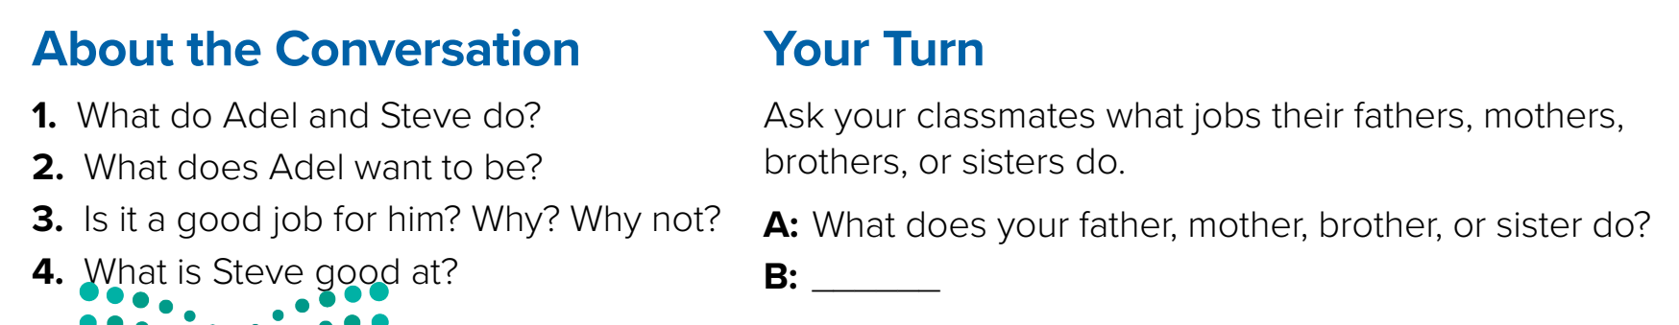
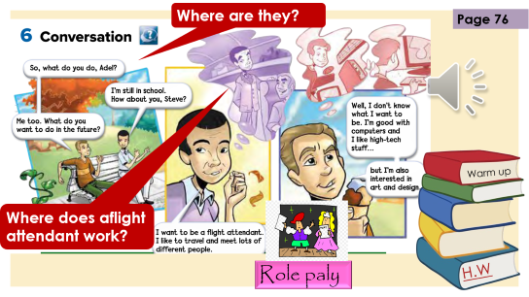
Name jobs in KSA?
They’re students
He wants to be a flight attendant
Yes, because he likes to travel
He’s good with computers
Warm up
H.W

Slide 11



Lets play
Warm up
H.W

Slide 12
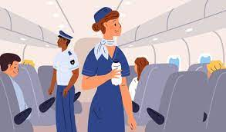



New Words
flight attendant
architecture
Art of building
advertising
اعلانات
website
Pages on internet
interested in
Like it

Slide 13
Write in your notebook
Like final test أسئلة للاختبار النهائي
Choose:
Mmmmmmm ………. mmmmmmm
( ssss – ssss – sssss)
Make a question

Slide 14





page 223 Ex(C)
for practice conversation
Warm up
H.W

Slide 15
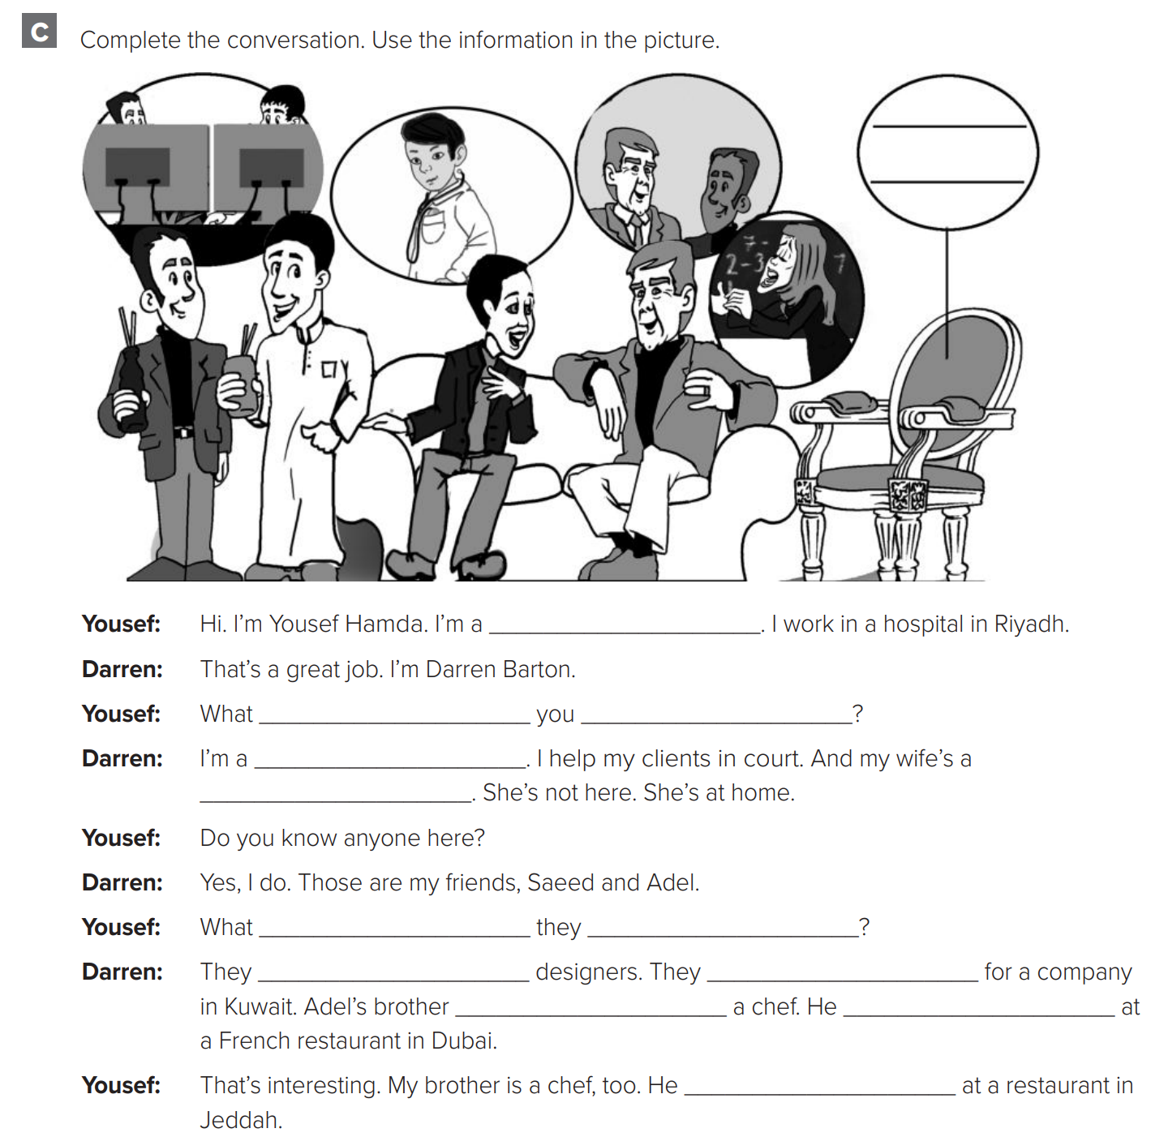
p.223
doctor
do
do
lawyer
teacher
Warm up
do
do
are
work
is
works
works
H.W

