Slide 1

Unit
9
What Do You Do?
Conversation
Page 76

Slide 2

LEARNING OBECTIVES
01 read a conversation correctly
02 practice making a conversation correctly

Slide 3




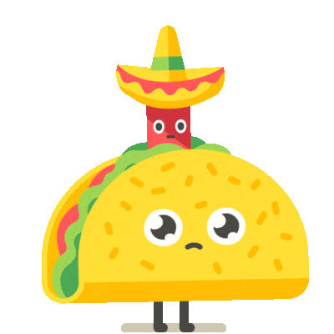

She always
( read ) Quran
A
Revision
Heba (drinks – drink )
tea every day
B
I ( eats – eat )
breakfast in the
morning
C
( Does – Do ) you
study English?
D

Slide 4
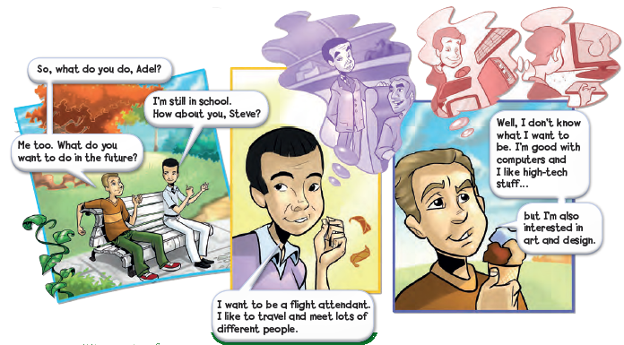
Where are the people?
What are their names?

Slide 5

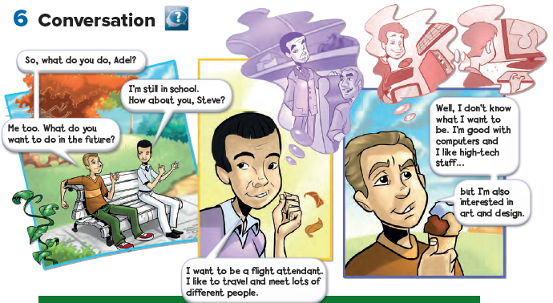

Slide 6
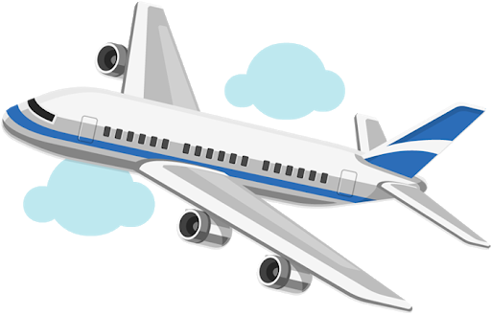
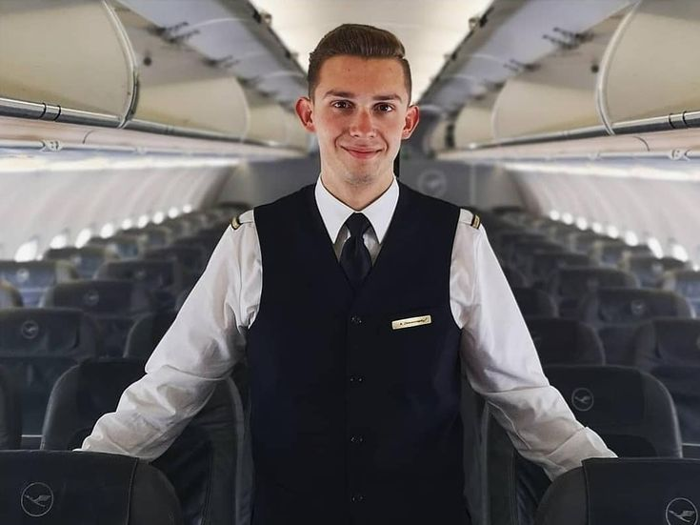
Where does a flight attendant work?
What does a flight attendant do ?

Slide 7
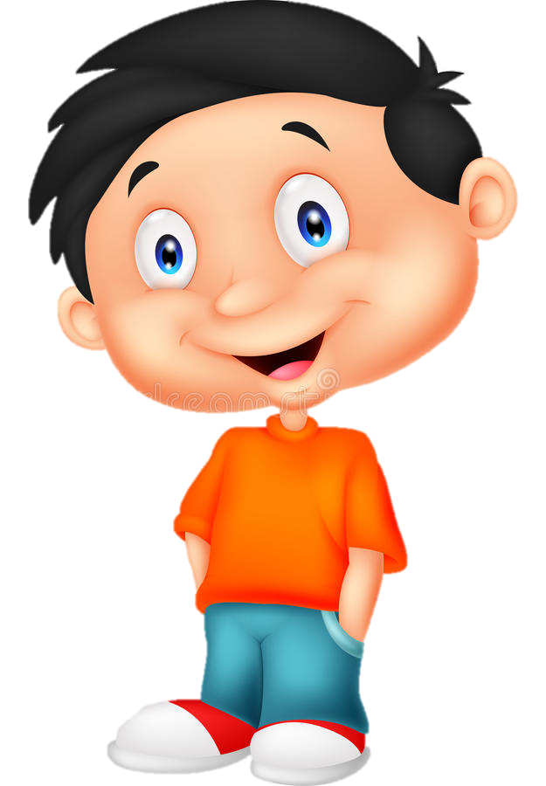
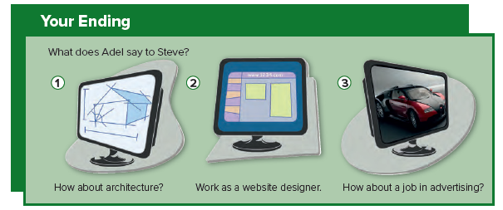
Which ending you choose ?

Slide 8
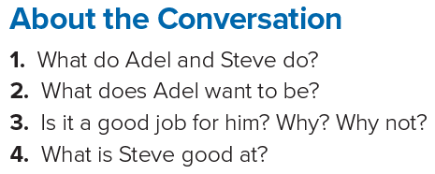
1. Adel and Steve are students.
2. He wants to be a flight attendant.
3. Yes, it is. He likes to travel and meet lots of different people.
4. Steve is good with computers.
Answers

Slide 9
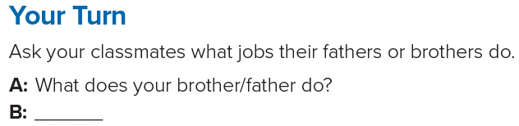
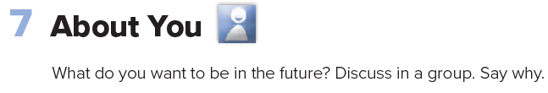

Slide 10
Homework

Slide 11
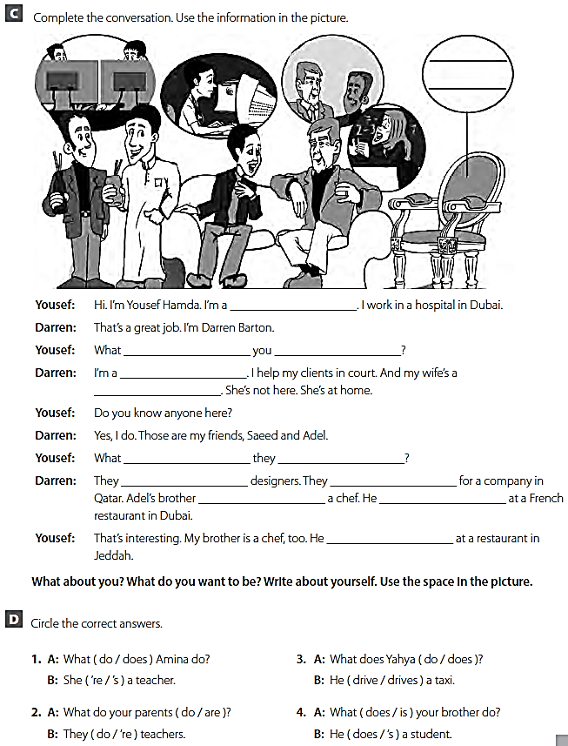
doctor
do
do
lawyer
teacher
do
do
are
work
is
works
works

