Slide 1

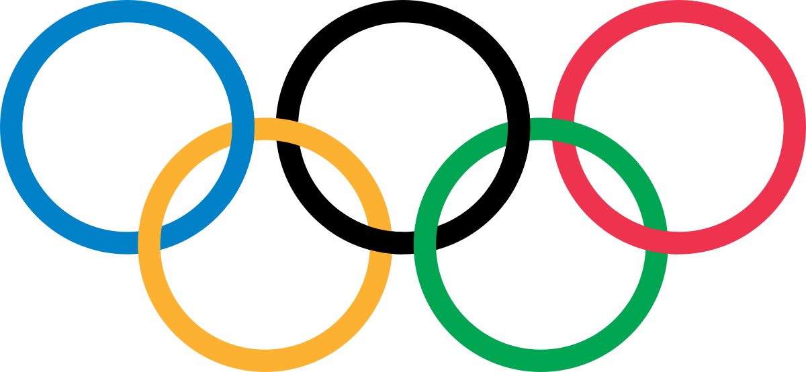
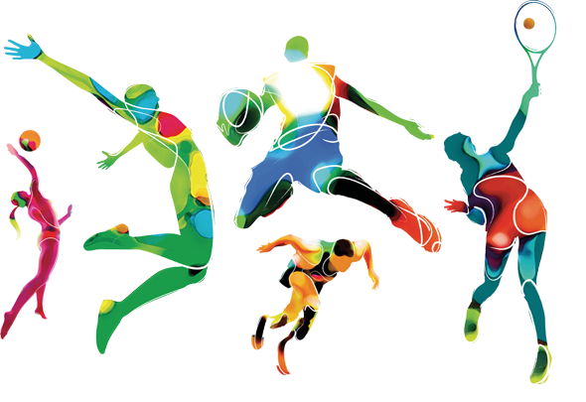
Mega Goal 4
Unit 2 - The Sporting Life
Listen and Discuss
By: Essa Al Hussaini

Slide 2

Objectives
Talk
about Olympics
Correct information according to the text
01
02
03
04
List
facts about the Olympics
Design
an Olympic flag

Slide 3

عن عائشة رضي الله عنها أنها كانت مع النبي صلى الله عليه وآله وسلم في سفر. قالت: فسابقته فسبقته على رجلي، فلما حملت اللحم سابقته فسبقني. فقال: "هذه بتلك"

Slide 4

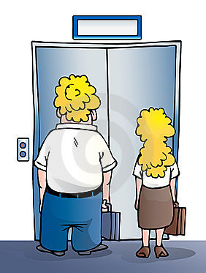

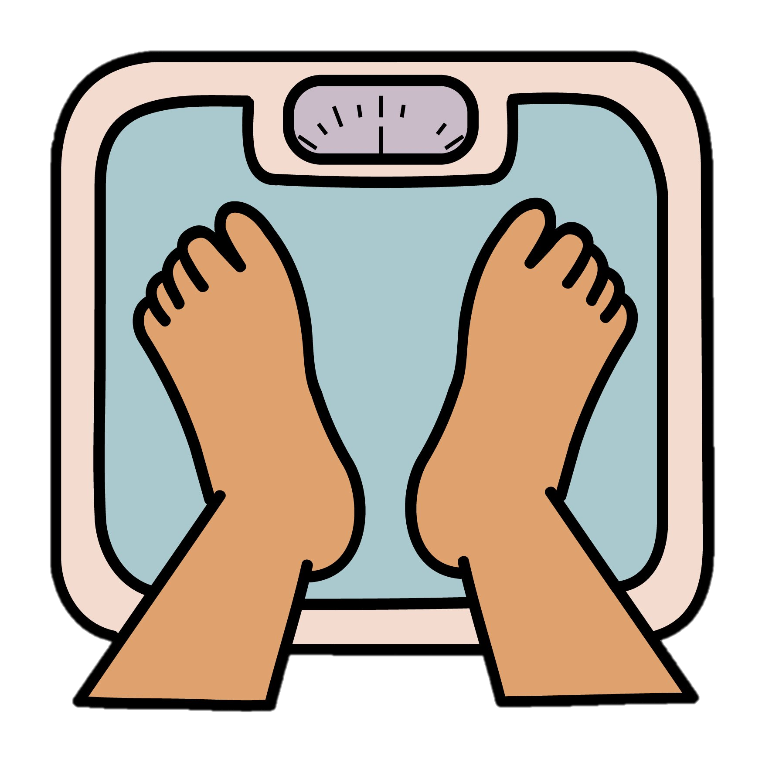

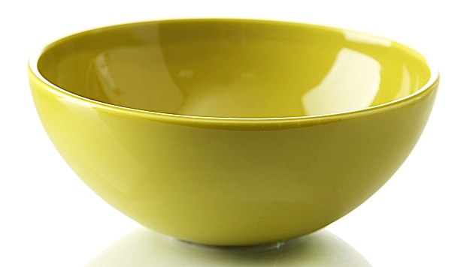
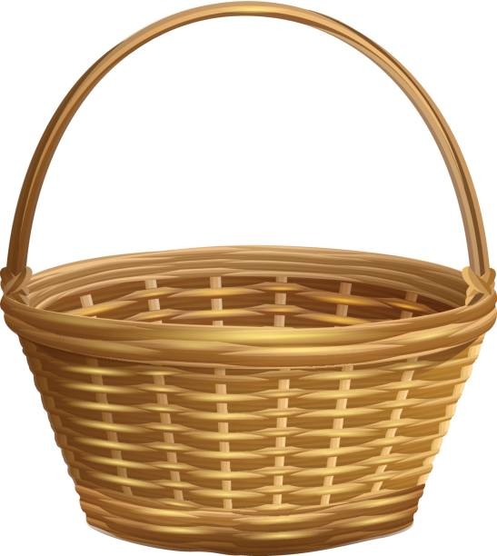
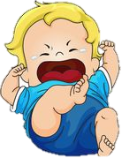
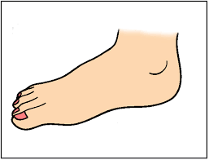
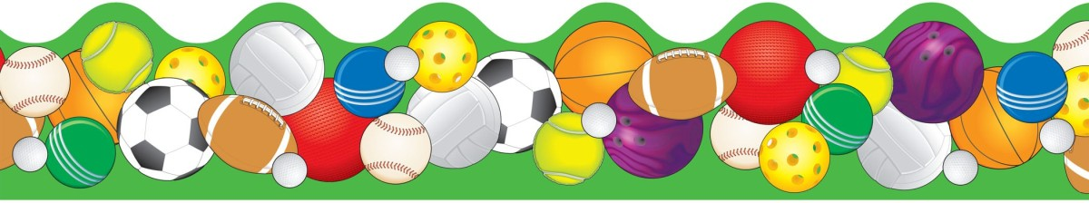
Warm Up
Let’s solve the PUZZLE
What’s the sport?
s
ing
ing

Slide 5

Warm Up
SPORTs = Football
Name some
Sports
Weird Sports
WORLD Competitions
Your favorite sports

Slide 6
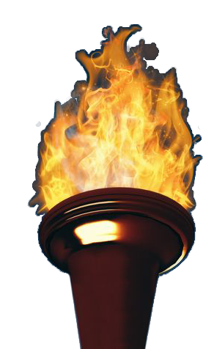
Warm Up
Which competition is that?
the Olympic Games

Slide 7
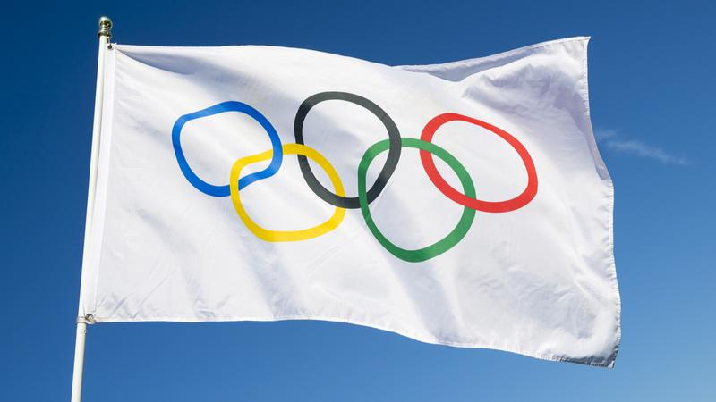
Warm Up
Let’s KNOW what you KNOW
How many
rings
does the Olympic flag have?
How many
colors
does the Olympic flag have?
What does the
5 Rings symbolize?
What does the
6 Colors represent?
How many sports
are in the Olympic Gams ?

Slide 8
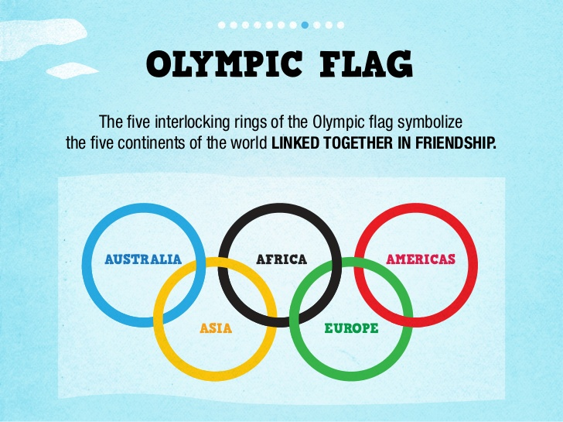
the six COLORS are those that appear on all the national flags of the world

Slide 9


Warm Up
Let’s KNOW what you KNOW
How often
do the Olympic Games
occur?
Has any
Saudi player won a prize
in the Olympic Games?
Has
KSA participated
in the Olympic Games?
Where did
the Olympic Games
begin?
What does
the winner get?
How is
the Olympic torch lit?

Slide 10
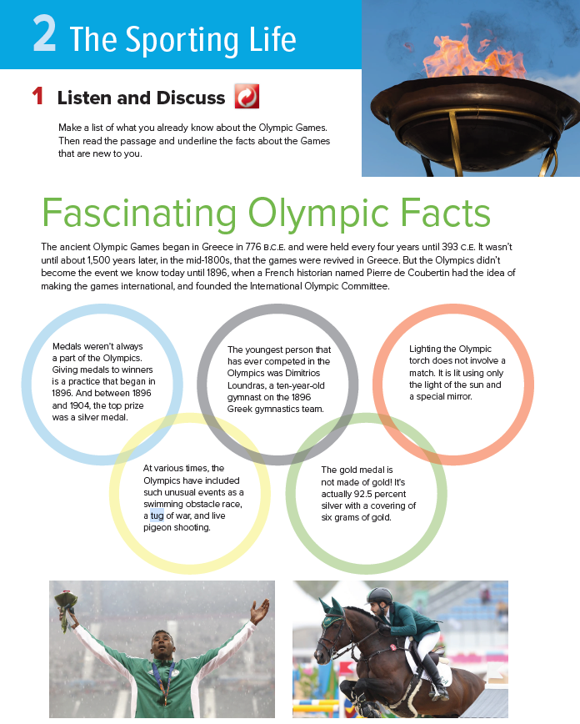
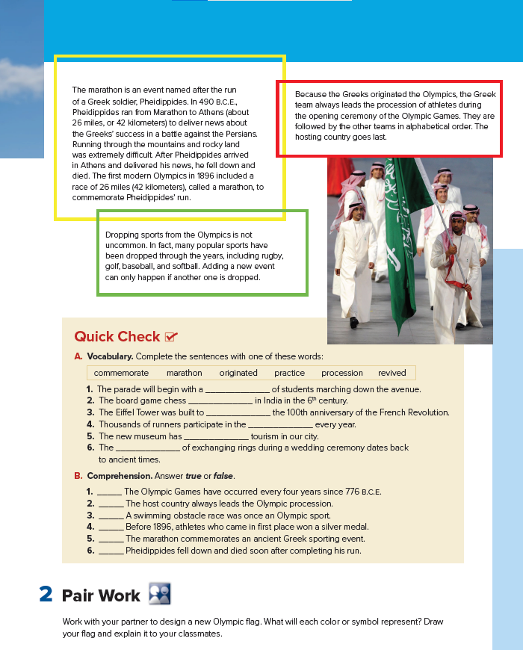
Listen & Discuss
The Sporting Life
Books open @
20 -21

Slide 11
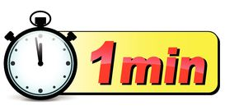


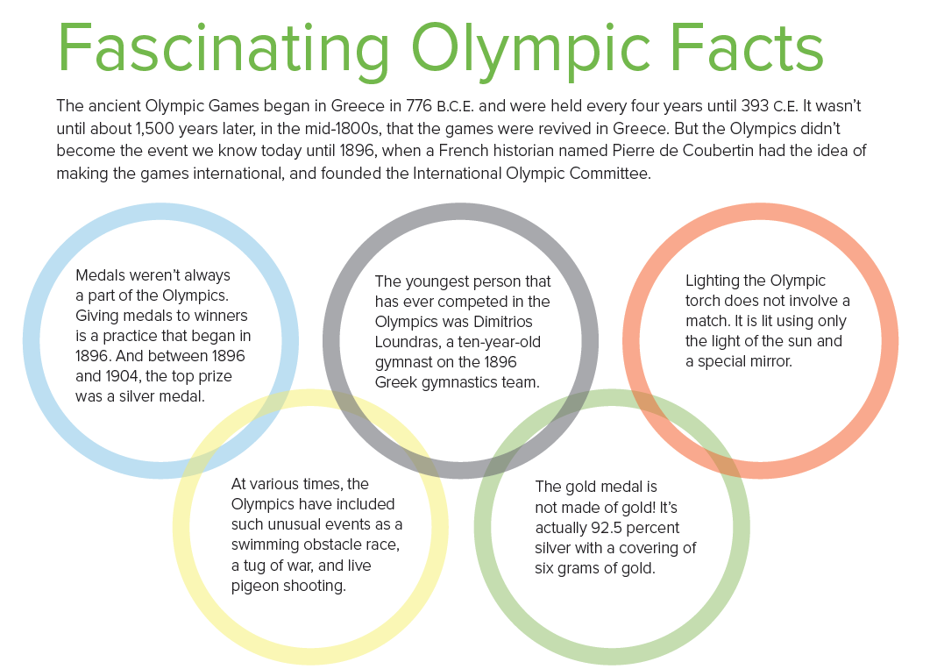
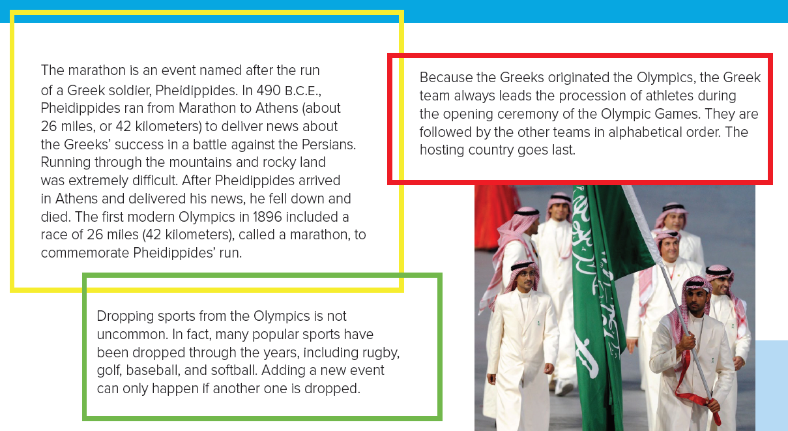
Use your BOOK @ 20-21
Circle Names & Dates
Listen & read a long

Slide 12
When
Scanning
was the youngest person
competed in the Olympic Games ?
were medals
given to winners?
was a marathon game
included in the Olympic Games ?
did the Olympic Games become
international?
were the Olympic Games
revived?
did the Olympic Games
begin?
776 BCE
began
Mid-1800s
revived
1896
international
Youngest athlete
Giving medals
Marathon

Slide 13
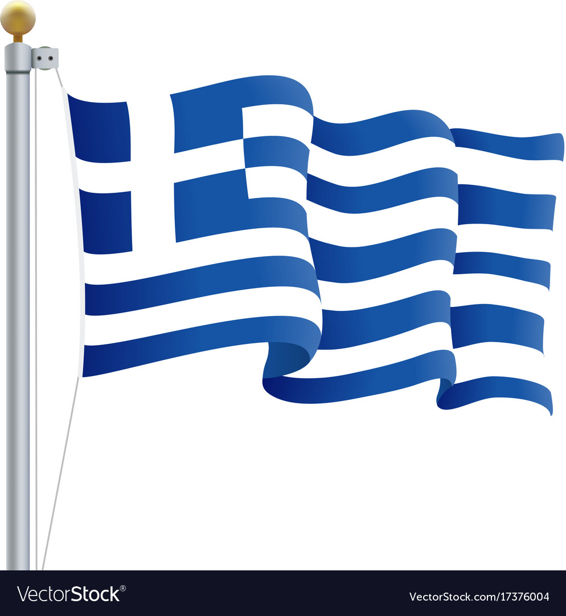
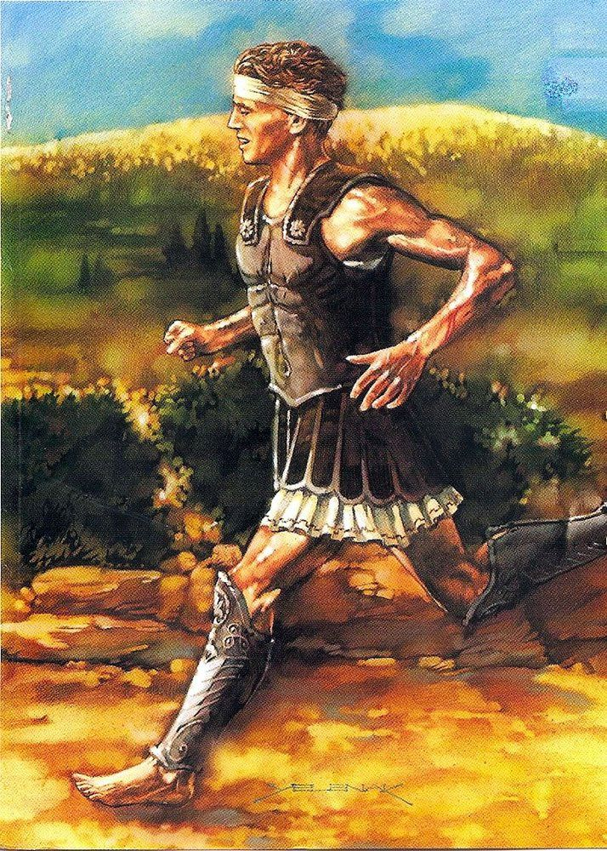
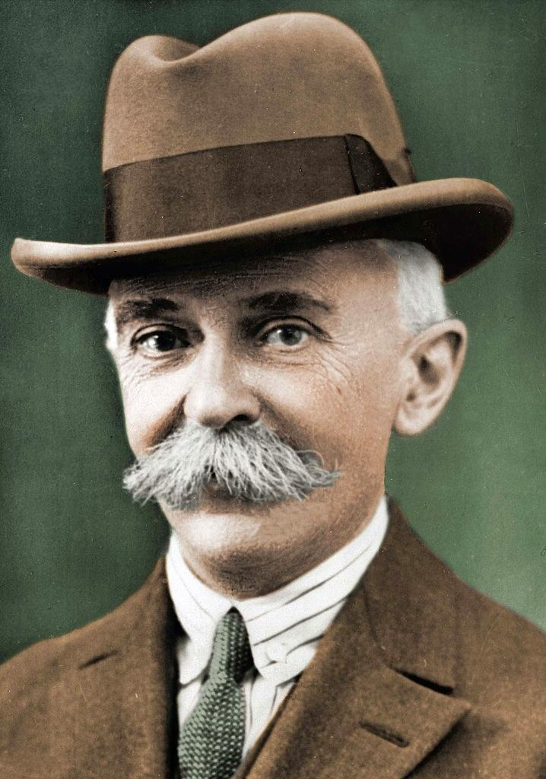
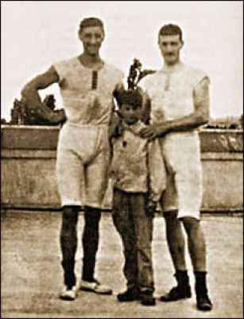
Who
Scanning
was the messenger
about the Greeks’ success?
had the idea of making
the games international?
was the youngest person competed in the Olympic Games?
originated
the Olympic Games?
the Greek
a Greek soldier Pheidippides
a French historian
Pierre de Coubertin
a Greek gymnast
Dimitrios Loundras

Slide 14

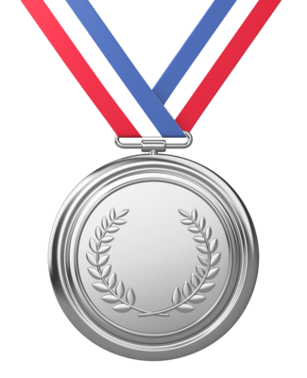
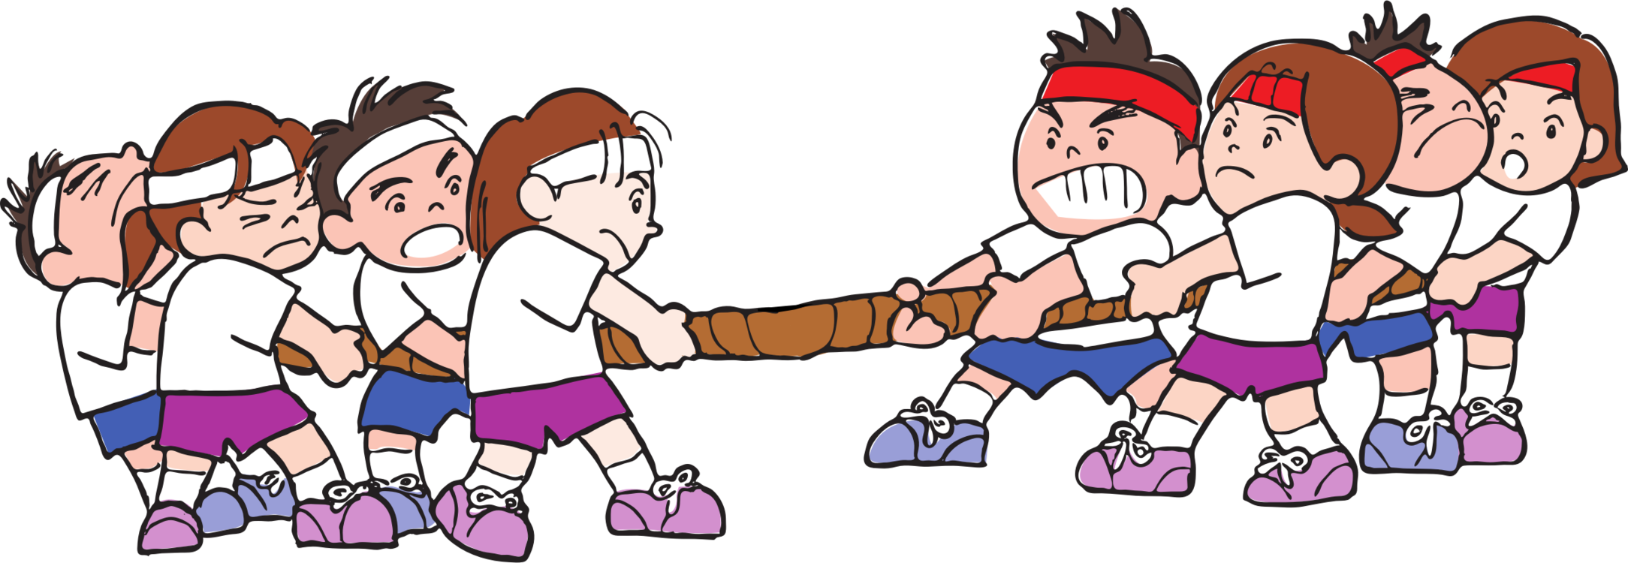

Discuss
.. stand for?
Before the Common Era
the Common Era
What was the
Top Prize?
How old was the youngest athlete?
How is the Olympic torch lit?
a word means
Something used to start a fire?
Give examples of
unusual events
How much gold is there in
a gold medal?

Slide 15
Discuss
Where did the messenger
start running?
Why does the Greek team always lead the procession?
Which country
goes last?
What happened to the messenger?
a word means
removing from?
How can a new event be added to the Olympic Games?

Slide 16
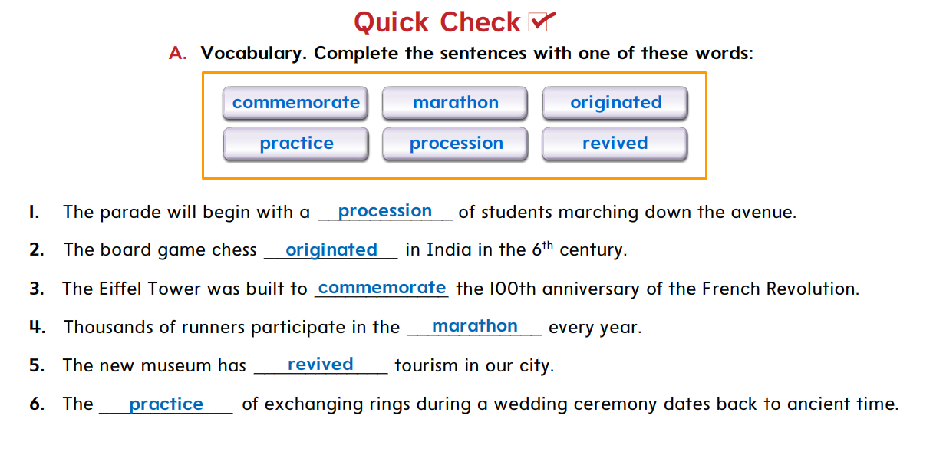

St Book @ 21

Slide 17
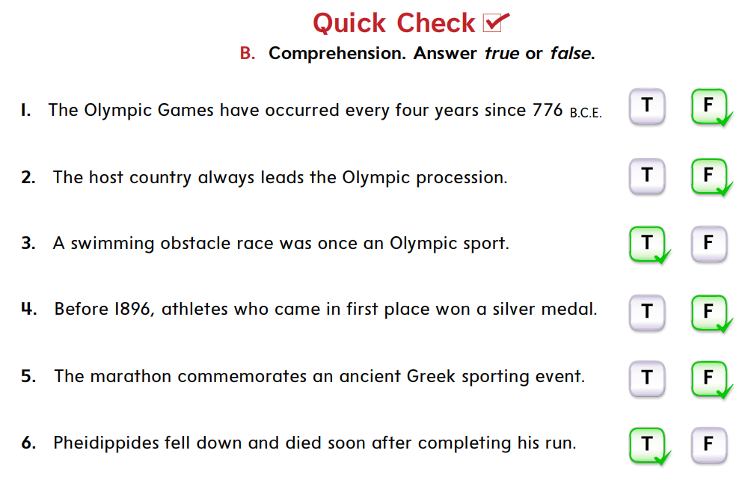
St Book @ 21
T / F
T / F
T / F
T / F
T / F
T / F

Slide 18

Your Turn
Design a new Olympic flag
Explain it to your classmates

Slide 19

QUIZ TIME

Slide 20

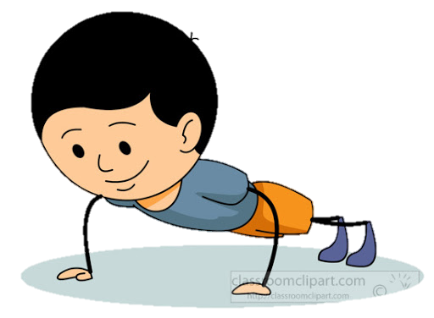
They represent the number of continents in the Olympic Games flag
The 6 colors
The 5 rings

Slide 21
Greece
Olympic Games started in …...
German
France

Slide 22
Medal
……… is lit by using the light of sun and mirror
Torch
Prize

Slide 23
pigeon
A game in which two teams pull on a rope
softball
Tug of war

Slide 24
parade
2 words mean
a line of people moving together in a ceremony
marathon
procession

Slide 25



Vocabulary TIME
https://wordwall.net/play/9996/623/382

Slide 26
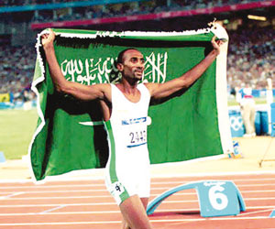
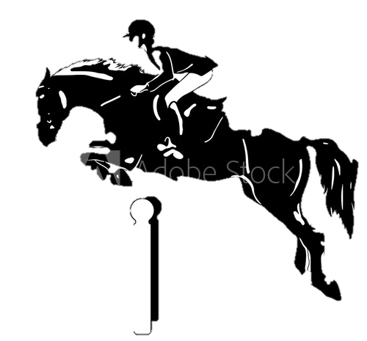
Saudi Arabia at the Olympics
Khaled Al Eid
2000 Sydney
Hadi Soan
Ramzy Al Duhami
Abdullah Al Saud
Kamal Bahamdan
Abdullah Sharbatly
2000 Sydney
2012 London

Slide 27
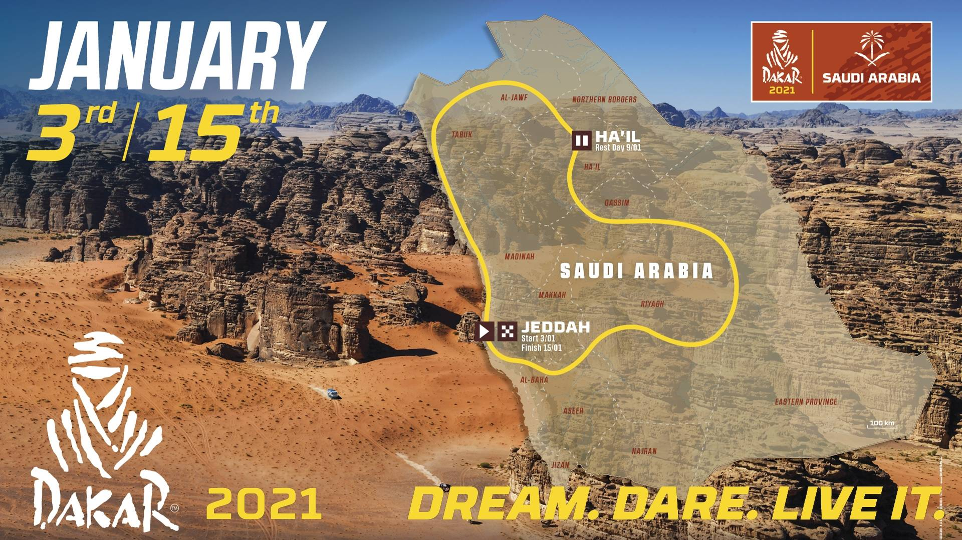
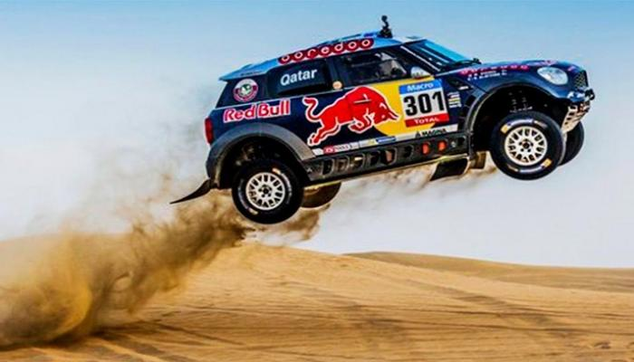
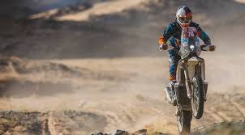
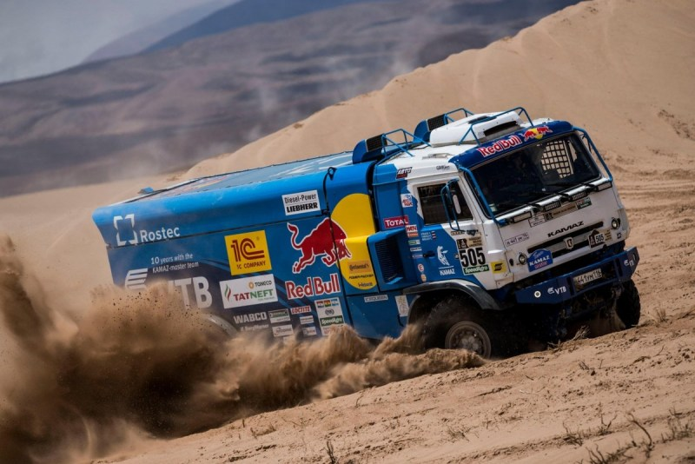
The 43rd edition of the Dakar was held in Saudi Arabia

Slide 28

11
HOMEWORK
Workbook page

Slide 29



