Slide 1
Good
Morning
اللَّهُمَّ انْفَعْنِي بما علمتني، وعلمني ما ينفعني، وَارْزُقْنِي علماً ينفعني

Slide 2
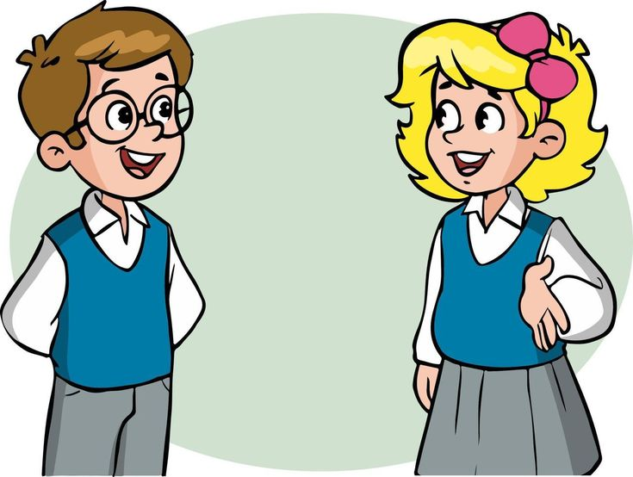
How are you today ?

Slide 3
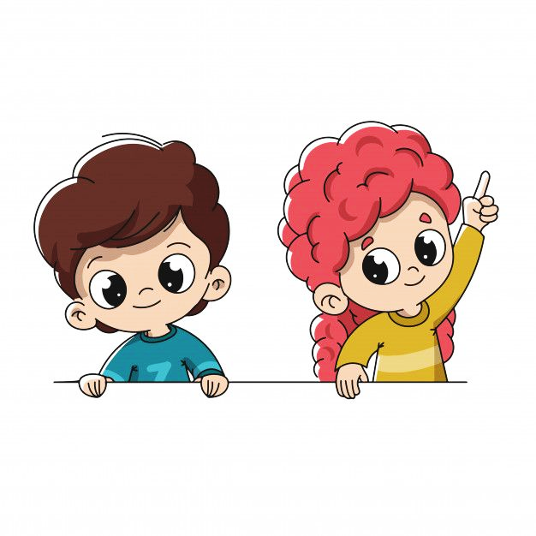
Revision
Use present simple tense in sentences
Build up questions and answers using (What).
Produce the different “S” sounds at the verb endings

Slide 4
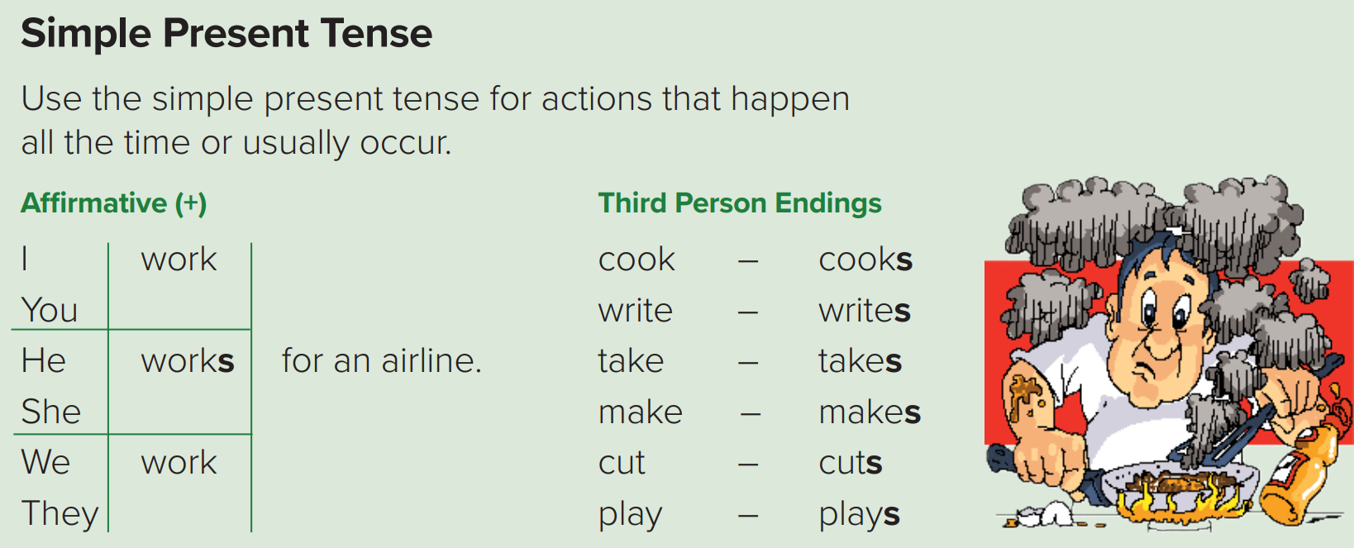

Slide 5
Let’s look at: the Present Simple Table
I
You
work
for an airline.
They
We
He
works
for an airline.
She
It
Notes:
. مع الفاعل المناسب. irregular verb Haveتوضيح استخدام فعل المضارع البسيط و

Slide 6
More example of Third-person Endings “S’
If the verb follows a third person singular noun such as
(he, she, Ahmed, Sarah, etc )
Then an “-s” will be added to the verd.
Read
She
reads
the story book.
Work
He
works
at the library.
Cut
cuts
Saud
the line.
Notes:
توضيح استخدام s بالفعل على حسب الفاعل

Slide 7
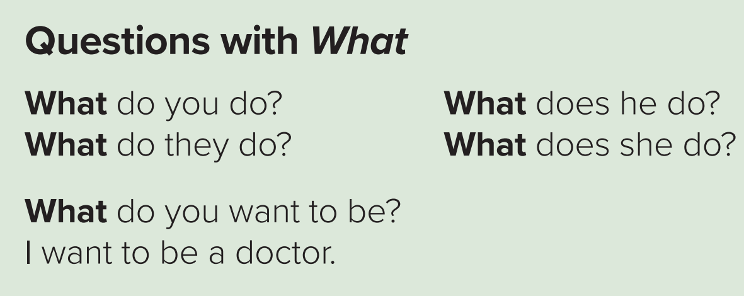
Moving on to the next grammar point
Notes:
. مع الفاعل المناسب. irregular verb Haveتوضيح استخدام فعل المضارع البسيط و

Slide 8
For example
Nice
So,
What do you do?
I’m a teacher.
Question Word + do\does + subject + main verb ?
What does she do?
She’s a chef.
What does he do?
He’s a mechanic.
What
do
they
do?
What
does
she
do?
Notes:
توضيح طريقة كتابة السؤال

Slide 11
Objectives
Today you will learn about..
Ask and answer questions about jobs and place of work.
Complete a chart with information from a listening text.
Recognize the different “s” sounds at the verb endings.
Practice a conversation about jobs and answer the questions.

Slide 13
Listen to each person talk about his job. Complete the chart.
Chef
At the restaurant
Salesperson
At the store.
Teacher
At the school.
Doctor
At the hospital.
Nice
Let’s listen again.

Slide 14
Listen to the endings of the following verbs. Then practice.
/s/
Mr. Penn writes for a magazine.
Mr. Chang works in a bank.
Pierre cooks in a restaurant.
/z/
John sells cameras in a store.
My father drives a bus.
My brother plays volleyball.

Slide 16
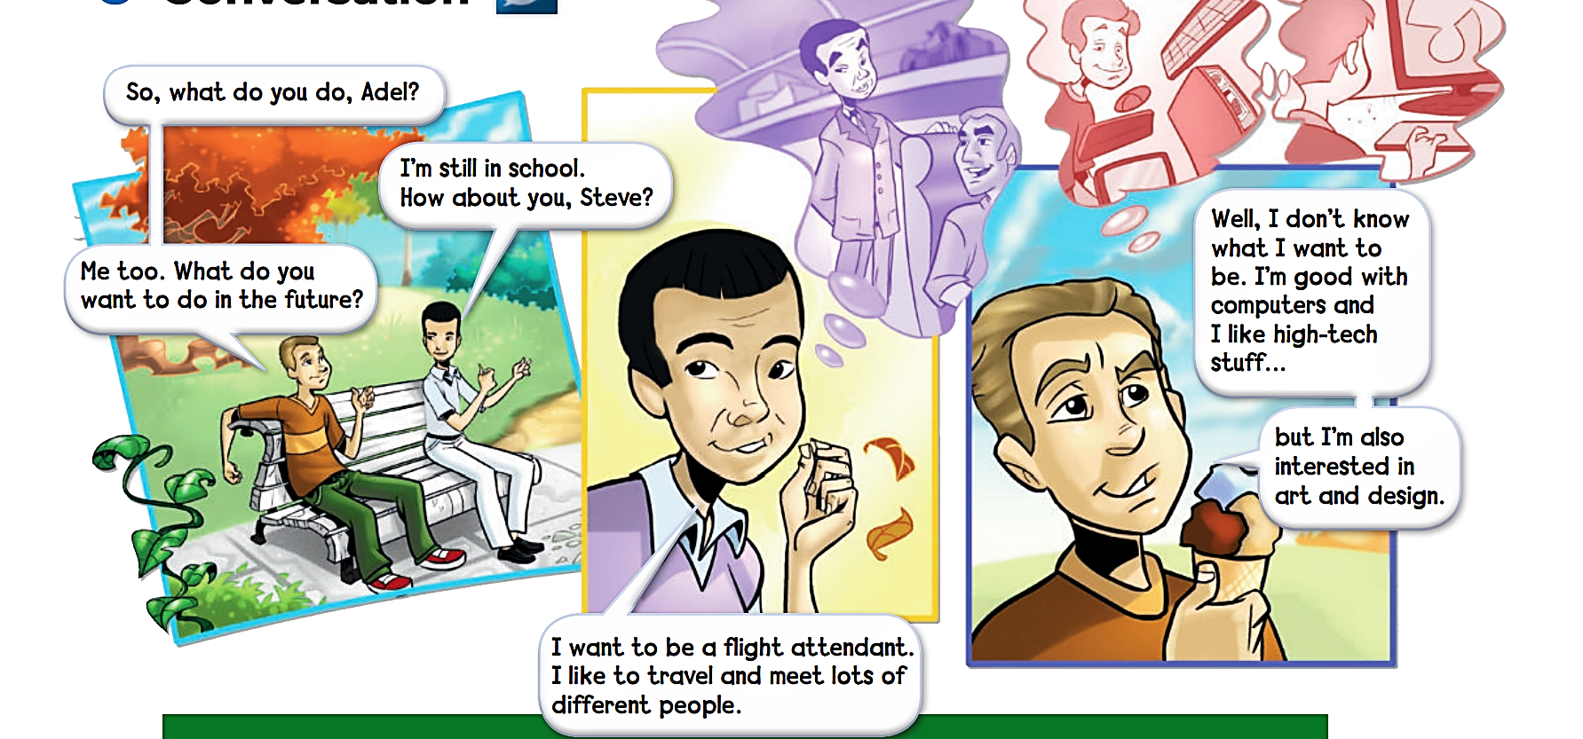
What would you like the ending to be ?
76

Slide 17
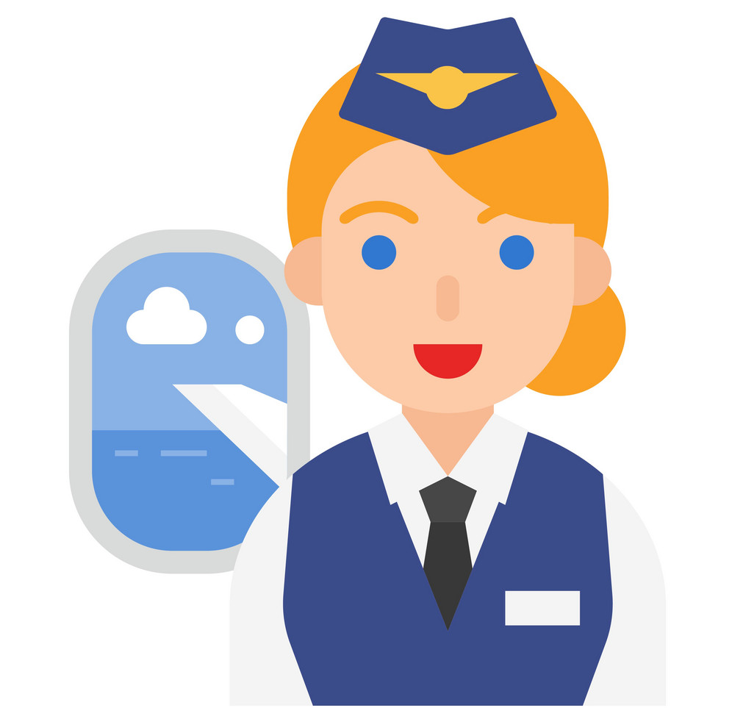
Conversation's Terms
Flight attendant
Architect
Advertising
responsible for passenger safety and comfort.
Designs building
to call the attention of the public to buy a product or service.

Slide 18
About the conversation
1. What do Adel and Steve do?
2. What does Adel want to be?
3. Is it a good job for him? Why? Why not?
4. What is Steve good at?
Adel and Steve are students.
He wants to be a flight attendant.
Yes, it is. Because he likes to travel and meet lots of different people.
Steve is good with computers.

Slide 19
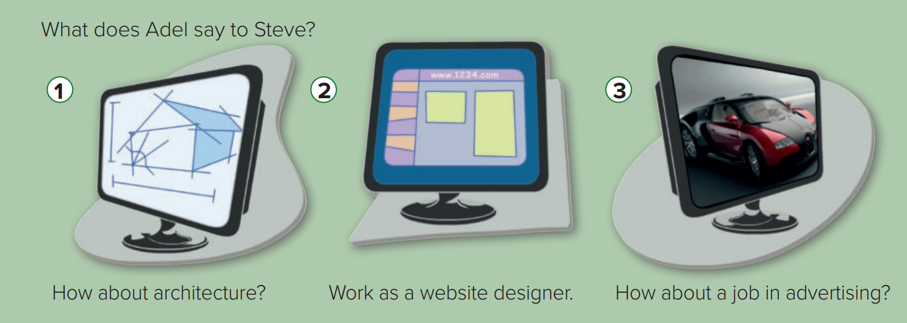

Slide 20
Pair Work

Slide 21
Ask your classmates what jobs their fathers, mothers, brothers, or sisters do.
A: What does your father, mother, brother, or sister do?
B: ______
My father is a policeman.
My brother is a solider.
My mother is a chef.
My sister is a doctor.

Slide 22
Your Turn
Nice
What do you want to be in the future?
Discuss in a group. Say why.
I want to be a ___________ because I like ___________.
doctor
helping sick people.

Slide 23
Book Time
Open page 75 - 76
Let’s fill out the listening
chart &
‘about the conversation’
answers together

Slide 24
Linking this lesson to my Religion
We should always remember that Allah Almighty
Prepared everything good for us in the future
You just have to keep believing and make dua’a and do the 5 prayers and do good deeds.
This can be your favorite daily dua’a :
اللهم إني استودعتك مستقبلاً لا أعلم خفاياه ولكني أعلم أنك خير مدبّر وخير من أُودِعت له الودائع، فأجعل القادم أجمل مما مضى ، اللهم إليك رفعت حاجتي وأنت بحاجتي أعلم، فيسر ولا تعسر وعجل ولا تؤجل وبارك ووفق وطمئن قلبي ووفقني إنك على كل شيء قدير.

Slide 26
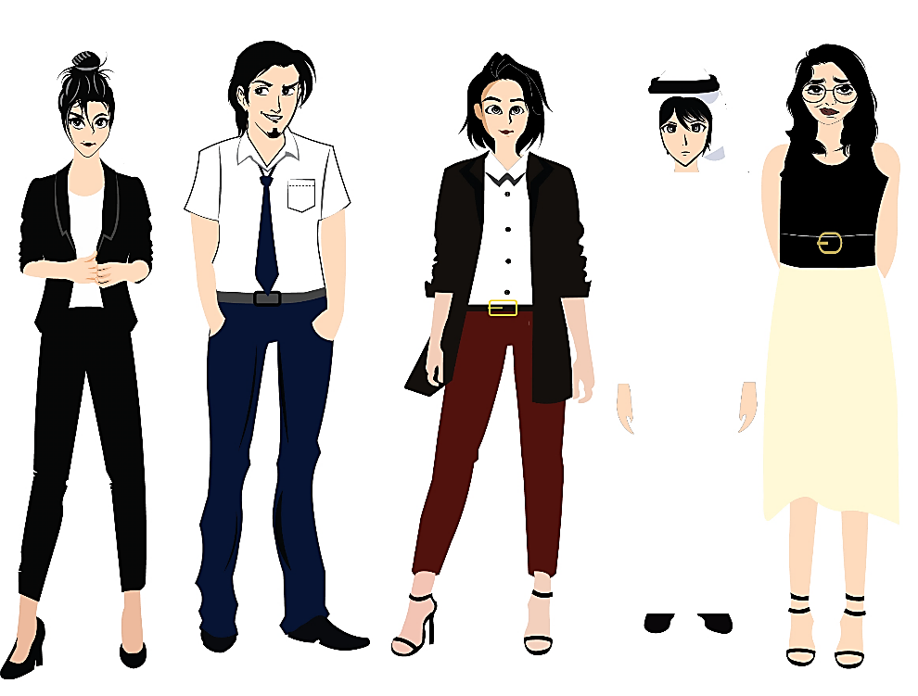
تم تصميم هذا العرض من قبل: فريق عمل البوابة الإنجليزية ، وهو مجاني لكي يستفيد منه معلمي اللغة الإنجليزية.
هذه الشريحة تعتبر كـ"حفظ حقوق" نتمنى عدم حذفها حال مشاركة العرض مع معلمين آخرين.
نسمح بحذف الحقوق في حالة واحدة فقط: اذا أراد معلم الإنجليزي إضافة هذا العرض كـ انتاج معرفي خاص فيه.

