Slide 1

Good
Morning
اللَّهُمَّ انْفَعْنِي بما علمتني، وعلمني ما ينفعني، وَارْزُقْنِي علماً ينفعني

Slide 2
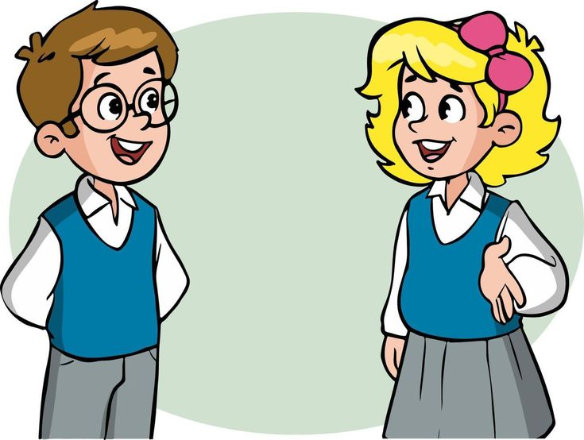
How are you today ?

Slide 3
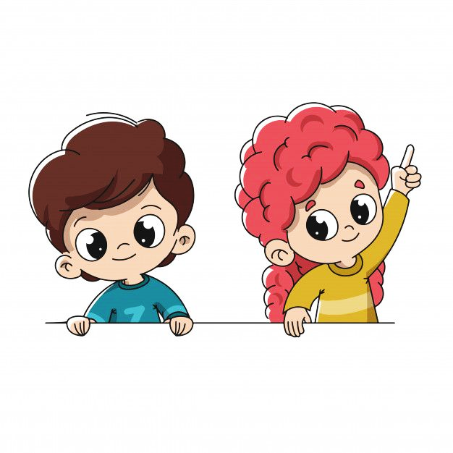
Revision
Writing – Form, Meaning and Function:
Writing: Read a text for specific information
Writing: Use personal notes to write about their dream job.
Form\Meaning & Function : Differentiate between the use of because \ so.
Form\Meaning & Function : Differentiate between the use of and \ but.

Slide 4


A. Read about Khalid’s dream job. Answer the questions.
People always ask me, “What do you want to be when you grow up?” I tell them that I want to be a teacher. Then they ask me, “Why?” Well, my parents are teachers and they are very happy with their jobs. My father teaches math at a college, and my mother teaches at a primary school. But I want to be a science teacher at a high school. I’m really interested in chemistry and physics, and I like to do experiments. I like to help my younger brothers with their homework, so I think I can be a good teacher. When I explain things to them, they usually understand. A teacher’s job is important because education is important. It’s a difficult job sometimes, but it’s rewarding when students learn from you.

Slide 5

We did the activity
1.What does “grow up” mean?
2. Why does Khalid want to be a teacher?
3. What does Khalid want to teach? Why?
4. Why do you think he says “it’s a difficult job sometimes”?
5. What do you think “rewarding” means?
To become adult.
His parents are teachers, and they are happy with their jobs,
He wants to be a science teacher at a high school because
he’s interested in chemistry and physics and likes to do experiments.
Because it’s challenging and need to be up to date with the new teaching technologies and resources.
Page 78
Satisfying or pleasing.

Slide 6
Writing Corner
1. Use because to explain why. Use so to explain a result.
I want to be a pilot because I’m interested in planes.
Reason
I like to help my younger brothers with their homework, so I think I can be a good teacher.
A result or consequence

Slide 7
Writing Corner
2. Use and to connect similar ideas. Use but to connect contrasting ideas.
1. I really like chemistry and physics.
2. My parents are teachers and they are happy.
3. My mother teaches math at a primary school, and my brother teaches art at a high school.

Slide 8
Writing Corner
2. Use and to connect similar ideas. Use but to connect contrasting ideas.
1. I really like chemistry and physics, but I don’t like history.
2. My parents are teachers and they are happy, but my sister is a doctor.
3. My mother teaches at a primary school, but I want to be a science teacher at a high school.

Slide 9


Slide 10
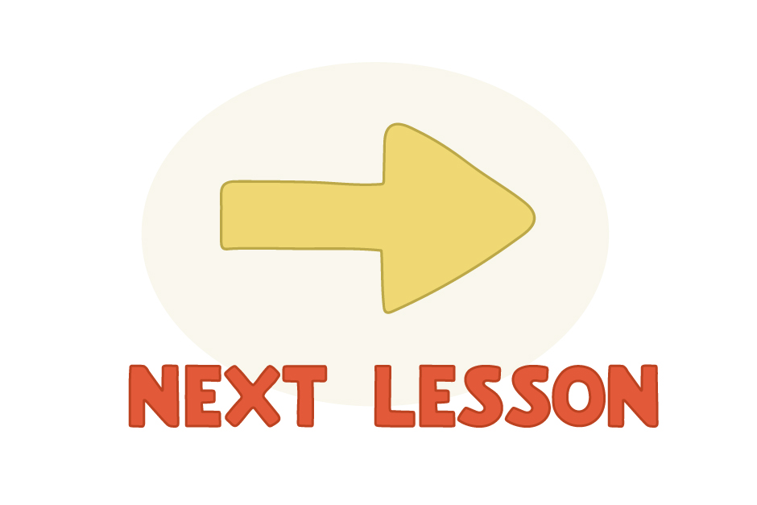

Slide 11


We have a new unit today

Slide 12


Objectives
We will learn about..
List several school subjects.
Describe subjects.
Describe people.

Slide 13


Slide 14

Before we start let me ask you some questions

Slide 15


At your school
who teaches you science ?

Slide 16
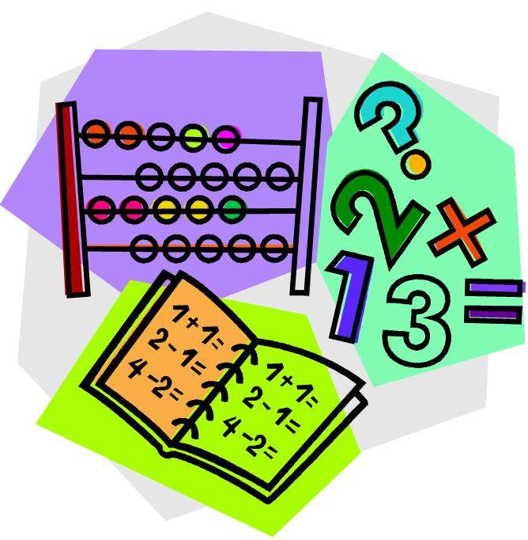

At your school
who teaches you math ?

Slide 17


Slide 18


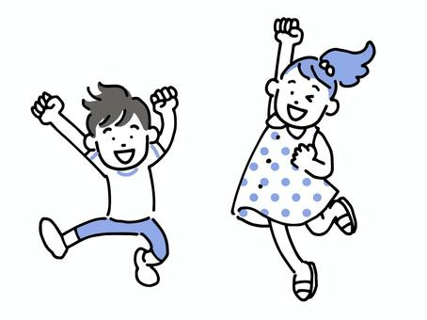



Adjectives
Interesting
Fun
engaging or exciting and holding the attention or curiosity,
something that provides amusement or enjoyment
Boring
difficult
lack of interest
hard to do, make, or carry out.

Slide 19


Adjectives
Easy
Simple effortless task.
Challenging
challenge is something new and difficult which requires great effort and determination.

Slide 20
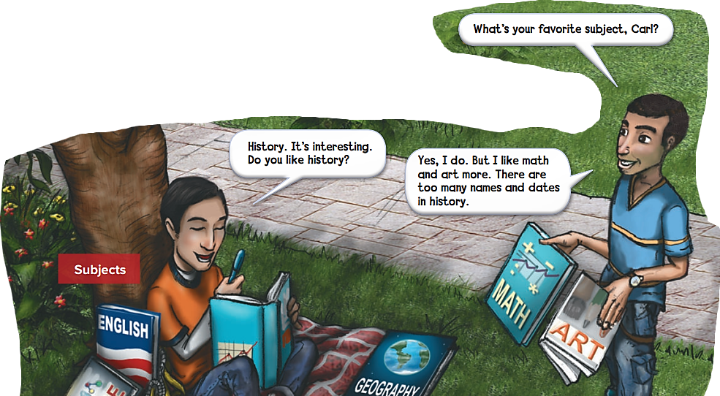

Slide 21


Slide 22
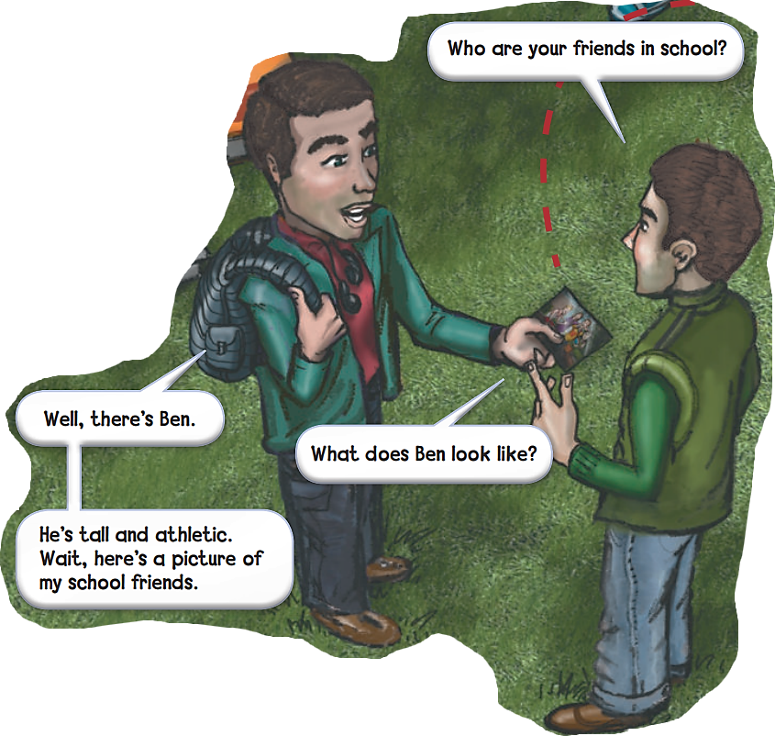

Slide 23
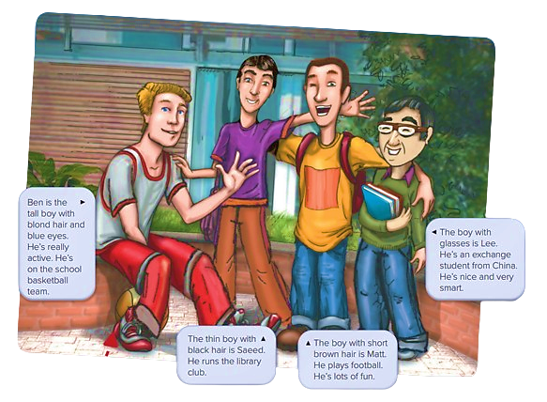

Slide 24


We say PE for physical education.

Slide 25
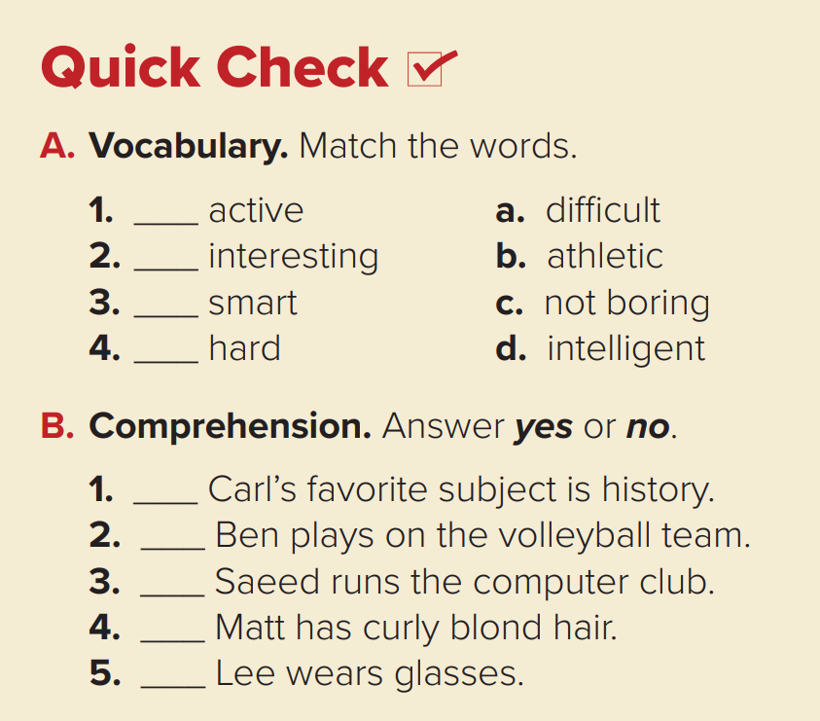

Nice
b
c
d
a

Slide 26
Nice
Yes
No
No
No
Yes

Slide 27

Pair Work

Slide 28

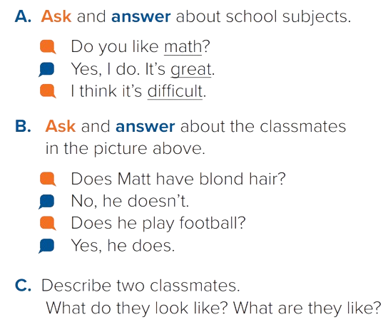
Nice

Slide 29
Nice

Slide 30

Your Turn
Nice

Slide 31
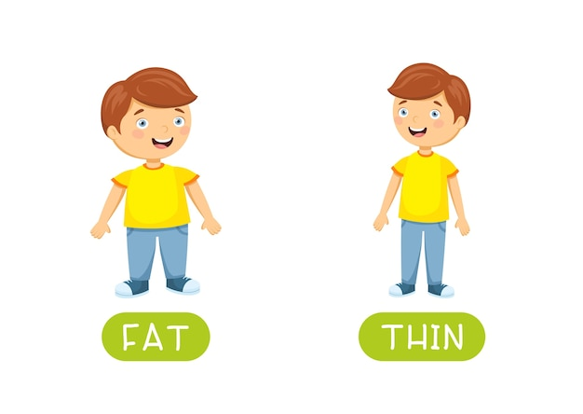
What does he/she look like?
=physical appearance.
He’s/She’s thin.

Slide 32

What’s he/she like?
= personality
He’s/She’s friendly

Slide 33

START

Slide 34


Slide 35

Work Book
Open page 80
Practice the vocabulary
for subjects’ names and activities.
Notes:
الرجاء النقر على زر الأنشطة الكتابية المحددة للانتقال لها لتوضيح الحل.

Slide 36
Linking this lesson to my Country.
Education in Saudi Arabia.
The system is open to all citizens, and provides students with free education, books and health services. While the study of Islam remains at its core, the modern Saudi educational system also provides quality instruction in diverse fields of arts and sciences
Alhamdulillah our country provides us with free educational services, to improve the academic backgrounds of their citizens and give them opportunities to study what suits them.

Slide 37


Slide 38

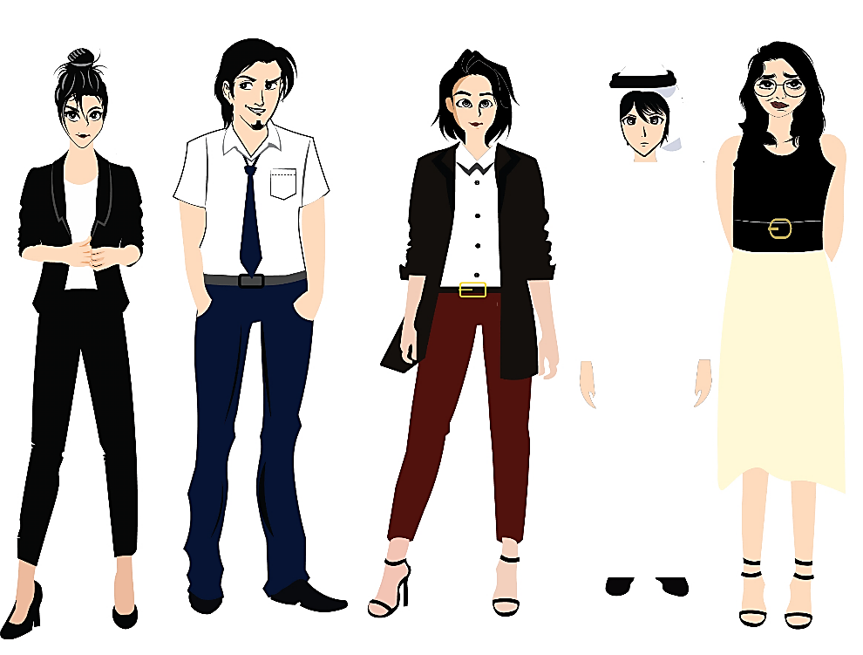


تم تصميم هذا العرض من قبل: فريق عمل البوابة الإنجليزية ، وهو مجاني لكي يستفيد منه معلمي اللغة الإنجليزية.
هذه الشريحة تعتبر كـ"حفظ حقوق" نتمنى عدم حذفها حال مشاركة العرض مع معلمين آخرين.
نسمح بحذف الحقوق في حالة واحدة فقط: اذا أراد معلم الإنجليزي إضافة هذا العرض كـ انتاج معرفي خاص فيه.

