Slide 1

Good
Morning
اللَّهُمَّ انْفَعْنِي بما علمتني، وعلمني ما ينفعني، وَارْزُقْنِي علماً ينفعني

Slide 2
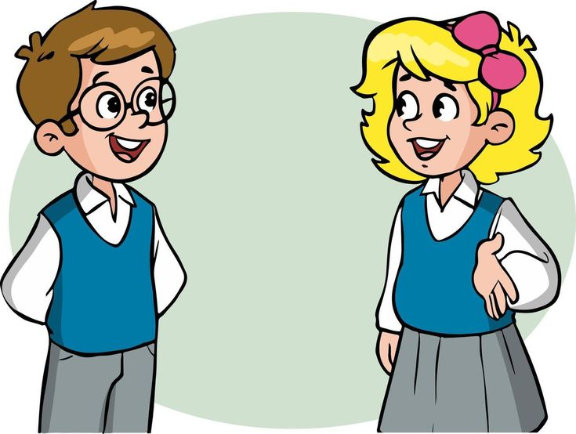
How are you today ?

Slide 3
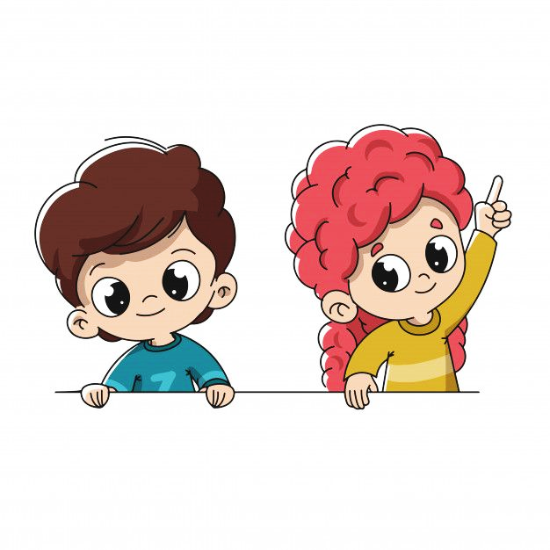

Revision
Listen & Discuss:
List several school subjects.
Describe subjects.
Describe people.

Slide 4

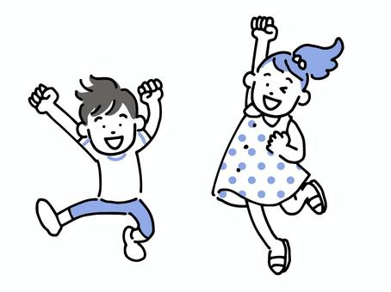

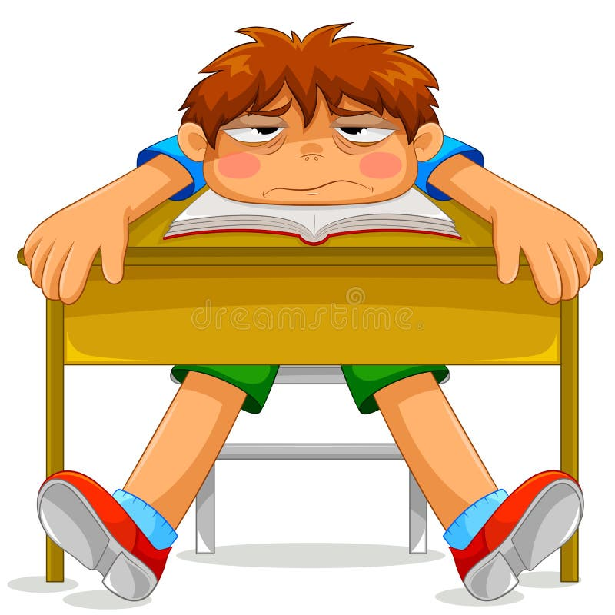

Adjectives
Interesting
Fun
engaging or exciting and holding the attention or curiosity,
something that provides amusement or enjoyment
Boring
difficult
lack of interest
hard to do, make, or carry out.

Slide 5
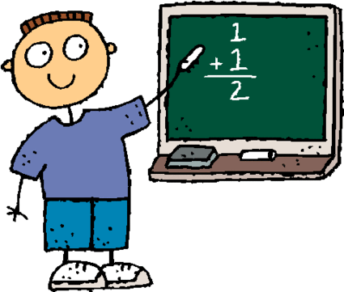

Adjectives
Easy
Simple effortless task.
Challenging
challenge is something new and difficult which requires great effort and determination.

Slide 6
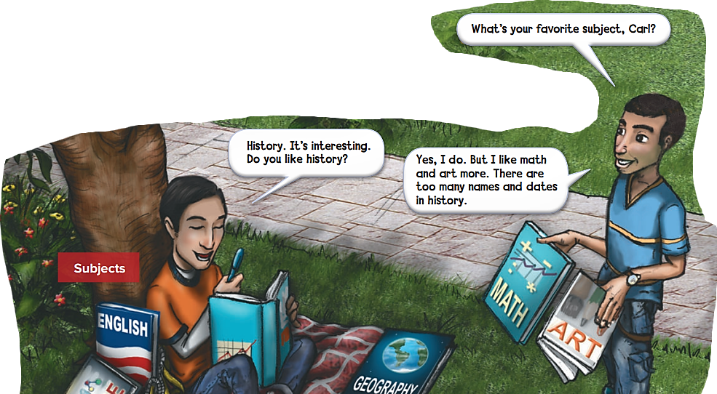

Slide 7


Slide 8
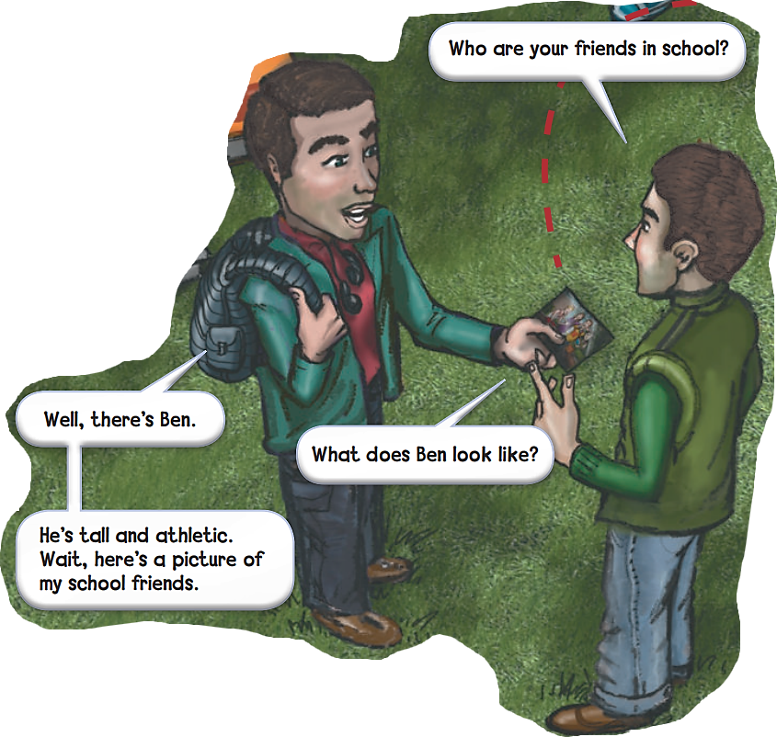
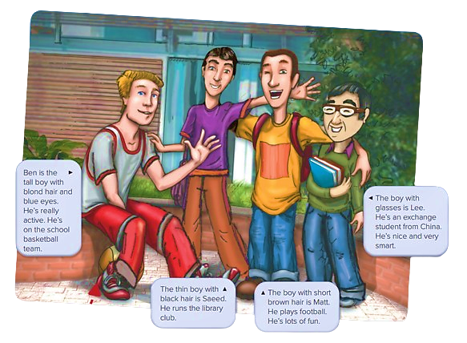

Slide 9


We say PE for physical education.

Slide 10
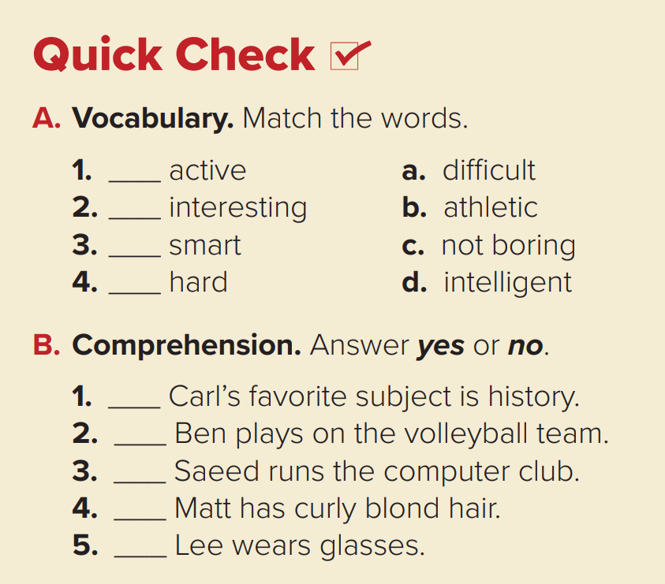

Nice
b
c
d
a

Slide 11
Nice
Yes
No
No
No
Yes

Slide 12
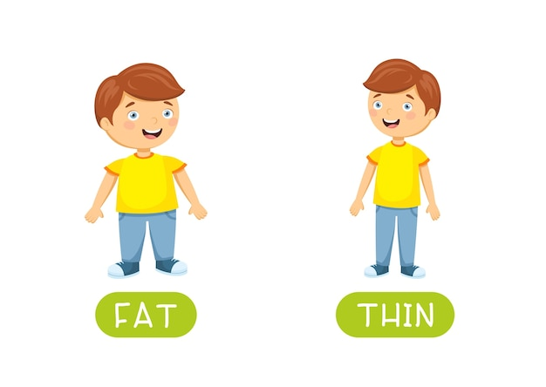
What does he/she look like?
=physical appearance.
He’s/She’s thin.

Slide 13
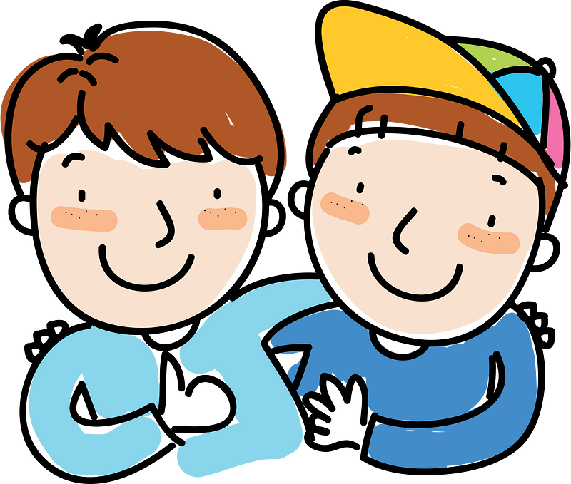
What’s he/she like?
= personality
He’s/She’s friendly

Slide 14

Pair Work

Slide 15


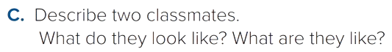
Your Turn
Nice

Slide 16
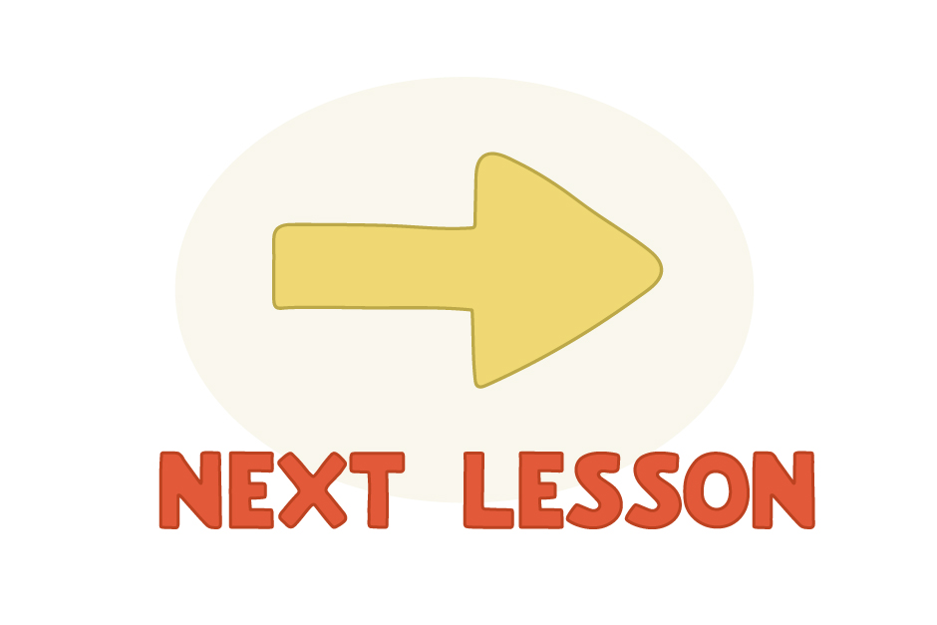

Slide 17


Objectives
At the end of the lesson, you will be able to..
Use simple present for statements and questions.
Use adjectives.
Connect each person to his description.

Slide 18


Slide 19


Let me start with this…
What did you notice ?
I work at the school.
Let’s look at today’s grammar rule
Khalid works at the hospital.
Why did we add an ‘s’ to the second sentence but not the first one?

Slide 20
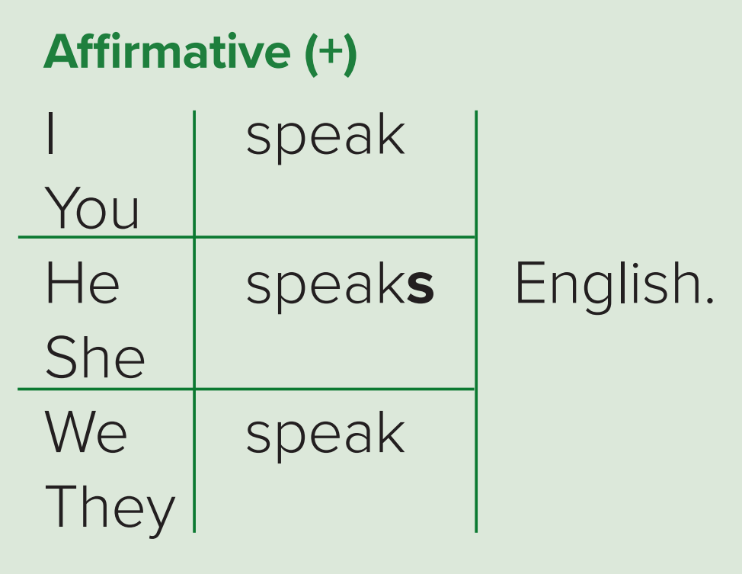
We add ‘-s’ for the third person singular (he/she/it).
I work at a hospital.
You work as a doctor.
They watch the tv.
We study at the library.
She works at the market.
He speaks Japanese.

Slide 21
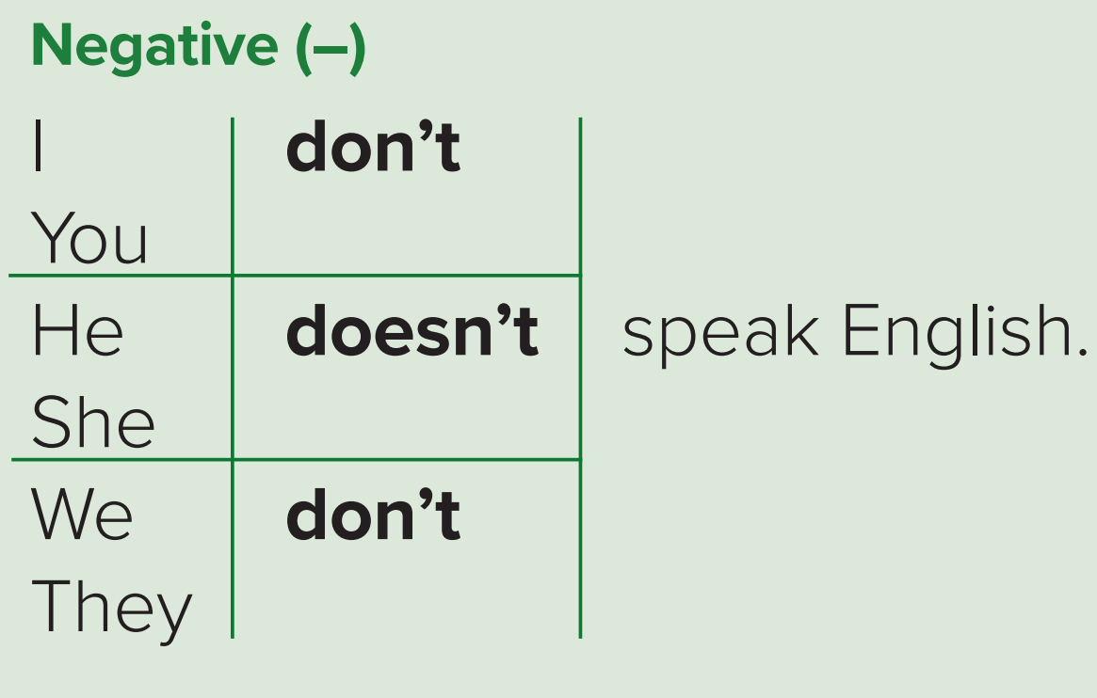
To make the negative form we add don’t and doesn’t
I don’t work at a hospital.
You don’t work as a doctor.
They don’t watch the tv.
We don’t study at the library.
She doesn’t work at the market.
He doesn’t speak Japanese.
Notice : We removed the ‘-s’ from the regular verb, because we added does\doesn’t.

Slide 22
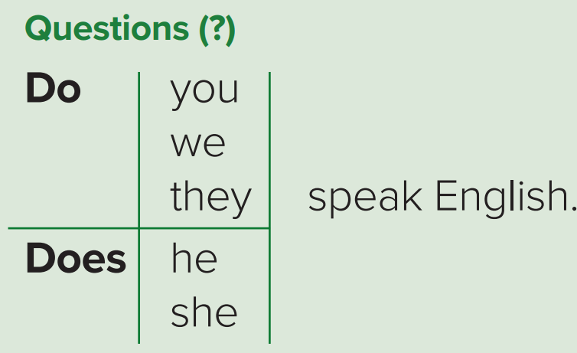
And to make the question form we add do or does:
Do you work at the hospital ?
Do they watch the tv?
Do we study at the library ?
Does she work at the market?
Does he speak Japanese ?
Notice: the we only switched the subject with “do\does”. The scissor strategy.

Slide 23
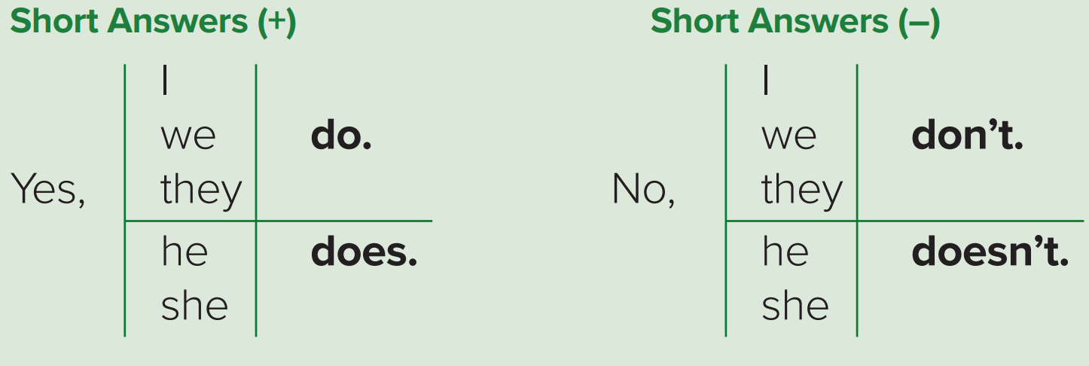

Slide 24
Some verbs that end in y change to -ies: study – studies
Verbs that end in ch and sh, add -es: teach – teaches, brush – brushes

Slide 25
Adjectives
In English, adjectives go before nouns or after the verb be.
Uncle Peter has a long beard.
adjective
noun
History is interesting.
Verb BE
Adjective

Slide 26

Open your book : Page 82

Slide 27
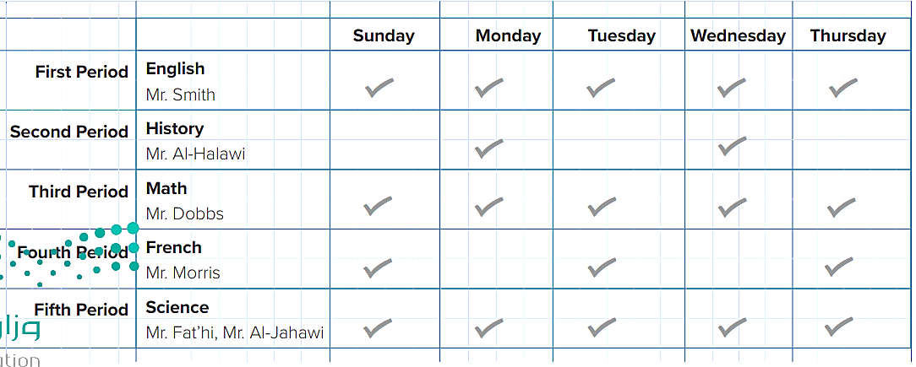
Answer the questions about Ahmed’s schedule
Q
Q
Let’s look at his periods, and what does he have ?

Slide 28
Now let’s look at the questions and try to answer them.
Back Table
Does Ahmed take Spanish?
Does he have French on Sunday?
Does Mr.Dobbs teach history ?
Does Mr.Fat’hi and Mr. Al-Jahawi teach science ?
No, he doesn’t. He takes French.
Yes, he does.
No, he doesn’t. He teaches math.
Yes, they do.

Slide 29
Now let’s look at the questions and try to answer them.
Back Table
5. What subject does Ahmed have last on Tuesday?
6. What subject does he have three times a week?
7.What subjects does he have every day?
8. What does Mr. Al-Halawi teach?
He had sciences last on Tuesday.
He had French three times a week.
Nice
He had English, math, and science every day.
He teaches history.

Slide 30
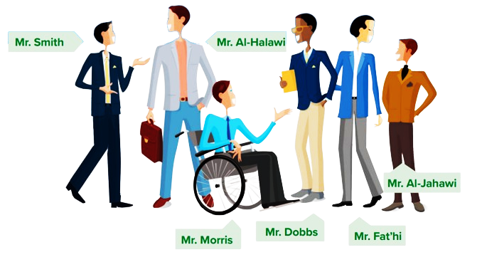
B. Look at the picture. Ahmed is writing about his schedule and his teachers. Complete his description.

Slide 31

teaches
I have classes from Sunday to Thursday, and I have six teachers. Mr. Smith (1) ______ English. He has (2) ______ ______ hair and blue eyes. He gives a lot of homework. Mr. Al-Halawi is the history teacher. He’s (3) ______ , and he has (4) ______ hair. Mr. Dobbs teaches math. He always (5) ______ a jacket and tie, and he’s a very good teacher. Mr. Fat’hi and Mr. Al-Jahawi (6) ______ science. Mr. Fat’hi has short (7) ______ hair. Mr. Al-Jahawi is short, and he has (8) ______ brown hair. They are very strict. French is my favorite subject, and Mr. Morris is our teacher. He has (9) ______ ______ hair and blue eyes, and he’s a lot of fun. We (10) ______ French in class, and I send emails to my friends in Canada in French.
short black
tall
brown
wears
teach
black
short
Short brown
speak

Slide 32


Slide 33

Activity Book
Open page 225
Exercise A+B

Slide 34
Linking this lesson to my Religion.
عن أبي هريرة رضي الله عنه قال: قال رسول الله صلى الله عليه وسلم:
((إذا مات الإنسان انقطع عنه عملُه إلا من ثلاثةٍ: إلا من صدقةٍ جاريةٍ، أو علمٍ يُنتفَع به، أو ولدٍ صالحٍ يدعو له)).
رواه مسلم
Education is a must
We are working on ourselves to help each other in the future,
to pass the knowledge that we have.
Try to leave a good effect on everyone that passes you, either it’s
An advice, knowledge, a nice word, or to offer help.

Slide 35


Slide 36

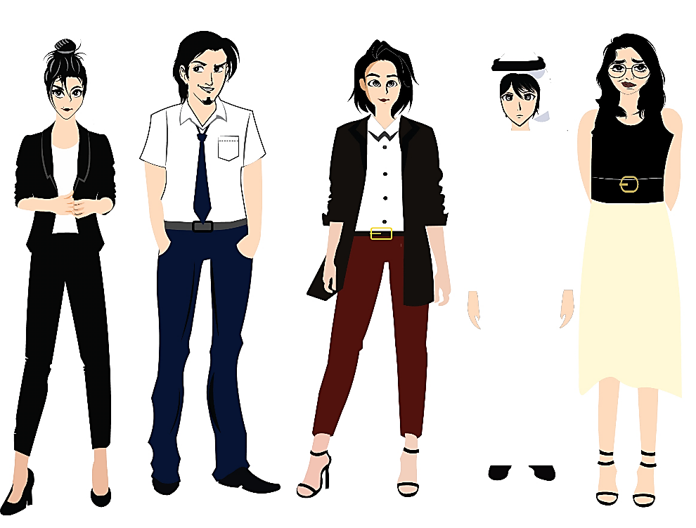


تم تصميم هذا العرض من قبل: فريق عمل البوابة الإنجليزية ، وهو مجاني لكي يستفيد منه معلمي اللغة الإنجليزية.
هذه الشريحة تعتبر كـ"حفظ حقوق" نتمنى عدم حذفها حال مشاركة العرض مع معلمين آخرين.
نسمح بحذف الحقوق في حالة واحدة فقط: اذا أراد معلم الإنجليزي إضافة هذا العرض كـ انتاج معرفي خاص فيه.

