Slide 1
Mega Goal 2.2
U: 4
The Sporting Life
Writing
By: Yousef Hilal Alyazedi

Slide 2
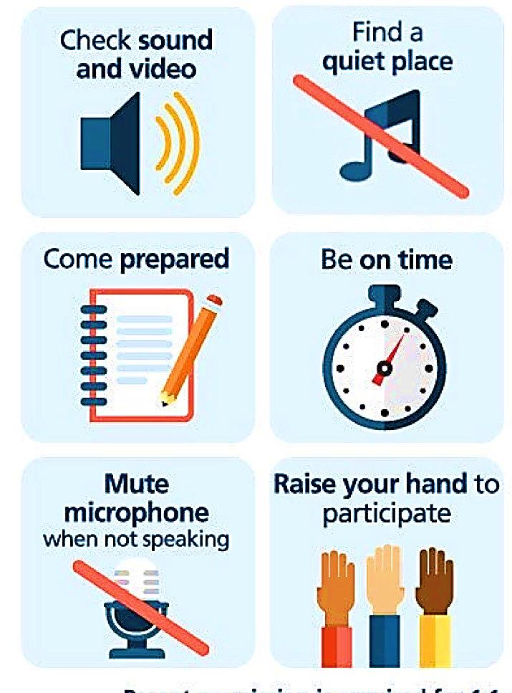
Online Classroom Rules

Slide 3



Slide 4

Lesson Objectives
The students will be able to :
Analyze a text to its main points .
Write notes about a sport .
Label each part of the plan .
Organize activity steps .

Slide 5
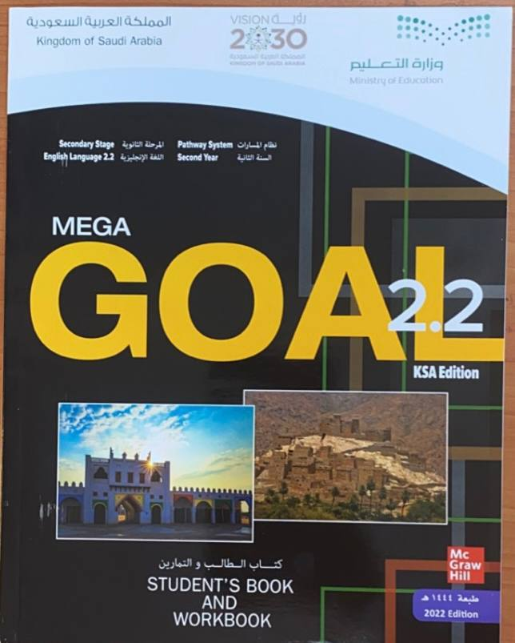

Open your Student’s book at page: 122

Slide 6

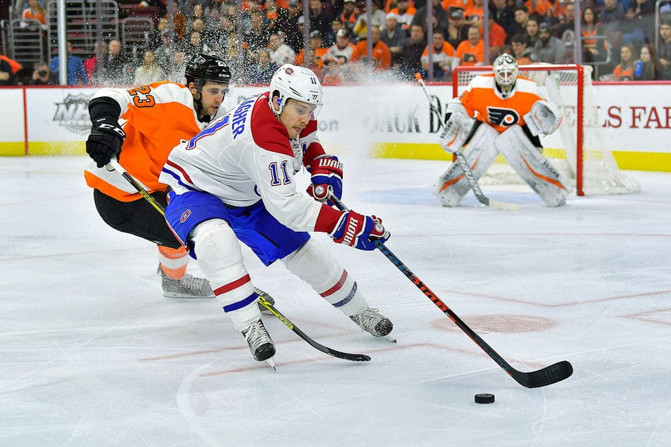
What kind of sport do they play ?
Ice hockey
Do you know how ice hockey is played ?
Two opposing teams use ice hockey sticks to control and shoot a closed rubber disc called a
‘’ puck ‘’ into the other team’s goal .
Where is ice hockey played on ?
on an ice skating rink with lines .

Slide 7
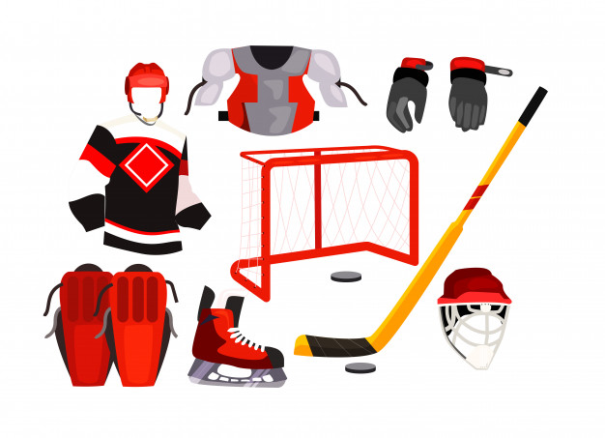
Can you name these equipment ?
Shoulder pads
gloves
jersey
stick
puck
Knee pads
helmet
skate

Slide 8
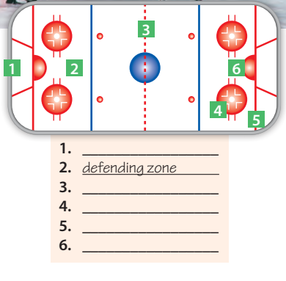
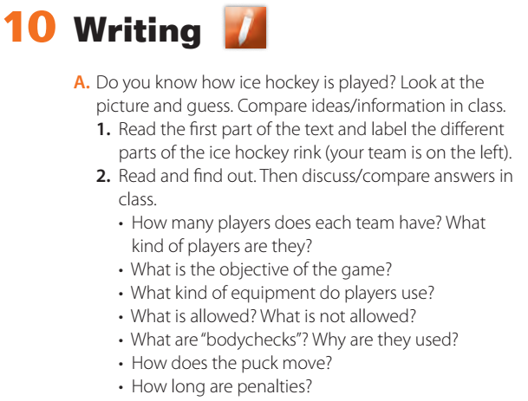
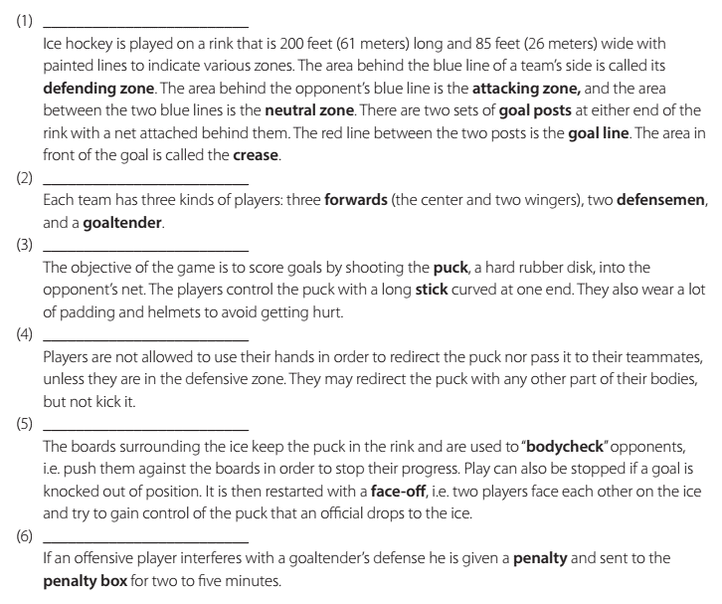
goal post
the neutral zone
the attacking zone
the goal line
the crease

Slide 9
Each team has six players; three forwards, two defensemen and a goaltender.
To score goals by shooting the puck into the opponent’s net.
A stick, a helmet and padding
Players are not allowed to use their hands in order to redirect the puck unless they are in the defensive zone.
They may redirect it with any other part of their body but not kick it.
“bodychecks” are moves that involve pushing opponents against the boards that surround the rink.
The puck is pushed with a stick by players towards the opponent’s net, or redirected with the players’ bodies but neither kicked nor pushed by hand.
2 to 5 minutes

Slide 10
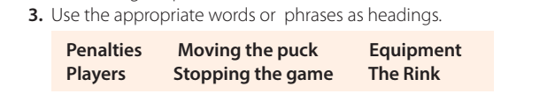

The Rink
players
Equipment
Moving the puck
Stopping the game
penalties

Slide 11
Open your Student’s book at page: 123

Slide 12
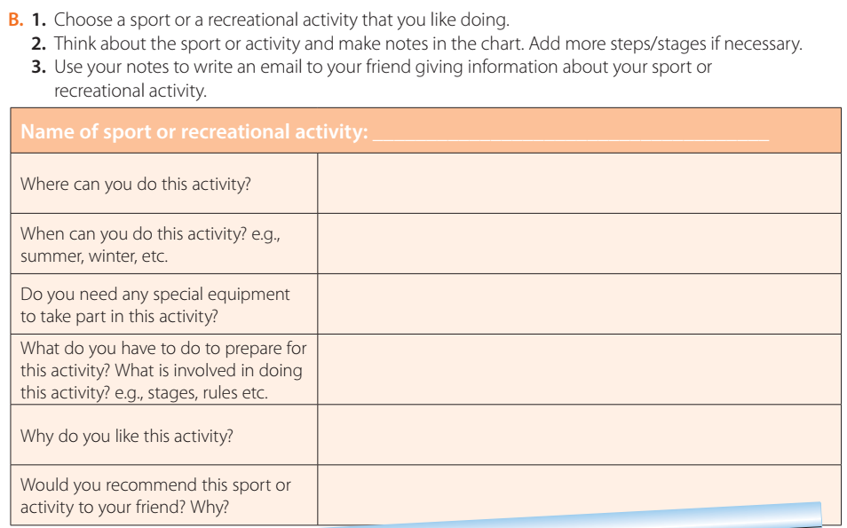
Fishing
At the sea, river and ocean .
Summer or winter
Line, bite, net stick
Equipment, boat, spot
Skills and manners
Yes, to learn how to be a good fisher and patient

Slide 13
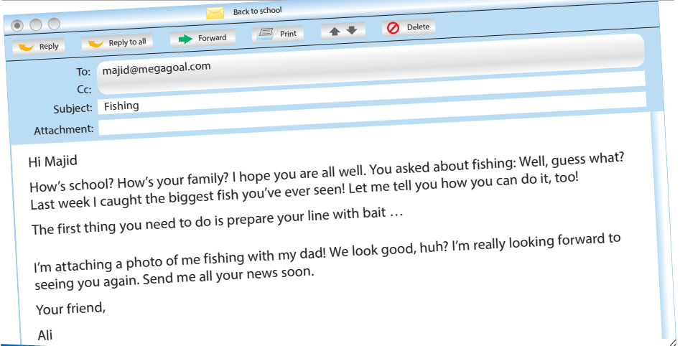

Slide 14
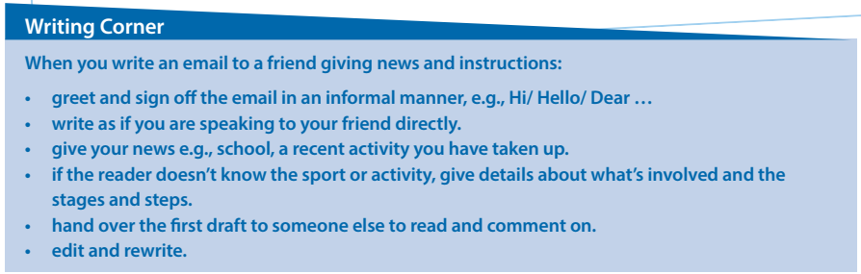

Slide 15

Workbook P. 302
Exercise L

Slide 16
