Slide 1
Mega Goal 2.2
U: 4
He Sporting Life
Reading
By: Yousef Hilal Alyazedi

Slide 2
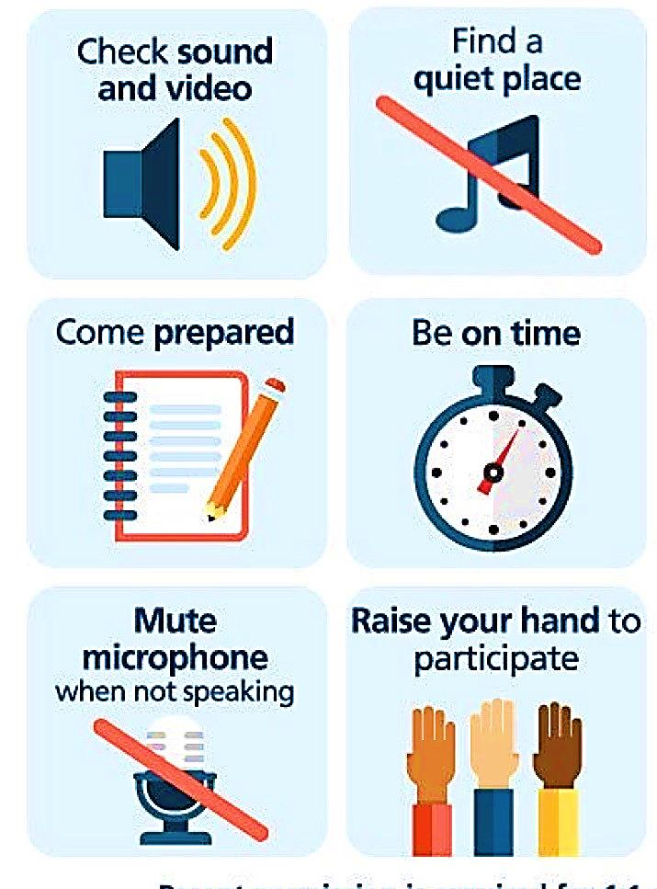
Online Classroom Rules

Slide 3



Slide 4


Lesson Objectives
The students will be able to :
1 – Mention some information about Norway.
2- Name some winter sports in Norway .
3 – Read for specific information .
4 – Talk about popular sports in Saudi Arabia.

Slide 5

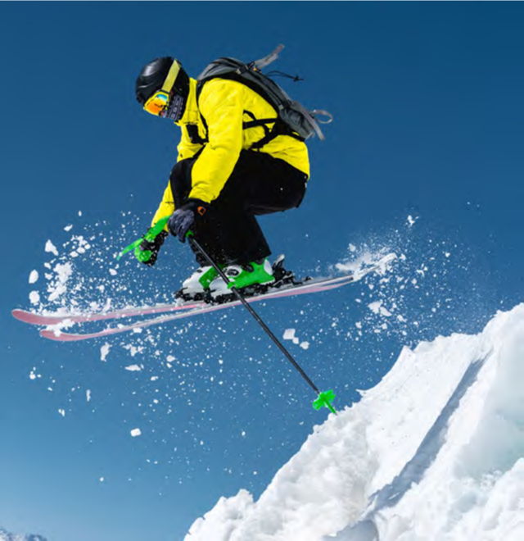
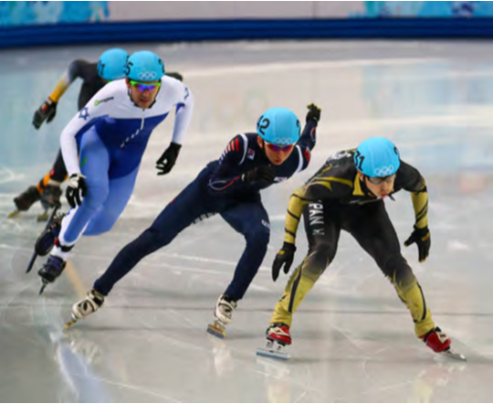
What are the people doing in each picture ?
Ski jumping
Speed skating

Slide 6
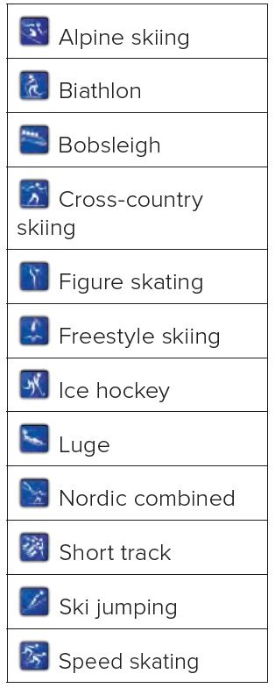
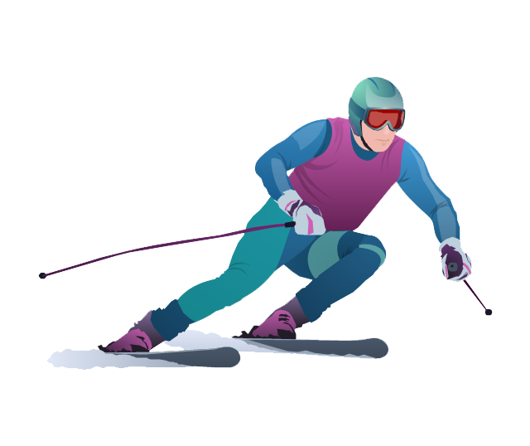
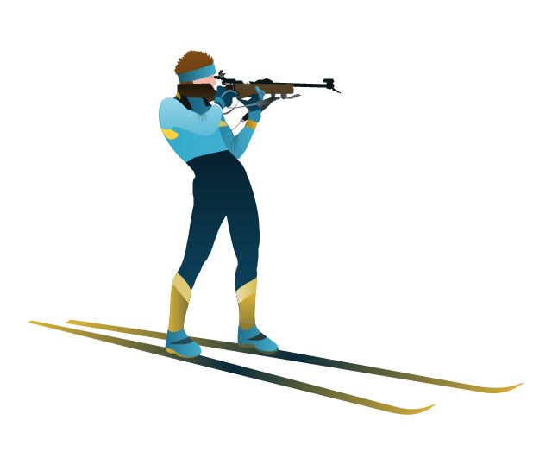
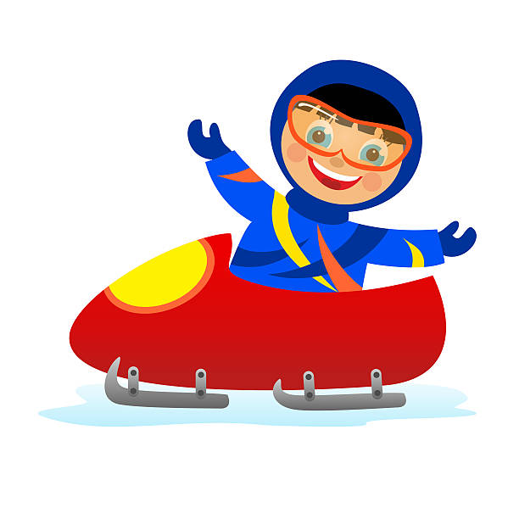
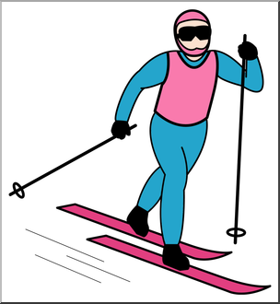

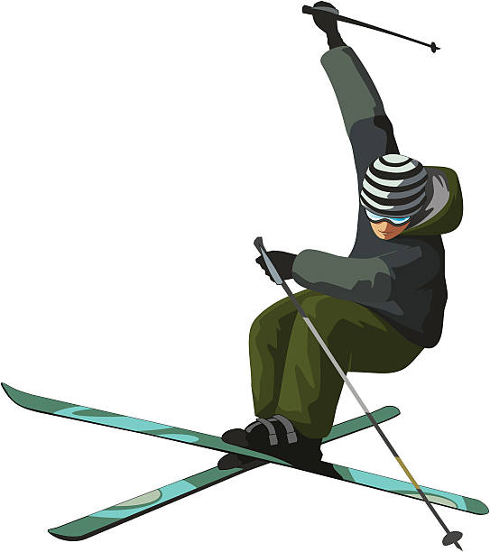
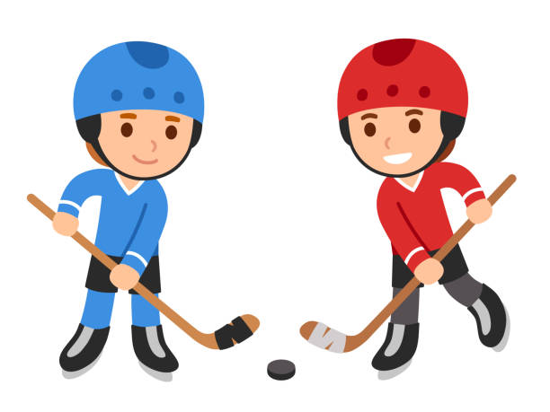
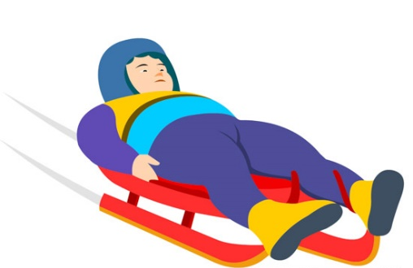
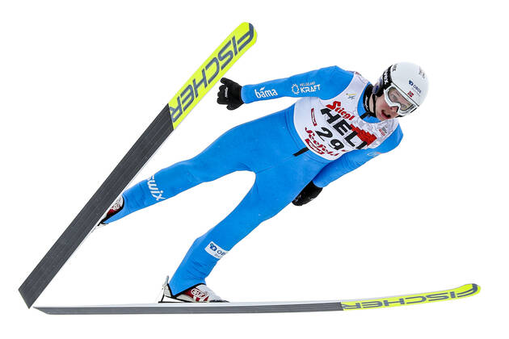
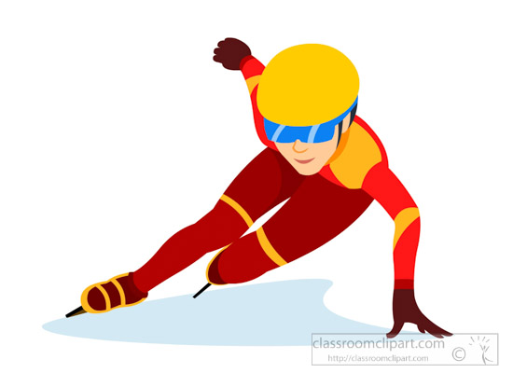
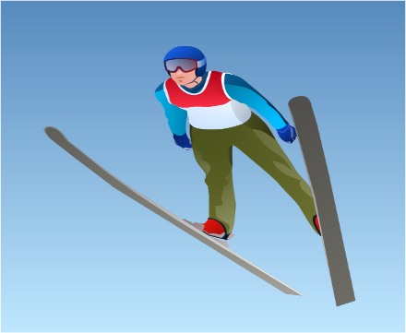
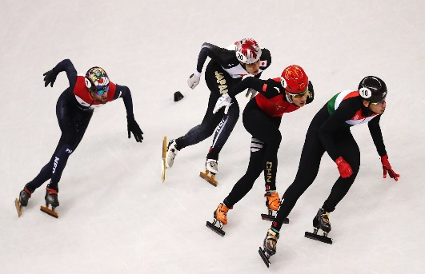
What are these ?
These are winter sports .

Slide 7

what do you think “a country born on skis” mean ?
It means that most Norwegians learn to ski from a very young age and therefore it becomes as natural as cycling or running.

Slide 8
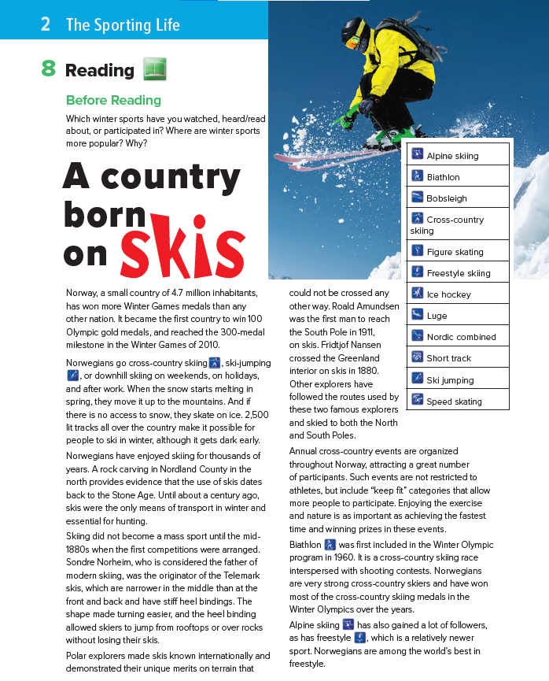
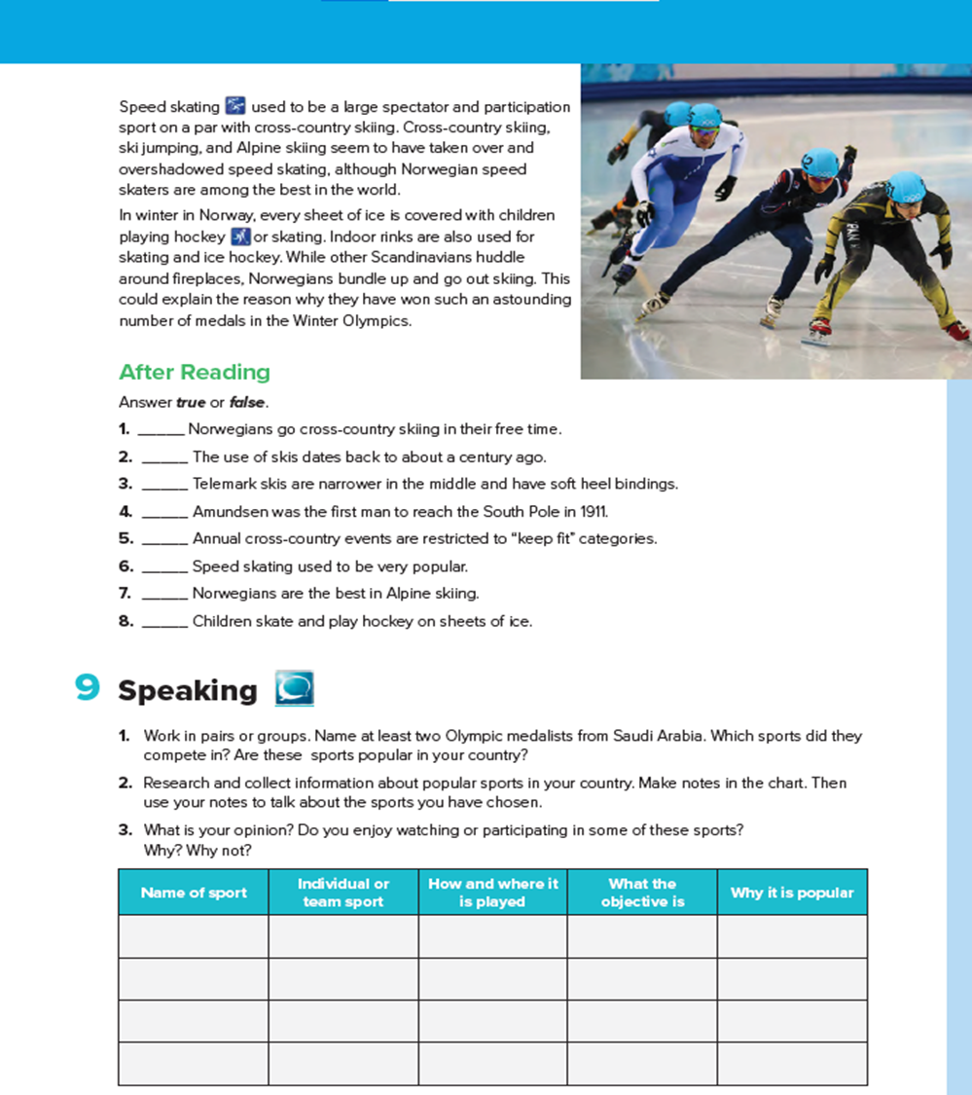


Slide 9

8
9
What is the title of the text ?
1
2
How many paragraphs are there ?
5
3
6
7
4

Slide 10
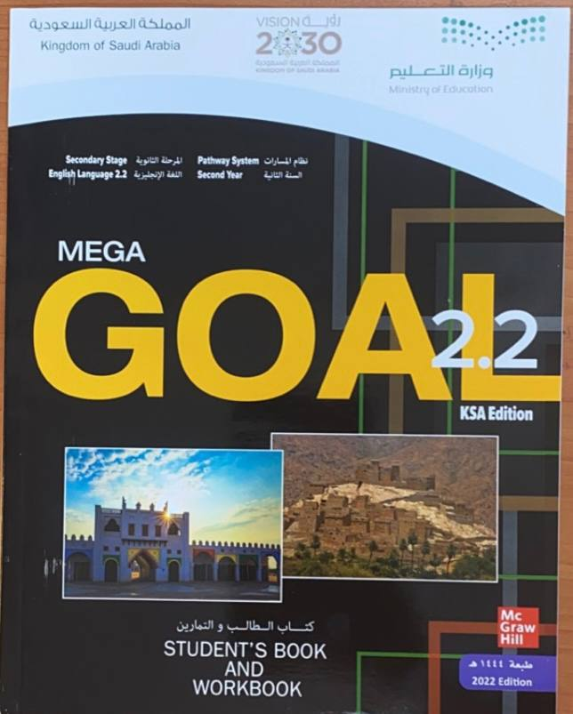

Open your Student’s book at page: 120

Slide 11

Our reading strategy is
Timed reading

Slide 12
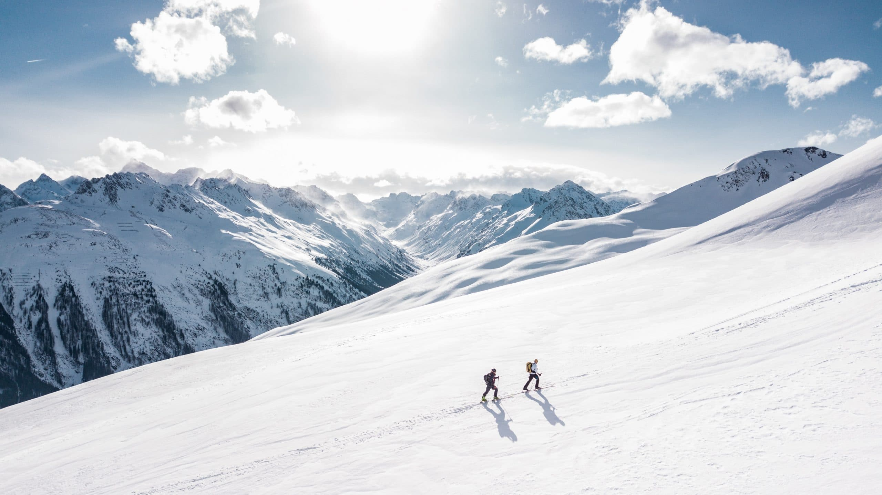
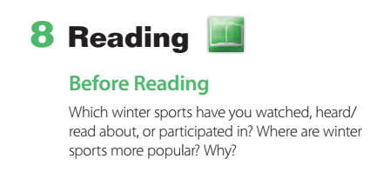

Slide 13
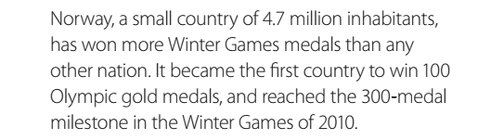
Facts about Norway in the Winter Games

Slide 14
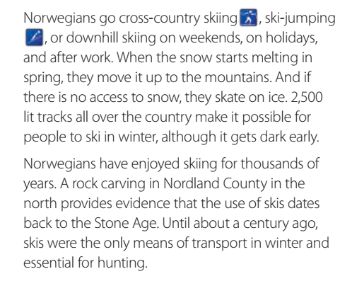
When do Norwegians go cross-country skiing ?
What do they do when the snow starts melting in spring ?
What do they do if there is no access to snow?
Is it possible for people to ski in winter in the dark ?
How important were skis a century ago ?

Slide 15
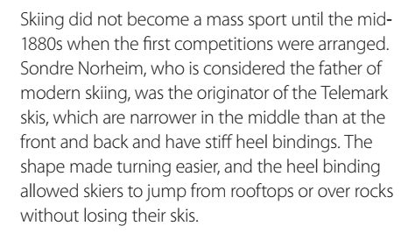
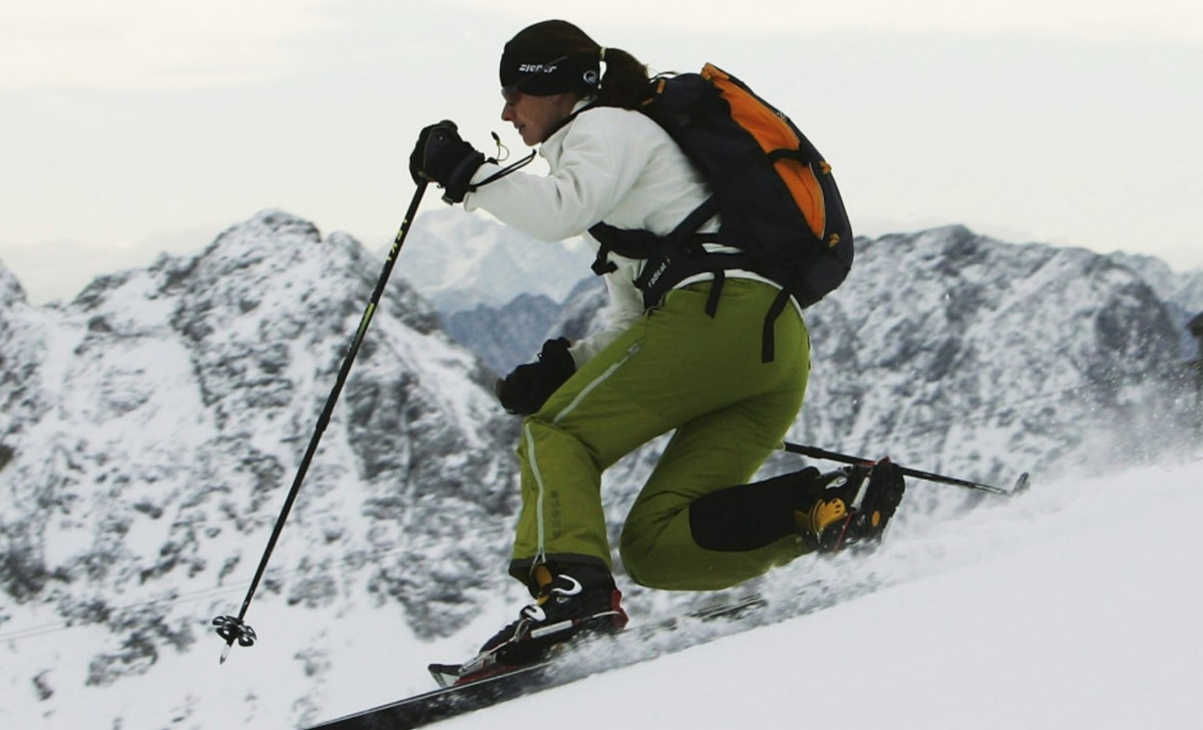
Who is considered to be the father of modern skiing ?
Telemark skiing is a technique that combines both alpine and nordic skiing elements. Telemark skiers are often known as 'free-heelers.'

Slide 16

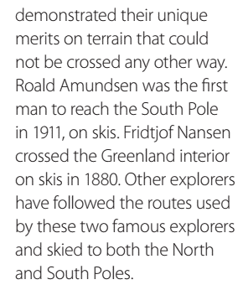
Who was the first man to reach the South Pole ?
When ?
How ?
Who crossed the Greenland interior on skis in 1880 ?

Slide 17
Open your Student’s book at page: 121

Slide 18
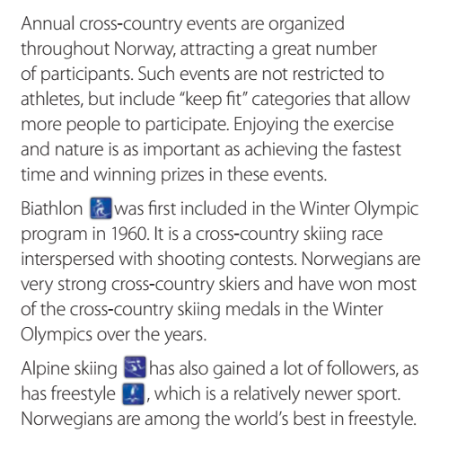
Which sport was first included in the Winter Olympic Program ?
When ?
What is Biathlon ?
Who have won the most of the cross-country skiing medals in the Winter Olympics over the years?

Slide 19
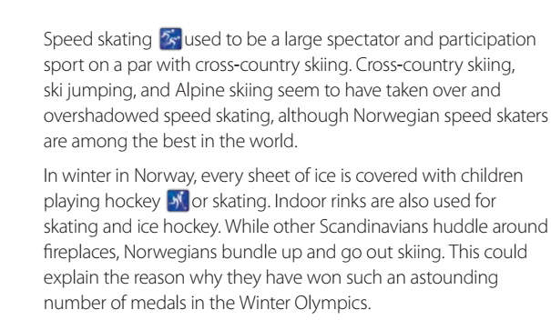
Are Norwegian speed skaters among the best in the world ?
How is Norway in winter ?
What are indoor rinks used for ?

Slide 20
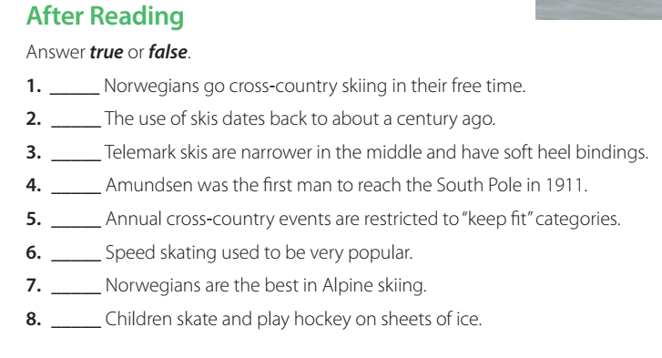
True
False
False
True
False
True
False
True

Slide 21
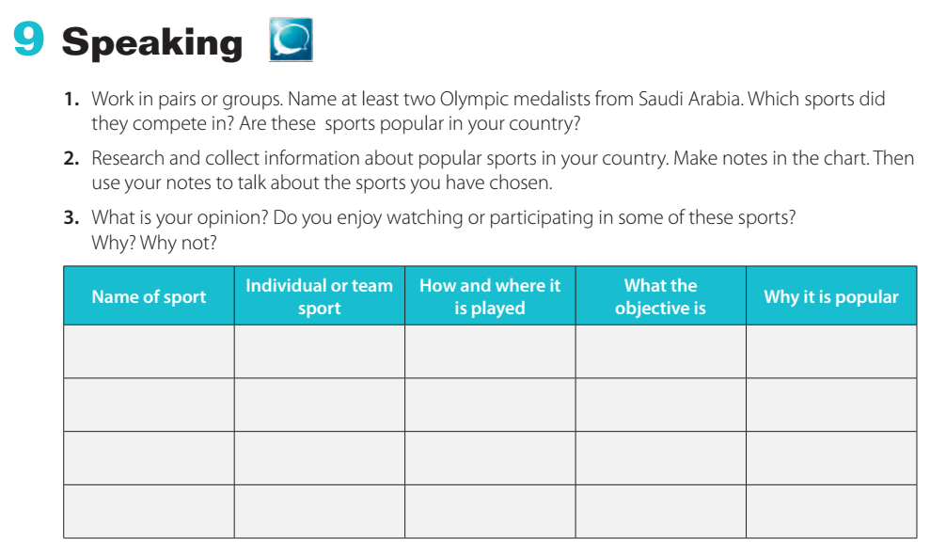

Slide 22
Open your Work Book at page: 300

Slide 23
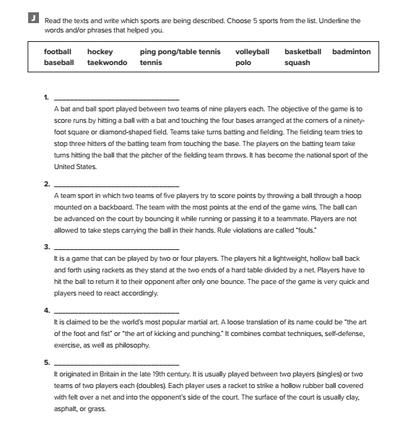
baseball
basketball
ping pong / table tennis
taekwondo
tennis

Slide 24

Workbook P. 299
Exercise I

Slide 25
