Slide 1
Mega Goal 2.2
U: 4
The Sporting Life
Listen and Discuss
By: Yousef Hilal Alyazedi

Slide 2
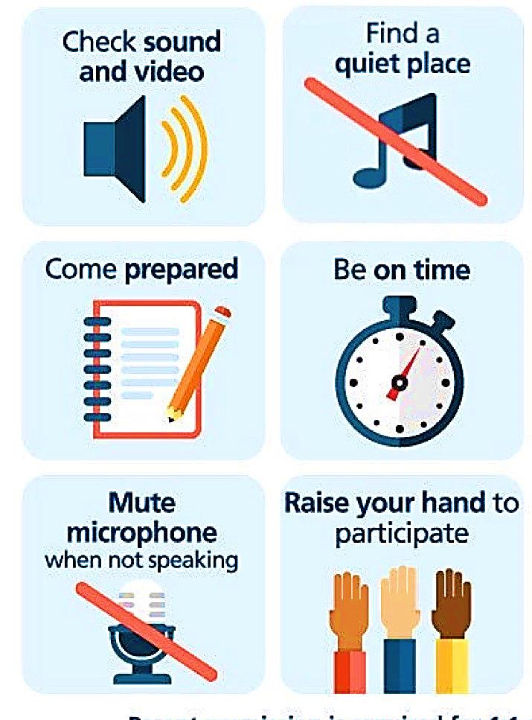
Online Classroom Rules

Slide 3
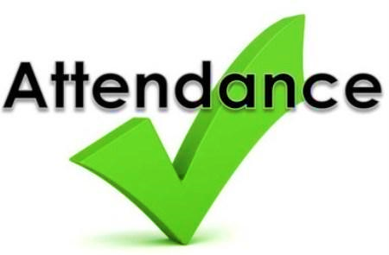
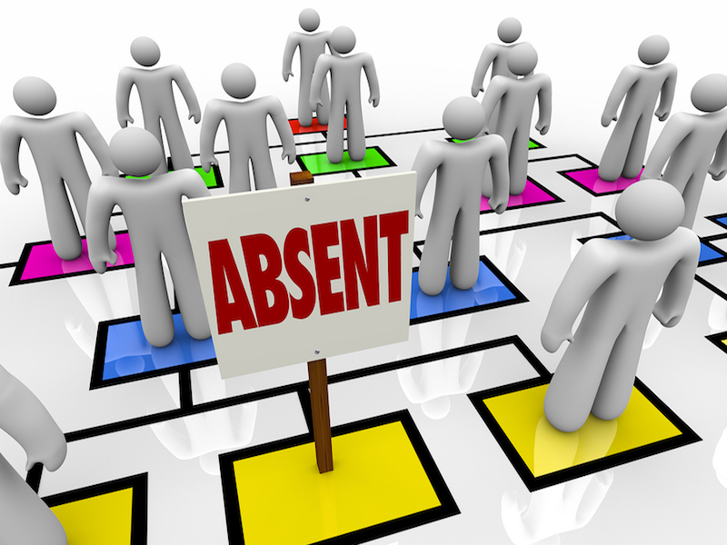

Slide 4


Lesson Objectives
The students will be able to :
1 – Listen for specific information .
2 – Match the word with their meanings .
3 – show interest in designing their won fags.

Slide 5
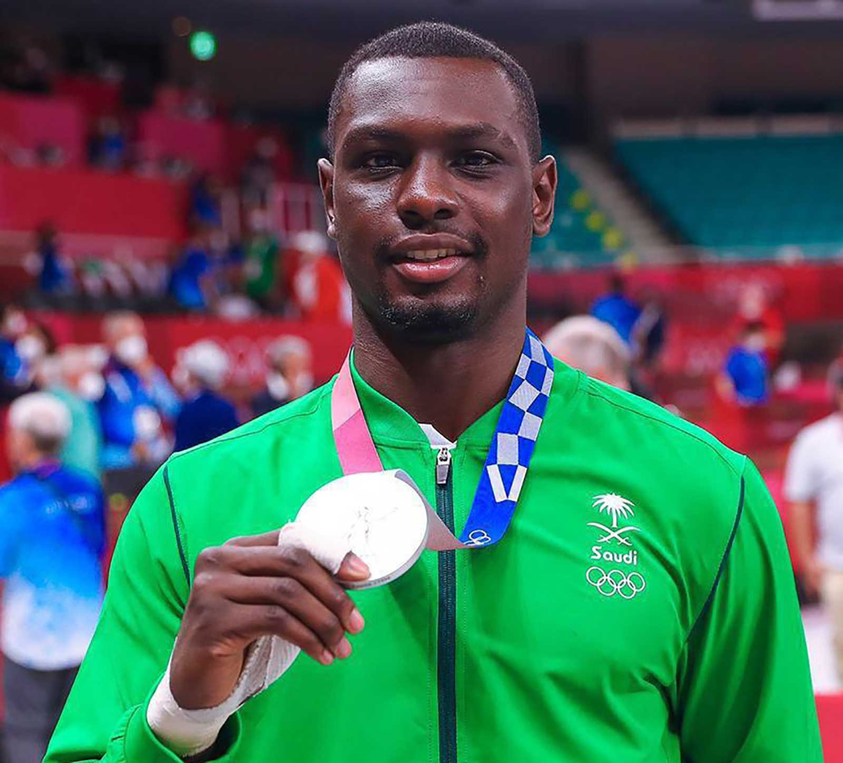
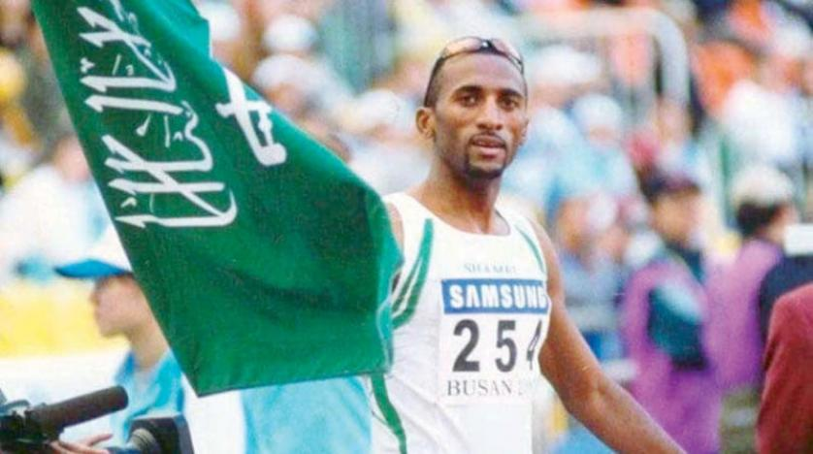
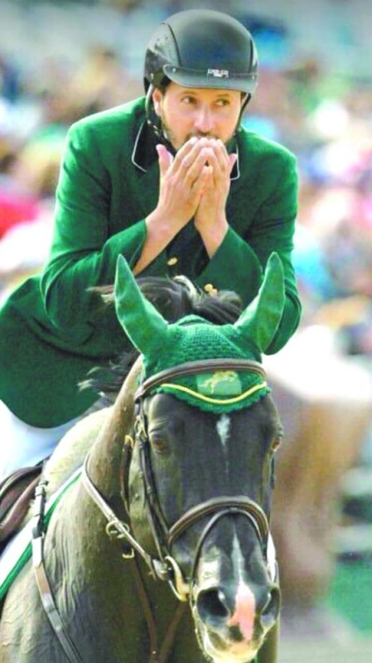
Great Saudi Athletes

Slide 6



Warm up
What does this picture refer ?

Slide 7
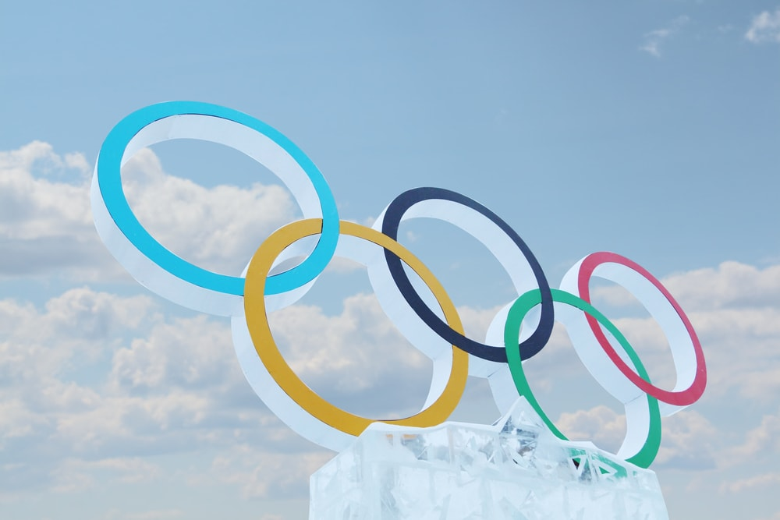
How often do they occur ?
What sports are included ?
Have you ever seen the Olympic Games, either in person or on television ?
Has Saudi Arabia participated in the Olympics ? How often ?
What is your favorite sport to watch during the Olympics ?

Slide 8


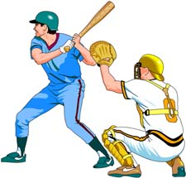
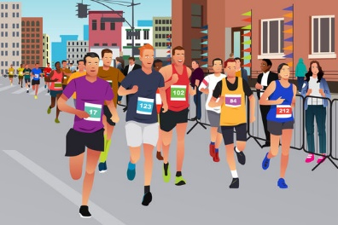
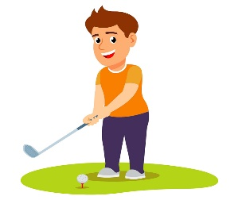
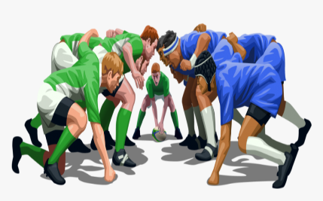
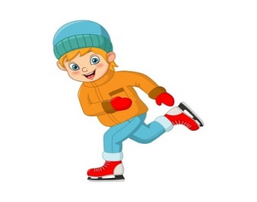


Discuss the following pictures

Slide 9
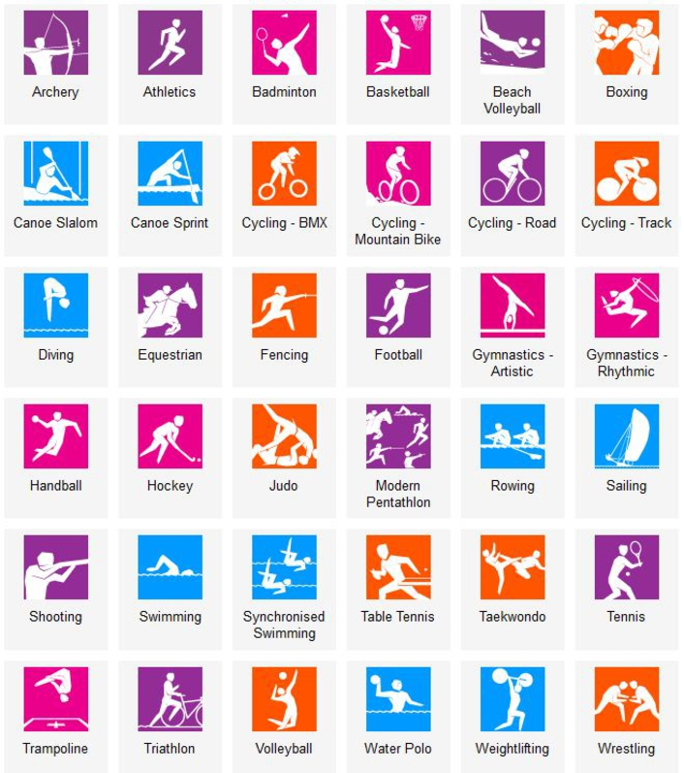

Slide 10
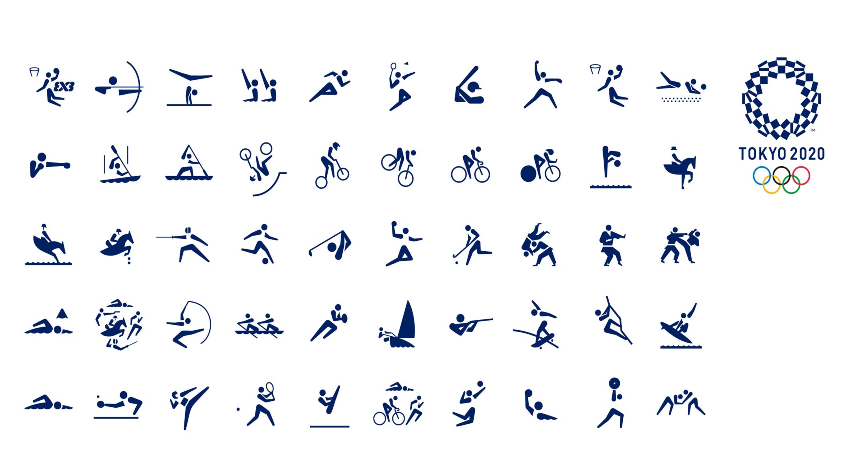

Slide 11
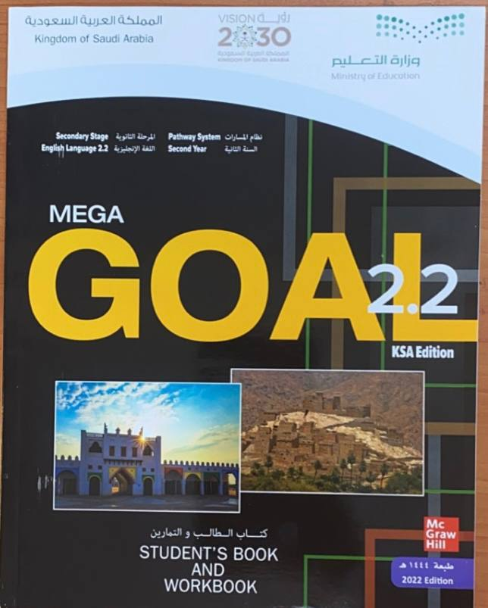

Open your Student’s book at page: 114

Slide 12
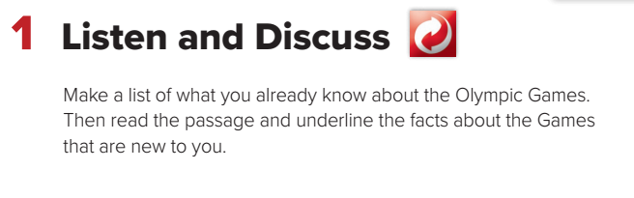

Slide 13
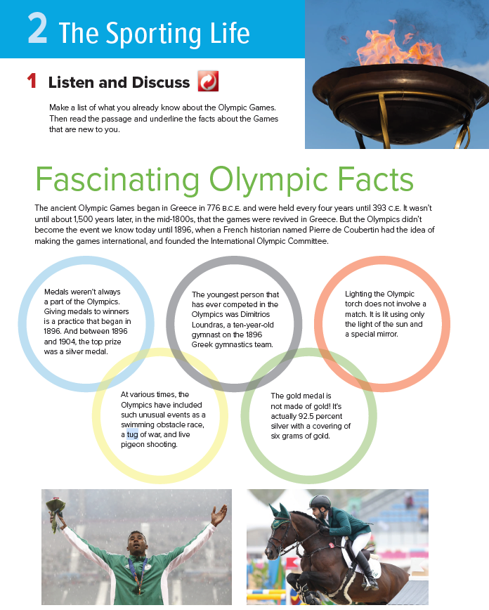
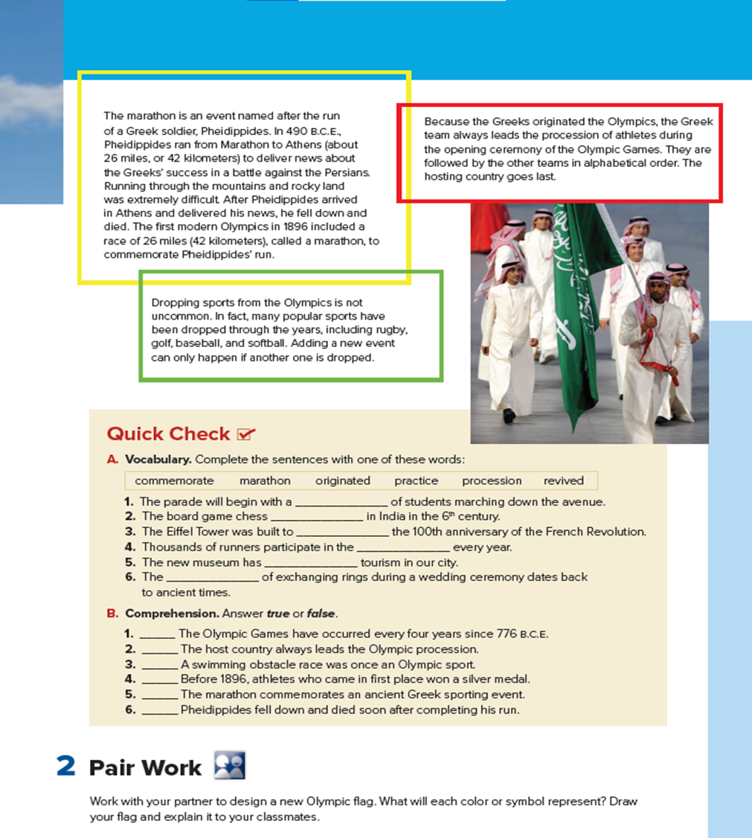


Read along as you listen

Slide 14
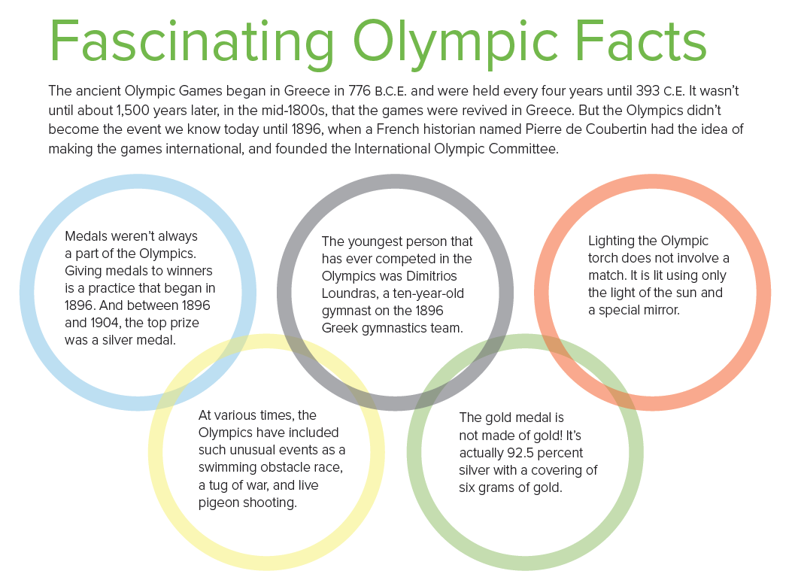
When did the ancient Olympic Games begin ?
When did the Olympics become an international event?
Who founded the Olympic Committee ?
What was the top prize in the Olympics in 186 ?
How old was the youngest person in the Olympics ?
How much gold is there in a gold medal ?

Slide 15
Open your Student’s book at page: 115

Slide 16
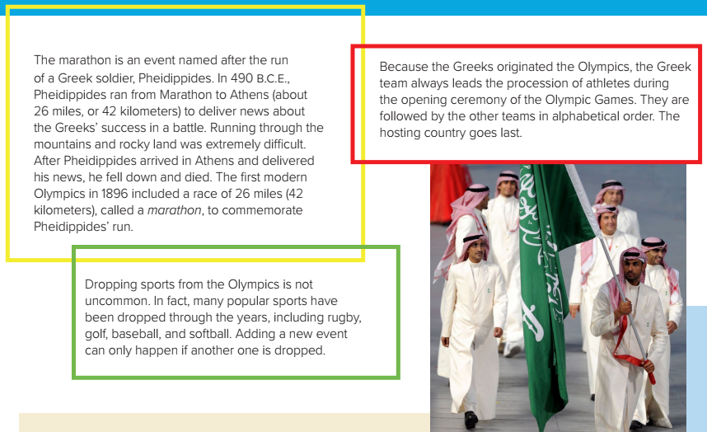
What is a ‘’ marathon ‘’ ?
When did the first ‘’ marathon ‘’ start ?
Give some examples of sports that have been dropped ?
Who originated the Olympics?
Which team goes first in the opening procession ?

Slide 17


Slide 18
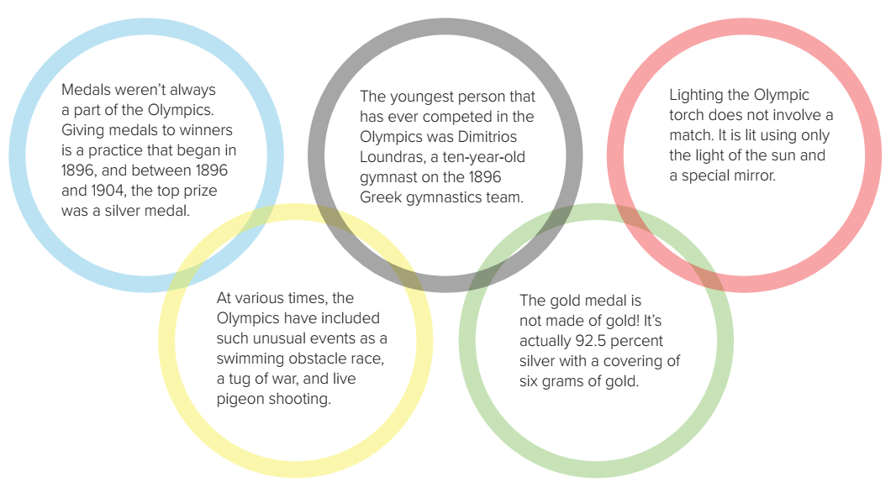
A word means
a game in which two teams pull on a rope
A word means
Something used to start a fire

Slide 19
A word means
A member of the military
A word means
Excluded or removed from a group

Slide 20
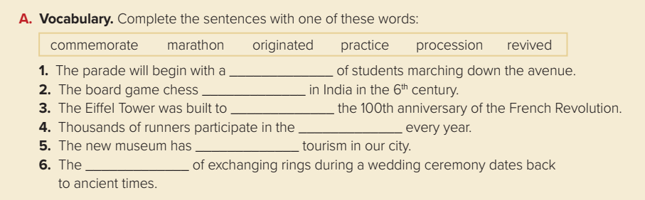
procession
originated
commemorate
marathon
revived
practice

Slide 21
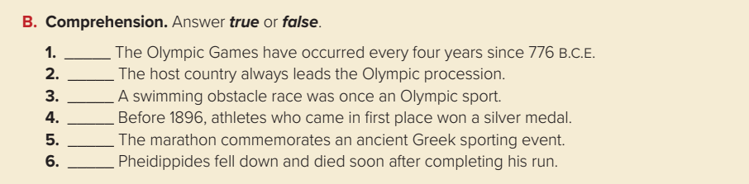
false
false
true
false
false
true

Slide 22


Slide 23
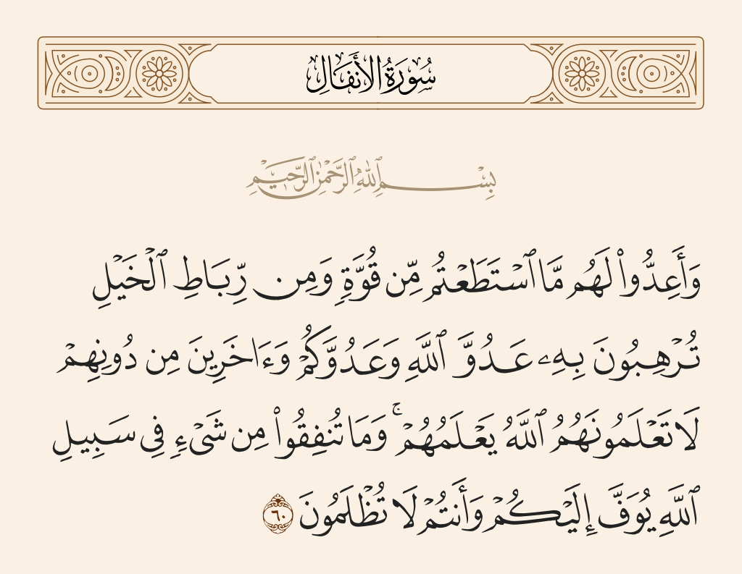

Slide 24

Workbook P. 295
Exercise A

Slide 25
