Slide 1
Mega Goal 2.2
U: 4
The Sporting Life
Grammar
By: Yousef Hilal Alyazedi

Slide 2

Online Classroom Rules

Slide 3



Slide 4


Lesson Objectives
The students will be able to :
1 – Use gerunds as subjects .
2 – Use Gerund phrases as subjects .
3 – Use superlative + present perfect.
4 – Apply the rules to do the exercises .

Slide 5
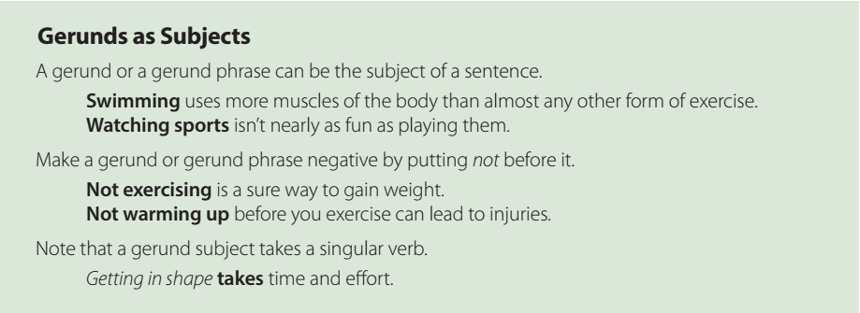
Riding a motorcycle is easy to do .
Walking is good exercise .
Not using your seat belt is dangerous .
cooking keeps you healthy .

Slide 6


Open your Work Book at page: 296

Slide 7
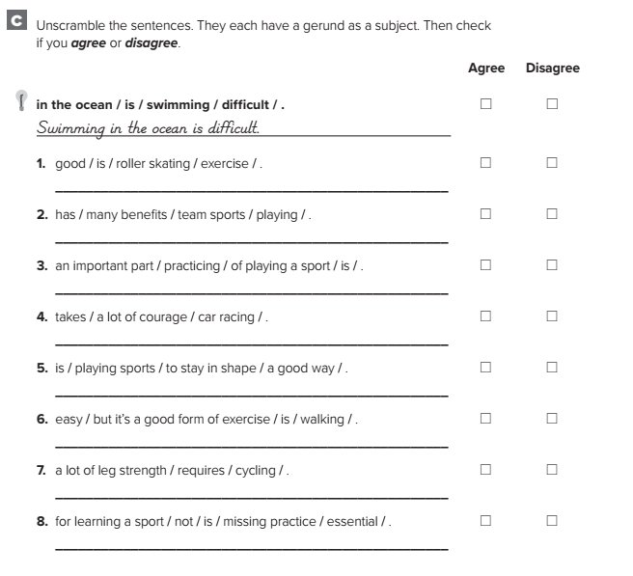
Roller skating is good exercise.
Playing team sports has many benefits.
Practicing is an important part of playing a sport.
Car racing takes a lot of courage.
Playing sports is a good way to stay in shape.
Walking is easy, but it’s a good form of exercise.
Bike racing requires a lot of leg strength.
Not missing practice is essential for learning a sport.

Slide 8
Open your Student’s book at page: 116

Slide 9

Russia is the coldest place we’ve ever been to .
This is the most beautiful performance I’ve ever seen .
This is the best coffee I’ve ever drunk .
Superlative
the + adj + est
coldest
the most + adj
the most expensive

Slide 10

( Play ) football is an interesting .
Correct
Playing football is an interesting .
This is the best laptop I’ve ever ( buy ) .
Correct
This is the best laptop I’ve ever bought

Slide 11
Write ( C ) if a sentence has the correct form and ( I ) for incorrect .
I
Reading books are a good way to improve your English .
I
Smoking not is the best for your health .
I
What is the best team you’ve ever see ?
C
This is the most dangerous place he’s ever visited .

Slide 12
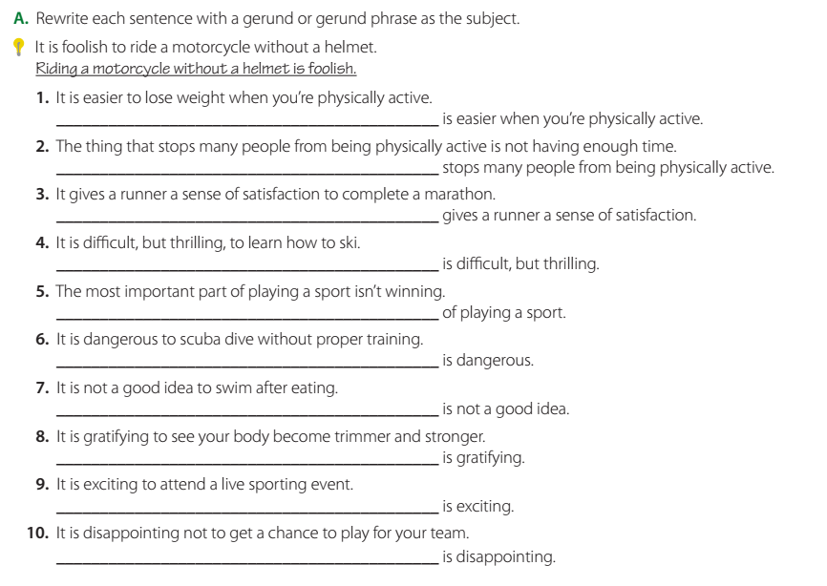
Losing weight
Not having much money
Completing a marathon
Learning to ski
Winning is the most important part
Scuba diving without proper training
Swimming after eating
Seeing your body become trimmer and stronger
Attending a live sporting event
Nott getting a chance to play for your team

Slide 13
Open your Student’s book at page: 117

Slide 14
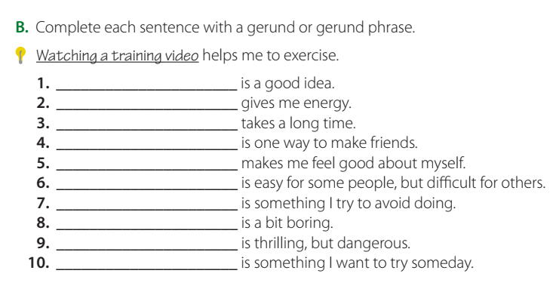
Sleeping eight hours
Exercising
Reading a book
Joining a club
Doing well in school
Making new friends
Buying things I don’t need
Watching TV
Sky diving
Mountain climbing

Slide 15
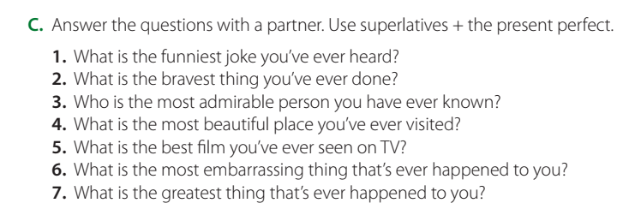

Slide 16
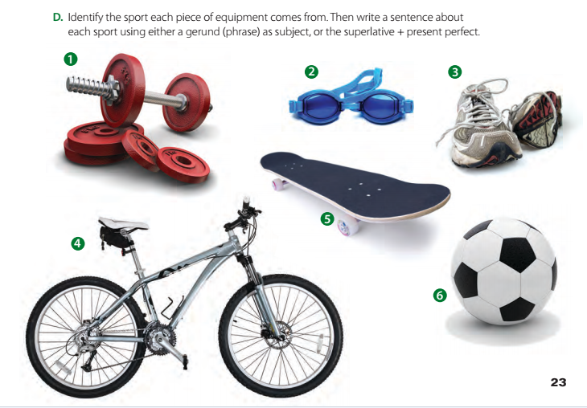
swimming
weightlifting
running
Bicycling
skateboarding
football

Slide 17
1. ( weight lifting ) What is the heaviest weight you have ever lifted ?
2. ( swimming ) The coldest water I have ever swum in is the Pacific Ocean .
3. ( running ) Running every day is good for your heart .
4. ( bicycling ) Riding a bicycle is the best way to get around town .
5. ( skateboarding ) Skateboarding is the most difficult sport I’ve ever tried .
6. ( football ) Playing football with friends is a fun thing to do .

Slide 18
Open your Work Book at page: 297

Slide 19
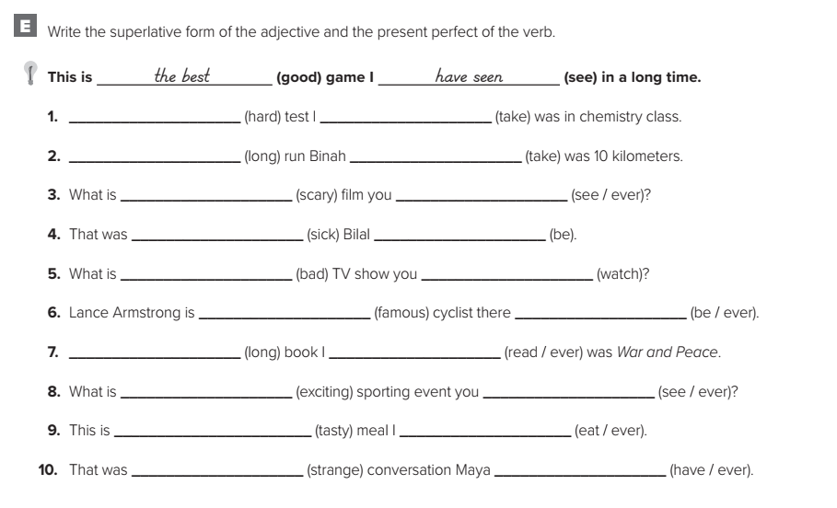
the hardest
have taken
the longest
has taken
the scariest
have ever seen
the sickest
has been
the worst
have watched
the most famous
has ever been
the longest
have ever read
the most exciting
have ever seen
the tastiest
have ever eaten
the strangest
has ever had

Slide 20

Workbook P. 296
Exercise D

Slide 21
