Slide 1
Mega Goal 2.2
U: 4
The Sporting Life
Form, Meaning and Function
By: Yousef Hilal Alyazedi

Slide 2
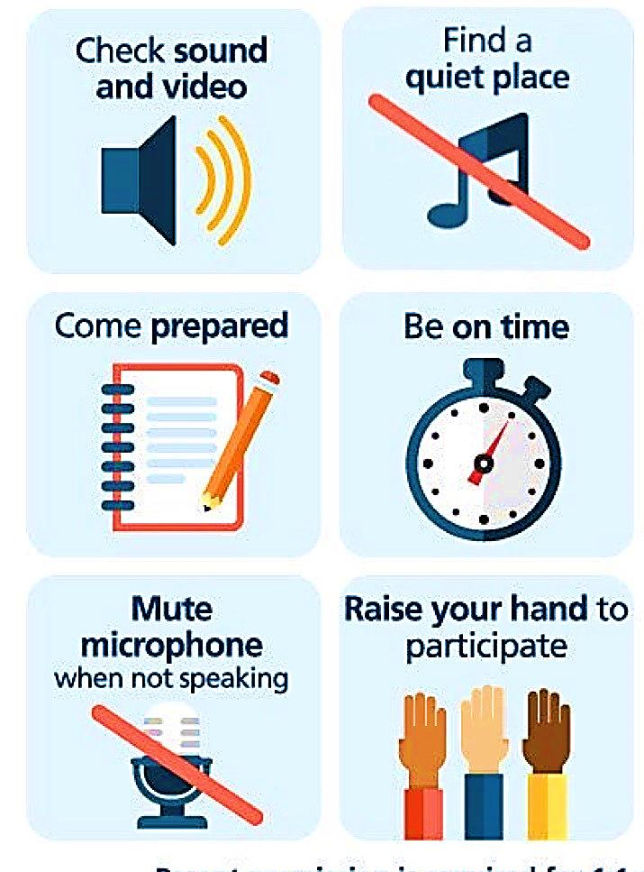
Online Classroom Rules

Slide 3

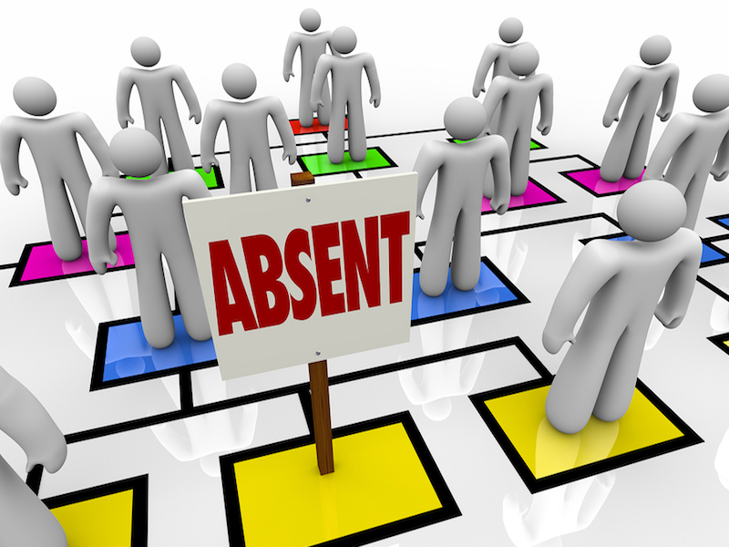

Slide 4

Lesson Objectives
The students will be able to :
1 – Distinguish between present perfect simple and present perfect progressive .
2 – Form sentences using present perfect progressive .
3 – Use adverb of manner in a correct sentence .
4 – Form sentences with comparative form of adjectives and adverbs .
5 – Form sentences using as……………as .
6 – Apply the rules to do the exercises .

Slide 5
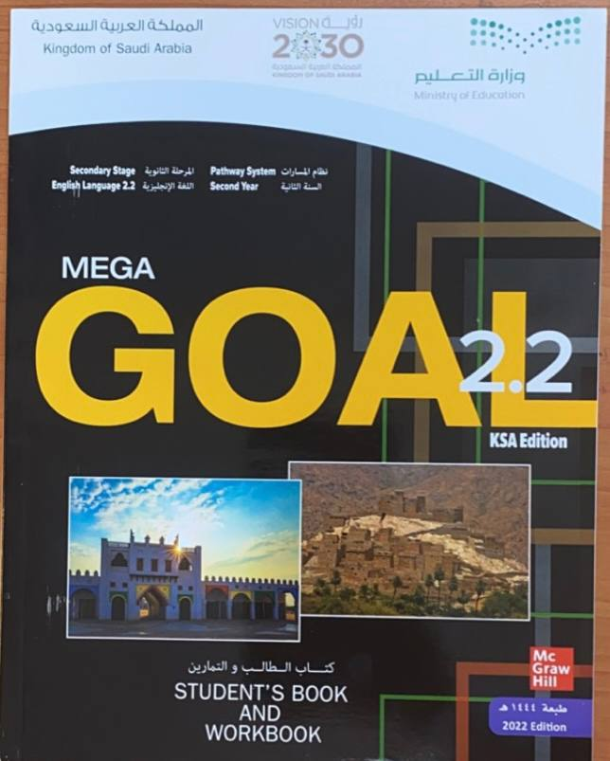

Open your Student’s book at page: 124

Slide 6
I have hiked that mountain many times with my kids .
We have been hiking for more than an hour .
“ Present Perfect simple“
She has been driving since two o’clock .
He has painted his bedroom .
“ Present Perfect progressive“
He has been painting his bedroom .
Have you ever played tennis ?
Have you been playing tennis ?
How many pages of that book have you read ?
How long have you been reading that book ?

Slide 7
** Present Perfect progressive VS Present Perfect simple **
Present Perfect Progressive | Present perfect Simple
Have / Has + been + V + ing | Have / Has + P.P
I have been playing for one hour | I have played four times .
Emphasis on the ongoing action | Emphasis on the result of an action( completion )
With ‘’ how long ‘’ questions | With ‘’ how often ‘’ questions
Emphasis on duration ( finished or unfinished ) | With ‘’ ever ‘’ and ‘’ never ‘’
When the action is finished but you can see the results | With non-action verbs

Slide 8

I
You
We
They
He
She
It
have
has

Slide 9
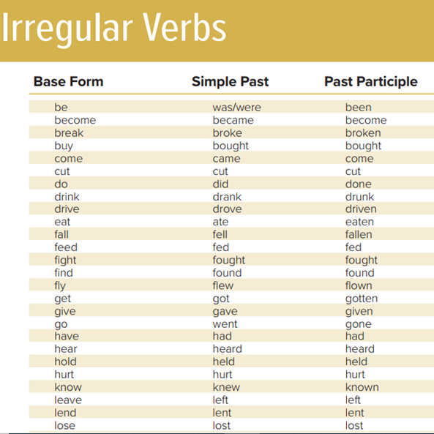
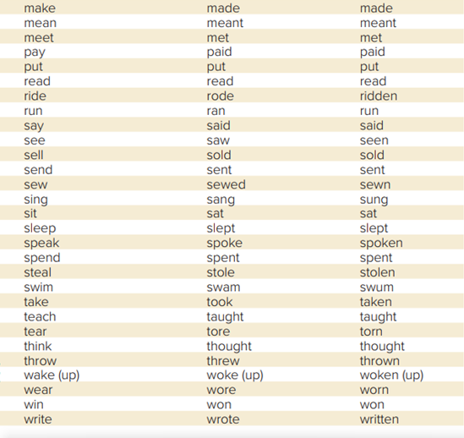

Slide 10
Form
Subject + has / have + V3
  He has learned his lessons.
Negative
Subject + has / have + not + V3
He hasn’t learned his lessons .
Question
Has / Have + subject + V3 + ?
Has he learned his lessons ?

Slide 11
Form
Subject + has / have + been + V-ing
He has been working .
Negative
Subject + has / have + not + been + V-ing
He hasn’t been working.
Question
Has / Have + subject + been + V-ing + ?
Has he been working ?

Slide 12
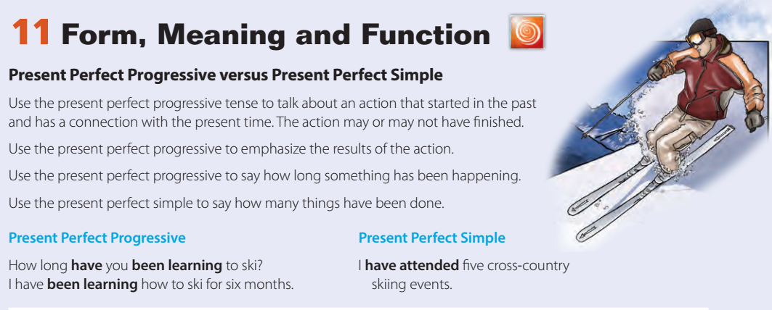

Slide 15
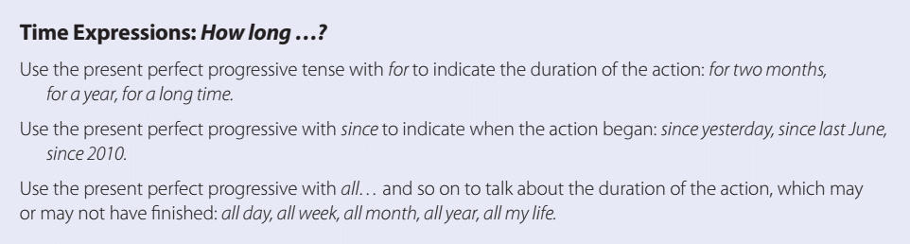
We use for and since to say how long something has been happening .
We use for + a period of time ; We’ve been playing for two hours .
We use since + the start of a period; We’ve been waiting since 7 o’clock .

Slide 16
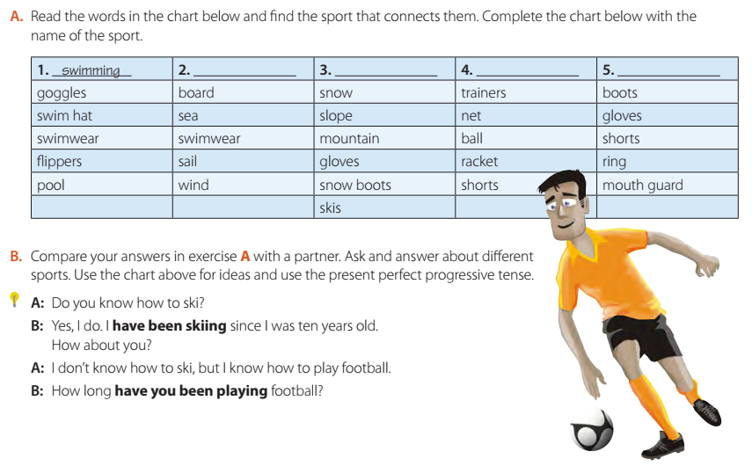
windsurfing
skiing
tennis
boxing

Slide 17
Write ( C ) if a sentence has the correct verb form and ( I ) for incorrect .
C
I have been watching the movie for two hours .
I
He has finish his homework .
I
Have you ever see that show ?
I
How long have you been teach in this school ?

Slide 18
Open your Student’s book at page: 125

Slide 19
He understands easily .
He spoke interestingly about his ideas .
The pianist is playing slowly .
She drives her car carefully .
What are adverbs of manner ?
Adverbs of manner tell us how someone does something or how something happens. They usually come after the main verb .

Slide 20
What is an adverb ?
A word that describes or modifies a verb, an adjective or another adverb .
Adverb Form
We make many adverbs by adding -ly to an adjective, for example:
quick (adjective) quickly (adverb)
careful (adjective) carefully (adverb)
beautiful (adjective) beautifully (adverb)

Slide 21
Unscramble
1) perfectly / Ali / English / speaks
Ali speaks English perfectly .
2) the exam / She / brilliantly / passed
She passed the exam brilliantly .
3) fast / They / swim
They swim fast .

Slide 22
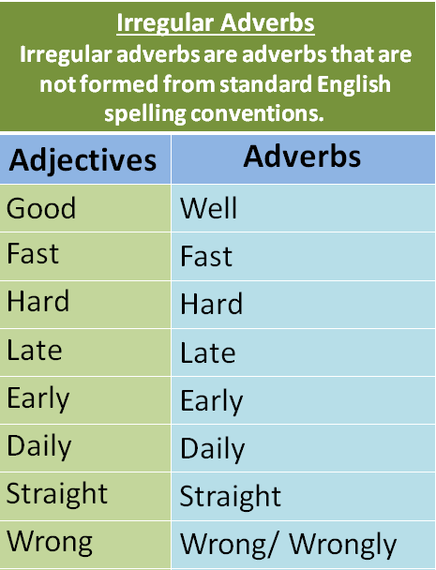
Irregular adverbs

Slide 23
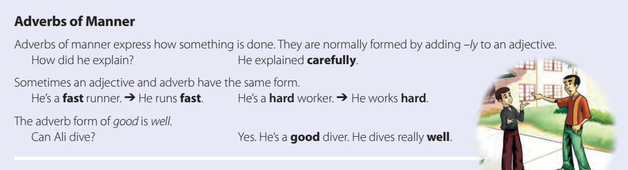

Slide 24
Open your work book at page: 304

Slide 25
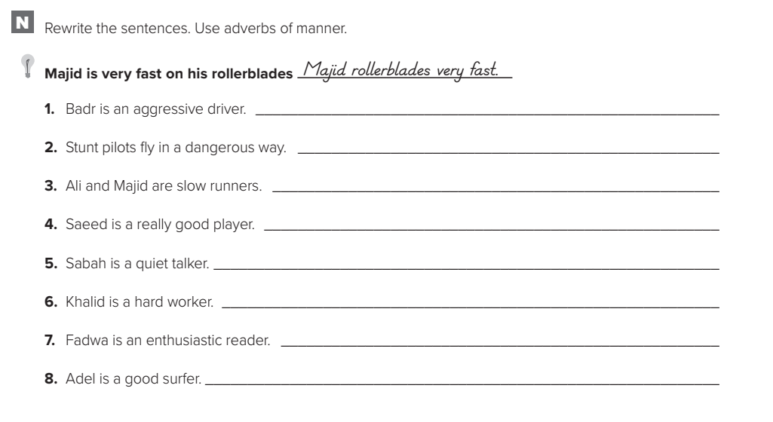
Badr drives aggressively .
Stunt pilots fly dangerously .
Ali and Majid run slowly .
Saeed plays well.
Sabah talks quietly.
Khalid works hard.
Fadwa reads enthusiastically.
Adel surfs well.

Slide 26
Open your Student’s book at page: 125

Slide 27
most one syllable adjectives and adverbs is formed by adding –er
Ali is taller than Faisal .
Sami ran faster than the other racers .
. most two or more syllable adjectives and adverbs is formed by adding more / less
Gold is more expensive than silver .
I drive more carefully in bad weather .

Slide 28
Some comparative forms of adjectives and adverbs are irregular .
good / well
better
bad / badly
worse
far
farther

Slide 29
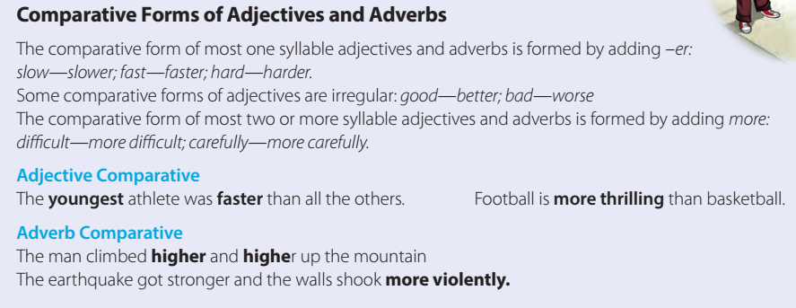

Slide 30
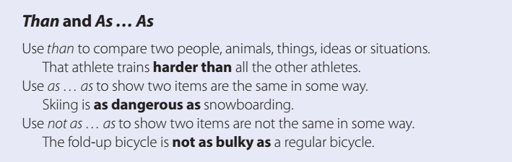
Saeed speaks faster than Salman .
Playing football is as interesting as playing volleyball .
Playing golf is not as dangerous as boxing .

Slide 31
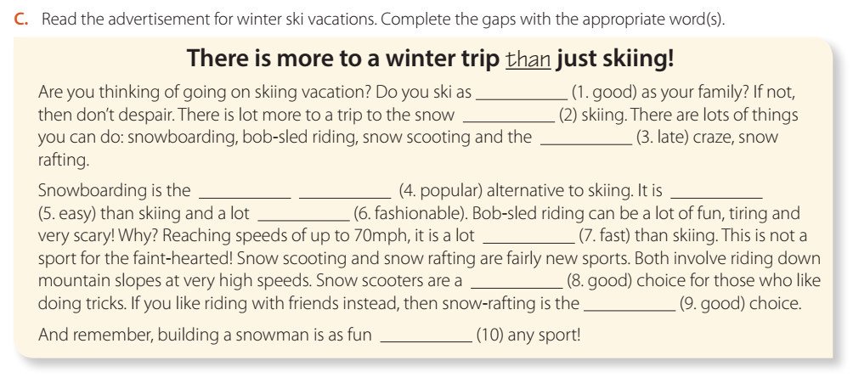
well
than
latest
popular
most
easier
more fashionable
faster
good
best
as

Slide 32
Write ( C ) if a sentence has the correct form and ( I ) for incorrect .
I
He drives fast than his brother .
I
She played goodly .
C
Sara is as short as Fatima .
I
Saudi Arabia is as not small as Bahrain .

Slide 33

Workbook P. 304
Exercise O

Slide 34
