Slide 1






اللهم انفَعْنِي بما عَلَّمْتَنِي ، وعَلِّمْنِي ما يَنْفَعُنِي ، وزِدْنِي عِلْمًا
Welcome Students!

Slide 2



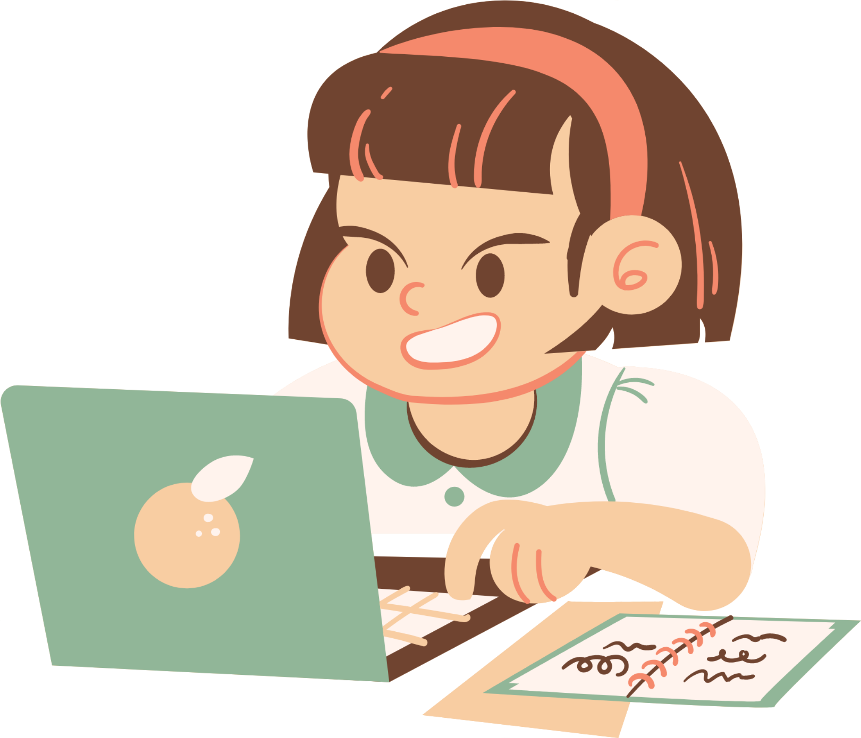
Lesson 03
Unit 8
Against the Odds

Slide 3



Class Rules
RULE 01
RULE 03
Listen when others are answering
Work quietly and do not disturb others
RULE 02
Follow direction
RULE 04
Work hard and never give up

Slide 4
Page 112
Let’s complete concept map
So ……that
So+…../……
Noncount noun
So
+
………./……….
So+ ……./…….
Plural noun

Slide 5




Find the fib
1-He has so a big family that he has cousins he hasn’t even met.
He has such a big family that he has cousins he hasn’t even met.
2-After I finishing a large meal, I often feel sleepy.
After finishing a large meal, I often feel sleepy.

Slide 6

Lesson For The Day
Conversation
Page:114

Slide 7

Lesson Objectives
Answer the questions about a conversation
Use ‘real talk’ in short conversation
Express surprise in a conversation

Slide 8
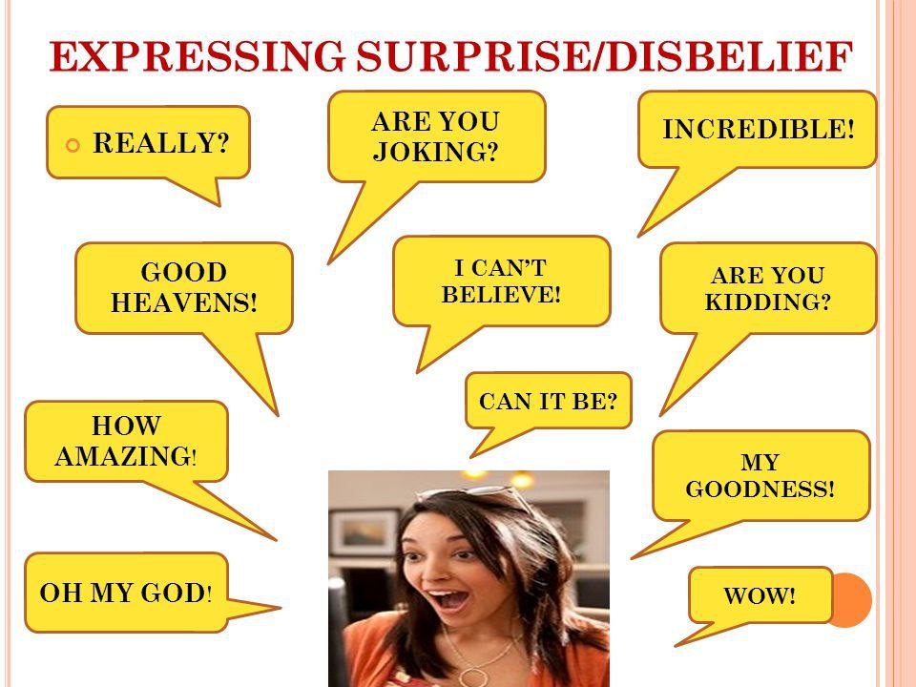
Brainstorming
What is the expression of showing surprise ?

Slide 9
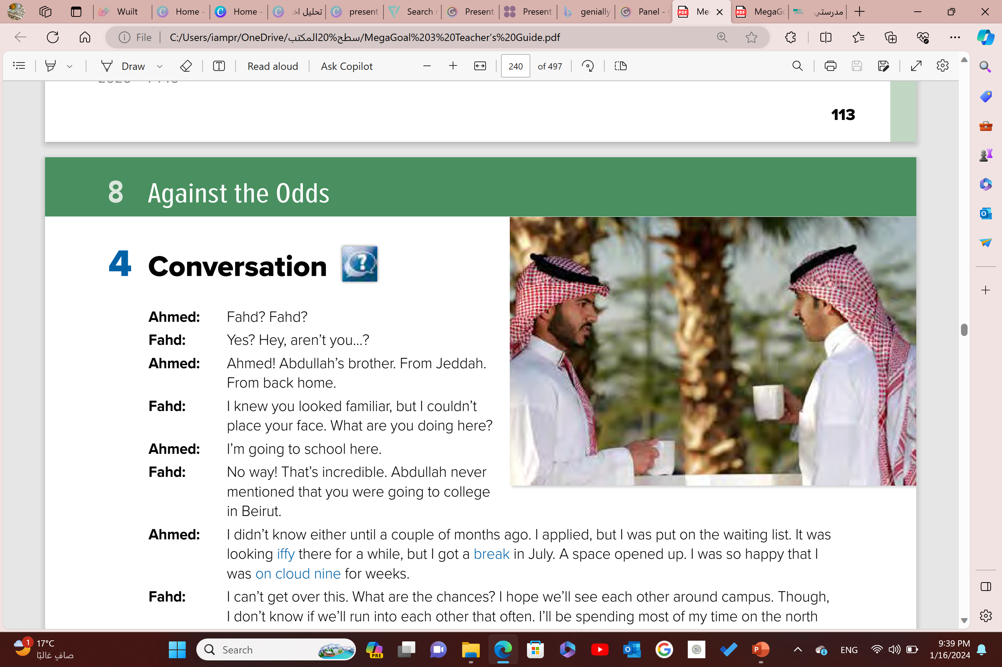
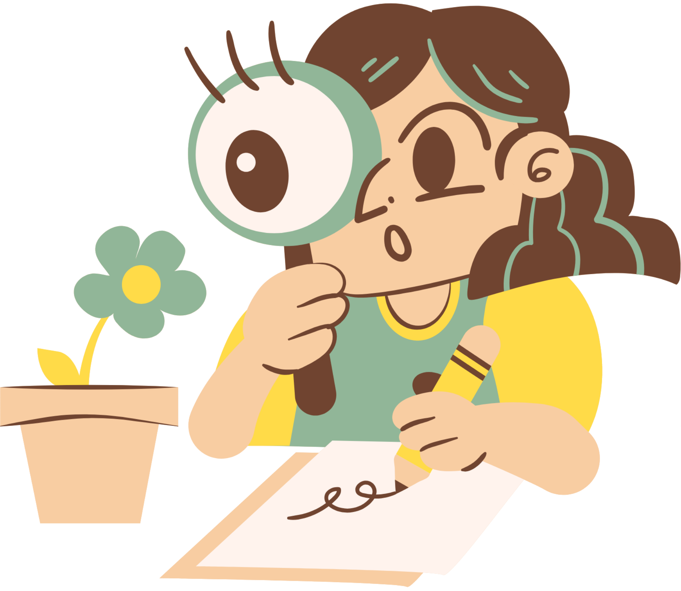
4-Conversation
Q 2
Q 1
What do you think they are talking about ?
What can you guess
about these people?
They must know each other well.
They might be friends.

Slide 10


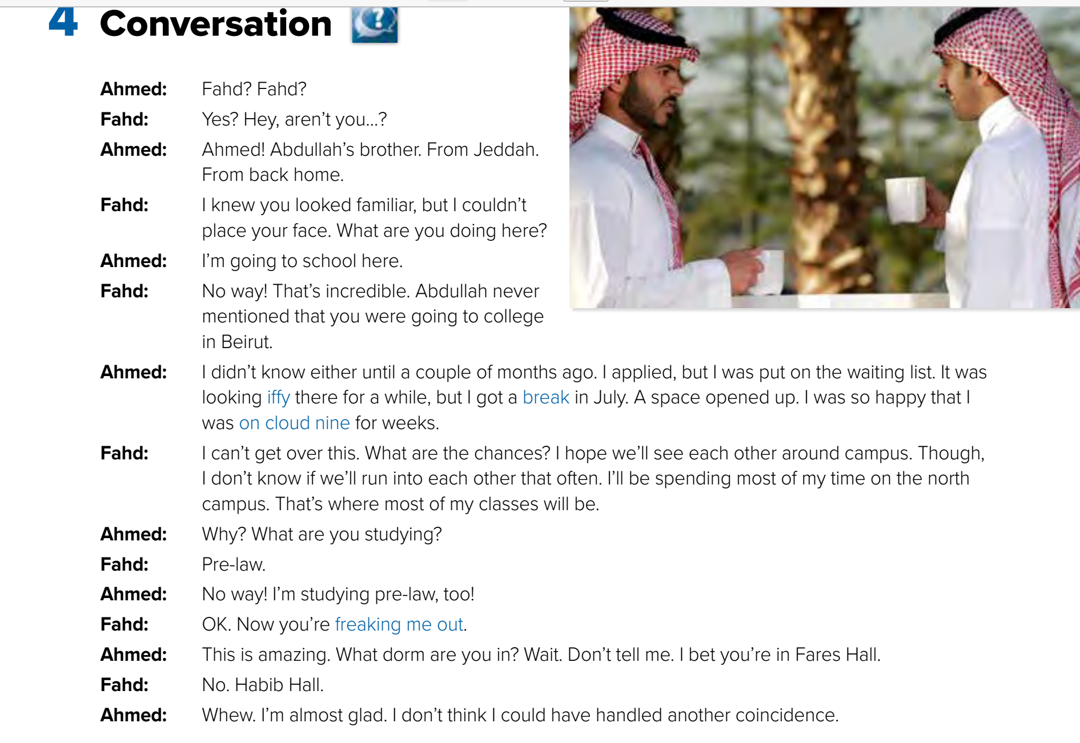


Slide 11
What was iffy?
Whether there would be a space at the college for Ahmed
Why was Ahmed on cloud nine?
He was accepted at the college
What is freaking Fahd out?
Finding out about
all of the coincidences between himself and Ahmed

Slide 12
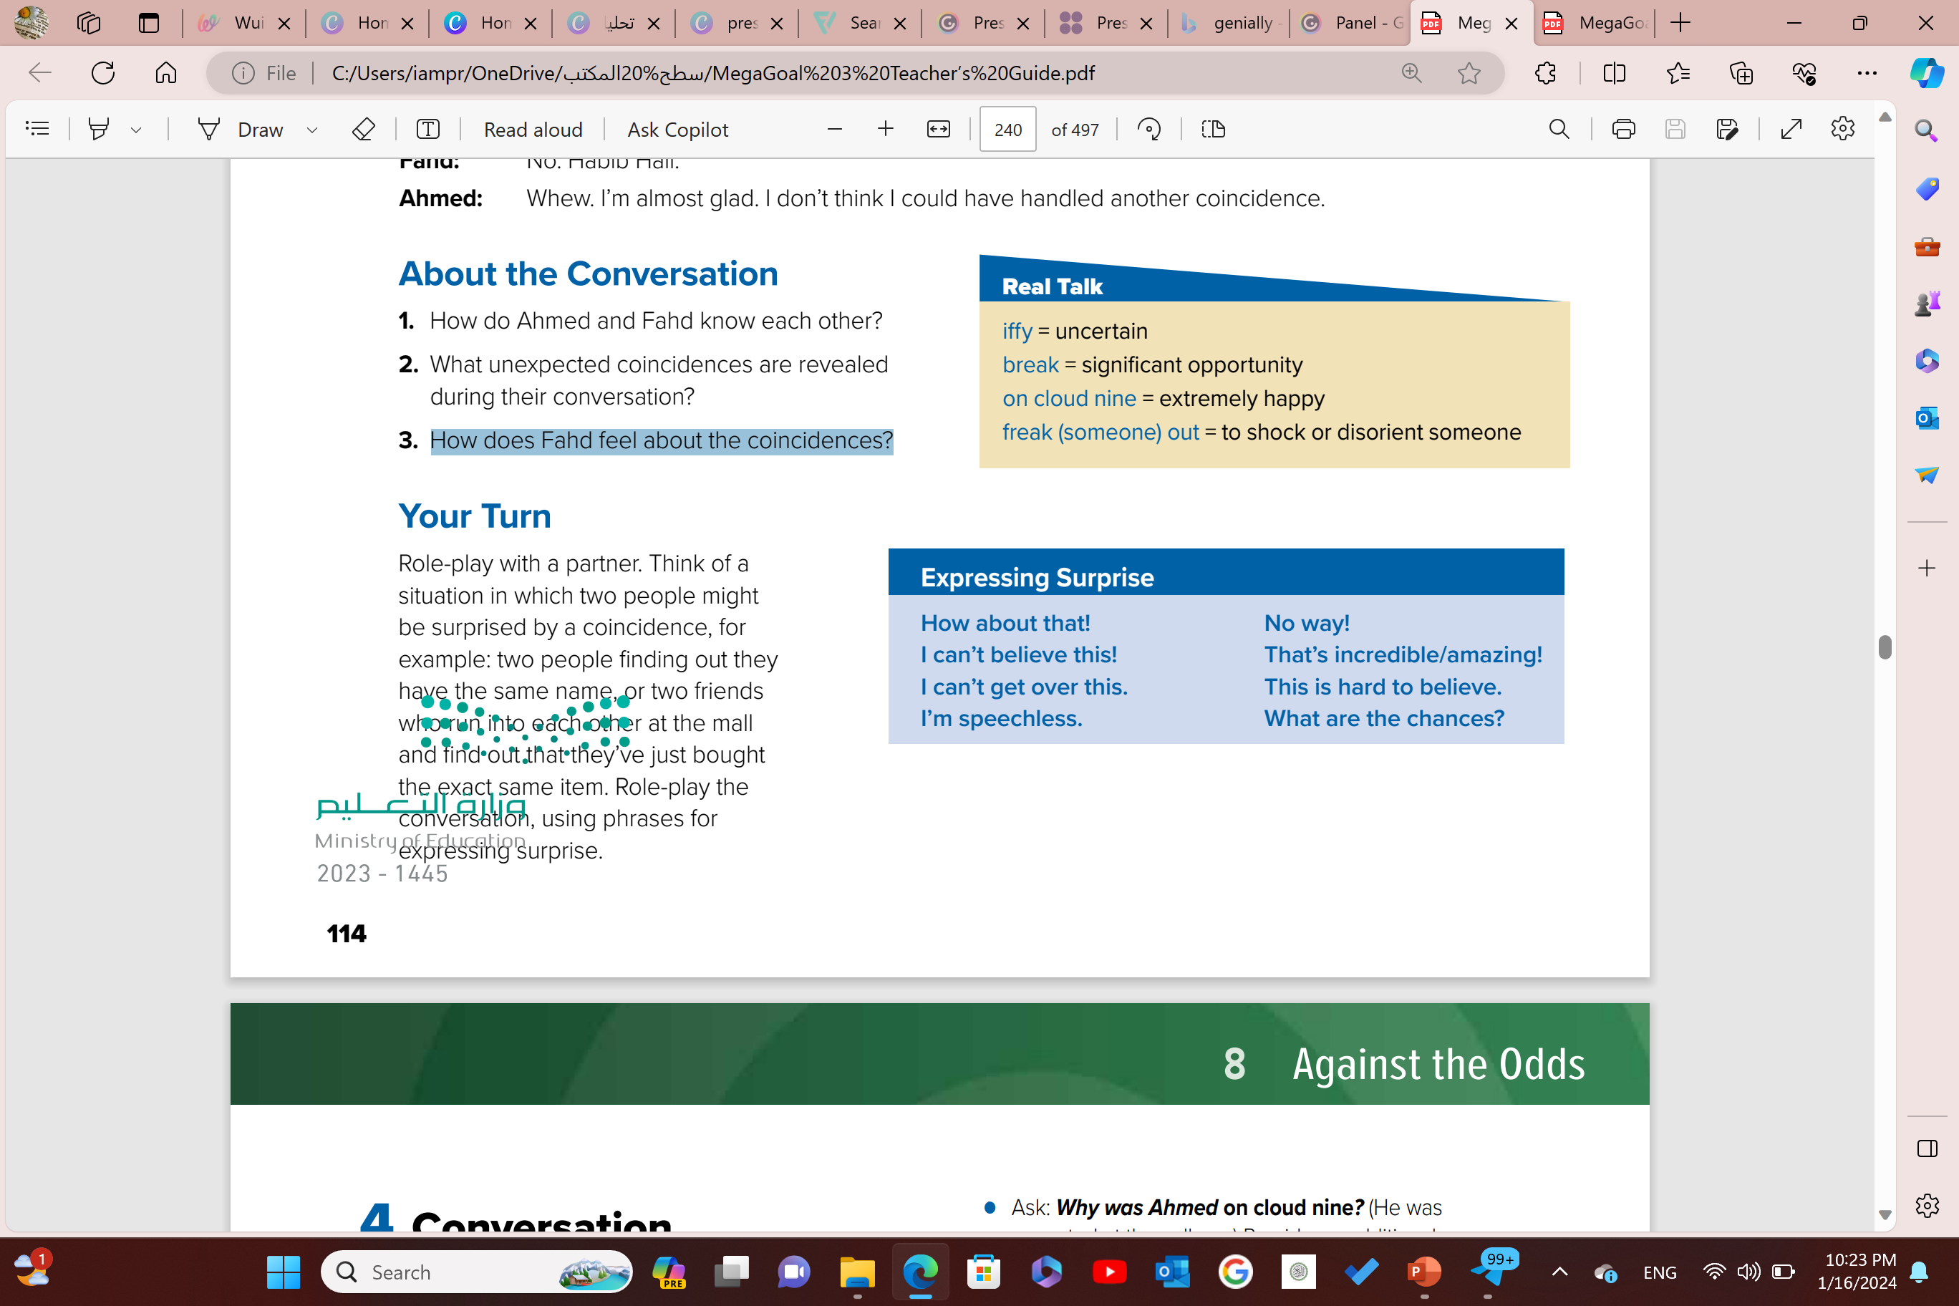
1-The weather is …………………..today.
It may rain, but it may not
iffy
Let’s practice more!
2-I was ……………………………...when I got the exam results
on cloud nine
3-I was……………………..
to discover that we had enrolled in all of the same classes at the same college.
freaked out

Slide 13
What unexpected coincidences are revealed
during their conversation?
About the conversation
Answer 2:
They are both studying pre-law at the same college in Beirut
How do Ahmed and Fahd know each other?.
How does Fahd feel about the coincidences?
Answer 1:
Answer 3:
They are both from Jeddah. Fahd is friends with Ahmed’s brother.
He feels shocked about the coincidences

Slide 14
Role-play with a partner. Think of a
situation in which two people might
be surprised by a coincidence, for
example:
two people finding out they
have the same name, or
two friends
who run into each other at the mall
and find out that they’ve just bought
the exact same item.
Role-play the
conversation, using phrases for
expressing surprise.
Activity Time

Slide 15



Describe a time that you were on cloud nine.

Slide 16

I knew you looked familiar, but I couldn’t place your face to place someone or something .
means to identify it by connecting it
with the proper place or circumstance.

Slide 17

Thank You
SEE YOU NEXT TIME

