Slide 1
Mega Goal 3.2
Unit 8
Against the odds
Conversation

Slide 2
Homework

Slide 3
Revision :
Choose:
He has……… big family that he has cousins he hasn`t met .
A- such a
B- such an
C- so

Slide 4
Choose:
The food was ….spicy that my mouth burned after eating it .
A-so few
B- so
C- such

Slide 5
Choose:
After ……… a large meal , I often feel sleepy.
A- finish
B- finished
C- finishing

Slide 6
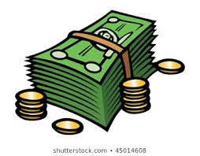
Warm-up!!
Despite difficult or unusual circumstances, thing sometimes happen against the odds .You can achieve extraordinary things
even when others think it`s not possible. Like…….
Go shopping
Being rich
Travelling abroad

Slide 7
Conversation
4

Slide 8
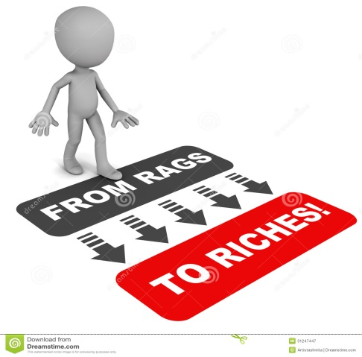
Objectives
1
Answer some questions about the conversation
2
Use “ Real Talk “ and specific phrases in sentences.
3
Discuss different options

Slide 9
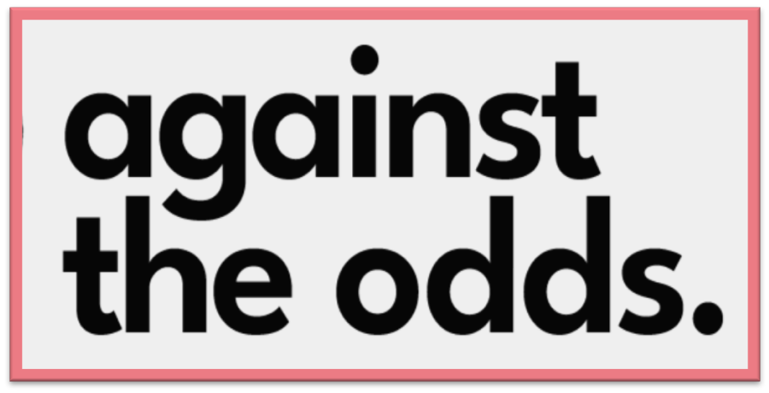
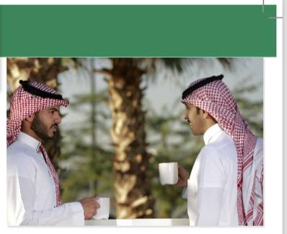
Imagine that you met your old friend by chance.
How do you feel ?

Slide 10
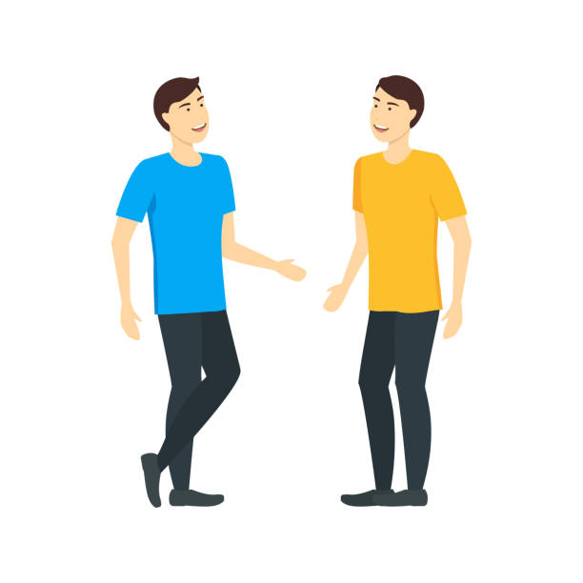
Conversation
1
Ahmed and Fahd met by chance in Jeddah, and Fahd is a friend of Ahmed's brother .
They also both study pre-law at the same college in Beirut and discovered it by coincidence

Slide 11
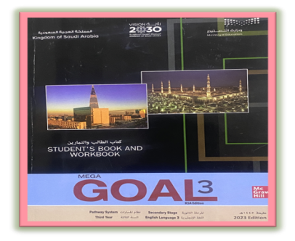
P.114
Pre- Reading
Describe the picture ?
Two persons are talking .

Slide 12
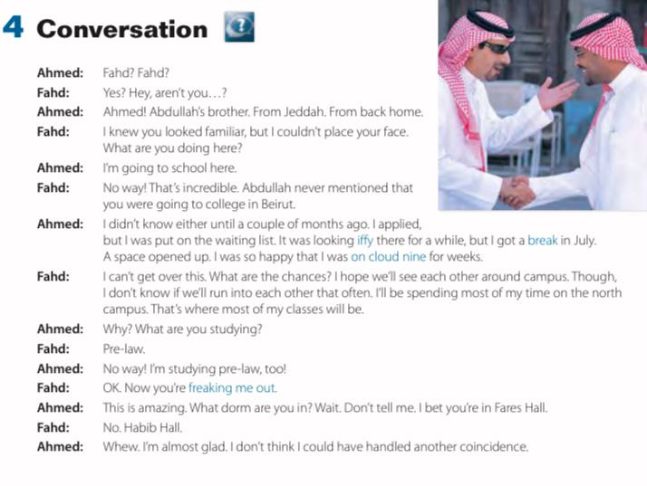
Listening task

Slide 13
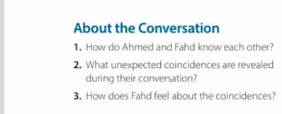
Post-Reading
Discussion
About Conversation
1. They are both from Jeddah. Fahd is friends with Ahmed’s
brother.
2. They are both studying pre-law at the same college in Beirut.
3. He feels shocked about the coincidences.. I think he will buy a used car, because that is what I would do.

Slide 14
Real Talk
What expression does Ahmed use to say “………………………
Who said this word ……….

Slide 15
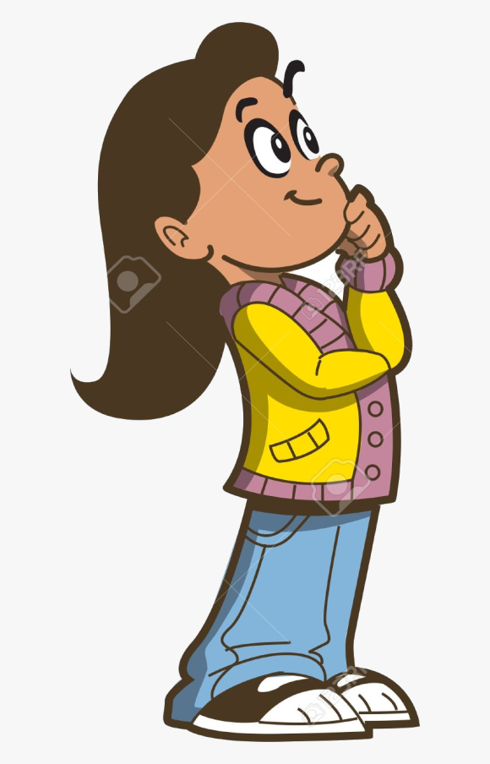
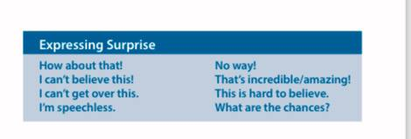
Discussing Options
Which expression does Ahmed and Fahd use in the conversation?
Phrases used to express surprising

Slide 16
Remember :

Slide 17
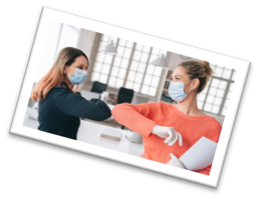
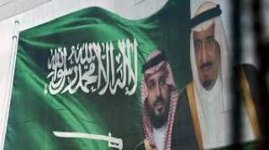
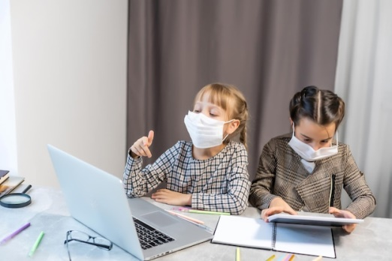
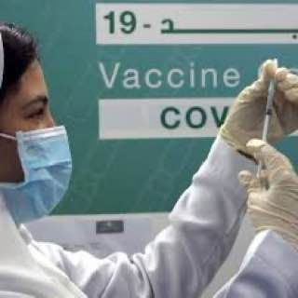
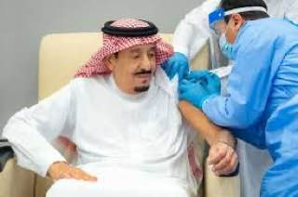
Remember :
The person who called the summit is
King Salman to fight the covid-19

Slide 18
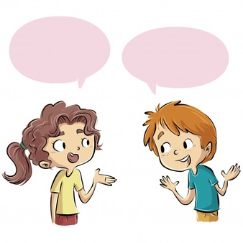
Application :

Slide 19
Any Questions ?

Slide 20
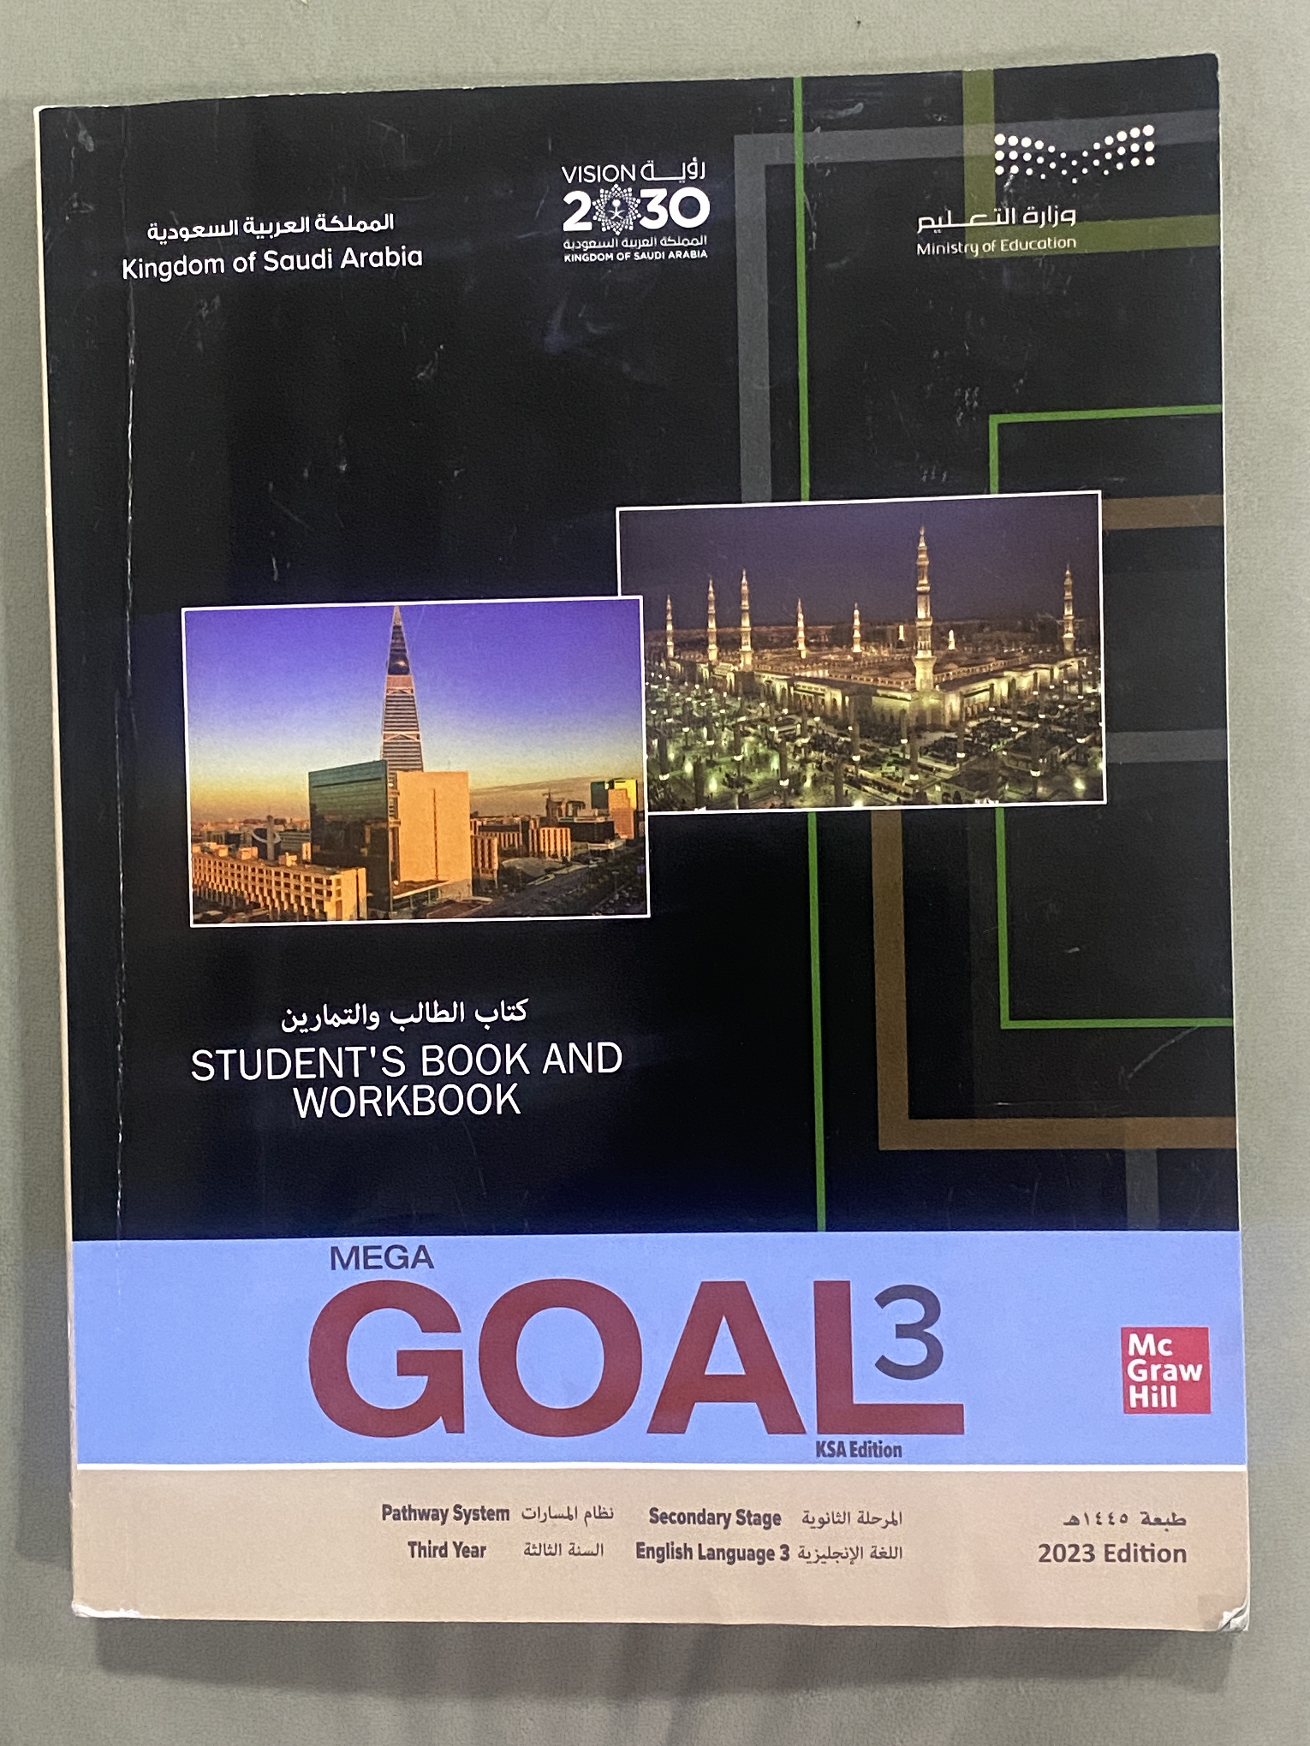
Homework
Open your
Work book
Page 302 ( H )

