Slide 1
Unit 7 Everyone Makes Mistakes Listen & Discuss
Mega Goal 3.2
Done by: Entisar Al-Obaidallah

Slide 2
Lesson Objectives
01
02
03
04
Discuss
Read
Remarkable events and coincidence
For specific information
complete
Answer
The sentences with the correct word
Some questions about the text correctly

Slide 3
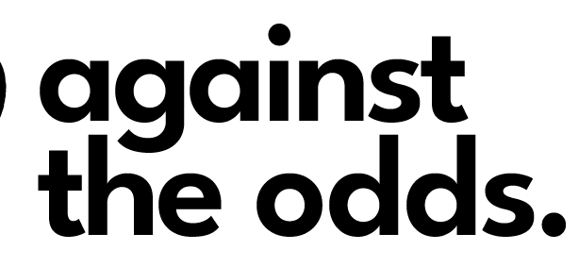
Warm Up
What does this title mean ?
It means despite a lot of difficulty or challenges . it happens or succeeds although it seemed impossible

Slide 4
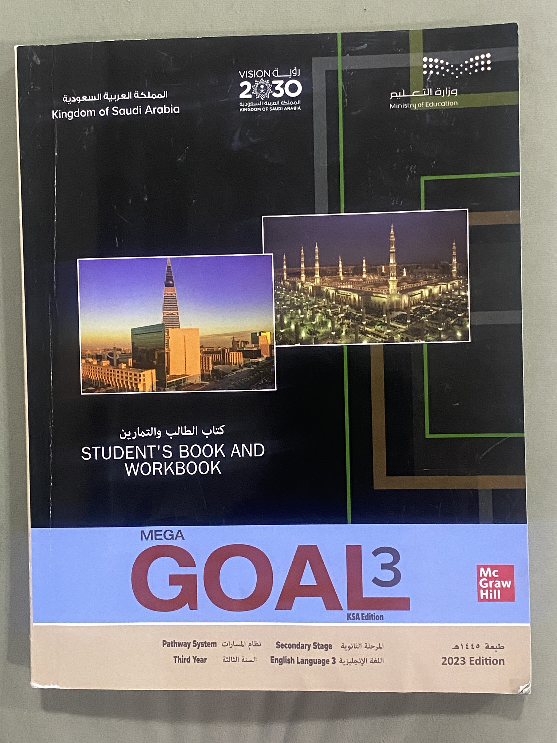
Open
Your studen’s book,
p. ( 110)

Slide 5
Read along as you listen

Slide 6
Do you know any countries that
are members of the G20?
Did any Middle Eastern country take on the G20 presidency?
Only Saudi Arabia in 2020

Slide 7
What happened soon after Saudi Arabia took over the G20 presidency for 2020?
Who called the summit?
the Covid-19
pandemic
King Salman

Slide 8
Who did the G20 promise to protect?
people, especially those who are vulnerable

Slide 9
How much money did the G20 leaders say they would put into the economy?
five trillion US dollars

Slide 10
Did the G20 leaders promise to help only some
countries?
No, they said they would help all countries

Slide 11
Open
Your studen’s book,
p. ( 111)

Slide 12
safeguard
pledged
summit
vulnerable
priority
disruption

Slide 13
1- It was held to discuss how to deal with the crisis caused by the pandemic.
2- They would cooperate with international organizations such as the World Health Organization,
the International Monetary Fund, the World Bank Group, and the United Nations.
3 They would manufacture more medical supplies and making them available to regions that
need them the most at affordable prices and as quickly as possible.
4- They planned to make sure that there was no disruption in the flow of important medical
supplies, agricultural products, and other goods and services across borders.
5- The G20 leaders would focus on helping developing and least developed countries

Slide 14
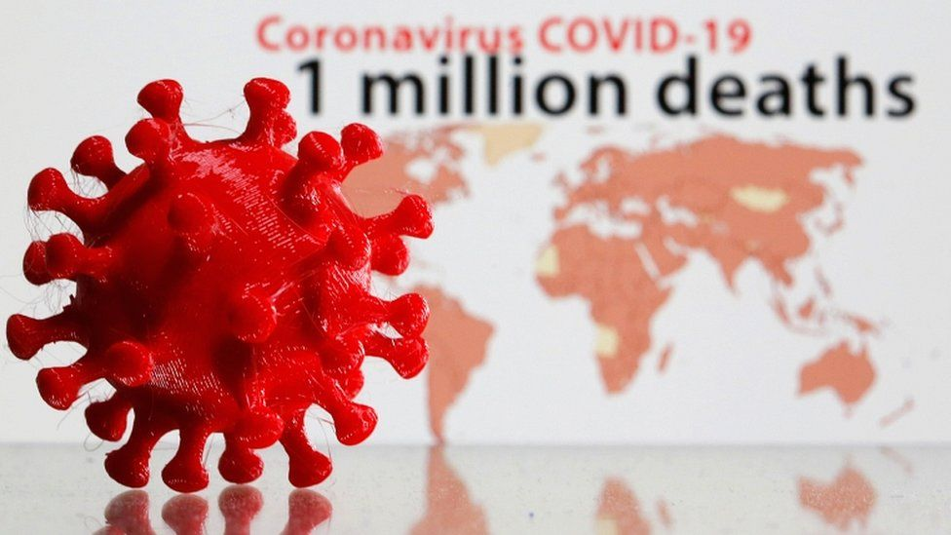
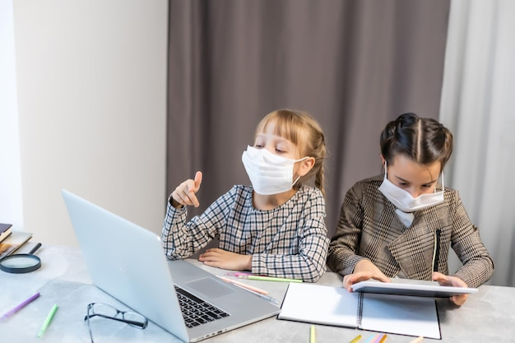
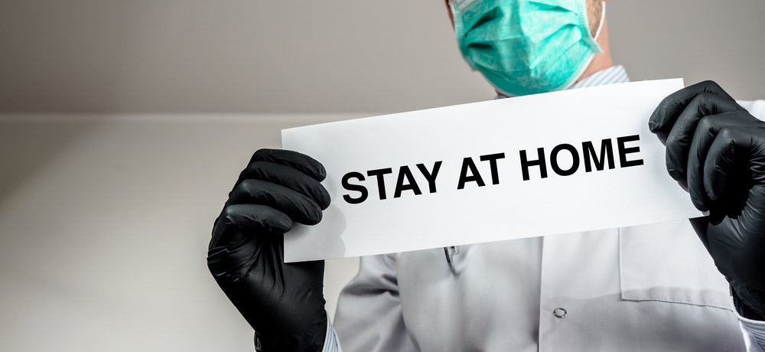
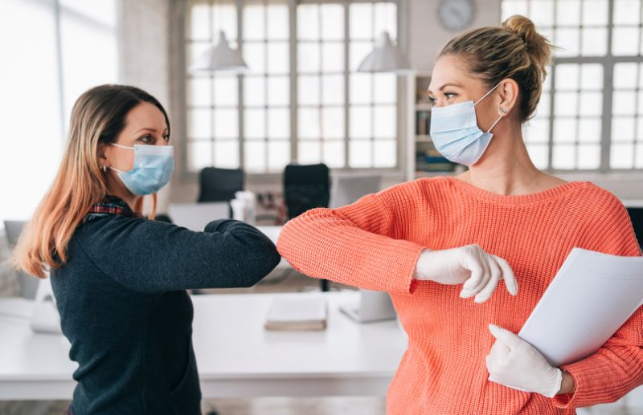

Slide 15
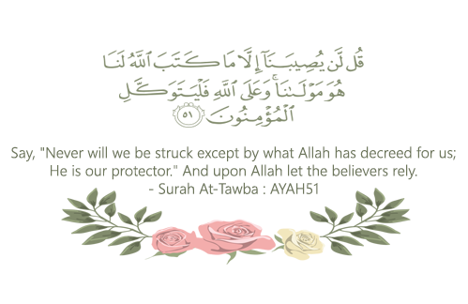
Remember..

Slide 16
Homework
On workbook, p. ( 299) ,
Exercises ( A,B)

Slide 17
THANKS!

Slide 18
ALTERNATIVE RESOURCES
Here’s an assortment of alternative resources whose style fits the one of this template:
Vector
Floral element collection

