Slide 1
Unit 8
Against the Odds
Grammar
Mega Goal 3.2
Done by: Entisr Al-Obaidallah

Slide 2
Lesson Objectives
01
02
Distinguish
Practice
Between the so…that and such…..that correctly
Reducing adverb clauses correctly
03
Apply
The rules to do the exercises correctly

Slide 3
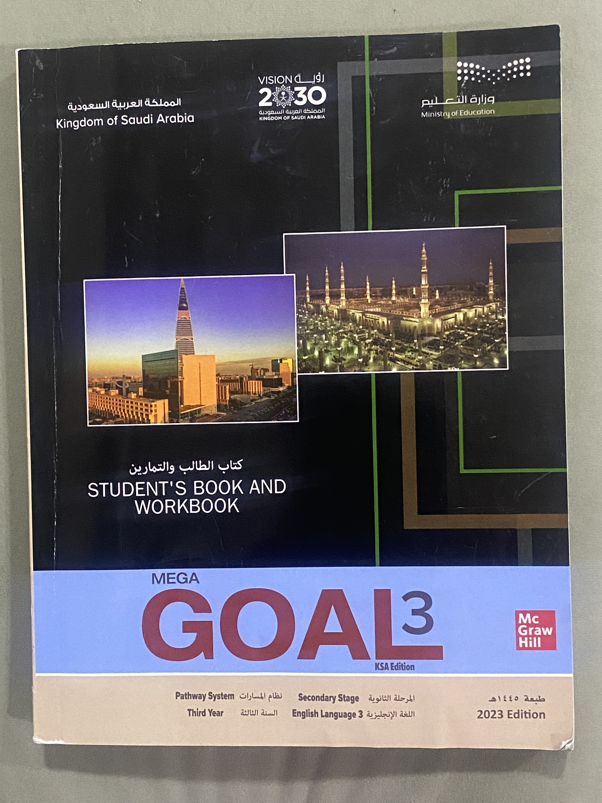
Open
Your student’s book ,p. (300) Exercises ( C)

Slide 4
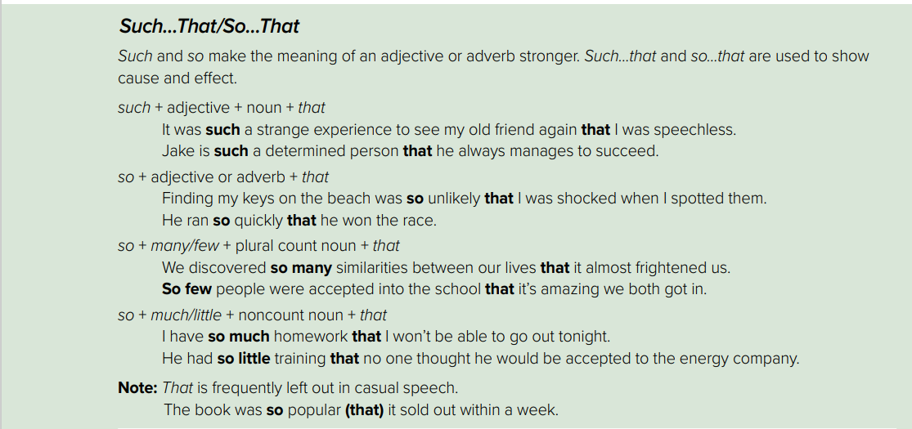


Slide 5


Such …………….That
1- make the meaning of an adjective or adverb stronger
2- show cause and effect.
Example
a) It is an amazing book .
The cause
b) I have read it many times.
The Result
We join the two sentences using this form: Such +Adjective + noun + that
adjective
noun
It is such an amazing books that I have read it many times.
The cause
The Result

Slide 6
So …………….That
1- make the meaning of an adjective or adverb stronger
2- show cause and effect.
Example
a) I was very tired .
The cause
b) I couldn’t finish my homework.
The Result
We join the two sentences using this form: So +Adjective + that
adjective
Note:
omit “very” when you join the two sentences
I was so tired that I couldn’t finish my homework.
The cause
The Result

Slide 7
So …………….That
So...that is used with quantifiers (many, much, few, little) even if there is a noun.
form
  so + many/much + noun + that
Countable noun
Example
There were so many people (that) I couldn’t find a seat.
Countable noun
There was so much noise (that) I couldn’t hear.

Slide 8
So …………….That
So...that is used with quantifiers (many, much, few, little) even if there is a noun.
form
  so + few / little + noun + that
Countable noun
Example
There were so few students (that) could solve the puzzle
uncountable noun
She has so little time (that) she couldn’t look after her kids.

Slide 9


Slide 10

Fan-N-pick
2
4
It was
( such – so)
a nice weather that we spend the whole day outside
I was
( so- such )
tired that I fell asleep in the sofa.
There were
( few – little)
question that everyone can answer it
There were
(many - much)
noise that I couldn’t sleep.
1
3

Slide 11
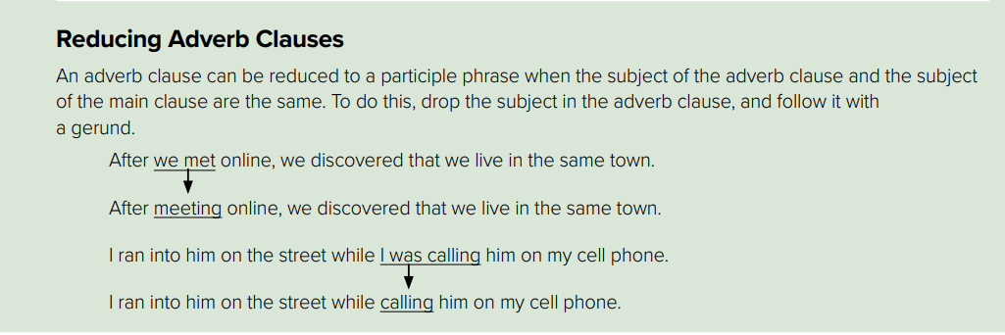

Slide 12

Reducing Adverb Clause
An adverb clause can ONLY be reduced if the subject in both clauses is the same.
subject
Verb “be”
subject
Example
While I was walking to class, I fell down.
If there is “be” verb after the subject , the subject and the ( be) verb are omitted.
omit subject
omit “be” verb
While I was walking to class, I fell down.
While walking to class, I fell down.

Slide 13

Reducing Adverb Clause
If there is NO “be” form of the verb, omit the subject and change the verb to –ing
Example
subject
Main verb
subject
Before I go school , I eat my breakfast.
omit subject
Add -ing
Before I go school , I eat my breakfast.
ing
Before I going school , I eat my breakfast.

Slide 15



Find the Fib
After I doing my homework , I watch TV
We have to omit the subject (I)
After I doing my homework , I watch TV

Slide 16
Find the Fib
While was driving to work ,he got a call
We have to omit the verb (be)
While driving to work ,he got a call from his boss

Slide 17
Find the Fib
While walk to work ,he saw his old friend.
We have to add (-ing ) at the end of the verb
While walking to work ,he saw his old friend.

Slide 18
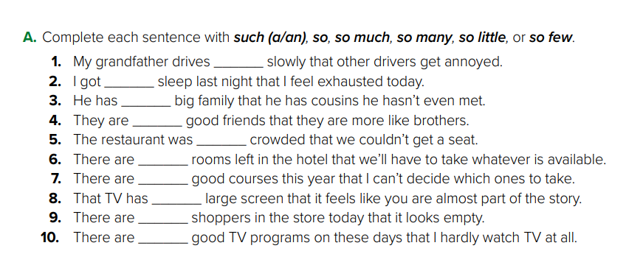
so
so little
such a
such
so
so few
so many
such a
so few
so few

Slide 19
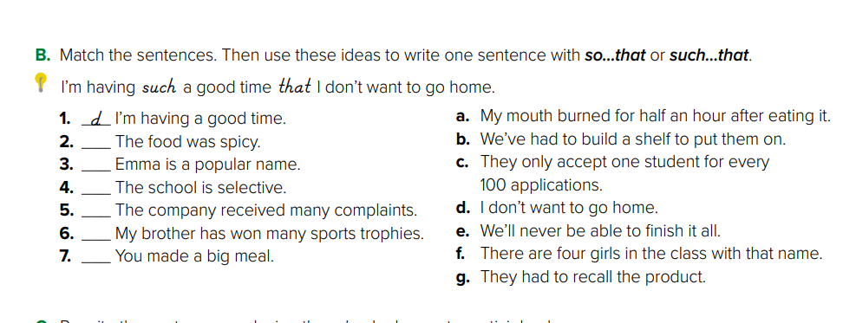
a
f
c
g
b
e

Slide 20
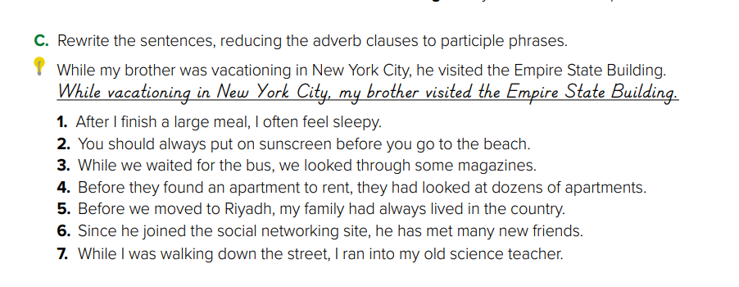
After finishing a large meal, I often feel sleepy.
You should always put on sunscreen before going to the beach.
While waiting for the bus, we looked through some magazines.
Before finding an apartment to rent, they had looked at dozens of apartments.
Before moving to Riyadh, my family had always lived in the country.
Since joining the social networking site, he has met many new friends.
While walking down the street, I ran into my old science teacher .

Slide 21
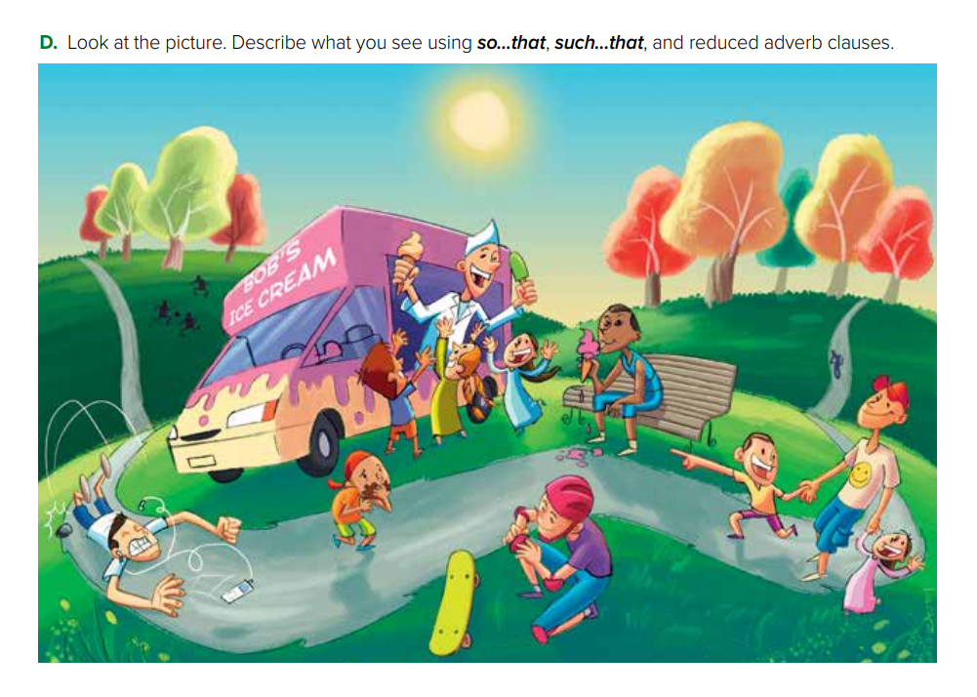
1. It is such a hot day that the teenage boy’s ice cream cone is dripping.
2. The little boy is so excited that he is dragging his father to the ice-cream truck.
3. The little boy has eaten so much ice cream that he feels sick.
4. While running, the teenage boy tripped and fell.
5. Before skateboarding, the boy is putting on knee pads.

Slide 22
“Such …that” in the
Holy Quran
قال تعالى:
"قَالُوا ادْعُ لَنَا رَبَّكَ يُبَيِّن لَّنَا مَا لَوْنُهَا ۚ قَالَ إِنَّهُ يَقُولُ إِنَّهَا بَقَرَةٌ صَفْرَاءُ فَاقِعٌ لَّوْنُهَا تَسُرُّ النَّاظِرِينَ “
“They said, "Call upon your Lord to show us what is her color." He said, "He says, 'It is such a yellow cow, bright in color - that pleases to the observers”

Slide 23
Homework
On workbook, p. ( 300) ,
Exercises ( C)

Slide 24

Thanks!

Slide 25
Resources
Did you like the resources on this template?
Get them on these websites:
Vectors
Floral doodle spring planner
Hand drawn school sticker collection I
Hand drawn school sticker collection II

Slide 26
Alternative resources
Here’s an assortment of alternative resources whose style fits that of this template:
Vectors
Orange and blue background list
Flat design school sticker design I
Flat design school sticker design II

