Slide 1


WE CAN 2
Unit 4 lesson 2
Rhythms and Listening
2nd Term 2024

Slide 2

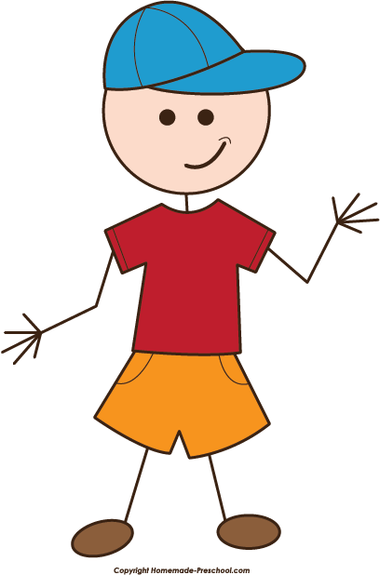
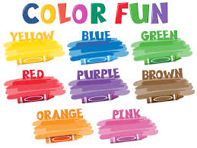

Slide 3

Let`s watch the video

Slide 4


see
Traffic lights

Slide 5


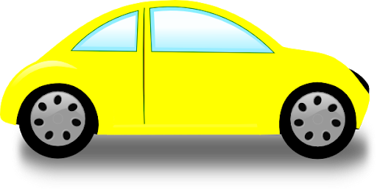






Traffic lights
When you see a red light, stop, stop, stop
When you see a yellow light, wait , wait, wait
When you see a green light, go , go ,go

Slide 6
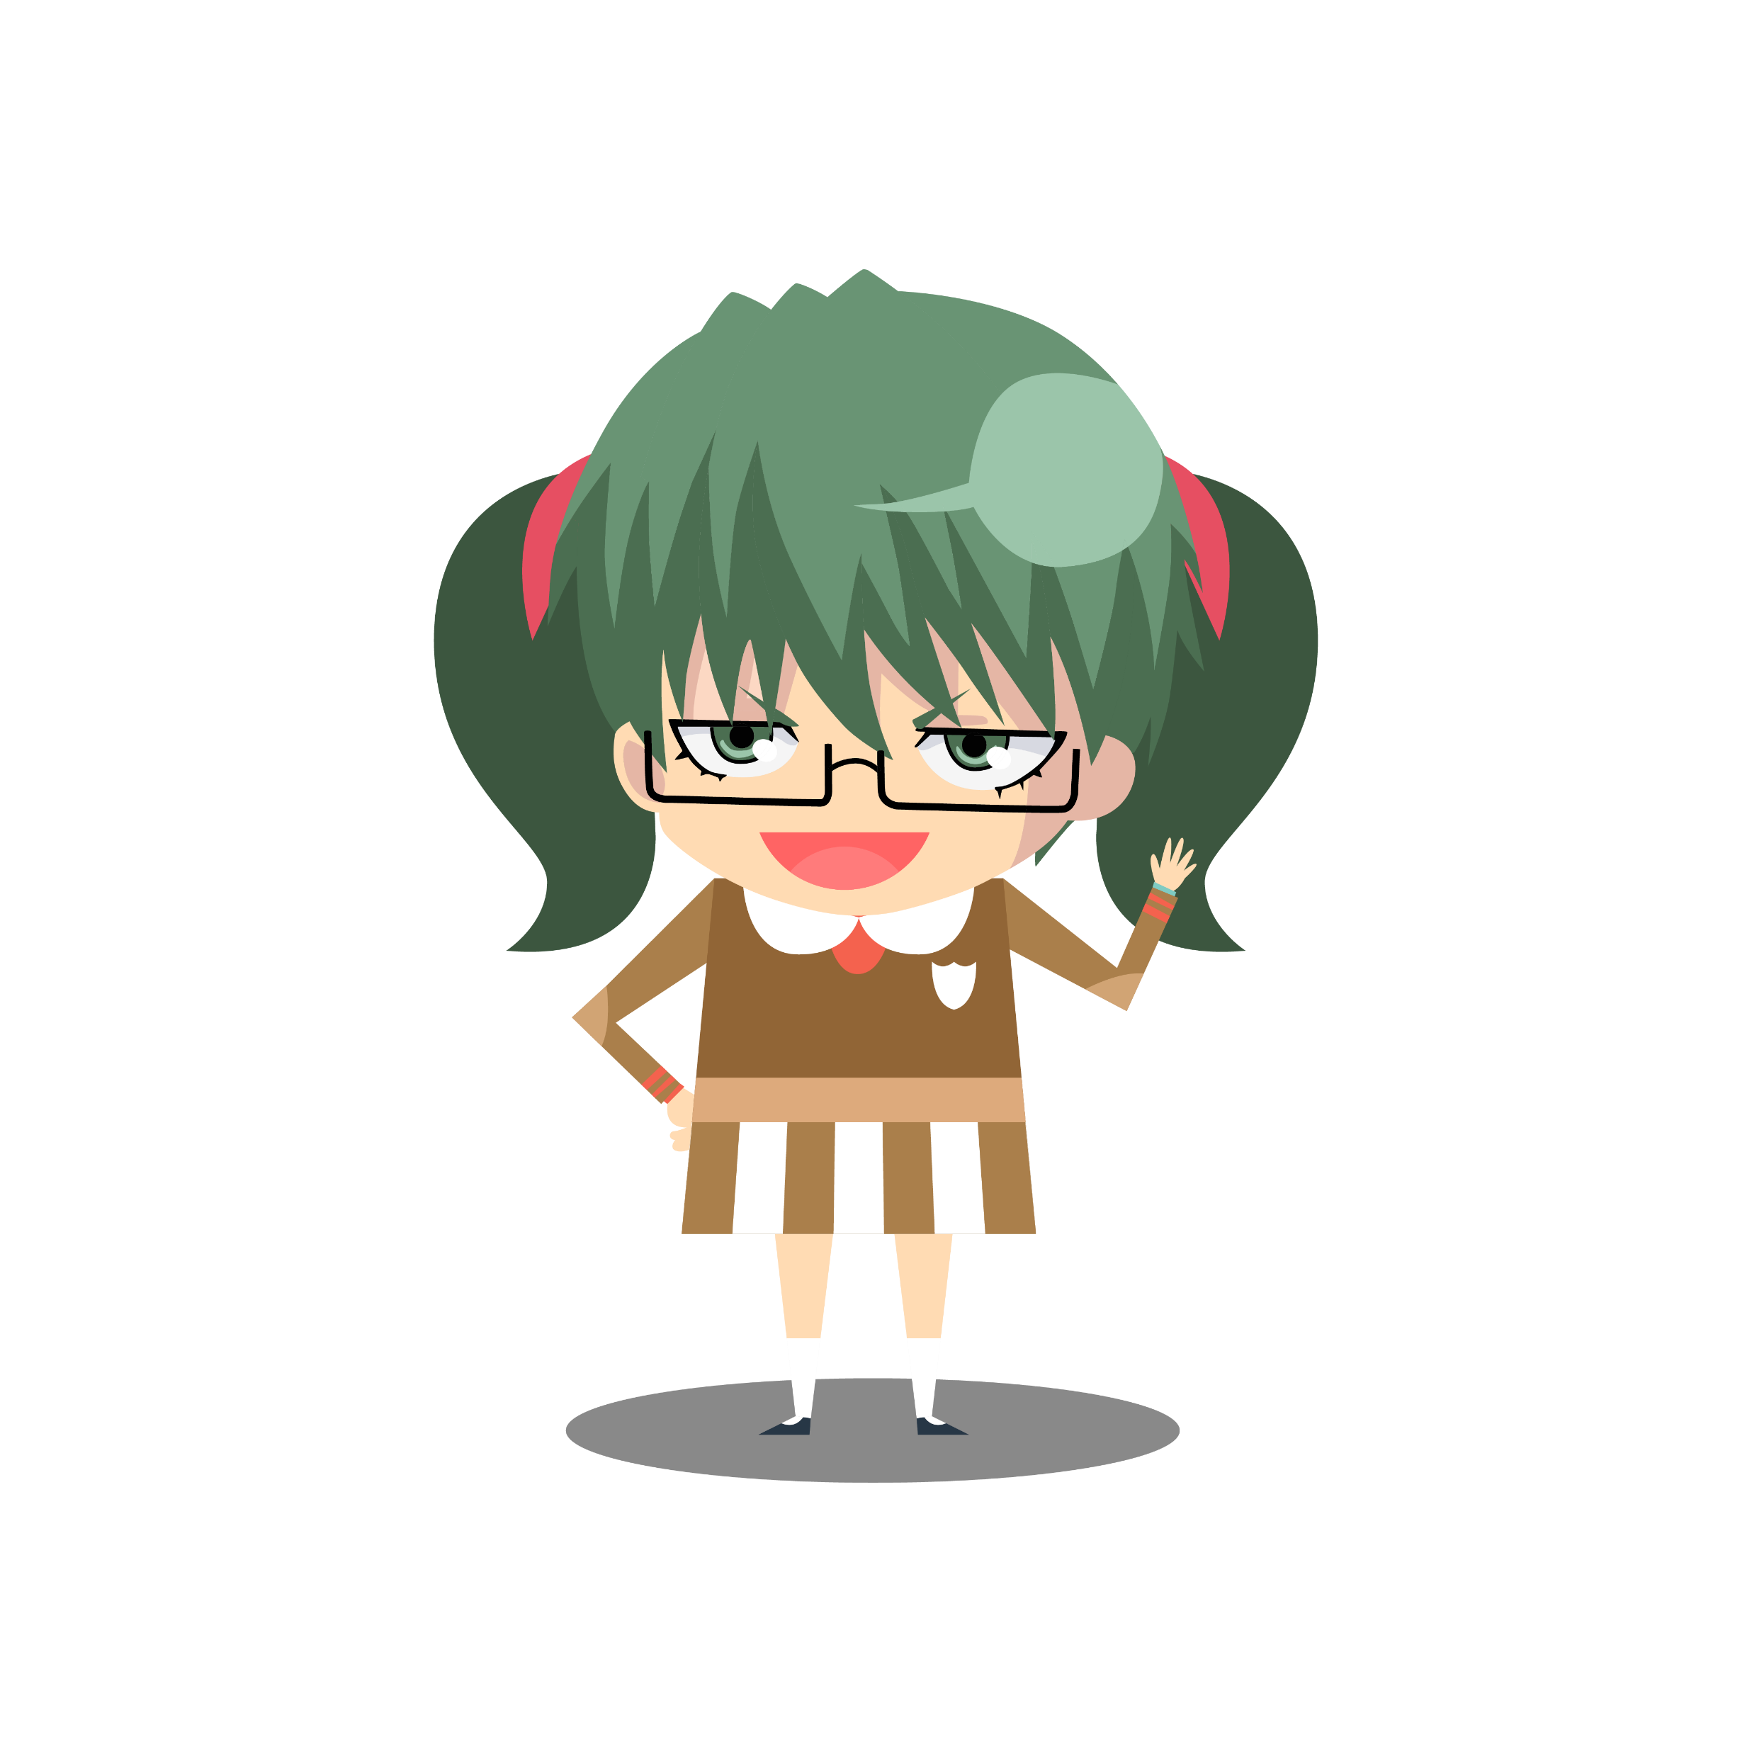

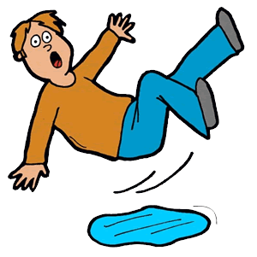
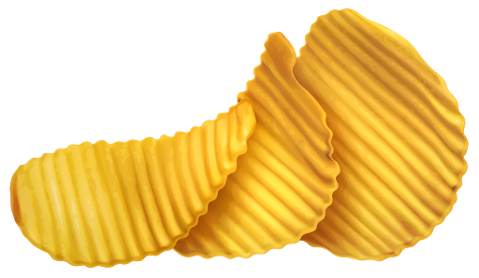






Listen and say
sh
,
ch
&
sl
ship
chip
slip

Slide 7

Sh sound

Slide 8

ch sound

Slide 9

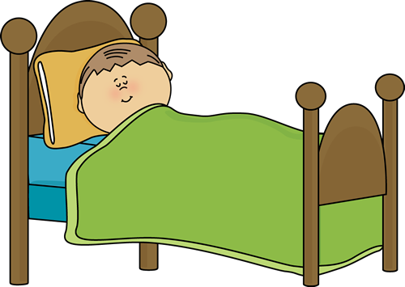
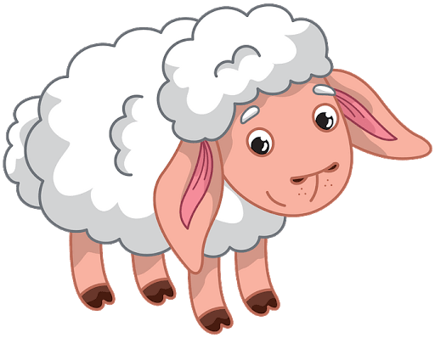

Listen then write the missing letters
sl
,
ch
,
sh
sh
ch
sl
___eese
___eep
__eep

Slide 10


