Slide 1
WE CAN 2
Unit 4 lesson3
Words in Action
2nd Term 2024

Slide 2
Watch out!

Slide 3
Let`s watch a video

Slide 4
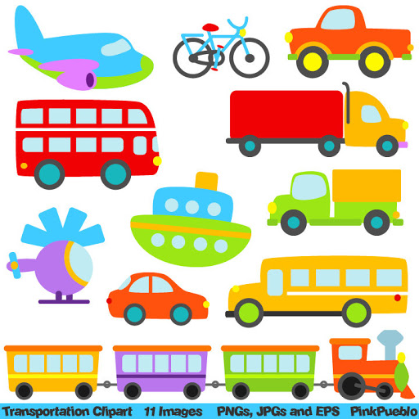
Can you name any of these vehicles?
This Photo by Unknown Author is licensed under CC BY-SA

Slide 5
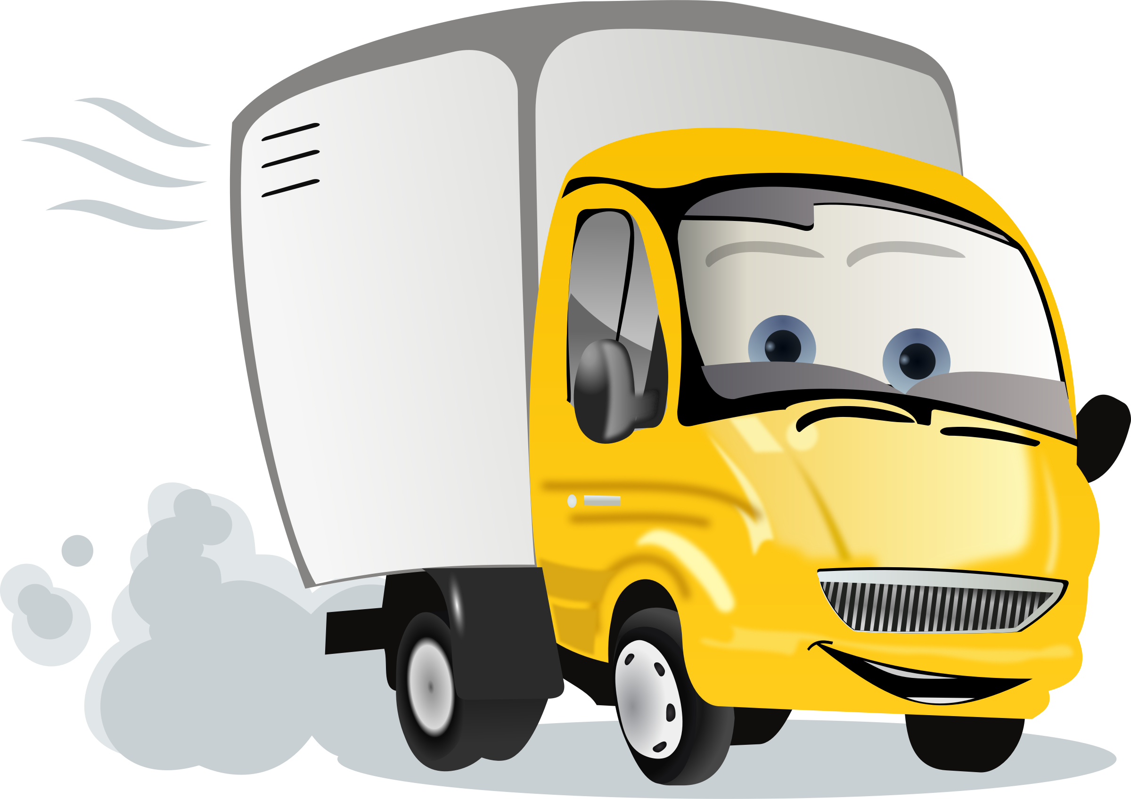
Watch out!......................
It`s a truck.

Slide 6
Watch out!......................
It`s a bus.

Slide 7
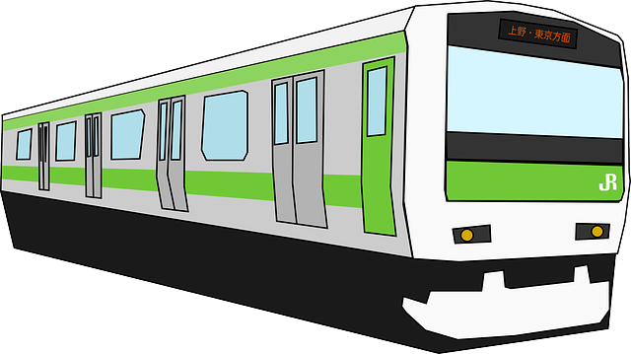
Watch out!......................
It`s a train.

Slide 8
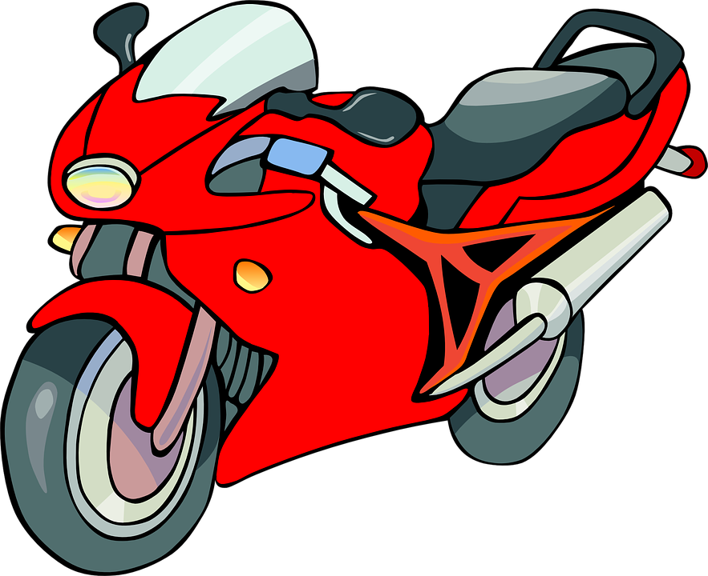
Watch out!......................
It`s a motorbike.

Slide 9
Watch out!......................
It`s a car.

Slide 10
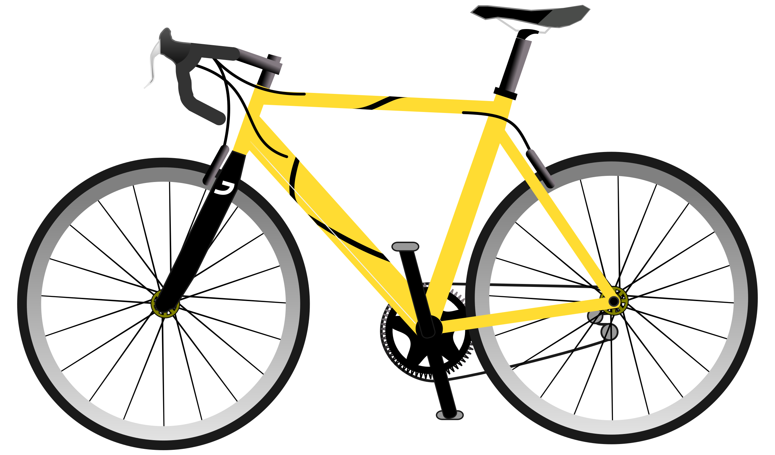
Watch out!......................
It`s a bicycle.

Slide 11
Watch out!......................
It`s a taxi.

Slide 12
Watch out!......................
It`s a police car.

Slide 13
Watch out!......................
It`s an ambulance.

Slide 15
I can
say the names of 3 vehicles
1………………….
2…………………
3……………….

Slide 17
Where are you ?

Slide 18
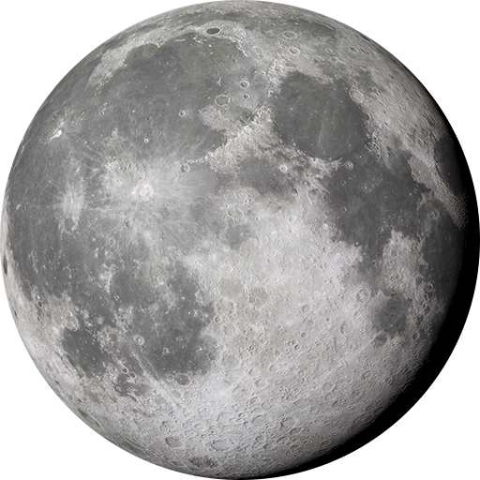
Let`s take a trip to the moon ?

Slide 19
Let`s take a trip to the moon ?
Follow the directions

Slide 20
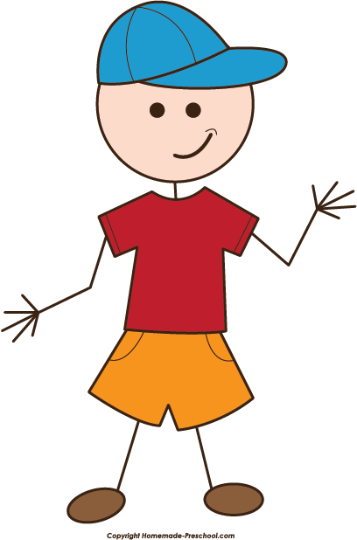
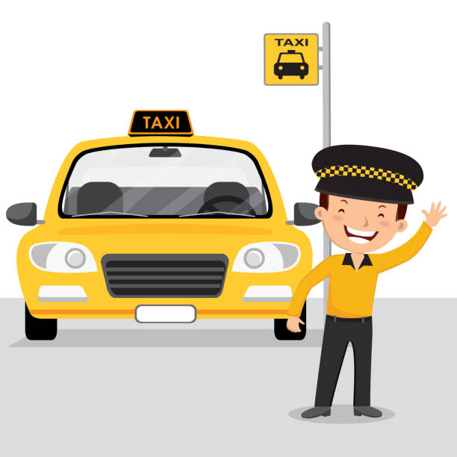
1
Take a bicycle
to
the taxi stand

Slide 21
2
Take a taxi
to
the hospital

Slide 22
3
walk
to
the school

Slide 23
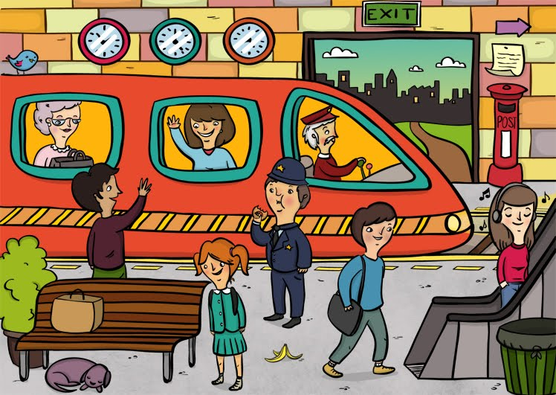
4
Take a school bus
to
the train station

Slide 24
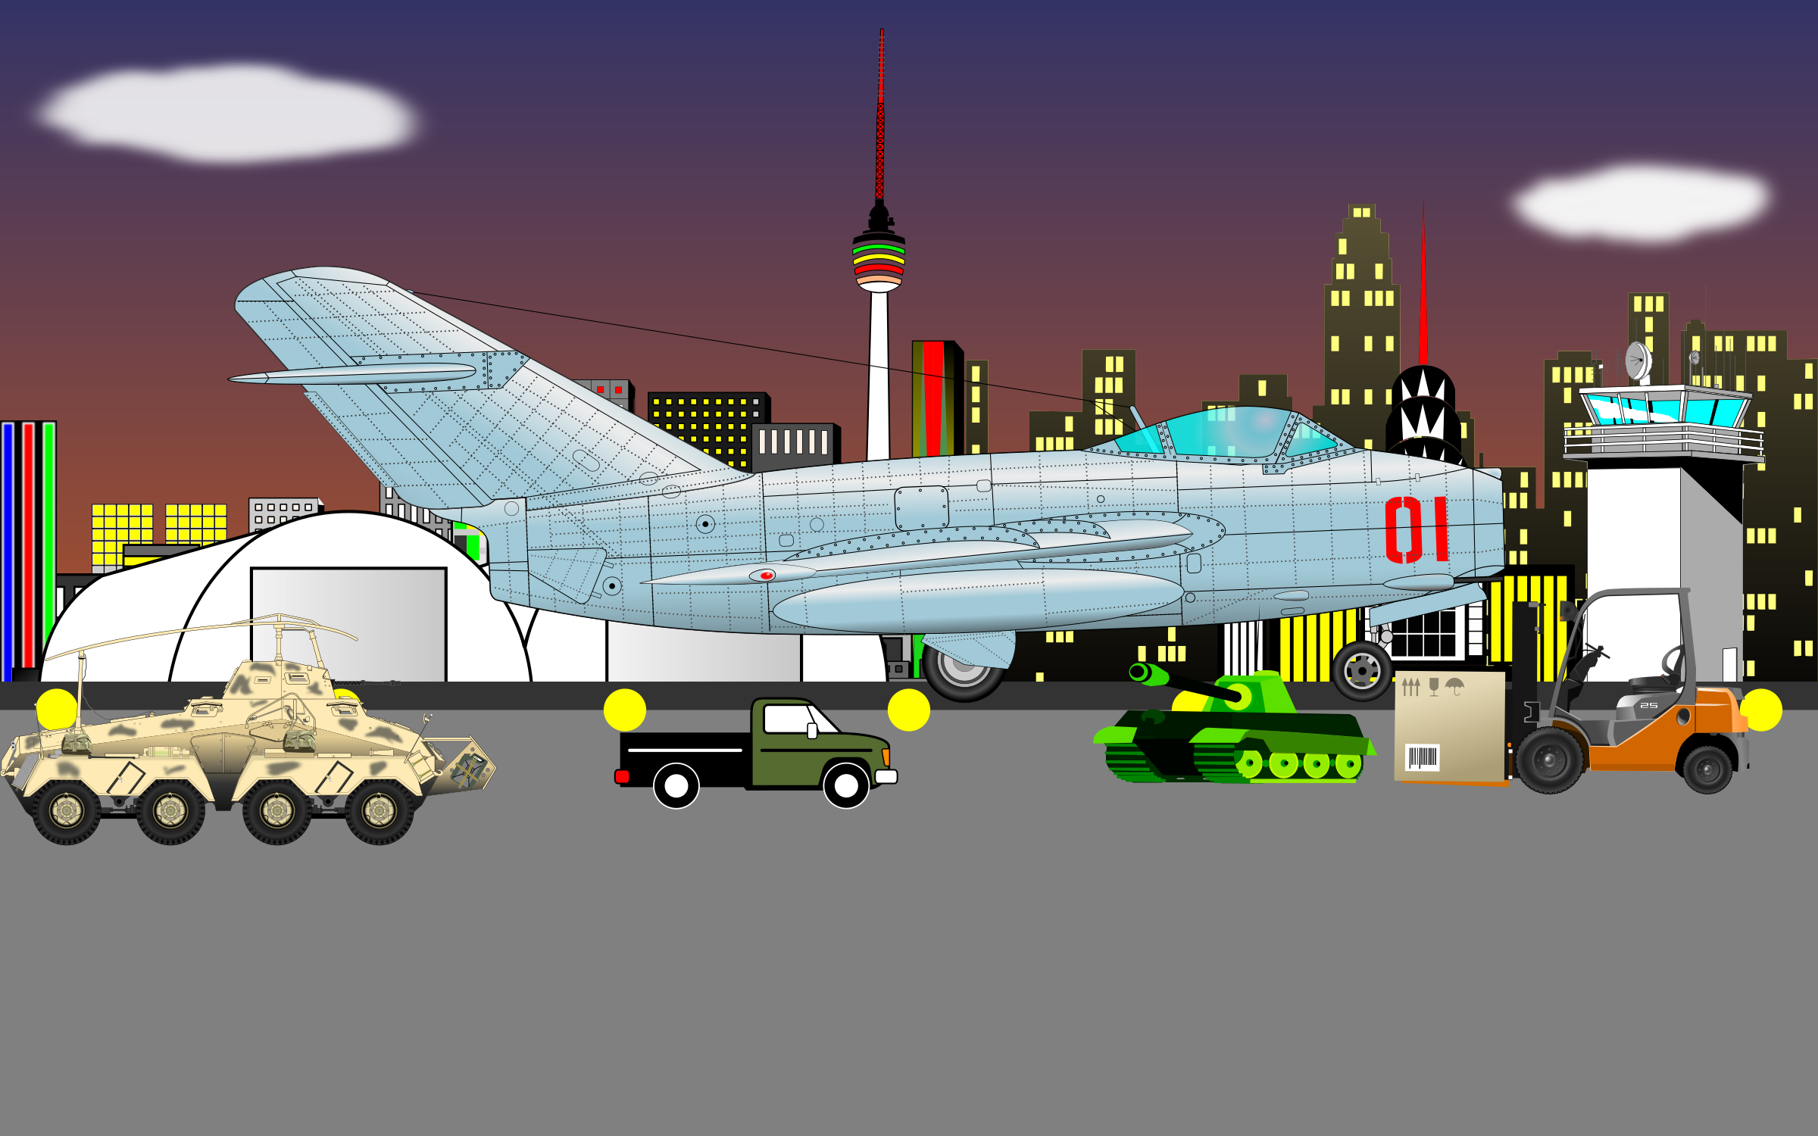
5
Take a train
to
the airport

Slide 25
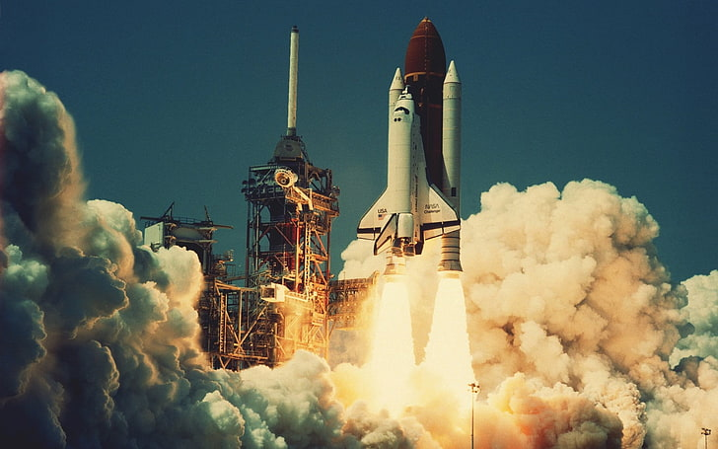
6
Take an airplane
to
the space station

Slide 26
7
Take a rocket
to
the moon
This Photo by Unknown Author is licensed under CC BY-SA

Slide 27
Where are you now?
I`m on the moon

