Slide 1


WE CAN 6
Unit 8 lesson3
Reading and Writing
2nd Term 2024
T.Hanan Allaheeb

Slide 2
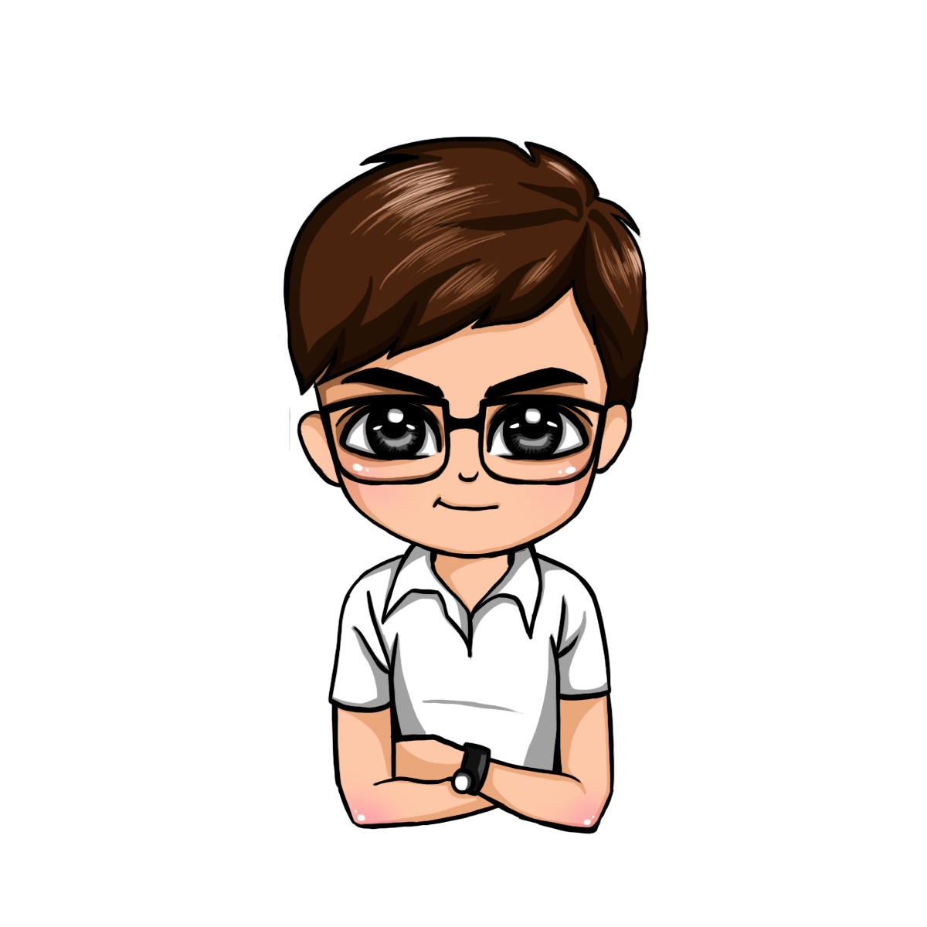
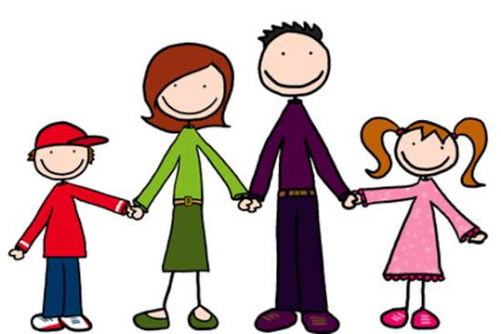


Listen and read
My Brother Khaled

Slide 3
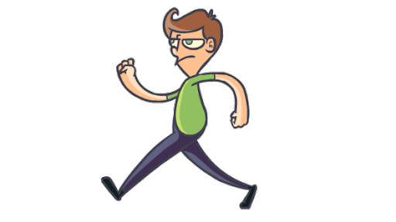

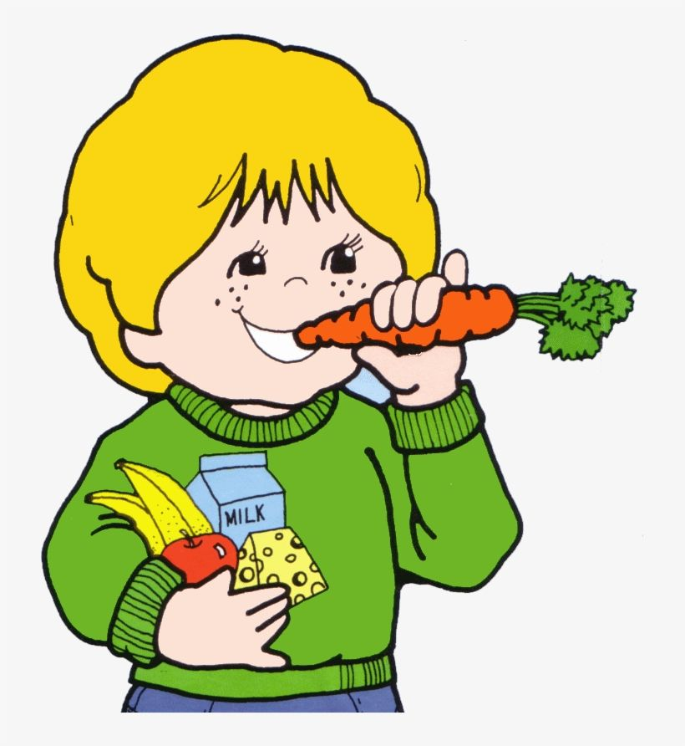

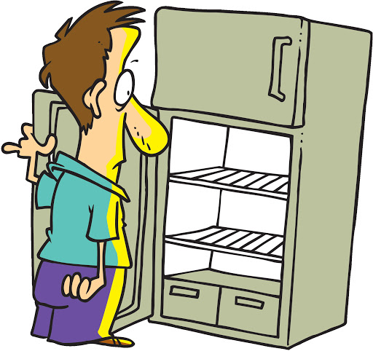


My brother Khaled went to the cupboard
To find something to eat.
cupboard
But when he got there,
The cupboard was bare,
*empty=فارغ
And so he had nothing to eat.

Slide 4
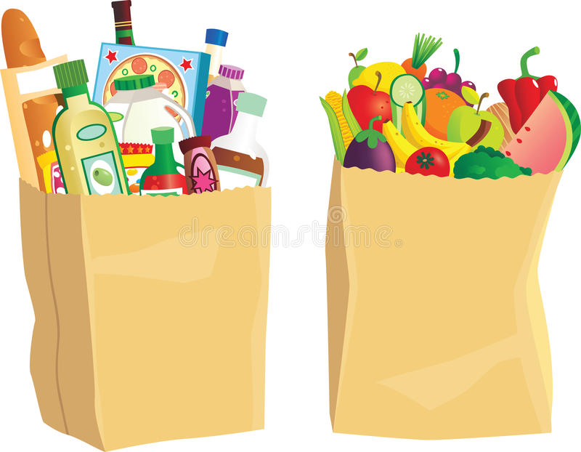
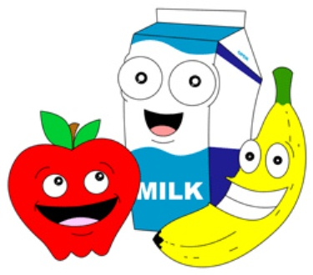







He went to the grocer’s,
To buy some fruit and milk.
But when he came back,
He was holding
an empty brown bag!
Poor Khaled!

Slide 5



change the verb tense in the story to present simple
My brother Khaled went to the cupboard
goes
To find something to eat.
But when he got there , The cupboard was bare,
gets
is
And so he had nothing to eat.
Choose from the box
has
goes
gets
is
has
goes
comes
goes
He went to the grocer’s,
To buy some fruit and milk.
But when he came back,
He was holding
an empty brown bag!
come
is

Slide 6





Let`s practice the words
meat chicken
cheese butter

Slide 7
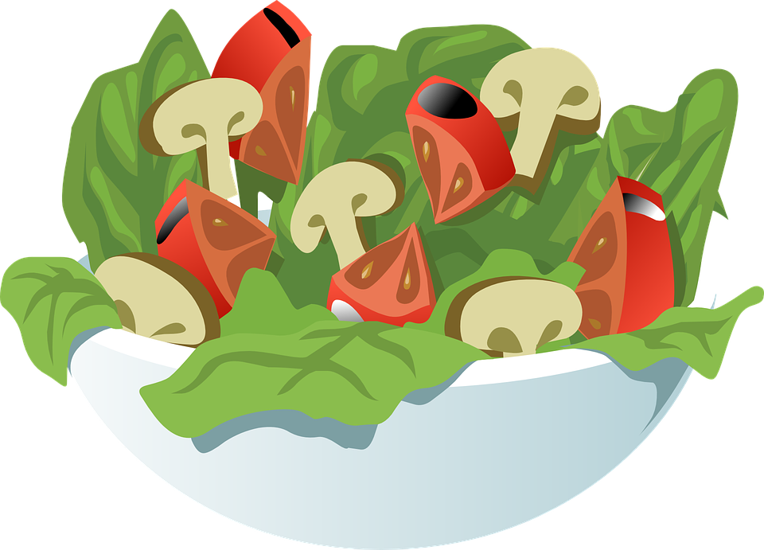
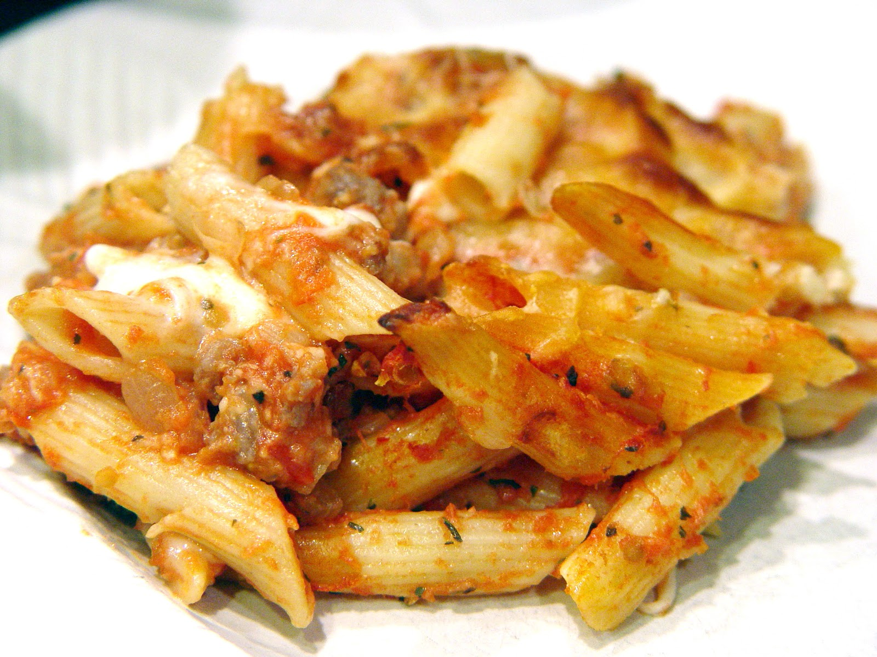
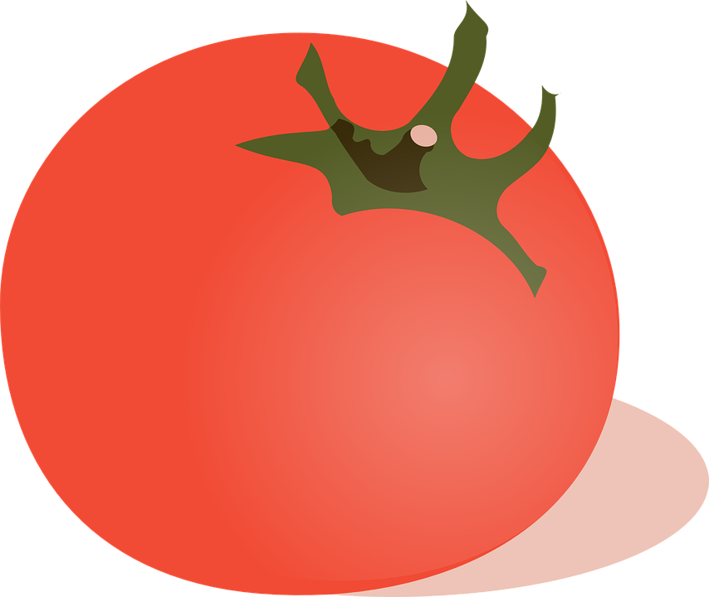
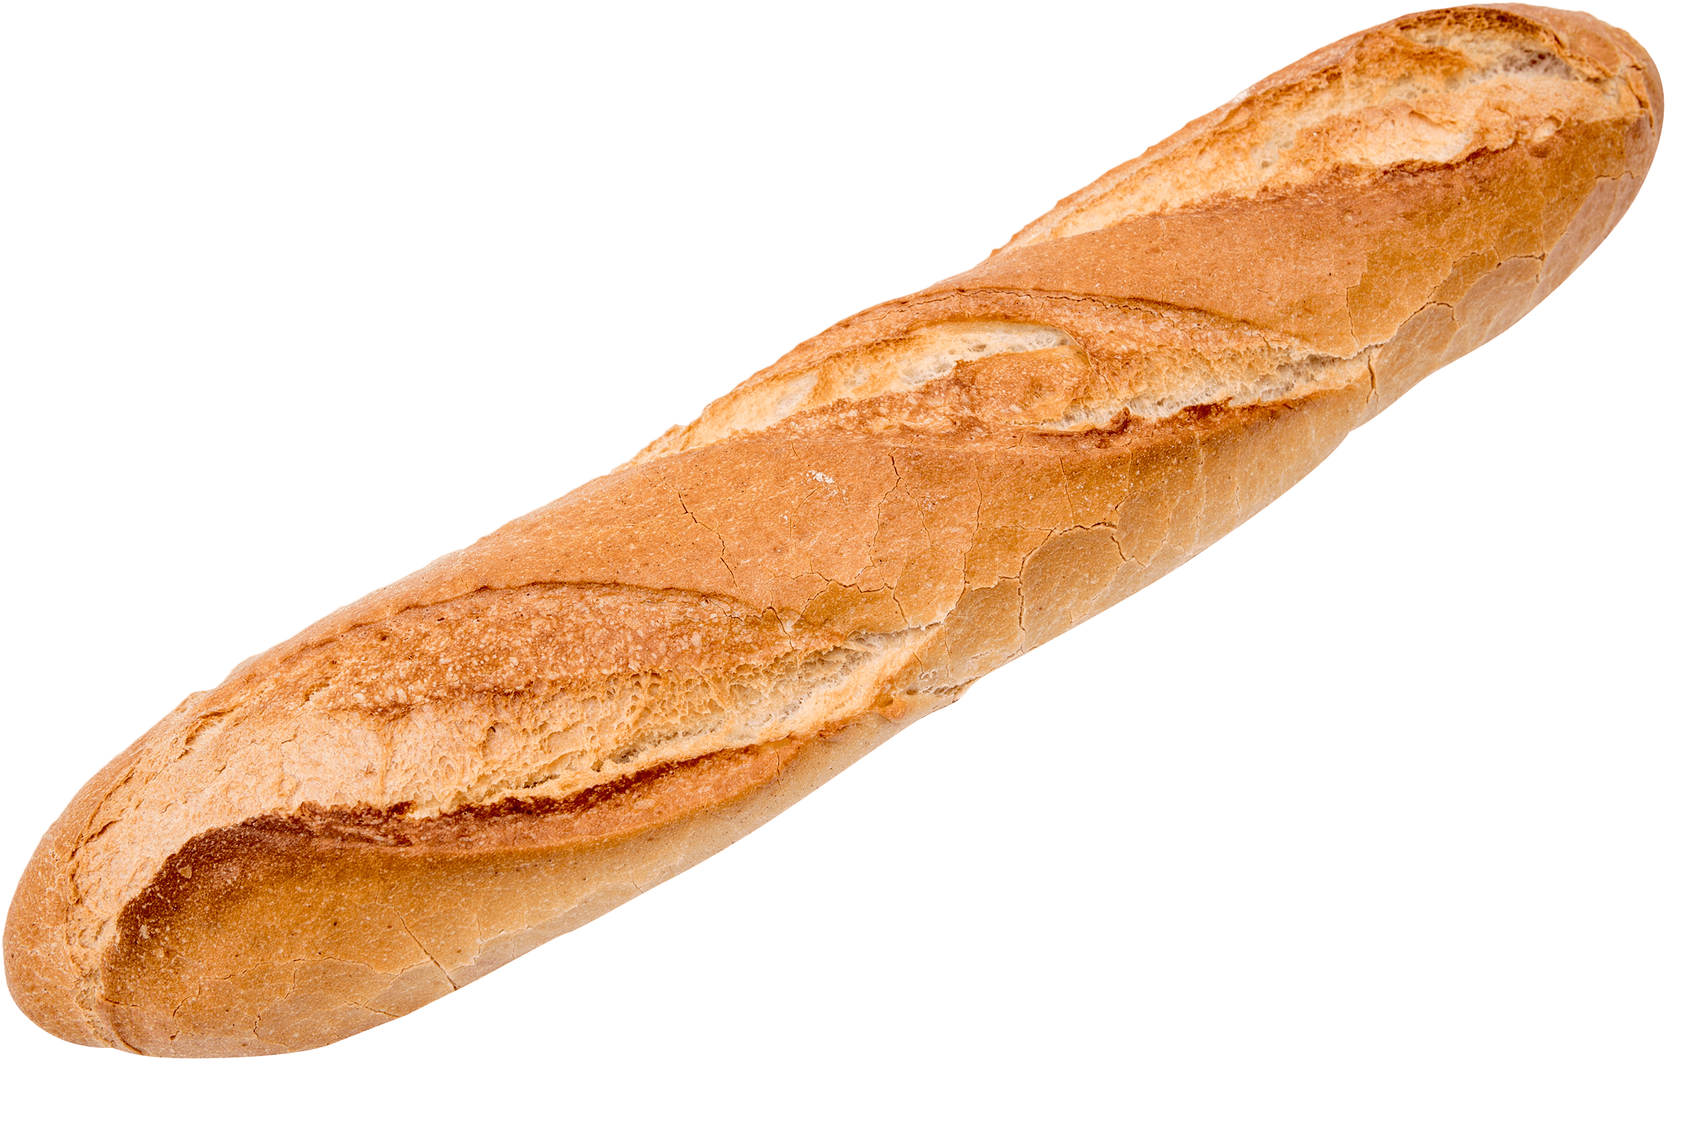
Let`s practice the words
tomatoes salad
macaroni bread

Slide 8




Let`s practice the words
carrots anions
potatoes apples

Slide 9


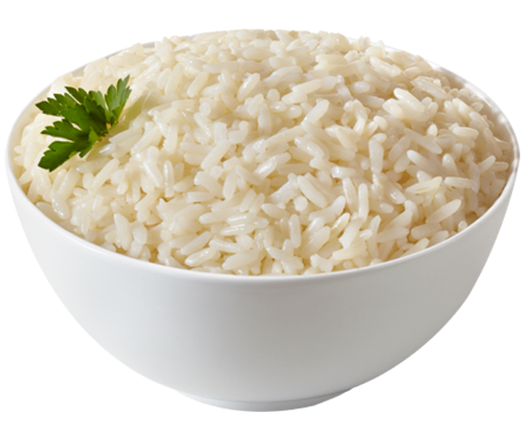

Let`s practice the words
rice flour
eggs oil

Slide 10




Let`s practice the words
juice milk
mustard ketchup

Slide 11


We had some tomatoes.
We didn`t have any tomatoes.

Slide 12
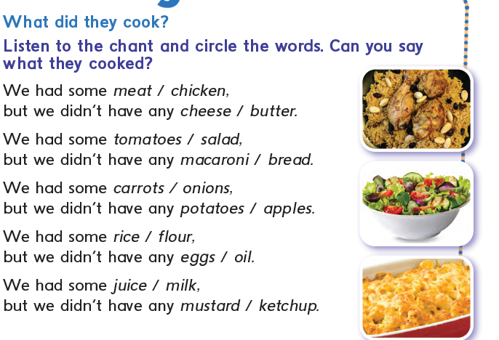














Slide 13
What did they have?
They had…….
Meat cheese tomatoes macaroni onions
apples flour eggs juice mustard

Slide 14




Comment on the chant
I think It`s……….
boring
interesting
difficult
easy

Slide 15
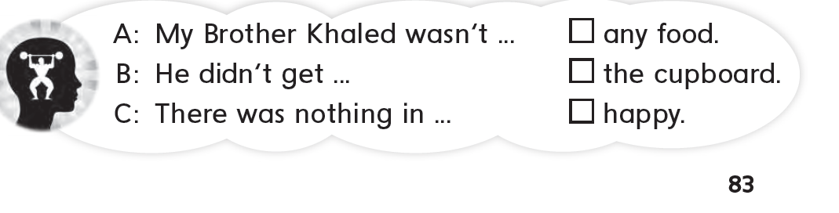



Write A ,B or C

Slide 16
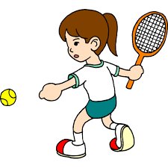
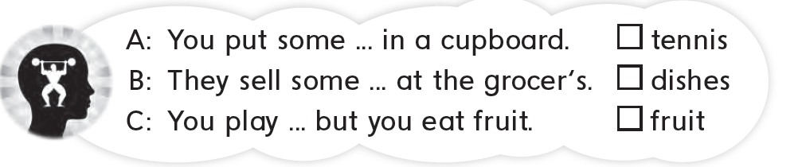



Write A ,B or C

Slide 17


