Slide 1
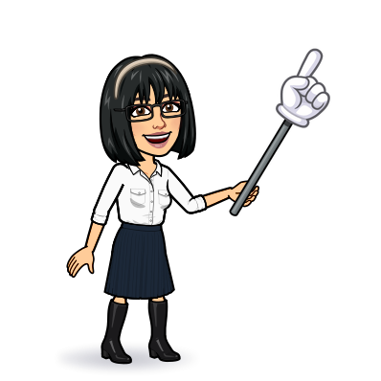
9 writing 10 project 11 form, meaning & function
Today:
Date:
- -
Page 86
By: Dalal Al-Juaid

Slide 2
Complete a chart about physical appearance
Design an advertisement for a school club
Warm up
Write about personal appearance & likes
Use intensifiers and adjectives
2-Pair work

Slide 3
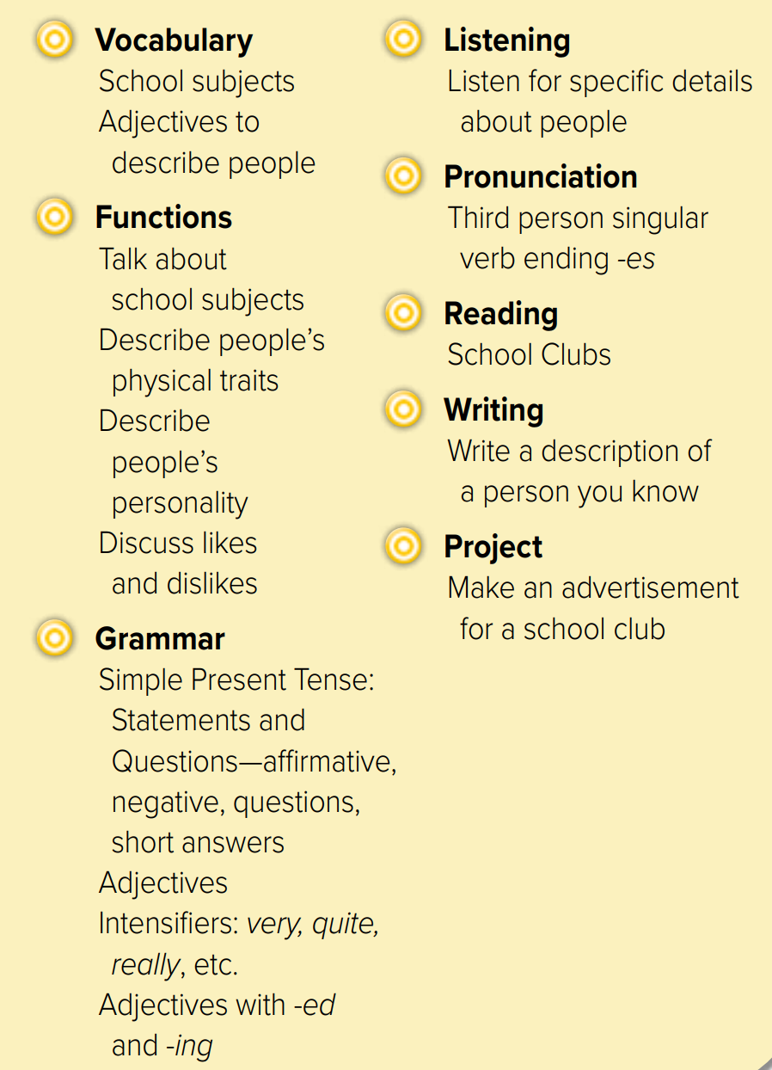

Slide 4
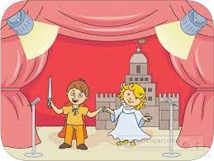
What does Joud look like ?
Revision
…….
Math – science – history
English – Art - Geography
Do you speak English?
Smart = ………
……
amazing
cool
…….
#
=
easy
……
……
#
……
old

Slide 5
What’s your favorite subject?
why?
Answer with emoji
Warm up
smart
adjective
interesting
difficult
subject
2-Pair work

Slide 6
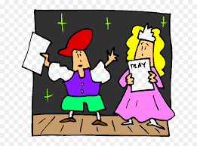
Page 86
What does she look like?
What is she like?
Role paly
What does she like?
Warm up
d
e
a
f
b
c
2-Pair work

Slide 7
Page 86
Warm up
Write in notebook
2-Pair work

Slide 8
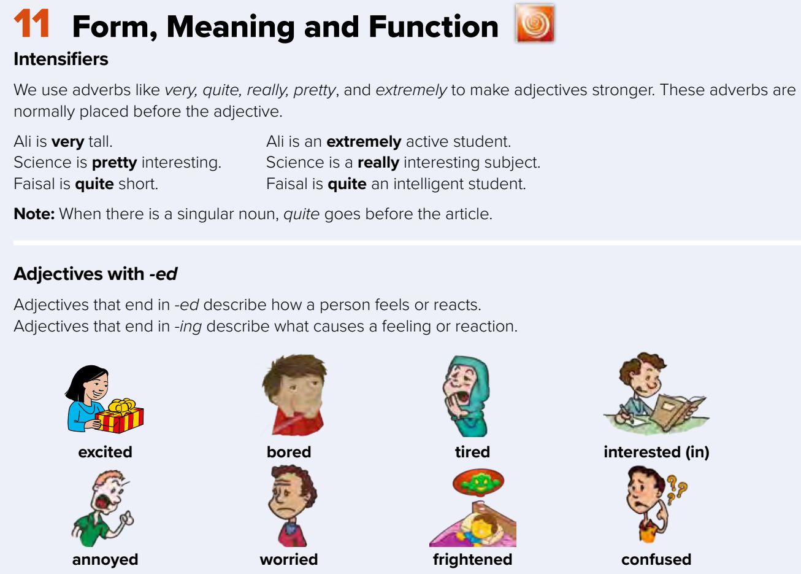
Page 87
That boy is quite tall.
He is ………………
Warm up
2-Pair work

Slide 9
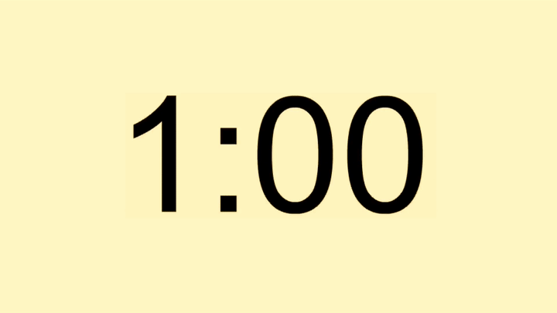
Page 87
Warm up
What does KSA do for schools?
2-Pair work

Slide 10
Think pair share
Math is quite a difficult subject
Maha is a really talented artist
Fahad is an extremely athletic student
Warm up
History is a pretty interesting subject
Mr. Parks is quite a strict teacher
2-Pair work

Slide 11
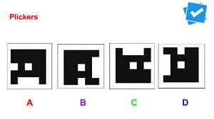
Lets play
Warm up
1-Listen
New words
Quick check
2-Pair work

Slide 12
Write in your notebook
Like final test أسئلة للاختبار النهائي
Choose:
Mmmmmmm ………. mmmmmmm
( ssss – ssss – sssss)
Make a question

Slide 13
page 228 Ex(H)
for practice writing
Warm up
2-Pair work

Slide 14
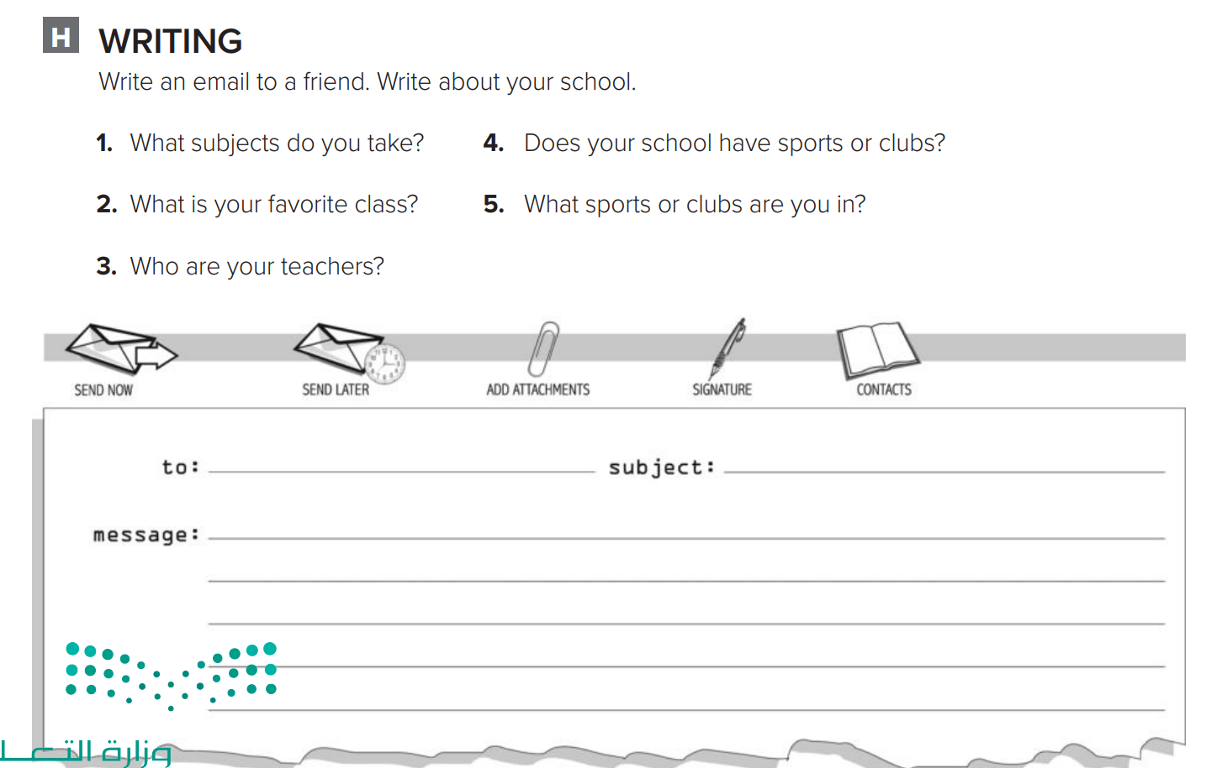
p.228
Hi Sara,
School is fun. I’m taking math, English, history, computer science, physical education, and art. My favorite class is art. My teachers are Miss Nouf , Miss Dalal , Miss Sabah , Miss Hind and Miss Amal. In school, I play on the football team. It’s great! I’m also in the Drama Club and the Computer Club.
Haneen
Warm up
2-Pair work

