Slide 1
Unit 9 What do you do?
Workbook pages (221 – 224)

Slide 2
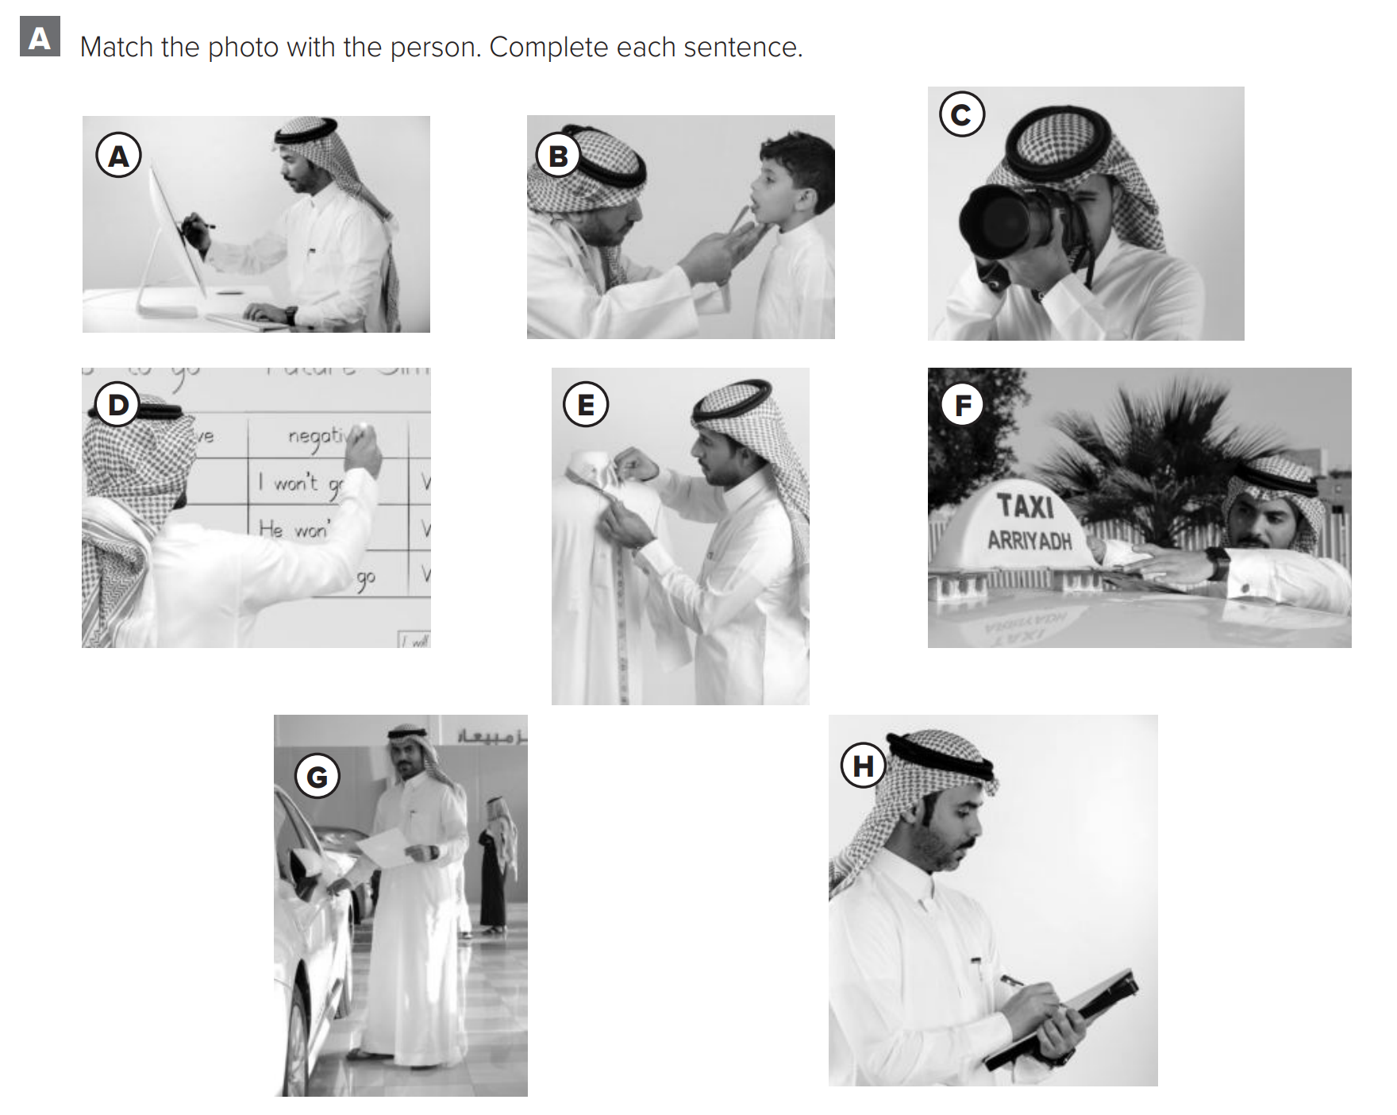
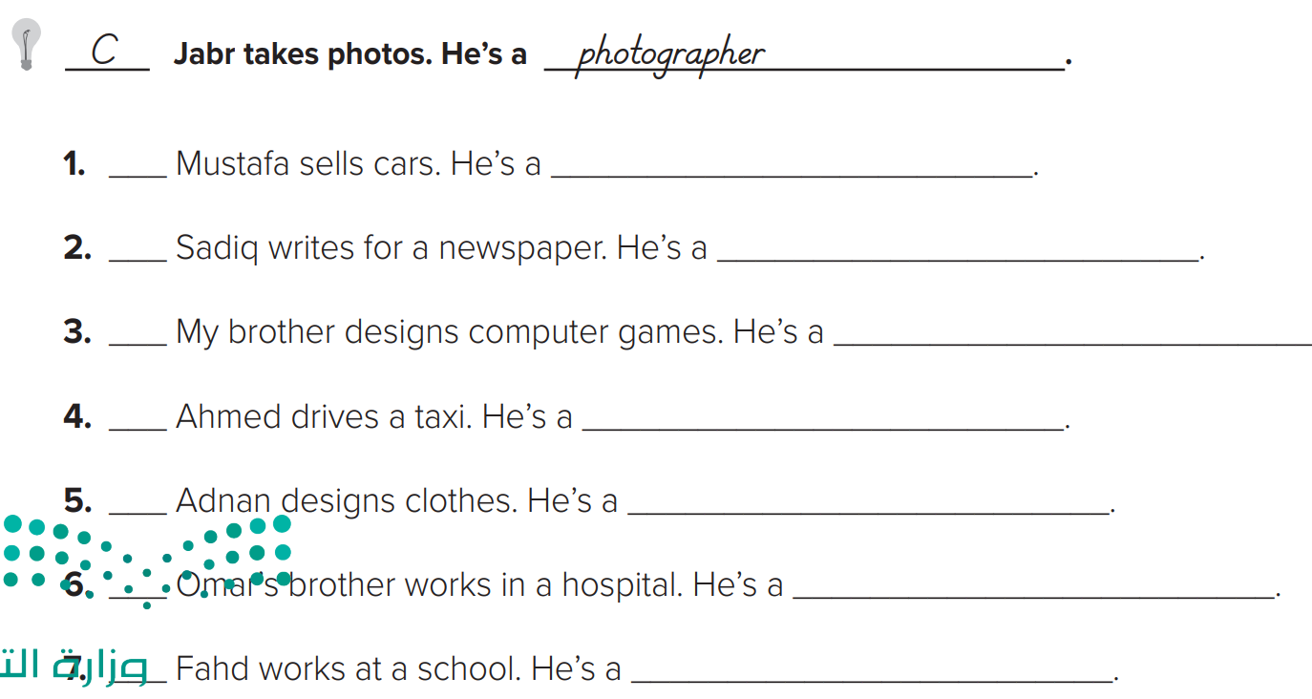
p.221
G
salesperson
H
reporter
A
High-tech designer
F
taxi driver
E
fashion designer
B
doctor
D
teacher

Slide 3
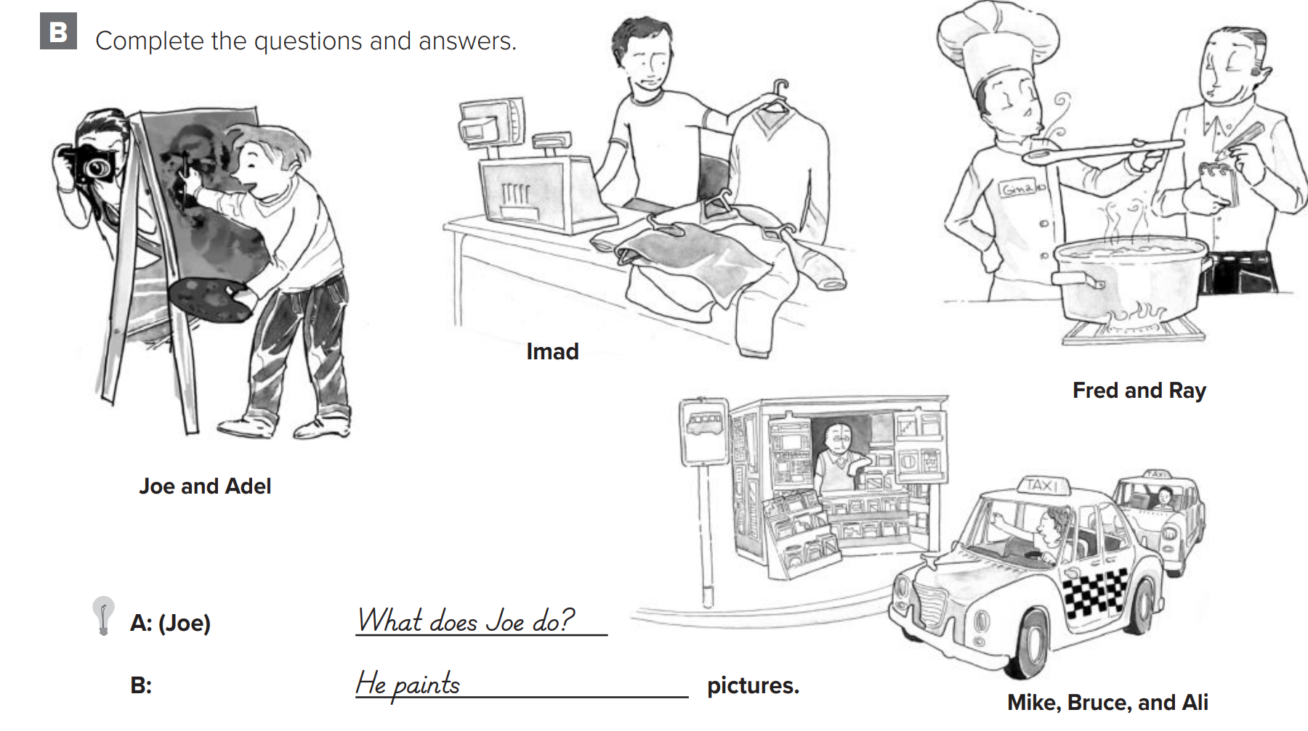
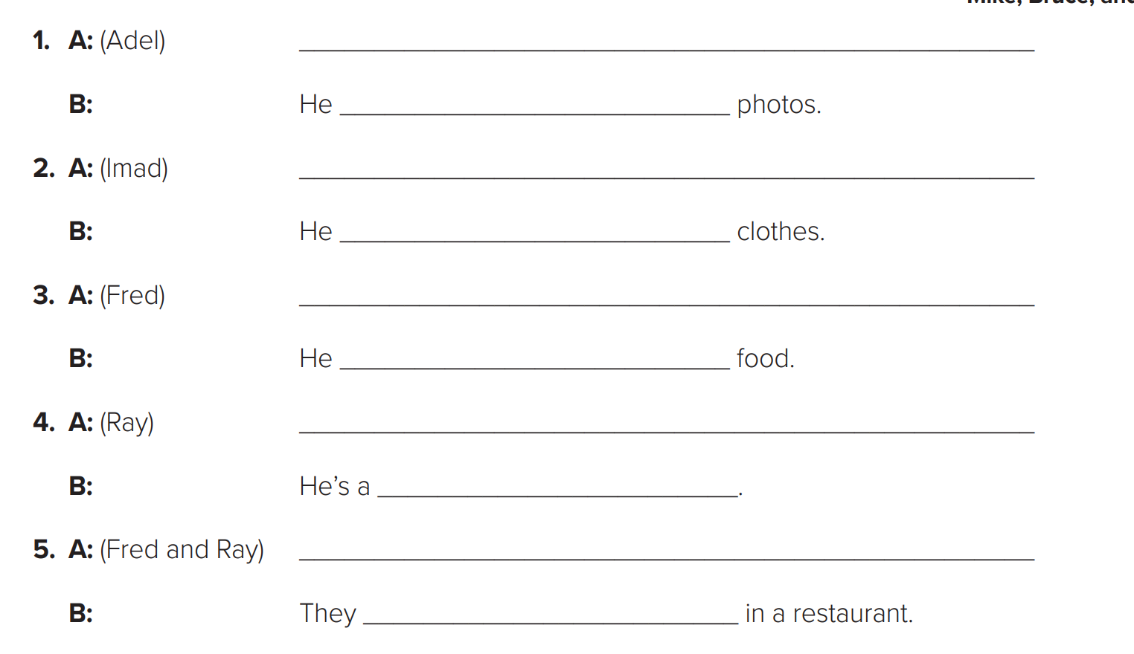
p.222
What does Adel do ?
takes
What does Imad do ?
sells
What does Fred do ?
cooks
What does Ray do ?
waiter
What do Fred & Ray do ?
work

Slide 4
p.223
doctor
do
do
lawyer
teacher
do
do
are
work
is
works
works

Slide 5
p.223

Slide 6
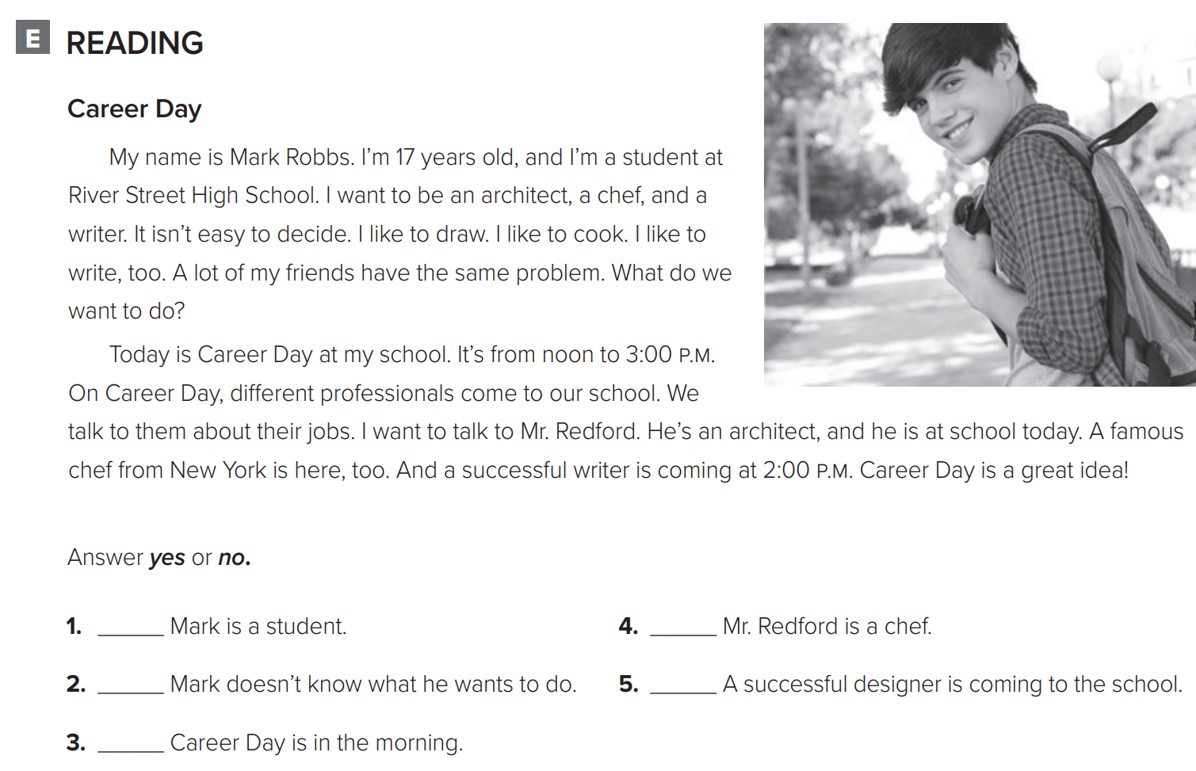
p.224
yes
no
yes
no
no

Slide 7
p.224
My school is having a Career Day. A lot of professionals are coming to school on that day. A chef is coming. A reporter and a designer are coming. The chef works at Roma’s Italian Restaurant. The reporter works at the TV station. The designer works for a computer company. I want to talk to the chef and the reporter.

