Slide 1
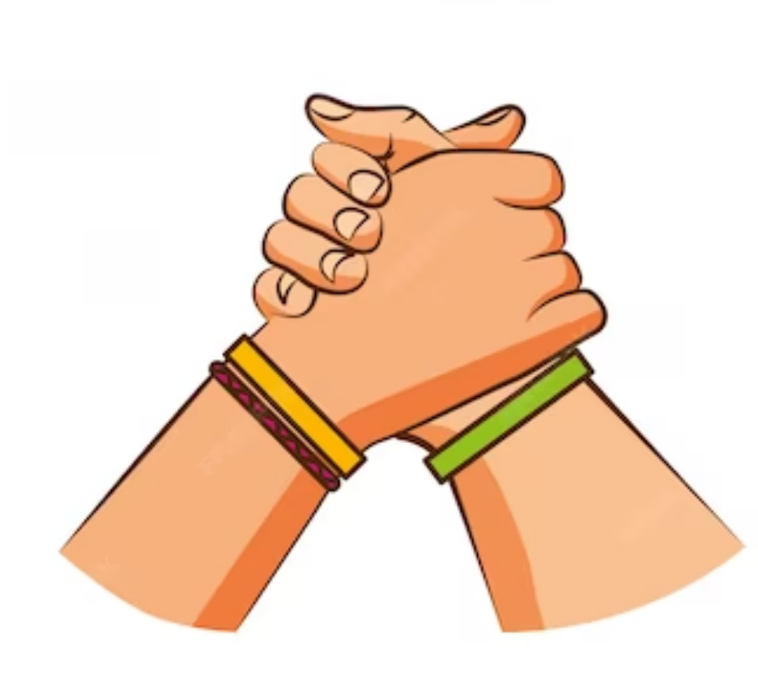
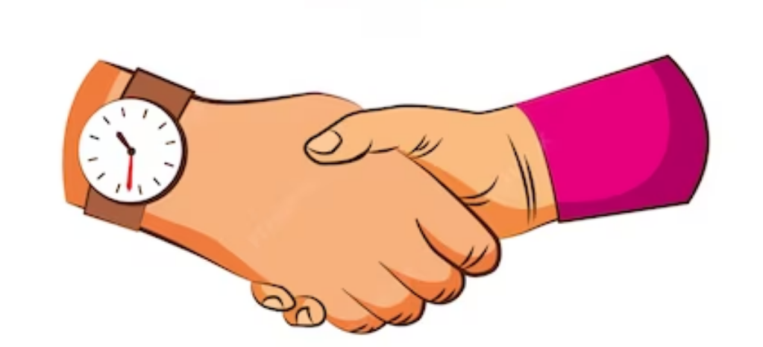
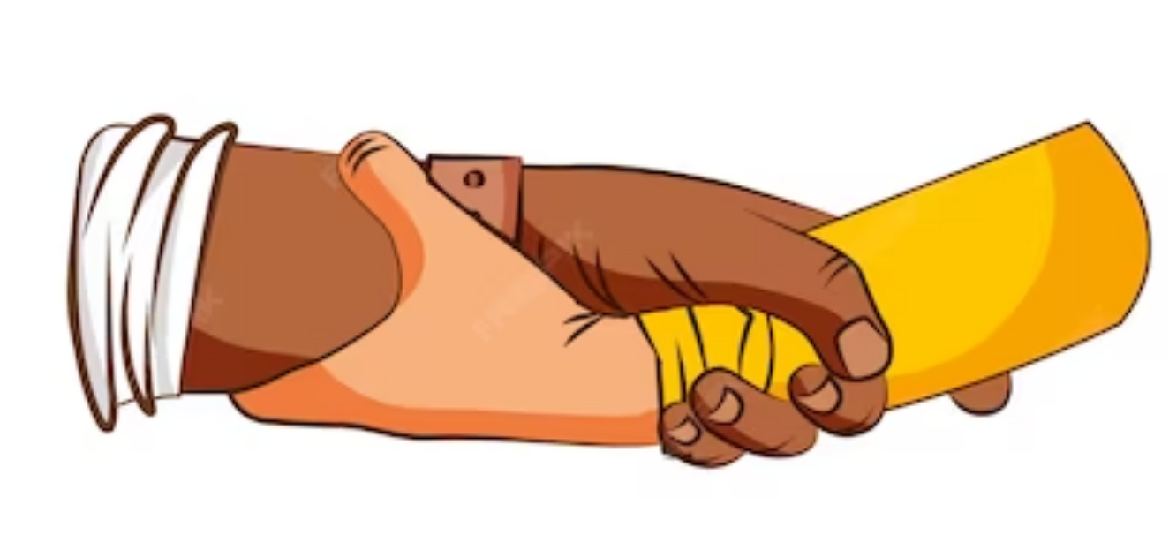
Good morning everyone!

Slide 2
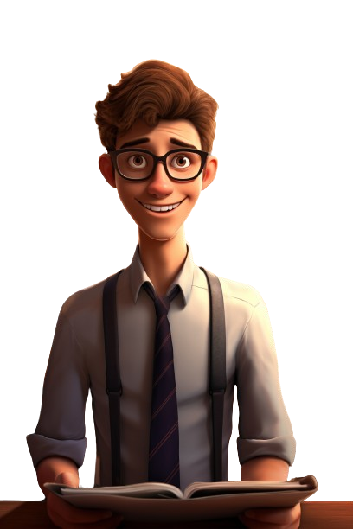
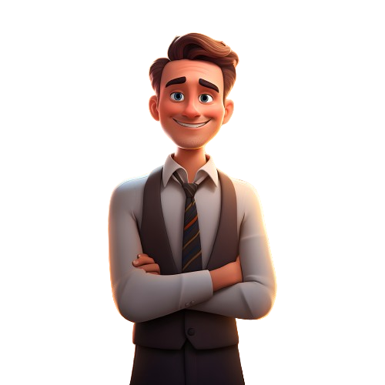
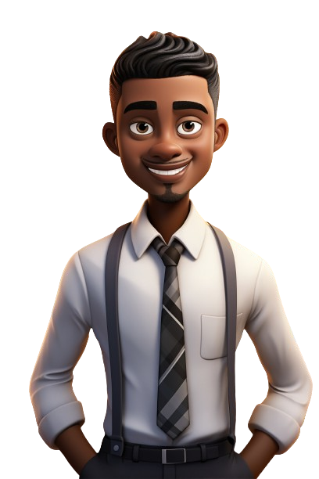
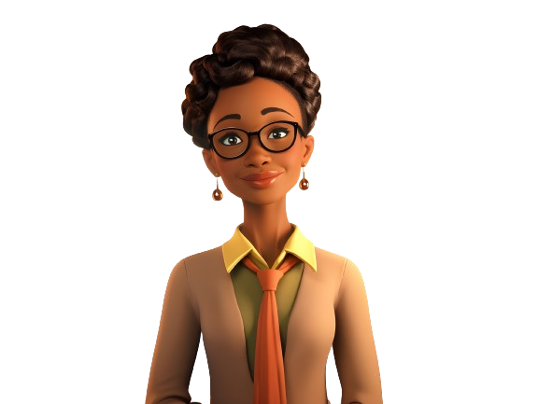
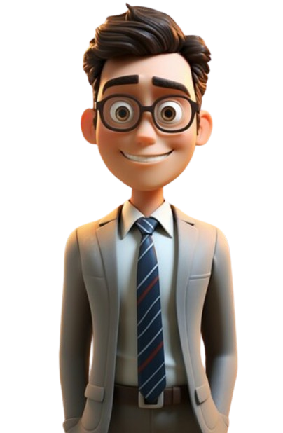
We are the super teachers! And we will guide you to the lesson of today
Hello, students! How is everyone feeling today?

Slide 3
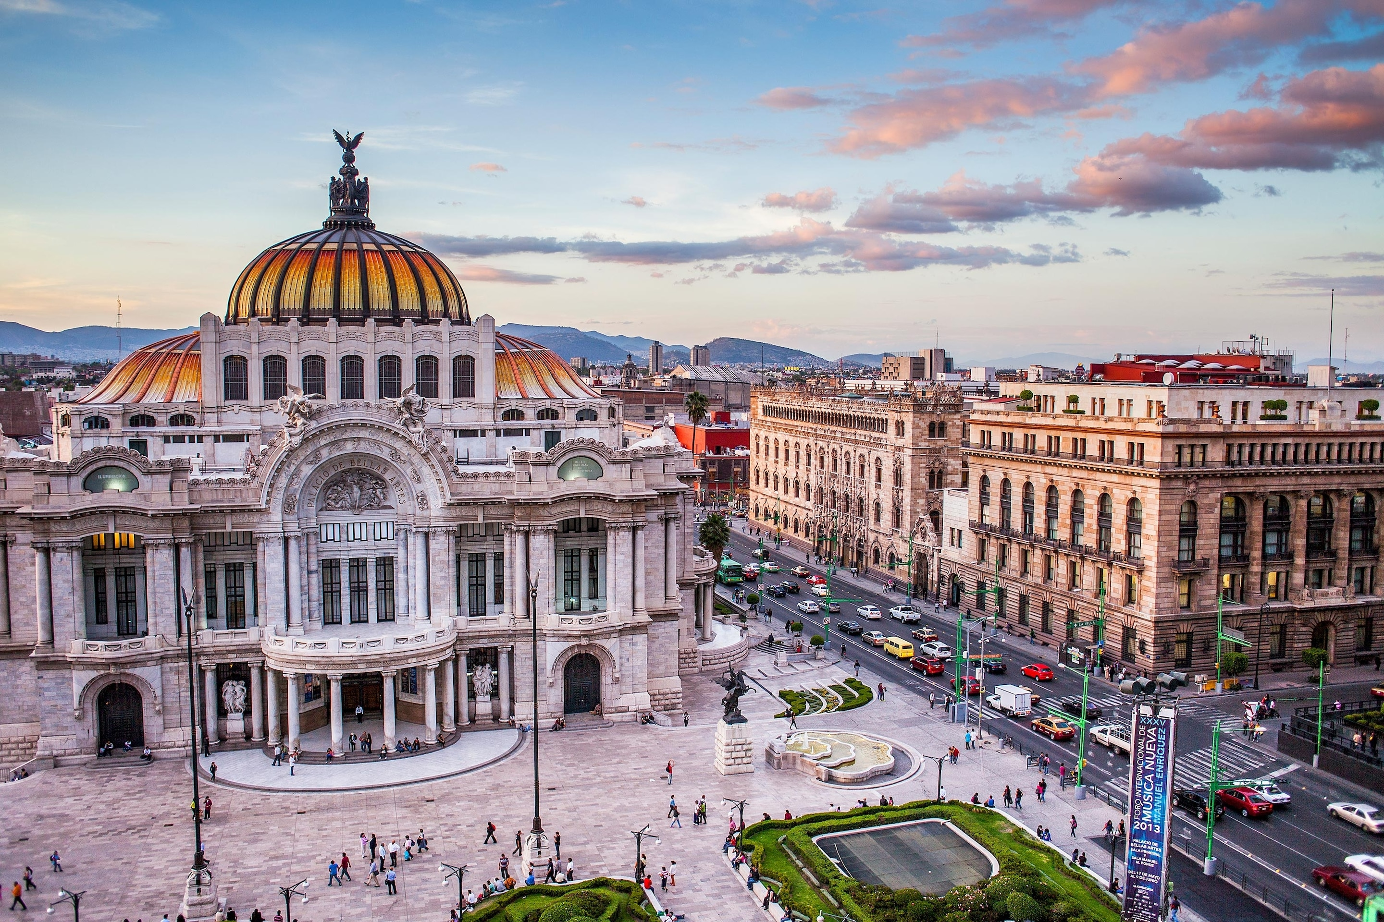
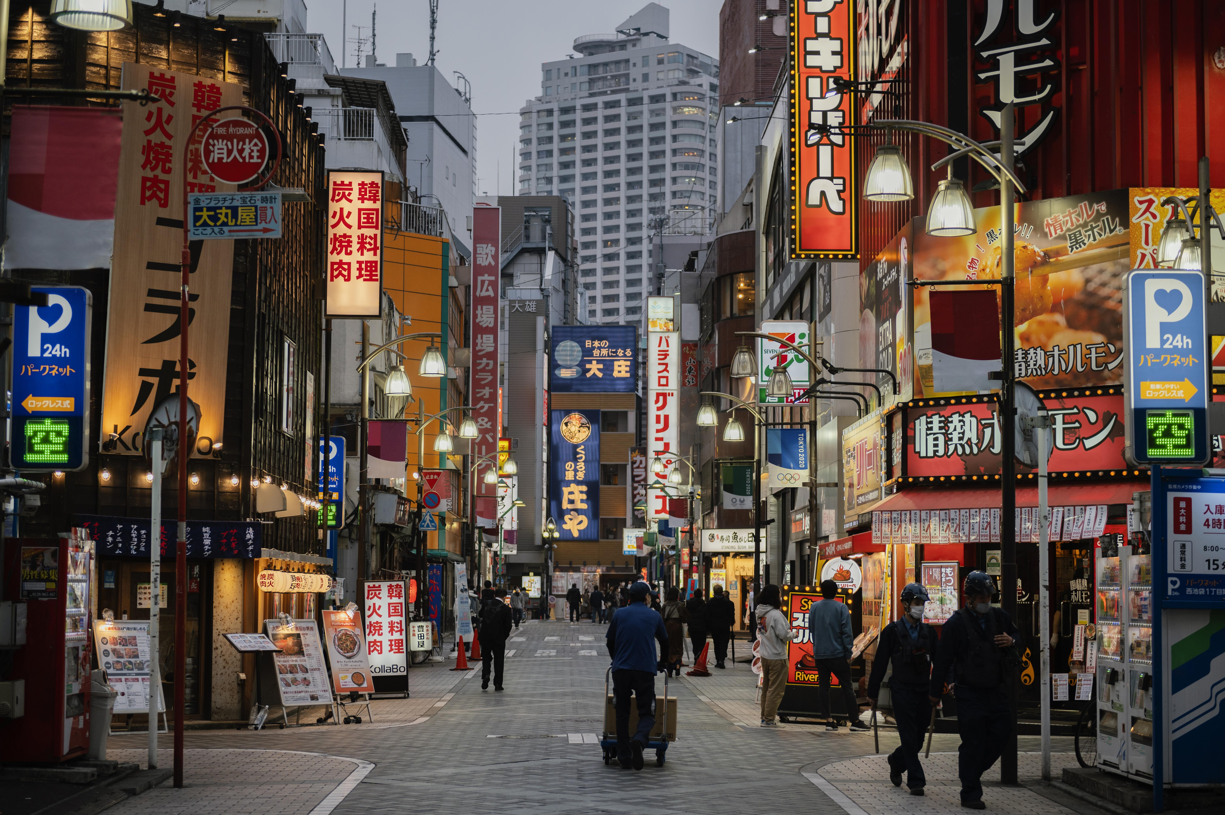
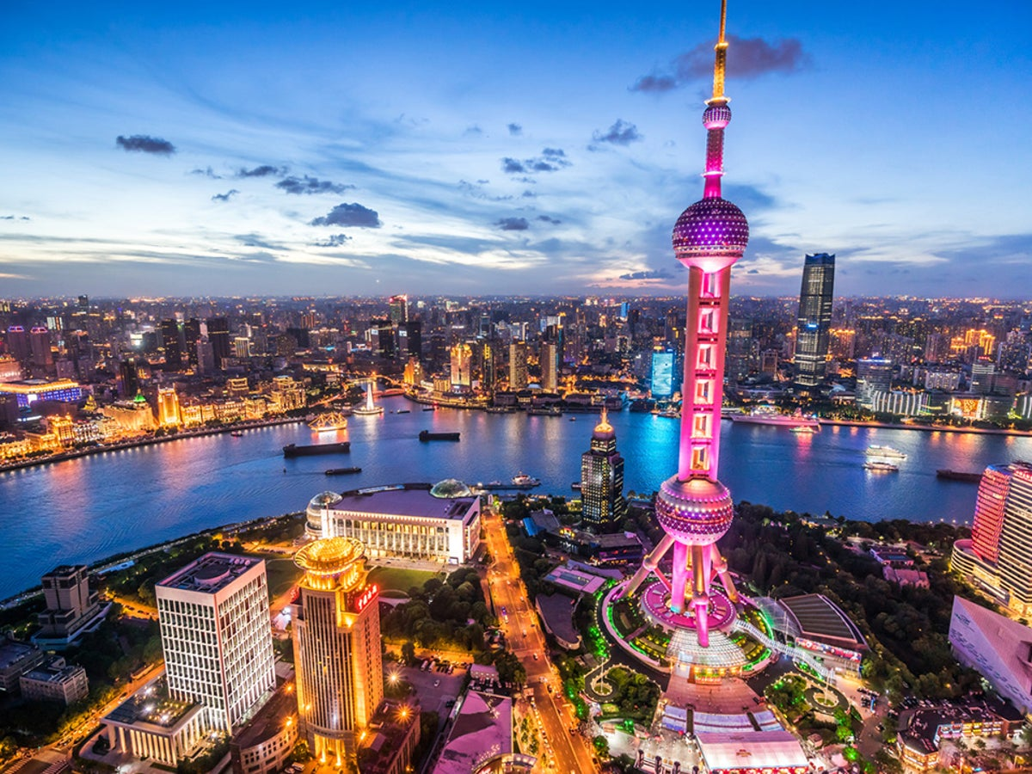
Revision:
Who knows what the world's biggest city with the most people is?
Mexico City
Shanghai
Tokyo

Slide 4
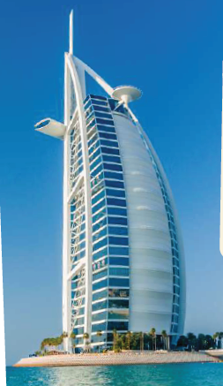
Revision:
Where is Burj Al Arab located?
In Dubai

Slide 5
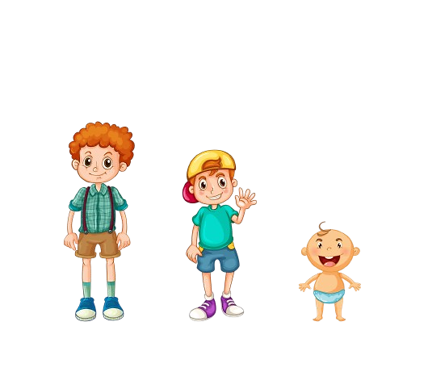
Unit 11
There’s No Comparison
Grammar

Slide 6
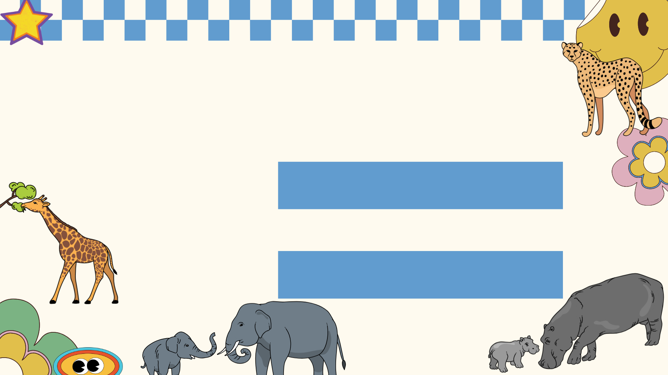
Today We are going to explain:
Comparative
Superlative

Slide 7
ARE YOU READY?

Slide 8
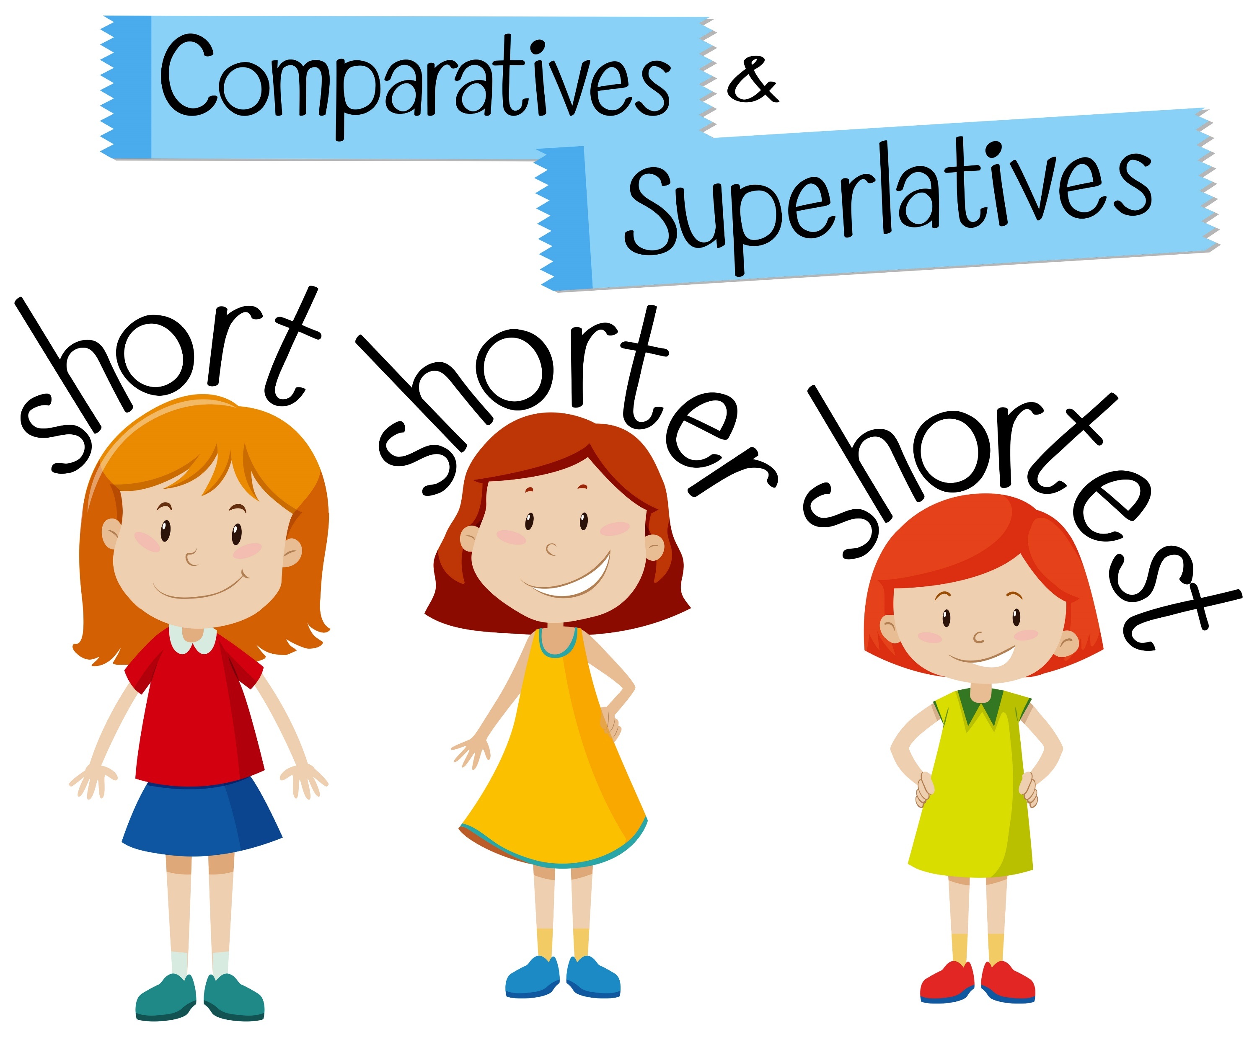

Slide 9
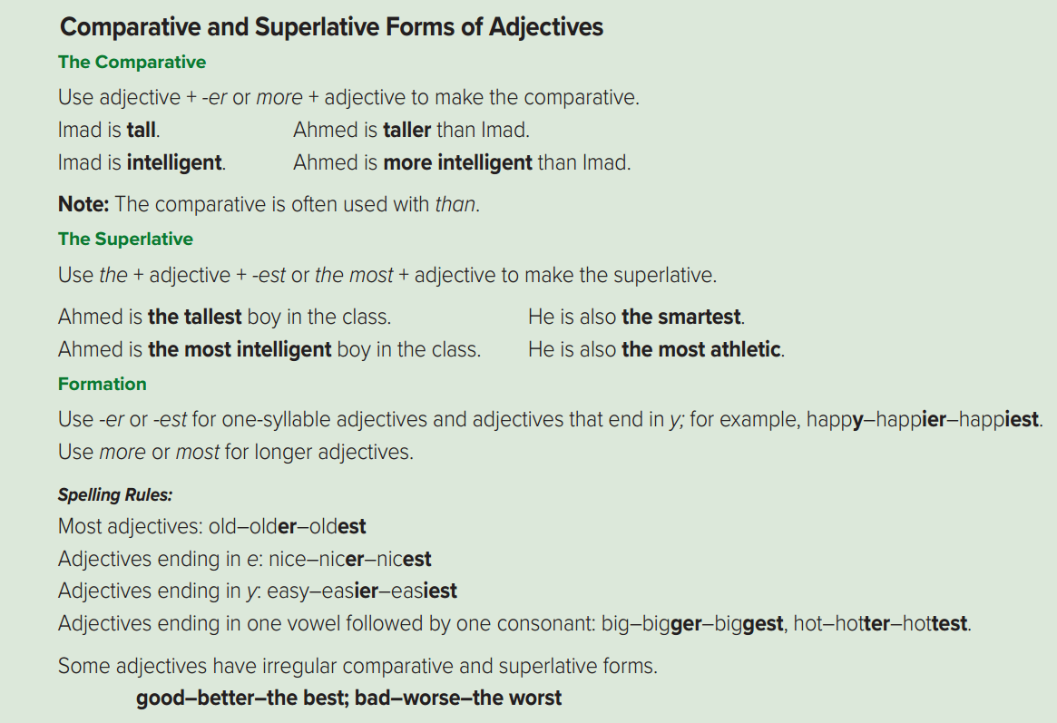
Open your book page 92

Slide 11
Page 92

Slide 12
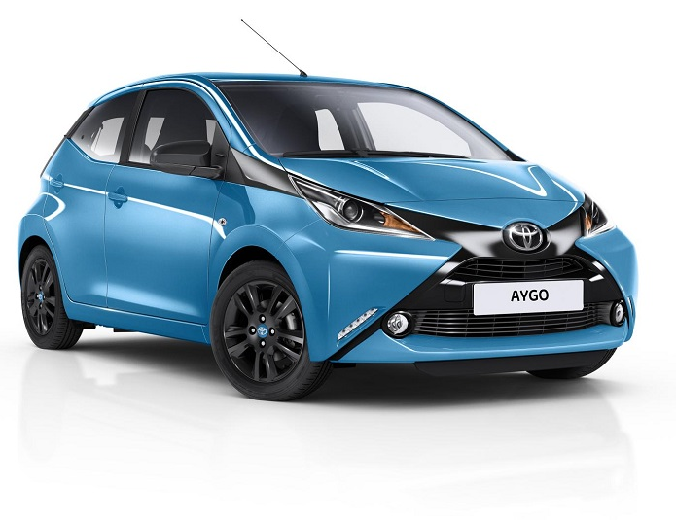
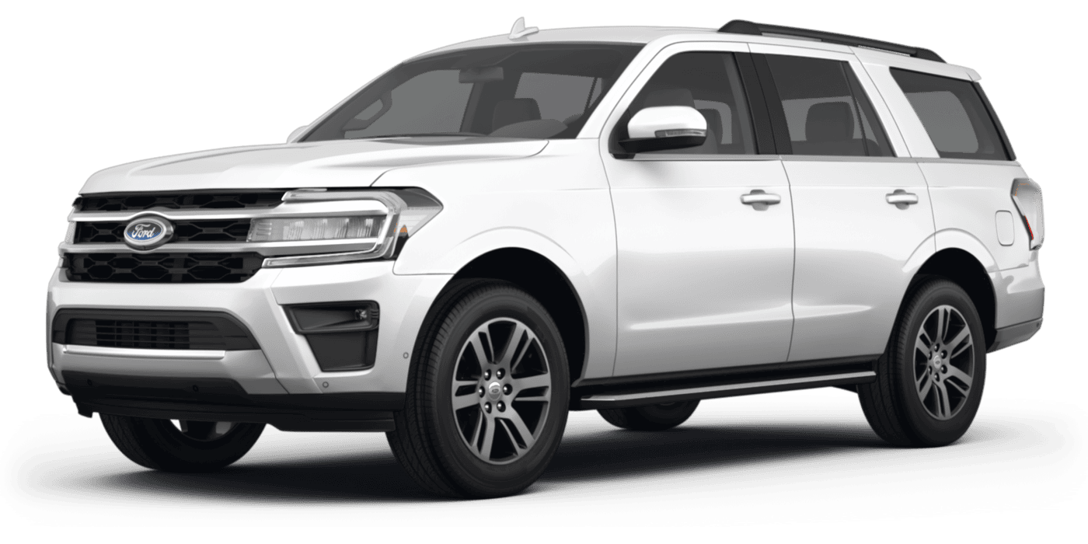
Comparative adjectives
When do we use them?
We use them to compare TWO objects, people, places…
Let’s say that I have two cars. I have a little Toyota and a big Ford. A comparative is used to show the difference between the two. so we can say…
The Toyota is smaller than the Ford
the Ford is bigger than the Toyota
To learn to use these we need to learn five basic rules:

Slide 13
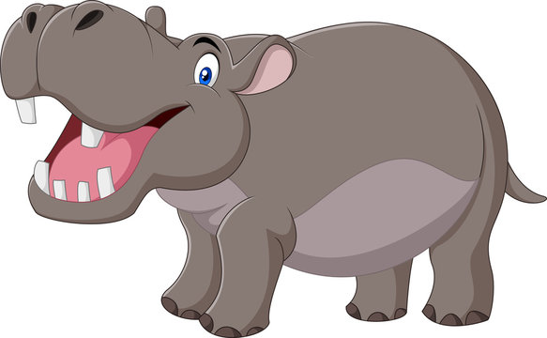
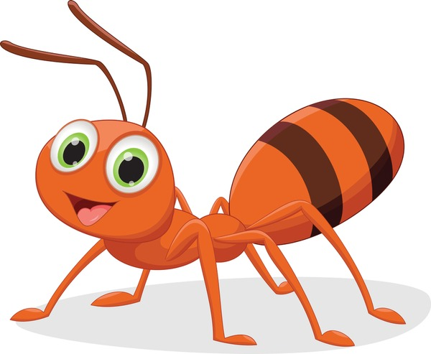
Rule 1
Adjective has 1 syllable
adjective has 1 syllable we add the ending –er to the adjective.
Adj. + -er + than
smaller than
small + er
harder than
hard + er
Example:
The ant is smaller than the hippo.

Slide 14
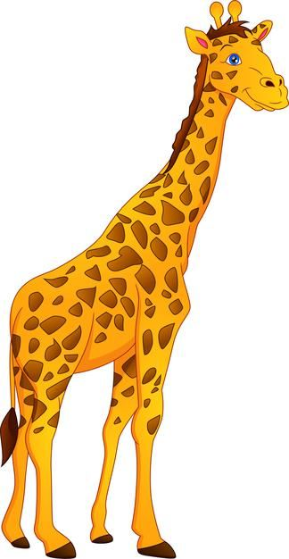
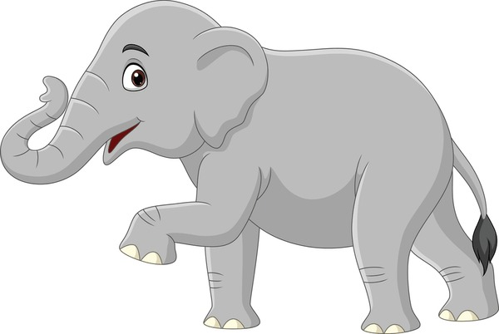
Rule 2
1 syllable adjective ends with
a consonant + a vowel + a consonant
If a 1 syllable adjectives ending with CONSONANT+VOWEL+CONSONANT double the last consonant and add –er.
vowel
consonant
consonant
double
big + er
fat + er
bigger than
fatter than
Example:
The elephant is fatter than the giraffe

Slide 15
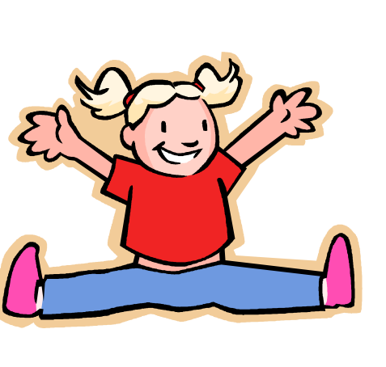
Rule 3
1 syllable adjective ends with–y
If an adjective ends with a “y”, remove the “y” and add –ier
happy –y + ier
funny –y + ier
happier than
funnier than
Example:
The girl is happier than the duck.

Slide 16
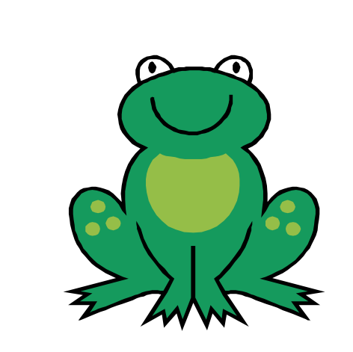
Rule 4
Adjectives with 2 or more syllables
If an adjective has 2 syllables or more dd the word “more” before the adjective
more + adj. (2 or more syllables) + than
beautiful + more
expensive + more
more beautiful than
more expensive than
Example:
The butterfly is more beautiful than the frog.

Slide 17
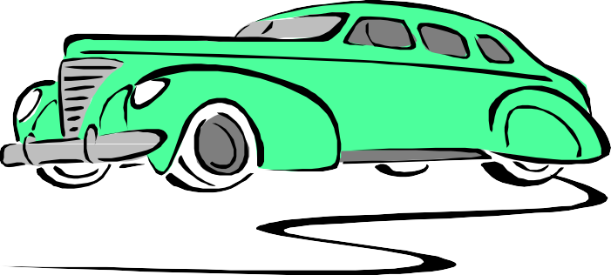
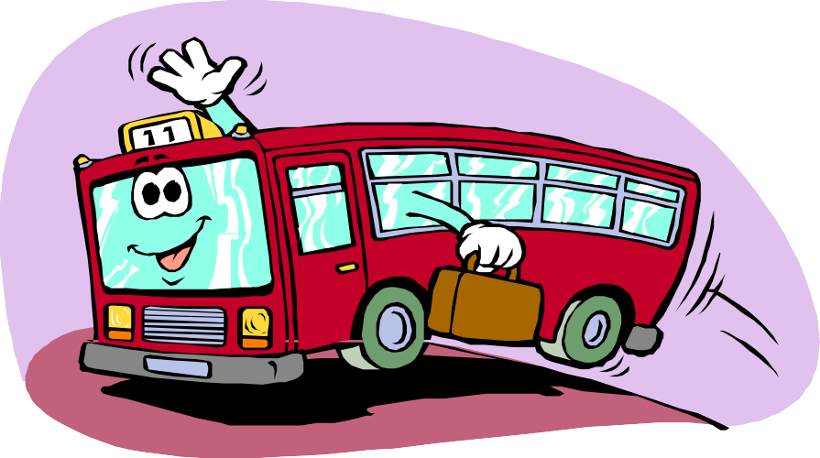
long
longer
………………………………………………

Slide 18
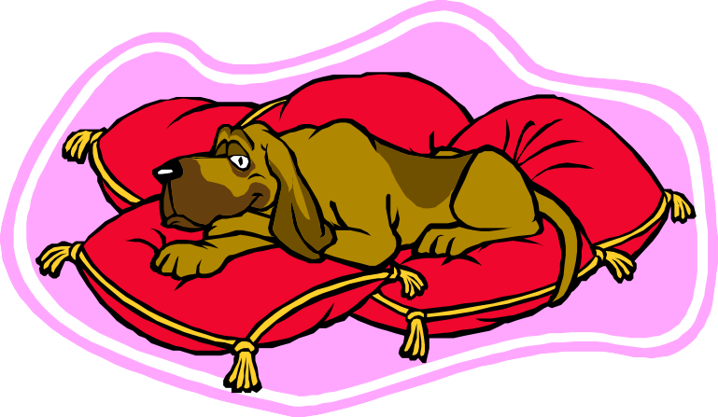
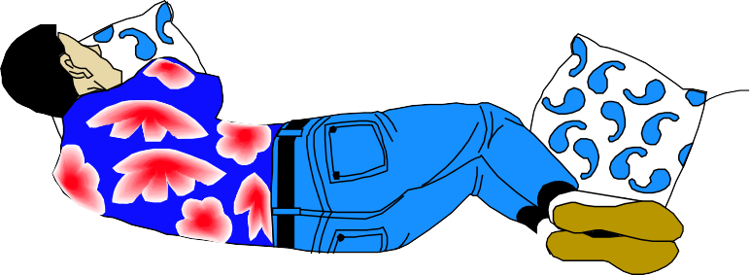
lazy
lazier
………………………………………………

Slide 19
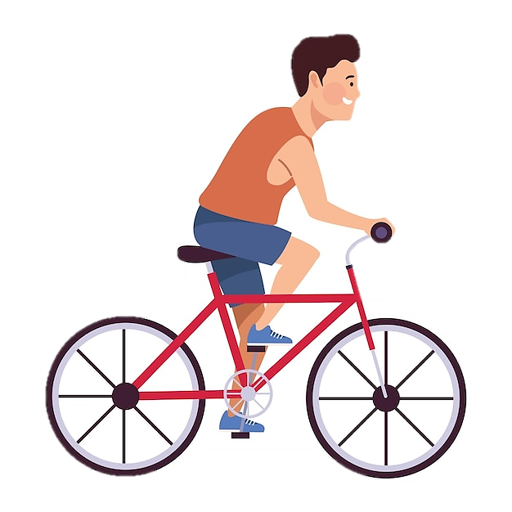

Slide 20
Page 92

Slide 21
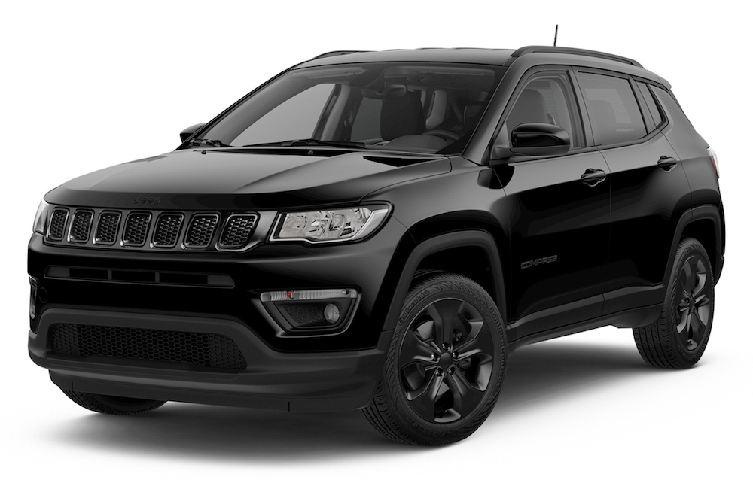
Superlative adjectives
When do we use them?
We use them to compare ONE object, person, place… in a GROUP or in the entire world.
Let’s say that I have three cars. I have a little Toyota, a medium size Jeep and a big Ford. A superlative is used to show the differences that exist in the group. The Ford is big so we can say…….
The Ford is the biggest
To learn to use these we need to learn five basic rules:

Slide 22
Rule 1
Adjective has 1 syllable
adjective has 1 syllable we add (the ) before the adj. and add the ending –est to the adjective.
the + adj. + -est
the smallest
small + est
hard + est
the hardest
Example:
The ant is the smallest

Slide 23
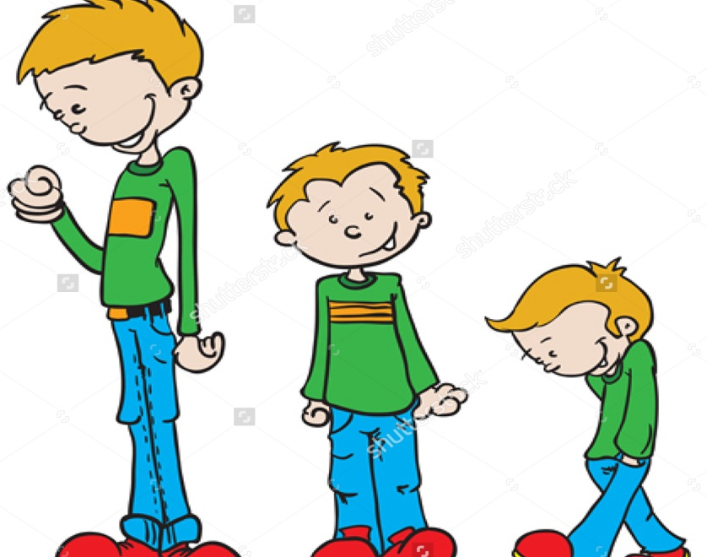
Example:
Superlative Adjectives
Ahmad
Ali
Ahmad
is
the
tall
est
boy
Sami
Sami is the shortest boy

Slide 24
Rule 2
1 syllable adjective ends with
a consonant + a vowel + a consonant
If a 1 syllable adjectives ending with CONSONANT+VOWEL+CONSONANT double the last consonant and add –est
consonant
vowel
consonant
double
big + est
fat + est
the biggest
the fattest
Example:
The hippo is the fattest.

Slide 25
Rule 3
1 syllable adjective ends with–y
If an adjective ends with a “y”, remove the “y” and add –iest
happy –y + iest
funny –y + iest
the happiest
the funniest
Example:
The elephant is the heaviest

Slide 26
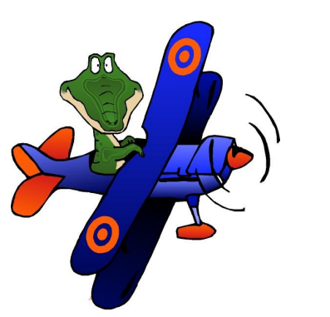
Rule 4
Adjectives with 2 or more syllables
If an adjective has 2 syllables or more dd the word “most” before the adjective
the most + adj. (2 or more syllables)
beautiful + most
expensive + most
the most beautiful
the most expensive
Example:
The airplane is the most expensive

Slide 27
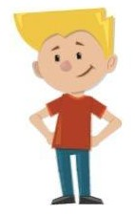
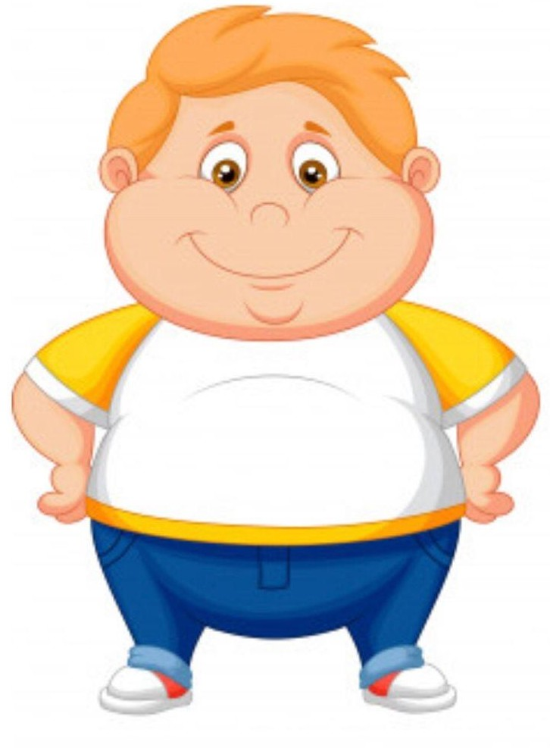
Mason is the……….
Mason
Cole
Gabe
taller - tallest - tall

Slide 28
Like many things in the English language, there are some exceptions:
Rule 5
for both –comparative- and –superlative-
Page 92
Adjective | Comparative | Superlative
Good | better | the best
Bad | worse | the worst

Slide 29
Summary The spelling rules
Page 92
Regular Adjectives
irregular Adjectives
Adjectives end in
Good
Bad
-e
One vowel
Better
Worse
-y
nice
easy
big
best
worst
nicer
easier
bigger
nicest
easiest
biggest
1- She is ( nicer – niceer ) than her friend .
2- They are ( good – better ) than their friend
3- It is ( easier – easyer ) than my exam .

Slide 30
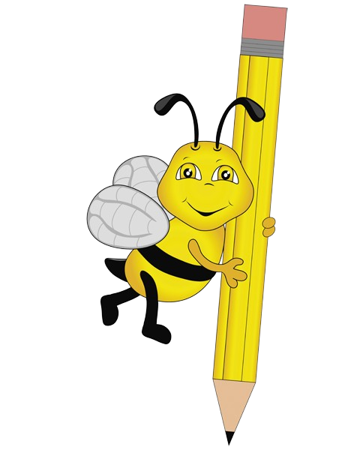

Slide 31
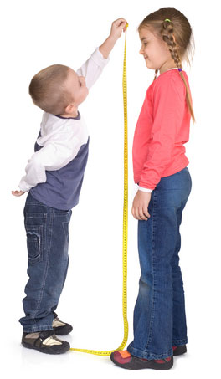
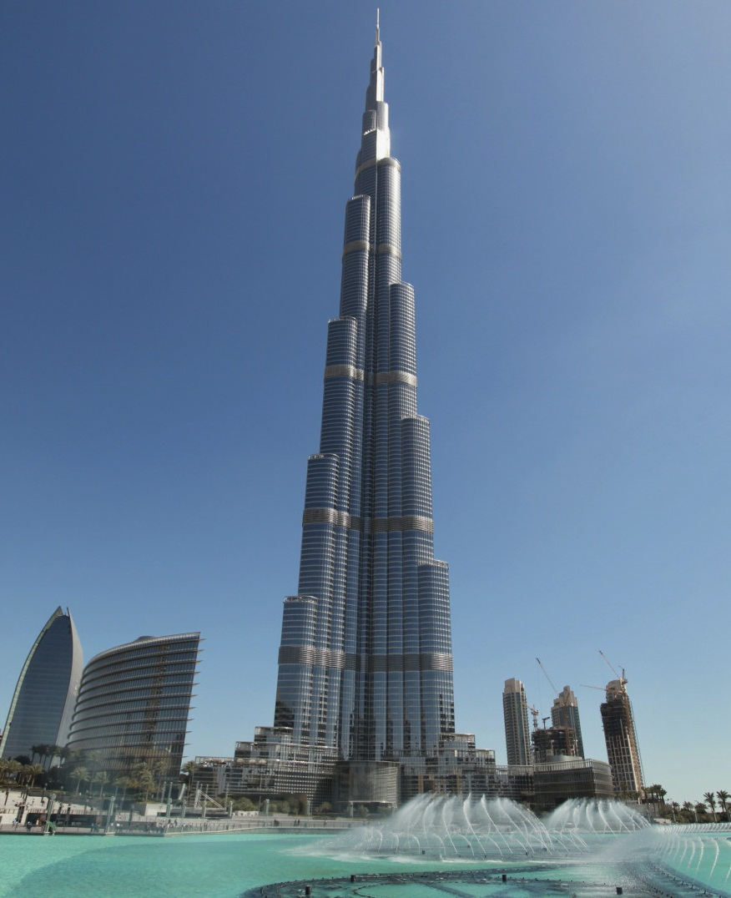
tall
taller
tallest
She is …………than her brother
Burj Khalifah is the ……………..building

Slide 32
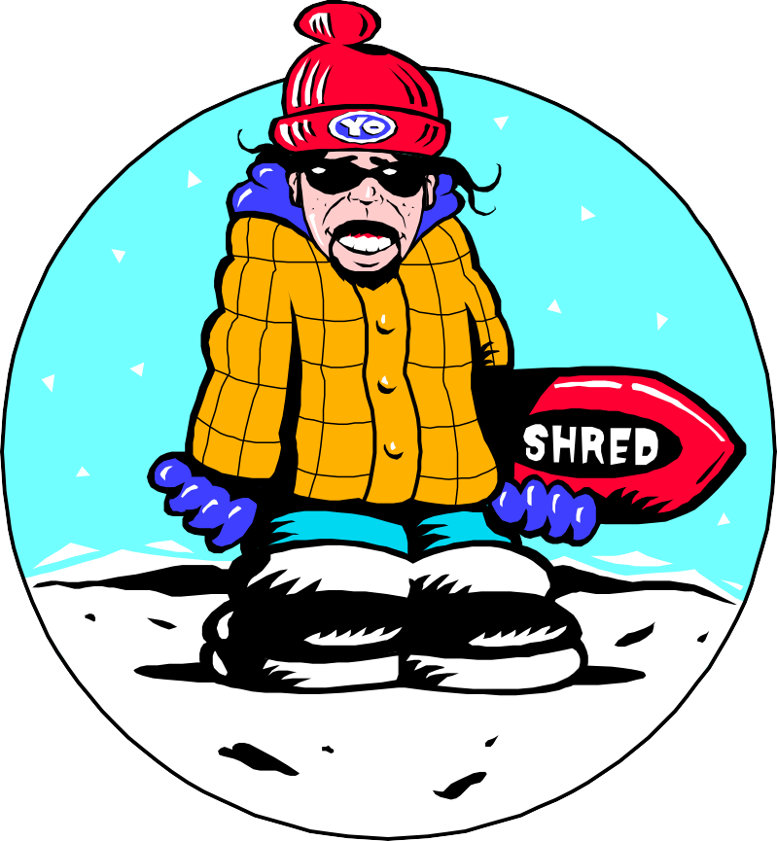
colder
Today is _______ than yesterday. (cold)

Slide 33
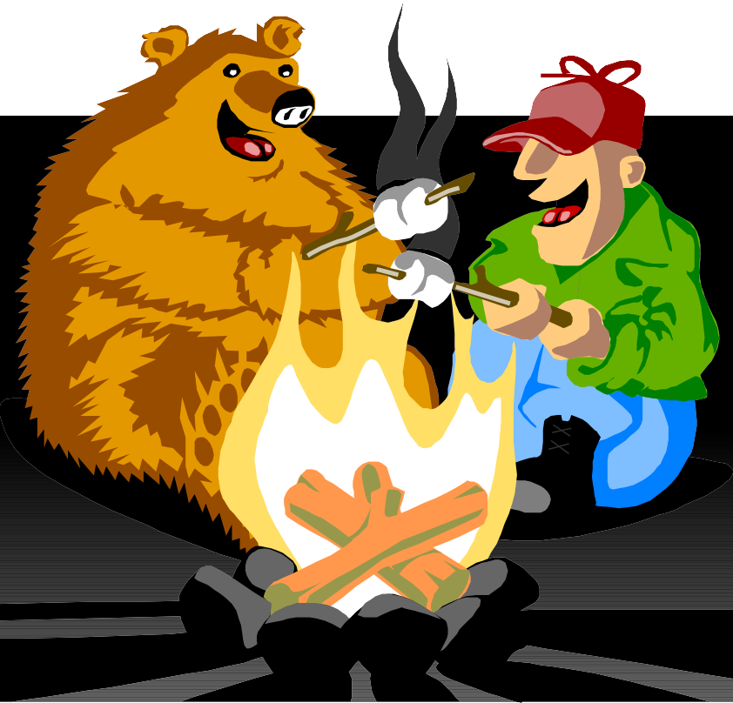
hotter
The fire is _______ than the candle. (hot)

Slide 34
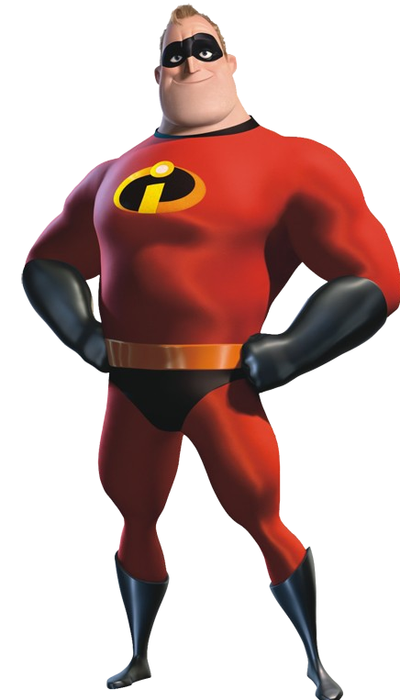
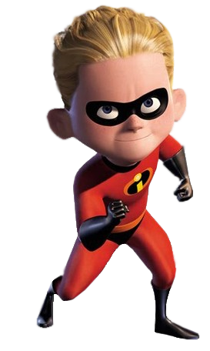
Dash
Mr. Incredible
Dash is faster than Mr. Incredible

Slide 35
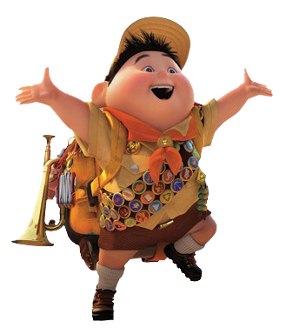
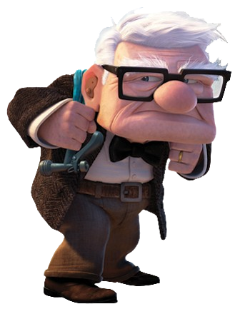
Carl
Russel
Carl is older than Russell.

Slide 36
Page 92
the most interesting
heavier
more expensive
better
the warmest
the driest
the highest
the quietest
the most beautiful
bigger

Slide 37
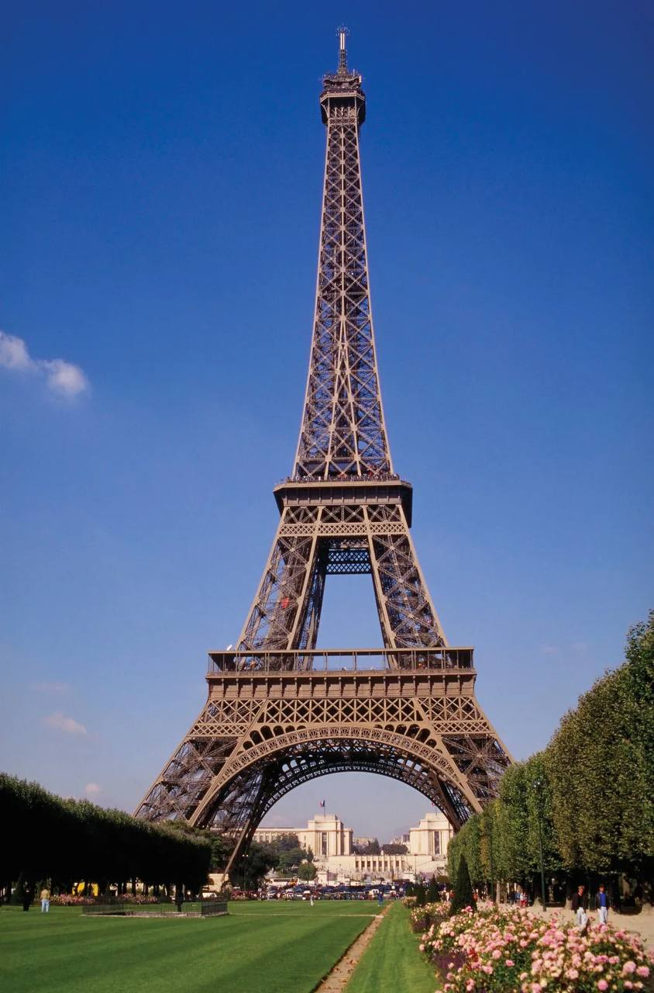
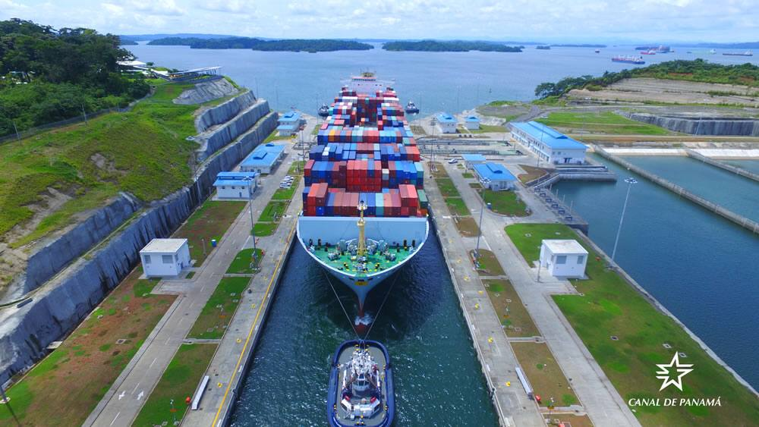
Page 92

Slide 38
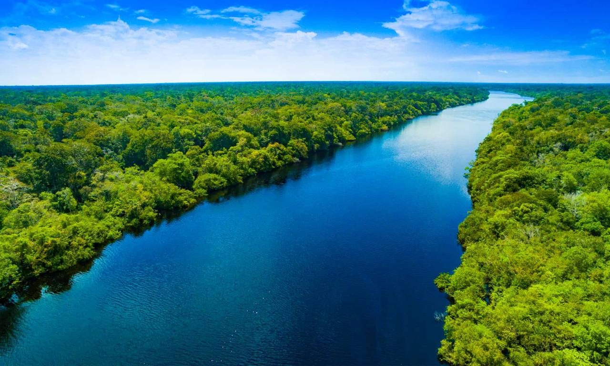
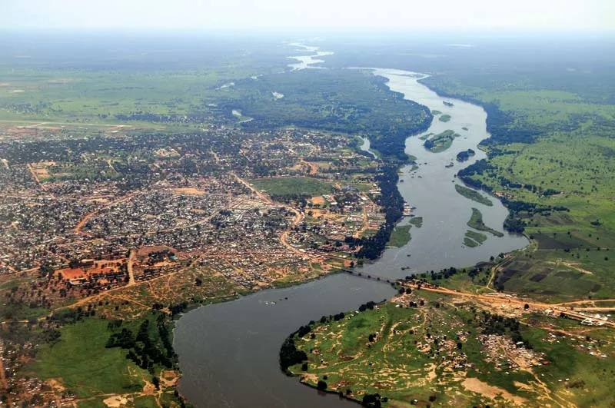
Page 92
1. A: The Amazon is longer than the Nile. (short)
B: No, it isn’t. It’s shorter.
(Amazon river)
(Nile river)

Slide 39
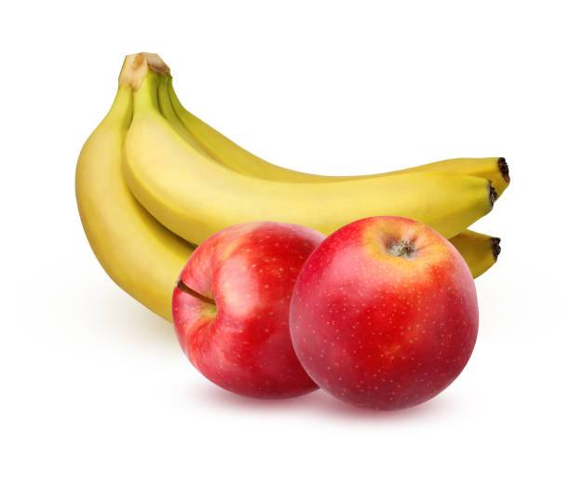
Page 92
2. A: Bananas are cheaper than apples. (expensive)
B: No, they aren’t. They’re more expensive.

Slide 40
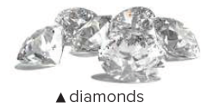
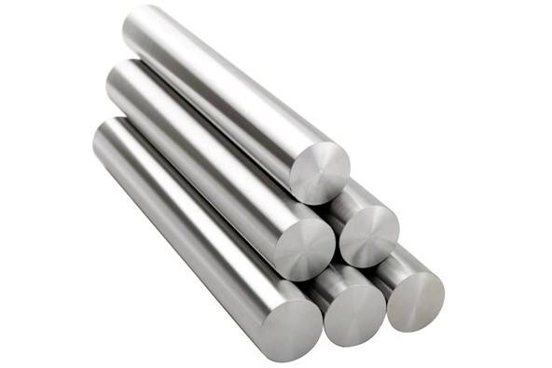
Page 92
3. A: Steel is much harder than diamonds.(soft)
B: No, it isn’t. It’s softer.

Slide 41
Page 92
4. A: China is larger than Canada.(small)
B: No, it isn’t. It’s smaller

Slide 42
Page 92
5. A: Plane travel is more dangerous than car travel.(safe)
B: No, it isn’t. It’s safer.

Slide 43
Page 92
6. A: Horses are stronger than elephants.(weak)
B: No, they aren’t. They’re weaker

Slide 44
Page 93

Slide 45
Page 93
B: I think a cheetah is faster than a horse
A: Which is faster?

Slide 46
B: I think surfing is more difficult than rollerblading
Page 93
A: Which is more difficult?

Slide 47
Page 93
B: I think driving is more dangerous than flying.
A: Which is more dangerous?

Slide 48
Page 93
B: I think sky diving is more exciting than sailing.
A: Which is more exciting?

Slide 49
B: I think football is more popular than rugby.
Page 93
A: Which is more popular?

Slide 50
B: I think English is easier than math
A: Which is easier?
Page 93

Slide 51
Page 93

Slide 52
Page 93
I think driving is the most
dangerous activity
we perform during
the day .
I think surfing is the most difficult sport in the world.

Slide 53
Let’s have a break and play a game!
Start

Slide 54
Workbook exercise

Slide 55
Page 230
smart
smarter
Intelligent
the most intelligent
more difficult
the most difficult
easier
the easiest
Long
longer
Short
the shortest
bigger
the biggest
Small
smaller
more dangerous
the most dangerous
prettier
the prettiest
more popular
the most popular
Good
better
Bad
the worst
Interesting
more interesting

Slide 56
Page 230
My father
My littler brother .
3 people .
English is the easiest subject for me .
Math is the most difficult subject for me
Yes , it is .

Slide 57
Linking this lesson to my religion
قول الله تعالى في سورة الحجرات (49: 13): "يا أيها الناس إنا خلقناكم من ذكر وأنثى وجعلناكم شعوبا وقبائل لتعارفوا إن أكرمكم عند الله أتقاكم إن الله عليم خبير».
The verse highlights that everyone is equal, no matter their gender, race, or background. It encourages us to see people's value based on how good and pious they are, not just on surface-level things.
This idea connects with studying grammar, where we compare and evaluate language elements, reminding us to look deeper at people's goodness rather than judging them superficially.

Slide 58
Linking this lesson to my country
Did you know that the Edge of the World near Riyadh isn't a mere cliff; it's an awe-inspiring escarpment, standing as one of the most breathtaking natural wonders, where visitors can marvel at the vastness of the landscape below
Let’s watch the video together …..
Next slide

Slide 60
End of the class
Thank you for joining today's lesson!
Goodbye and see you next time!

Slide 61
تم تصميم هذا العرض من قبل: فريق عمل البوابة الإنجليزية ، وهو مجاني لكي يستفيد منه معلمي اللغة الإنجليزية.
هذه الشريحة تعتبر كـ"حفظ حقوق" نتمنى عدم حذفها حال مشاركة العرض مع معلمين آخرين.
نسمح بحذف الحقوق في حالة واحدة فقط: اذا أراد معلم الإنجليزي إضافة هذا العرض كـ انتاج معرفي خاص فيه.

