Slide 1
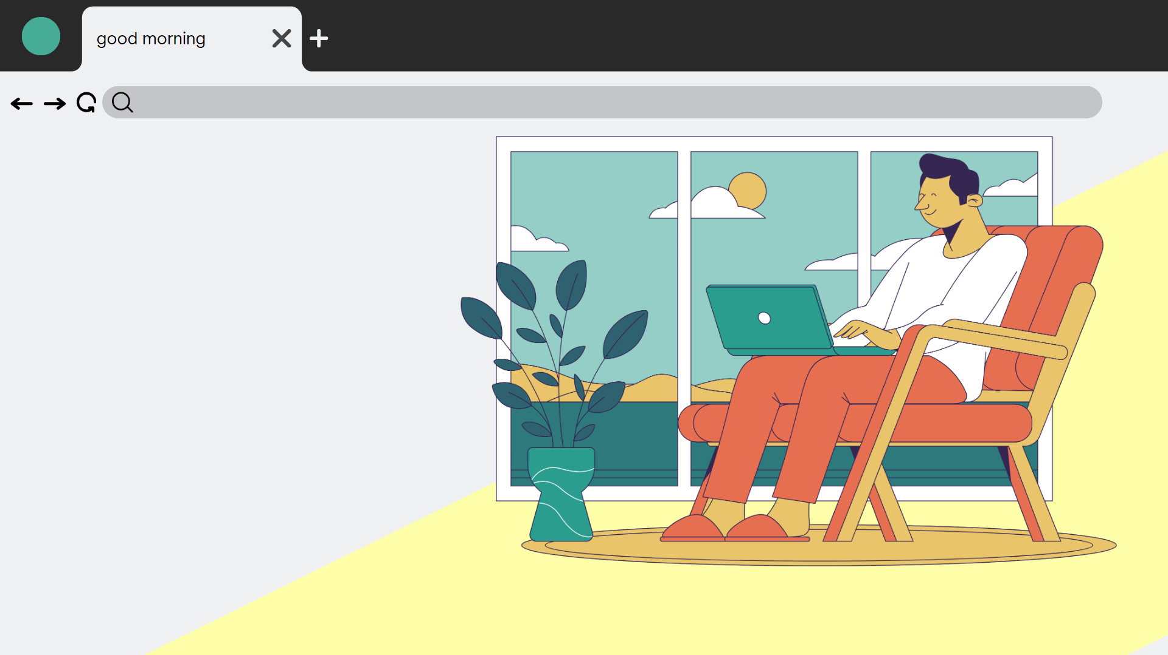
Good morning!

Slide 2
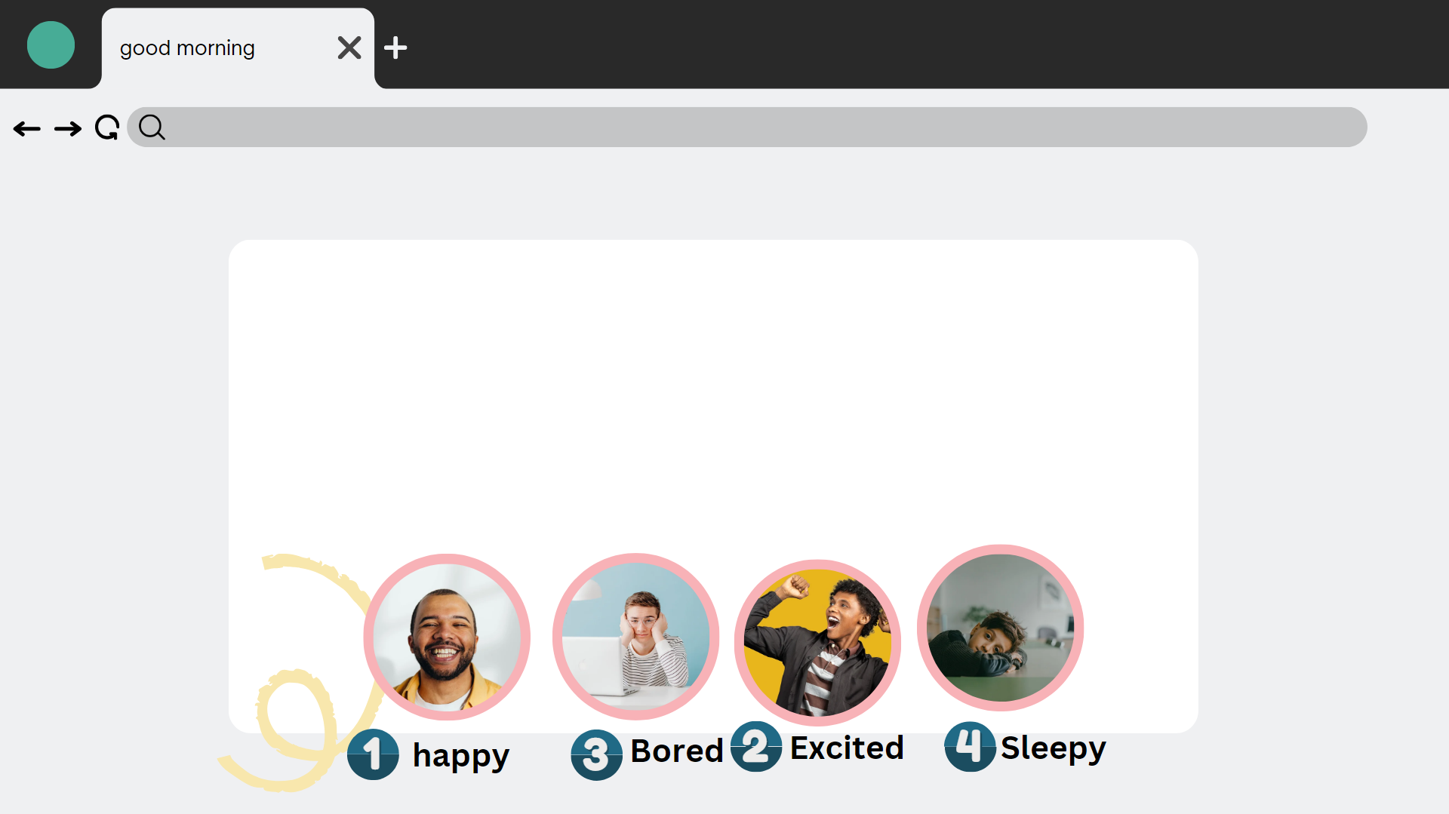
Hi students
How are you feeling today?

Slide 3
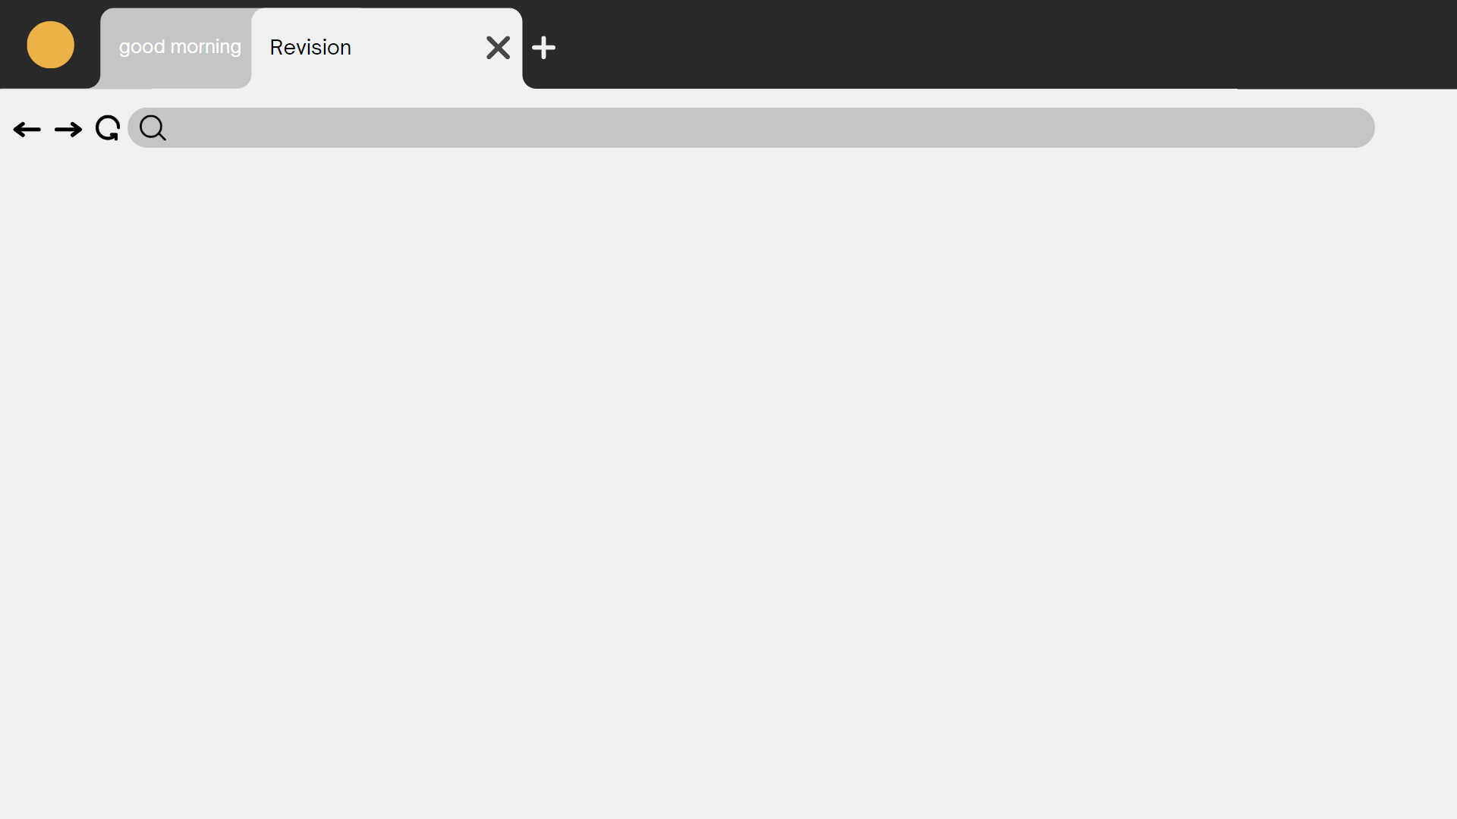
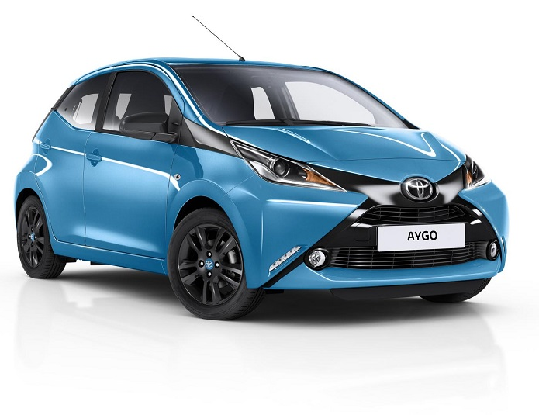
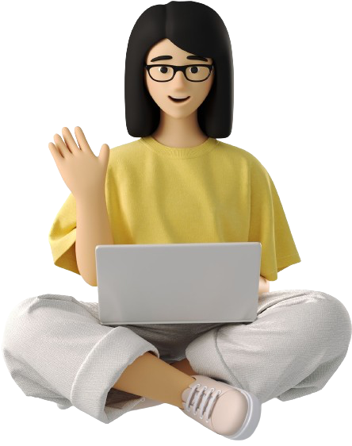
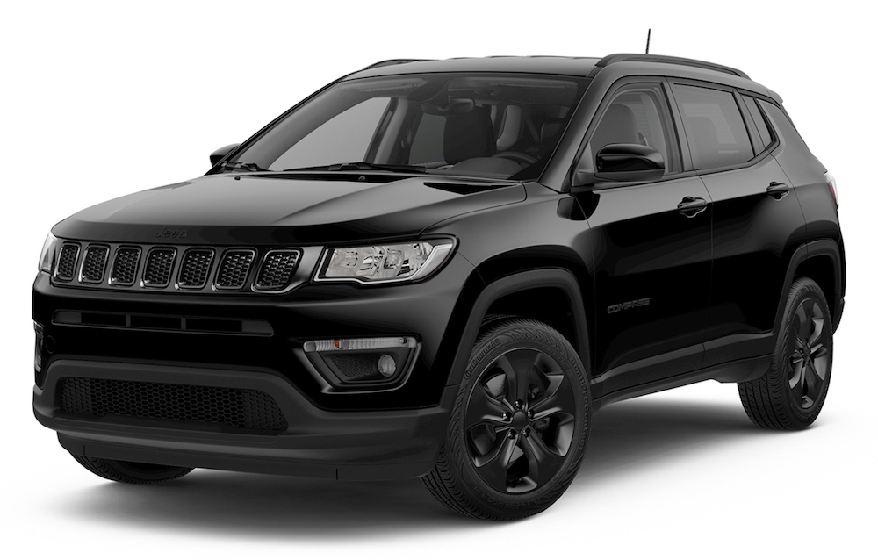
Revision:
In our last lesson, we studied comparative and superlative adjectives, so let's review together and take a quick quiz:
Q1\ The black car is ……………........ than the blue car
(expensiver – more expensive – expensive )

Slide 4
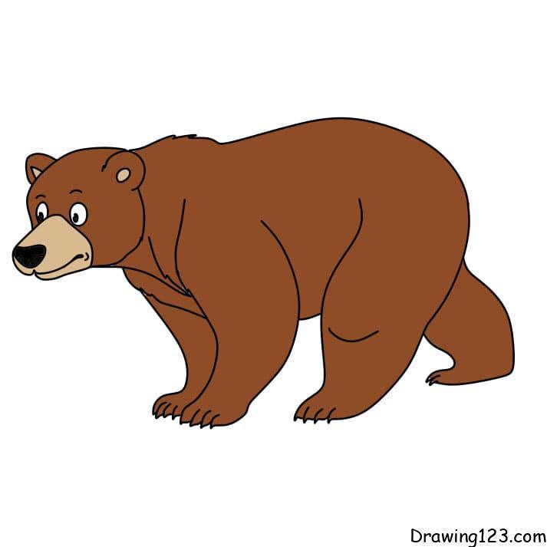
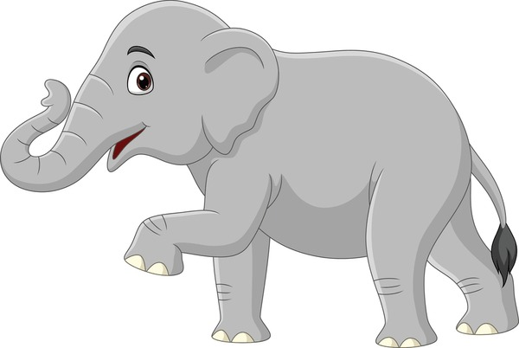
Revision:
Q\ Correct:
Elephants are (big ) than bears
( biger – more big – bigger )

Slide 5
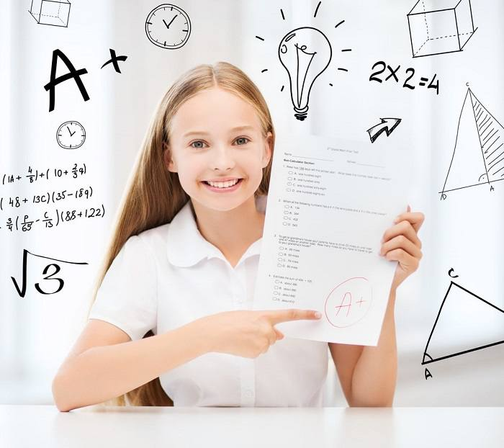
Revision:
Amal gets the …………………mark in the class
( good – better - best )

Slide 6
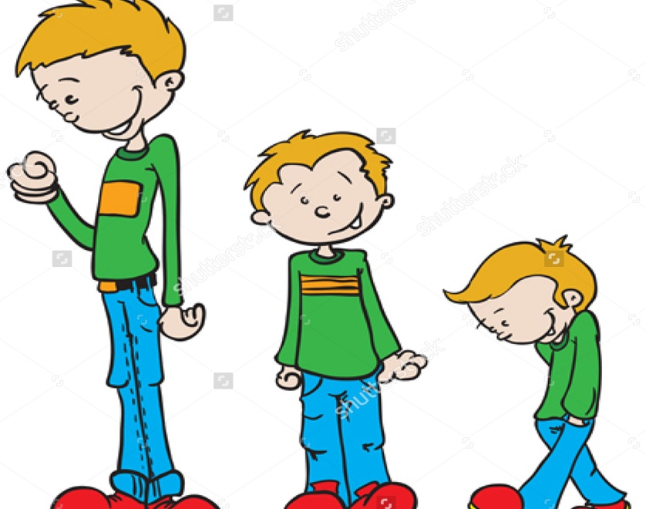
Revision:
Ahmad
Ali
Sami is the …………boy
Sami
( Short – most short – shortest )

Slide 7
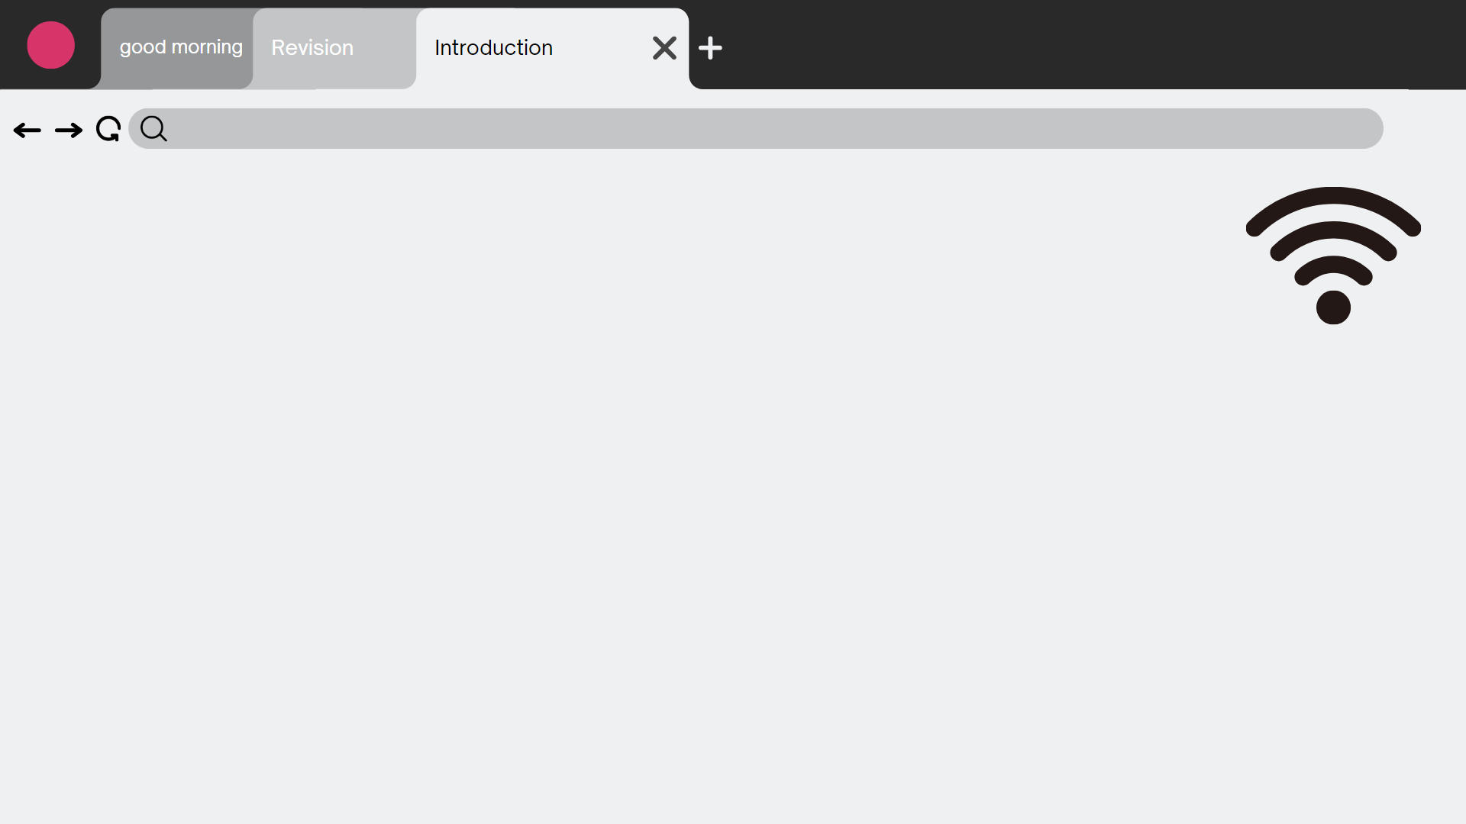
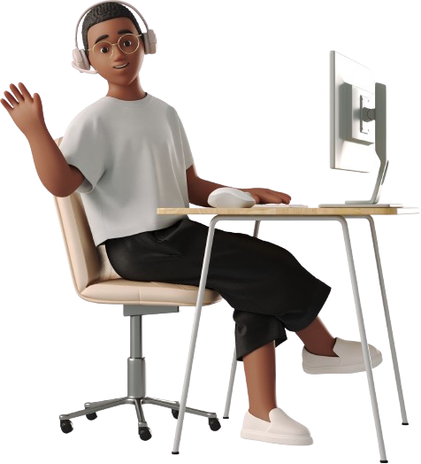
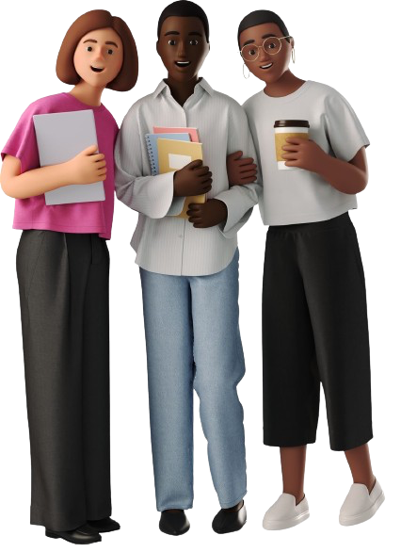
Unit 11
There’s No Comparison
Listening + pronunciation + conversation

Slide 8
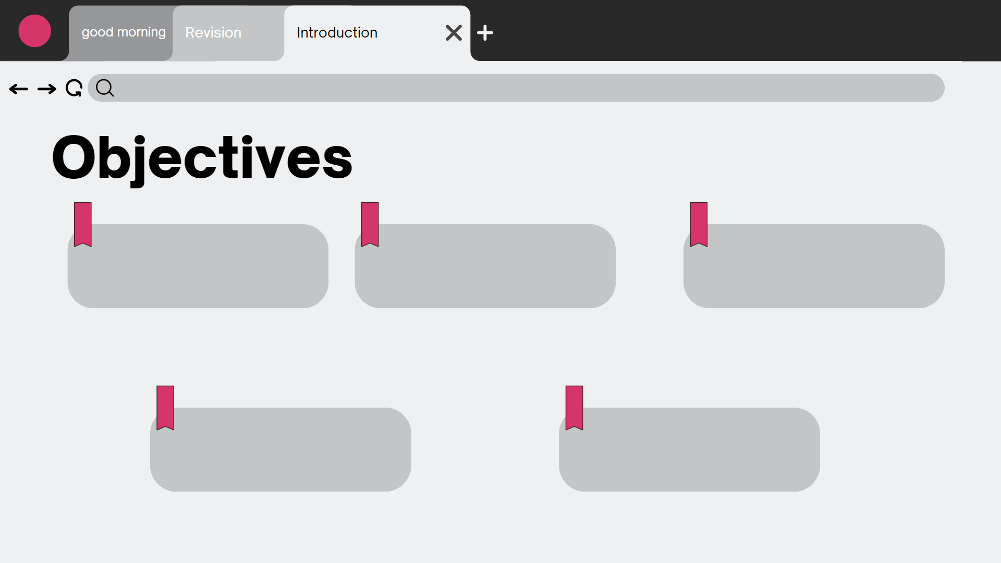
At the end of this session, the students will be able to :
Fill in the missing information from an audio material
Practice the –er sound at the end of the words
Practice a conversation
Answer questions about a conversation
practice stating one's opinion

Slide 9
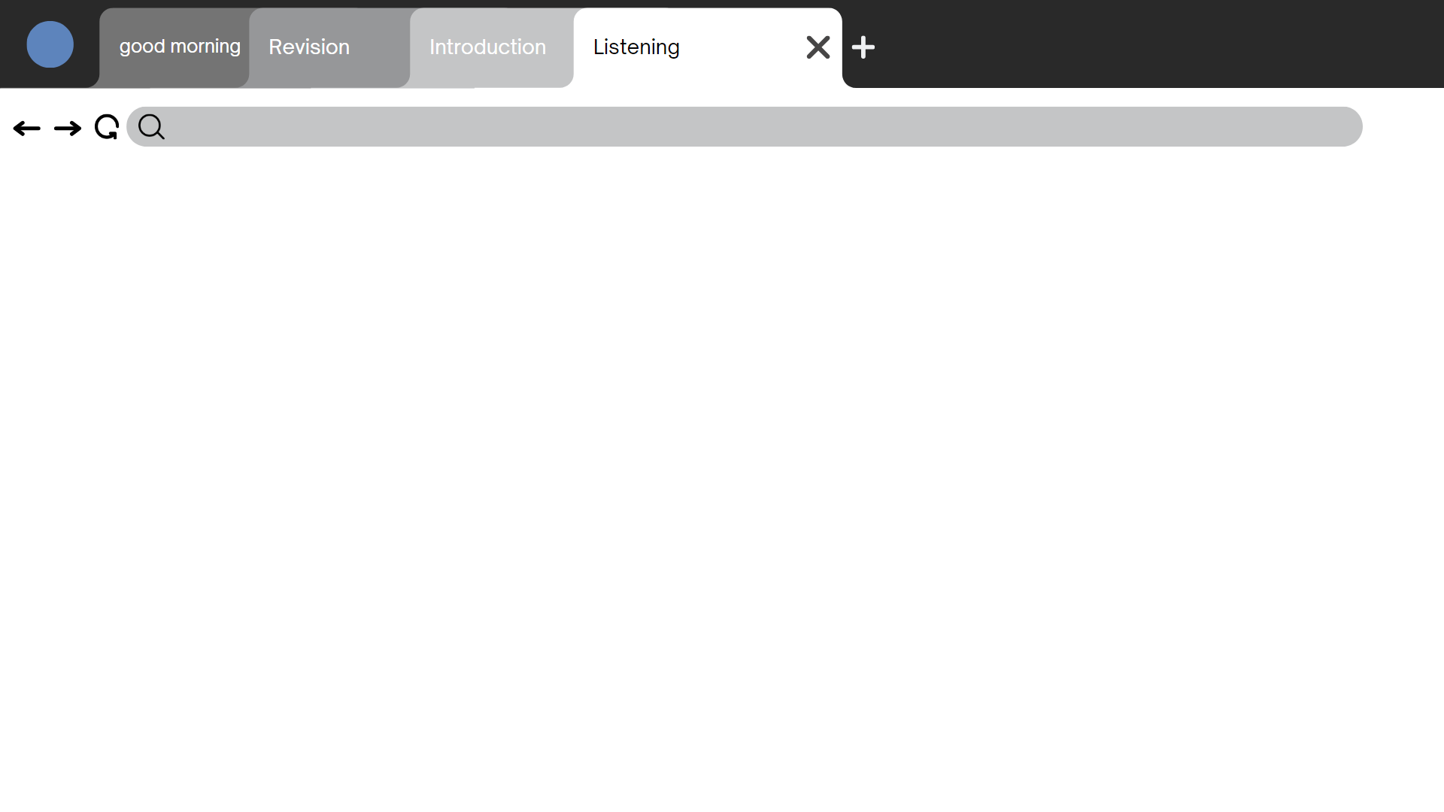
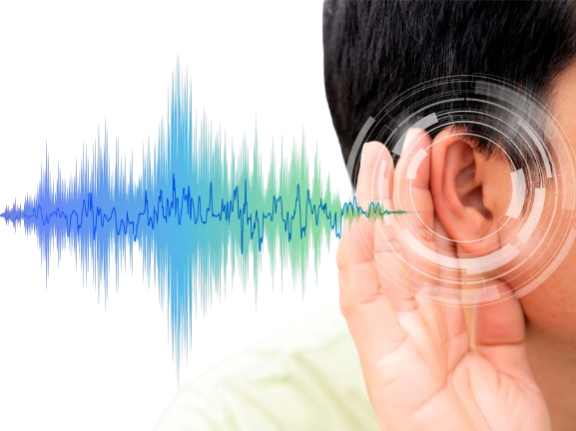
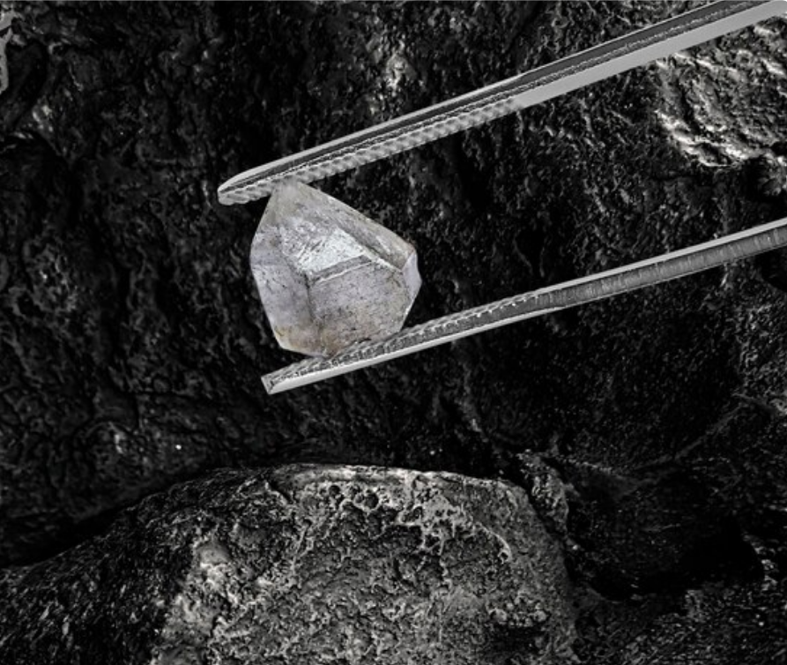
Listening
Open your book page 93

Slide 10
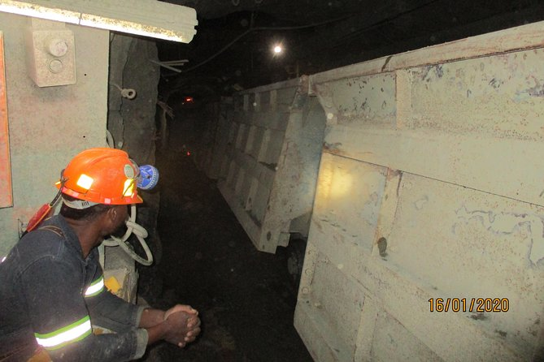
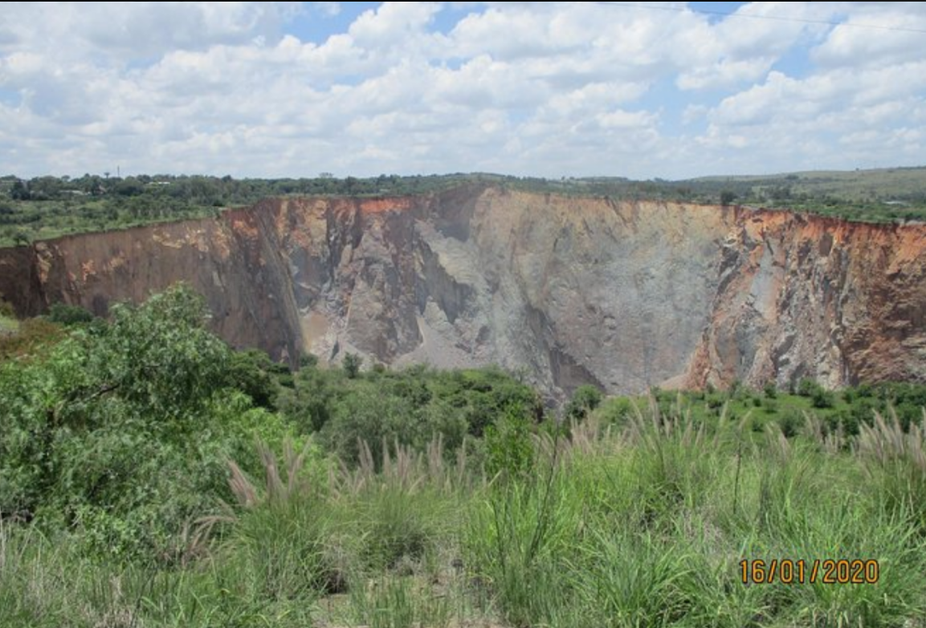
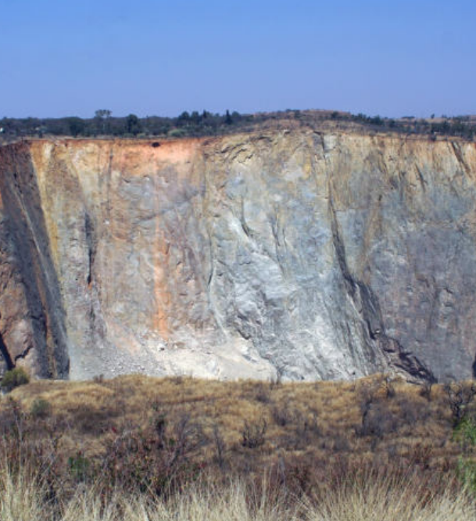
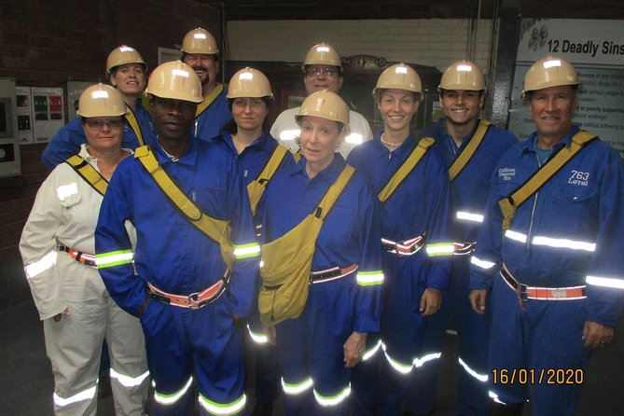
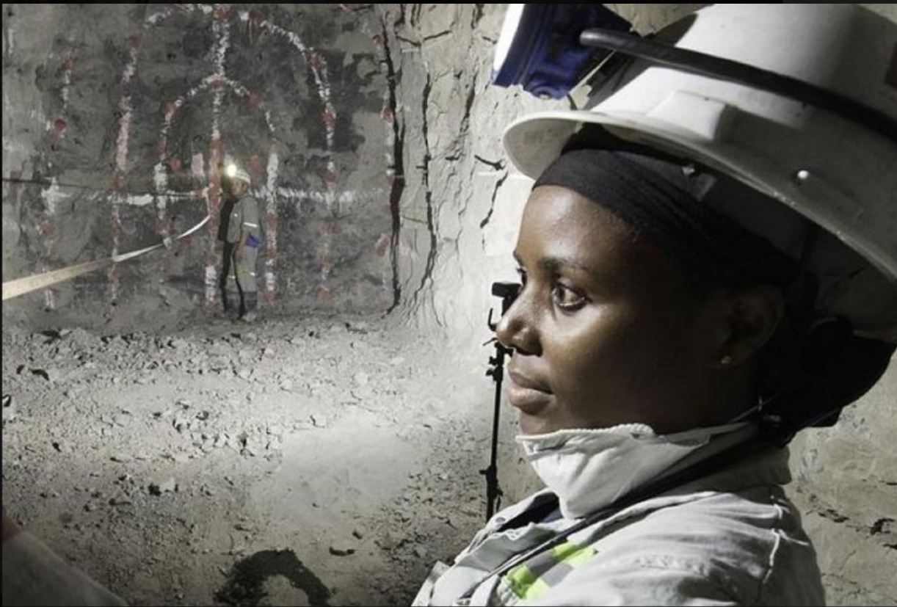
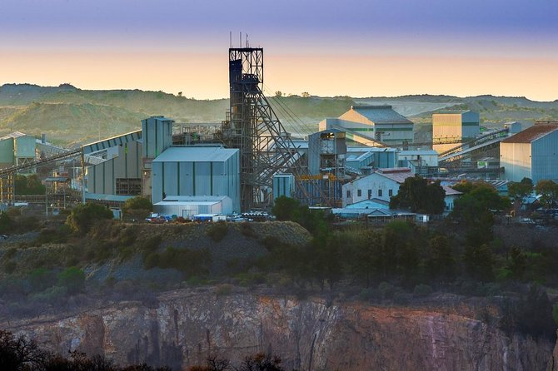
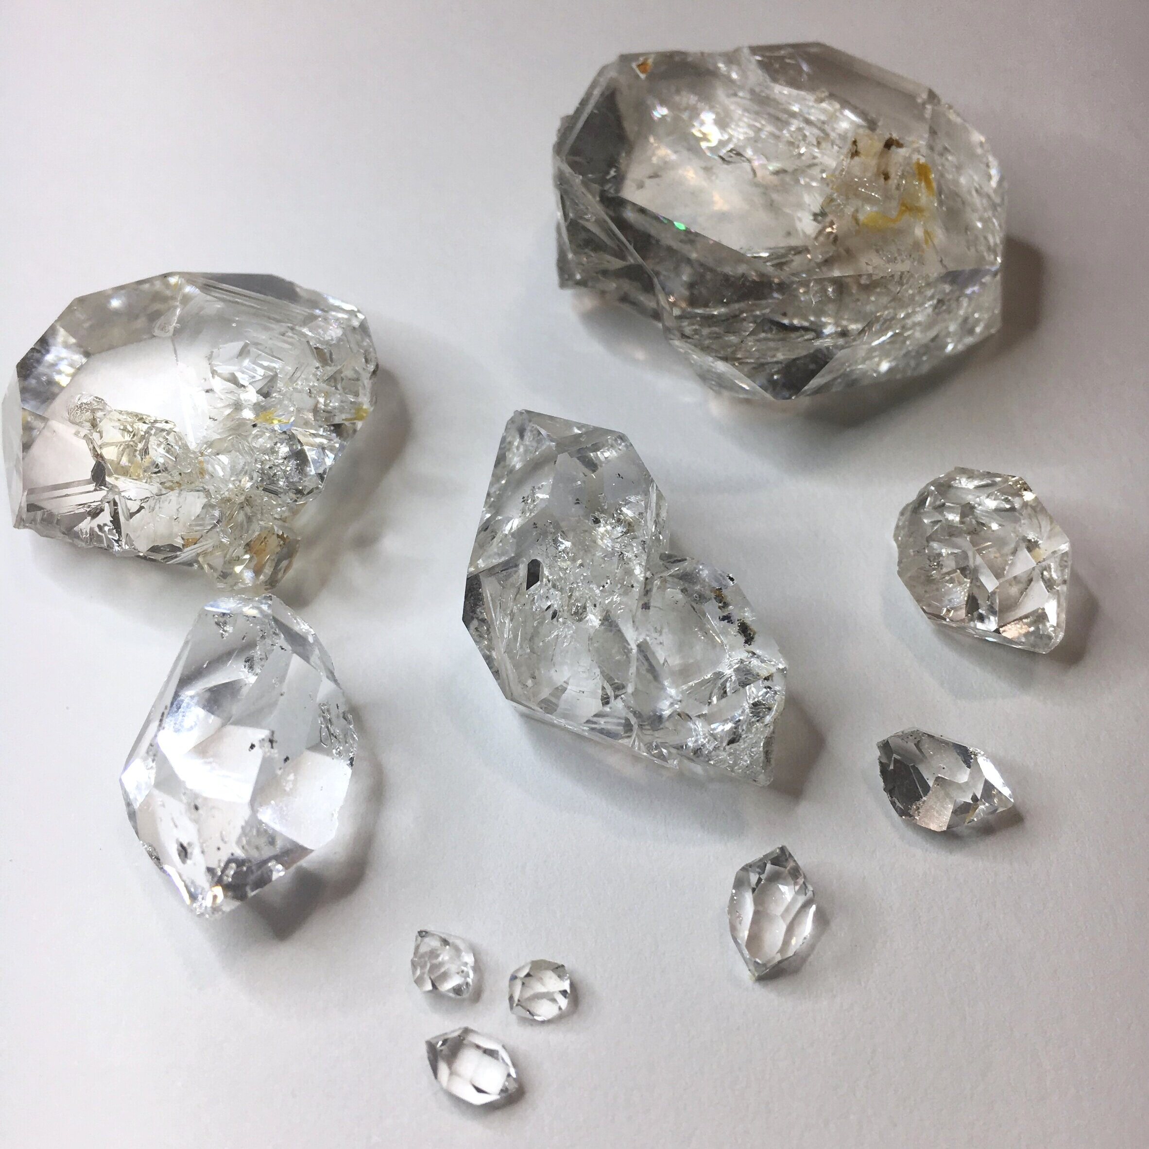

Slide 11
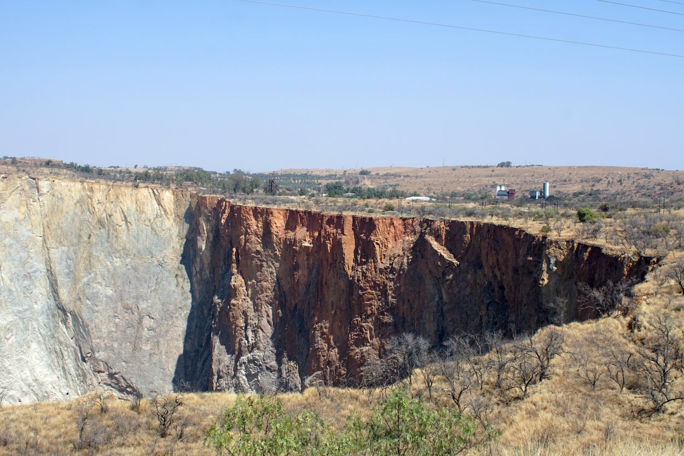
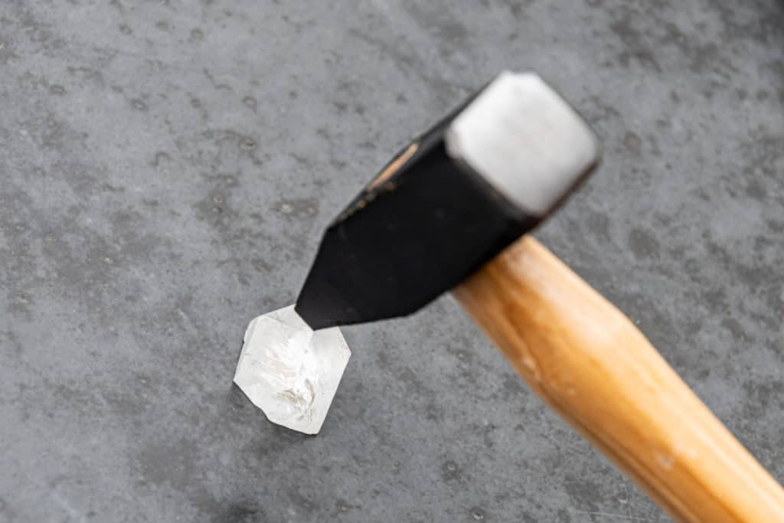
Yes
No

Slide 12
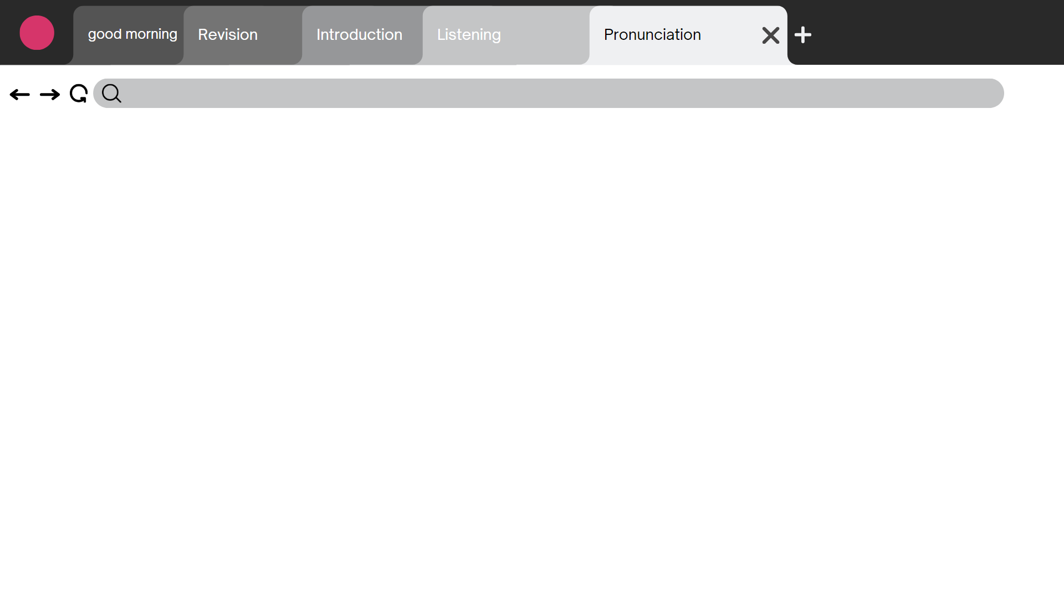
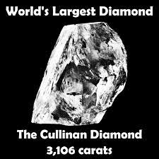
No
Yes

Slide 13
Let’s watch the vide to know how do they mine diamonds?

Slide 15
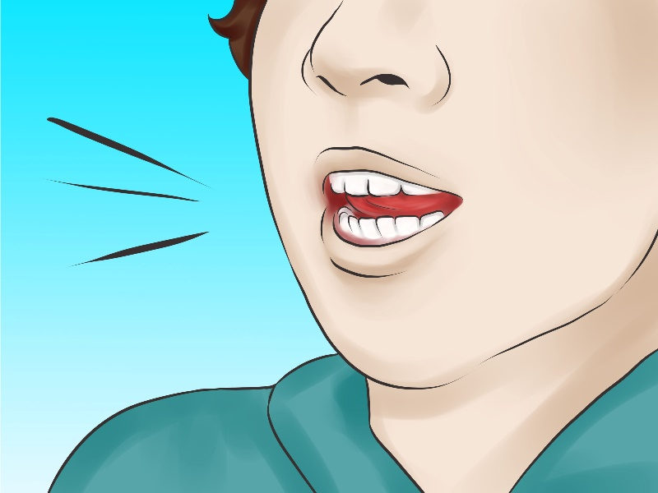
Pronunciation
Look at page 93

Slide 16
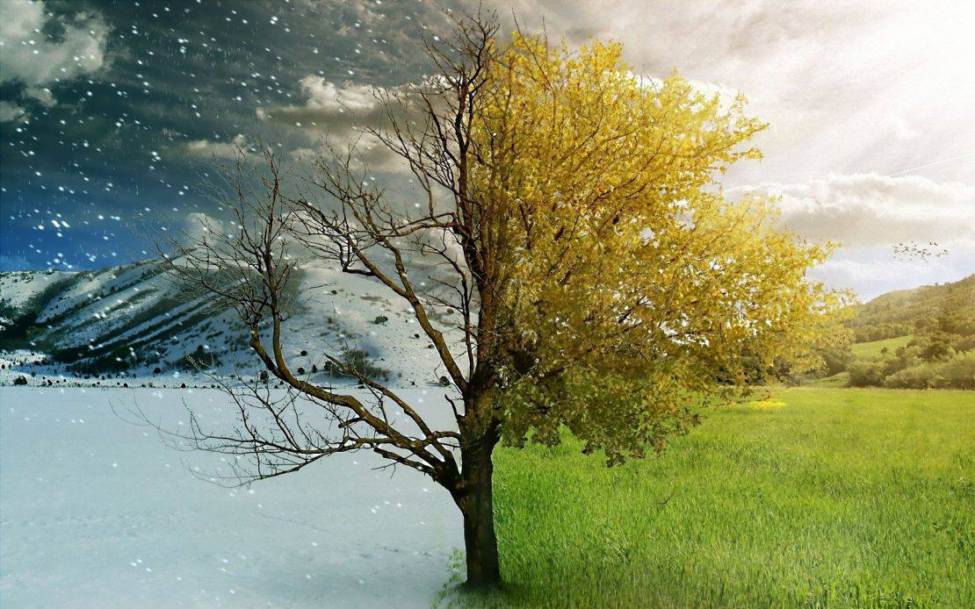
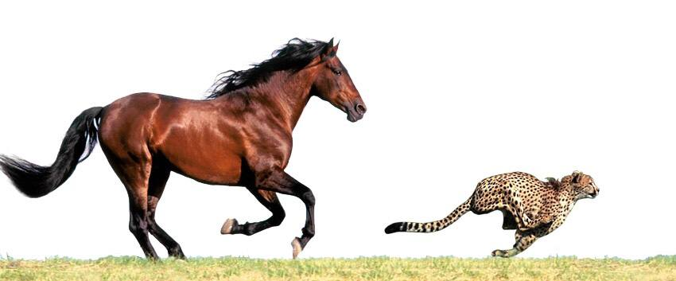

Slide 17
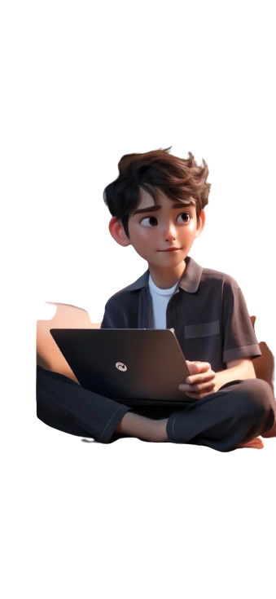
Conversation
………….
………..
Look at page 94

Slide 18
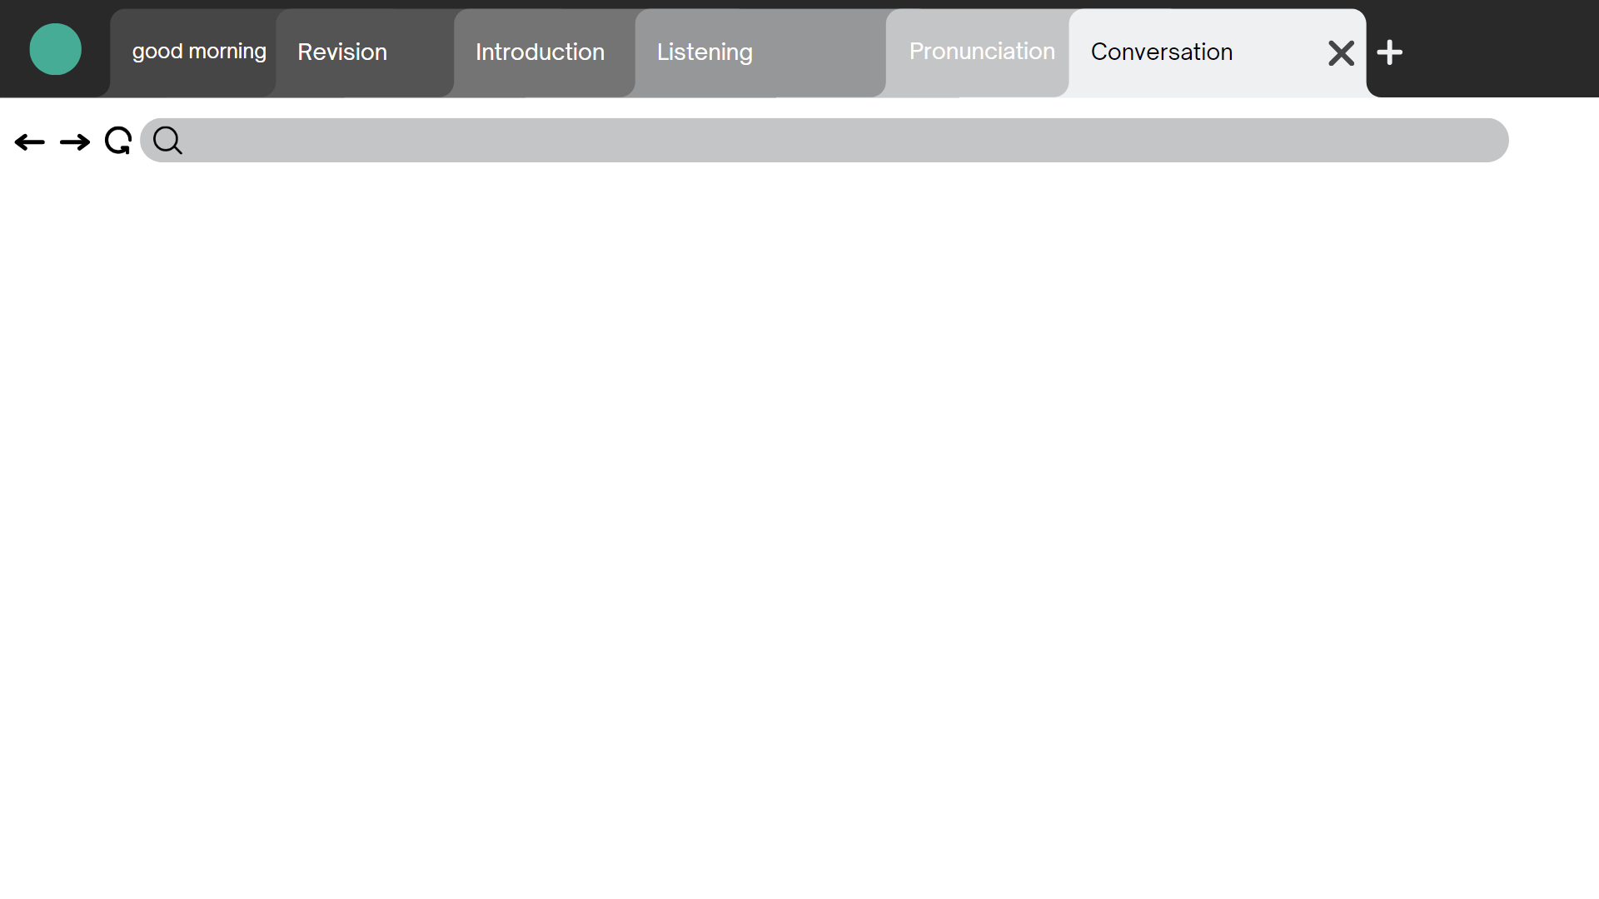
Guess .. What is he drawing ?

Slide 19
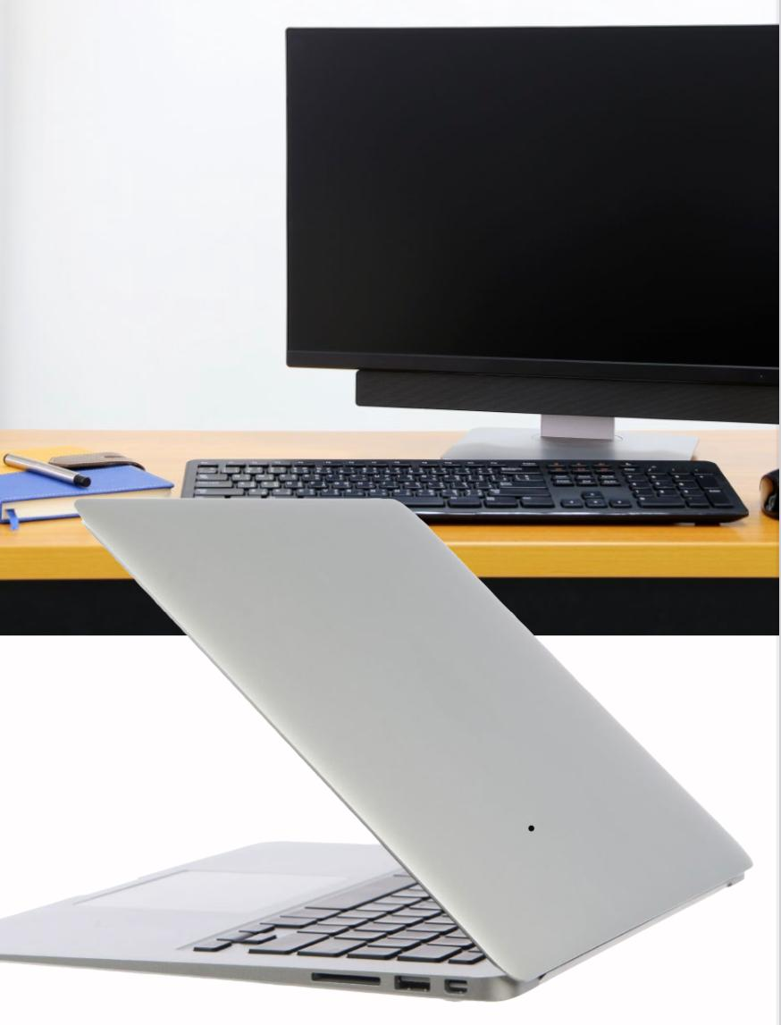
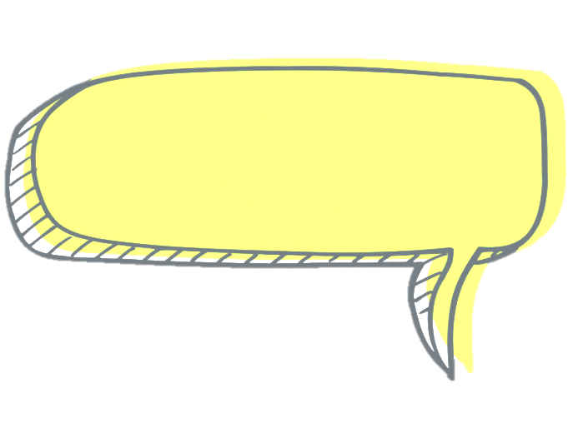
Warm up
What are these?

Slide 20
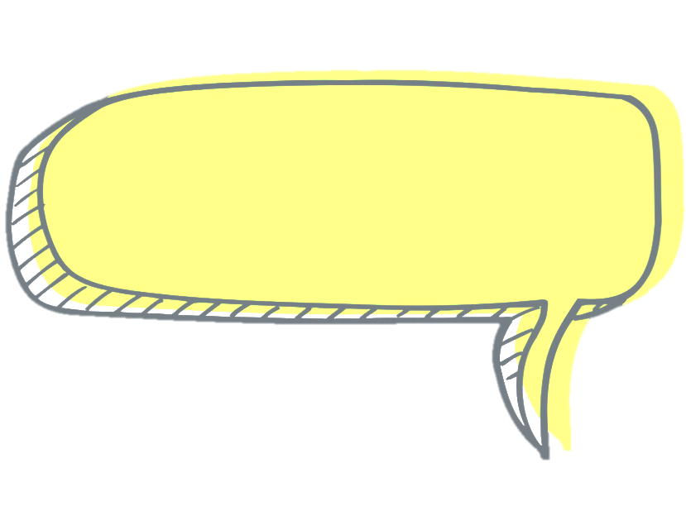
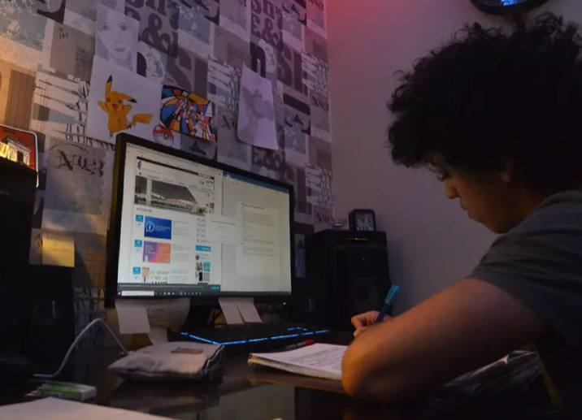
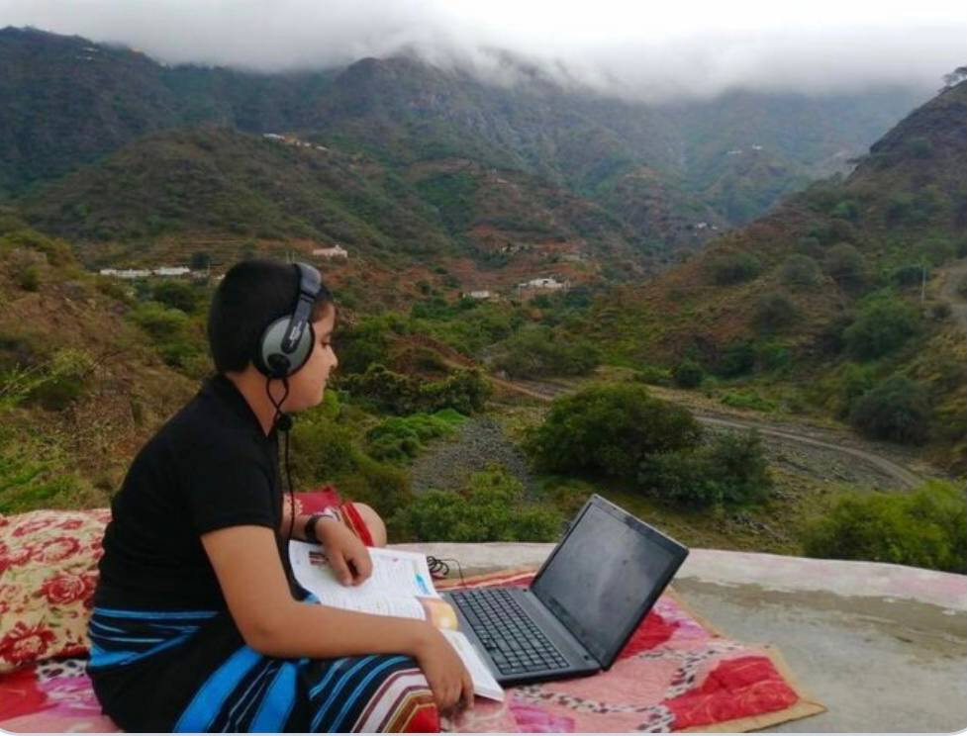
Do you prefer to use a laptop or a desktop ? Why?

Slide 21
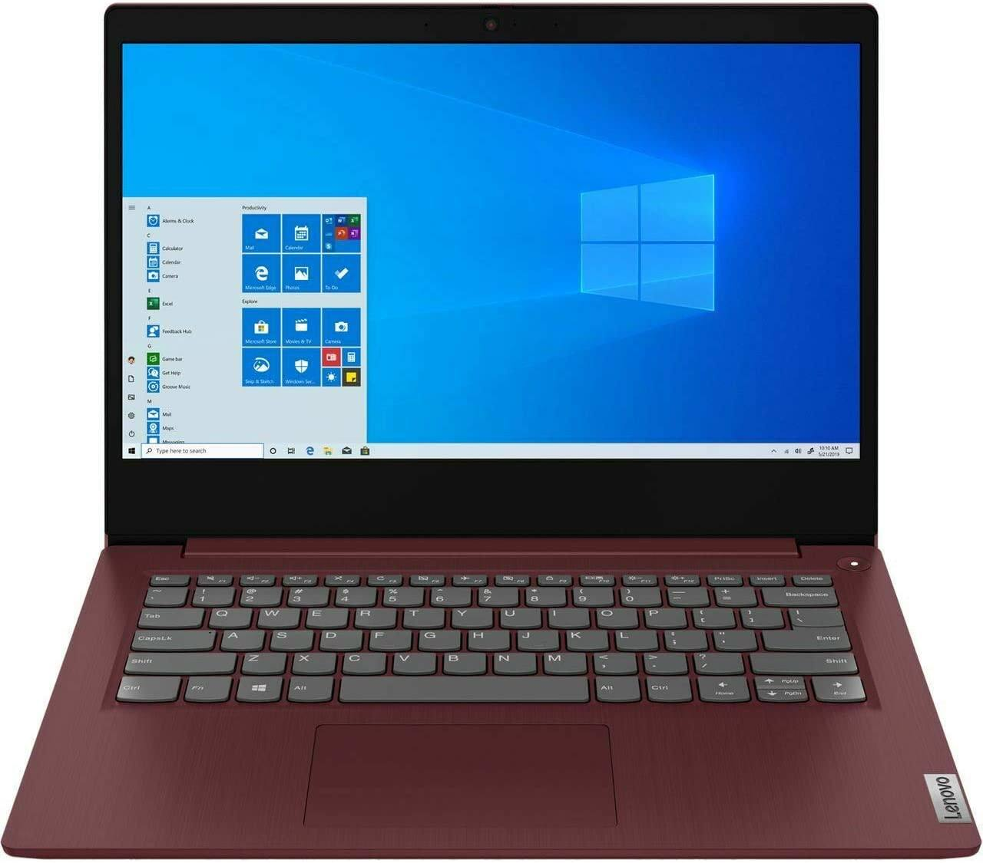
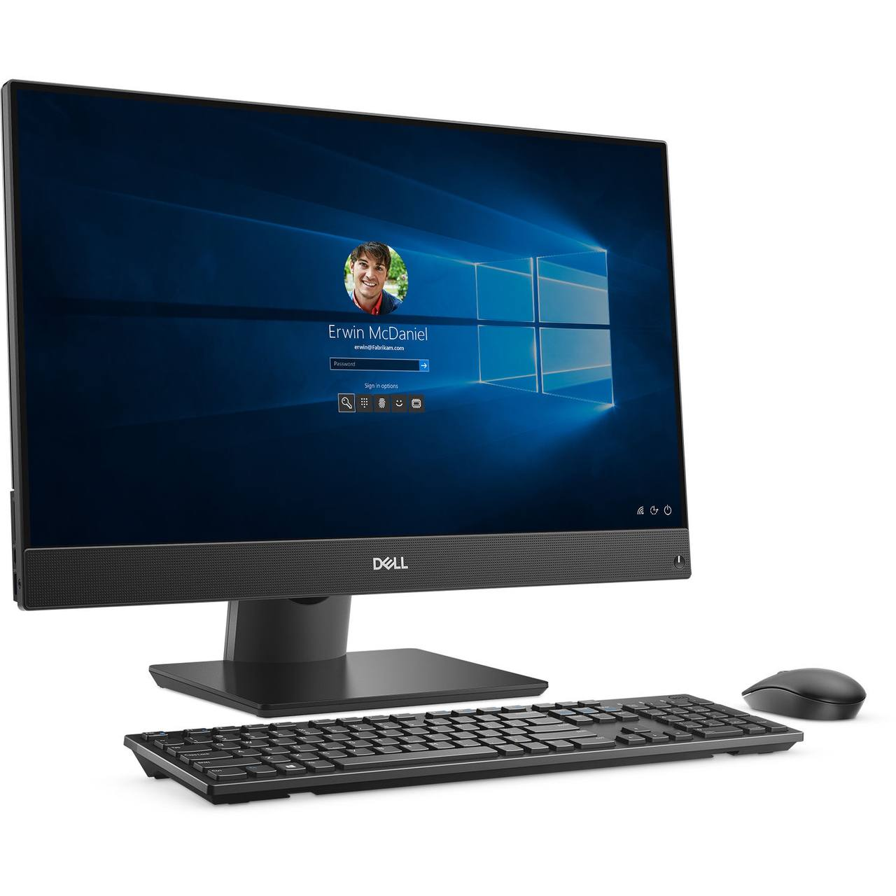
Do you think computer is important ? Why?
Yes
No

Slide 22
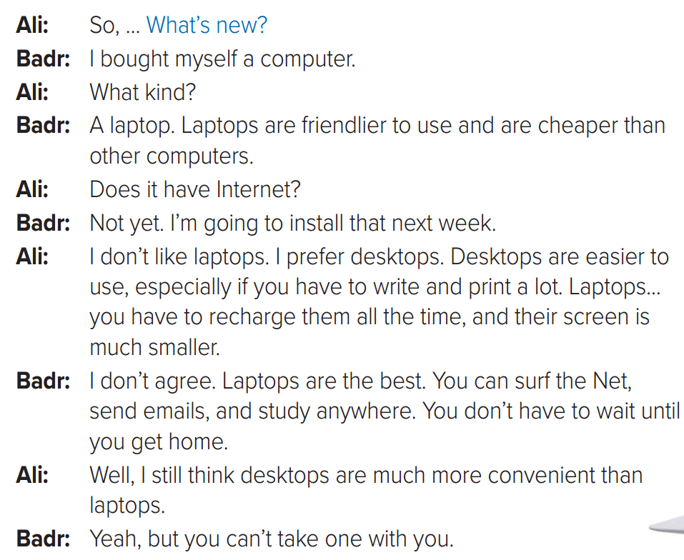
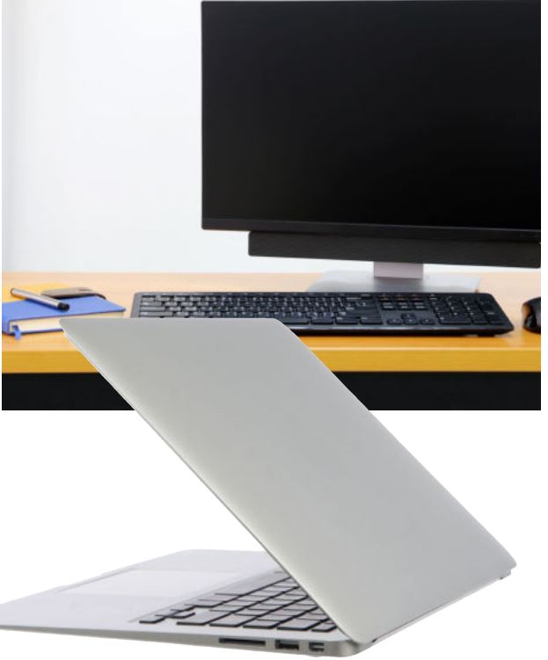
Page 94

Slide 23
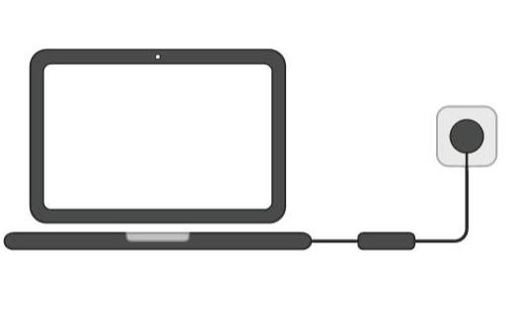
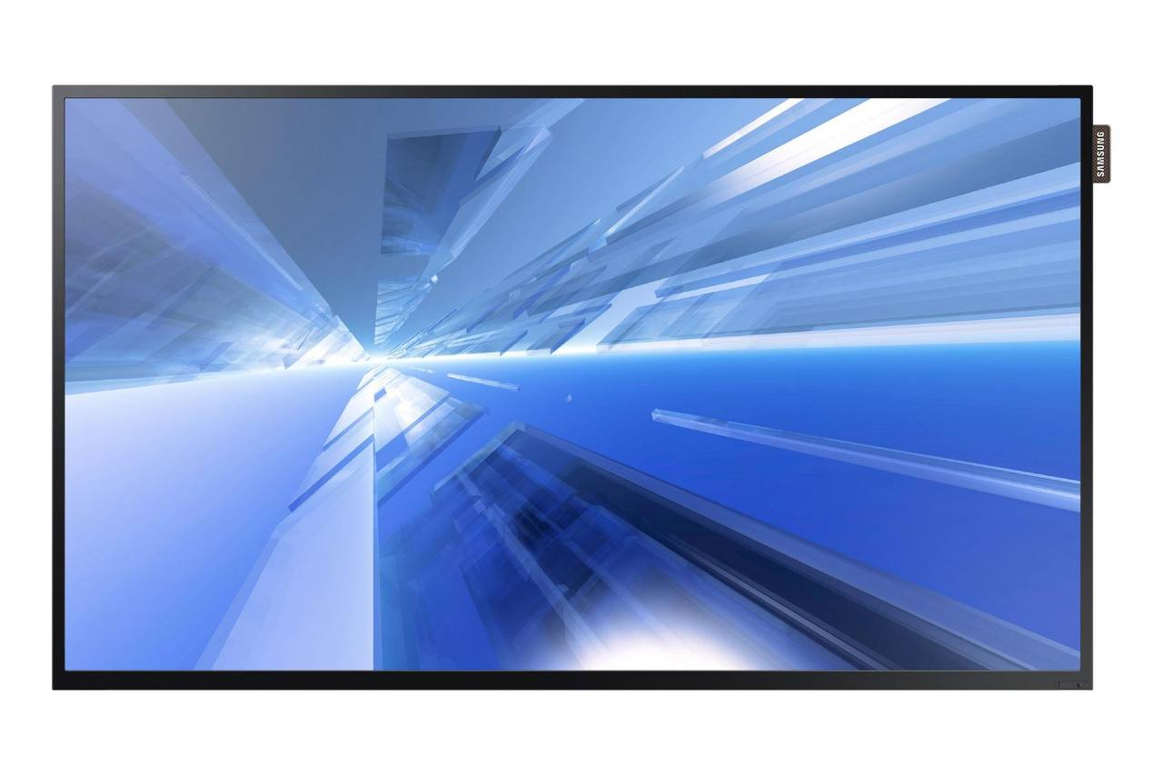
Page 94
1
2
install
1
recharge
3
2
3
4
screen
4
surf

Slide 24
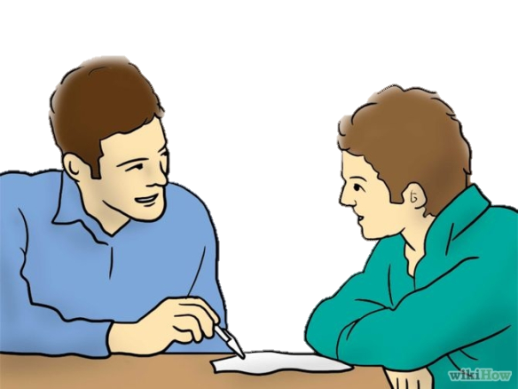
What do the people probably talk about in the conversation?
Who prefers using desktop ?
Who prefers using Laptop ?

Slide 25
What do you think of the desktop computer?
What about the laptop?

Slide 26
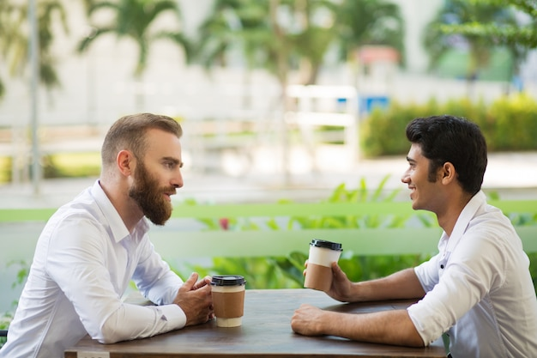
Who says What’s new?
(Ali)
we usually say ( What’s new) at the start of a conversation, Imagine that you haven’t seen someone in a few months or for a while and to think if anything important has happened to you in that period
So….
What’s new?
Nothing much
Note:
if nothing (interesting) has happened recently, typical responses are Not much or Nothing much.

Slide 27
laptops are friendlier to use and cheaper than other computers.
1

Slide 28
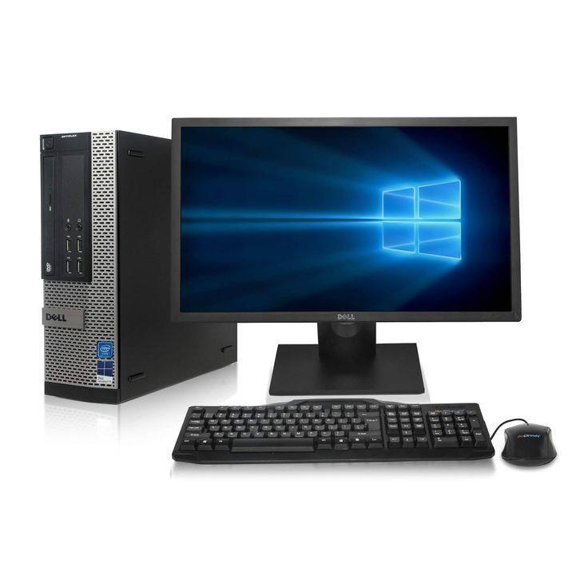
because they are easier to use if you have to write and print a lot.
2

Slide 29
because you have to recharge them all the time, and their screen is smaller
3

Slide 30
laptops are the best because you can surf the Net, send emails, and study anywhere
3

Slide 31
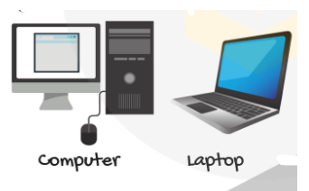
Page 22
Laptop | Desktop | topic
 |  | cost
 |  | size
 |  | screen
 |  | Repair
cheap
expensive
Desktops are large in size.
They are designed to be used in a single location and not moved around much.
They were designed to be taken from place to place, carried in a backpack or laptop carrying case. They are great for on-the-go use.
screen size is big
screen size is small
Repairing a desktop computer is generally easier
Repairing a laptop is difficult

Slide 33
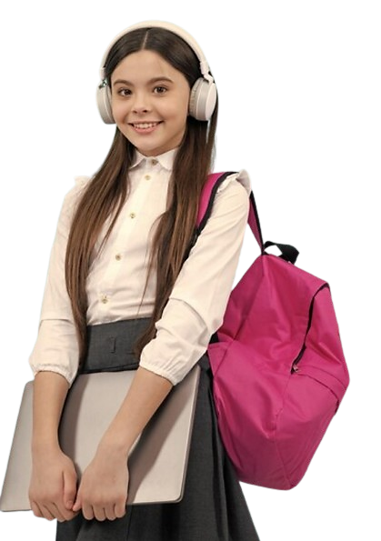
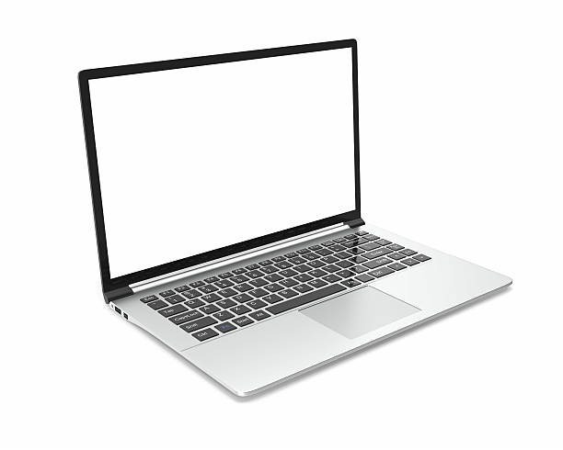
I prefer laptop because it is smaller and it can run on a long-lasting battery

Slide 34
Rana is the youngest student in my class

Slide 35
Mona is the smartest student in my class

Slide 36
Abha is the coldest city in my country

Slide 37
Riyadh is the most famous city in my country

Slide 38
Sami Al Jaber is the best football player in my country

Slide 39
Albaik

Slide 40
The better thing is being close enough to get to a hospital quickly. shopping and restaurants are nearby

Slide 41
Let’s have a break and play a game!
Start

Slide 42
Linking this lesson to my religion
Dear Students,
Be selective on what you watch or use on laptop

Slide 43
Linking this lesson to my country
Dear students, as we all use laptops, desktops, and mobile devices, the state consistently emphasizes not sharing personal info and passwords for your safety. In case of digital breaches, the “كلنا أمن" app provides a helpline to report cybercrimes.
Remember, cybersecurity is a shared responsibility, and staying alert helps protect yourself and contributes to our community's overall digital safety.

Slide 44
End of the class
Thank you for joining today's lesson!
Goodbye and see you next time!

Slide 45
تم تصميم هذا العرض من قبل: فريق عمل البوابة الإنجليزية ، وهو مجاني لكي يستفيد منه معلمي اللغة الإنجليزية.
هذه الشريحة تعتبر كـ"حفظ حقوق" نتمنى عدم حذفها حال مشاركة العرض مع معلمين آخرين.
نسمح بحذف الحقوق في حالة واحدة فقط: اذا أراد معلم الإنجليزي إضافة هذا العرض كـ انتاج معرفي خاص فيه.

