Slide 1
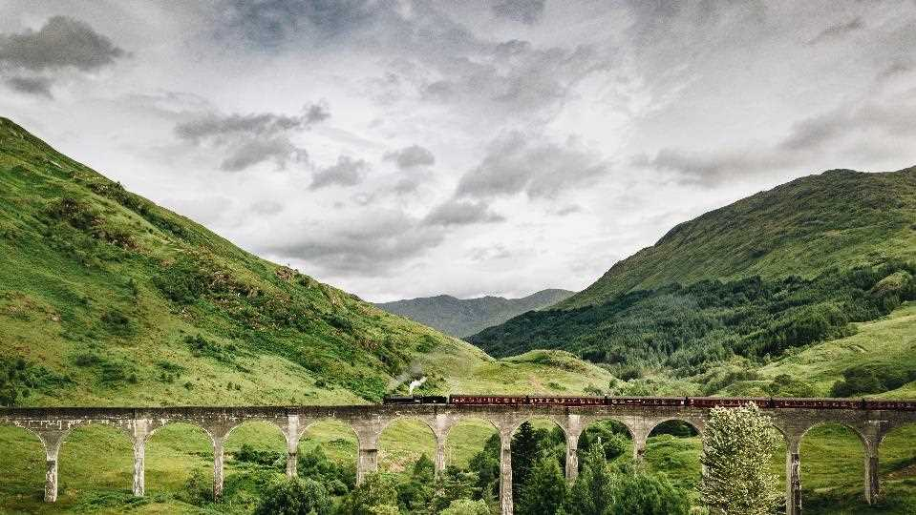
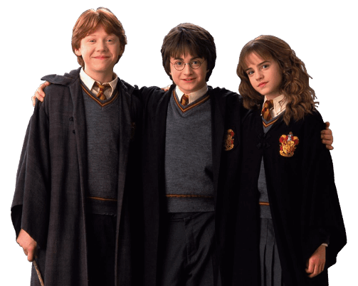
Good morning everyone

Slide 2
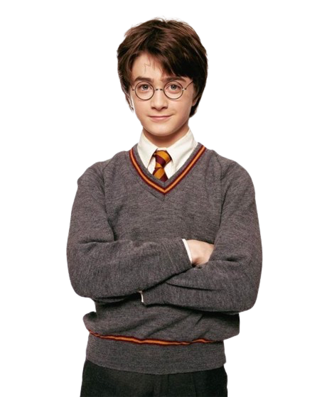
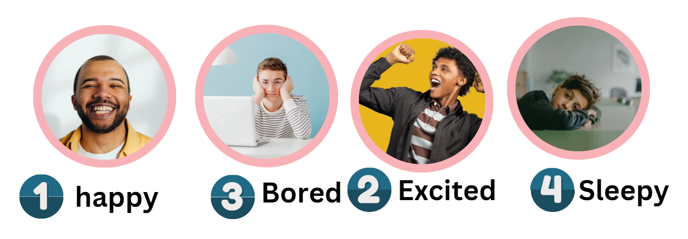
Hi students!
How are you feeling today?

Slide 3

Great! Let's review our last lesson
(Choose): What does the word Vision refer to?
A
a magical power to flay
B
a popular brand of soft drink
C
a picture of the future

Slide 4
(Choose): The meaning of valuable
A
has many disadvantages
B
worth a great deal of money
C
Having fun

Slide 5
(Choose): The meaning of opportunities
A
chances
B
gift
C
duties

Slide 6

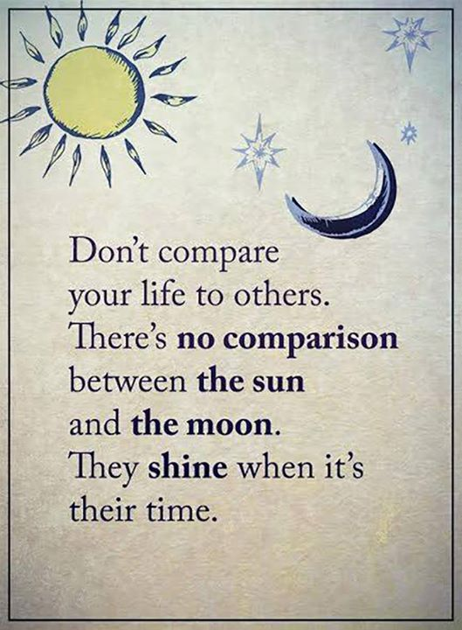
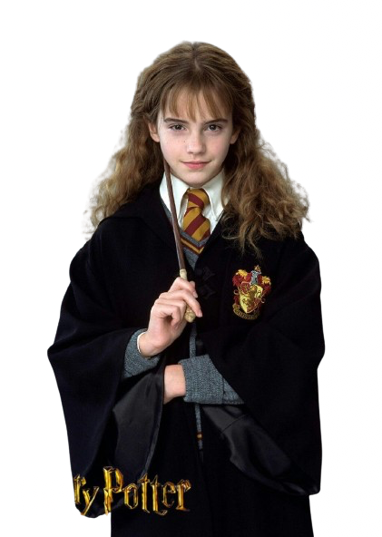
Unit 11
There’s No Comparison
Writing + form, meaning, and function
Now, let's dive into today's lesson

Slide 7

What will we learn today?
01
Use the passive form in the present or past tense
02
Use " by " to show the agent that did the action
03
Write a text from the book of record
04
  Use So\such...That

Slide 8
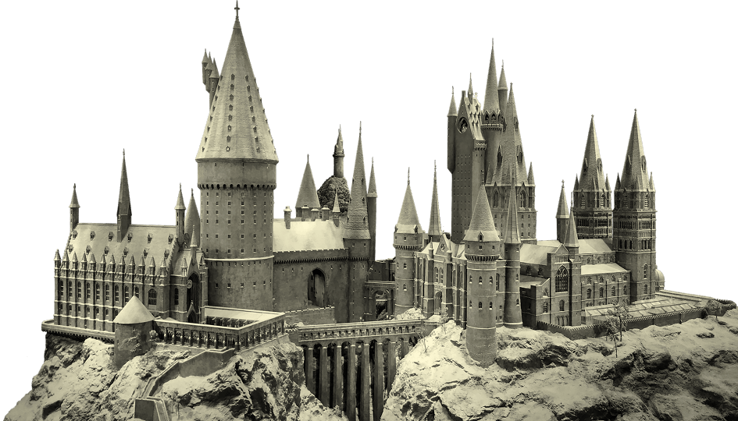


Writing
Describe the topic of the section here

Slide 9


Open your book page 96

Slide 10
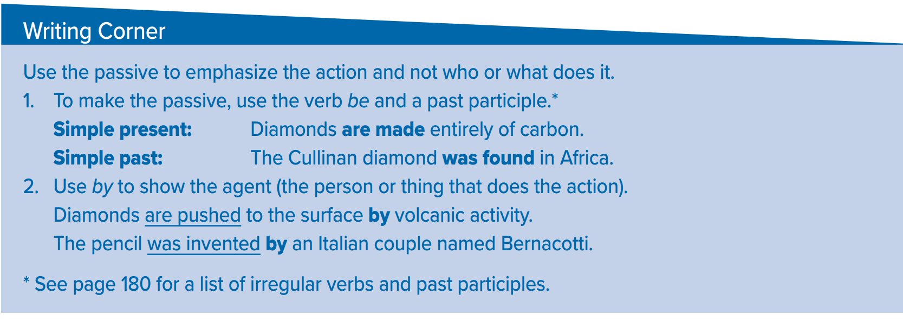
Go to the next slides

Slide 11
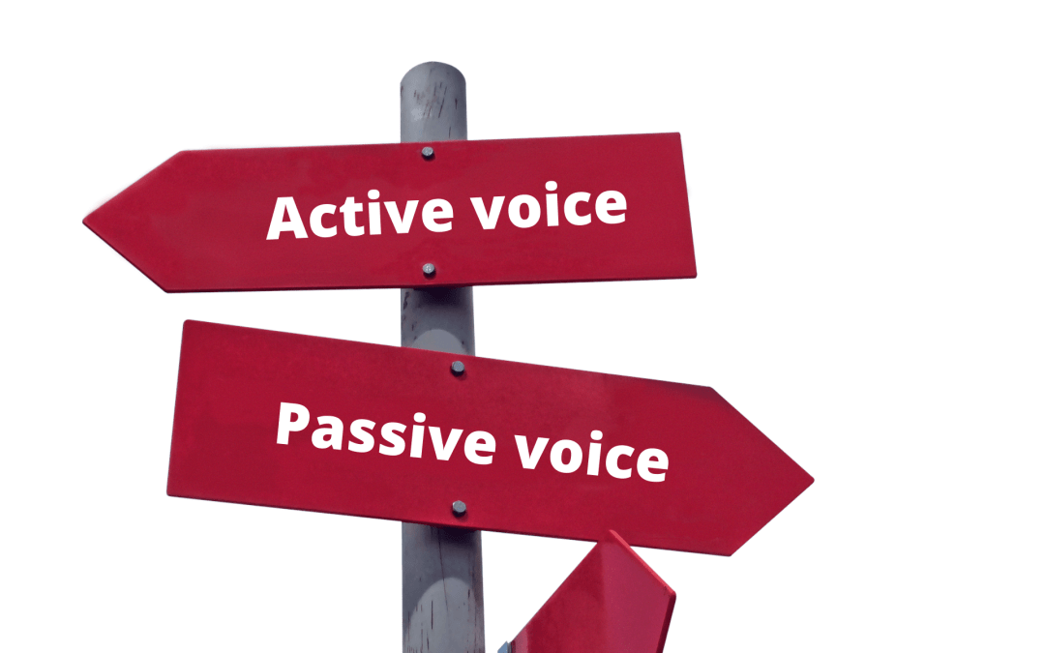

Slide 12




The apple is eaten
What’s the type of the sentence?
Active
Passive
You don’t know the agent
( the person or thing that
does the action )
If the Action is more important
than the agent
The apple is eaten by Ahmad.

Slide 13
Present Passive
The apple is eaten
by Ahmed.
Verb
Be +V3
Subject
agent
Page 180
1- Magazines are printed every month.
2- Medals are given to people.

Slide 14
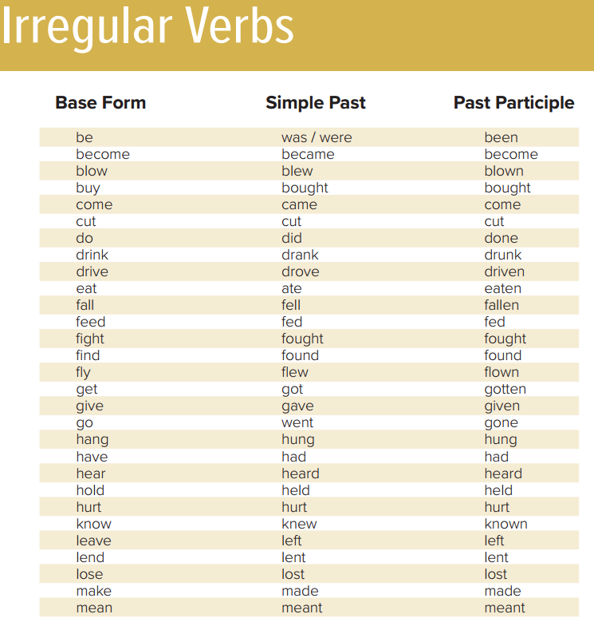
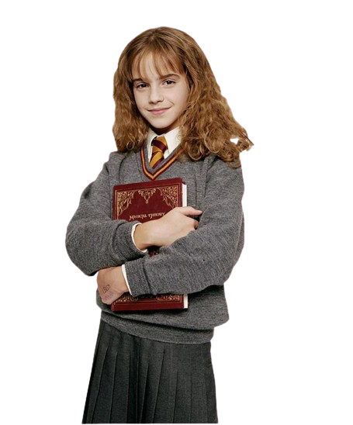
V3
On page 180 you'll find verbs in their third form of conjugation, for example, "eat" becomes "eaten”

Slide 15
Past Passive
is >> was
are >> were
The apple was eaten
Verb
Be +V3
Subject
agent
1- The television was invented in 1923.

Slide 16
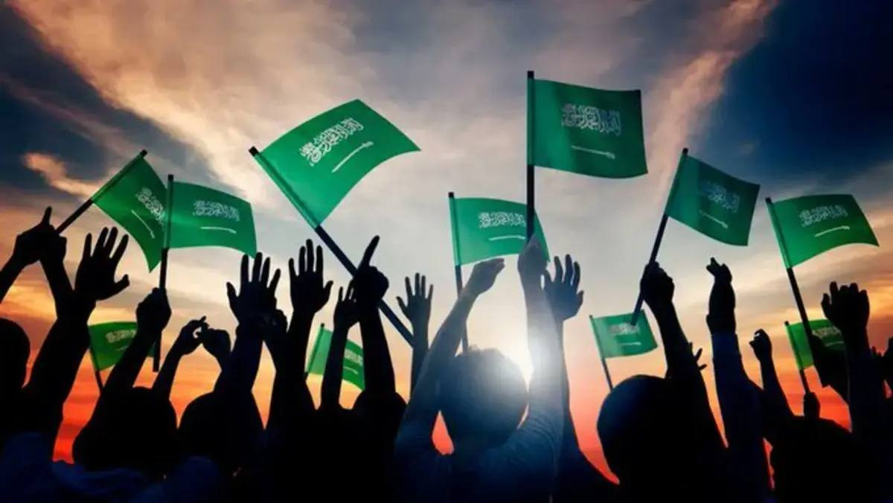
Saudi Arabian people celebrate National Day on September 23rd.
National Day
is celebrated
by Saudi Arabian people on September 23rd.

Slide 17
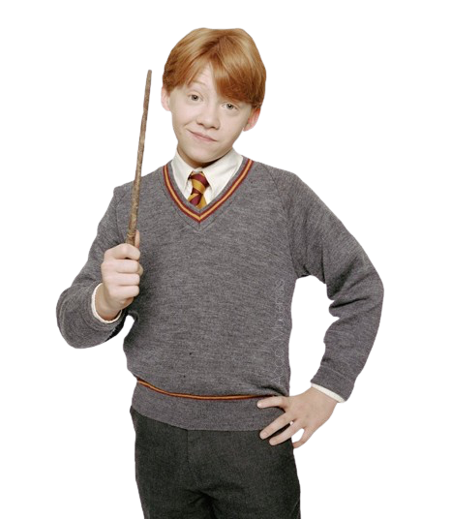
Change the active sentence into passive
The girls paint the picture
Next slide

Slide 18
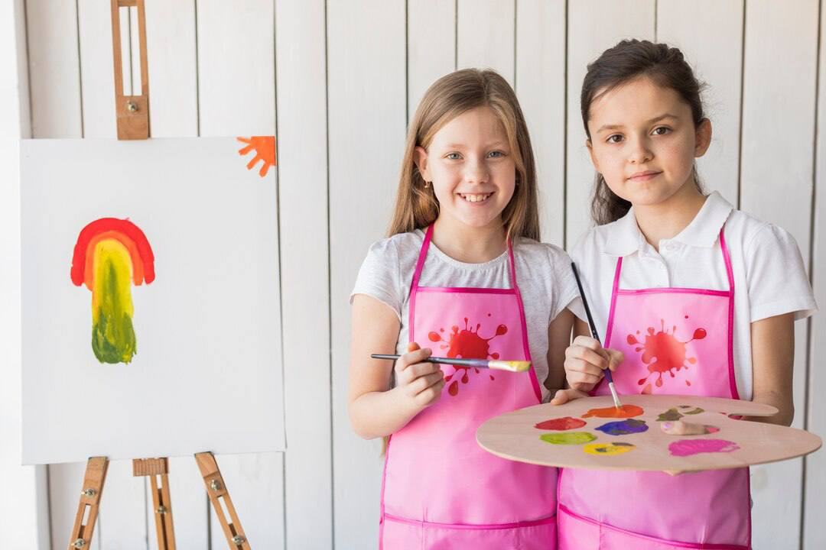
subject
Verb
present
Object
Active:
The girls paint the picture.
Passive:
The picture
is painted
by the girls
Subject
Verb Be+V3
agent

Slide 19

Change the active sentence into passive
Shakespeare wrote Hamlet
Next slide

Slide 20
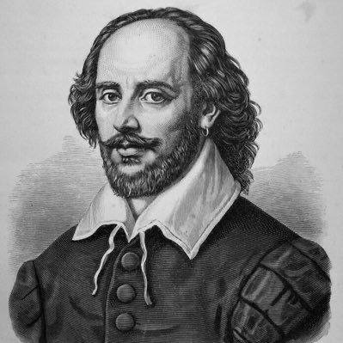
subject
Active verb
Direct Object
Active:
Shakespeare wrote Hamlet.
Passive:
Hamlet
Was written
by shakespeare
Subject
Passive verb
Agent object

Slide 21
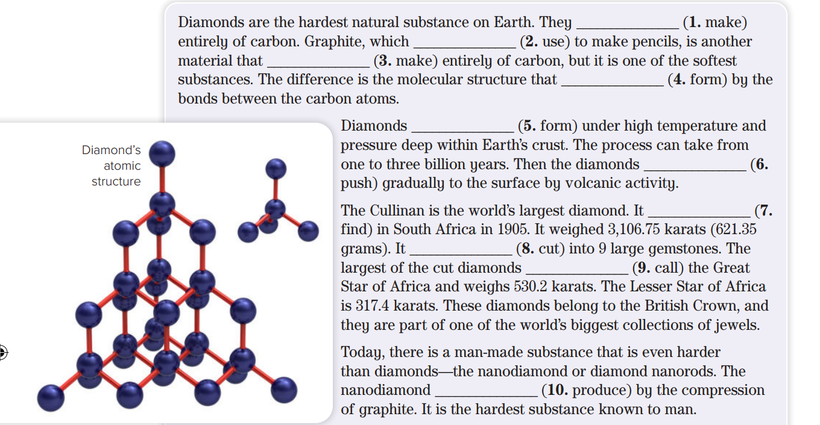
Page 96
are made
Is used
is made
is formed
are found
are pushed
was found
was cut
is called
is produced

Slide 22
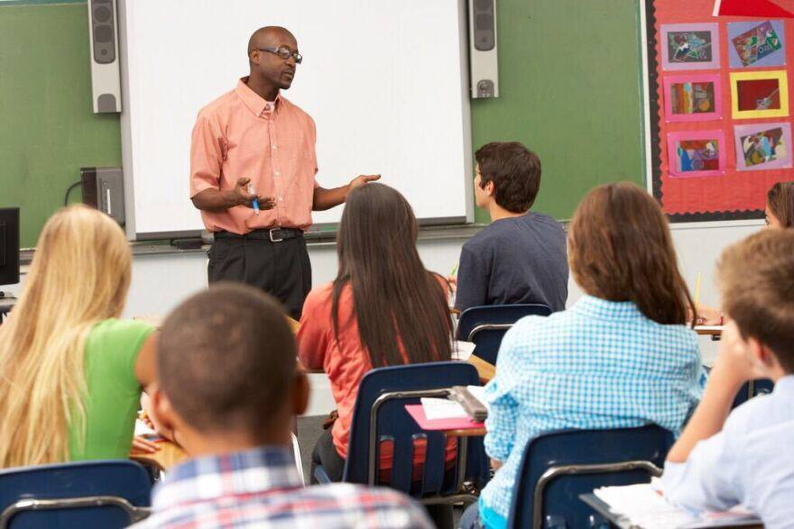
Teacher teaches students English everyday
Students are taught English everyday by Teacher

Slide 23
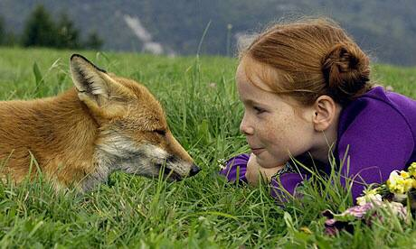
Amal saw the fox
The fox was seen by Amal

Slide 24

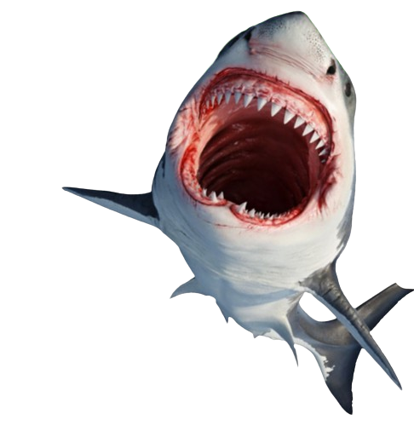
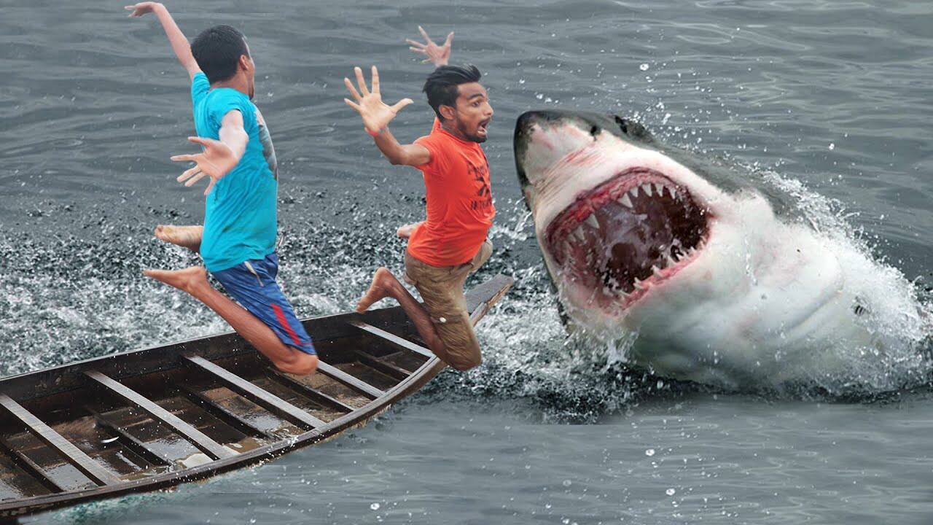
Page 96
Shark is the most dangerous animal in the world.
active
Sharks attack people.
passive
People are attacked by sharks.

Slide 25
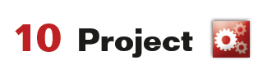
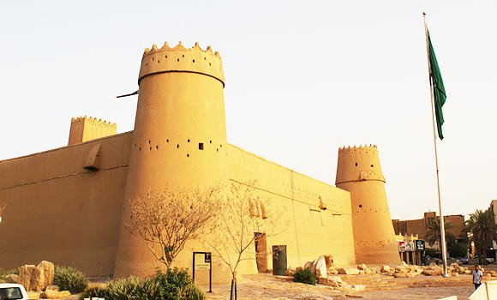
Page 96
The Masmak Palace
Qasr al-Masmak, in Riyadh
It is a high, strong and thick building. Built in 1865

Slide 26
form, meaning, and function
Describe the topic of the section here

Slide 27
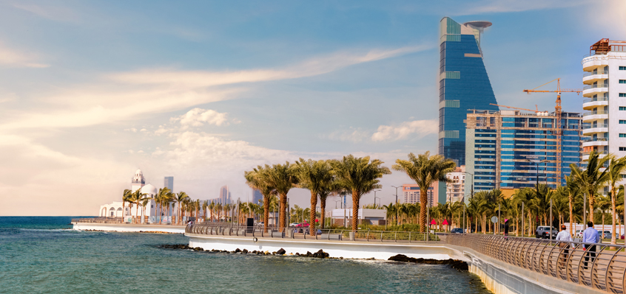
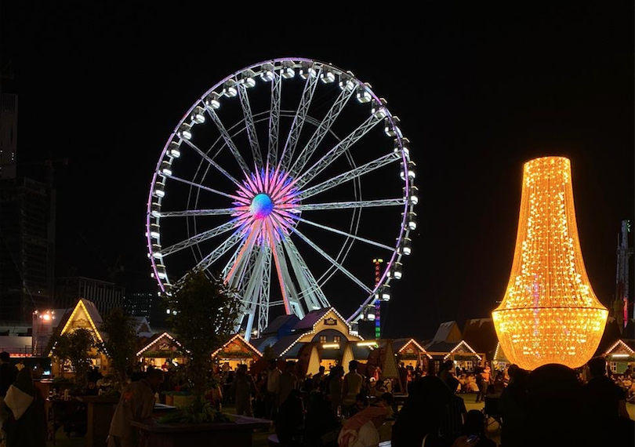
Warm up
Jeddah is such a beautiful city that we visit it every month,
According to 2030 vision There is so many events that you can see it in Saudi Arabia.

Slide 28
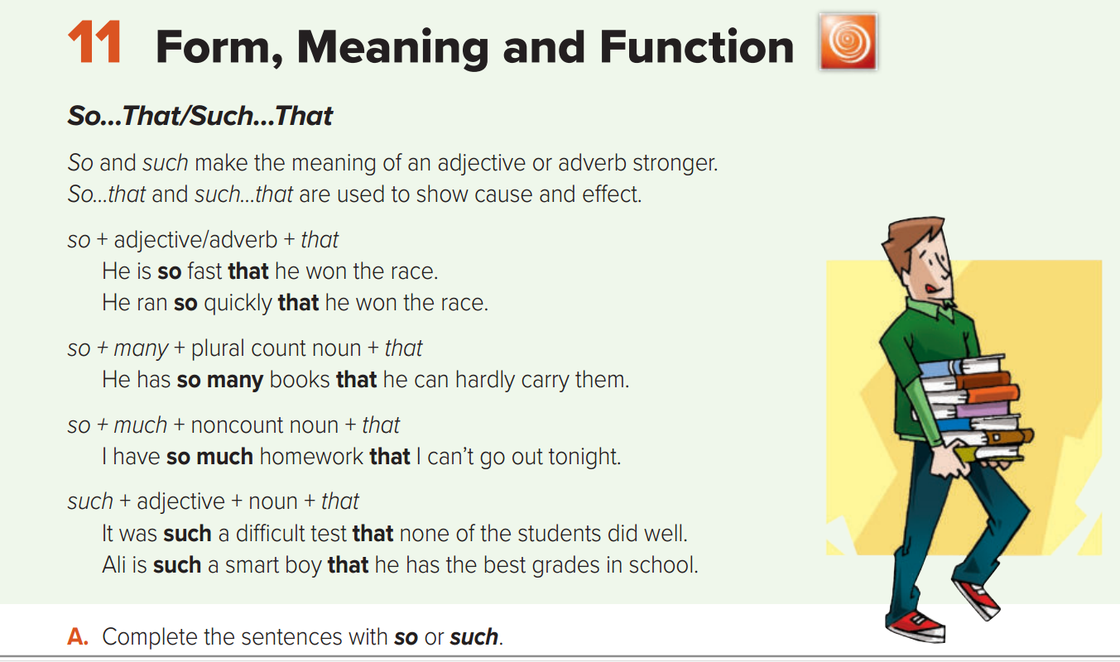
Look at page 97

Slide 29
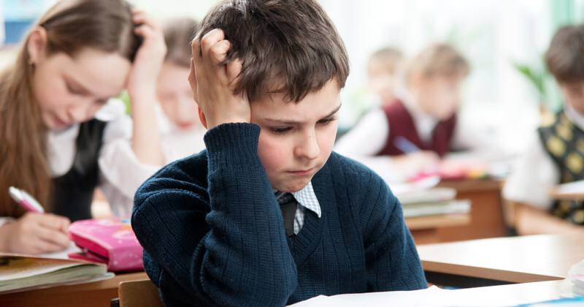

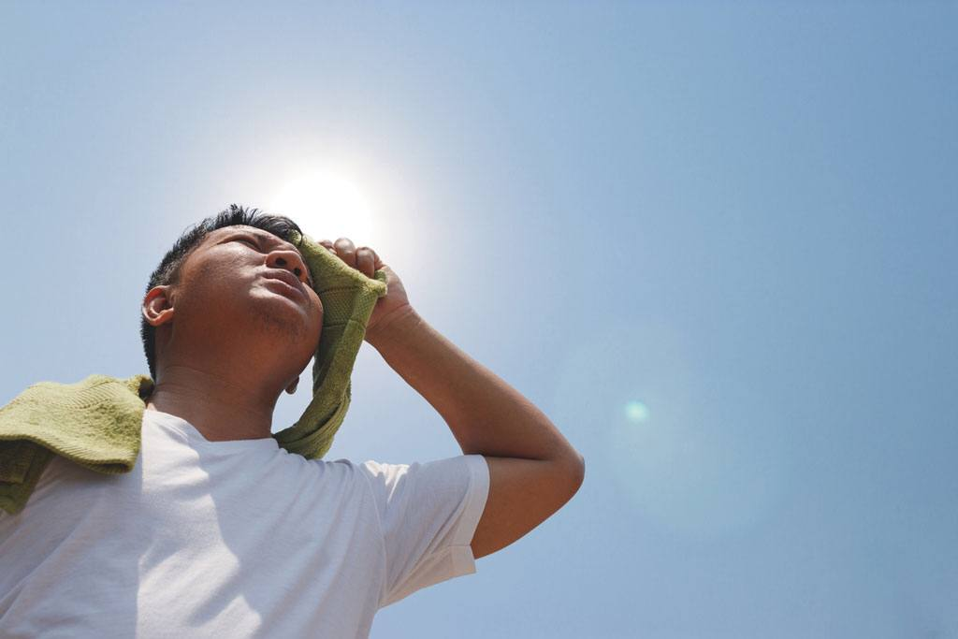

The test was so difficult.
It was such a hot day.
so + adj\adv
such + a\an + adj + noun
What do such and so mean in these sentences?
They emphasize the adjective and make it stronger.

Slide 30
+That
The test was so difficult that….
It was such a hot day that ….
so + adj\adv
such + a\an + adj + noun
by adding the word that, these phrases now express a cause.
Complete each sentence with an effect:
…I couldn’t answer all the questions;
…no one passed; etc.
..…we went to the beach;
…we couldn’t play football ;

Slide 31
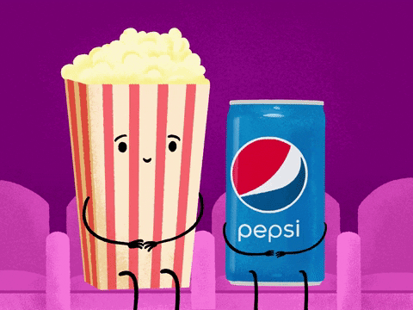
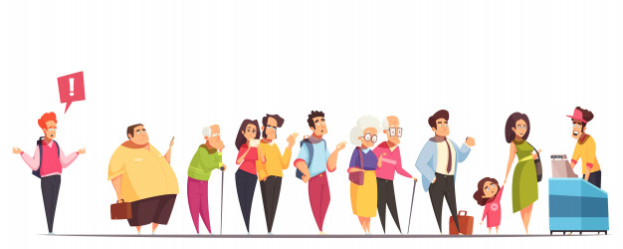
It was such a good movie that many people watches it.
Adj + noun

Slide 32
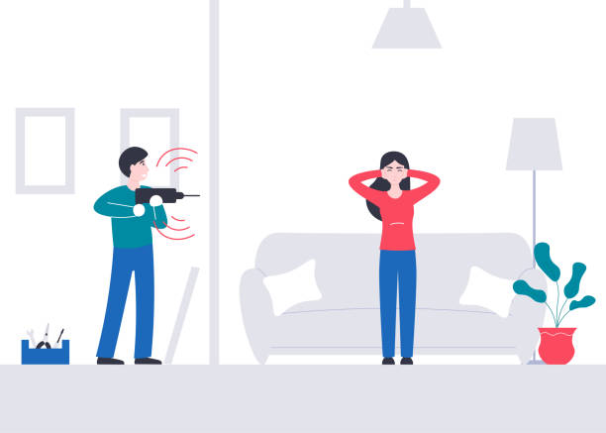
This machine works loudly
This machine works so loudly that I have a headache
I have a headache

Slide 33
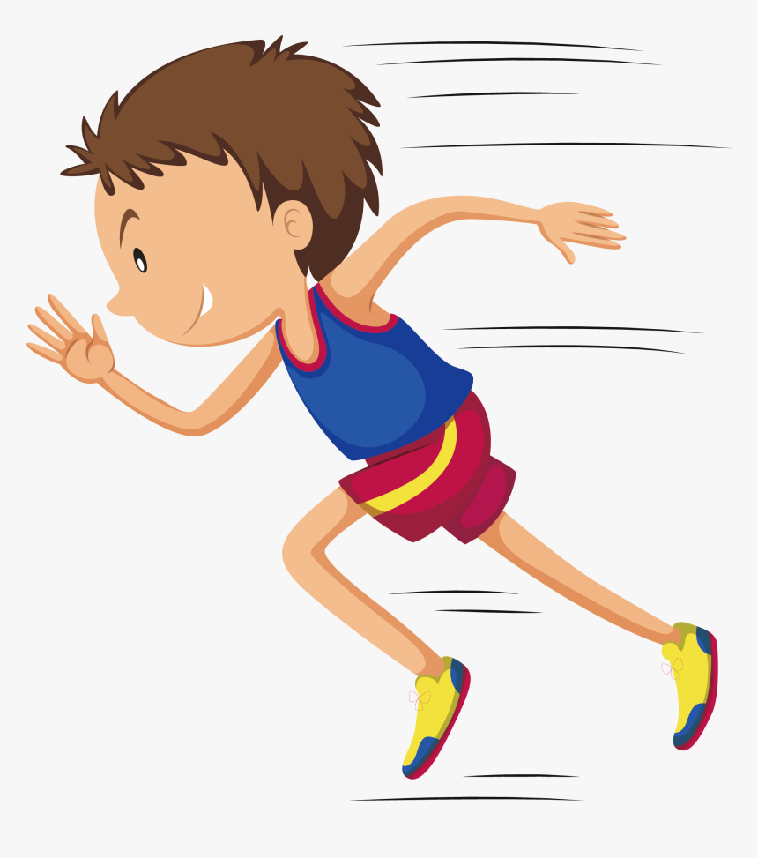
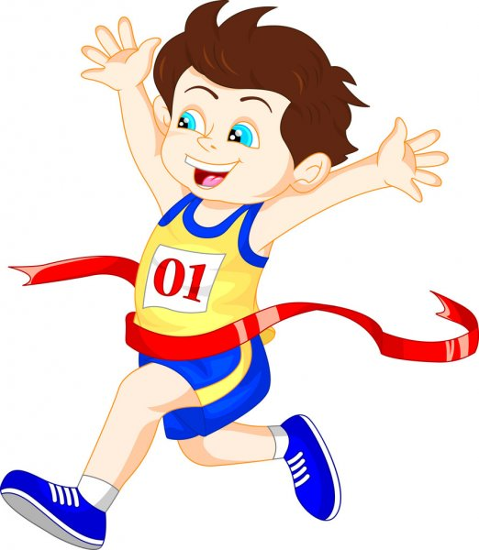
He is so fast
He is so fast that he won the race.
He won the race

Slide 35


So much ……that
So many ……that
It uses with noncount nouns
- Time - noise -
It uses with plural count nouns
- Apples - books -
she has so much Homework that she can’t go to the park.
He has so many books that he can’t hardly carry them
Complete:
I drink so …………..coffee so I couldn’t sleep well
Complete:
There are so ……..…cars that we couldn’t park,
Much
Many

Slide 36


Slide 37
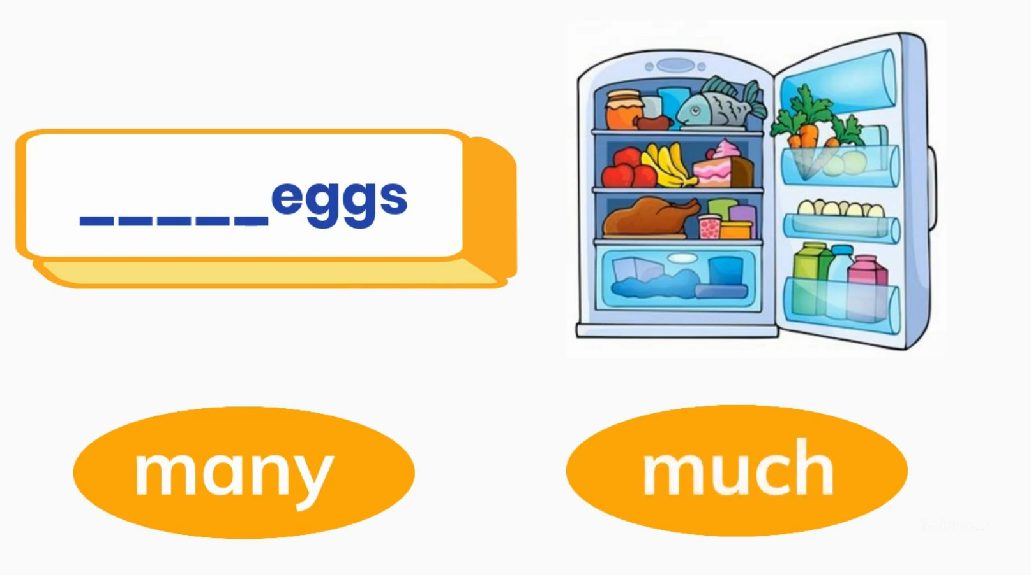

Choose the correct answer:

Slide 38
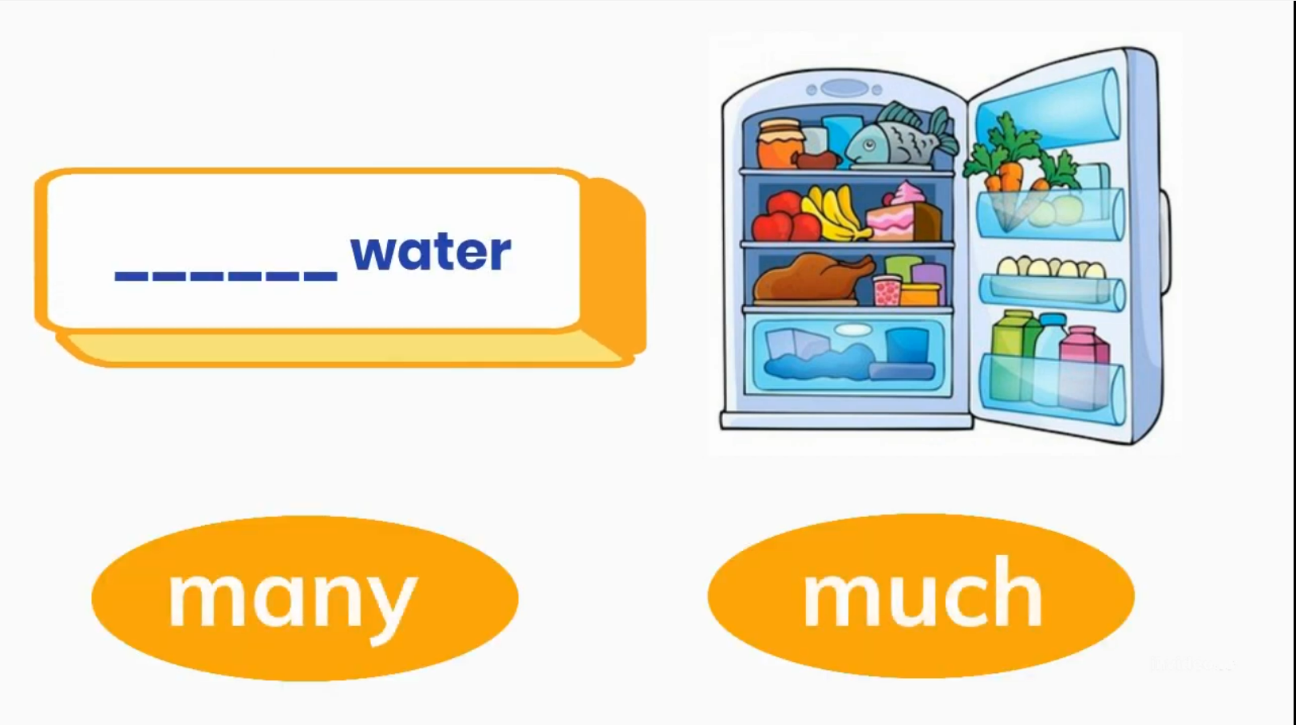
Choose the correct answer:

Slide 39
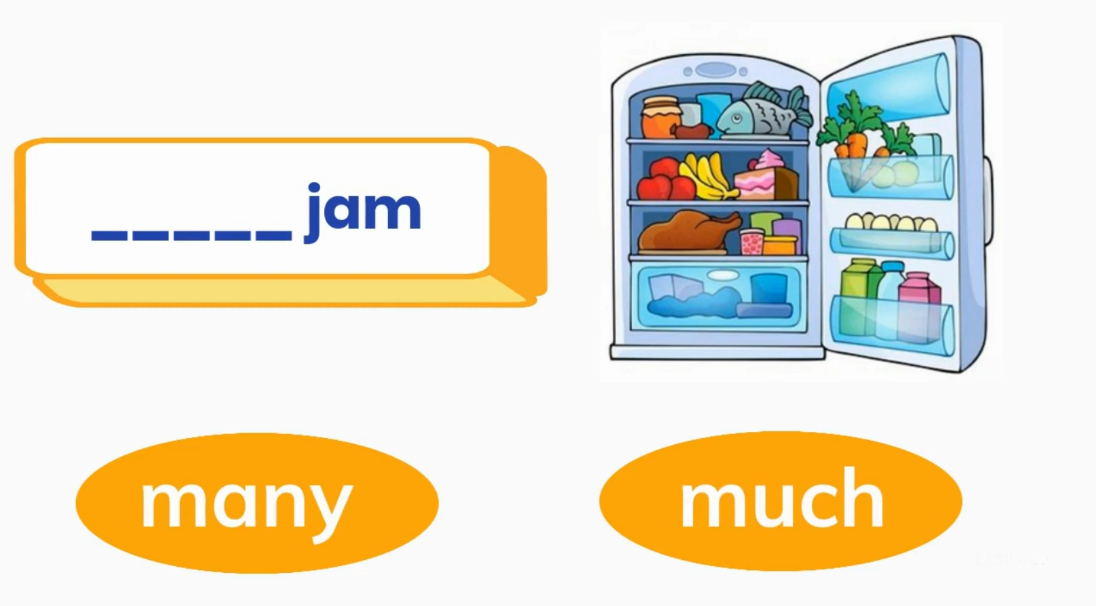
Choose the correct answer:

Slide 40
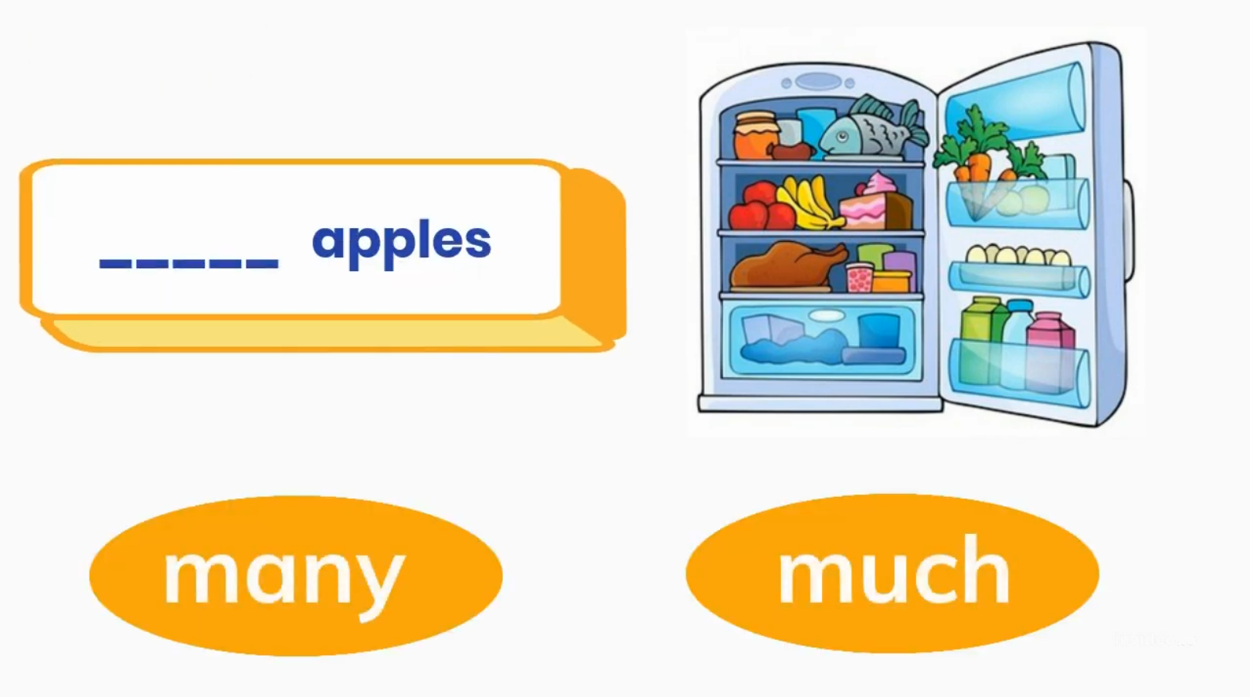
Choose the correct answer:

Slide 41
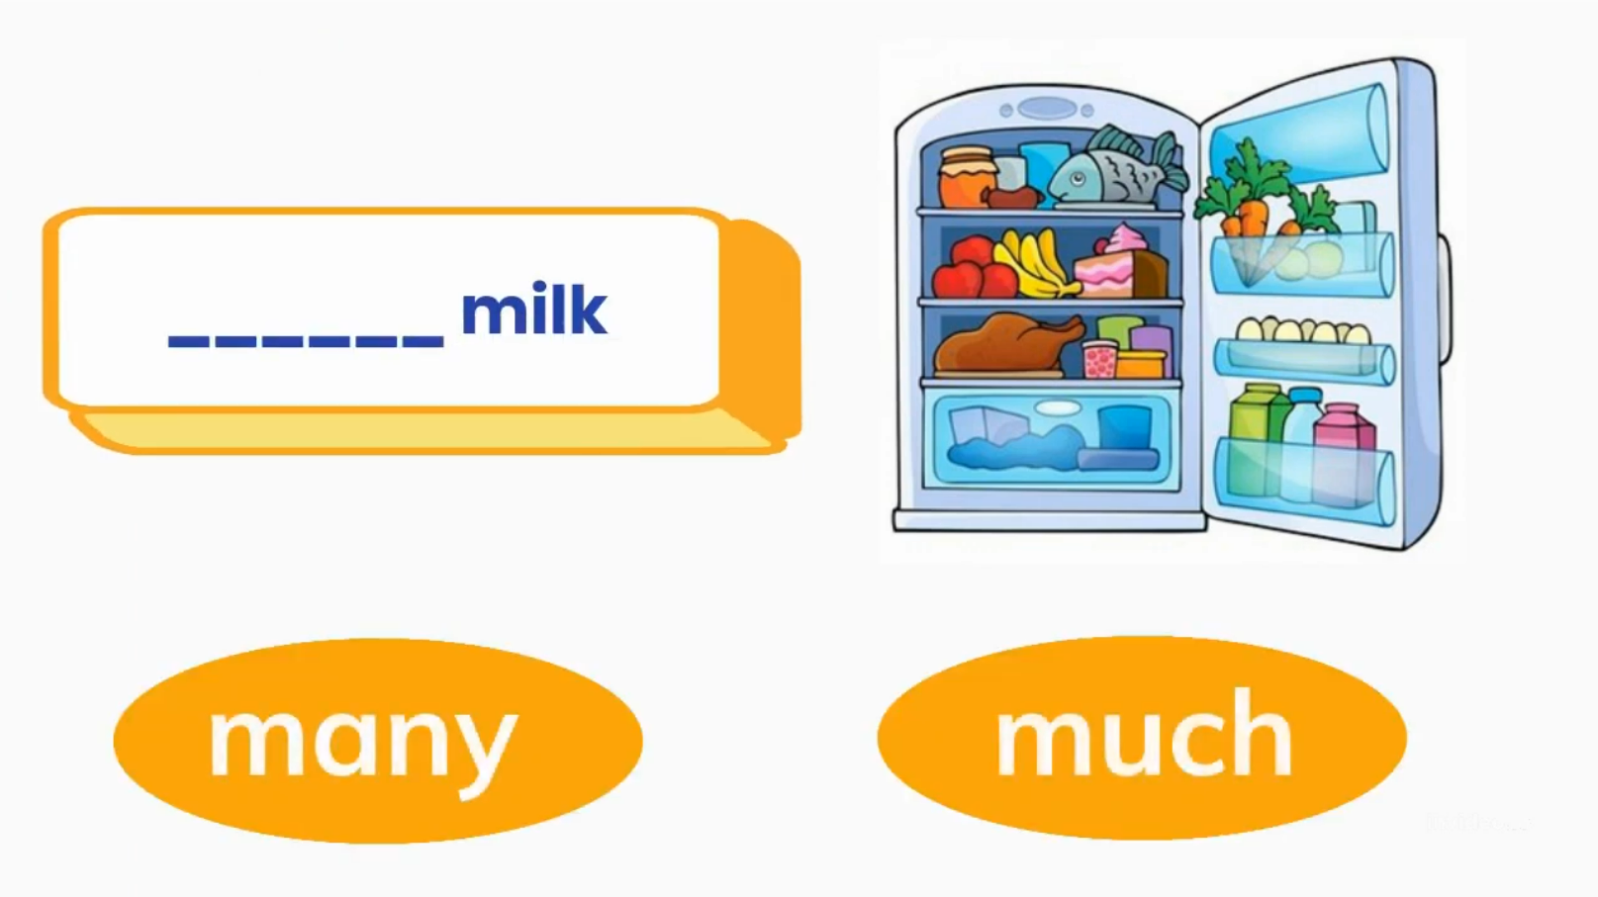
Choose the correct answer:

Slide 42
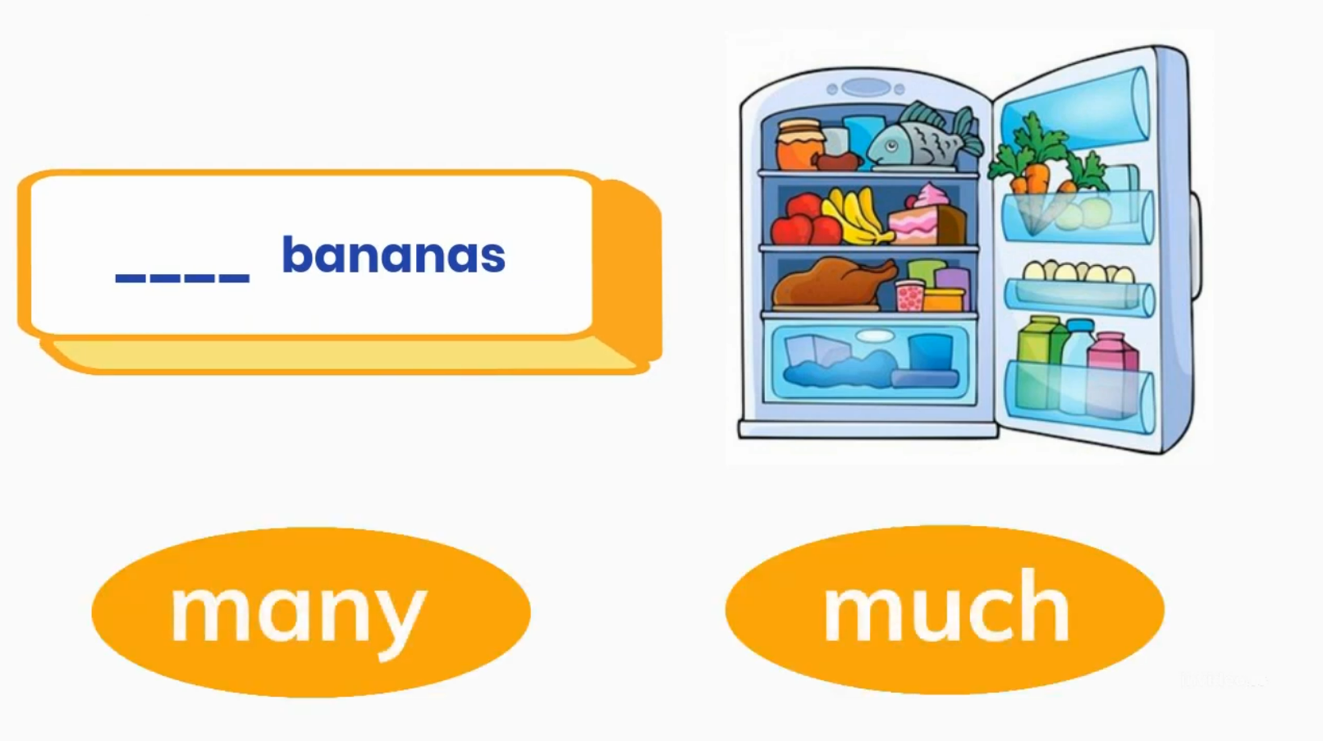
Choose the correct answer:

Slide 43

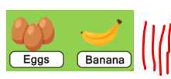
Complete with :(such – many – much – such )
many
1-He ate so _____ cookies that he felt sick.
2-She drank so _____ coffee that she couldn’t sleep.
3-The film on TV was _____ boring that I fell asleep.
4-It’s _____ a nice day! Let’s go outside.
much
so
such
so much
so many

Slide 44


2
It was
( such – so)
nice weather that we spend the whole day outside
I was
(so- such)
Tired that I fell asleep in the sofa.
1
4
He eats so
( many – much )
sugar that he may be a diabetic
3
It was
( such – so)
Easy question that every body can answer it

Slide 45



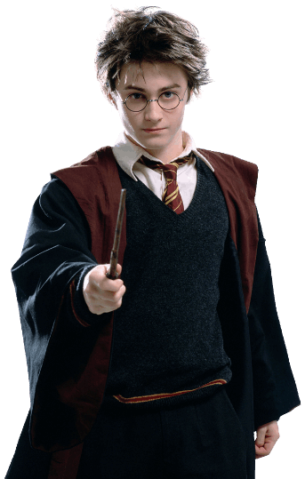
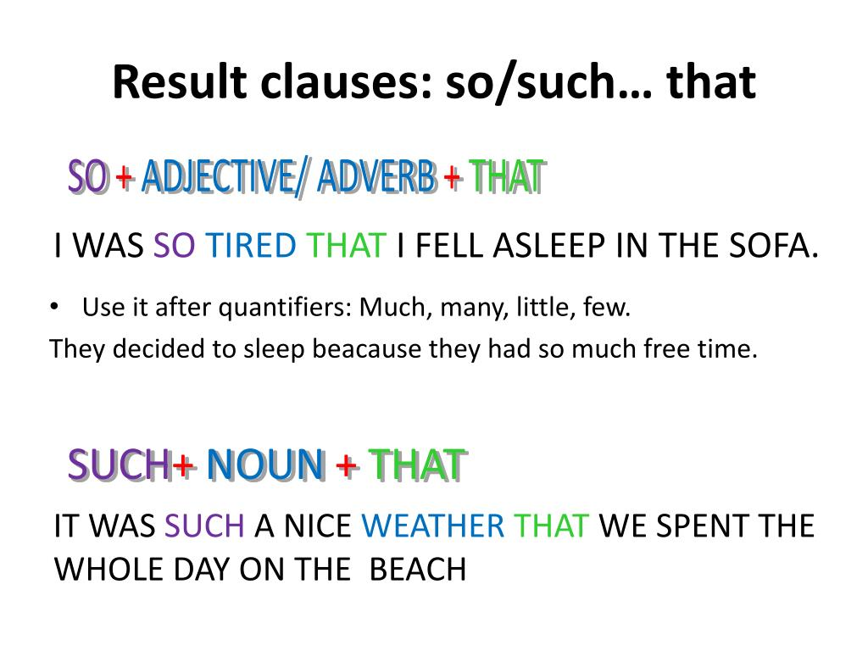
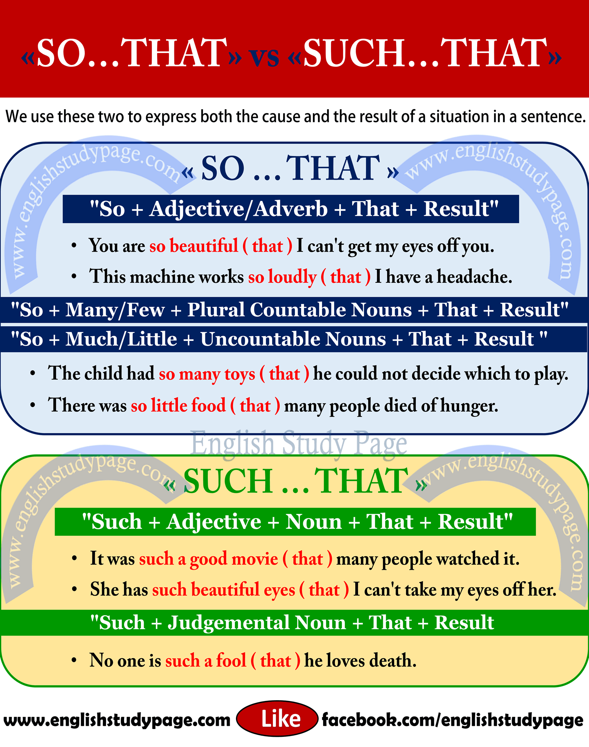
So.…..that
So …..such
So many +count noun + that
So much + Noncount noun + that
Make the meaning of an adj or adv stronger
Summarize
Used to show cause or effect

Slide 46
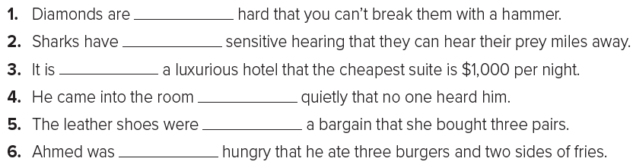
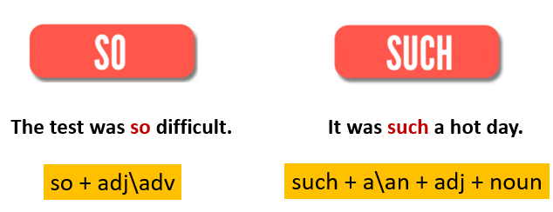
Page 97
so
such
such
so
such
so

Slide 47
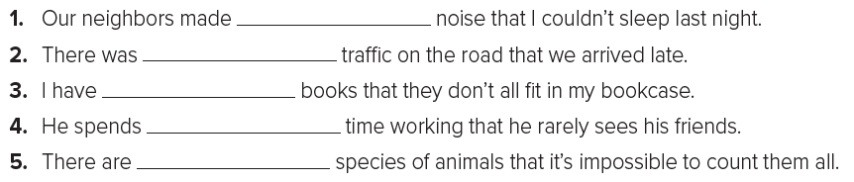
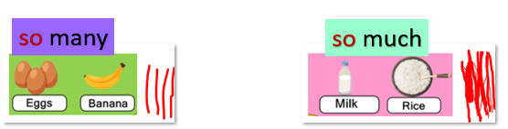
Page 97
so much
so much
so many
so much
so many

Slide 48
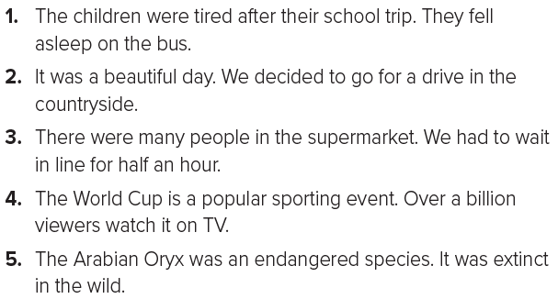
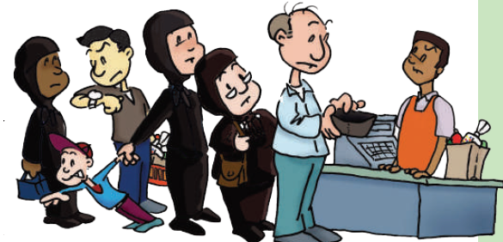
Page 97
The children were so tired after their school trip that they fell asleep on the bus.
It was such a beautiful day that we decided to go for a drive in the countryside.

Slide 49
There were so many people in the supermarket that we had to wait in line for half an hour.
The World Cup is such a popular sporting event that over a billion viewers watch it on TV.
The Arabian Oryx was such an endangered species that it was extinct in the wild.

Slide 50
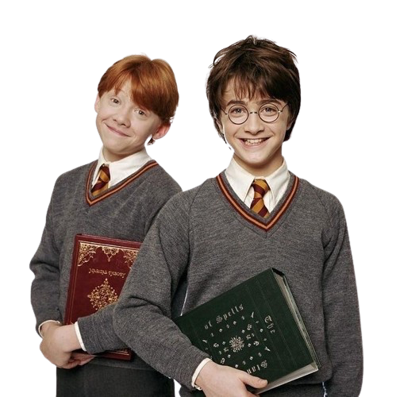

Let's play a game to practice what we've learned!
Describe the topic of the section here

Slide 51
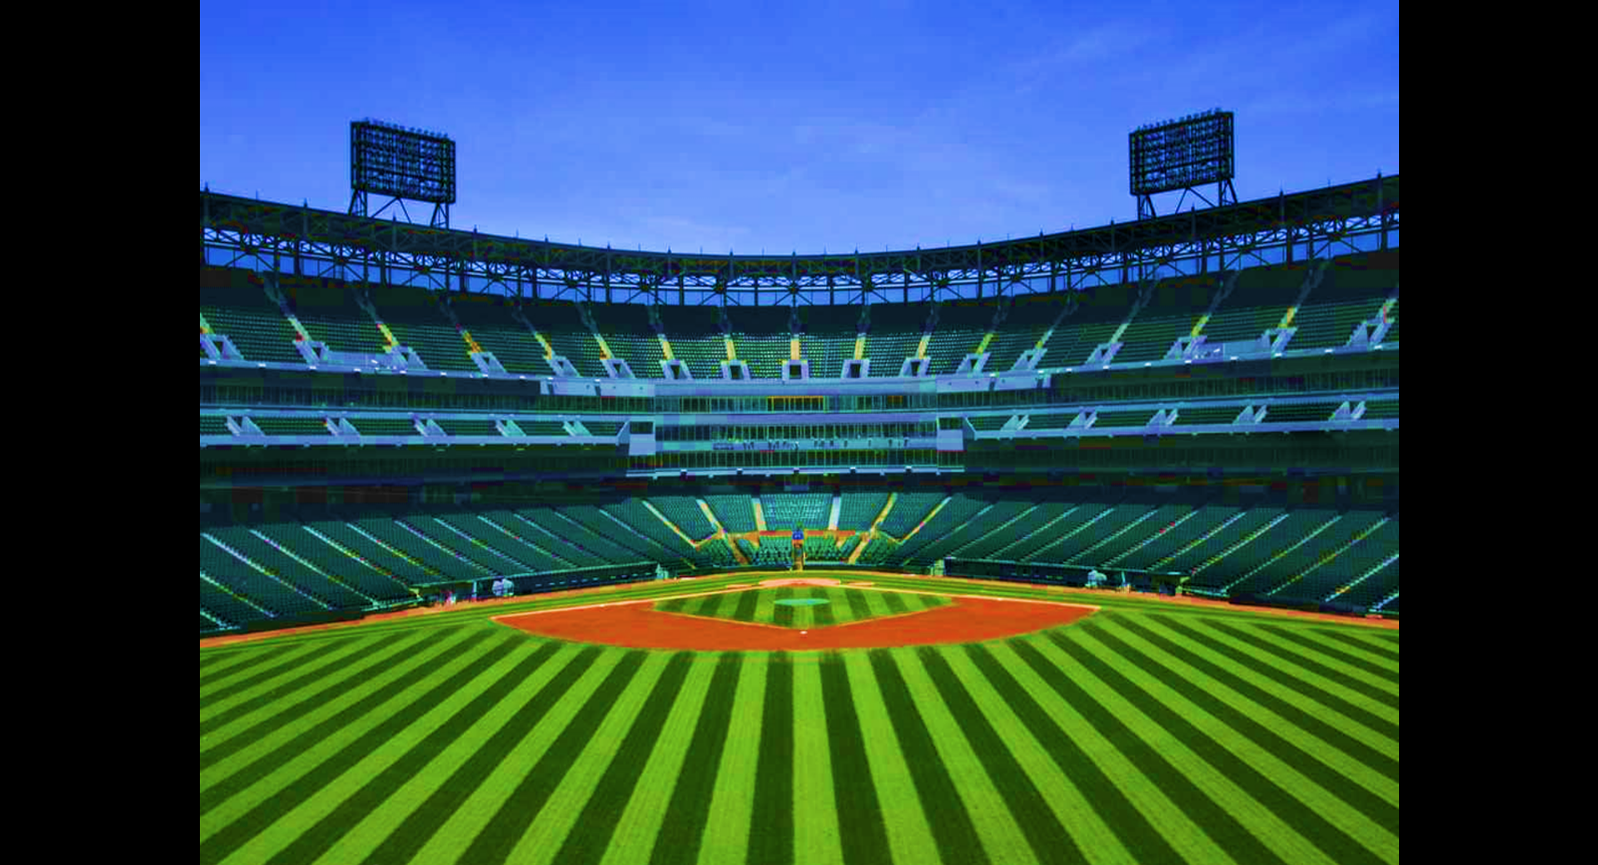




SO - SUCH

Slide 52






HOME RUN!
1/9
such
It was _____ a hot weather
that we decided to go to the beach.
so
such
NEXT
Click on the right option

Slide 53
HOME RUN!
2/9
so
She is ______ funny! She always makes me laugh.
so
such
NEXT
Click on the right option

Slide 54
HOME RUN!
3/9
such
Ali is _____ a friendly boy.
so
such
NEXT
Click on the right option

Slide 55
HOME RUN!
4/9
so
Two o'clock? I never go to bed _____ late!
so
such
NEXT
Click on the right option

Slide 56
HOME RUN!
5/9
so
I didn't know that your brother was _____ tall.
so
such
NEXT
Click on the right option

Slide 57
HOME RUN!
6/9
I'm glad they are our students.
They are _____ nice children.
such
so
such
NEXT
Click on the right option

Slide 58
HOME RUN!
7/9
so
Please don't drive _____ fast.
so
such
NEXT
Click on the right option

Slide 59
HOME RUN!
8/9
such
It's _____ a nice day. Let's go out!
so
such
NEXT
Click on the right option

Slide 60
HOME RUN!
9/9
so
I didn't like this movie; it was _____ boring.
so
such
EXIT
Click on the right option

Slide 61

Workbook exercise
Describe the topic of the section here

Slide 62



Page 232
I went to Pike’s Peak in Colorado. It was great! We took a train to the top of the mountain. It is the tallest mountain in the state of Colorado. Before that, I went to the beach on vacation. It was fun, but I really like the mountains. For me, the mountains are nicer than the beach. Hiking is more fun than swimming, so my vacation to Pike’s Peak was better than my vacation to the beach.

Slide 63


tallest
Page 231
biggest
largest
longer
best
most exciting
taller

Slide 64

Page 231
Yes
No
Yes
Yes
No

Slide 65




Linking this lesson to my country
Vision 2030 has such big dreams for Saudi Arabia, showing that the country can lead the world in many different things. So, students, get excited and explore these opportunities. There are so many ways your efforts can help our country become a global leader.

Slide 66
End of the class
Remember
practice makes perfect. Keep honing your magical language skills, and until next time, farewell!

Slide 67




تم تصميم هذا العرض من قبل: فريق عمل البوابة الإنجليزية ، وهو مجاني لكي يستفيد منه معلمي اللغة الإنجليزية.
هذه الشريحة تعتبر كـ"حفظ حقوق" نتمنى عدم حذفها حال مشاركة العرض مع معلمين آخرين.
نسمح بحذف الحقوق في حالة واحدة فقط: اذا أراد معلم الإنجليزي إضافة هذا العرض كـ انتاج معرفي خاص فيه.

