Slide 1




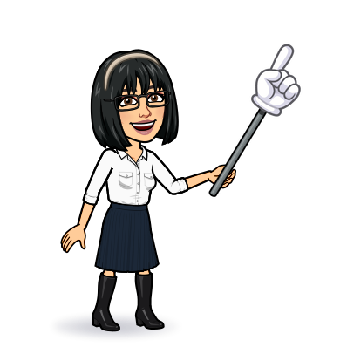

4 listening
5 pronunciation
6 conversation
7 about you
Today:
Date:
- -
Page 91 - 92
By: Dalal Al-Juaid

Slide 2


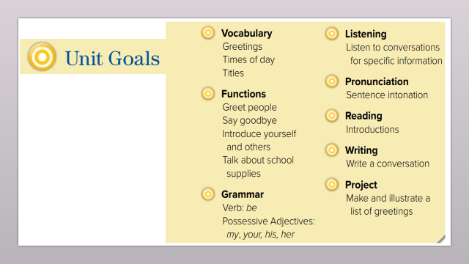
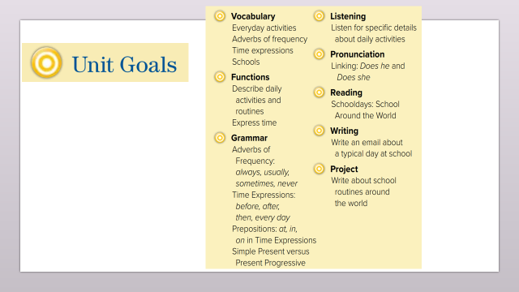
Use adverbs of frequency to talk about daily activities
Apply reduction in Does he/ Does she
Warm up
Use the "real talk " phrases in a conversation
Answer questions from a conversation

Slide 3
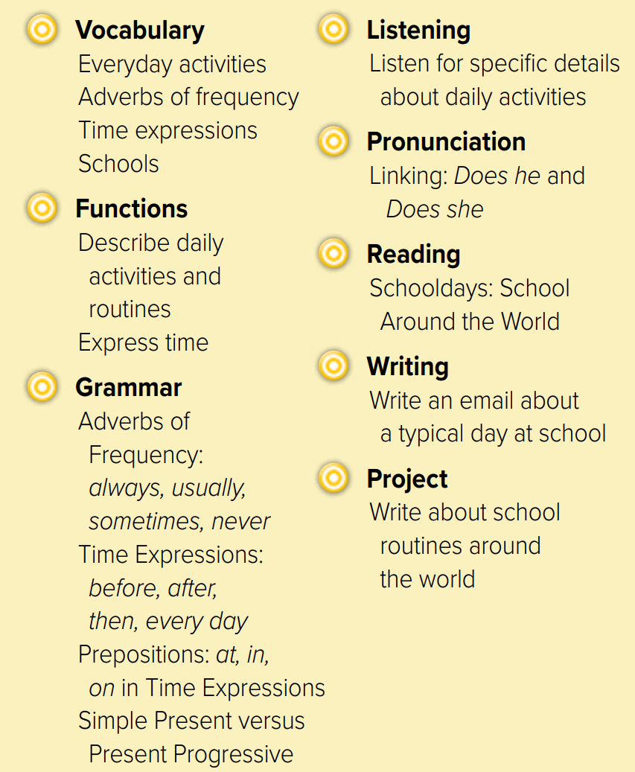
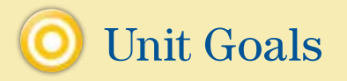

Slide 4


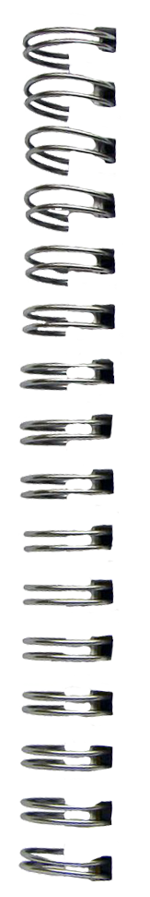
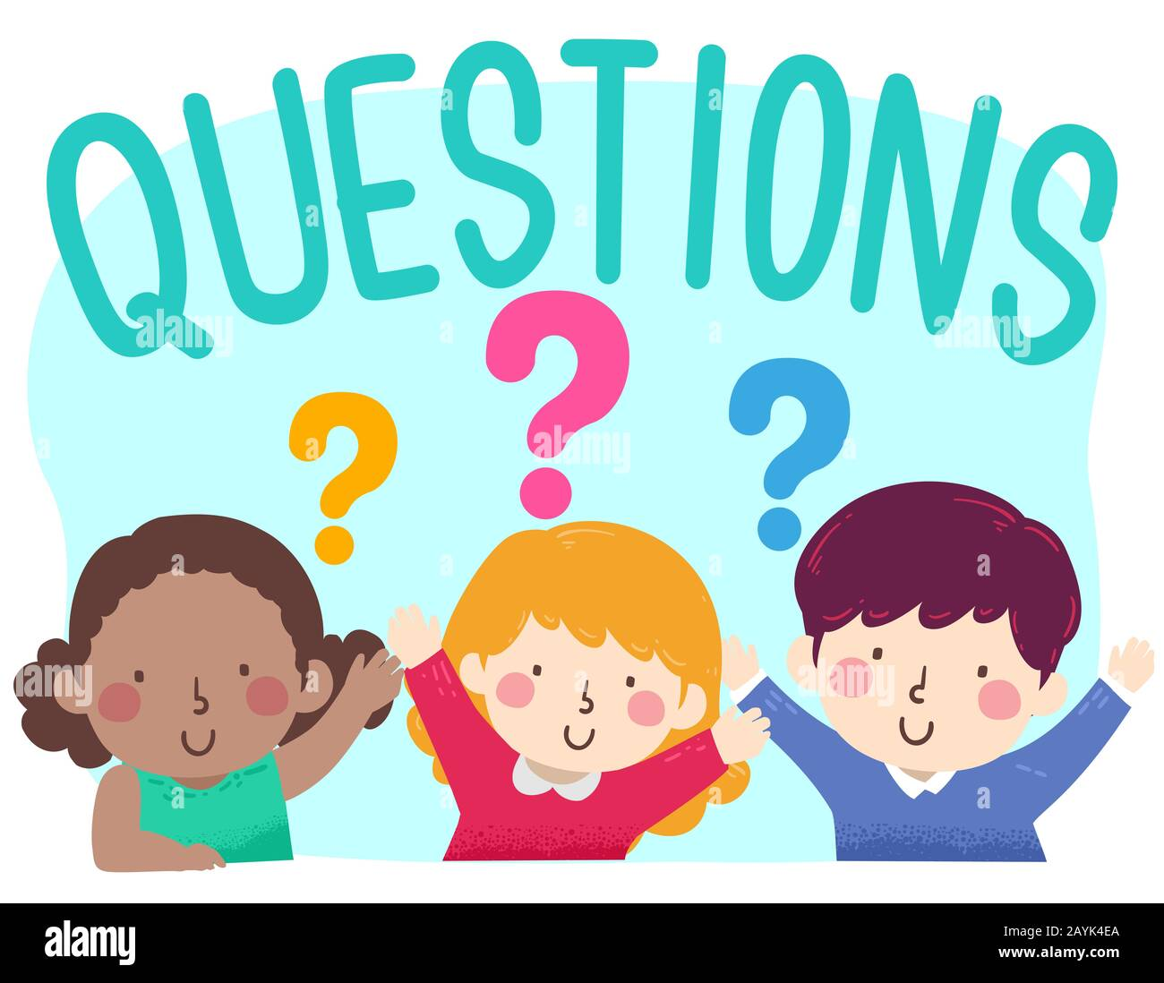
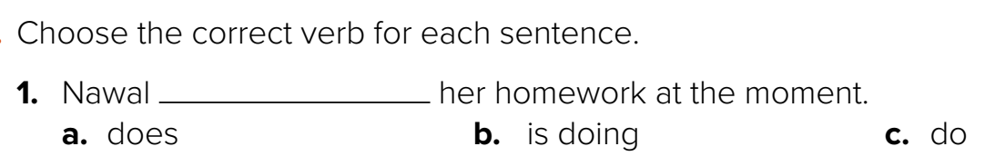
Revision
…..
…..
…..
….
100%
80%
50%
I go to school …………
The bank usually opens ….. nine.
….
#
late

Slide 5
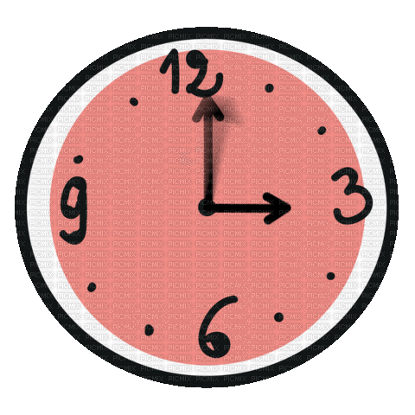









Answer with emoji
Warm up
O’clock
night
early
Monday
sometimes

Slide 6
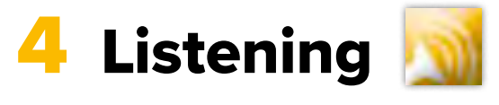
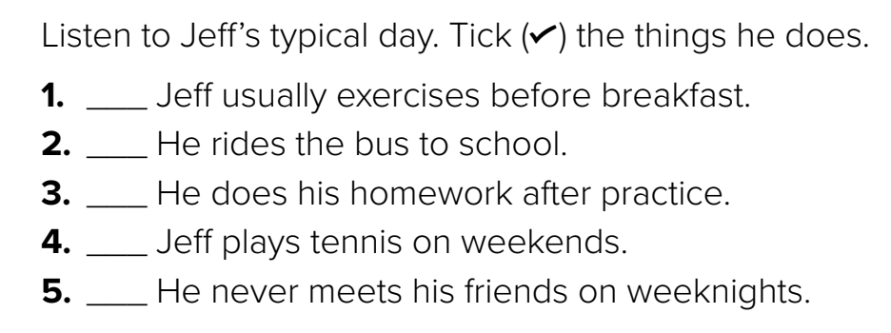

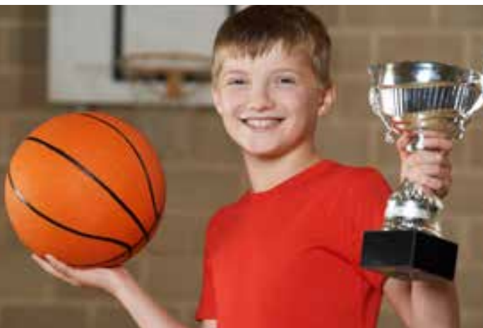

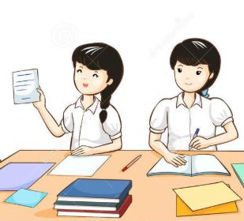
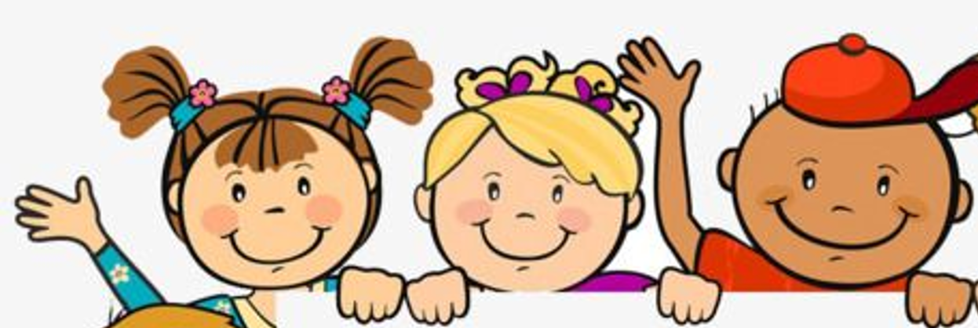

What ….. he do ?
Page 91
Warm up
Think pair share

Slide 7
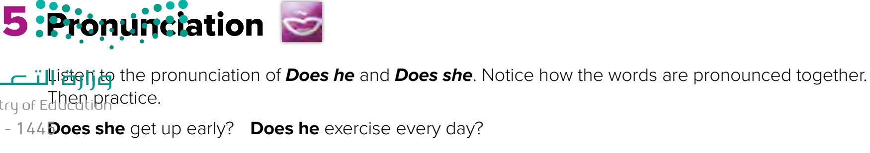

Page 91
Warm up
Listen
repeat

Slide 8
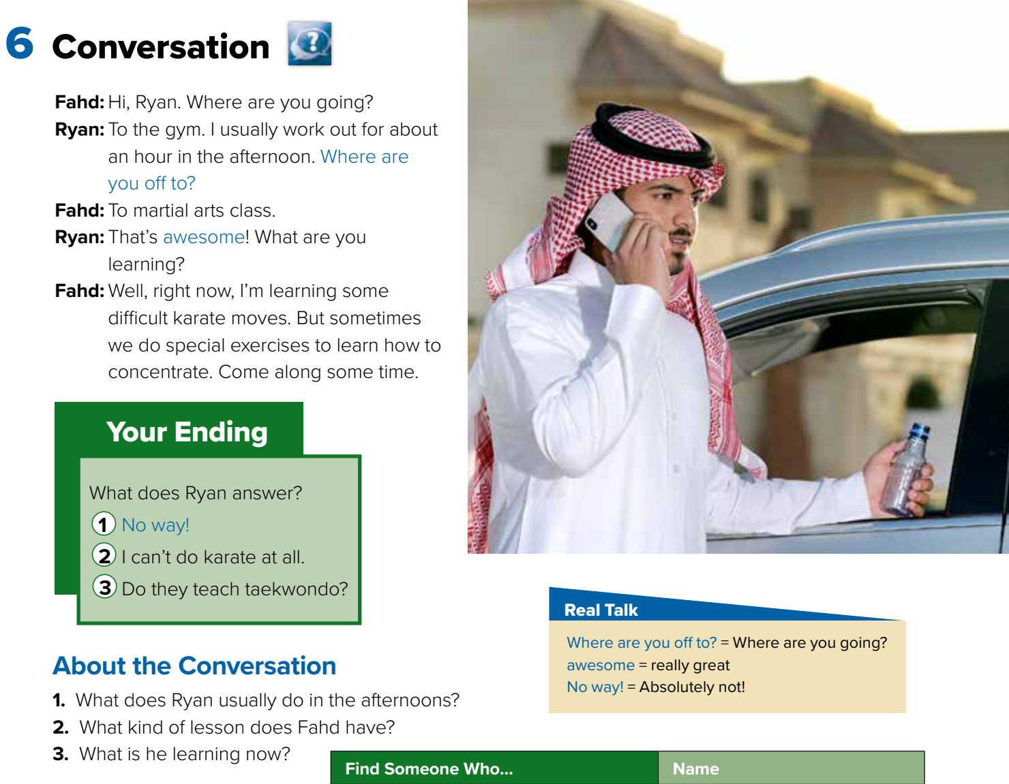
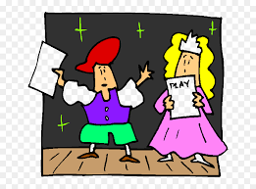

Page 92
What is he doing ?
Role paly
Warm up

Slide 9
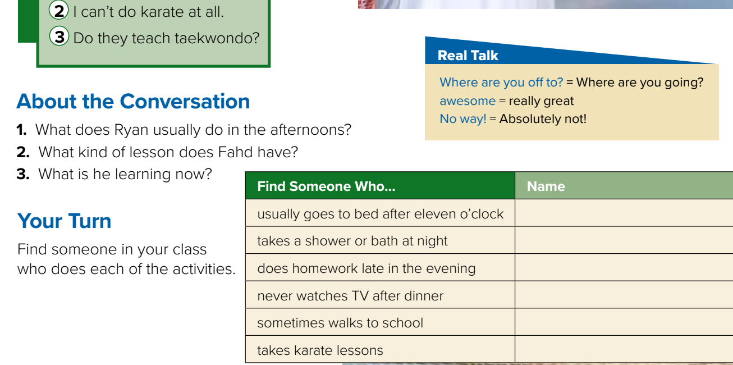

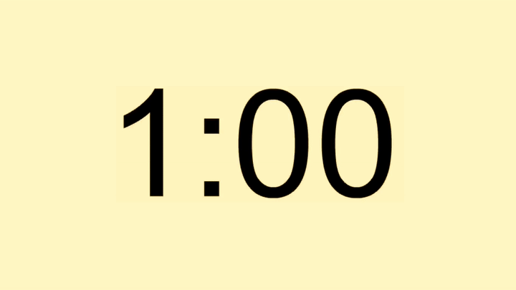
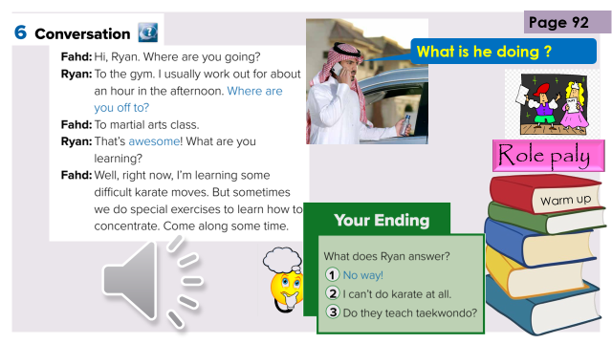
Page 92
Warm up
1- He usually works out for an hour.
2- He has a karate lesson.
3- He’s learning some difficult karate moves.

Slide 10
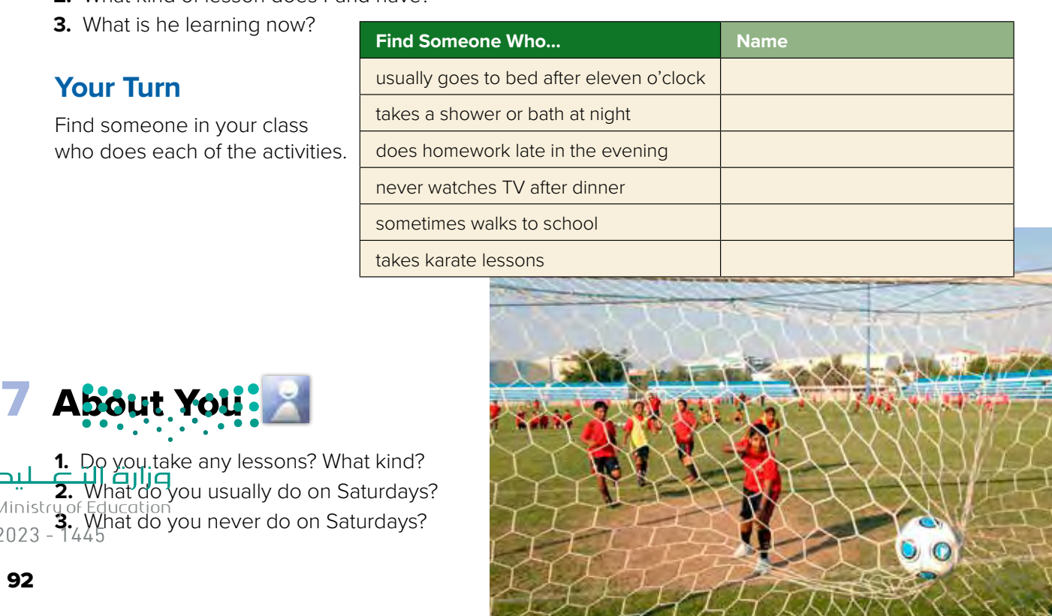
are riding
Warm up

Slide 11
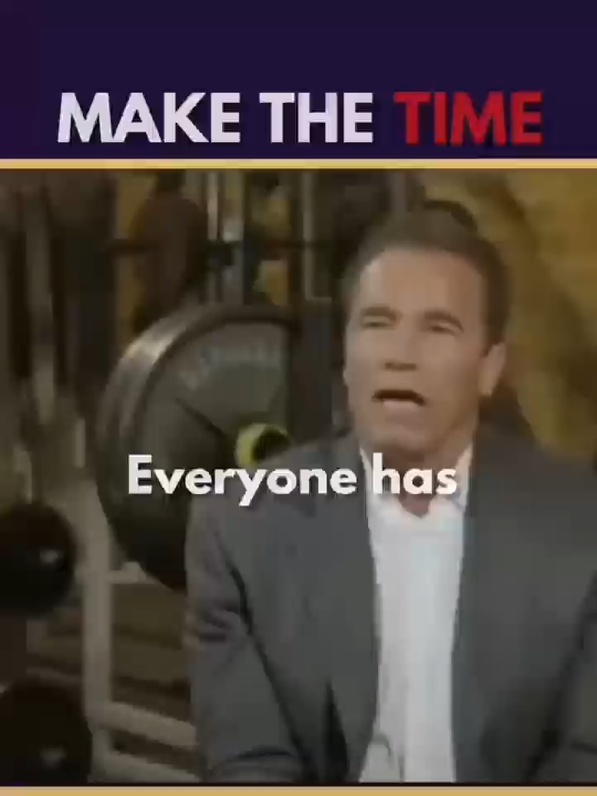


Lets play

Slide 12





page 231 Ex(E)
for practice conversation
Warm up

Slide 13
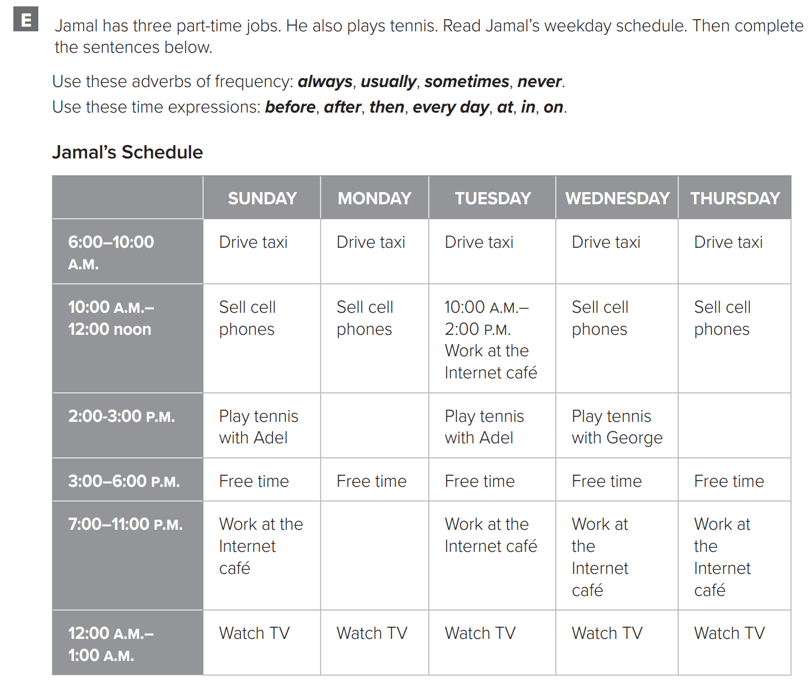
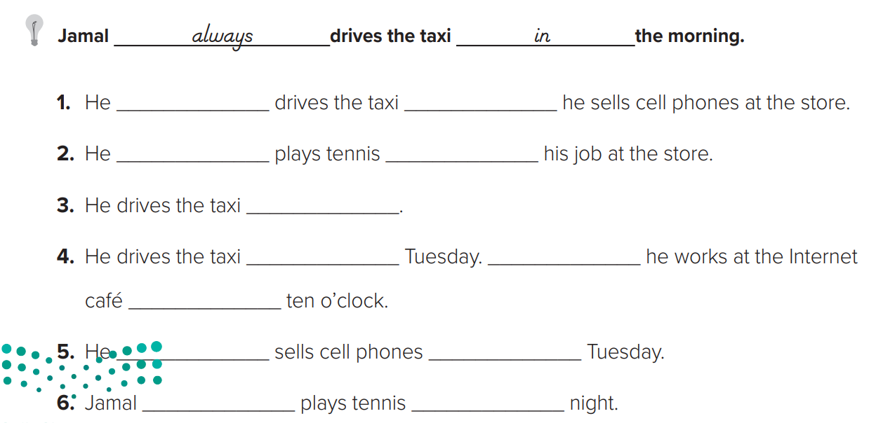
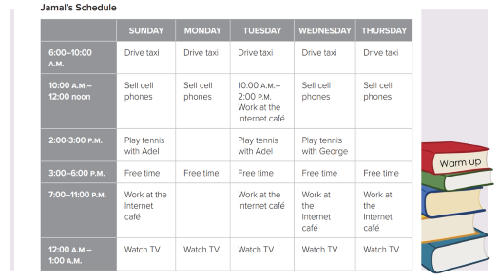
p.231
always
before
usually
after
everyday
Warm up
on
Then
at
never
on
never
at

Slide 14
Warm up

