Slide 1




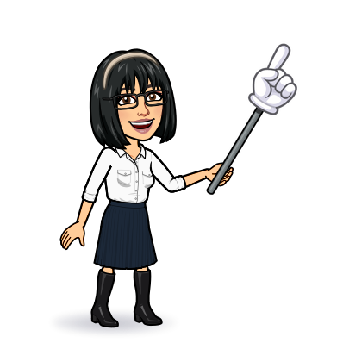

1 Listen & discuss
2 pair work
Today:
Date:
- -
Page 88
By: Dalal Al-Juaid

Slide 2


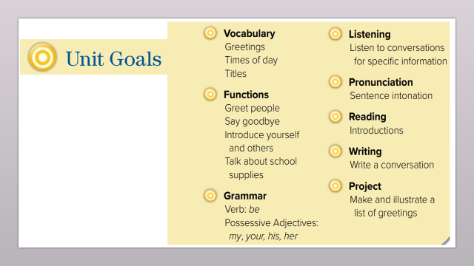
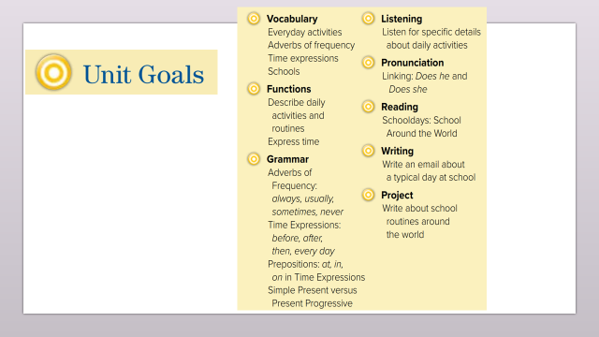
Describe everyday activities
Tell what time it is
Warm up
1-Listen
Ask & answer about daily activities
New words
Quick check
2-Pair work

Slide 3
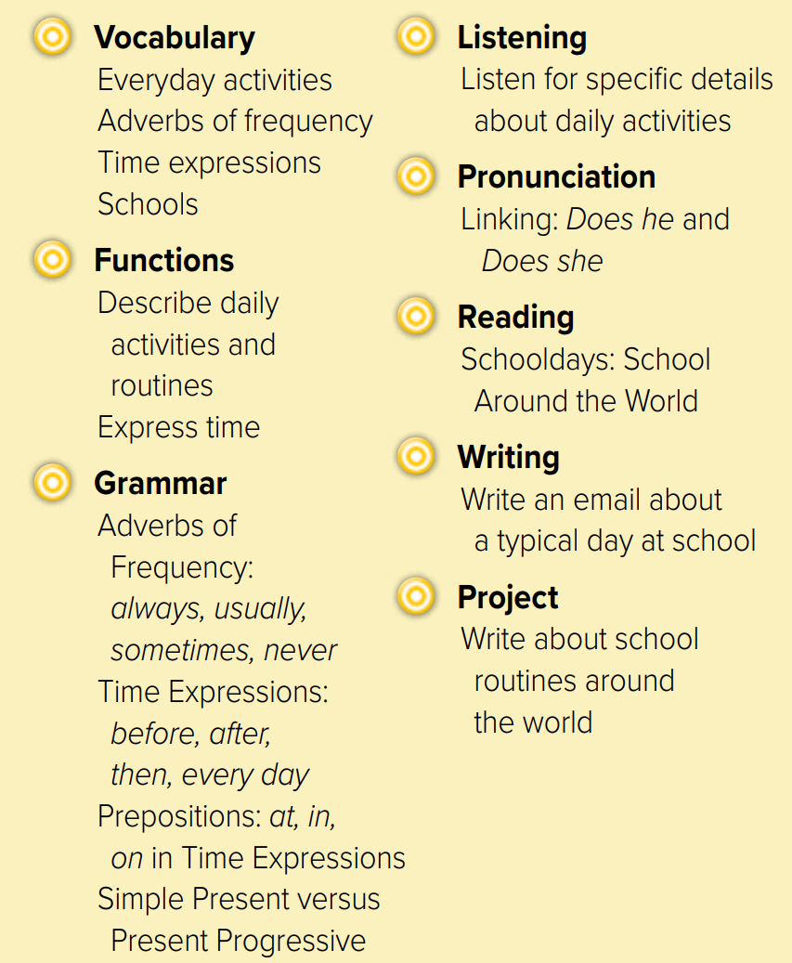
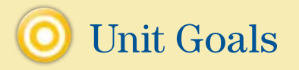

Slide 4
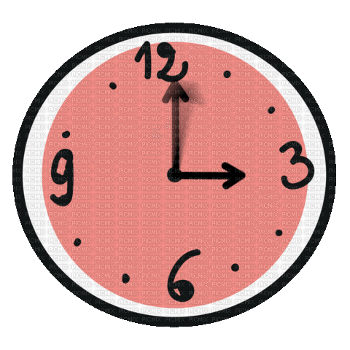


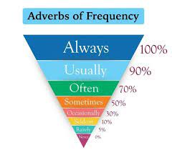





I get up ………………
I go to school …………
Warm up
1-Listen
New words
Quick check
2-Pair work

Slide 5

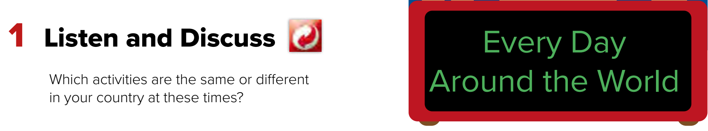


Page 88
get up,
have dinner,
go to work,
Warm up
1-Listen
New words
Jeff and Rick always take the train to work.
(simple present)
Quick check
Amal is waking up.
(present progressive)
2-Pair work

Slide 6
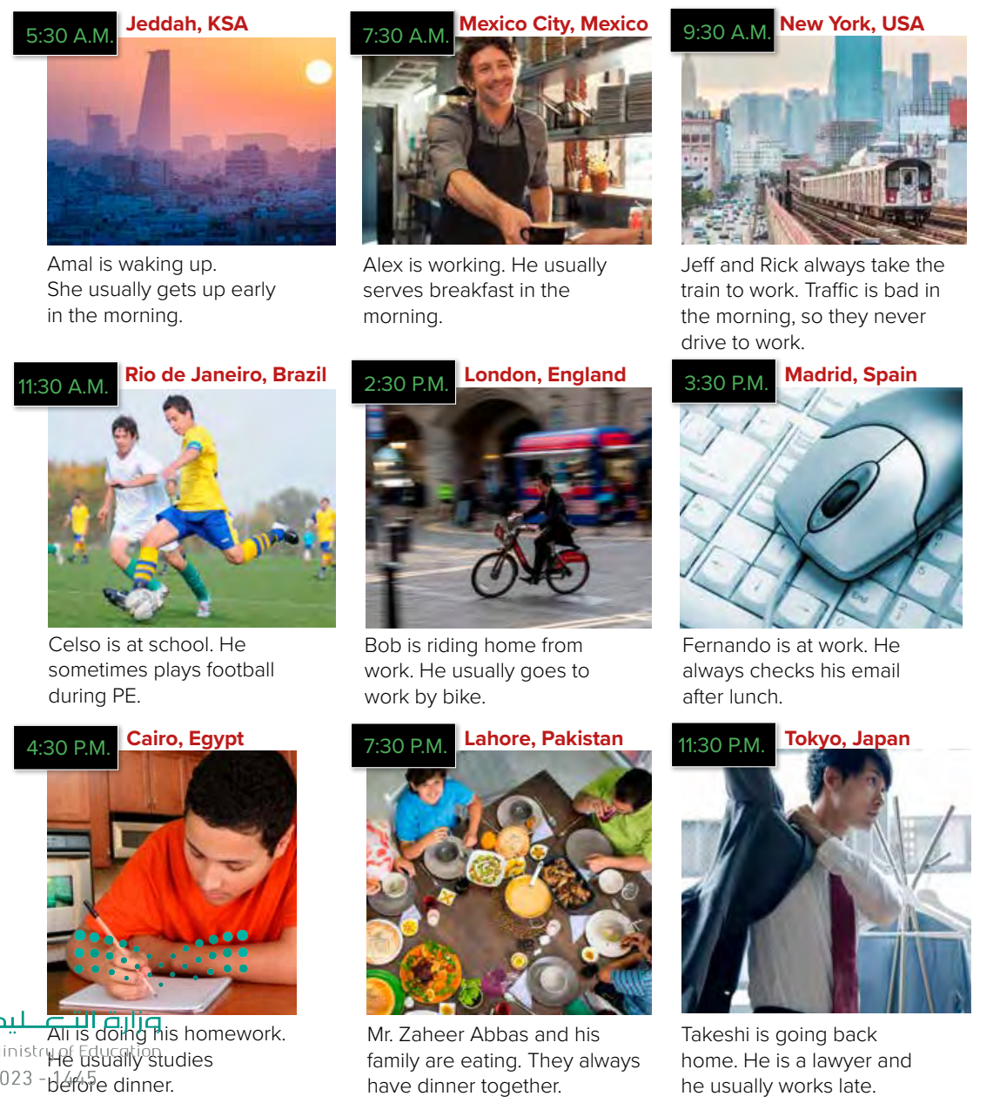

Page 88
Who’s in Spain?
What is Bob doing?
What time does Ali study ?
Warm up
1-Listen
New words
Quick check
2-Pair work

Slide 7
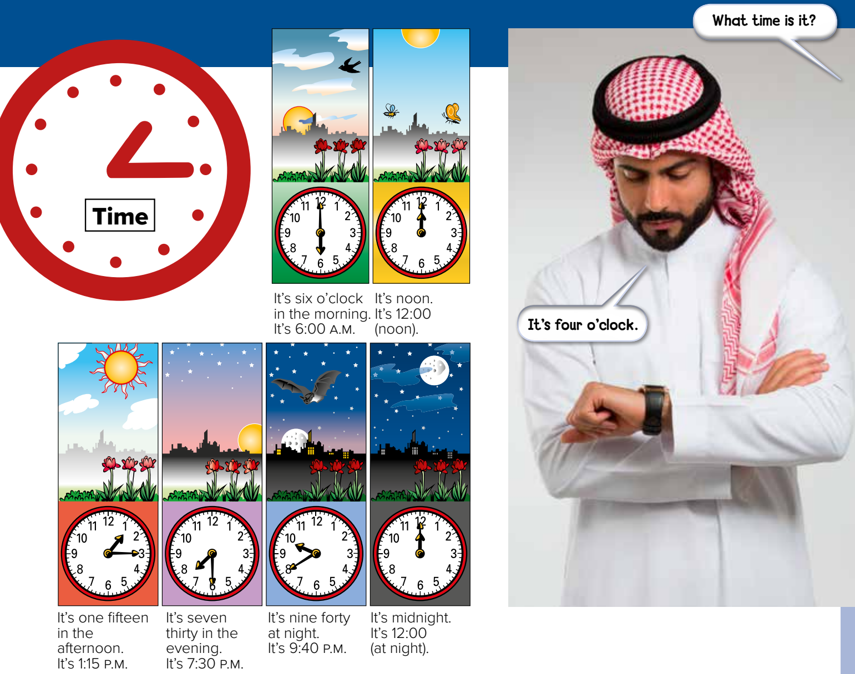
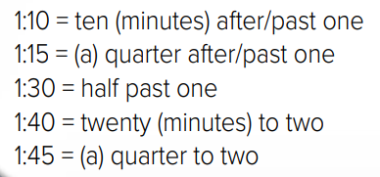
Page 89
What time is it?
Warm up
1-Listen
New words
Quick check
2-Pair work

Slide 8




New Words
time
always
usually
sometimes
100%
80%
50%
midnight
12 a.m
Have dinner
=
eating
early
#
late

Slide 9

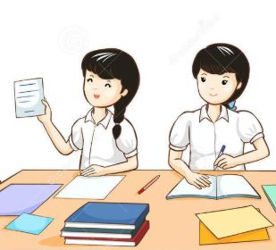

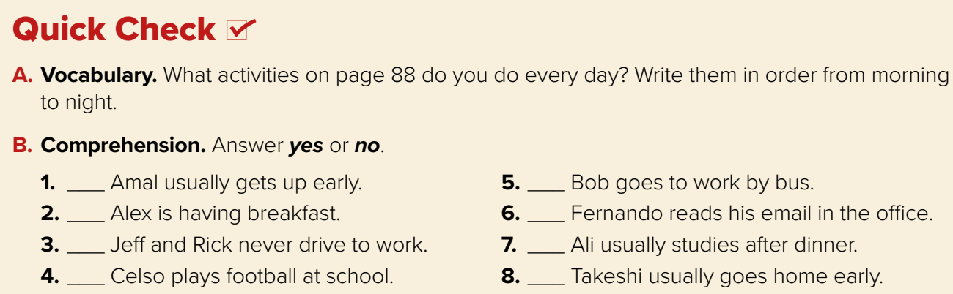
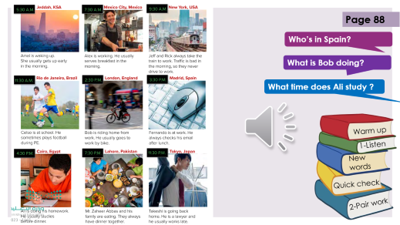
Page 89
Think pair share
yes
no
no
yes
Warm up
yes
no
1-Listen
yes
no
New words
Quick check
2-Pair work

Slide 10



Lets play
Warm up
1-Listen
New words
Quick check
2-Pair work

Slide 11


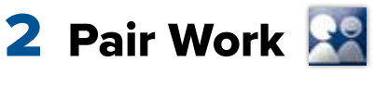
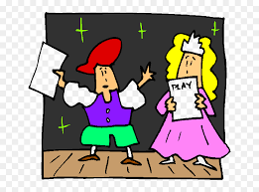
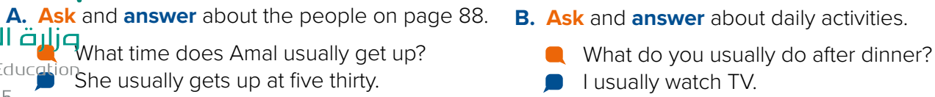
Talk about activities in Saudi Arabia ?
Role paly
Warm up
1-Listen
New words
Quick check
2-Pair work

Slide 12
Write in your notebook
Like final test أسئلة للاختبار النهائي
Choose:
Mmmmmmm ………. mmmmmmm
( ssss – ssss – sssss)
Make a question

Slide 13





page 229 Ex(A)
for practice new words
Warm up
1-Listen
New words
Quick check
2-Pair work

Slide 14
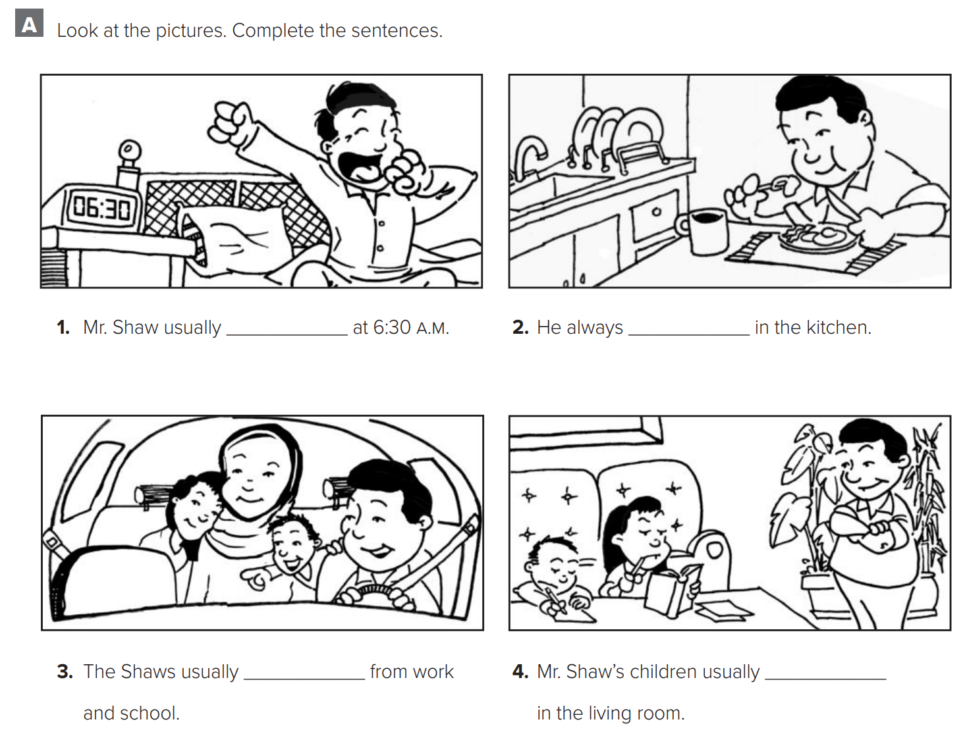
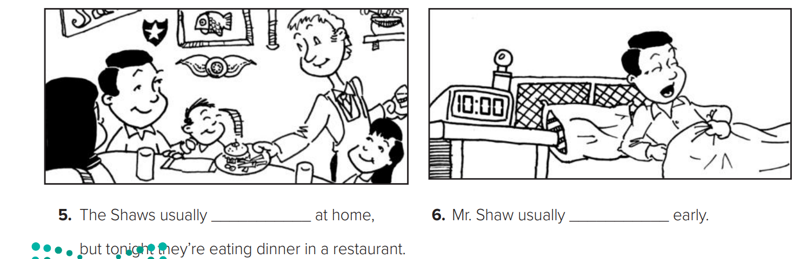
p.229
gets up
eats
drives
study
Warm up
1-Listen
New words
Quick check
eat
sleeps
2-Pair work

